Slide 1

Github Link:
Notes:
#

Slide 2

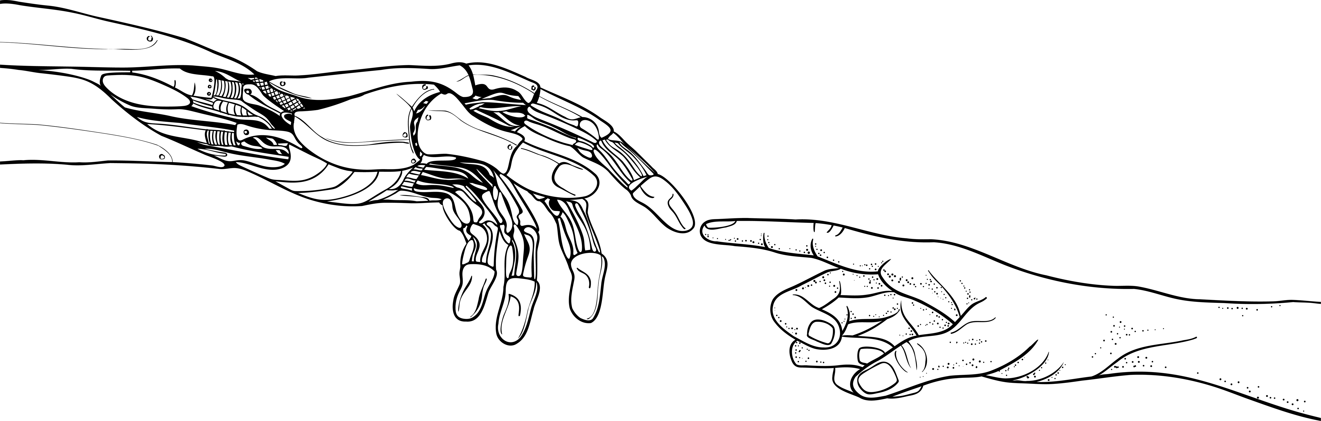
Title: Smart Vision
Team Name: Luffytaro
Team Members:
1.Vishwas kisaniya(ML Model Development and Deploying)
2.Prince(ML Developer and Trainer)
3.Harnoor kaur saggu(ML Trainer and Presenter)
4.Hardik kumar(Model Trainer and Data Collector)
College/University:
1.Punjab Engineering College(PEC)
2.Chandigarh Cngineering College, Landran
3.Sri Sukhmani Institute of Engineering and Technology
Date: 20-10-2024

Slide 3
Objective:
We aim to develop a smart quality test system utilizing cutting-edge camera vision technology. This system will automate the quality inspection process for India's leading e-commerce company, ensuring that products meet both quantity and quality standards efficiently.
Key Features of Our Solution:
1.) Advanced Imaging Systems: We employ high-resolution cameras and proper lighting setups to capture clear and consistent images.
2.) Image Preprocessing: Our system normalizes images for brightness and contrast, while applying filters to reduce noise and highlight critical product features.
3.) Feature Extraction: Using OCR, the system will detect text, such as product names, MRP, and serial numbers. Additionally, geometric features like shape and texture will be analyzed to detect defects or inconsistencies.
4.) Classification and Decision-Making: Machine learning models will classify products and detect defects with high accuracy. Deep learning will enhance the system’s ability to recognize products over time.
5.) Real-Time Feedback and Automation: The system provides immediate results to operators, allowing real-time rejection of defective products. Additionally, it integrates seamlessly with existing automated handling systems.
Applications in E-Commerce:
1.) Item Recognition: Ensuring correct product identification and packaging.
2.) Fresh Produce Inspection: Detecting freshness and predicting shelf life based on visual cues.
3.) Expiry Date Validation: Automating the detection of printed expiration dates.
4.) Challenges Addressed: Our solution will overcome challenges such as varying lighting conditions, product diversity, and the cost of integrating the system with existing operations.
Outcome:
This smart vision system will enhance the efficiency, accuracy, and cost-effectiveness of quality testing in e-commerce, providing a scalable solution that can handle large volumes while ensuring that only the best products reach the customer.

Slide 4
Technical Approach
Overview: The proposed solution leverages advanced machine learning and computer vision techniques to automate the quality control process for an e-commerce company, focusing on detecting textual information, counting objects, and determining the freshness of fruits and vegetables. By integrating Optical Character Recognition (OCR), YOLOv9 for object detection, and VGG16 for freshness assessment, the system ensures precise, efficient, and scalable quality inspections.
Component 1: Text Detection and Extraction (OCR)
We use Tesseract OCR to detect and extract crucial text from product labels in real-time, such as product names, expiration dates, and serial numbers. Images captured using high-resolution cameras are preprocessed (noise reduction, binarization) and passed to the OCR engine. The extracted text is formatted and stored in an XML file for integration into inventory management systems. This enables accurate, automated data collection for tracking and verifying product information.
Component 2: Object Detection and IR based Counting (YOLOv9)
OThe YOLOv9 model is used to detect and count objects, including fruits, vegetables, and other packaged goods, in real-time. The model is trained on a custom dataset to recognize various products and their quantities, providing accurate detection in dynamic environments like conveyor belts. The real-time object count ensures that the correct number of items is packaged and processed, helping streamline inventory management and reduce human error.
Component 3: Freshness Detection Using CNN (VGG16)
A VGG16-based CNN is utilized to assess the freshness of fruits and vegetables. The model is fine-tuned to classify whether a product is fresh or rotten by analyzing visual features such as color, texture, and shape. This classification is performed in real-time, allowing the system to sort or reject spoiled products automatically. This component ensures that only fresh, high-quality products are delivered to customers, improving overall quality control.

Slide 5
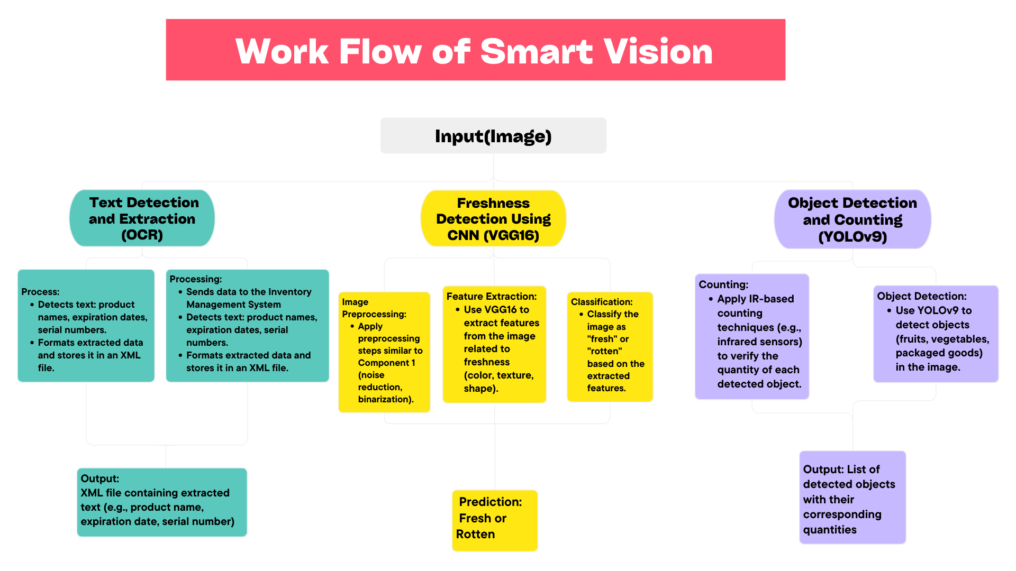


Slide 6
