Slide 1

Kammavari Sangham (R) 1952, K.S.Group of Institutions
K. S SCHOOL OF ENGINEERING AND MANAGEMENT, BENGALURU-560109
(Affiliated to VTU, Belagavi & Approved by AICTE, New Delhi, Accredited by NAAC)
DEPARTMENT OF COMPUTER SCIENCE AND ENGINEERING Project Work Phase-2 (18CSP83) : Review-2
“Smart Traffic Management For Ambulance ”
Batch No: B_02
Group No: G4
Name | USN
SUNIL M | 1KG19CS102
V YASHASWINI NAIDU | 1KG19CS108
VIGNESH R | 1KG19CS115
VISHWAS P | 1KG19CS117
Under the Guidance of
Mrs. Amitha S
Assistant Professor
Department of Computer Science and Engineering

Slide 2
Introduction
Literature survey
Problem Statement
Objectives
Methodology
High level design(For Ex- Sequence/ Use case / Data flow diagram)
Technology & Tools Used
Implementation / Snapshots
Conclusion and future enhancements
References
AGENDA

Slide 3
INTRODUCTION
With the increased vehicles, the road traffic in many parts of the country is very bad.
The vehicular movement during the peak hours or daytime will be dead slow.
We will be hearing sirens of the Ambulances which get stuck in busy traffic.
The journey which would take 5-10 minutes, will take more than 30 Minutes due to traffic

Slide 4
With the ever increasing number of vehicles on the road, the Traffic Monitoring Authority has to find new methods of overcoming such a problem.
One way to improve traffic flow and safety of the current transportation system is to apply automation and intelligent control methods.
In this system traffic light is changed of particular lane with priority given to ambulance.

Slide 5
Literature survey
IOT Based Smart Traffic Management System
The Canny Edge Detector is one of the maximum typically used photo processing gear detecting edges in a totally strong manner.
The structure takes traffic solidity as input from cameras which is abstracted from Digital Image Processing technique and sensors data, resultantly giving output as signal data.
An algorithm is given to predict the traffic solidity for future to minimize the traffic congestion. Development of IOT based traffic management system

Slide 6
RFID based automatic lane clearance for ambulance
This project presents an intelligent traffic control system to pass an ambulance smoothly by implementing RFID system.
Every vehicle is equipped with a WI-FI module which acts as a receiver and the hotspot in ambulance act as a transmitter the power is measured by the received signal denoted by RSSI.
This system is automatic switching of signals in order to help ambulance to reach the hospital on time during emergency situation and to intimate the vehicle drivers who are nearby to the ambulance.

Slide 7
PROBLEM STATEMENT
“To design, develop and implement a system which detects Ambulance struck in traffic and frees the signal from red to green”

Slide 8
OBJECTIVES
To collect and store the datasets.
To provide the live stream of the video as the input to the program
To crop or extract images of each and every ambulance from each frame extracted.
To release the signal after the ambulance is detected from the extracted frame.
Enable easy movement of ambulance in traffic to help get medical care at the earliest.

Slide 9
METHODOLOGY
Methodology of objective-1: The data set used are images of ambulance, ambulance word, red and blue light present on the ambulance.
Methodology of objective-2: The input should be a live stream video containing the images of ambulance to be analyzed.
Methodology of objective-3: For frame extraction a separate set of commands are defined using OpenCV library which allows the system to extract out frames from the real time video.
Methodology of objective-4: The camera collects data of the real-time density of vehicles present on the road and detects the ambulance.
Methodology of objective-5: This information is fed to the Arduino controller which determines the change in signal.

Slide 10
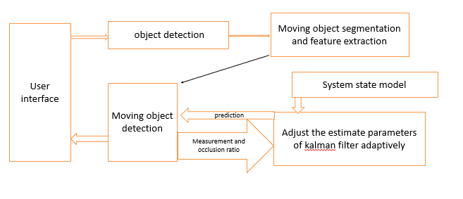
DESIGN
Fig 1 : Interface Design

Slide 11
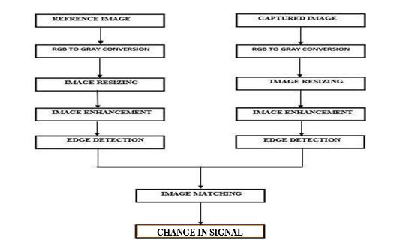
FLOWCHART
Fig 2 : Flow Chart

Slide 12
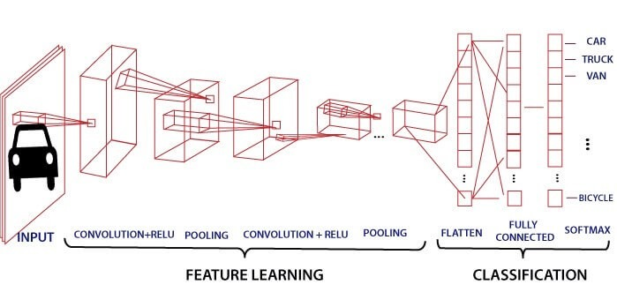
CNN-DESIGN
Fig 3 : Working Of CNN

Slide 13
TECHNOLOGY AND TOOLS USED
Software Requirements
Python
TensorFlow
Pandas
Arduino
USB Camera

Slide 14
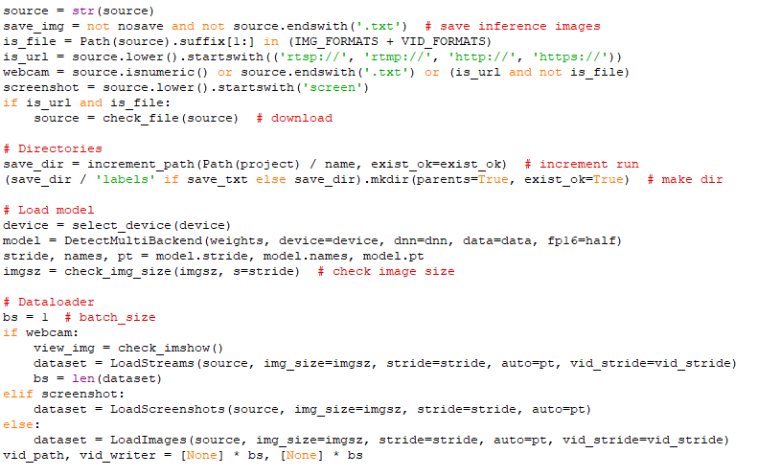
IMPLEMENTATION
Fig 4 : Dataset Loader

Slide 15
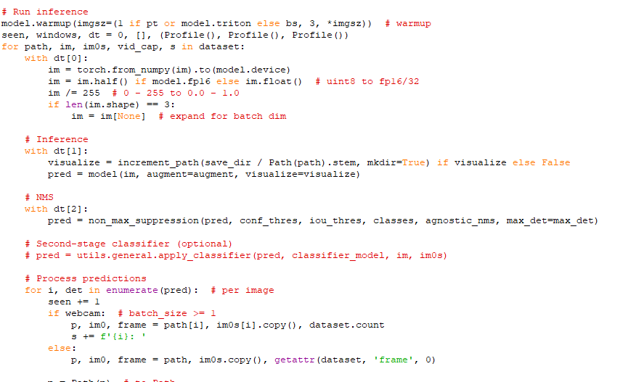
Fig 5 : Prediction

Slide 16
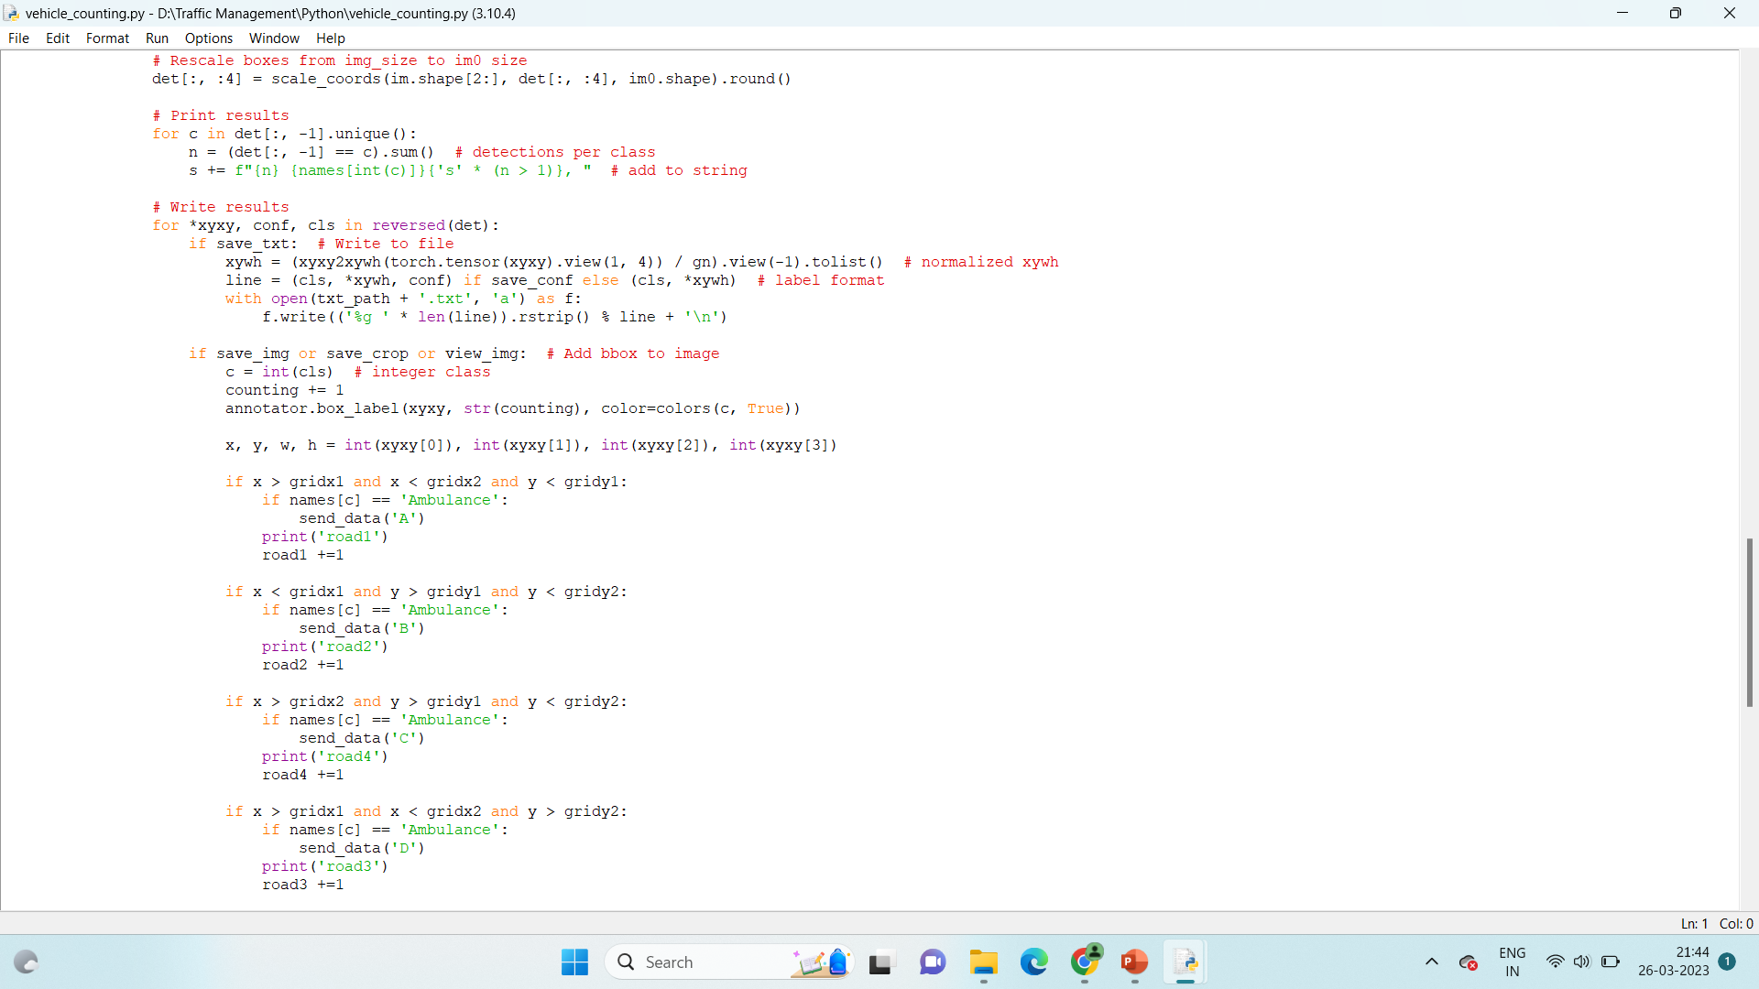
Fig 5 : Prediction from Grids

Slide 17
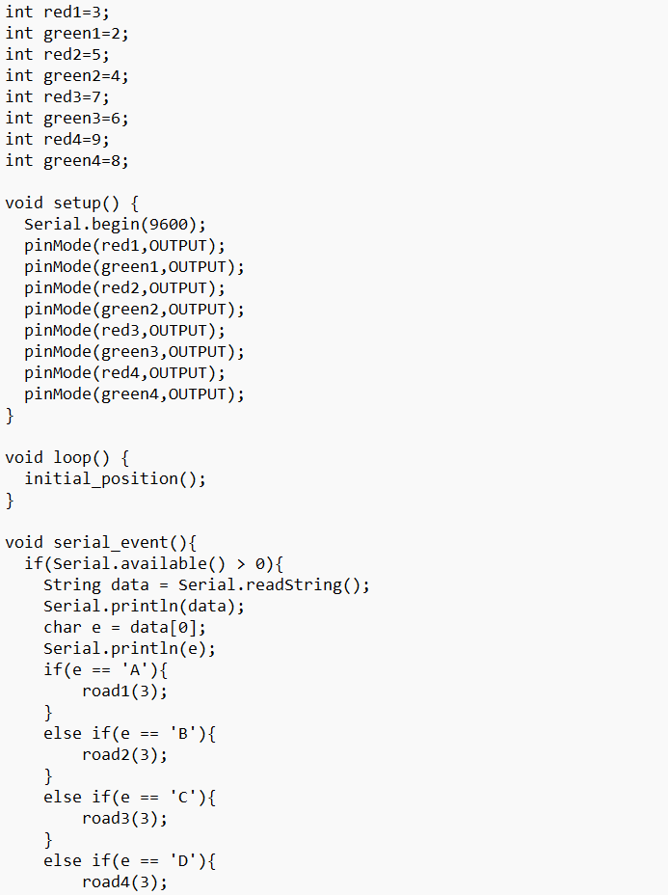
Fig 6 : Arduino implementation

Slide 18
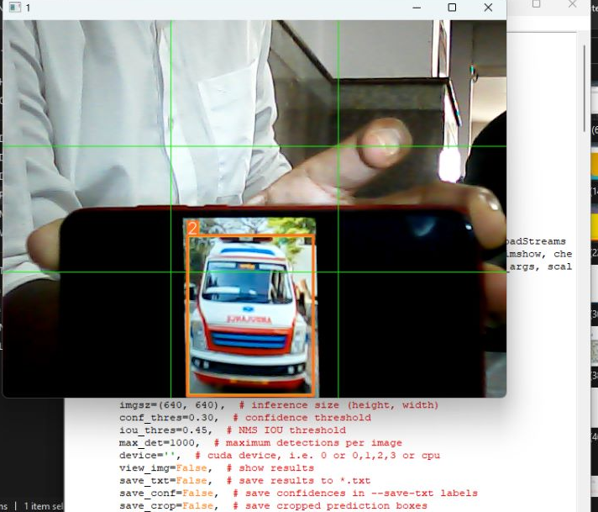
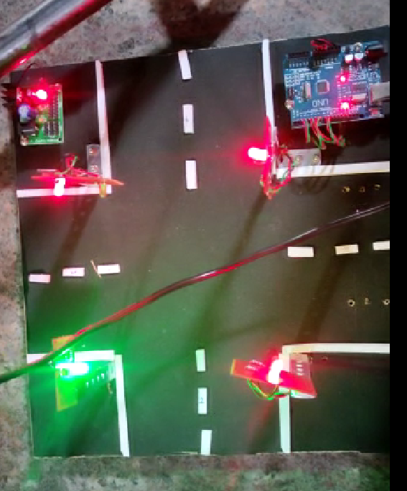
(a)
Fig 7: Final result
(b)

Slide 19
CONCLUSION AND FUTURE ENHANCEMENTS
CONCLUSION: With the remarkable potential of object detection will be implemented with the help of CNN, the proposed system can recognize vehicle of all type. The experimental results verified that the proposed vehicle detection method for Traffic surveillance scenes has good performance and practicability.
FUTURE ENHANCEMENTS:
This system can be implemented to all other emergency vehicles in future like fire engine, police, cars etc., in future.
The patient information can be shared to the hospital to which it is headed so that they get ready with the required medicines or infrastructure to treat that patient.
Traffic signal timer can be controlled dependent on number of vehicles present in front of the ambulance

Slide 20
REFERENCES
[1]. Pandiaraj, K., et al. "RFID Based Automatic Lane Clearance for Ambulance." 2021 International Conference on Advance Computing and Innovative Technologies in Engineering (ICACITE). IEEE, 2021.
[2]. Kamdar, Arihant, and Jigarkumar Shah. "Smart traffic system using traffic flow models." 2021 International Conference on Artificial Intelligence and Smart Systems (ICAIS). IEEE, 2021.
[3]. Rachana K P, Aravind R, Ranjitha M, Spoorthi Jwanita, Soumya K, 2021, IOT Based Smart Traffic Management System, INTERNATIONAL JOURNAL OF ENGINEERING RESEARCH & TECHNOLOGY (IJERT) NCCDS – 2021 (Volume 09 – Issue 12),
[4]. Lingani, Guy M., Danda B. Rawat, and Moses Garuba. "Smart traffic management system using deep learning for smart city applications." 2019 IEEE 9th annual computing and communication workshop and conference (CCWC). IEEE, 2019.
[5]. Javaid, Sabeen, et al. "Smart traffic management system using Internet of Things." 2018 20th international conference on advanced communication technology (ICACT). IEEE, 2018.

Slide 21
THANK YOU

