Slide 1

Voice based evaluation
Assessing Indian Law
VISHWAS SETTY N
2021FA04168

Slide 2
Need for Personalized Evaluation Methods
Challenges in Legal Education:
Assessing comprehensive understanding and communication skills of law students.
Importance of Effective Articulation:
Recognizing the significance of communication skills in the legal profession.
Current Evaluation Methods:
Limitations of traditional assessment approaches in legal education.

Slide 3
Problem Statement
Efficient and Precise evaluation is an issue
Huge data validation like IPC is a bottleneck
Mandatory Human presence in evaluation
User friendly evaluation techniques is a challenge
Context based evaluation than value based

Slide 4
Objective of the project
Understanding huge volumes of data (IPC)
Retaining context of the data
Machine oriented evaluation technique
User friendly evaluations
Context based evaluation

Slide 5
Literature Survey
Attention is all you need
An attention function can be described as mapping a query and a set of key-value pairs to an output, where the query, keys, values, and output are all vectors. The Transformer
follows this overall architecture using stacked self-attention and point-wise, fully connected layers for both the encoder and decoder
NLP-based Automatic Answer Evaluation
Keyword-based summarizing algorithms are utilized to generate a summary from the retrieved material. A pipeline function that chronologically calls other functions in order to finally reach a conclusion. Based on rule-based technique a threshold level is selected after careful observations on the dataset.

Slide 6
Literature Survey
A Novel Approach for Building Domain-Specific Chatbots by Exploring Sentence Transformers-based Encoding
Sentence transformers encode sentence meaning and semantic similarity, enabling the generation of contextually coherent and relevant responses. Cosine similarity is simply a measure of similarity between two vectors. After the encoding layer, there comes the need for answer retrieval.
Sentence Similarity Based on Semantic Vector
The semantic similarity of two sentences is calculated using information from a structured lexical database, How-net. Adjusting semantic vector, semantic similarity between two sentences is defined as the cosine coefficient between the two semantic

Slide 7
Literature Survey
Speech-to-Text and Text-to-Speech Recognition using DeepLearning
Using acoustic modelling, text units are assigned to the acoustic characteristics of speech, such as pitch, duration, and spectral patterns. To increase the precision of voice recognition, language modelling entails capturing the statistical features of language, such as word frequencies and n-gram probabilities.
Towards Unsupervised Speech-to-text translations
Word-by-Word Translation System - use an unsupervised bilingualdictionary induction (BDI) algorithm to learn a cross-lingual mapping from the source embedding space to the target embedding space.
Speech2Vec model was trained and also text embedding space was trained by Word2Vec using fastTextwith default settings without subword information

Slide 8
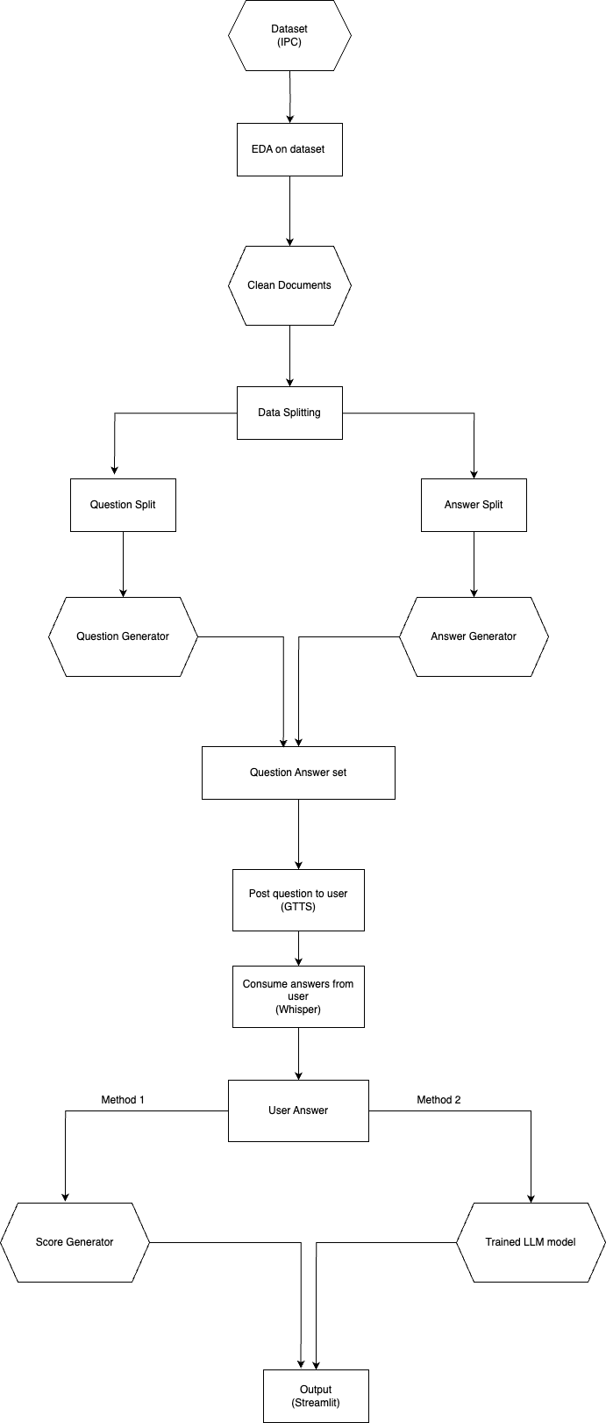
Architecture

Slide 9
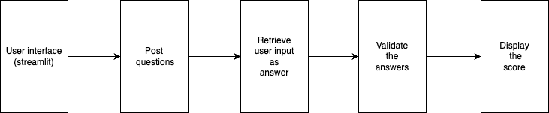
User level data flow

Slide 10
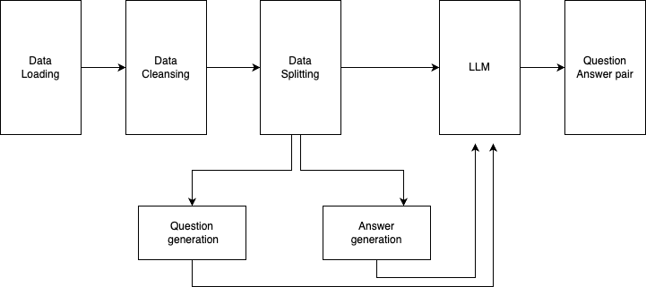
Data pre-processing

Slide 11
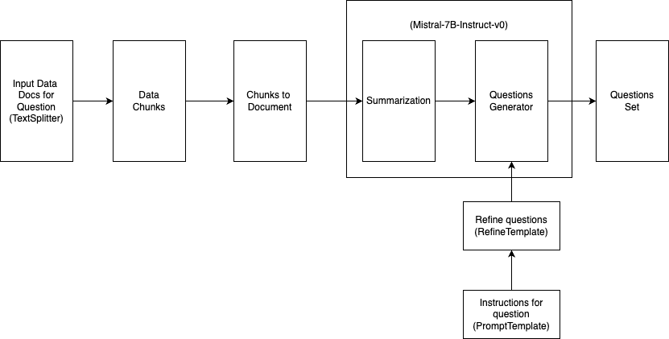
Question Generation Flow

Slide 12
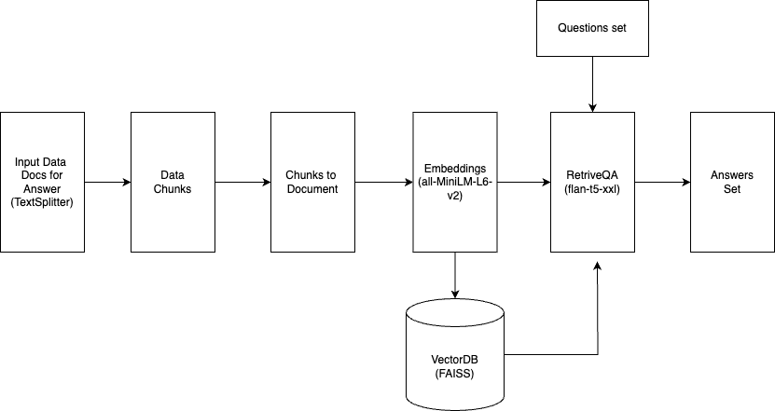
Answer Generation Flow

Slide 13
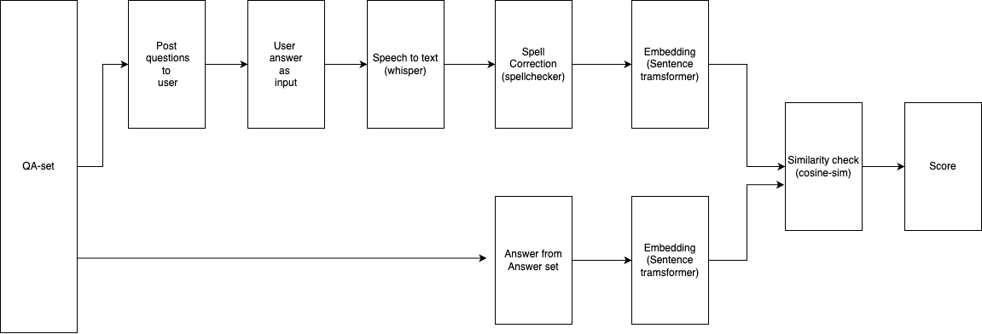
Score Generation Flow

Slide 14
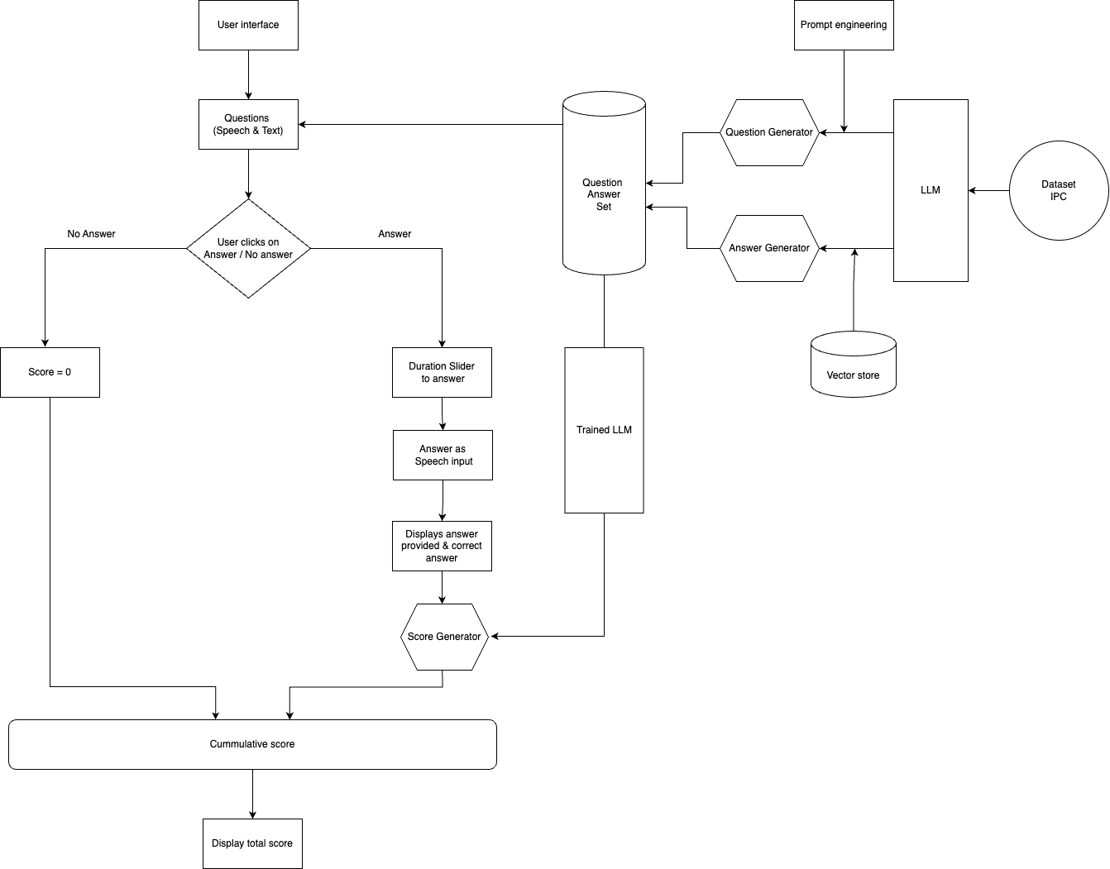
Business process
flow

Slide 15
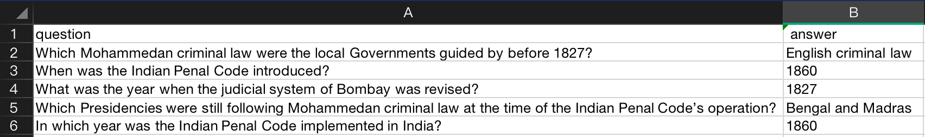
Evaluation
Question Answer Set

Slide 16
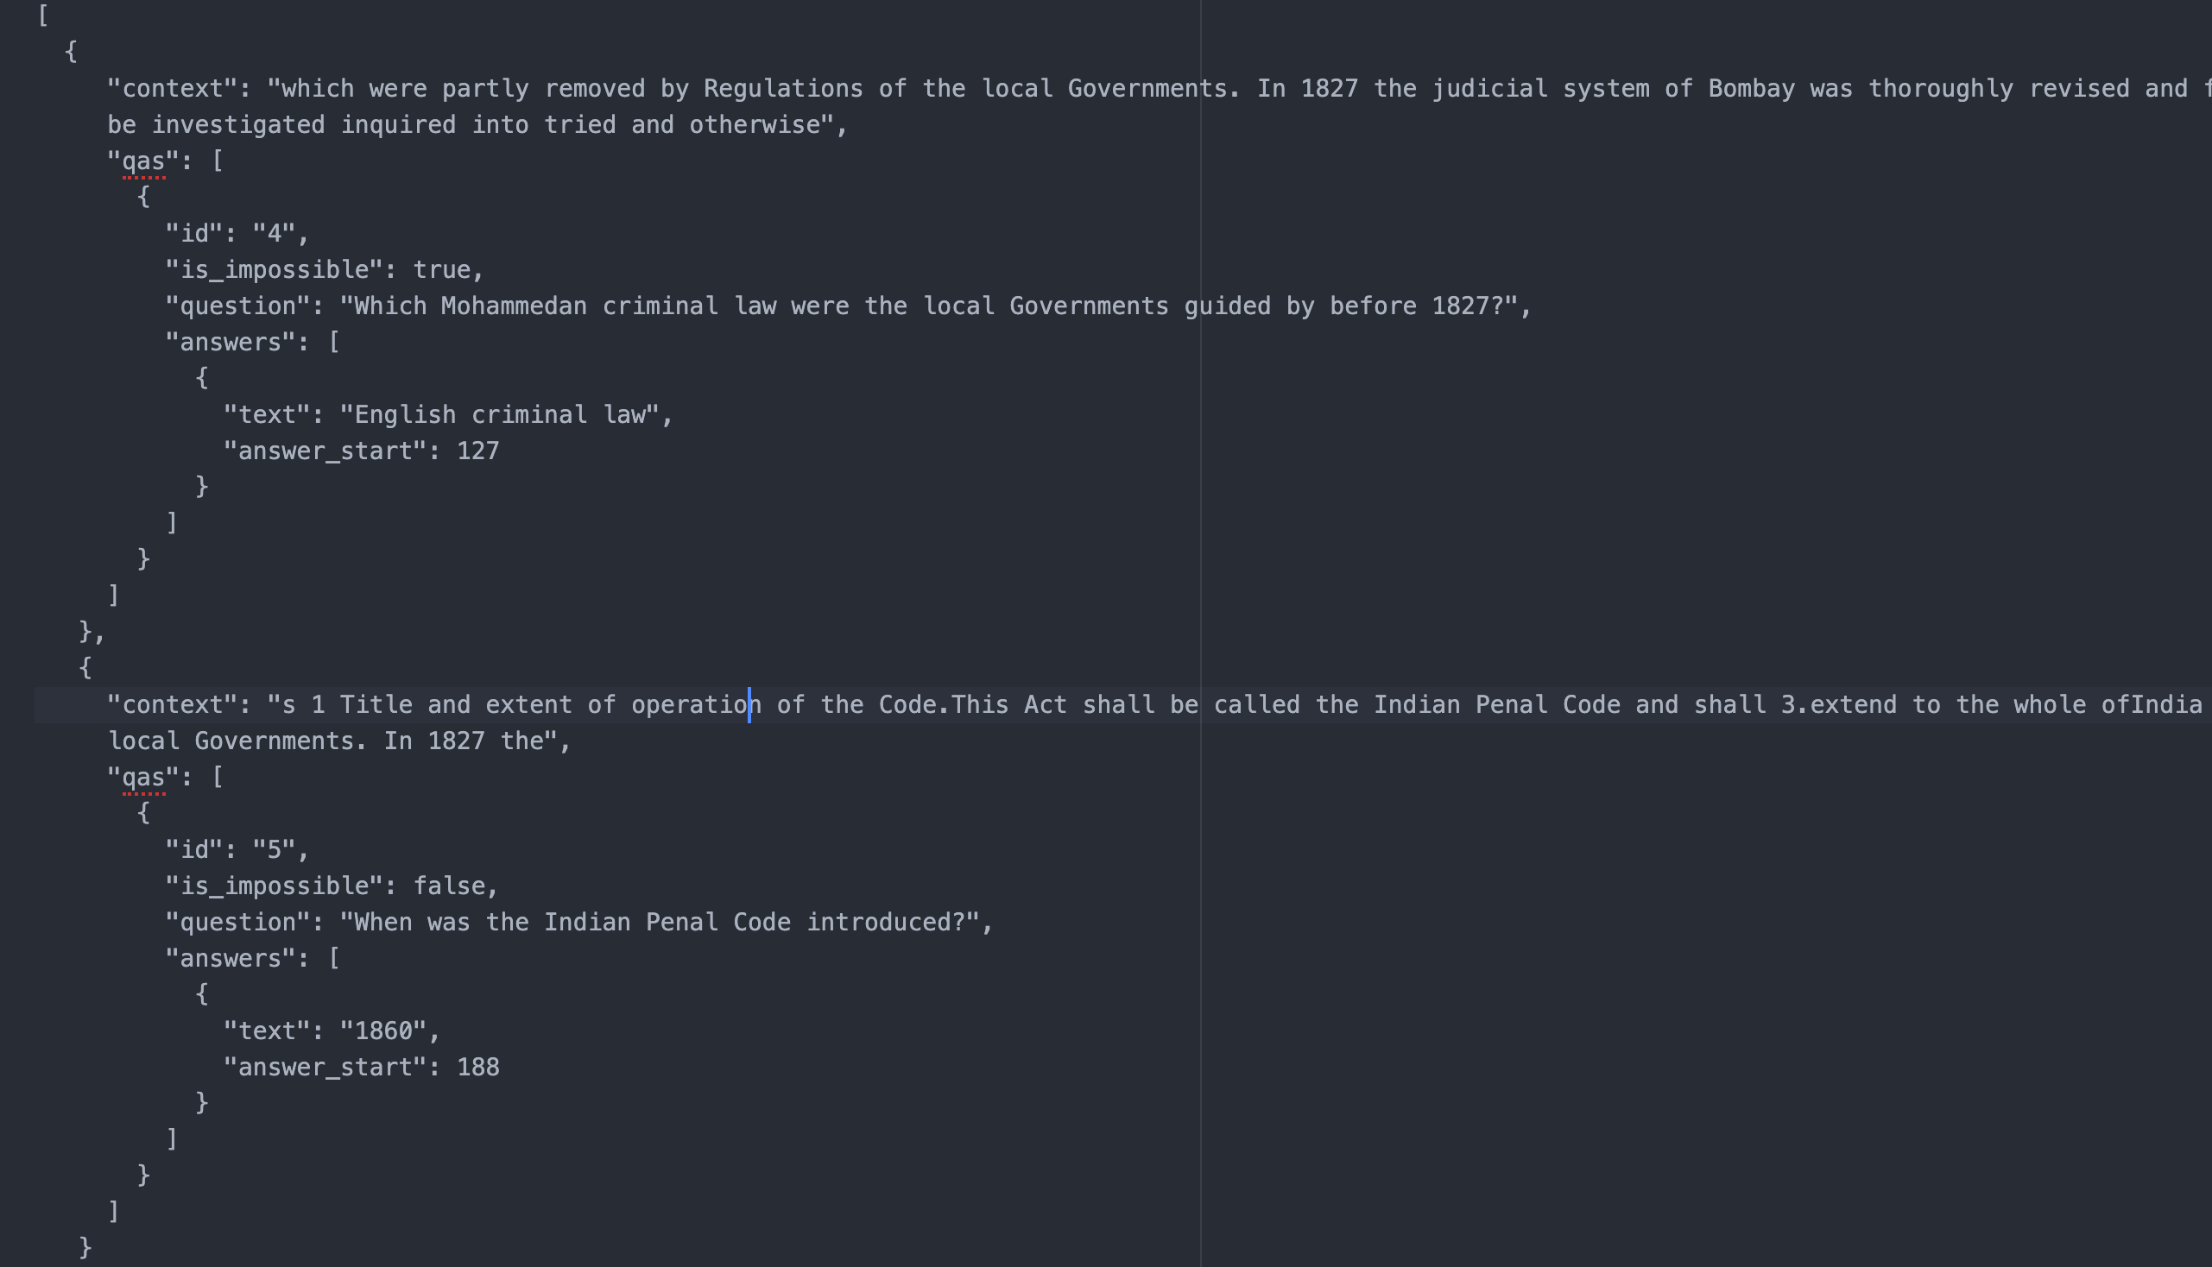
Evaluation
DataSet for training

Slide 17
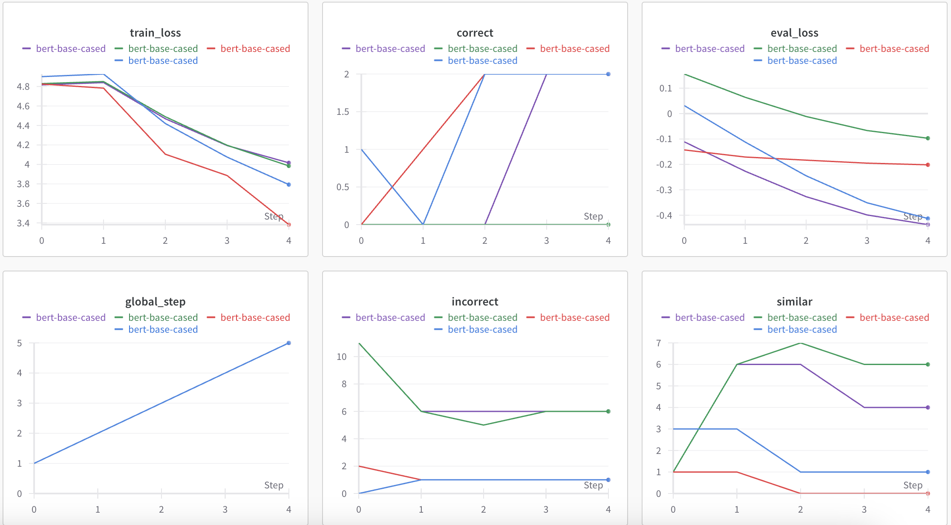
Evaluation
WANDB
metrics

Slide 18
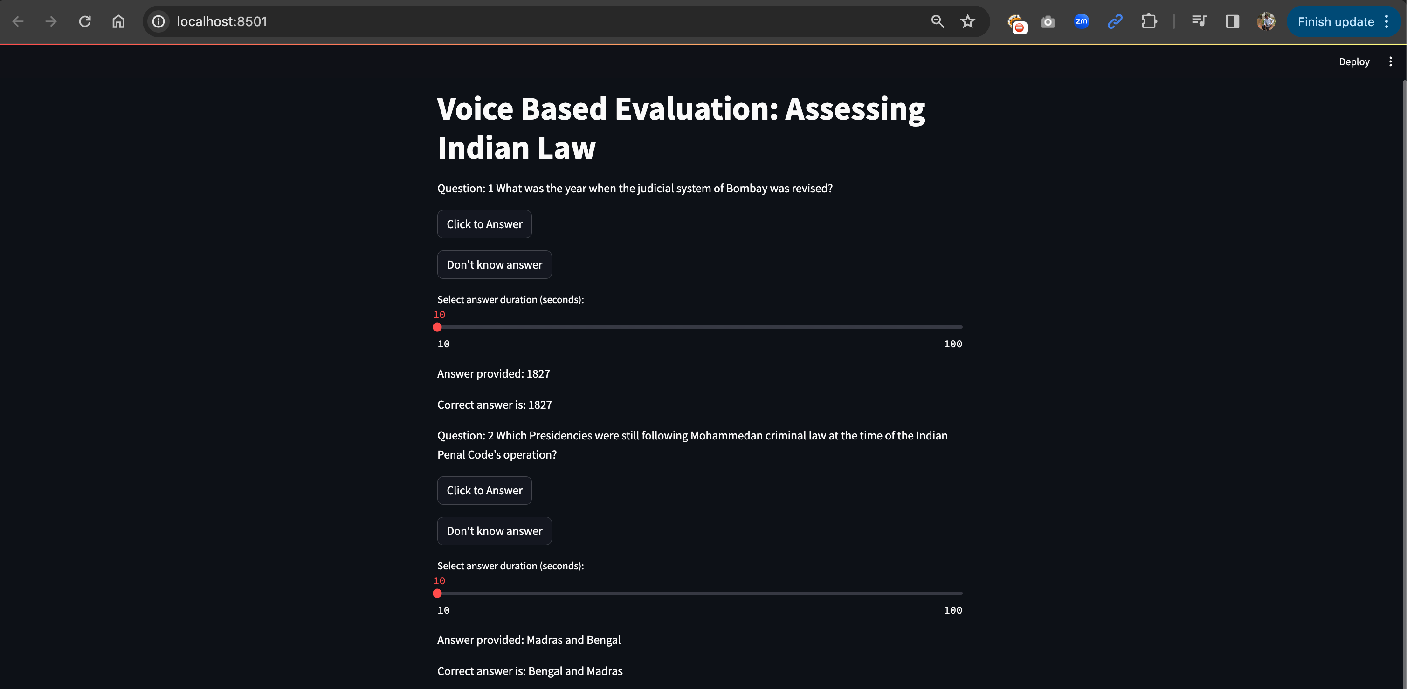
Output

Slide 19
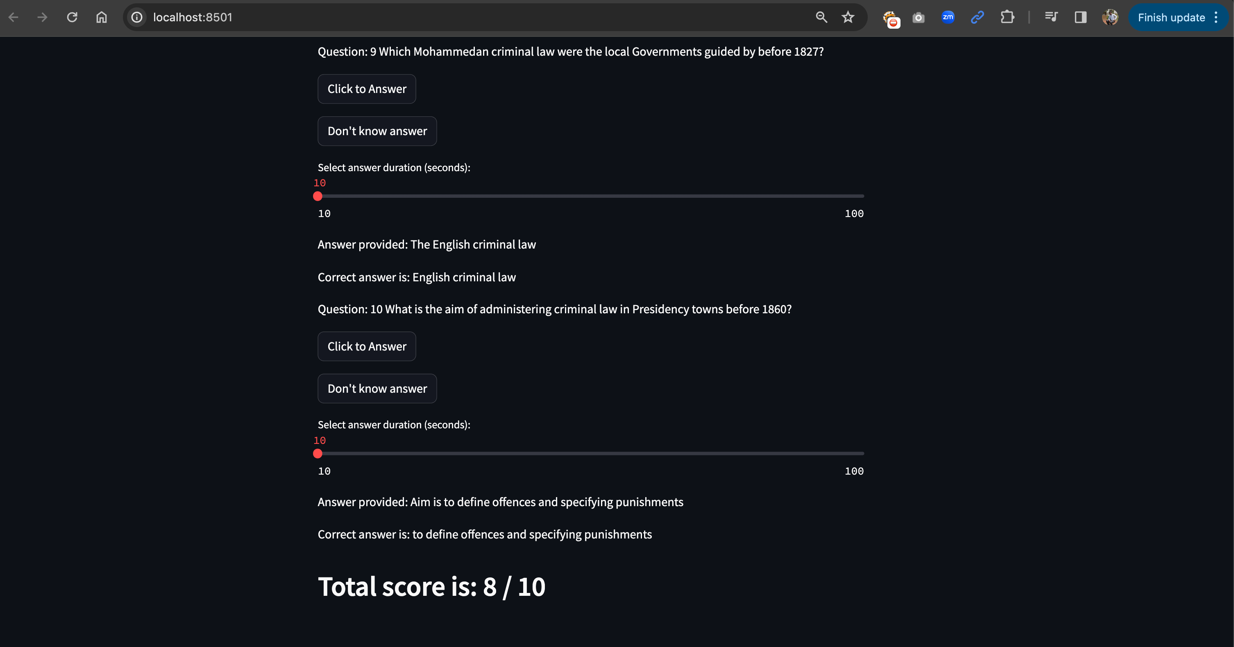
Output

Slide 20
Conclusion
Voice-based Evaluation Incorporating NLP and LLMs: Utilizing LangChain's Prompt templates and Mistral-7B-Instruct models, along with BERT base models and SimpleTransformer techniques, facilitates question generation and answer evaluation.
Advanced Technologies Integration: Integration of wand technology for developer convenience and Whisper AI for real-time speech-to-text processing enhances system usability and interface effectiveness.
Precise Outcome with Cosine Similarity: Utilizing trained models for precise outcome as well ad cosine similarity for similarity checks ensures precise evaluation of user-provided answers, aligning system performance with expectations.
Potential for Further Enhancement: Optimizing user-friendliness and evolving into a more sophisticated interview-based model. Continued exploration and refinement can contribute to overall efficacy and user satisfaction.

Slide 21
Future enhancement
Enhanced Customer Engagement: By customizing the model to generate questions based on user experience and responses, rather than relying on predefined questions, businesses can engage with customers in a more personalized and interactive manner.
Improved Interview Process: Tailoring the interview process to generate intelligent recurring questions based on user feedback enhances the assessment of a person's depth of understanding and expertise in a given field.
Creating Interactive Dialogue: The overarching goal of the model is to create a more interactive that it starts asking counter questions based on the answers provided by the student. This helps the model to be more precise as an interviewer.

Slide 22
Thank you

