Slide 1
Class Diagrams: Basic Concepts

Slide 2
Objects
  The purpose of class modeling is to describe objects.
  An object is a concept, abstraction or thing that has meaning for a domain/application.
  Some objects have real world counterparts while others are conceptual entities.
  The choice of objects depends on judgment and the nature of problem.
  ِAll objects have identity and are distinguishable.

Slide 3
Classes
  An object is an instance – occurrence – of a class
  ِ A class describes a group of objects with the same properties (attributes), behavior (operations), kinds of relationships, and semantics.
  The objects in a class share a common semantic purpose, above and beyond the requirement of common attributes and behavior.
  By grouping objects onto classes we abstract a problem.

Slide 4
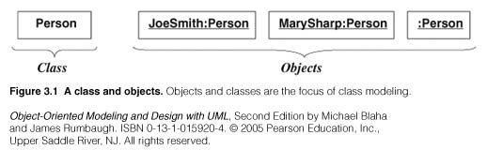
UML representation of classes/objects:
UML: Unified Modeling Language (OMG Standard): O.O Visual Modeling language
Class/object representation

Slide 5
Values and attributes
Value : piece of data.
Attribute: a named property of a class that describes a value held by each object of the class.
  Attributes may be discovered by looking for adjectives or by abstracting typical values.
  Don’t confuse values with objects:
    An attribute should describe values, not objects.
    Unlike objects, values lac identity

Slide 6
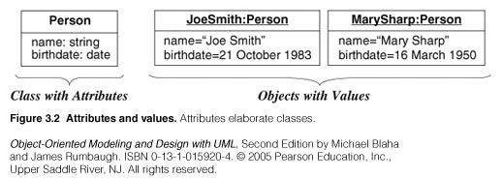
UML representation

Slide 7
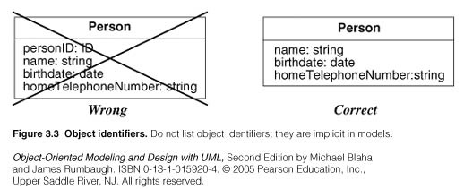
Object identifiers
Objects identifiers are implicit.
Objects belonging to the same and having the same attributes values may be different individual objects.

Slide 8
Operations and Methods
An operation is a function or procedure that may be applied to or by objects in a class.
Each operation has a target object as an implicit parameter.
All objects in a class share the same operations.
The behavior of the operation depends on the class of its target.
The same operation may apply to many different classes. Such an operation is POLYMORPHIC.

Slide 9
Operations and Methods
A method is the implementation of an operation for a class.
A different piece of code may implement each method.
An operation may have arguments in addition to its target object. These arguments may be placeholders for values and/or for objects.
When an operation has methods on several classes these methods must have the same SIGNATURE: number and types of arguments, type of result value.

Slide 10
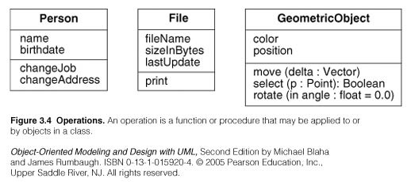
UML representation

Slide 11
Links and Association concepts
A link is a physical or conceptual connection among objects.
Most links relate two objects, but some links relate three or more objects.
A link is defined as a tuple, that is a list of objects.
A link is an instance of an association.
An association is a description of a group of links with common structure and semantics.
Association is denoted by a line. Its name is optional if the model is unambigious.

Slide 12
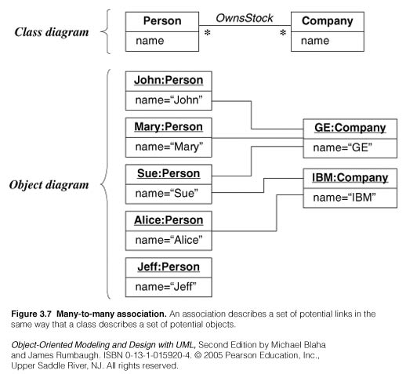
Examples

Slide 13
Associations are inherently bi-directional. The association name is usually read in a particular direction but the binary association may be traversed in either direction.
ِ A reference is an attribute in one object that refers to another object.

Slide 14
Multiplicity
It specifies the number of instances of one class that may relate to a single instance of the associated class.
UML diagrams explicitly list multiplicity at the end of association lines.
Intervals are used to express multiplicity:
  1 (exactly one)
  0..1 (zero or one)
  1..* (one or more)
  0..* (zero or more)
  3..5 (three to five inclusive)

Slide 15
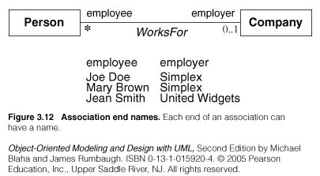
Association Ends
Associations have ends. They are called ‘Association Ends’.
They may have names (which often appear in problem descriptions).

Slide 16
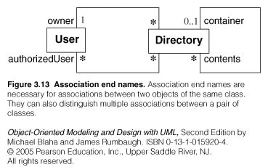
Association Ends
Use of association end names is optional.
But association end names are useful for traversing associations.
ِAssociation end names are necessary for for associations between objects of the same class.

Slide 17
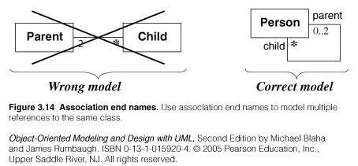
Example of association ends use

Slide 18
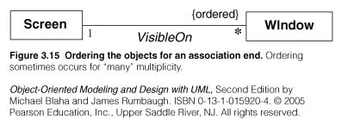
Association: ordering, bag, sequence
On a ‘many” association end, sometimes, it is required that objects have an explicit order.
In this case the ordering is an inherent part of the association
Example:

Slide 19
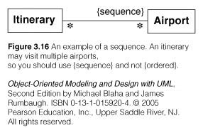
Association: ordering, bag, sequence
Ordinary a binary association has at most one link for a pair of objects
However we can permit multiple links for a pair of objects by annotating an association end with {bag} or {sequence}
A bag is a collection of elements with duplicates allowed.
A sequence is an ordered collection of elements with duplicates allowed

Slide 20
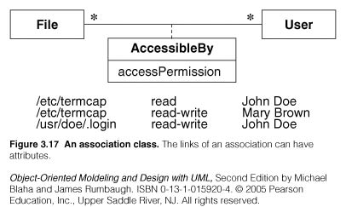
Association class
UML offers the ability to describe links of association with attributes like any class.
An association class is an association that is also a class.

Slide 21
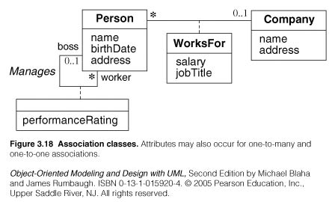
Association class
Examples:

Slide 22
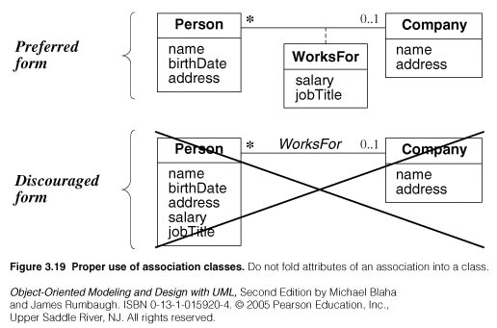
Association class
Example

Slide 23
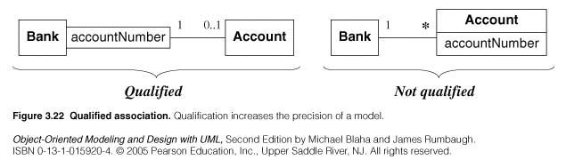
Qualified Association
A qualified association is an association in which an attribute called Qualifier disambiguates the objects for a ‘many’ association’ end.
A qualifier selects among the target objects, reducing the effective multiplicity fro ‘many’ to ‘one’.
Both below models are acceptable but the qualified model adds information.

Slide 24
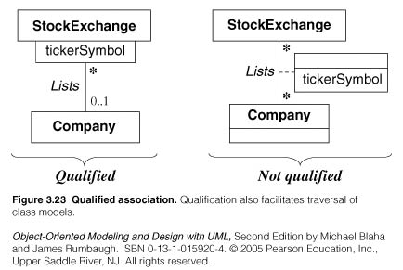
Qualified Association
Example:

Slide 25
Generalization/Inheritance
Generalization is the relationship between a class (superclass) and one or more variations of the class (subclasses).
Generalization organizes classes by their similarities and their differences, structuring the descriptions of objects.
A superclass holds common attributes, attributes and associations.
The subclasses adds specific attributes, operations, and associations. They inherit the features of their superclass.
Often Generalization is called a “IS A” relationship
Simple generalization organizes classes into a hierarchy.
A subclass may override a superclass feature (attribute default values, operation) by redefining a feature with the same name.
Never override the signature of methods.

Slide 26
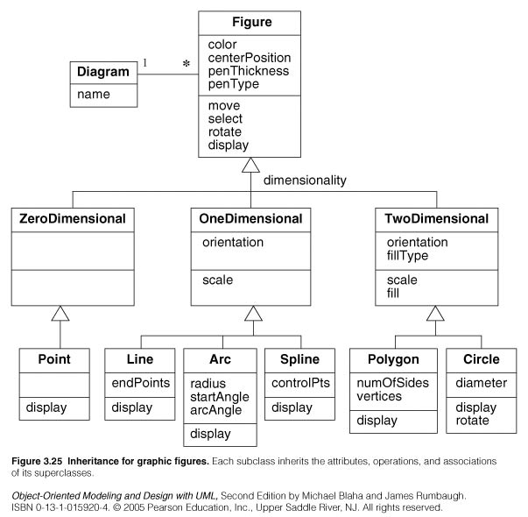

Slide 27
Use of generalization
Used for three purposes:
  Support of polymorphism:
    polymorphism increases the flexibility of software.
    Adding a new subclass and automatically inheriting superclass behavior.
  Structuring the description of objects:
    Forming a taxonomy (classification), organizing objects according to their similarities. It is much more profound than modeling each class individually and in isolation of other similar classes.
  Enabling code reuse:
    Reuse is more productive than repeatedly writing code from scratch.

Slide 28
Aggregation
Aggregation is a strong form of association in which an aggregate object is made of constituent parts.
The aggregate is semantically an extended object that is treated as a UNIT in many operations, although physically it is made of several lesser objects.
Aggregation is a transitive relation:
  if A is a part od B and B is a part of C then A is also a part of C
Aggregation is an antisymmetric relation:
  If A is a part of B then B is not a part of A.

Slide 29
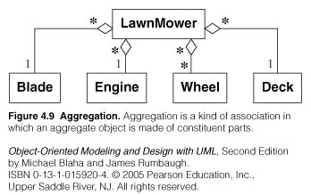

Slide 30
Aggregation versus Association
Aggregation is a special form of association, not an independent concept.
Aggregation adds semantic connotations:
  If two objects are tightly bound by a part-whole relation it is an aggregation.
  If the two objects are usually considered as independent, even though they may often be linked, it is an association. ِ
Discovering aggregation
  Would you use the phrase part of ?
  Do some operations on the whole automatically apply to its parts?
  Do some attributes values propagates from the whole to all or some parts?
  Is there an asymmetry to the association, where one class is subordinate to the other?

Slide 31
Aggregation versus Composition
Composition is a form of aggregation with additional constraints:
  A constituent part can belong to at most one assembly (whole).
    it has a coincident lifetime with the assembly.
    Deletion of an assembly object triggers automatically a deletion of all constituent objects via composition.
  Composition implies ownership of the parts by the whole.
    Parts cannot be shared by different wholes.

Slide 32
Aggregation versus Composition
Composition is a strong form of aggregation where:
    Deletion of a “whole” triggers automatically deletion of all its “parts”. (Lifetime)
“Parts” are included in at most one “whole” at a time. (Sharing)

Slide 33
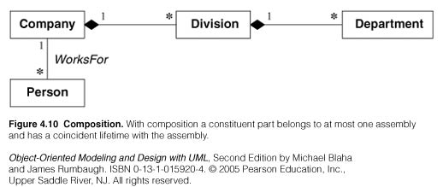

Slide 34
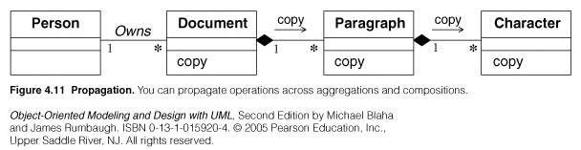
Propagation of operations
Propagation is the automatic application of an operation to a network of objects when the operation is applied to some starting object.
Propagation of operations to parts is often a good indicator of propagation.

