Slide 1

Capstone Project-1
Stock Price Prediction Team Members Vishesh Singhal Vishwash Bharti Vivek Anand Yatharth

Slide 2
CONTENT
Problem Statement
Objective
Tools Used
Data Summary
Exploratory Data Analysis
Challenges
Recommendations
Conclusions
Q & A

Slide 3
PROBLEM STATEMENT
Analyzing Tesla stock prices presents a complex challenge due to the dynamic nature of financial markets. The project aims to harness the power of artificial intelligence, employing advanced time series forecasting techniques like ARIMA, LSTM, and Prophet.
The objective is to visualize and do in depth analysis of the data in order to develop models that accurately predict Tesla stock prices, providing valuable insights for investors and financial analysts in navigating the unpredictable nature of the stock market.

Slide 4


Slide 5
OBJECTIVE
The objective of this project is to develop robust and accurate predictive models for Tesla stock prices using advanced artificial intelligence and time series forecasting techniques, including ARIMA, LSTM, and Prophet.
By harnessing the power of these methodologies, the project aims to provide investors and financial analysts with reliable predictions and valuable insights into the future movements of Tesla stock prices.
The ultimate goal is to equip stakeholders with actionable information to make informed investment decisions and navigate the complexities of the dynamic financial markets effectively.

Slide 6
Tools Used
Jupyter Notebook is used as IDE.
Pandas and NumPy are used for Data Manipulation & Pre-processing and Mathematical functions respectively.
Exploratory data analysis is automated by data prep.
For visualization of the plots, Matplotlib, Seaborn are used.
GitHub is used as version control system
Sklearn library is used for Machine learning tools

Slide 7

DATA SUMMARY
Categorical Data
1. Date
Numerical Data
1. Open
2. Close
3. High
4. Low
5. Adj Close
6. Volume
Unique Data
1. Date

Slide 8
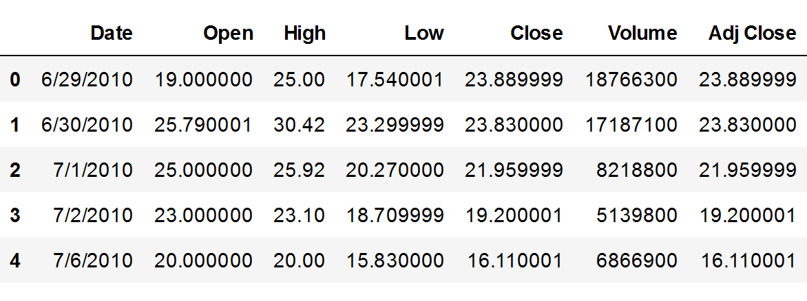
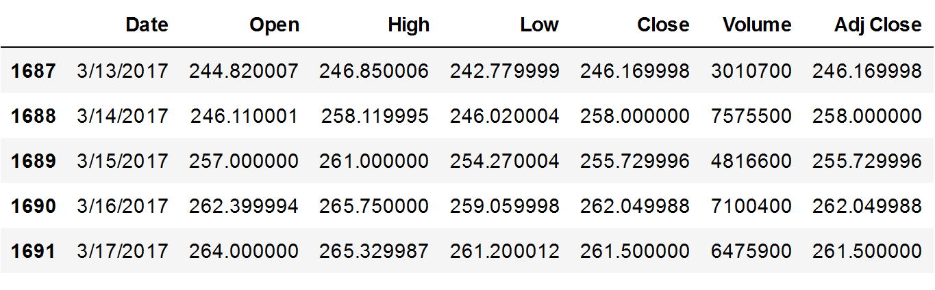
DATA SUMMARY
This is the Tesla Stocks dataset. In the below table it shows the top and bottom 5 rows respectively

Slide 9
FEATURES DESCRIPTION
Date : Represents the specific date of the trading day.
Open : Denotes the price at which the first trade occurs on a trading day.
Close : Represents the final price at which a stock is traded during a trading day.
High : Signifies the highest price at which a stock was traded during a trading day.
Low : Denotes the lowest price at which a stock was traded during a trading day.
Volume : Indicates the total number of shares traded on a given trading day.
Adj Close : Reflects the stock's closing price adjusted for factors such as dividends, stock splits etc.

Slide 10
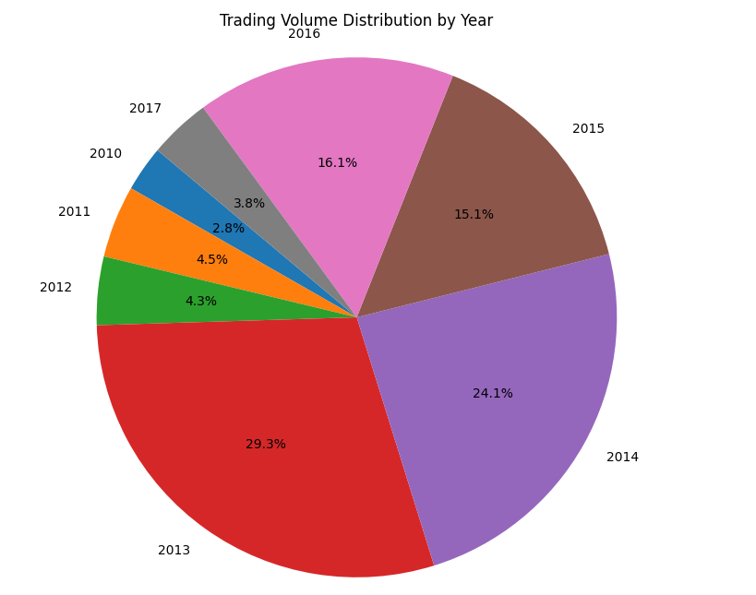
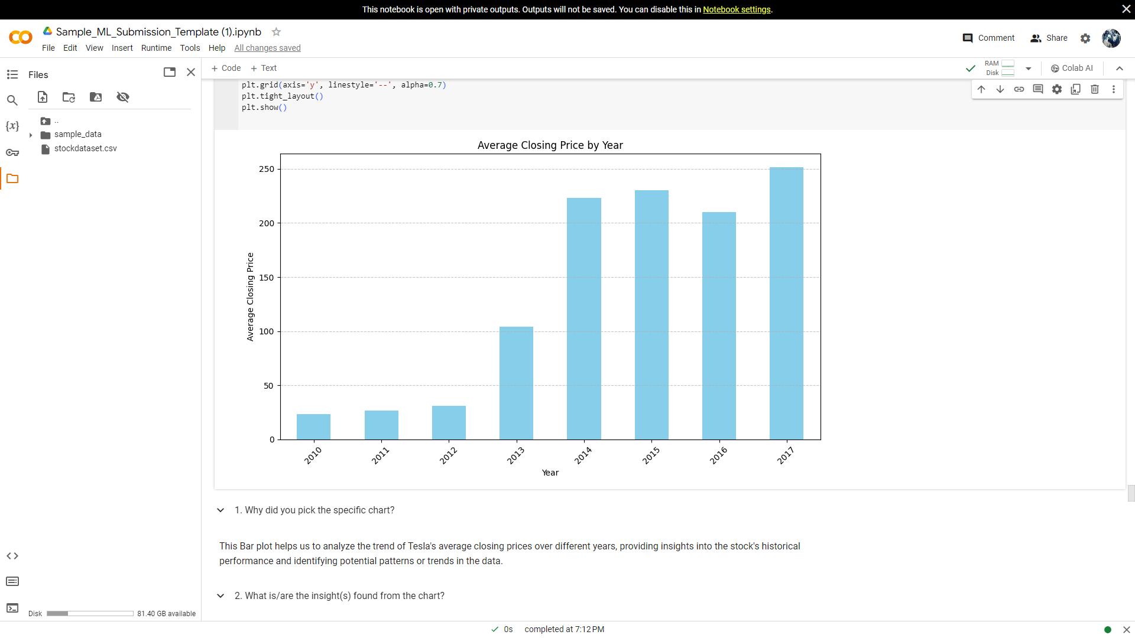
Analysis of the Distribution of Volume Traded by Year and Average Closing Price by Year
Below plot on the left side is a pie chart showing Trading Volume Distribution by Year
And on the right side the Bar plot showing the Average Closing Price by Year
The year 2013 saw the highest no. of shares traded followed by the year 2014. 2016 comes in as the year with 3rd highest no. of shares traded and 2015 follows closely at 4th highest. 2010,2011,2012 and 2017 have the least amount of shares traded.
The highest average closing price is in the year 2017. The lowst average closing price is in the year 2010.

Slide 11
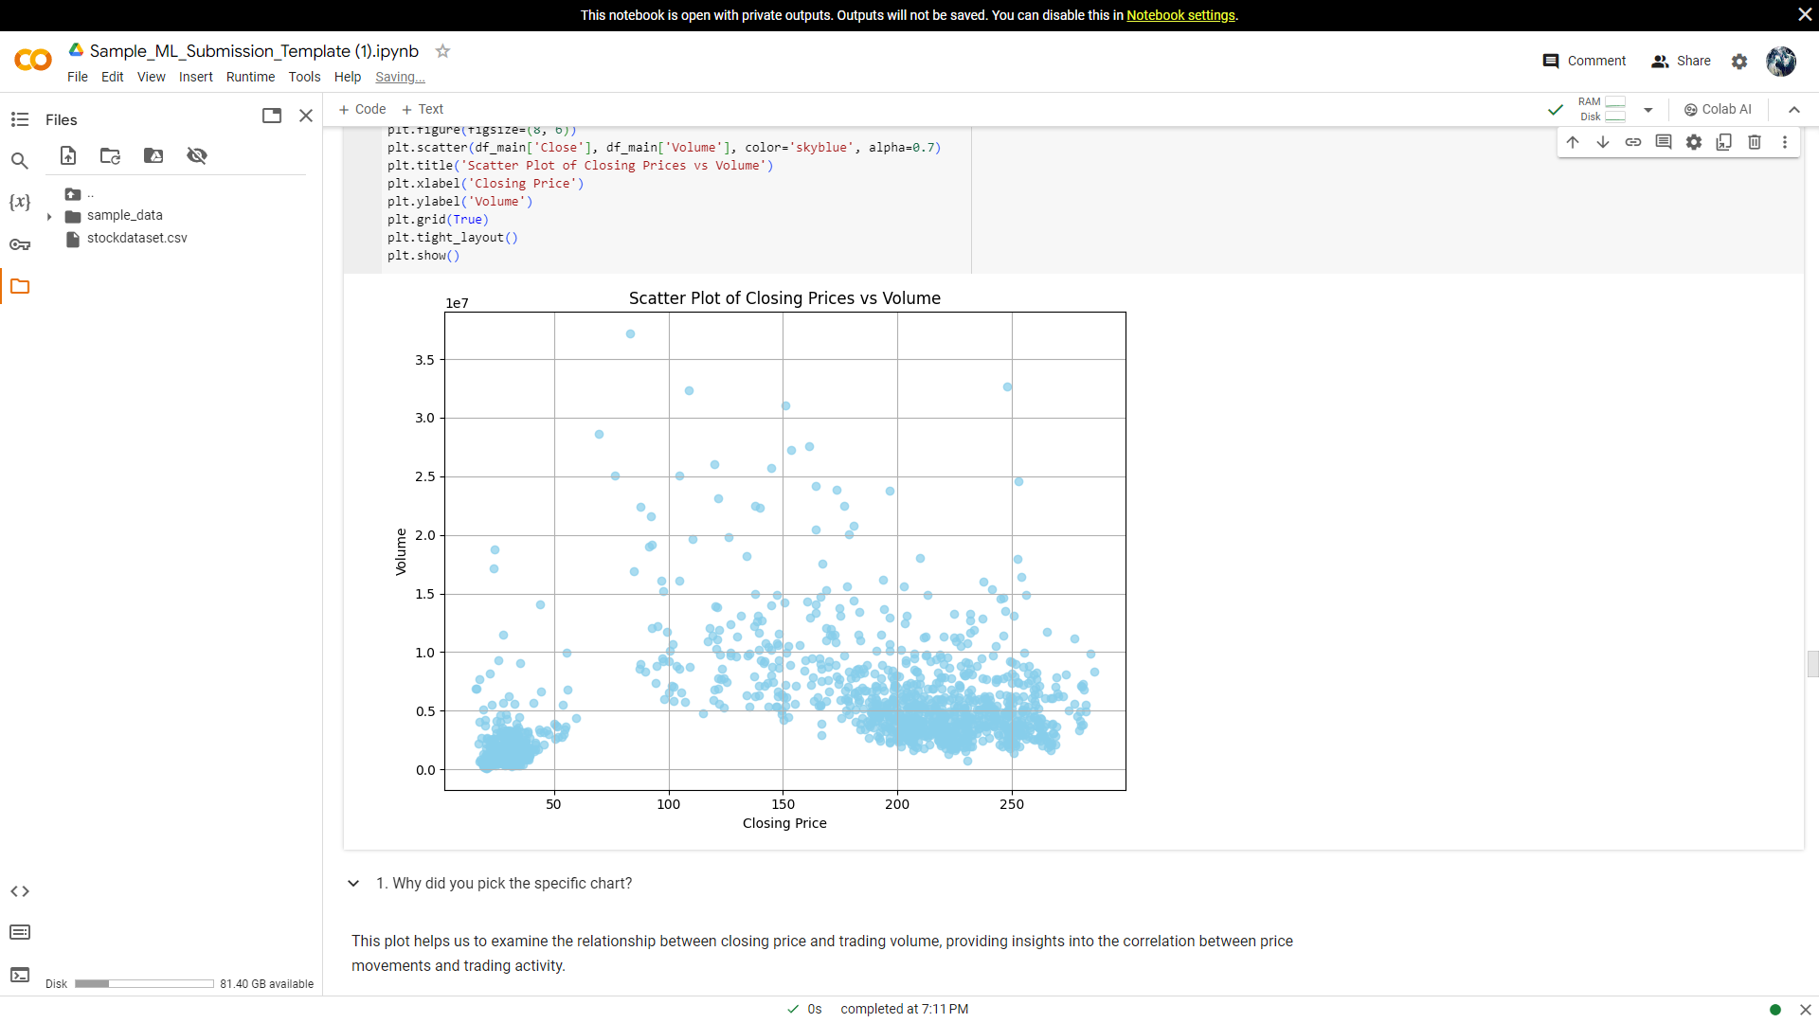
Closing Price V/S Volume
This Scatter plot depicts that in the closing price range from 175-250 a dense cluster of points suggests that there are many instances where both the closing price and the trading volume fall within a narrow range. This indicates periods of high trading activity where the stock price and trading volume remain relatively consistent.
Ironically, the highest volume traded was observed when prices were in the range between 50 - 100.
Also, In the range 50 - 100 there isn't much activity. Infact this range has the least amount of activity meaning when prices were in this range trading activity hasn't been very consistent

Slide 12
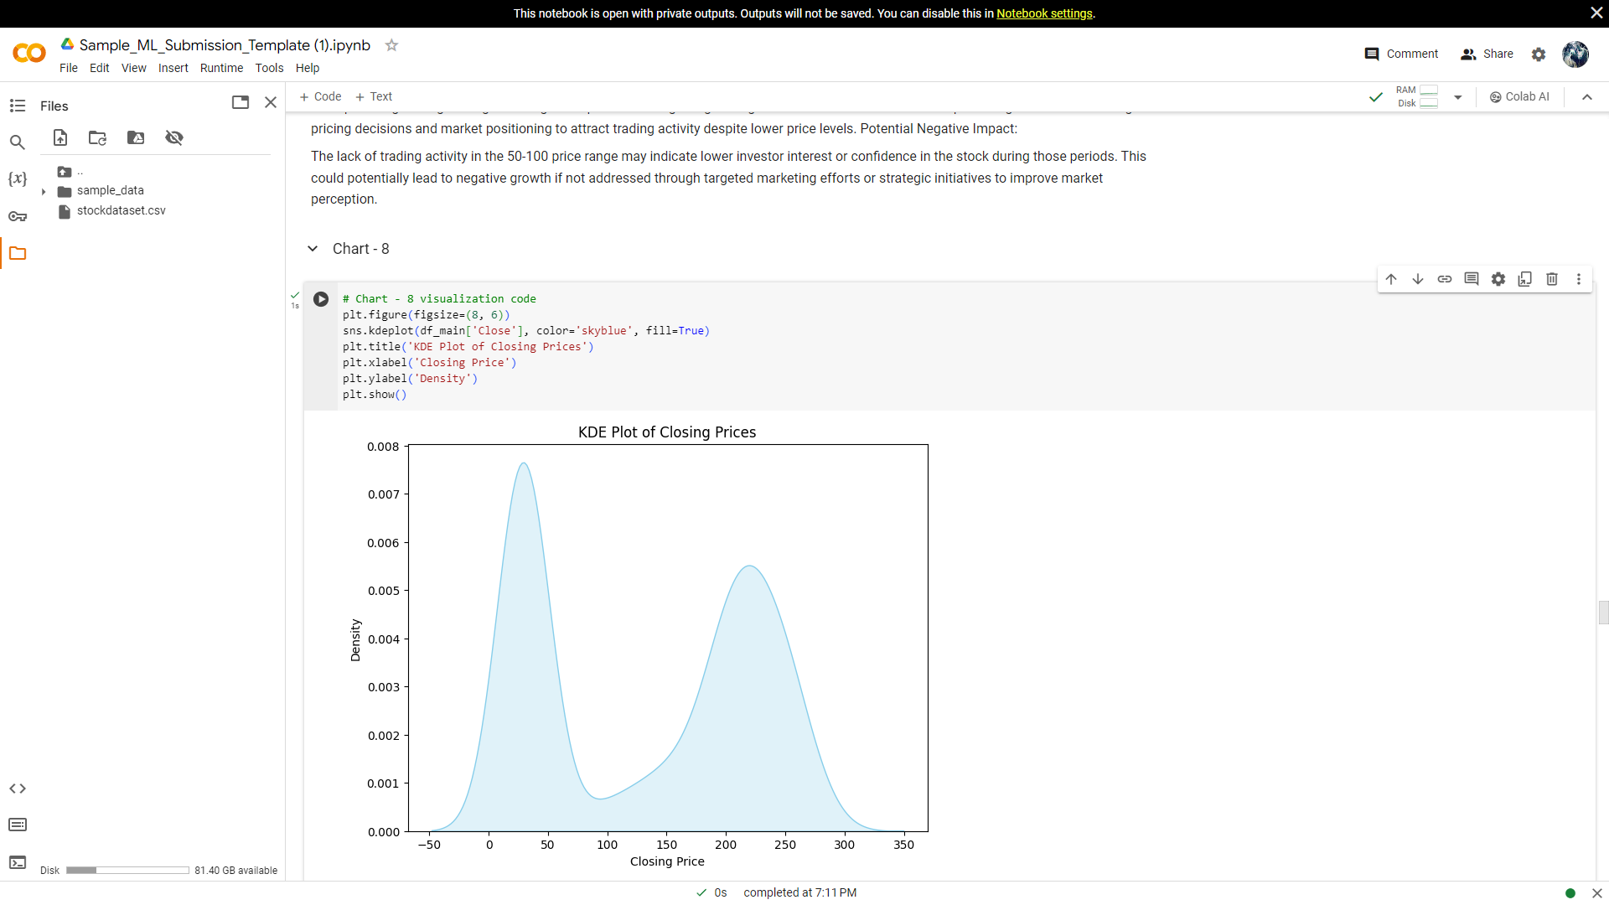
KDE Plot of Closing Price
From the KDE plot below, we can observe a couple of things about the distribution of closing price
The central tendency of the data is along the range 0-50 meaning the most common closing price range is 0-50
The amount of closing prices is the least in the range 100-150.
The amount of closing prices in the range 150-250 is also high suggesting on a lot of days the closing prices were in this range

Slide 13
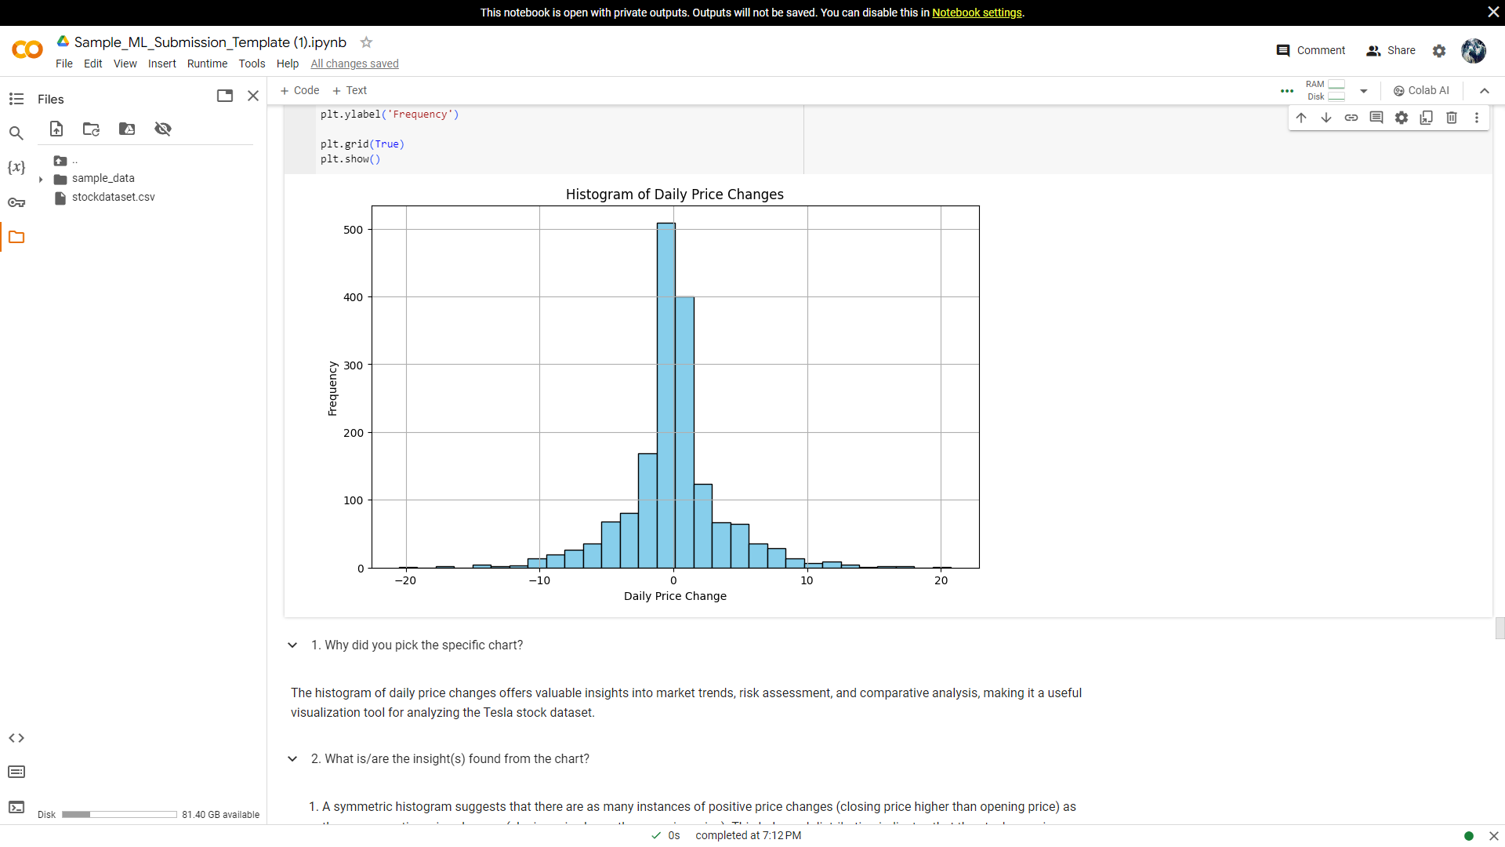
Histogram of Daily Price Changes
The symmetric histogram suggests that there are as many instances of positive price changes (closing price higher than opening price) as there are negative price changes (closing price lower than opening price).
This balanced distribution indicates that the stock experiences both upward and downward movements with similar frequencies over the period analyzed.
There are more instances of negative price changes (closing price lower than opening price) compared to positive changes. This observation implies that, on average, the stock tends to experience more downward movements or decreases in price on a daily basis.

Slide 14
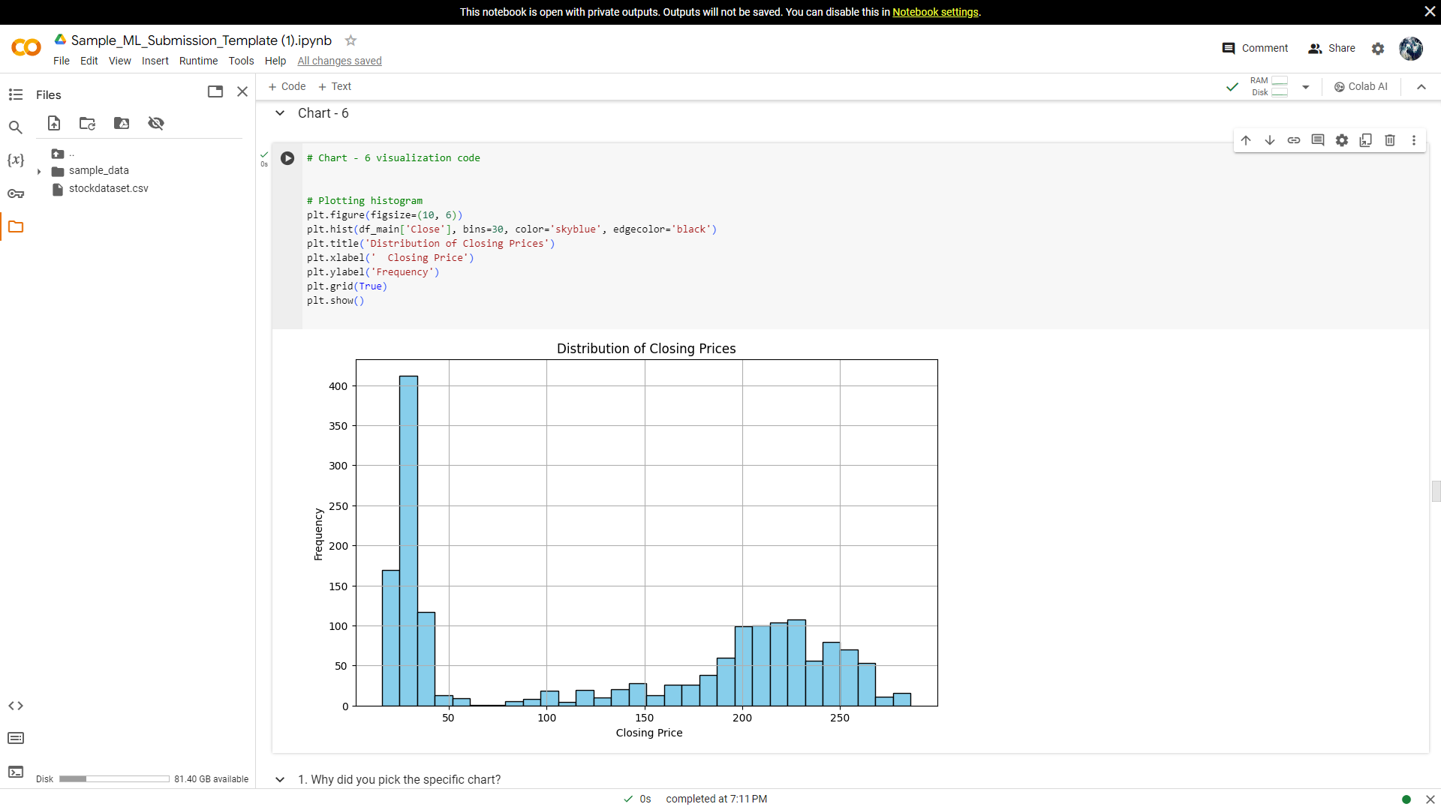
Histogram showing Distribution of Closing Prices
From this histogram we found that the data is positively skewed.
The spread of the histogram is quite wide suggesting a broader range of closing prices.
The most common closing price is in the range 0 to 50.
The prices Close in the range 150 - 250 pretty consistently.

Slide 15
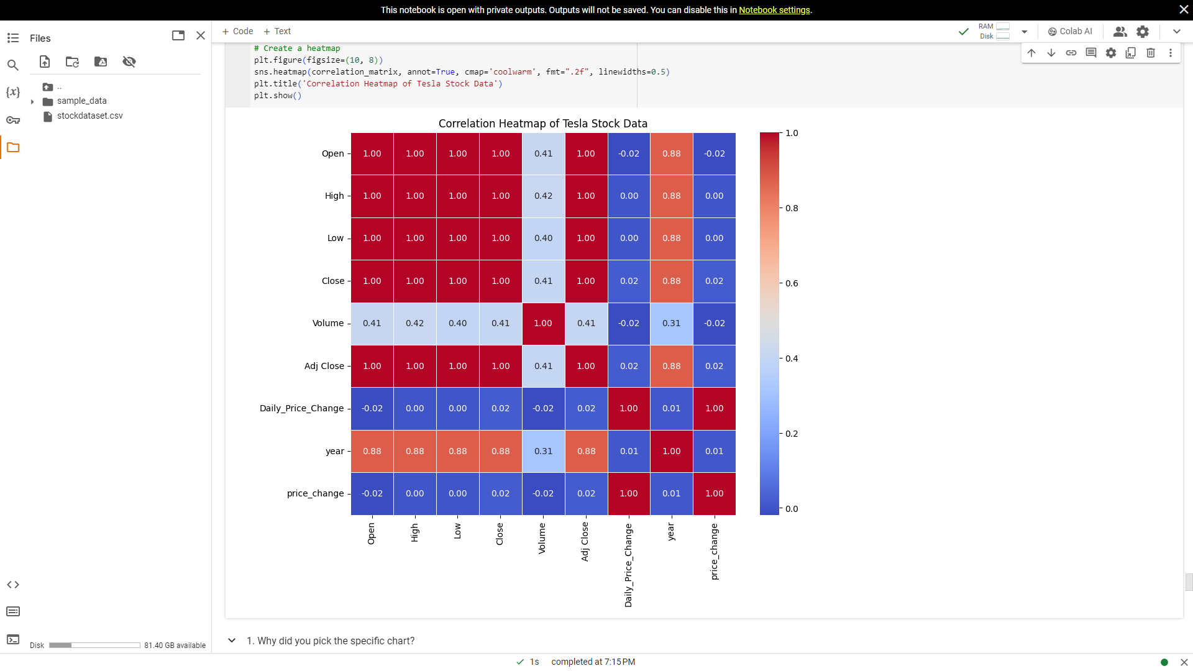
Correlation Heatmap
We can identify the correlations between different variabes
We can see that some variables exhibit positive or negative correlation with other variables
It helps us to identify patterns and vriation of variables with other variables

Slide 16
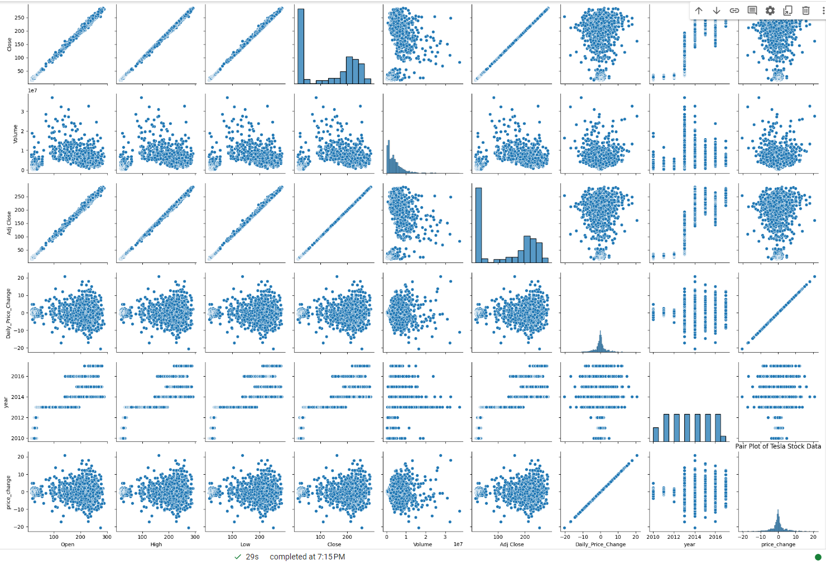
Reviews Count at Different Phases of Month
This plot helps us with identification of strong positive or negative correlations between pairs of variables, which indicates how variables move together or in opposite directions.

Slide 17
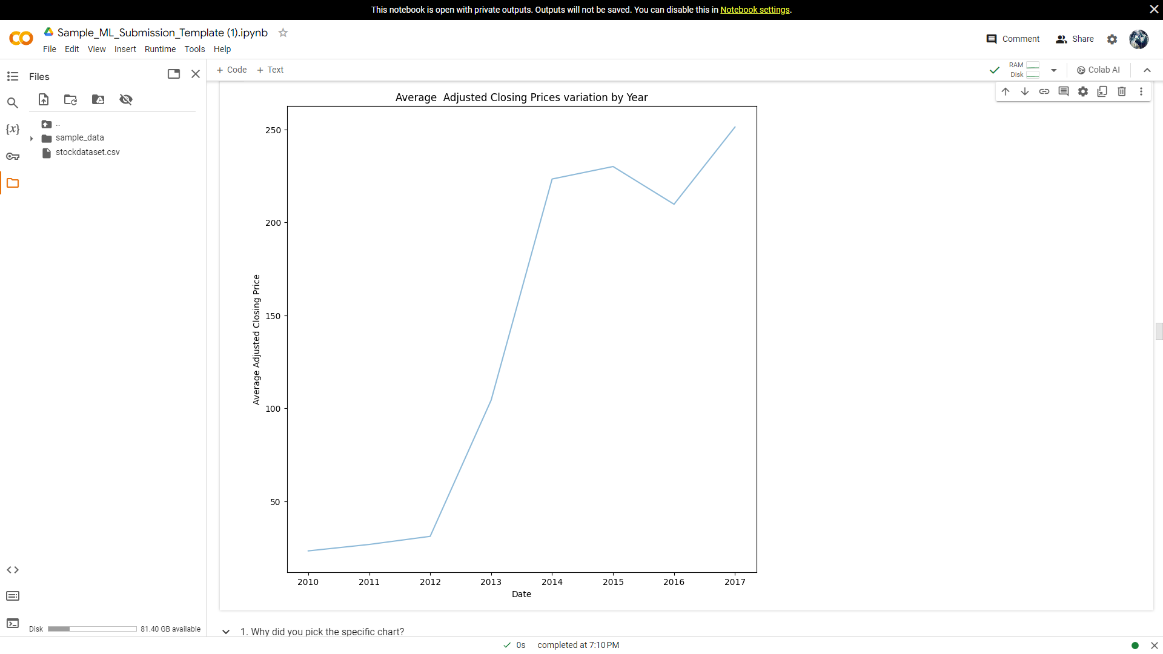
Average Adjusted Closing Price by Year
. In the beginning of the given timeframe during the years between 2010 to 2012 the prices are the lowest and are fairly consistent throughout.There is a slight increase during this time.
1. In the year 2012 there is a sudden and shar rise in the prices
2. Between the years 2012 to 2014 there is a sharp rise in prices .
3. Between 2014 and 2015 there isn't much growth in terms of prices. The prices remain fairly consistent throughout.
4. Between 2015 to 2016 there is a decrease between 2015 to 2016. The prices during this time are lower than 2014.
5. The prices start increasing again from 2016 and are rising consistently until 2017.

Slide 18
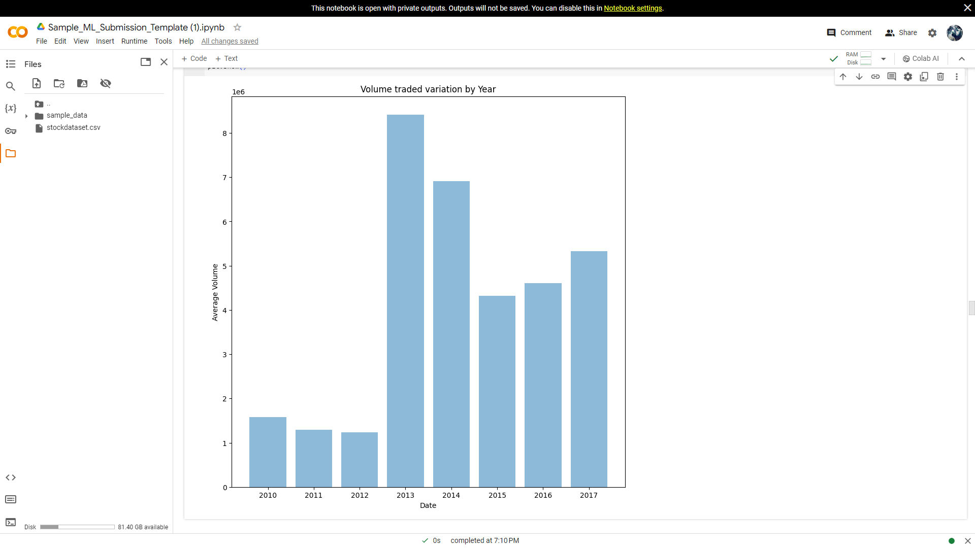
Box Plot for Volume Traded By Year
The volume of shares traded is very low in 2010 and is slightly decreasing from 2010 to 2011. From 2011 to 2012 there is further decrease in the volume traded but the decrease is at a slightly lesser rate than 2010 to 2011. In 2011 the least no of shares were traded during this time period according to the data.
The no. skyrocketed between 2012 and 2013. Reaching the highest volumne of shares traded by the end of 2012. Between the years 2013 and 2015 the volume of shares traded decreased.
The growth continued in the year 2016 at a slightly faster rate than last year

Slide 19
Recommendations
Long-term Perspective: Approach Tesla's stock with a long-term investment horizon, considering its disruptive potential in the automotive and energy sectors.
Risk Awareness: Acknowledge the volatility inherent in Tesla's stock price, understanding that it may fluctuate significantly due to factors such as production challenges, regulatory scrutiny, and market sentiment.
Evaluate Innovation: Assess Tesla's commitment to innovation and technological leadership in electric vehicles and renewable energy solutions as key indicators of its future growth potential.
Monitor Financials: Stay informed about Tesla's financial performance, including revenue growth, production scalability, and profitability, to make informed investment decisions.
Diversification: Consider diversifying investment portfolios to mitigate risk, balancing exposure to high-growth stocks like Tesla with more stable assets.

Slide 20
Challenges
We faced difficulty to represent and visualize such large data.
The columns in the dataset took some time to understand in order to get useful insights .
There is less categorical data.
Making accurate interpretations from the data analysis results, considering the complexity of financial data and the need for domain expertise to understand stock market dynamics.
Choosing appropriate visualization techniques to effectively communicate insights from the data.

Slide 21
Conclusions
People tend to show more interest in giving the reviews mostly during ending days of each month and during holidays.
Tesla's trading volume peaked in 2013 and 2014, indicating high investor interest during those years, while 2017 saw the highest average closing price, reflecting significant market value growth over time.
Despite high trading volume occurring in the price range of 50 - 100, this range exhibited relatively low consistency in trading activity, suggesting fluctuations in investor sentiment or market dynamics.
The most common closing price range for Tesla stock is between 0 and 50, with a significant number of instances falling within the 150 - 250 range, indicating stability and consistency in those price levels.’
The stock experienced a notable price surge in 2012, followed by a sharp rise from 2012 to 2014, indicating periods of substantial growth and market optimism.
From 2015 to 2016, there was a slight downturn in prices, followed by a consistent upward trend until 2017, suggesting resilience in Tesla's market performance despite occasional fluctuations.

