Slide 1


Enhancing Visitor experience at ISKCON using text analytics
Notes:
Frankle

Slide 2
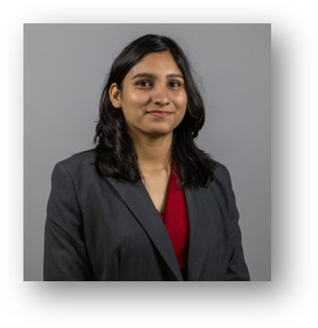
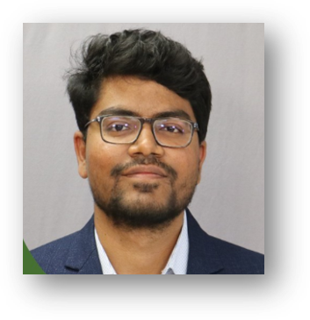
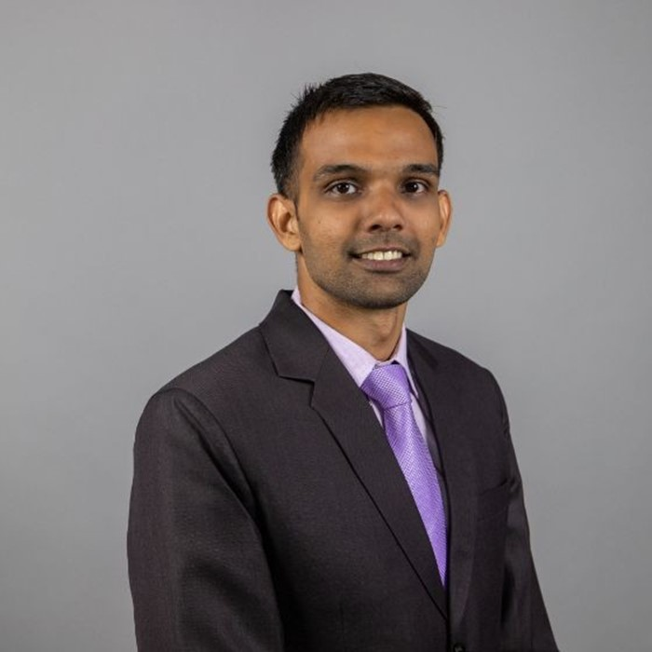
MEET THE TEAM
Shubhi Gupta
Asif Syed
Prashant Sharma

Slide 3
FACTS
TEMPLES
SERVICES
ORIGINS
Within 11 years, he established 100+ centers, temples, and various projects.
ISKCON began operations in Bangalore in 1987 and later built a large temple in 1997.
Prabhupada went to the US in 1965 to start a global Hare Krishna movement.
ISKCON was founded by Prabhupada in NYC in 1966
ISKCON Bangalore focuses on social work and well-being through various initiatives.
They conduct activities like pilgrimages, cow protection, food distribution, and spiritual programs.
100+
Notes:
Frankle

Slide 4




PROBLEM STATEMENT
ISKCON's online presence team collected visitor feedback from social media to improve services but faced manual effort challenges
ISKCON sought an automated solution for sentiment analysis, trends, emotions, and top issues from visitor feedback
The collected reviews had issues like multiple languages, spelling errors, and duplication
Classification of mixed and neutral classes in reviews presented difficulties in the analysis process

Slide 5
DATA OVERVIEW

Slide 6




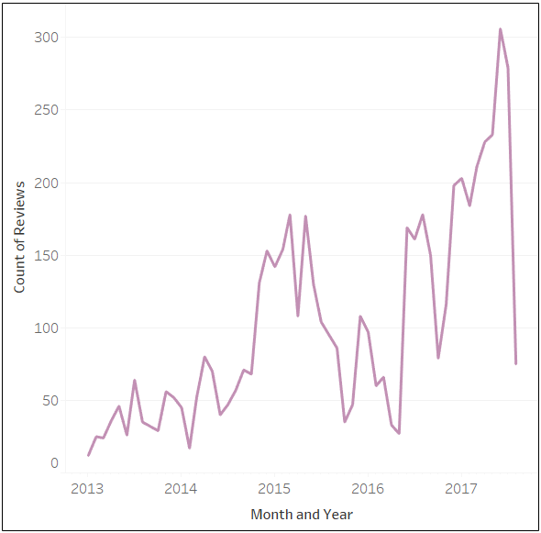
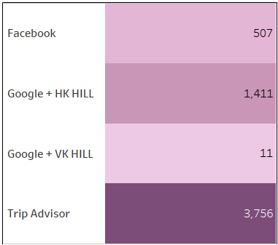
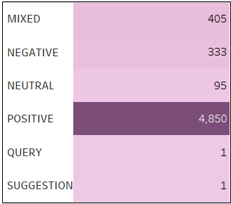
5 Years of REVIEW DATA
5685 Reviews
4 sources of reviews
Review History: Jan 2013 – Aug 2017
6 different Categories
With four review sources, TripAdvisor has the most reviews, highlighting its importance for gathering visitor feedback.
There are various review types, with a higher number of positive feedbacks and fewer queries and suggestions.

Slide 7
DATA ISSUES
Issue | Remedy
Duplicate Reviews | Combined columns ‘Source’, ‘Review By’ and ‘ Review Date’ . Filtered duplicates on this column
Data inconsistencies between review subject and review text columns | Merged review subject and review text columns
Review text in languages other than English | Performed language detection to remove non-English text

Slide 8
EXPLORATORY DATA ANALYSIS

Slide 9
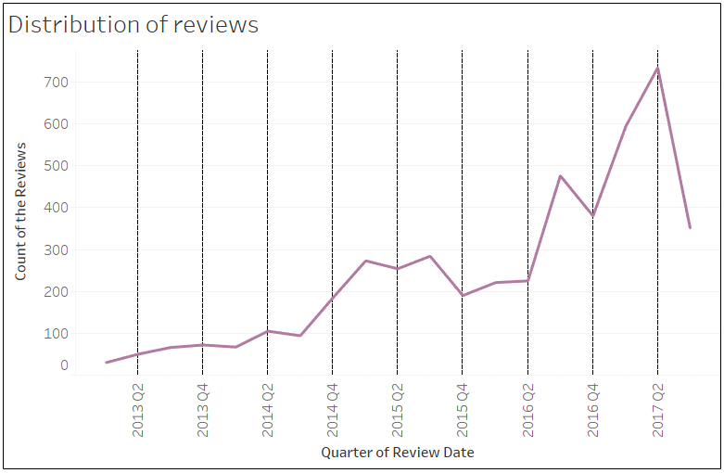
NUMBER OF REVIEWS OVER THE TIME
The number of reviews collected has significantly increased in recent times, with the highest volume of reviews gathered during the second quarter of 2017

Slide 10
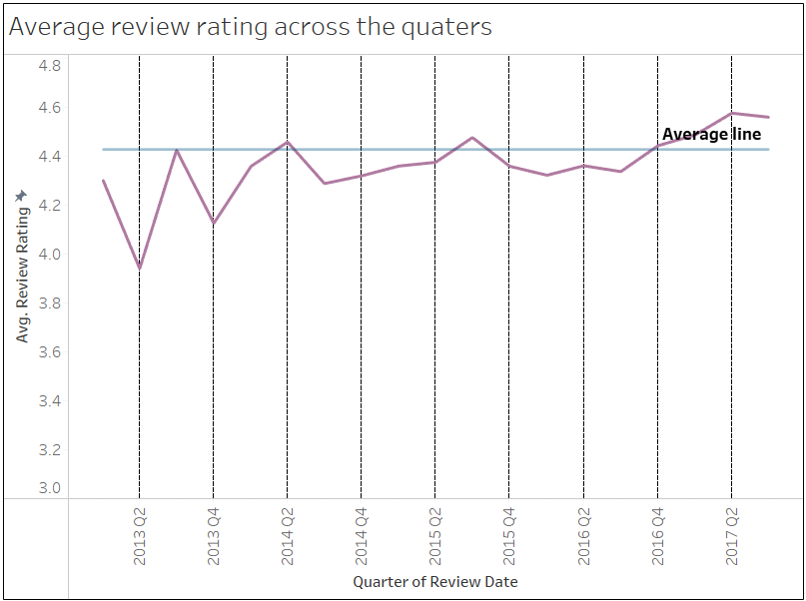

HOW THE AVERAGE RATING VARIED OVER THE TIME
The first quarter of each year has consistently exhibited lower average ratings compared to the second and third quarters

Slide 11
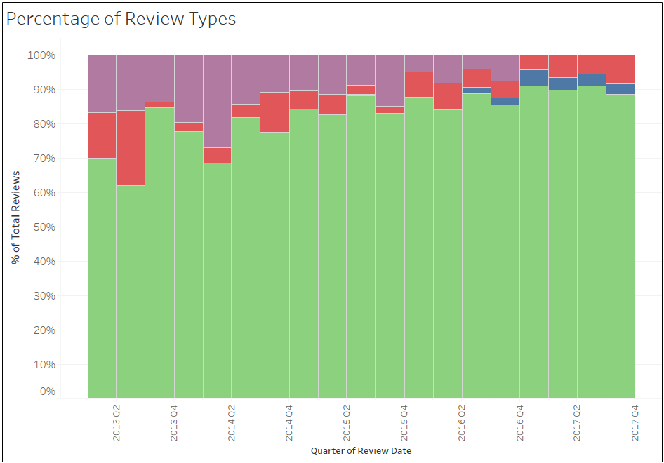
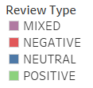
PERCENTAGE OF REVIEW TYPES OVER THE TIME PERIOD
According to the manual labels, positive reviews consistently outnumber negative and mixed reviews each quarter. The limited number of neutral reviews may suggest that people tend to express sentiment rather than merely stating facts in their reviews

Slide 12
SENTIMENT ANALYSIS

Slide 13
SENTIMENT ANALYSIS PROCEDURE
Used VADER Pre-trained model on internet text
Broke down each review in sentences
Calculated polarity score for each sentence from VADER
Calculated % of +ve sentences and –ve sentences in each review. – this removes the need for mixed category

Slide 14
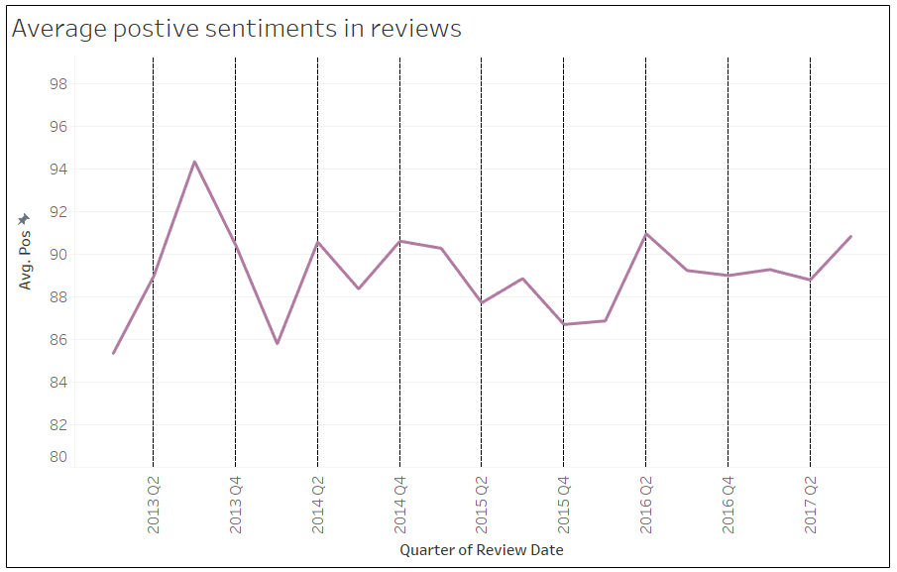
HOW POSITIVE SENTIMENT VARIED IN THE REVIEWS OVER THE TIME
The prevalence of positive sentiment in reviews, ranging from 80 to 95%, indicates that individuals are more inclined to share favorable experiences about devotional places rather than offering criticism

Slide 15
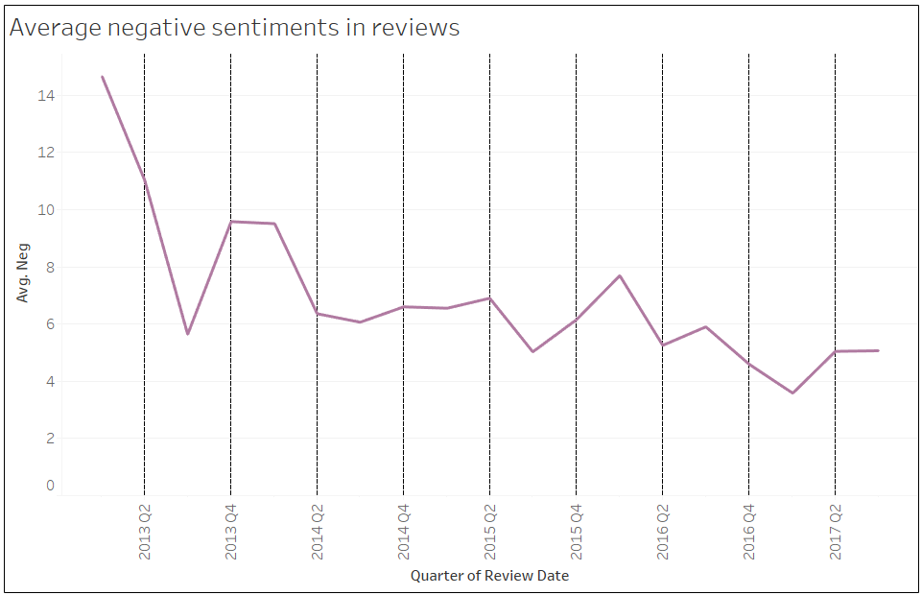
HOW NEGATIVE SENTIMENT VARIED IN THE REVIEWS OVER THE TIME
Over time, there has been a noticeable decrease in the negative sentiment expressed in reviews. This trend suggests that efforts to address concerns and improve the overall experience at the ISKCON have been successful, leading to a more satisfying experience for visitors

Slide 16
EMOTION ANALYSIS

Slide 17
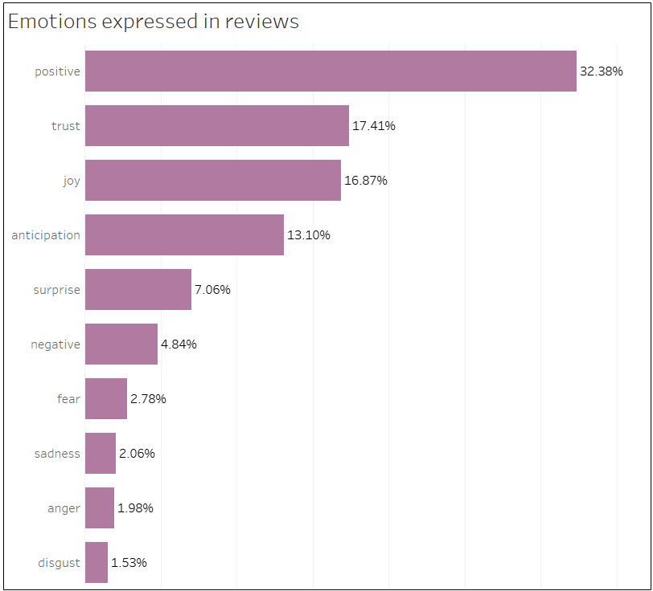
DISTRIBUTION OF VARIOUS EMOTIONS IN THE REVIEW
The majority of reviews showcase emotions such as positivity, joy, trust, and anticipation, indicating that ISKCON is providing visitors with a positive and uplifting experience. A minimal number of reviews express emotions like anger, sadness, or disgust, further emphasizing the overall satisfaction and enjoyment experienced by guests at the devotional place. This highlights ISKCON's success in creating a welcoming and spiritually enriching atmosphere for its visitors

Slide 18
RECOMMENDATIONS

Slide 19

Short Term Recommendations
Long Term Recommendations
Make description mandatory to avoid empty descriptions
Provide web form in regional languages to reduce user friction
Address subjectivity in ratings for clearer user sentiment
Use Google Translate for backend English output
Note discrepancies between positive descriptions and low ratings
Standardize data collection with a web form (e.g., Google Forms)
Implement a Likert scale with clear labels as an alternative to a 1-5 scale
Connect form to a database and visualization tool for quick analysis

Slide 20
CONCLUSION

Slide 21
Problem | Solution Recommended
How can ISKCON reduce the manual effort and automate the current process and How can ISKCON create a user interface (UI) that will make the entire data analysis more efficient | To enhance the process of gathering and analyzing visitor feedback, a simple web form can be created using Google Forms. This intuitive platform allows for seamless collection of reviews from visitors. As feedback is submitted, it can be directly stored in a Google Sheet or another suitable database. To further analyze and process the data, Python can be utilized to perform sentiment analysis, uncover trends, and extract valuable insights from the collected reviews. Lastly, the processed data can be visualized using Tableau or a similar data visualization tool, resulting in an engaging and interactive user interface.

Slide 22
Problem | Solution Recommended
How can ISKCON reduce the manual effort and automate the current process and How can ISKCON create a user interface (UI) that will make the entire data analysis more efficient | To make the review submission process more accessible and user-friendly, it's essential to ensure that the web form is available in various regional languages. This approach can significantly reduce the language barrier that many users may face, thereby encouraging a higher percentage of visitors to share their experiences. To streamline the data analysis process, the backend can be integrated with Google Translate, automatically translating the collected reviews into English.

