Slide 1
Covid-19
INSAID
Tableau Project
By Vishweshwar Satpute
November 19 Batch.

Slide 2
Resources
Please find the data description and source for the covid project here.
The dataset maintained and updated by the Johns Hopkins University Center for Systems Science and Engineering. Tableau cleans, reshapes, and makes this data ready for your analysis, and is updated at approximately 7 p.m. PST.
World Covid Activity
Covid_19_India

Slide 3
Protect yourself and others by making these 6 simple precautions your new habits
Clean your hands often
Cough or sneeze in your bent elbow - not your hands!
Avoid touching your eyes, nose and mouth
Limit social gatherings and time spent in crowded places
Avoid close contact with someone who is sick
Clean and disinfect frequently touched objects and surfaces

Slide 4
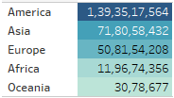
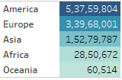

Lets see the total Covid Positive Cases in different Continents.
Total Positive
Total Deaths

Slide 5
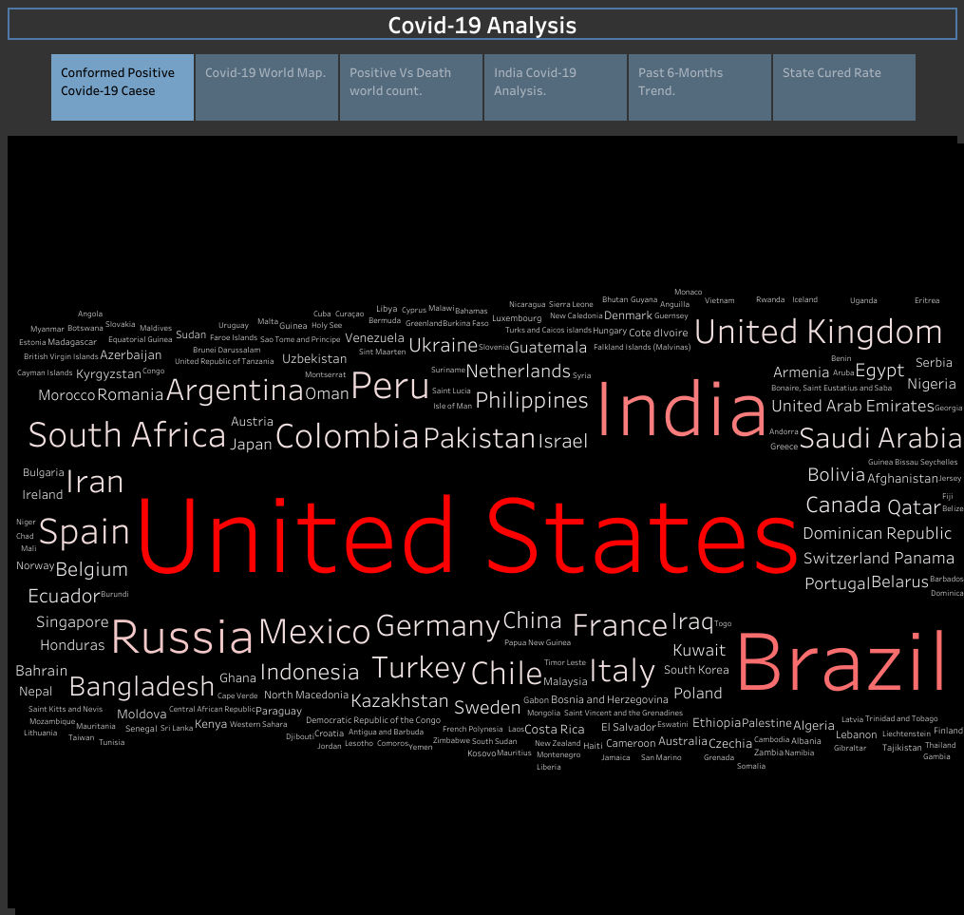

Slide 6
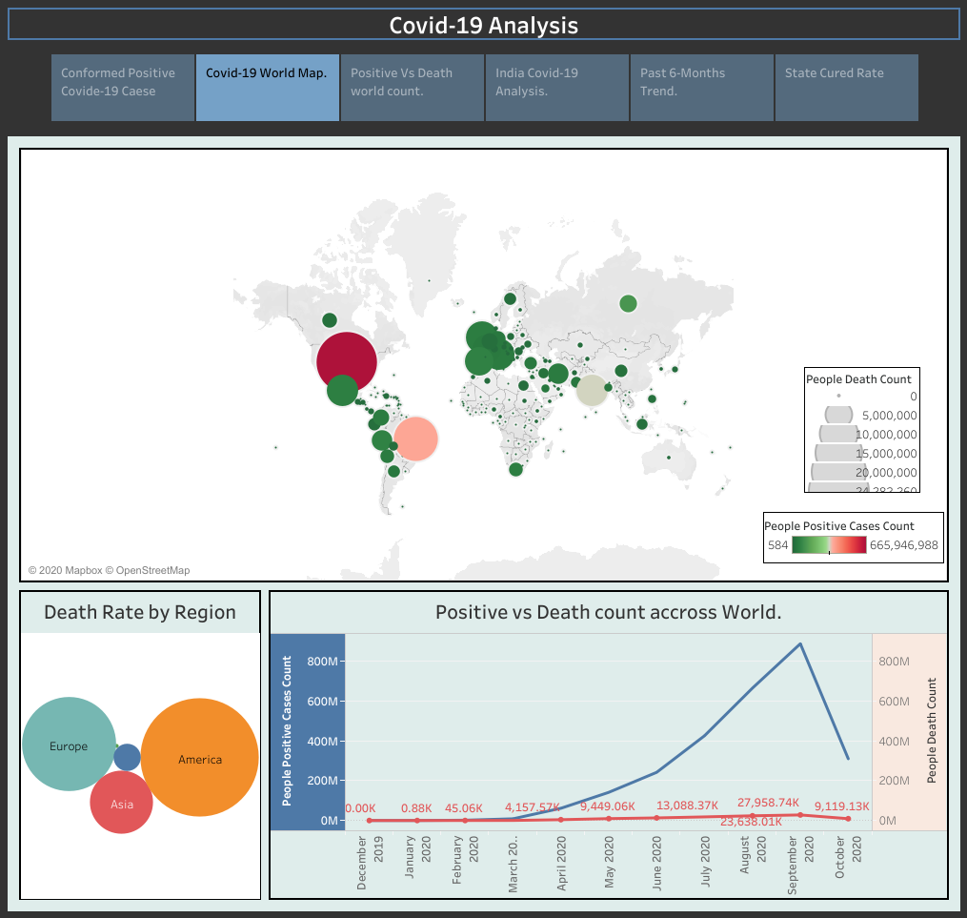

Slide 7
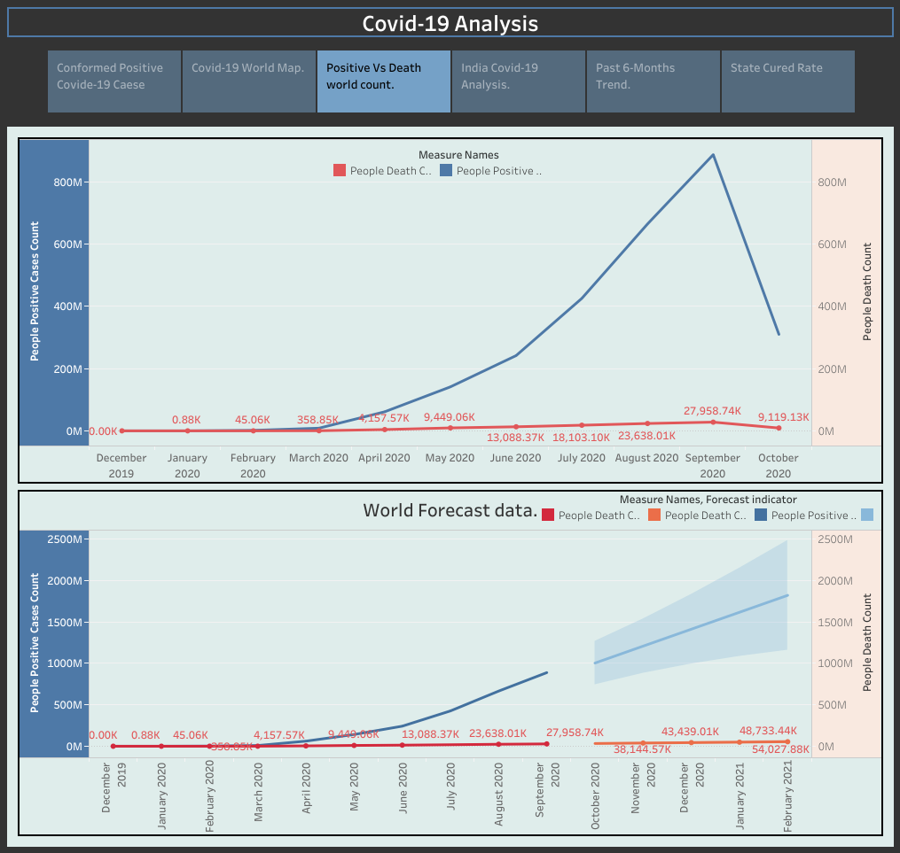

Forecast Data

Slide 8
Lets look at India

Slide 9
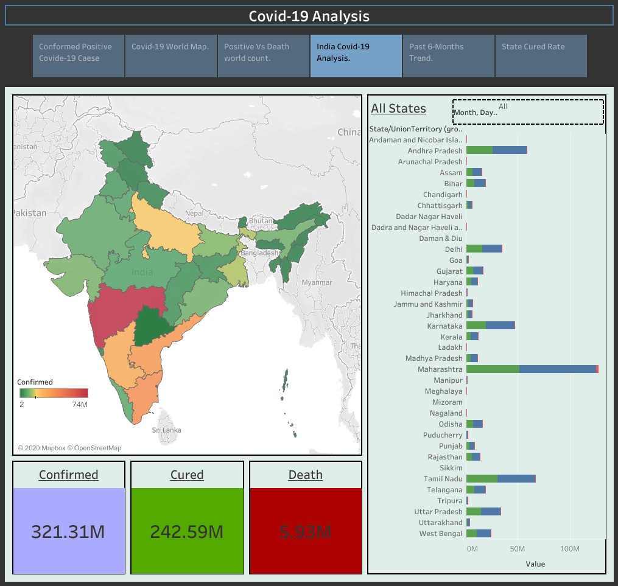

Slide 10
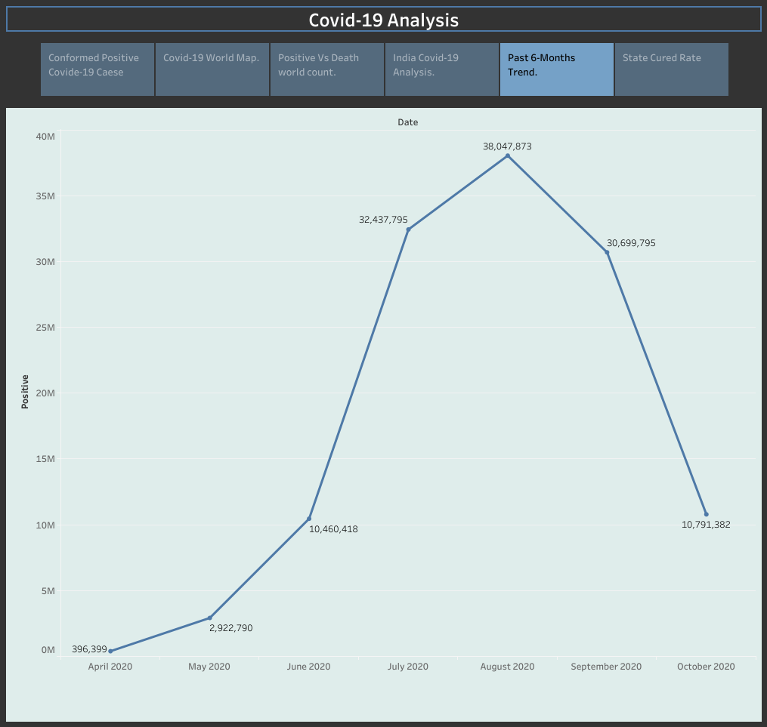
Past 6-months
Looking at the analysis October has a down fall which is a ray of hope for new beginning

Slide 11
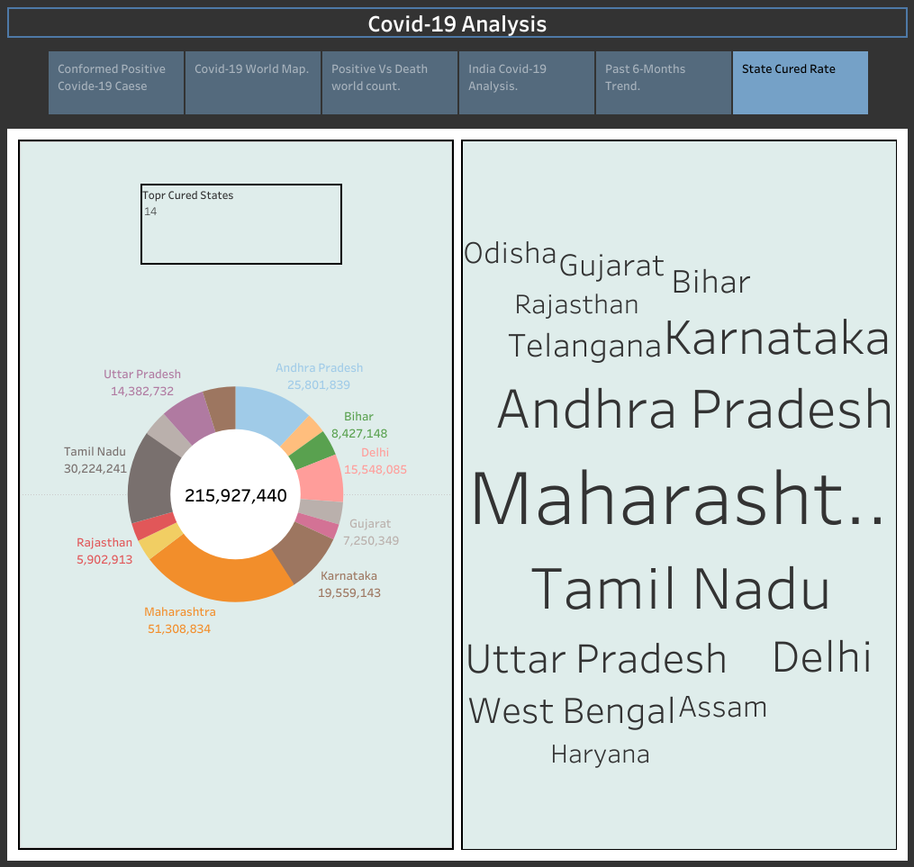
Maharashtra
Tamilnadu
Andhra Pradesh
Top Cured States

Slide 12
Thank You.

