Slide 1

GreenSense: The Complete IoT Solution for Plant Growth and Care Using Machine Vision and AI-Powered Disease Detection.
B.M.S. College of Engineering
Department of Information Science and Engineering
Project Phase Two Review - I
Presented by:
Sanat K
Shreesha Bhat
Vishal S
Under the guidance of
Dr. Anitha H M
Assistant Professor
Department of ISE

Slide 2
Introduction
In modern homes, plants play a vital role in enhancing aesthetic appeal and creating a calming, natural environment. However, caring for indoor plants can be challenging, especially with busy lifestyles, inconsistent watering schedules, and changing environmental conditions.
Additionally, as water resources become scarce due to pollution and climate change, efficient use of water in plant care has become increasingly important.
Dry soil, insufficient watering, and unpredictable indoor conditions are some of the common issues that hinder the growth of decorative plants, often leading to their premature decline.
These challenges highlight the need for a smarter, more sustainable approach to home plant care.
Objectives-
Sustainable Urban Gardening: Enable urban and terrace gardeners to monitor and care for plants with minimal manual intervention, promoting water conservation and resource efficiency.
AI and Machine Vision for Plant Health: Use machine learning and machine vision to detect plant diseases early and provide actionable care recommendations, ensuring healthier plants and optimized fertilizer use.
Scalable Agricultural Solutions: Develop a modular system that can be scaled for larger agricultural use, empowering small-scale farmers to improve crop yield and productivity through data-driven insights.

Slide 3
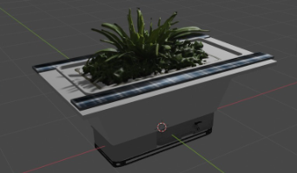
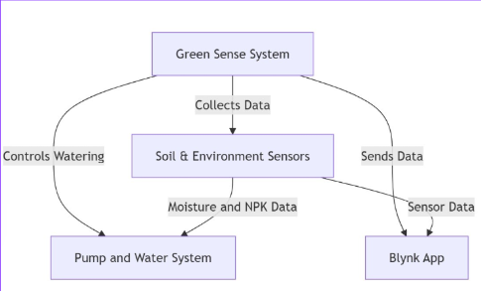
System Design
High level Design –
The GreenSense system is an IoT-enabled smart pot designed for real-time plant monitoring and automation.
It uses sensors to track soil moisture, temperature, light levels, and air quality, while a camera module with machine learning detects plant diseases.
The system automates irrigation, provides fertilizer suggestions, and sends notifications via the Blynk app.
Powered by solar energy, it is affordable, modular, and scalable, making it ideal for urban gardeners and small-scale farmers, with potential applications in large agricultural lands.

Slide 4
Low Level Design -
Sensors Module:
Collects real-time data for humidity, temperature, light, and soil moisture.
Sends data to the microcontroller for processing.
ESP32 Microcontroller:
Acts as the central control unit. Receives data from sensors, processes it, and controls actuators like the pump.
Communicates with the cloud via Wi-Fi.
Disease Detection Module:
Captures images using the camera module.
Processes images locally or sends them to the cloud for CNN-based analysis.

Slide 5
Cloud Services:
Stores and analyzes collected sensor data and images.
Hosts machine learning models for disease detection and yield prediction.
Generates insights and sends notifications to the user.
User Interface:
Provides a mobile application for users to view real-time data, insights, trends, recommendations and alerts.
Power Module:
Includes a solar panel and a 3.7v rechargeable Li-ion battery to power the system.
Communication Module:
Enables multiple ESP32 units to communicate and share data in larger setups using Bluetooth Low Energy and Wi-Fi.

Slide 6
Data Flow Diagrams

Slide 7
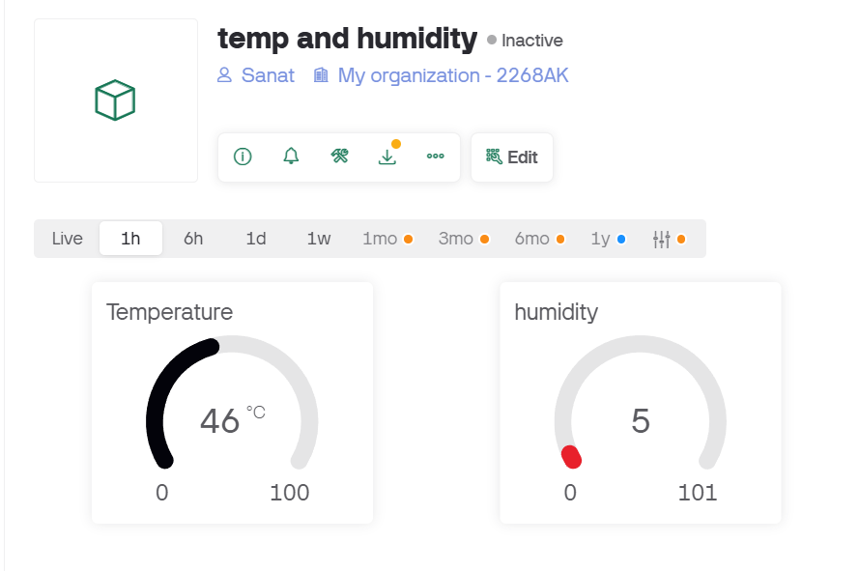
Implementation
Algorithm Steps (Detailed Analysis of Data Structures Used)
Mathematical Model if Any
GUI Screen Shots
Technology Stack – Tools Used
If open source tools and existing codes used (from any source code repository) – classify the percentage of your contribution
Mere implementation of existing open source codes are not valid

Slide 8
Conclusions
Conclusion
Future Work

Slide 9
References

Slide 10
Outcome
Research Paper/ Poster Presentation / Hardware Prototype Video Demo/ National Level or International Level Technical Competition Participation/ Patent Filed or Proposal if any

