Slide 1
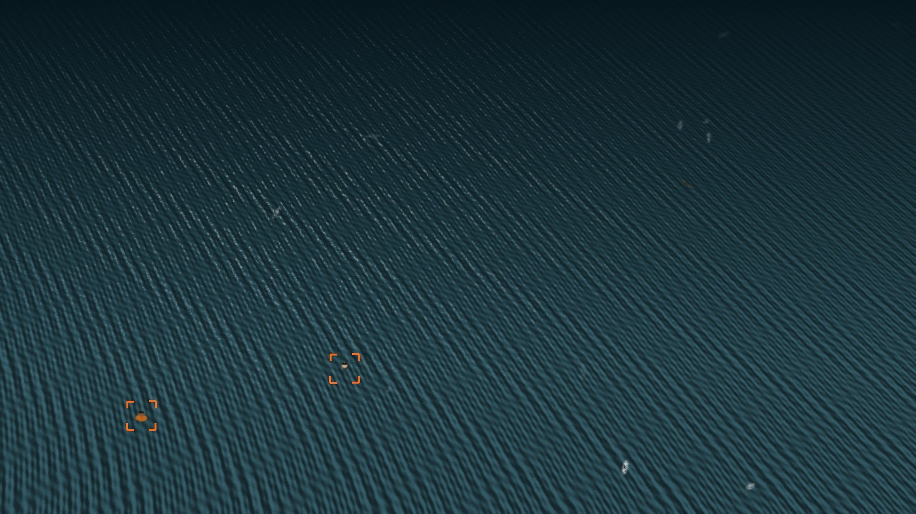
Vision-Assisted Survivor Localisation in Maritime SAR
using Texture-Anomaly Modelling
Tanish Hemant Kuvar 240962540
M. Vishal Kumar 240962546
Samyak Jain 240962638
AIML-A / FCV mini-project
SEQ 05 / FRAME 31 / SYNTHETIC
Notes:
We built a system that looks at aerial video of open water and gives a rescue operator a short ranked list of places to check. The two orange brackets on this frame are its output. Everything shown today is from our own code, run on a synthetic benchmark, and we will be clear about what that does and doesn't prove.

Slide 2
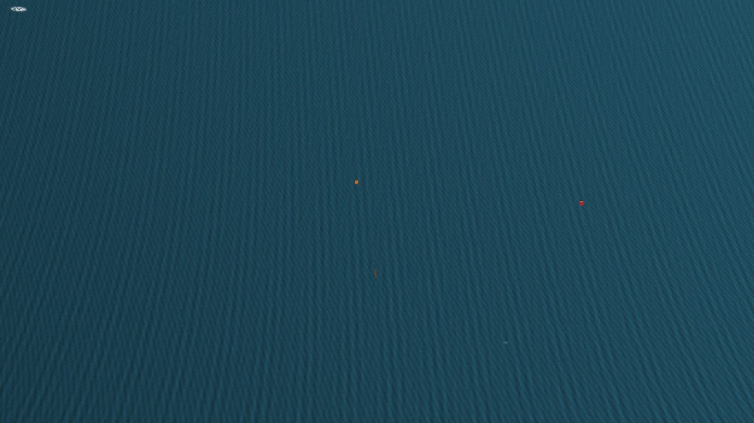
There are two people in this frame
SEQ 04 / FRAME 31 / 150 M / SYNTHETIC
Notes:
Give the room about five seconds to look for them before moving on. Most people won't find both.

Slide 3
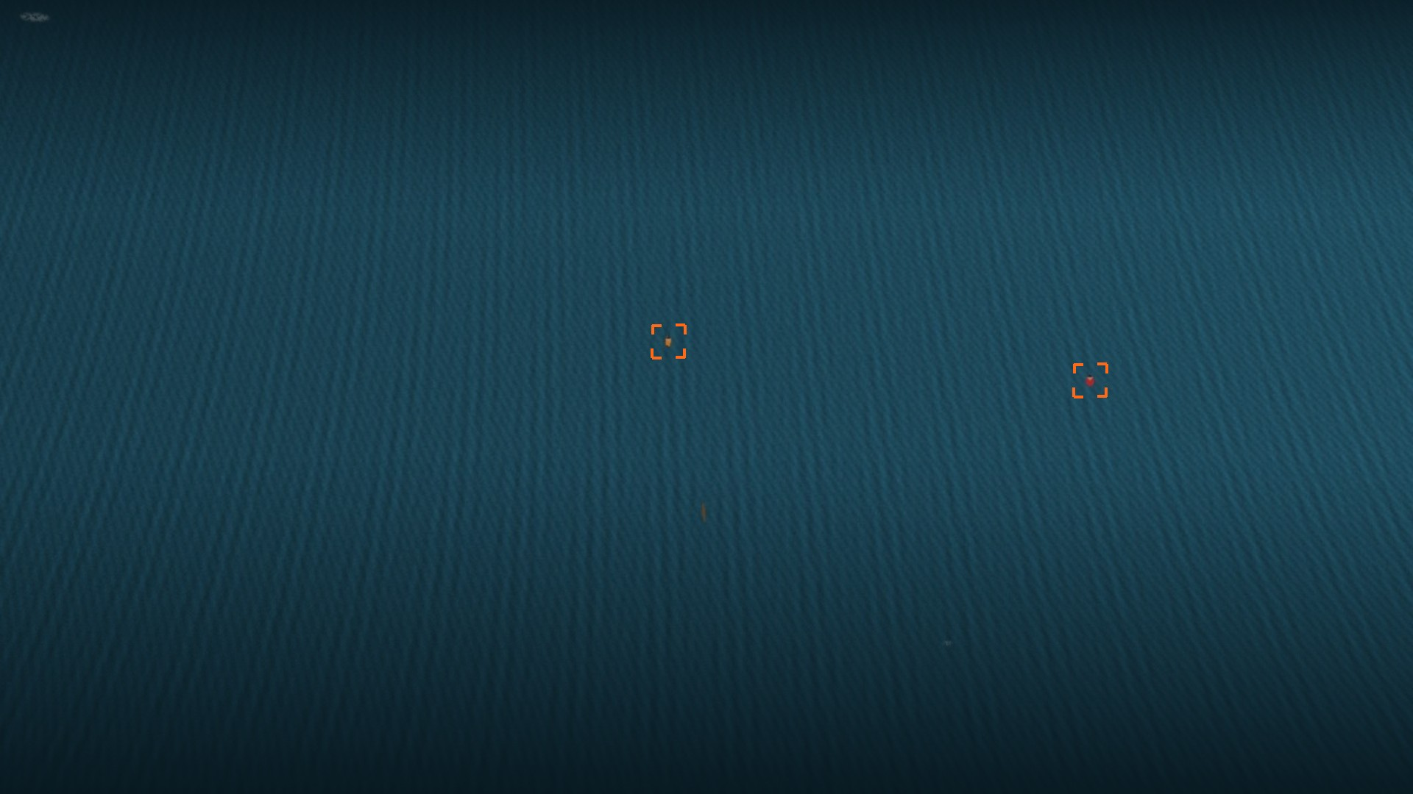
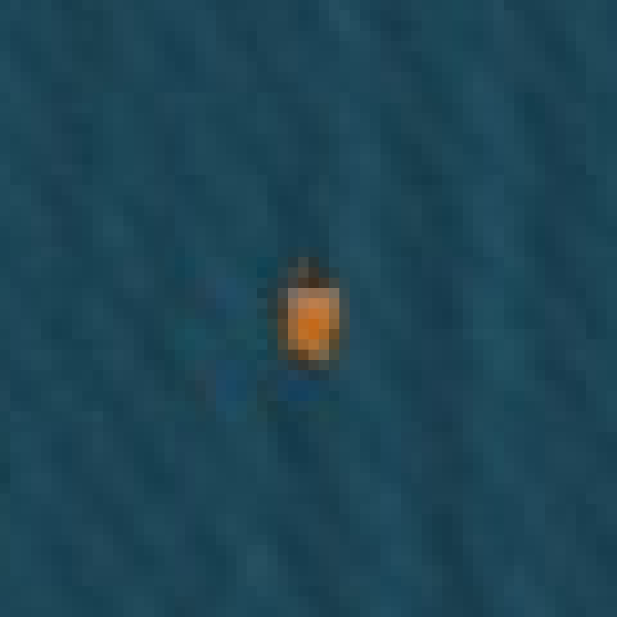
At 150 m, a person is 5 × 9 pixels
618 of the 739 people annotated in our benchmark are under 16 px across. At that size there isn't much body shape left to detect.
So we stopped trying to recognise people.
60 × 60 PX CROP, ENLARGED 12×
Notes:
That orange smudge is the whole person: 5 by 9 pixels. Size here is the square root of box area, and 618 of 739 annotations fall below 16 pixels. A learned detector would need many labelled examples at this size. We took a different route.

Slide 4
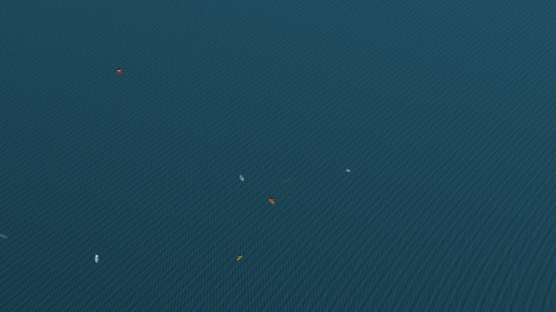
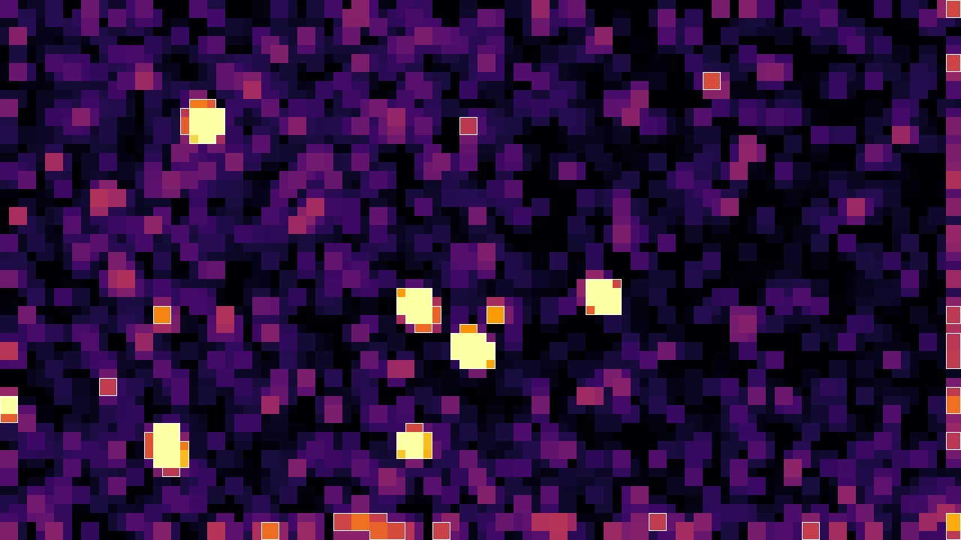
So we model the water instead
INPUT
ANOMALY MAP, SAME FRAME
Sea texture is regular enough to describe with numbers. Each tile of the frame is compared with the sea around it, and whatever breaks the pattern becomes a candidate.
The frame is its own reference, so there is no training set and no training step. Only classical OpenCV and NumPy operations.
Notes:
This is the main idea of the project. Normal sea gets described per tile, and tiles that deviate from their surroundings light up. Notice nothing here knows what a person looks like. Whitecaps and debris light up too, and the later stages deal with those. Because annotated data is used only to measure results, a new camera doesn't need a new training set.

Slide 5
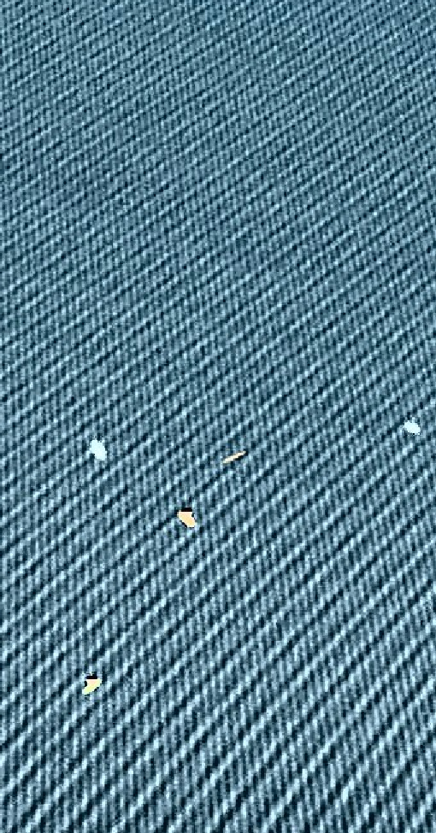
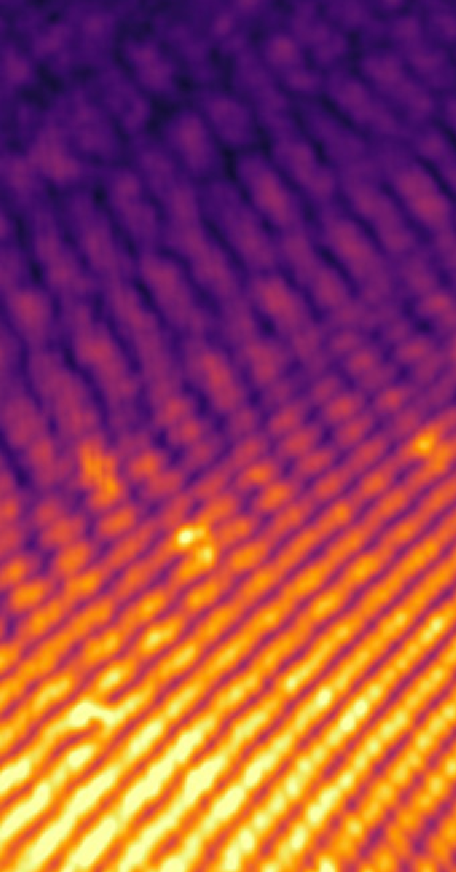
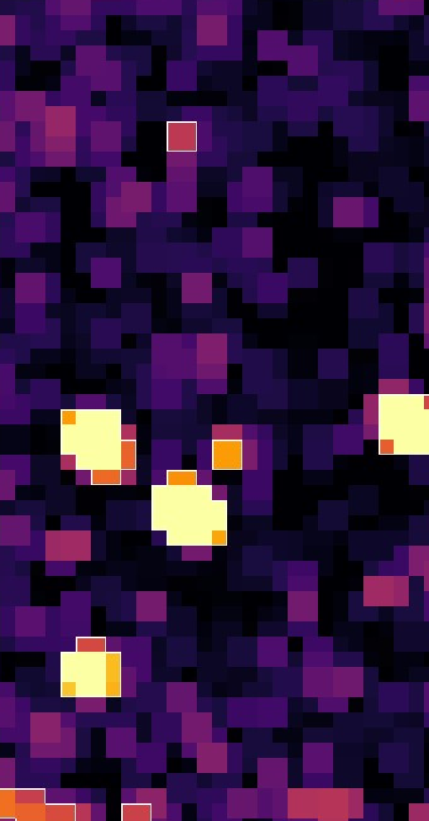

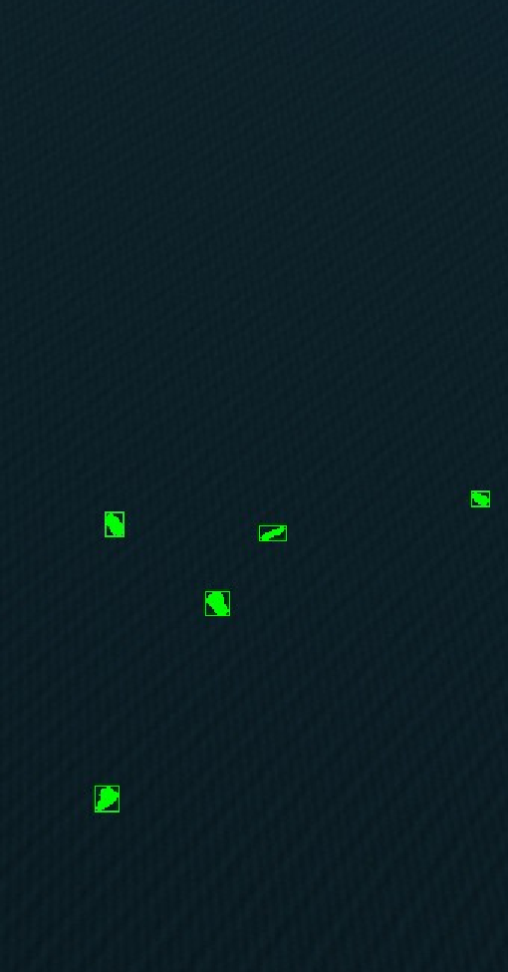
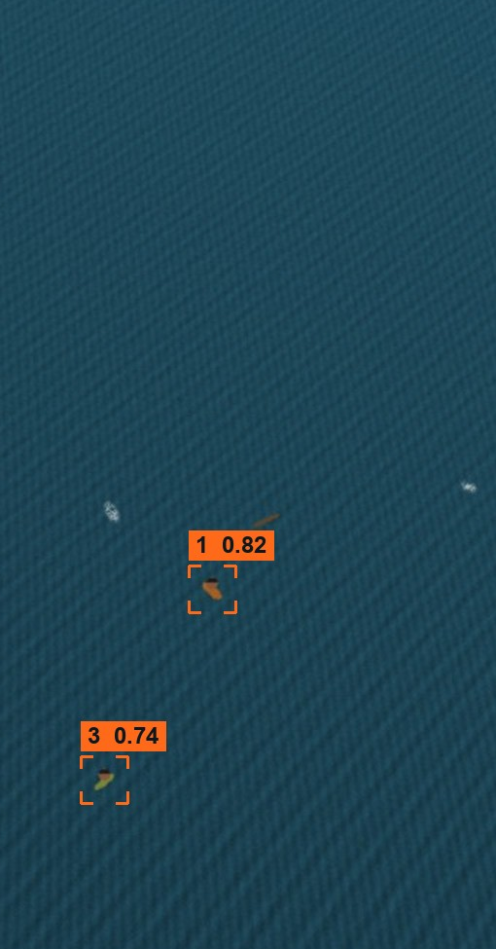
Six stages, one frame in, at most k boxes out
1 Normalise
2 Texture
3 Anomaly
4 Glint
5 Shape
6 Shortlist
Flat-field, CLAHE, contrast stretch
Gabor bank + uniform LBP per tile
χ² against local median, z > 3
Bright + achromatic pixels removed
Area, eccentricity, solidity
Tracks that persist, ranked
Notes:
These six panels are the same crop of the same frame, passing through the pipeline. Stage 3 fires on several things in this crop, including whitecaps and debris. By stage 6, only the two people in this crop are on the shortlist. The rest of this section takes each stage in turn.

Slide 6
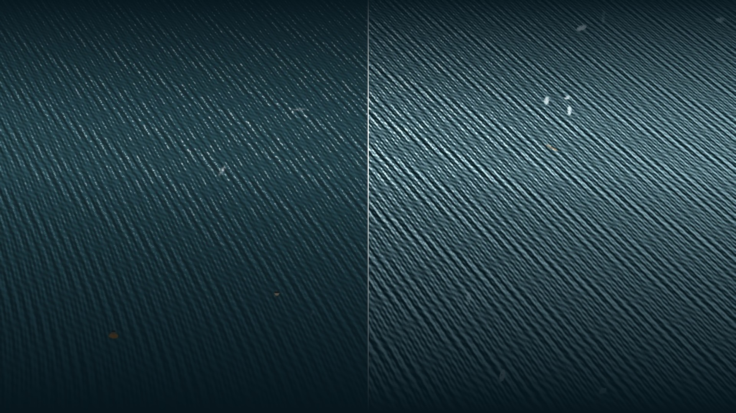
Stage 1: even out the light
RAW
NORMALISED
Flat-field
CLAHE
Piecewise-linear stretch
18 → 56
Divide Lab L by a heavy Gaussian blur of itself (σ = width / 8) to remove the sun-side gradient.
Histogram equalisation per region. Clip 2.0, 8 × 8 grid.
Map the 1st and 99th percentiles to 10 and 245.
standard deviation of L on this frame
Notes:
Left half raw, right half after normalisation. The waves that were barely visible are now strong, and they look the same across the frame. Later stages compare texture between tiles, so the brightness gradient has to be gone first. These are three operations straight from the lab sessions.

Slide 7
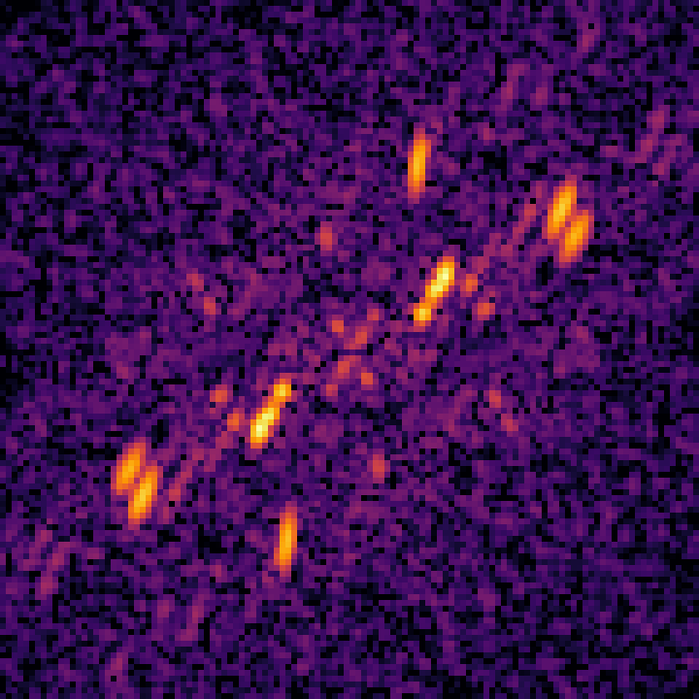

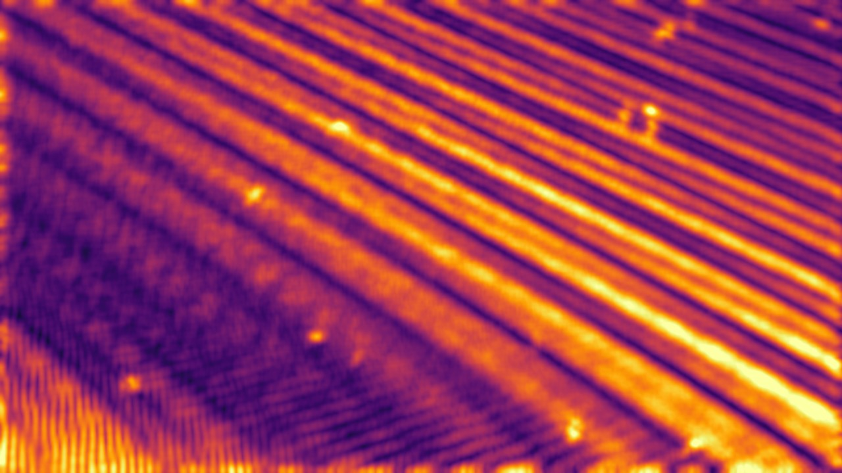

Stage 2: measure the waves, then tune filters
GABOR BANK, 4 ORIENTATIONS
Gabor energy. Even/odd filter pairs tuned to the measured wave, starting at its own angle. Local energy doesn't depend on wave phase.
Uniform LBP. 59-bin histogram of local micro-texture.
Overlapping tiles. Stride is T/2, so a person on a tile border isn't split. Here T = 24 px, 6,254 tiles.
GABOR ENERGY
2-D DFT POWER SPECTRUM
The strongest peak in the 4–32 px band gives the wave's length and direction. Here: λ = 11.5 px, θ = 138°.
LBP CODES
Notes:
Instead of a fixed filter bank, we estimate the wave first. Each of three horizontal bands gets a DFT, and the spectral peak gives wavelength and orientation. Far-field waves are shorter than near-field, so the bands matter. The Gabor bank is built from those numbers. LBP adds fine texture. The descriptor for each tile is the mean Gabor energies plus the LBP histogram.

Slide 8

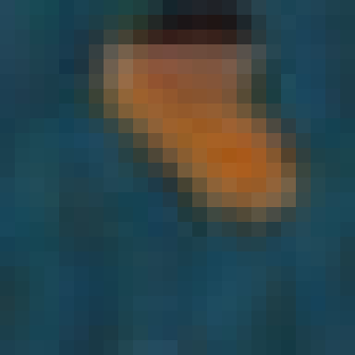

Stage 3: score every tile against its neighbours
PERSON TILE
SEA TILE
z = 32
z = −0.3
χ² = ½ Σ (a − b)² / (a + b)
Computed separately for LBP and Gabor, then fused as robust z-scores: median and 1.4826 · MAD over all tiles.
SEQ 02 / FRAME 31 / 91 OF 6,254 TILES OVER z = 3
Inside flagged tiles, Lab colour distance cuts the blob down to exact pixels.
Reference: median descriptor over a 9 × 9-tile window. The median stays clean when a person or boat covers a few tiles.
Notes:
Each tile gets compared with what the sea looks like around it. Chi-square works well for comparing histograms. Robust z-scoring puts the Gabor and LBP distances on the same scale and stops outliers from distorting that scale. The numbers on the two tiles are real: a person tile scores 32, plain sea about zero, and our threshold is 3.

Slide 9
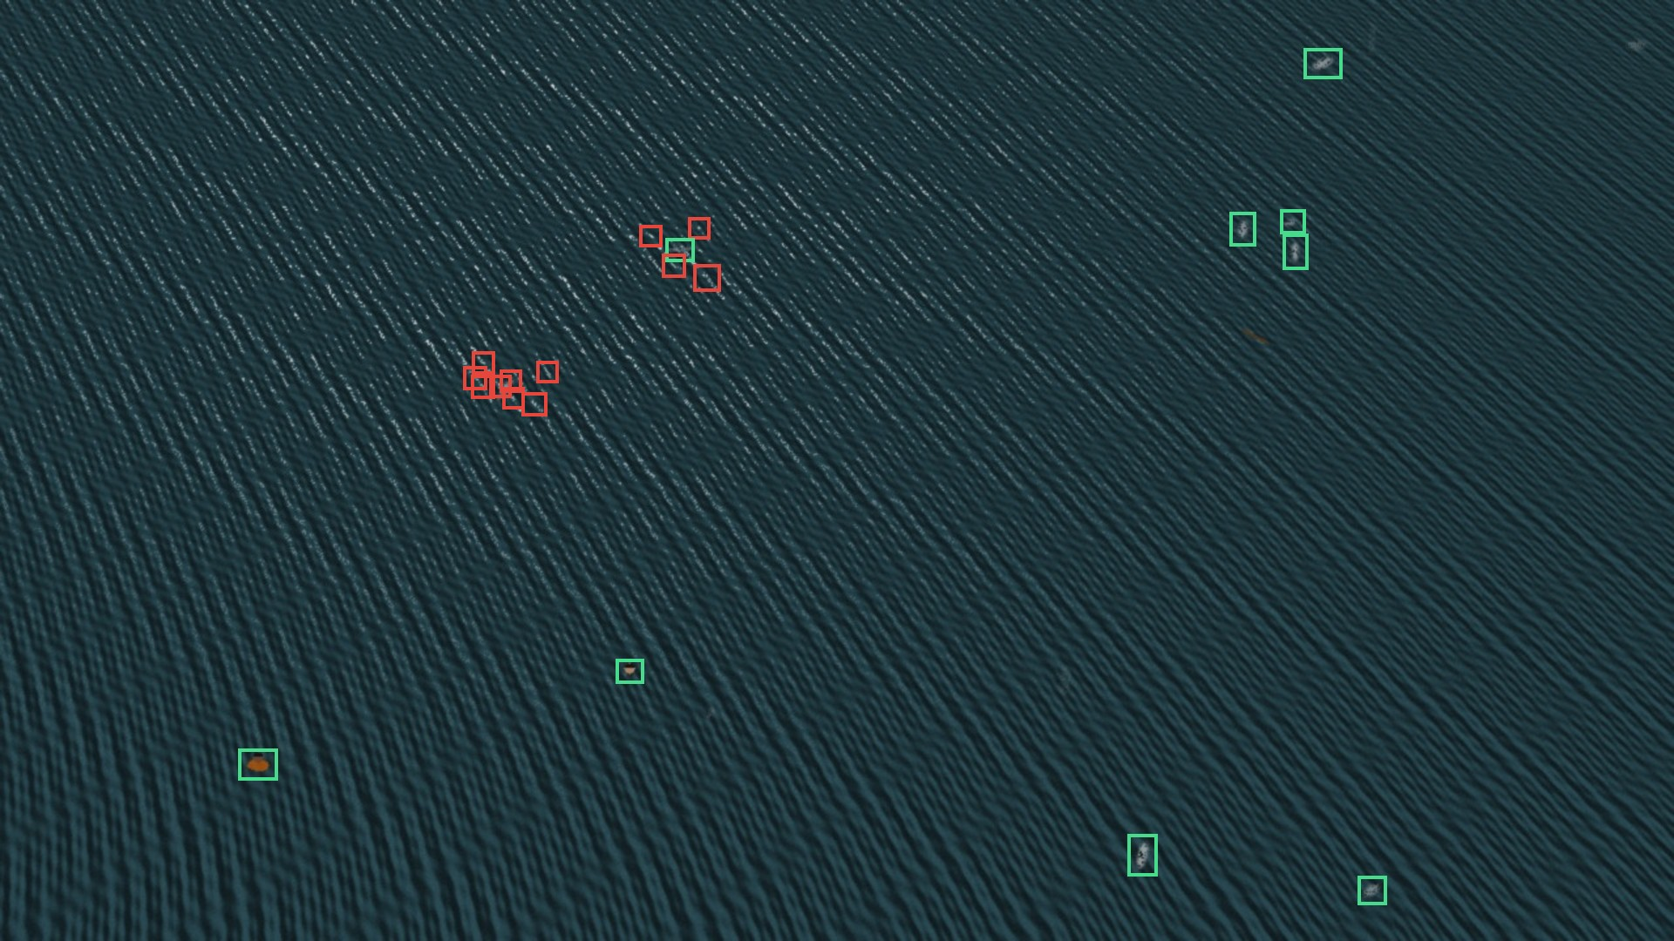
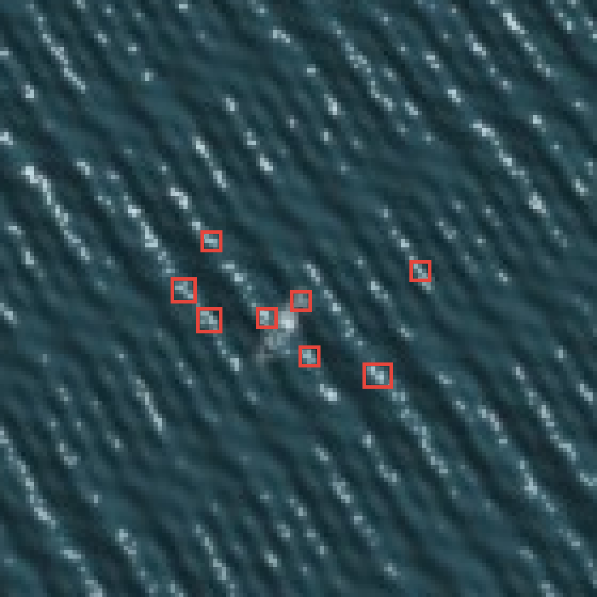
Stages 4–5: remove glitter and foam
21
blobs in this frame
12
rejected: 11 too small, 1 too thin
CLUSTER, 6×
Glint test. Specular glint saturates all channels, so its rgb chromaticity sits near (⅓, ⅓, ⅓). A pixel must be bright and achromatic, which spares a black wetsuit.
Shape test. Open 3 × 3, close 5 × 5, then area 12 to 2,500 px, eccentricity ≤ 0.97, solidity ≥ 0.45.
SEQ 05 / FRAME 31 / GREEN KEPT, RED REJECTED
Connected components use 8-connectivity. Each surviving blob is scored by peak z × colour contrast.
Notes:
Glint and foam both pass the anomaly stage. The glint test looks at colour: pure sun glint has almost no chroma. Requiring brightness too means a dark wetsuit isn't thrown out by mistake. Then morphology and a shape filter remove specks and streaks. On this frame, 12 of 21 blobs were rejected. We'll see later that on this benchmark the glint test contributes very little, because the shape stage already catches the small specks.

Slide 10
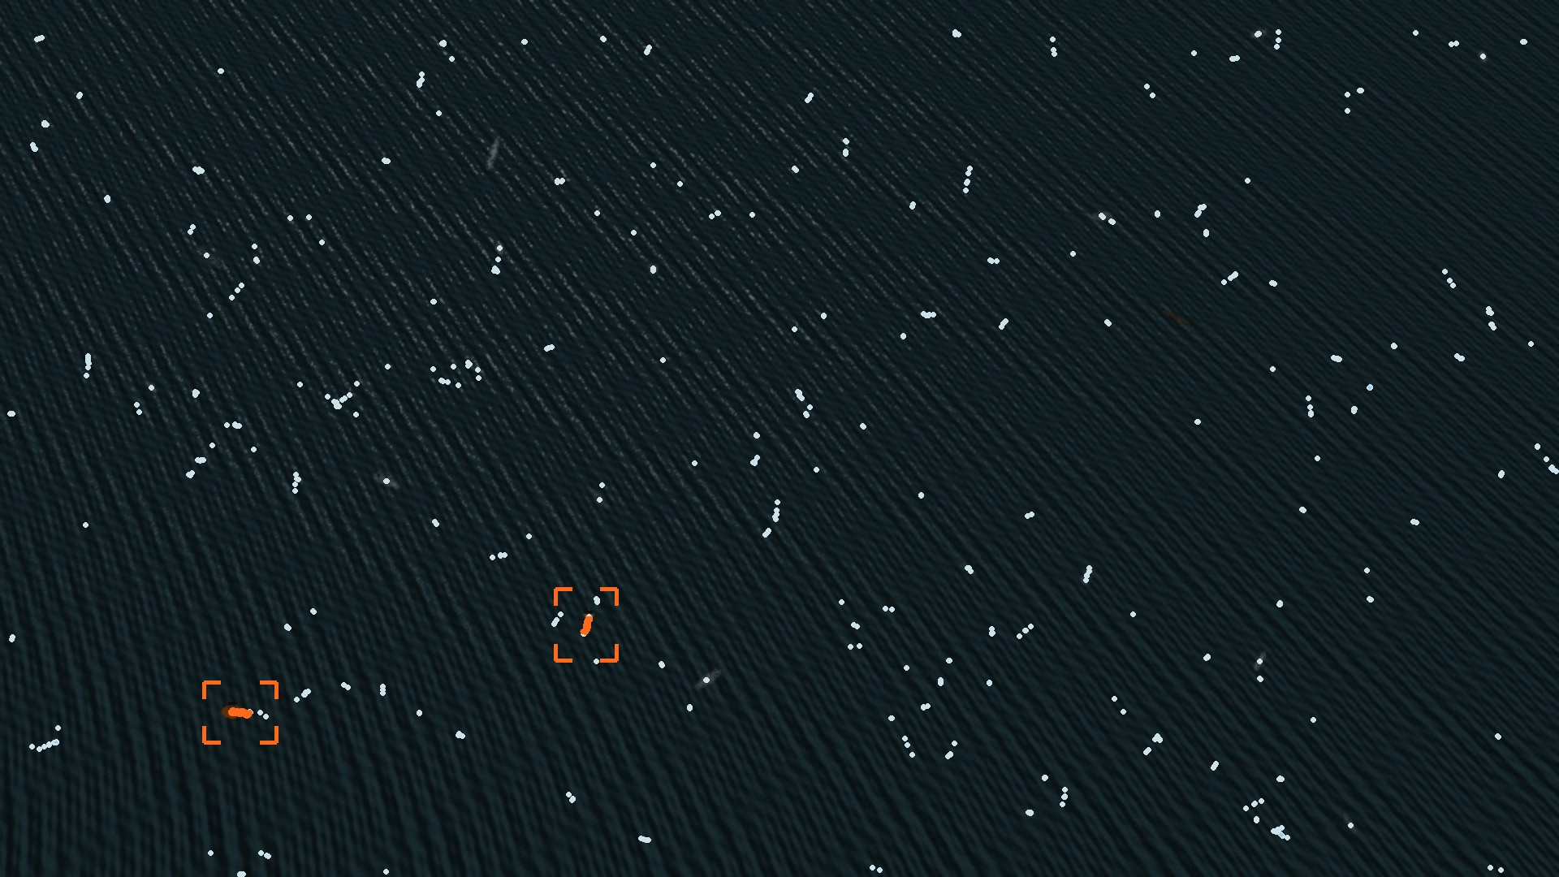
Stage 6: people stay, whitecaps don't
665
raw detections (the dots)
56
frames on the shortlist, for each person's track
≤ 7
frames on the shortlist, for every other track
Nearest-neighbour matching with a constant-velocity prediction. Promoted after 5 hits if the drift is coherent. Gaps of 3 frames are allowed, for a head under a wave.
SEQ 05 / ALL 60 FRAMES ON ONE PICTURE
Notes:
This is the most useful picture in the deck. Each dot is a per-frame detection on the roughest sequence: 665 over 60 frames. The two orange lines are the tracks that follow the two real people, on the top-10 shortlist for 56 frames each. No other track lasted more than 7. Ranking is 0.4 times anomaly confidence plus 0.6 times persistence times coherence.

Slide 11
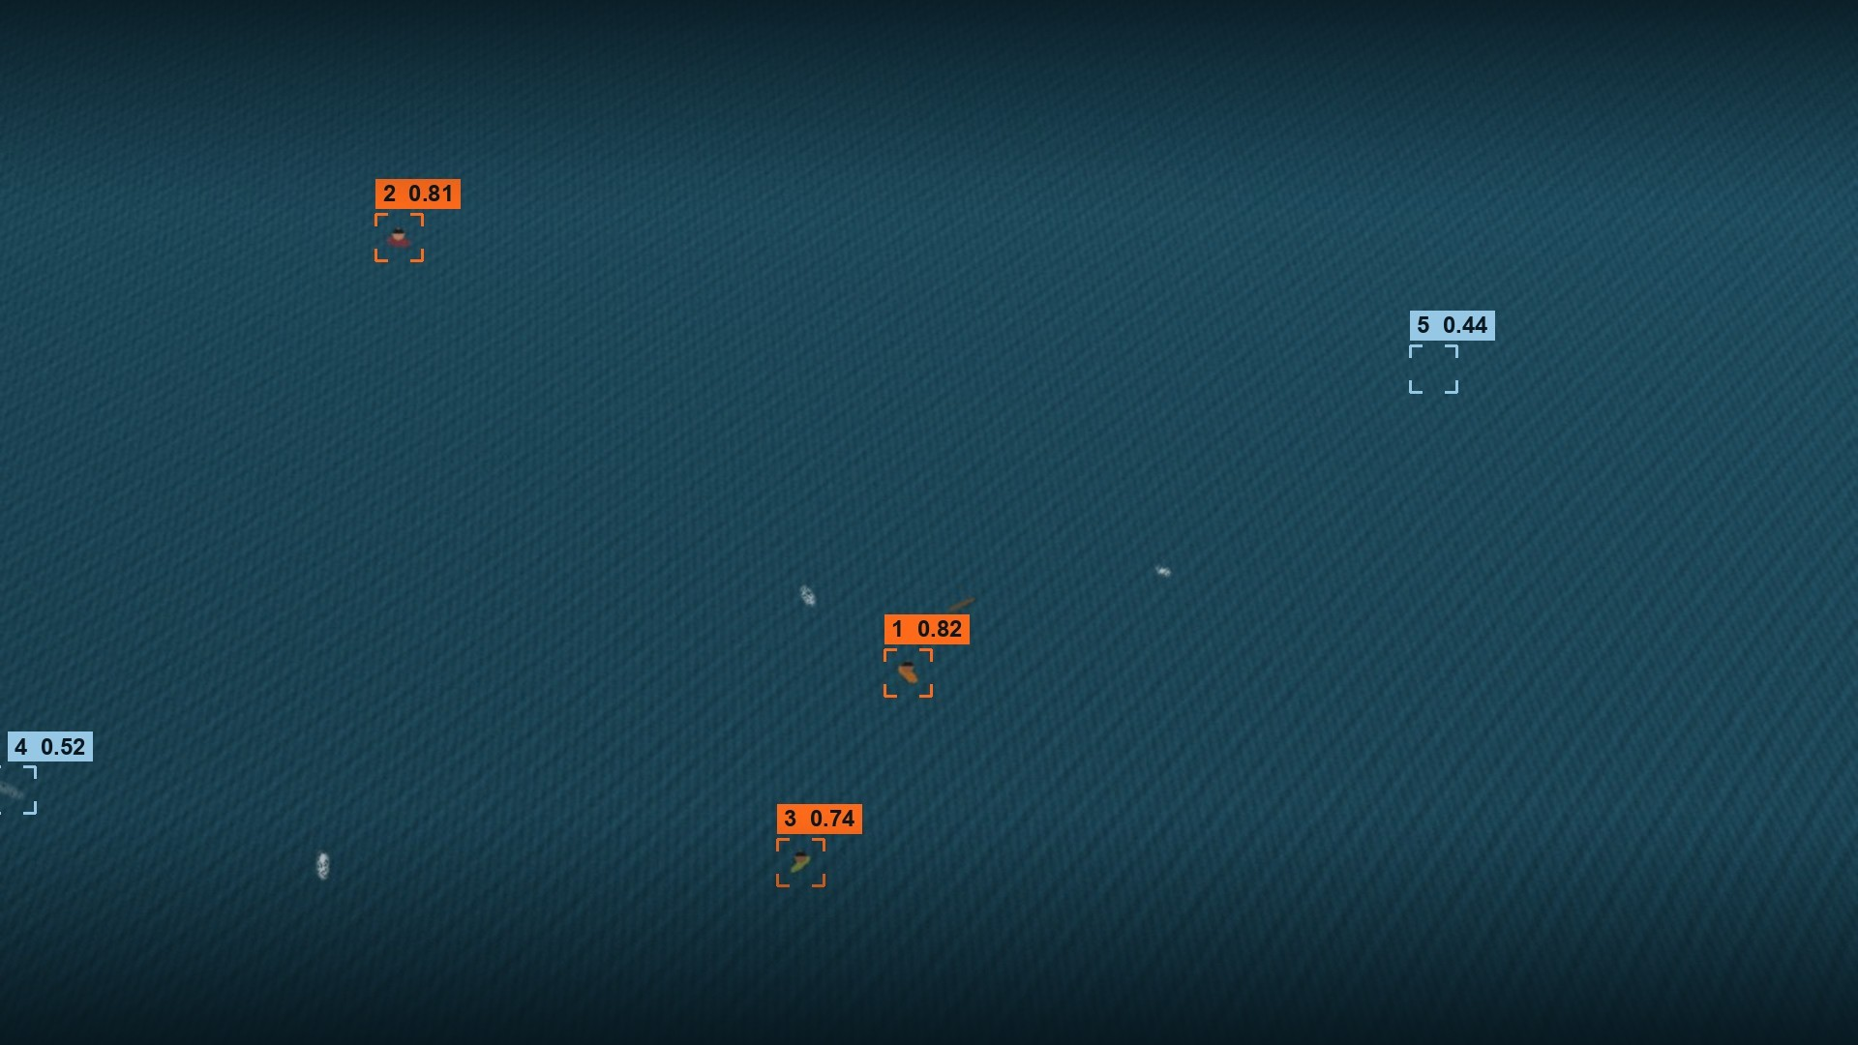
Top three boxes, three people
Orange hit a person. Blue are false alarms, ranked below every person with lower confidence.
SEQ 02 / FRAME 31 / 80 M / SYNTHETIC
Notes:
This is what the operator sees: a rank and a confidence on each box. Two false alarms are still on screen in this frame, one a whitecap at the left edge. They sit at ranks 4 and 5, so an operator checking from the top reaches all three people first.

Slide 12
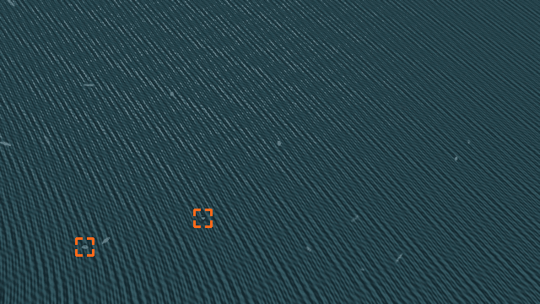
Same system, on the roughest sea we rendered
Sea state 1.6, about 2 new whitecaps per frame, strong glitter.
One person in dark clothing, one in orange.
When the clip loops back to frame 1, nothing shows for 4 frames. That's the warm-up.
SEQ 05 / SEA STATE 1.6 / LOOPING CLIP
Notes:
This plays in slide-show mode, as a GIF, so nothing needs installing. It's the actual shortlist on every frame. Point out how steady the two orange brackets are while blue ones appear and disappear. Then point out the warm-up when the loop restarts.

Slide 13
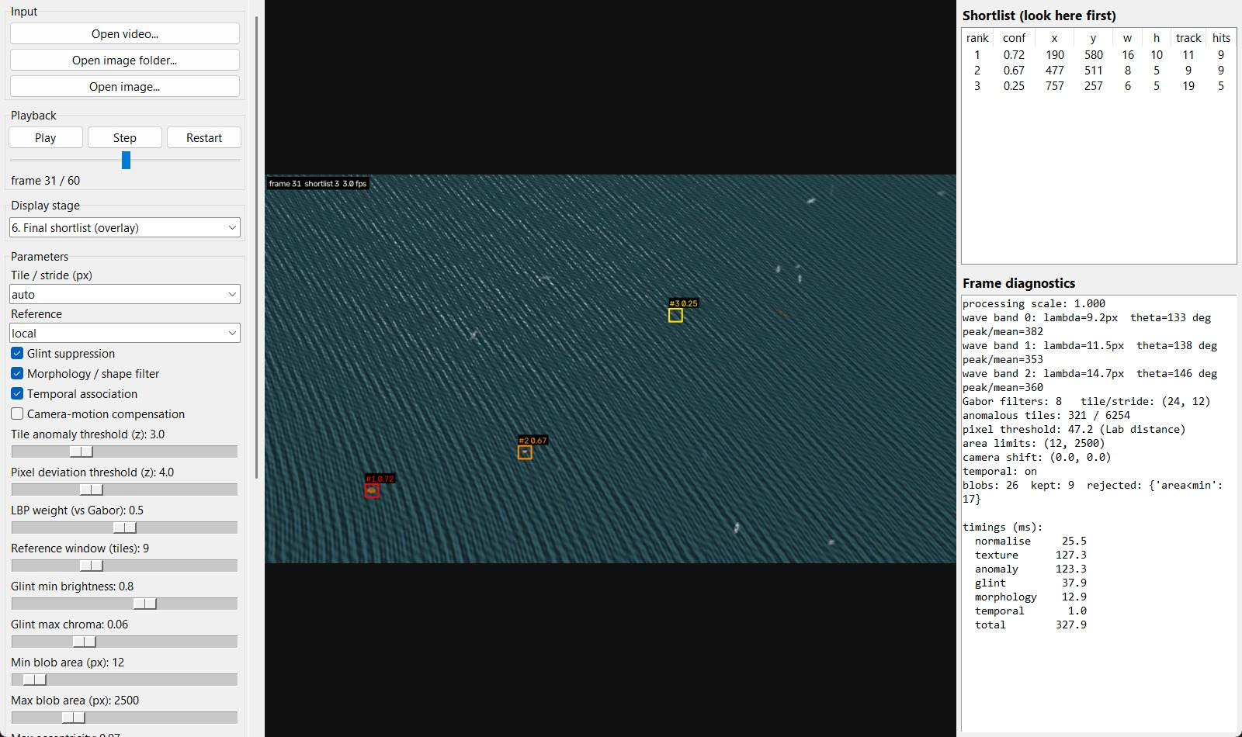
Every stage and threshold is in the GUI
Step through any stage's output, move a slider, and see the result straight away.
Diagnostics show the measured waves, thresholds, blob rejections and per-stage timing.
~80%
of frame time goes to texture and anomaly scoring (about 226 of 288 ms). Tracking takes under 1 ms.
OUR TKINTER APP, SEQ 05
Notes:
The same config dataclass drives the GUI, command line and evaluation, so a setting tuned here can be reused in an evaluation run. The timing is from our re-run on a laptop CPU. Most of the cost is texture and anomaly scoring, which is where any speed-up should go first.

Slide 14
92.4% of people make the top-5 shortlist
92.4%
99.3%
recall@5 once tracks can exist (from frame 5)
1.77
false alarms per frame, top 5
recall@5 over all frames, default parameters
51.7%
of shown boxes hit a person
Hit rule: predicted centre within max(8 px, largest box side) of the true centre. IoU is too harsh on 10–30 px boxes.
2.7 fps
1280 × 720, laptop CPU, pure Python/OpenCV
These are synthetic numbers. 6 rendered sequences, 360 frames, 739 people. They show the pipeline and evaluation work end to end. They are not a claim about real-world performance.
Notes:
Be upfront about this slide. 92.4 percent recall at a shortlist of five, 99.3 once the first four frames are excluded, because nothing can be promoted before then. Precision is only 52 percent, which is fine for a shortlist a human checks but wouldn't be for an autonomous system. And all of this is on data we rendered ourselves.

Slide 15
With tracking, three boxes nearly do the job
72% → 92%
Most frames hold 2–3 people, so recall@1 can't exceed about 45%. From k = 7 the no-temporal run has higher recall, because tracking can't show anything during warm-up, but it pays in false alarms: 3.7 against 2.1 per frame at k = 7.
recall@3 with tracking on
Notes:
Tracking pushes people above transient clutter in the ranking. At k equals 3, recall goes from 72 to 92 percent while false alarms fall from 1.47 to 0.76 per frame. The full system's recall flattens at 92.4 because of the warm-up frames. That's the honest cost of the temporal stage, and at k of 7 and above the no-temporal run has higher recall.

Slide 16
Turning stages off shows which ones matter
Run | Recall@5 | Precision@5 | Steady recall
Full system | 92.4% | 51.7% | 99.3%
No temporal | 89.2% | 40.2% | 88.7%
No shape filter | 92.4% | 45.7% | 99.3%
No glint test | 92.4% | 51.2% | 99.3%
Temporal: false alarms drop 35%, precision rises from 40% to 52%.
Shape filter: removes elongated foam and debris, 2.50 → 1.77 false alarms.
Glint test: barely moves anything here, 1.81 → 1.77. Rendered glitter specks are 1–3 px, so opening and minimum area already catch them. Real glint patches should be larger, but that is untested.
Notes:
We ran the full system and then the same system with one stage disabled. Temporal does the most. Shape filtering is next. The glint stage barely moves anything on this benchmark, and we're saying that plainly: our rendered glitter is too small to need it, so we can't claim it helps until we test on real footage.

Slide 17
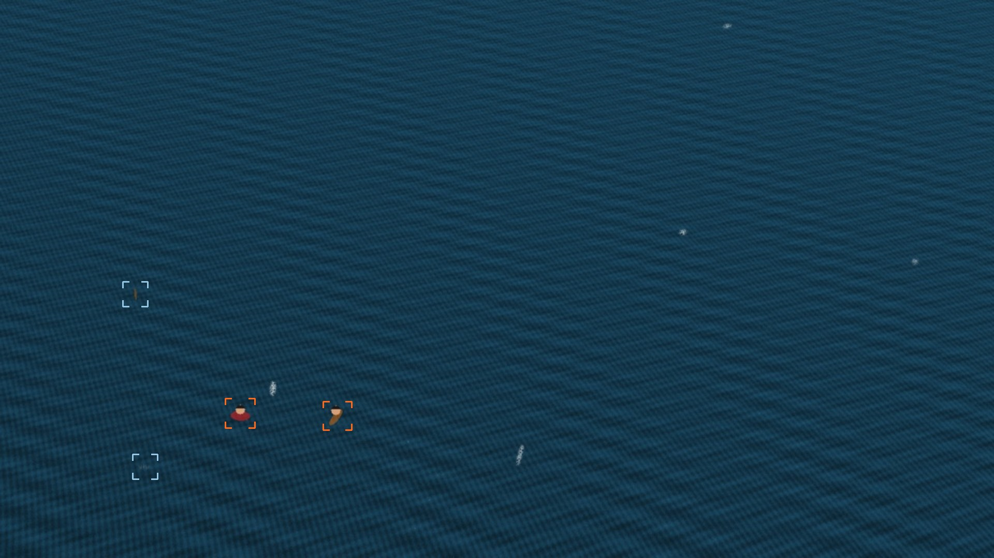
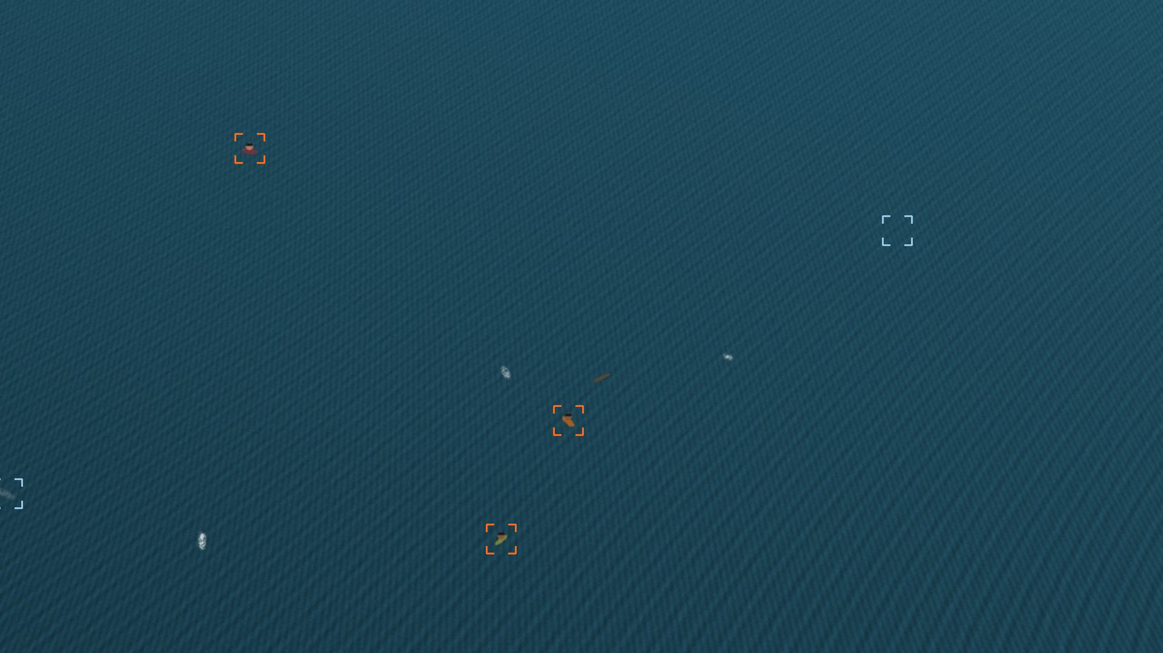
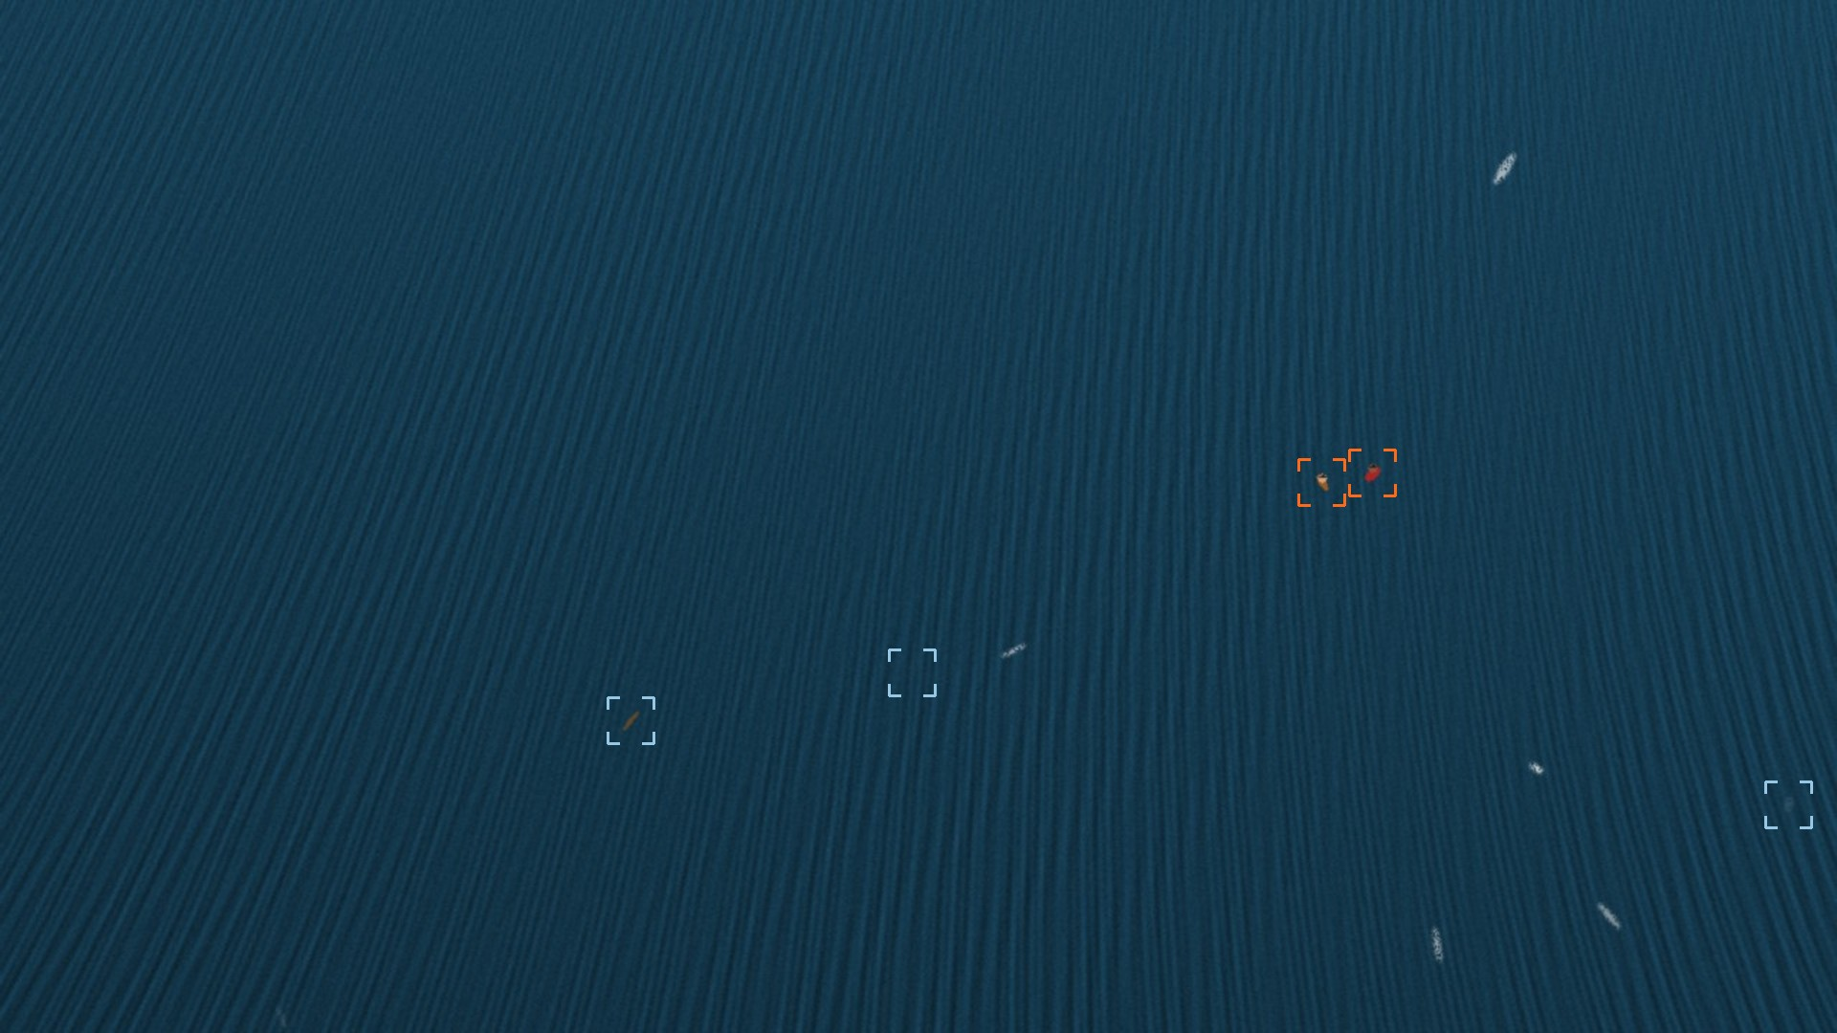
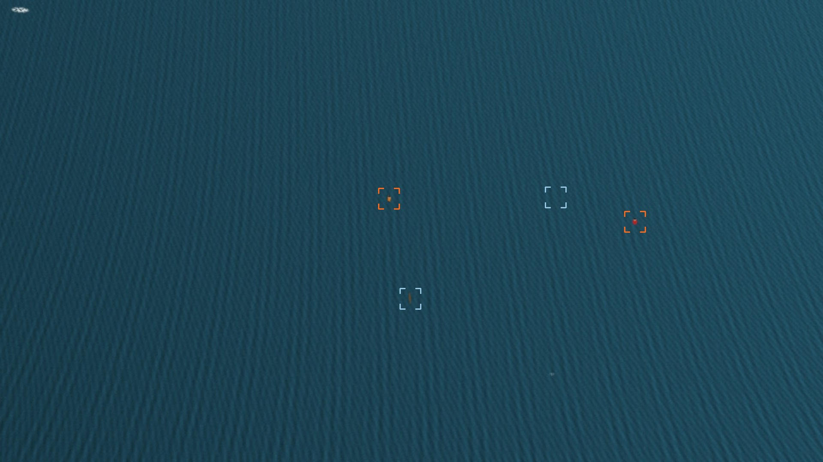
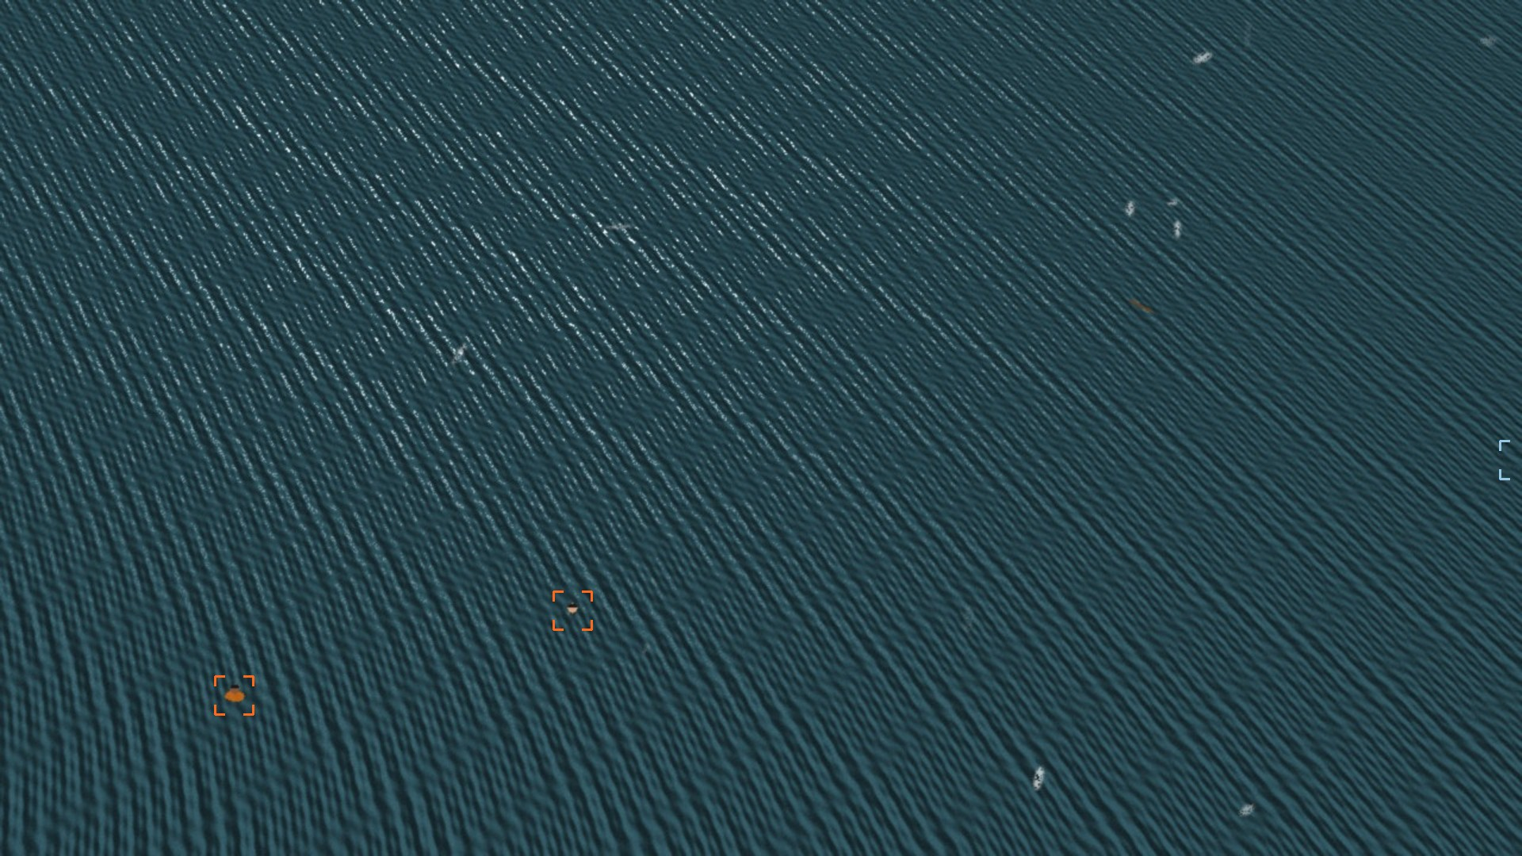
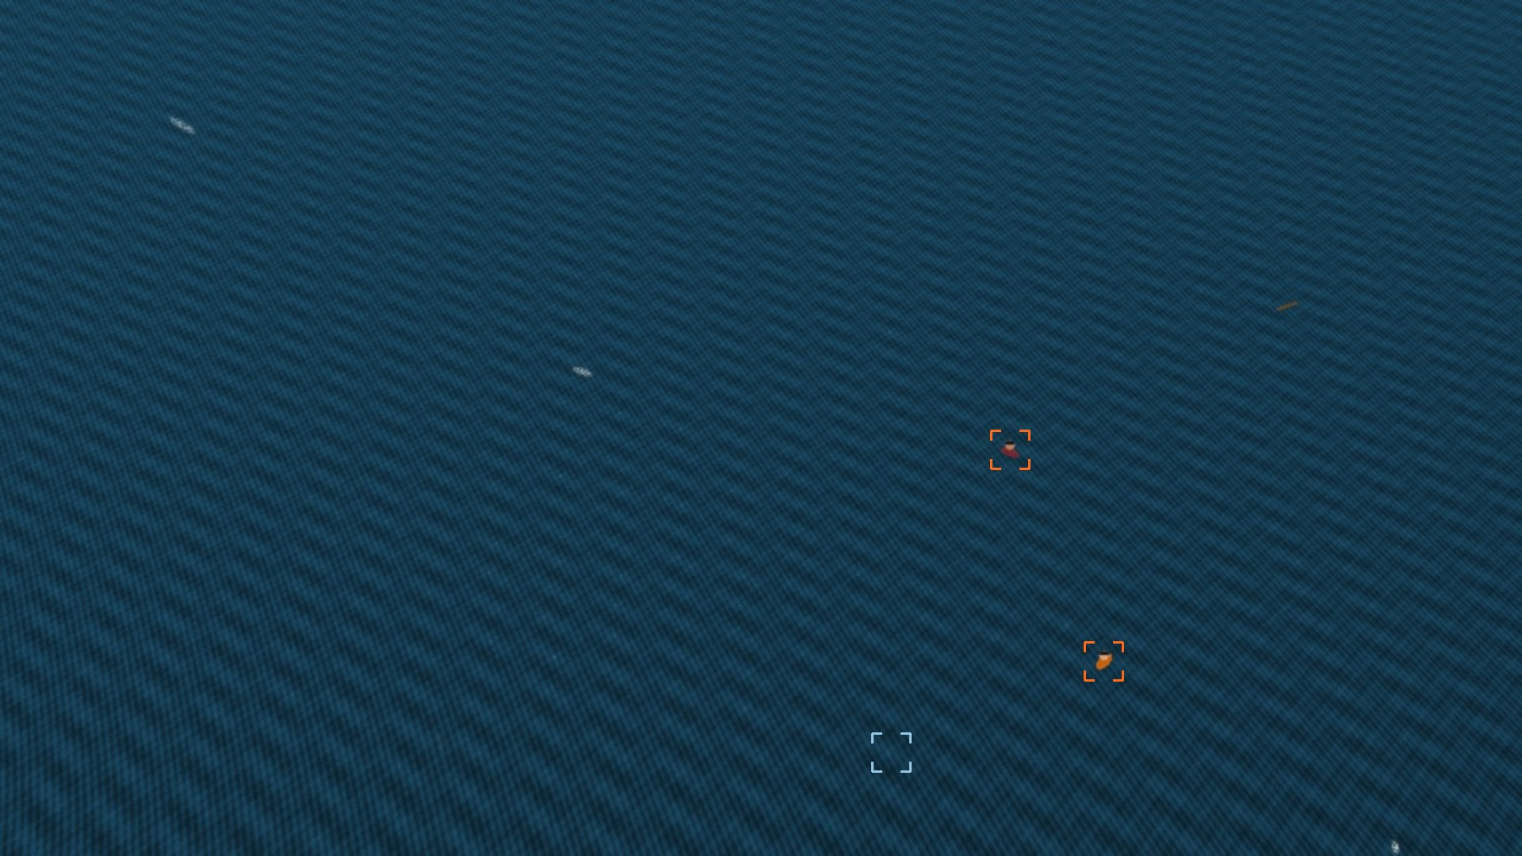
Recall holds across altitude and sea state
93.2% 2.23 false alarms / frame
92.9% 1.60 false alarms / frame
89.0% 2.90 false alarms / frame
SEQ 1 / 50 m / SEA 0.8
SEQ 2 / 80 m / SEA 1.0
SEQ 3 / 110 m / SEA 1.2
93.3% 1.77 false alarms / frame
93.1% 1.07 false alarms / frame
92.7% 1.07 false alarms / frame
SEQ 4 / 150 m / SEA 0.6
SEQ 5 / 80 m / SEA 1.6
SEQ 6 / 80 m, panning / SEA 1.0
Notes:
Each thumbnail is a sequence with recall@5 and false alarms underneath. Recall stays between 89 and 93 percent. The weakest is sequence 3. By target size, recall is 92.2 percent under 16 pixels and 93.4 percent from 16 to 32 pixels. We have no targets larger than 32 pixels in this benchmark.

Slide 18
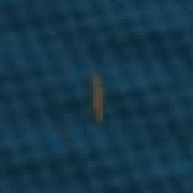
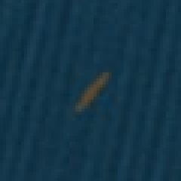
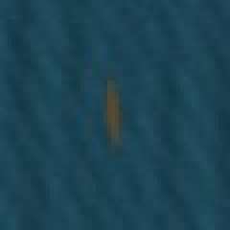

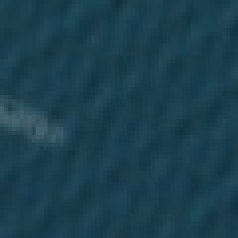
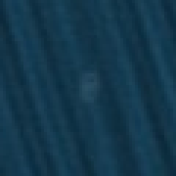





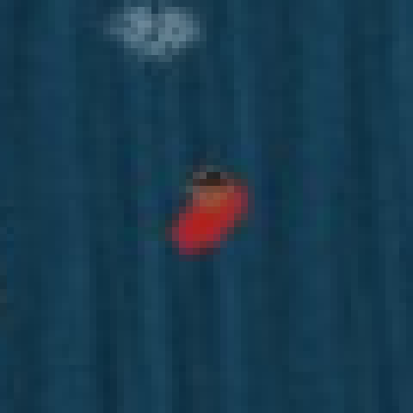
Frame 31's false alarms, looked at one by one
3 floating debris
3 whitecaps
0.63
0.69
0.31
0.40
0.52
0.53
5 with nothing visible, just water
A miss
0.44
0.48
0.35
0.16
0.23
Debris is a real anomaly, so flagging it is reasonable. The empty-water boxes tend to score lower. The miss is seq 3, frames 27–30: a person with a whitecap right beside them.
Notes:
We went through every false alarm at frame 31 across all six sequences by eye, 11 in total. Three are debris, which the method is doing correctly since debris is an anomaly, it just isn't a person. Three are whitecaps. Five have nothing visible. The labels here are from looking at the crops. The last crop is one of the few steady-state misses in the run. We haven't confirmed the whitecap is the cause.

Slide 19
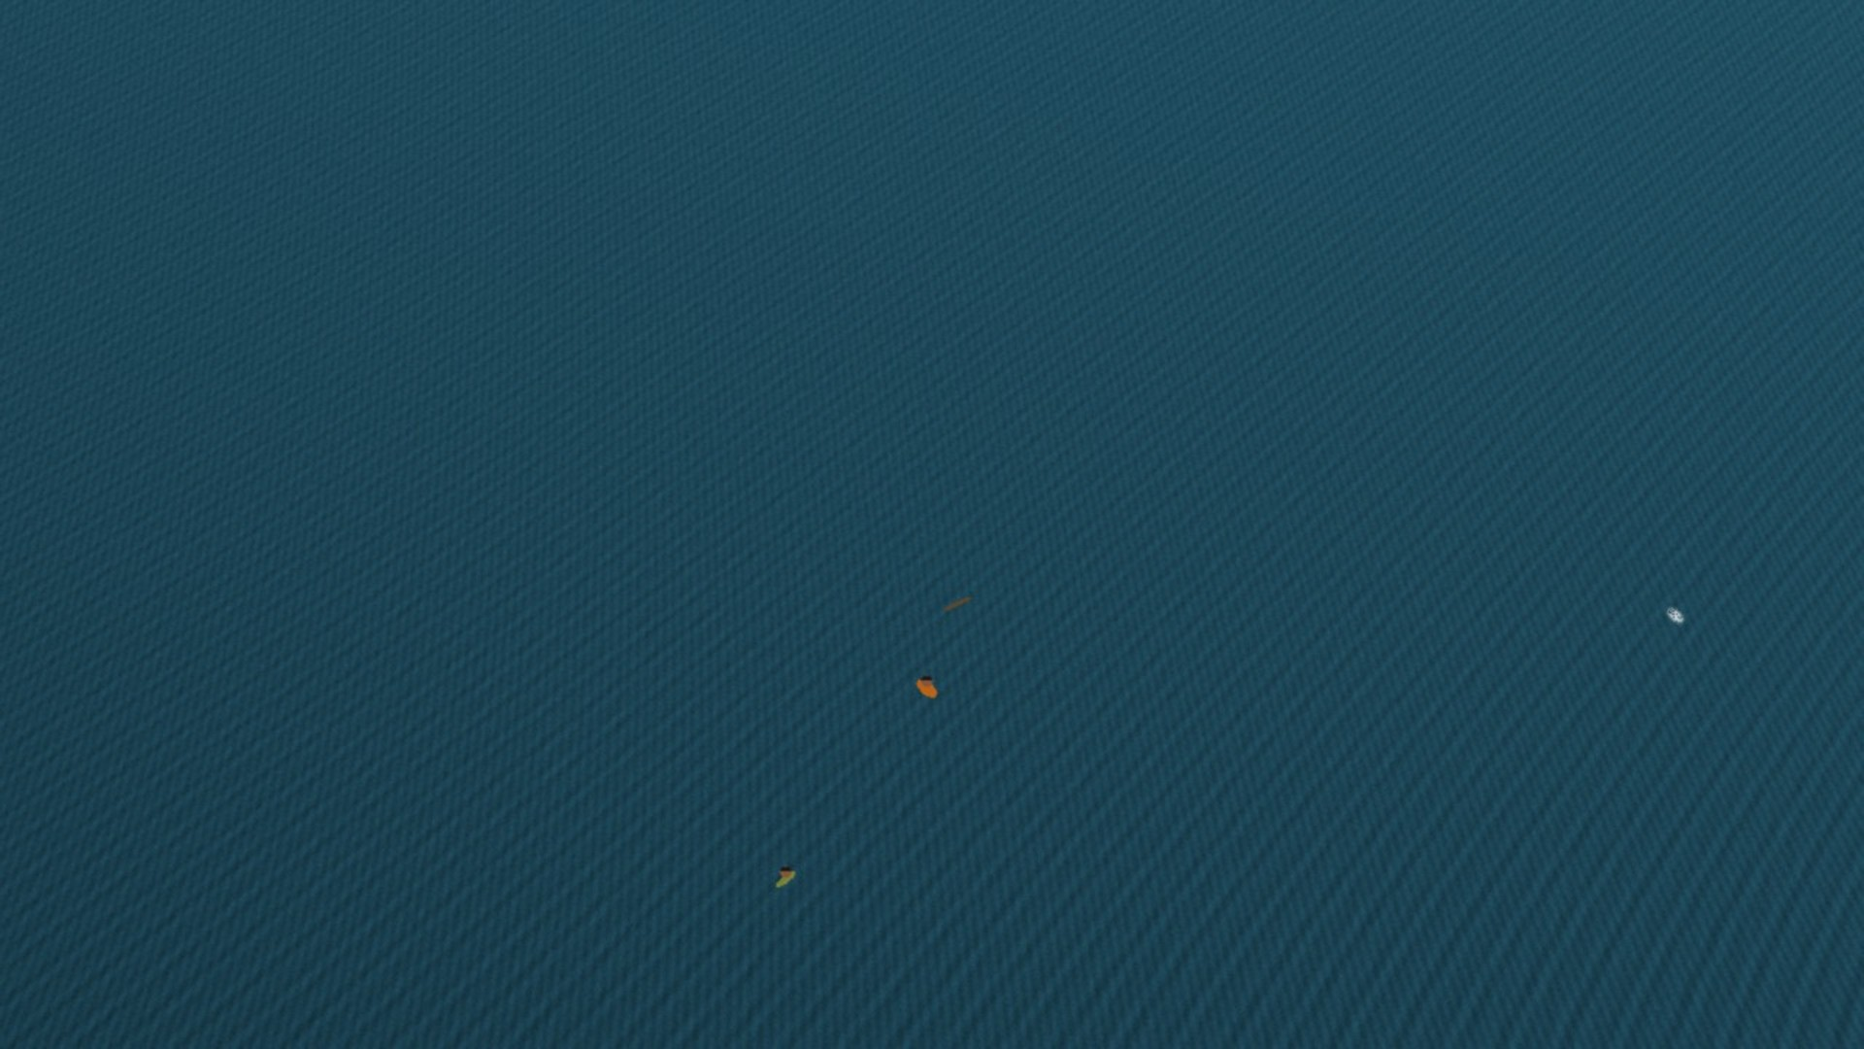
Where it breaks
Synthetic only so far. No real-footage numbers yet.
Warm-up. Nothing shows in the first 4 frames.
Dark, colourless targets. Weak colour and texture contrast.
Very bright white or grey clothing. Can be removed as glint.
Persistent clutter. Long whitecaps and debris get promoted.
Coastline or a large ship. Contaminates the local reference.
Camera rotation and zoom. Phase correlation handles translation only.
Hand-tuned thresholds. May need retuning per camera. Daylight RGB only.
SEQ 02 / FRAME 4 / EMPTY: NO TRACK PROMOTED YET
Warm-up is a fair price at 10 fps: 4 frames is 0.4 s. On higher frame-rate video, min_persistence has to go up so that it outlasts a whitecap, about 1–2 s.
Notes:
Expect questions here. The biggest limitation is that we haven't run on real footage. After that, dark targets and persistent clutter would be our first concerns on real video. Night and thermal are out of scope because the colour test assumes daylight RGB.

Slide 20
Built from Labs 1–5
Topic | What we used | Where in the code
Intensity transforms | Piecewise-linear contrast stretch | normalise.piecewise_linear
Histogram processing | CLAHE | normalise.normalise
Spatial filtering | Gaussian, median, Gabor convolution | normalise.flat_field, texture.gabor_energy
Frequency domain | 2-D DFT power spectrum | texture.estimate_wave
Texture | Uniform LBP, chi-square histogram distance | texture.uniform_lbp, anomaly.chi_square
Colour spaces | Lab, normalised rgb chromaticity | anomaly.colour_deviation, glint.chromaticity
Thresholding | Robust median + k · MAD thresholds | anomaly.score_anomalies
Morphology | Opening, closing, structuring elements | morphology.refine
Region analysis | Connected components, moments, convex hull | morphology.refine, eccentricity, solidity
Notes:
Every stage maps to something from the lab sessions, and each function is named so you can open it if asked. No deep learning anywhere in the pipeline.

Slide 21
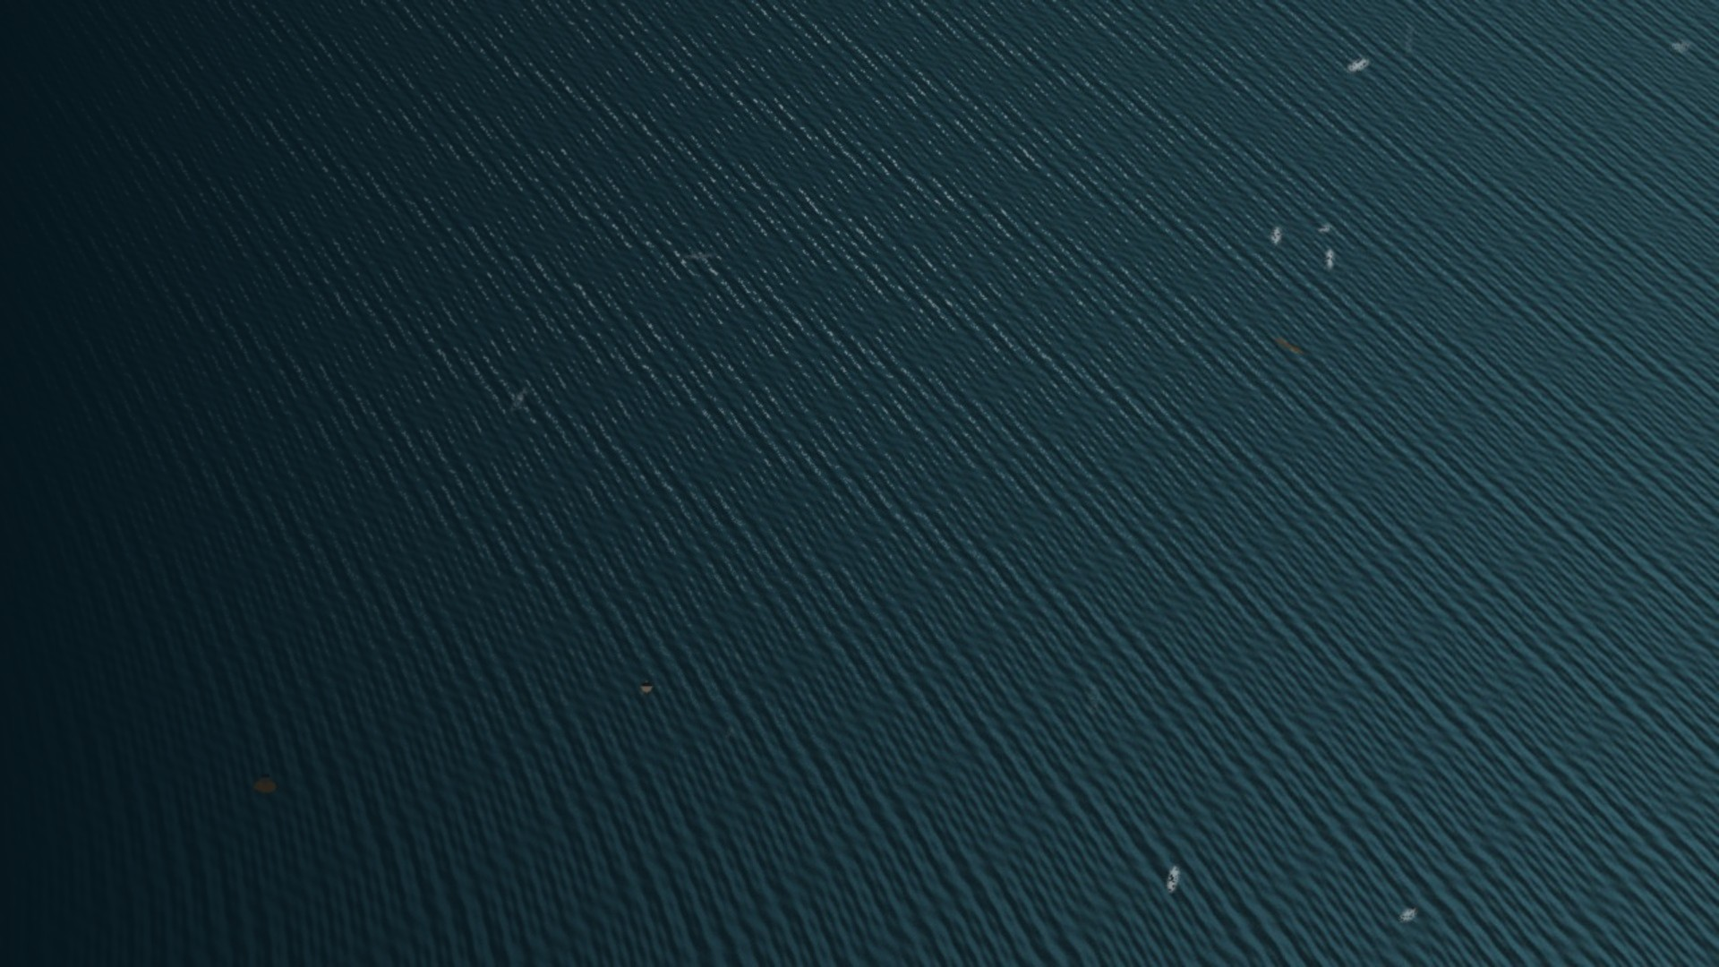
Next: real footage
The pipeline, tooling and evaluation all run end to end on synthetic data. The real test is still ahead of us.
SeaDronesSee
COCO JSON with altitude. Results per altitude bin.
MOBDrone
Man-overboard drone video.
AFO
Mostly single images, so no temporal stage.
Loaders and commands are in the repo. These runs haven't been done yet.
CPU-only, about 2,900 lines of Python, 40 tests passing
Notes:
To sum up: model the water, flag what breaks the pattern, and use persistence to separate people from clutter. It works on our benchmark. Real footage is the next step and the method needs no retraining for it, only annotations to measure against. Then take questions.

