Slide 1
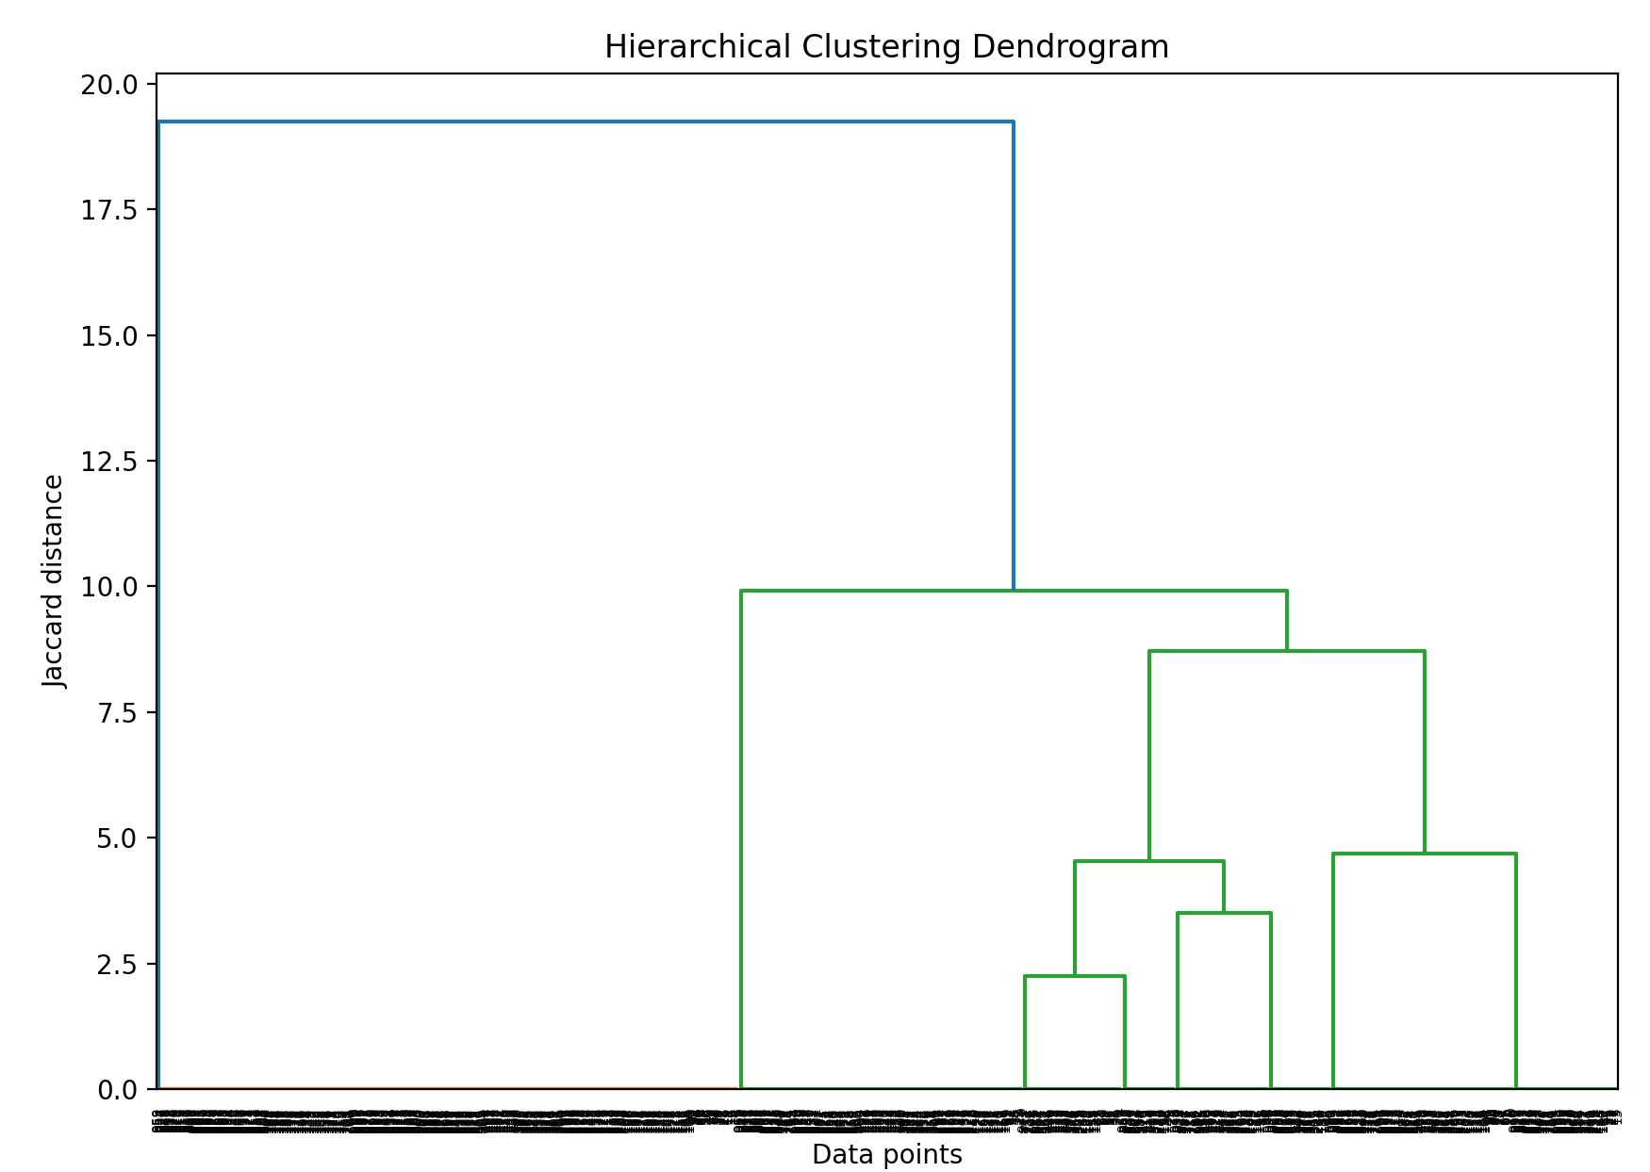
Project-4 Cluster Analysis By Vishakha Mishra
The dendrogram, shows 2 major cluster.
The green cluster has many sub-clusters
Optimal number of cluster seem to be 2 i.e. the blue cluster and the green cluster

Slide 2
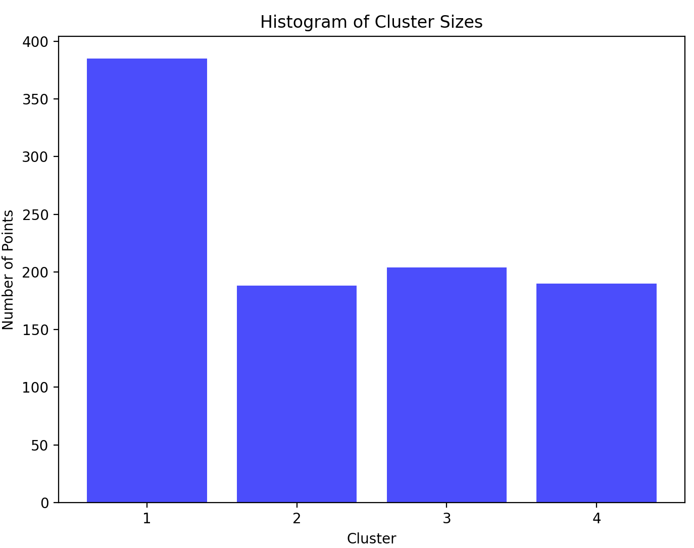
We see 4 cluster in the histogram
Cluster 2 and 4 are of same points
Cluster 1 and 3 are too distinct

Slide 3
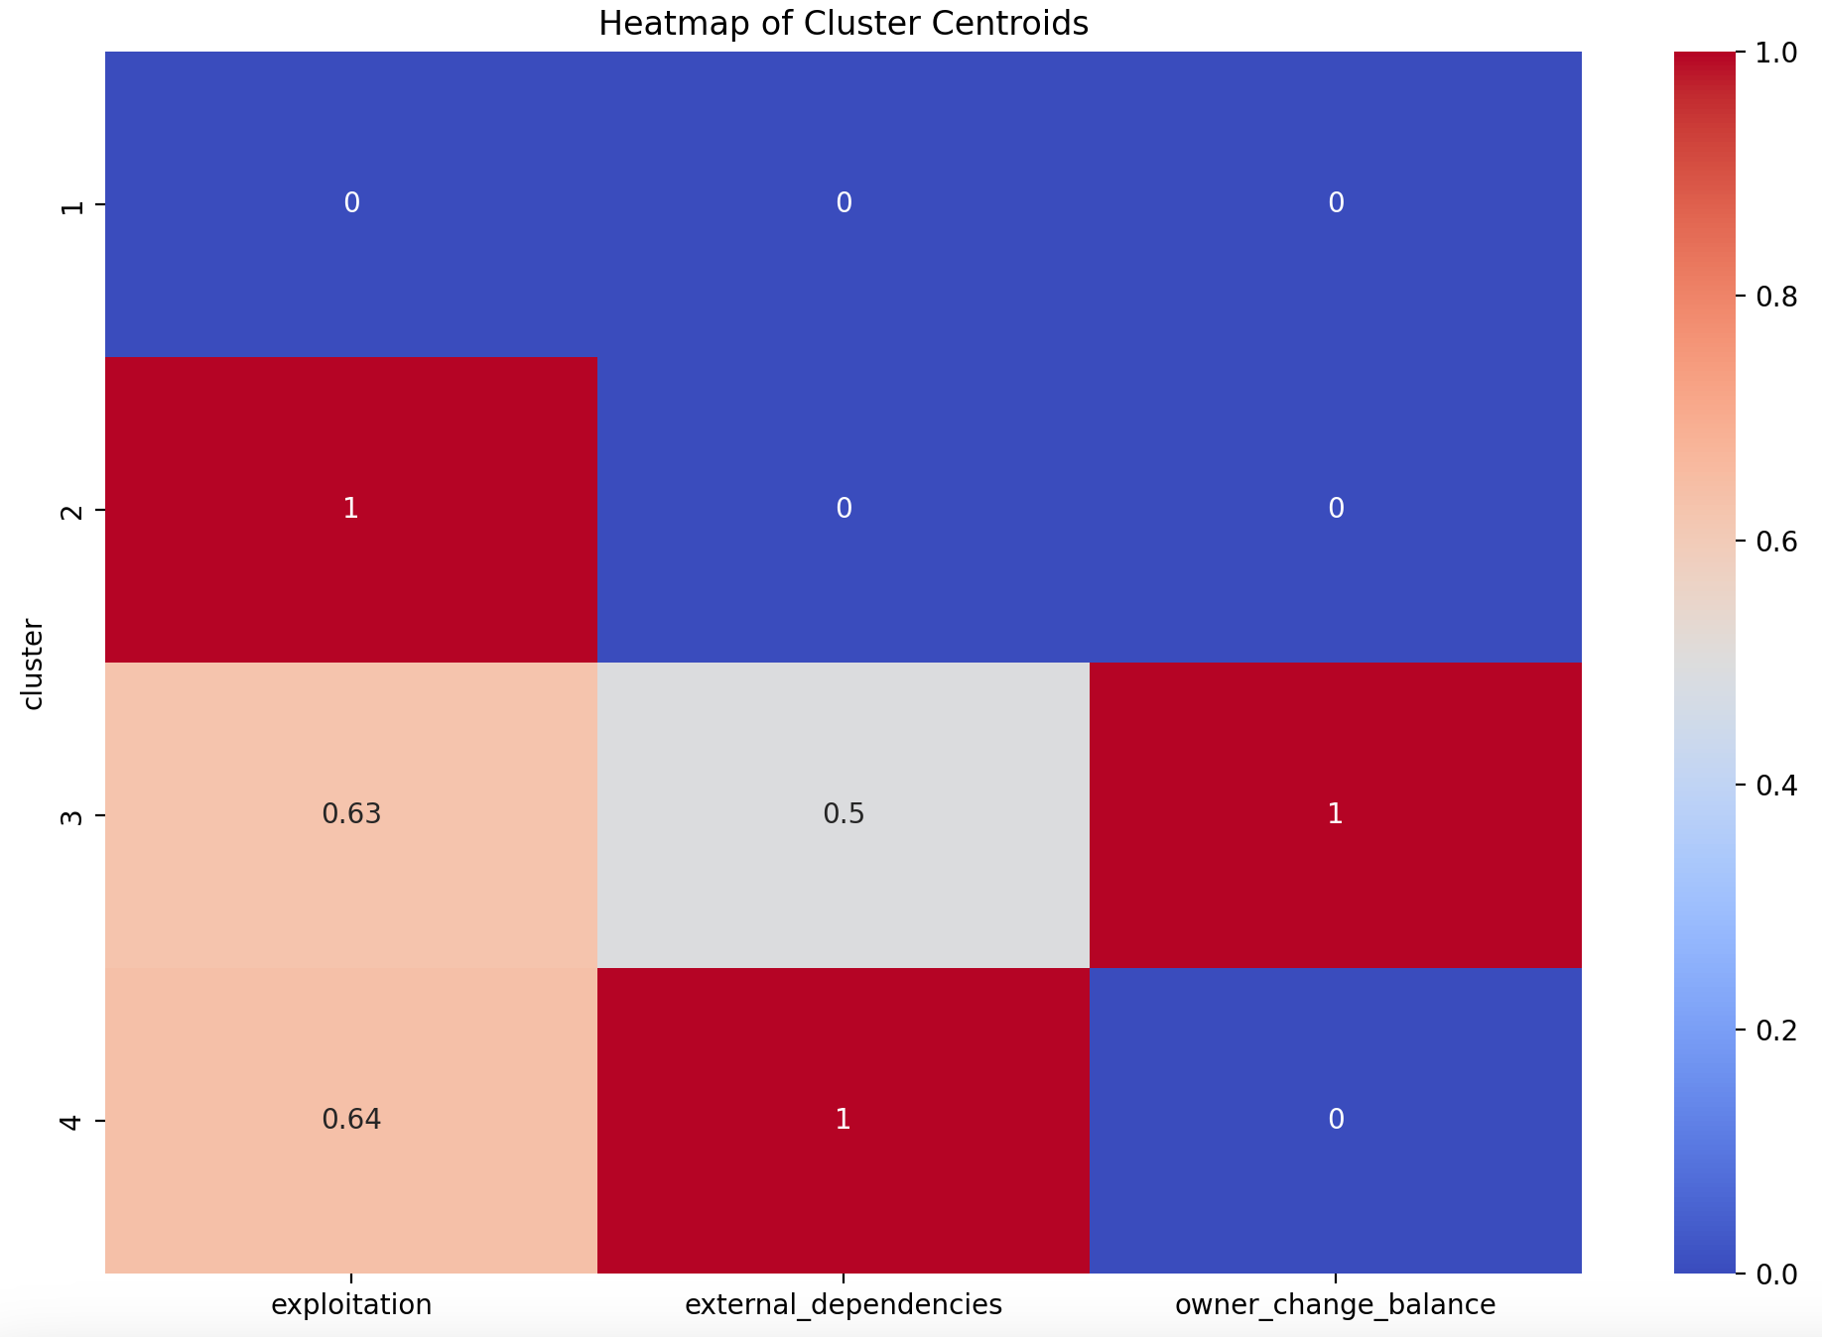
We see four clusters:
In Cluster 1 all features are 0 indicating smart contract has no risk
In Cluster 2 exploitation is only at risk
In Cluster 3 owner_change_balance poses highest risk followed by exploitation and external_dependencies
In Cluster 4 external_dependencies shows greater risk, followed by exploitation, however owner_change_balance shows no risk

