Slide 1
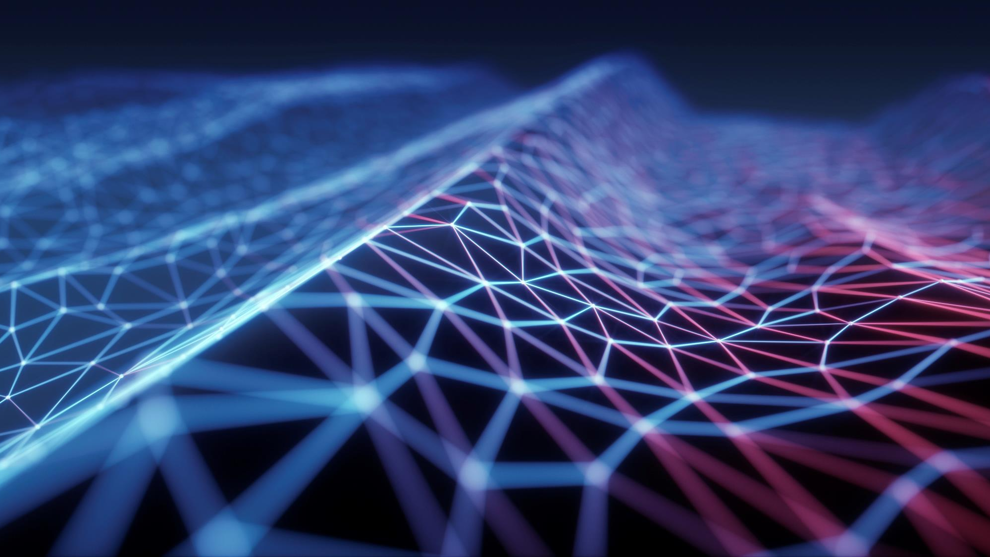
Troubleshooting Tools-hardware tools
Prepared by
Diya Darji (196140307025)
Shrestha Miskin(196140307063)
Drashti Patel (196140307088)
Vrunda Thakar (196140307143)
Disha Trapasiya(196140307146)

Slide 2
Hardware Troubleshooting tools
Hardware troubleshooting is the process of reviewing, diagnosing and identifying operational or technical problems within a hardware device or equipment.
It aims to resolve physical and logical problems and issues within a computing hardware.
Hardware troubleshooting is done by hardware or technical support technician.

Slide 3
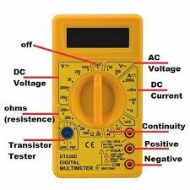
Digital Voltmeter
Digital Voltmeter abbreviated as DVM is an instrument used to measure the electrical potential difference between two points in a circuit.
The voltage could be an alternating current (AC) or direct current (DC).
It measures the input voltage after converting the analog voltage to digital voltage and displays it in number format using a convertor.
The usage of digital voltmeter has increased the speed and accuracy with which the readings are noted.

Slide 4
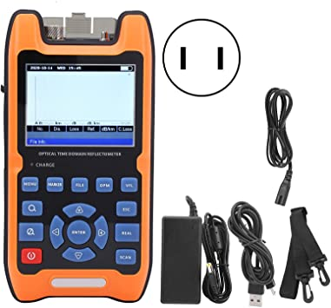
Time-Domain Reflectometers(TDRs)

Slide 5
Time-Domain Reflectometers(TDRs)
A time-domain reflectometer (TDR) is an electronic instrument used to determine the characteristics of electrical lines by observing reflected waveforms.
Sends sonar like electrical signal into actable and can determine the location of a break in the cable.
Network performance suffers when the cable is not intact. If the TDR locates a problem , the problem is analysed and the results are displayed.

Slide 6
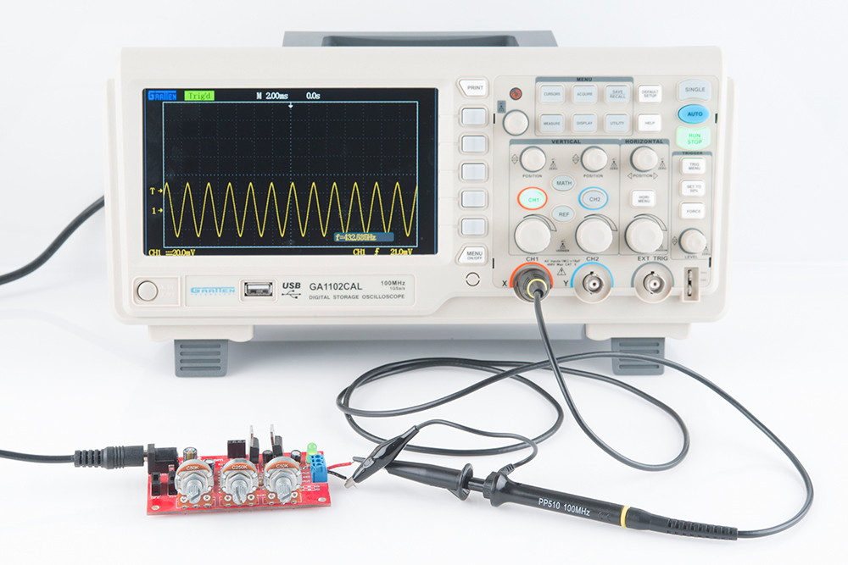
Oscilloscope
Oscilloscopes are advanced pieces of electronic equipment that measure signal voltage per unit of time and display the result on a monitor.
The oscilloscope can be adjusted so that repetitive signals can be displayed as persistent waveforms on the screen. A storage oscilloscope can capture a single event and display it continuously, so the user can observe events that would otherwise appear too briefly to be seen directly.
When used with TDRs , an oscilloscopes an display :
Shorts.
Sharp bends or crimps in the cable.

Slide 7
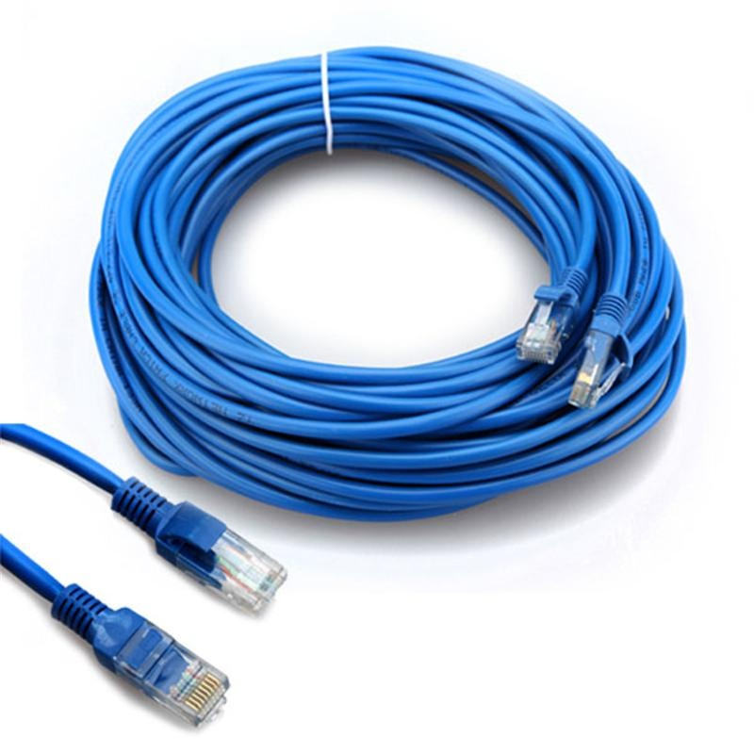
Cross over Cables
An Ethernet crossover cable is a crossover cable for Ethernet used to connect computing devices together directly.
It is most often used to connect two devices of the same type, e.g. two computers (via their network interface controllers) or two switches to each other. By contrast, straight through patch cables are used to connect devices of different types, such as a computer to a network switch.
Intentionally crossed wiring in the crossover cable connects the transmit signals at one end to the receive signals at the other end.

Slide 8
Thank You

