Slide 1




HarmonySteps
-Error404
Project Track: Music and Tech Fusion Project Title: Harmony Steps- Music-Driven Dance Generator

Slide 2
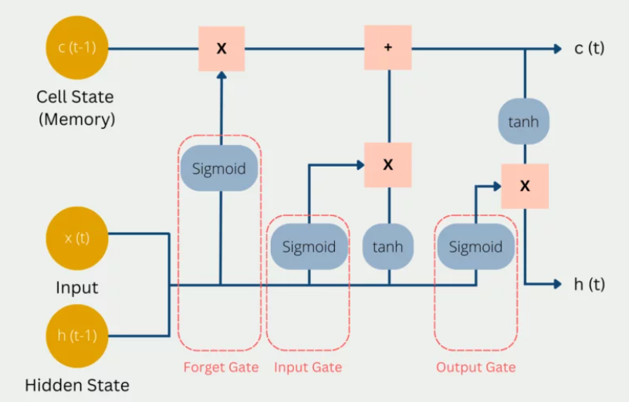
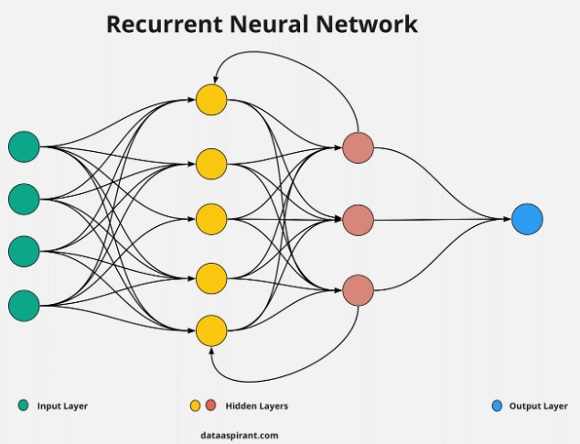
Idea:
Using innovative neural network-powered system designed to bridge the gap between music and dance, to provide users with personalized and synchronized dance moves
1
Goal:
Revolutionize choreography for faster, vibrant routines in harmony with modern music.
Problem Statement:
Traditional methods struggle to synchronize dance routines with dynamic musical trends.
Problem statement
MOOD
Idea
Rhythm

Slide 3

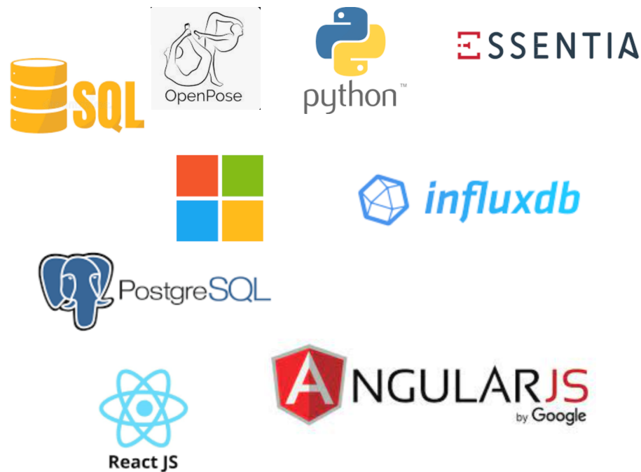

Error404’s Idea flow and Tech Stack:-
3
Project Approach Overview:-
We've delved into a multitude of databases like FMA, Million Song Dataset, NTU RGB+D Dataset, and H3.6M Dataset, tapping into a rich well of music and dance data. Python has been our go-to toolkit, leveraging powerful libraries such as Librosa, Essentia, and Matplotlib to meticulously dissect musical notes, uncovering their nuances and patterns.
For dance data preprocessing, we have seamlessly integrated OpenPose and Microsoft Azure Kinect, harnessing their skeletal tracking capabilities to prepare the data for further analysis. Once refined, we ensure efficient storage using both relational and time series databases, enabling swift retrieval through the mastery of SQL and OpenTDSB.
Organizing this wealth of data into coherent training and testing datasets is crucial, laying the foundation for robust model development. Leveraging the capabilities of LSTM neural networks, we will train models that adeptly capture the intricate dynamics of music and dance sequences.
But our journey doesn't stop there. I recognize the importance of user experience in every step of the process. That's why I'm committed to crafting intuitive and engaging interfaces using cutting-edge technologies like React and AngularJS. Prioritizing user engagement ensures seamless data handling and model training, ultimately delivering a cohesive and enriching experience for all stakeholders involved.

Slide 4
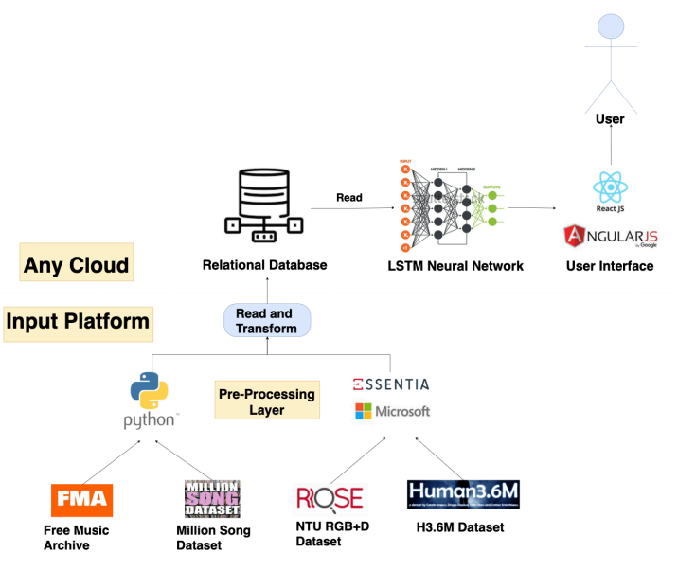
Work Flow:-
2

Slide 5
Market:-
4
In the vibrant world of music, dance takes center stage captivating a broad and passionate community.
- Our product is meticulously designed to cater to this dynamic group, offering an efficient and convenient way of learning dance.
-Beyond the joy of movement and self-expression, dance also serves as a fantastic fitness activity.
-We aspire to empower individuals within the music-based community, not only providing them with the skills to master the most impressive dance moves but also contributing to their overall wellbeing through the fitness benefits of dance.
-This, in turn, ensures they radiate confidence and shine brightly at their next social gathering or event, seamlessly blending the joy of dance with the rich tapestry of music culture.

Slide 6
Future Prospects and Protype
Future prospects
Protype
Augmented Reality (AR) Integration:
• Integrating AR technology could provide users with an immersive dance-learning experience. Users might follow holographic dance instructors or project dance moves into their own spaces, making the learning process more interactive Translating content into various languages and incorporating diverse cultural dance styles could further enhance its appeal.
Personalized AI Recommendations:
• Enhancing HarmonySteps AI capabilities to provide personalized dance recommendations based on users' preferences, learning styles, and progress could offer a more tailored and engaging experience.
https://github.com/Vishy204/ERROR404

Slide 7

Team Members
Vishwajith P Btech CSE IS
Vinay G Btech CSE IoT
Akshath Rajkumar Btech CSE AI ML

