Slide 1
A Lightweight Detect, Defense and Awareness System for AI-Driven Scams
FINAL PRESENTATION — RESEARCH PROJECT (IT4010) • 2026
Specializing in Cyber Security | SLIIT — Faculty of Computing
Group ID: RP-CS-011 Supervisor: Mr. Dinith Primal
Student IT Number | Name | Co-Topic
IT22277268 | Aberathna H M M K | A Lightweight Defense Model for AI-Driven Scams
IT22299048 | Vidara S V | Human Centered Defense & Detect System For AI – Driven Scams
IT22628718 | Priyadewa P D J C | Explainable AI – Based Steganographic Image Detection in Email Attachments
Detection Pipeline · Defense & Awareness · Steganographic Image Detection

Slide 2
RESEARCH PROBLEM & SOLUTION
Research problem
Proposed solution
Email scams can combine deceptive messages, impersonated senders, malicious links, and suspicious attachments. Traditional single-purpose checks may miss parts of the threat, while warnings alone may not explain the evidence or guide users toward safer actions.
The project integrates three components in Thunderbird: a lightweight AI-driven scam detector, a human-centred defense and awareness system, and StegoGuard for explainable steganographic image detection. Together, they analyse different signals, provide understandable evidence, and support risk-based protective actions.
HOW THE COMPONENTS WORK TOGETHER
01
02
03
Detect scams
Inspect images
Protect & explain
Email text, sender, links and risk indicators
Clean/Stego prediction and Grad-CAM heatmap
Risk-based action, evidence and user awareness

Slide 3
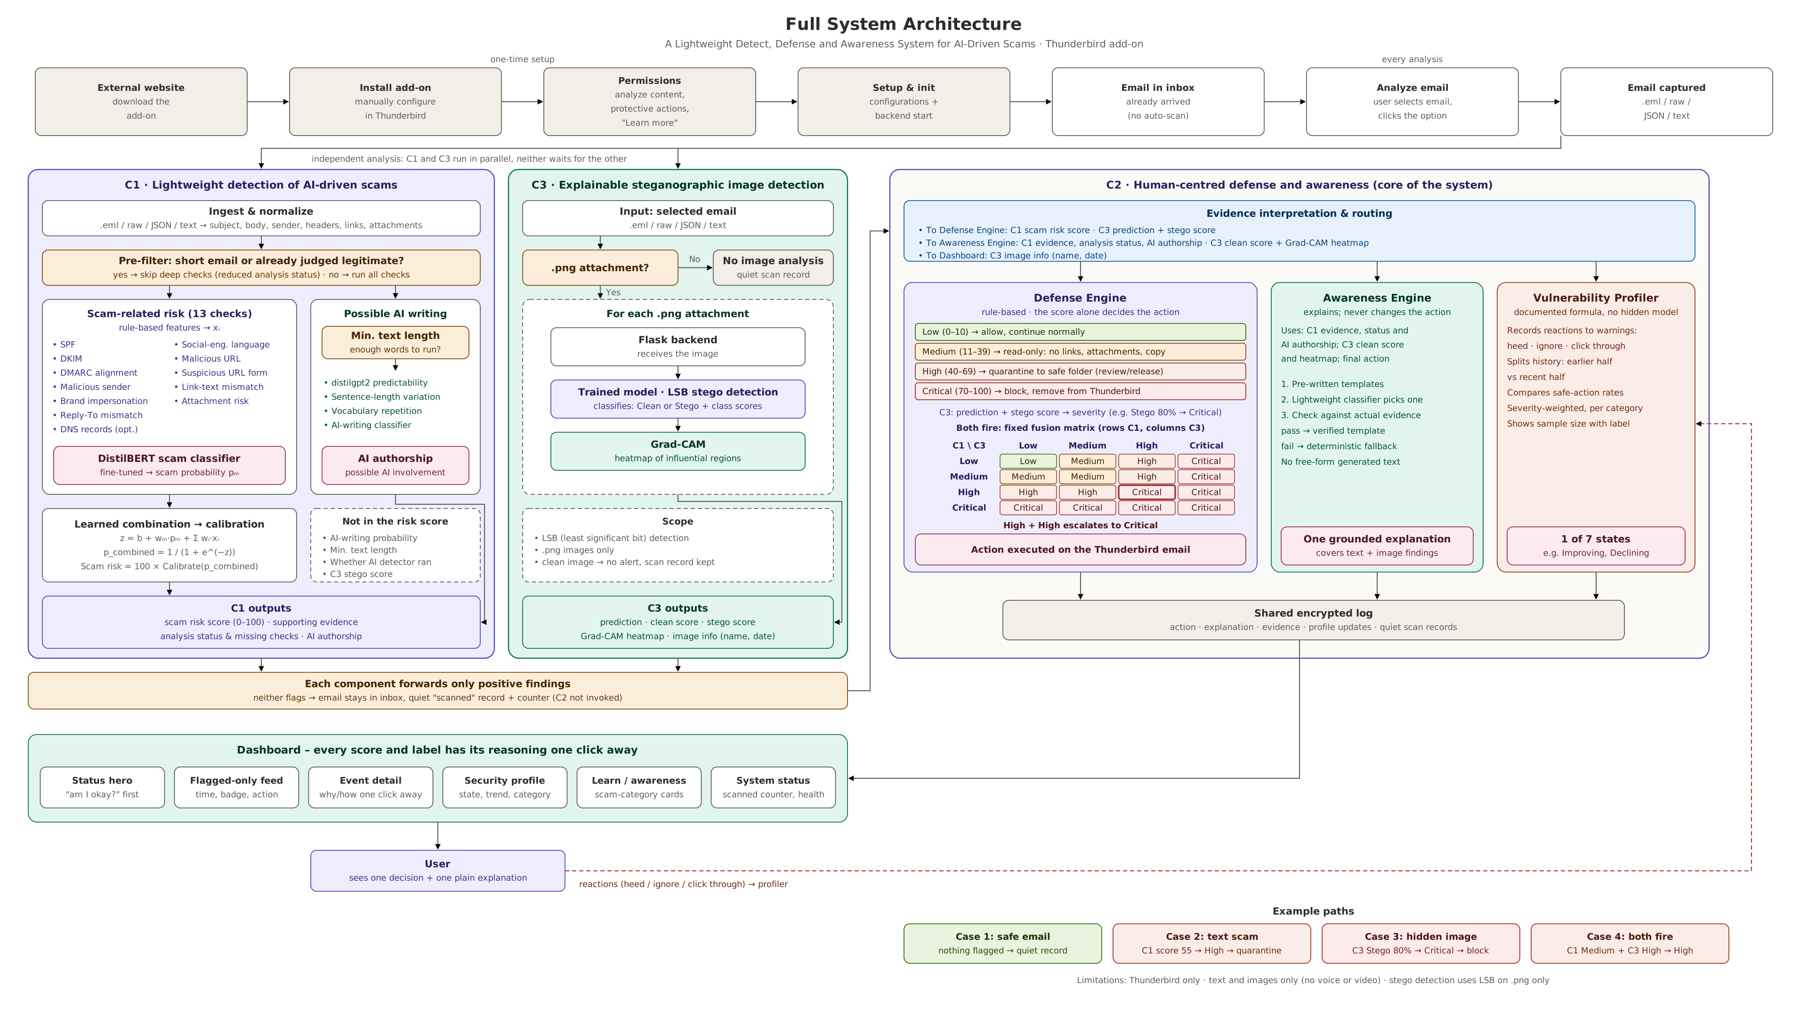
Overall Design Excellence

Slide 4

Lightweight AI-Driven Scam Detection
Presenter: Aberathna H M M K
Student ID: IT22277268
COMPONENT OVERVIEW
This component analyses selected emails in Thunderbird to identify possible scam activity. It combines sender and authentication checks, URL and attachment indicators, social-engineering signals, and AI-based text classification to estimate the scam risk and provide supporting evidence. The resulting risk score and analysis details are passed to the integrated defense and awareness component, helping it decide how to respond and explain the risk to the user.

Slide 5
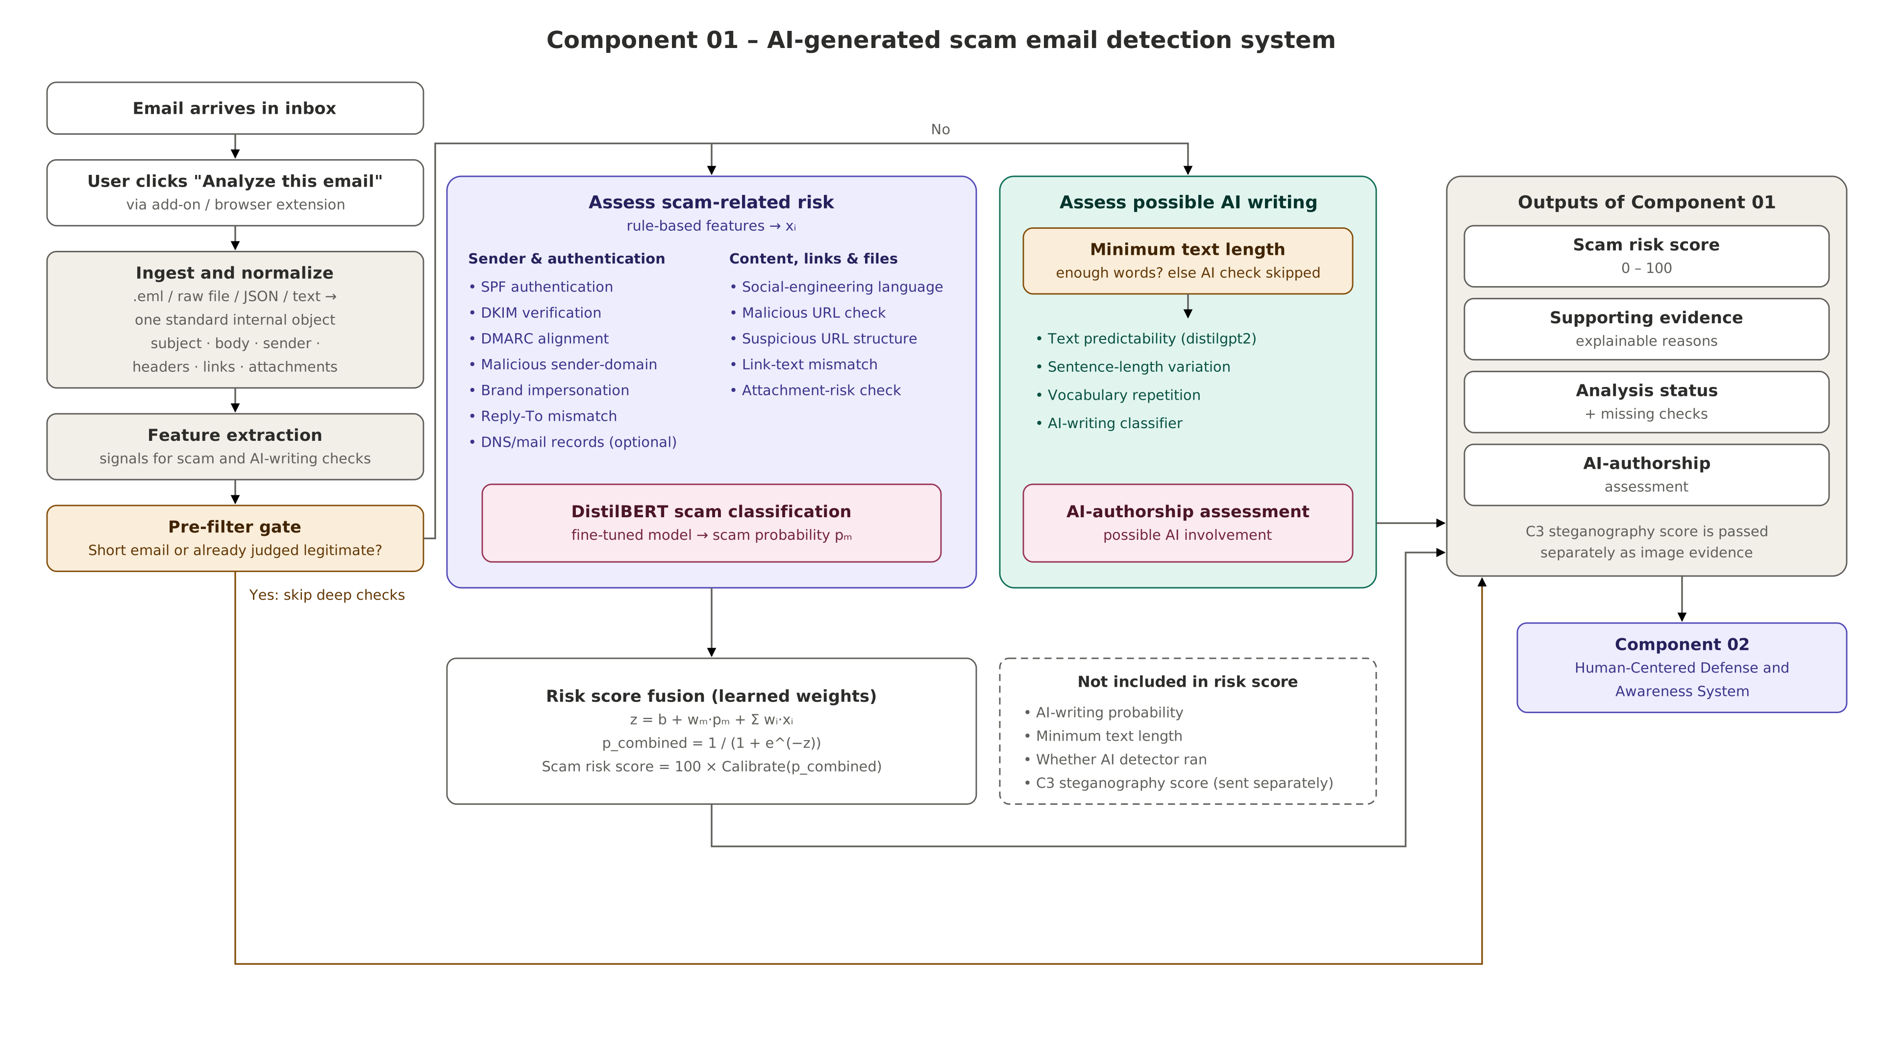
Lightweight AI-Driven Scam Detection

Slide 6

Human-Centred Defense and Awareness System
Presenter: Vidara S V
Student ID: IT22299048
COMPONENT OVERVIEW
This component uses the threat information produced by the detection components to support suitable protective actions and clear user explanations. Its defense engine applies risk-based responses, such as allowing, restricting, quarantining, or blocking suspicious emails, while its awareness engine presents the reasons and evidence behind a warning. A user security profile and activity history can also help users review security events and understand their interactions with potential threats.

Slide 7
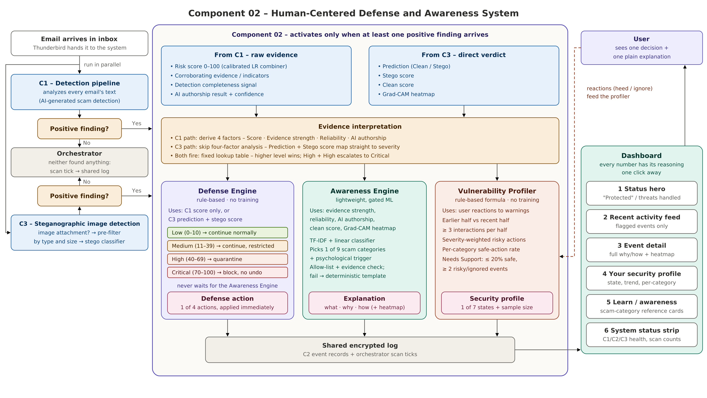
Human-Centred Defense and Awareness System

Slide 8

StegoGuard: Explainable AI-Based
Steganographic Image Detection
Presenter: Priyadewa P D J C
Student ID: IT22628718
COMPONENT OVERVIEW
StegoGuard analyses image attachments from emails to identify whether they may contain hidden information embedded through steganography. A trained AI model classifies each supported image as Clean or Stego and provides class scores for the prediction. Grad-CAM generates a heatmap to highlight image regions that influenced the model, making the result easier to interpret. The prediction and supporting explanation can then contribute to the integrated system’s image-related defense and user awareness.

Slide 9
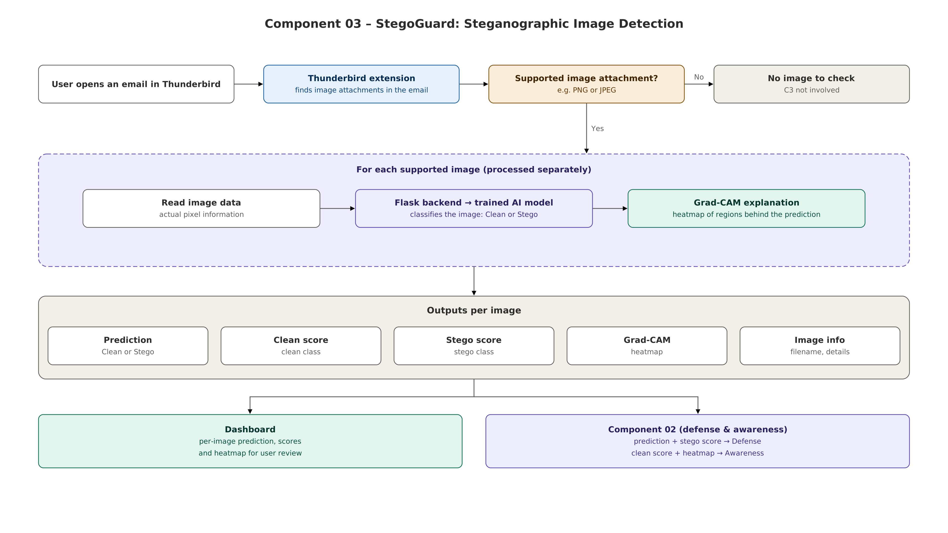
StegoGuard: Explainable AI-Based Steganographic Image Detection

Slide 10
Current limitations and next steps
LIMITATIONS
FUTURE WORK
• Detection performance depends on the quality and diversity of training and test data.
• AI models may produce false positives or miss unfamiliar scam patterns.
• Image analysis is limited to supported attachment formats and works only as a binary classification to detect Clean or Stego images.
• Compatibility, response time, and user experience require testing across broader real-world environments.
• Expand datasets with more diverse, recent scam emails and steganographic images.
• Improve model robustness, threshold calibration, and evaluation against unseen examples.
• Extend supported file formats and extend the model to identify hidden payloads.
• Conduct larger user-acceptance studies to assess clarity, usability, and the usefulness of protective actions.

Slide 11
Conclusion
This research project brings together AI-driven scam detection, explainable image steganography detection, and human-centred defense and awareness in a single email-security workflow. By combining different sources of threat evidence with risk-based protective responses and clear explanations, the system aims to help users recognise suspicious emails, understand why they may be dangerous, and respond more safely. Further evaluation and broader testing are important next steps toward improving reliability and real-world readiness.
DETECT
EXPLAIN
DEFEND
Identify suspicious email and image signals
Show evidence behind the findings
Support safer user decisions

Slide 12

Live System Demonstration
We now invite the panel to view a live demonstration of the system in action.

