Slide 1
A Lightweight Detect, Defense and Awareness System for AI-Driven Scams
PROGRESS PRESENTATION 2 — RESEARCH PROJECT (IT4010) • 2026
Specializing in Cyber Security | SLIIT — Faculty of Computing
Group ID: RP-CS-011 Supervisor: Mr. Dinith Primal
Student IT Number | Name | Co-Topic
IT22277268 | Aberathna H M M K | A Lightweight Defense Model for AI-Driven Scams
IT22299048 | Vidara S V | Human Centered Defense & Detect System For AI – Driven Scams
IT22628718 | Priyadewa P D J C | Explainable AI – Based Steganographic Image Detection in Email Attachments
Detection Pipeline · Defense & Awareness · Steganographic Image Detection
RP-CS-011 · Progress Presentation 2 · Specializing in Cyber Security
01 / 16

Slide 2
Progress Presentation 1’s — Comments & How We Addressed Them
Student ID | Panel Comments | How We Addressed It
IT22277268 | System is still not integrated. | System Integrated.
 | Input has to be copied and pasted. | The Thunderbird Web Extension automatically captures displayed email content and sends it to the backend without manual input.
 | Risk score calculation is not presented clearly. | Displays the final 0–100 risk score and Low/Medium/High label with a breakdown of pre-filter flags, ScamClassifier confidence, and AI-generation likelihood.
IT22299048 | No proof of existing system not using phycological factors | We removed the unsupported claim that existing systems do not use psychological factors. Instead, Component 2 explicitly integrates psychological scam triggers such as urgency, authority, fear, reward, scarcity, and financial pressure.
IT22628718 | Research component change was not approved. | Discussed the component change with my supervisor and formally emailed the CDAP team and panel members requesting approval for the change.
 | Dataset upload/location in Google Colab was unclear. | Moved training from Google Colab to local PC with RTX 5060 GPU and organized the dataset inside the project folder.
 | Demo was hard-coded and not based on real data. | Developed a fully functional Flask dashboard using real Thunderbird .eml files, real image attachments, AI predictions, and Grad-CAM heatmaps.
RP-CS-011 · Progress Presentation 2 · Specializing in Cyber Security
02 / 16

Slide 3
WELCOME TO
A Lightweight Detect, Defense & Awareness System for AI-Driven Scams
The privacy-preserving Thunderbird add-on for AI-authorship-aware scam detection, adaptive defense, and steganographic image analysis
RP-CS-011 · Progress Presentation 2 · Specializing in Cyber Security
04 / 16

Slide 4


The Problem We're Solving
A Lightweight Detect, Defense and Awareness System for AI-Driven Scams
Research Problem
Research Gaps → Objectives
LLM-assisted scam emails are fluent enough to evade filters built for human-authored scam patterns, opening a widening detection gap.
Individuals, SMEs without security teams, and non-technical or vulnerable users carry the risk directly.
A block alone gives no lasting protection — users stay just as vulnerable to the next, differently worded attack.
Gap: No local AI-authorship signal
Objective: Detect likely LLM-generated scams, not just scam vs. legitimate
Gap: Detection without lasting education
Objective: Pair every action with a technique-specific, plain-language explanation
Gap: Unmonitored image channel
Objective: Detect & explain hidden data in scam-attached images
Gap: Privacy cost of cloud tools
Objective: Keep every stage fully local — no email content ever leaves the machine
RP-CS-011 · Progress Presentation 2 · Specializing in Cyber Security
05 / 16

Slide 5



Solution & Methodology
One local process, three cooperating components, one shared contract — nothing leaves the machine
A single Python backend hosts all three components as importable modules behind one orchestrator; every email flows through the same five-stage pipeline and the same JSON contract, which is what keeps each component replaceable without the others knowing its internals.
Component 1
Component 3
Component 2
Detection Pipeline
Steganographic Image Detection
Defense & Awareness
Function
Rule-based prefilter + fine-tuned DistilBERT scam classifier + stylometric AI-authorship detector + risk scorer.
Novelty
Flags likely AI-authorship as a first-class signal, not just scam vs. legitimate.
Function
EfficientNet-B2 CNN flags hidden data in scam-attached images; Grad-CAM explains the verdict visually.
Novelty
An explainable visual-forensics layer inside a consumer email client — rare even in commercial tools.
Function
ResponseController maps risk to action; AwarenessEngine classifies scam-type and trigger, in parallel.
Novelty
Treats education and defense as co-equal outputs — reduces vulnerability to the next attack, not just this one.
System-level novelty: the combination — local AI-authorship-aware detection, explainable steganalysis, and personalised education, all fully on-device — is what no single component delivers alone.
RP-CS-011 · Progress Presentation 2 · Specializing in Cyber Security
06 / 16

Slide 6
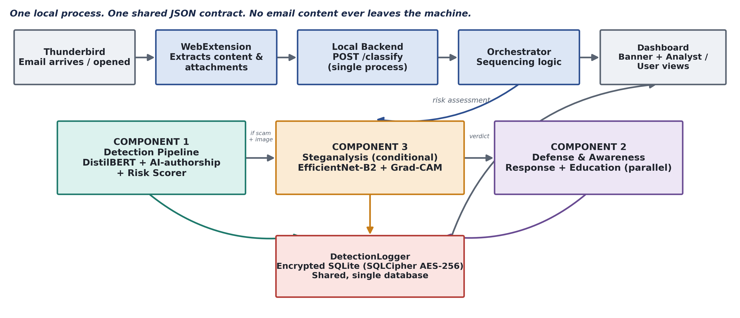
System Architecture
End-to-end pipeline, mapped to the three components and their evidence points
Evidence: Component 1 — 0.998 ROC-AUC on validation. Component 3 — heatmap validity pending task-specific testing. Component 2 — macro-F1 vs. rule-based baseline.
RP-CS-011 · Progress Presentation 2 · Specializing in Cyber Security
07 / 16

Slide 7






Evaluation, Issues & Commercialization
How the system was tested, what it delivers, where it's bounded, and how it reaches real users
Baseline & Comparison
Results
Limitations
All 4 system objectives confirmed via schema & output evidence, on both success and fallback paths
Zero outbound traffic carrying email content — verified directly by network-capture testing
Every scam-classified email with an image produces a verdict plus a visual heatmap explanation
Defensive action and awareness explanation generated in parallel for every scam event
Single-user, single-machine, CPU-only deployment — no multi-tenant or server mode
English-language email only; other languages unvalidated
Component 3 preprocessing-fidelity & Grad-CAM task-fit still open validation items
Trained ML/DL approach beats rule-based / statistical baselines on all three components (illustrative target bands).
Metrics & Non-Functional Requirements
Professional, Legal, Social, Security & Ethical
Macro-F1, ROC-AUC, confusion-matrix analysis and false-negative rate tracked per classifier, not blended into one accuracy figure
Latency budgets enforced per module: <50ms prefilter, <200ms scam classifier, ~100ms awareness content — all CPU-only
Every NFR tied to a named evidence mechanism: network capture for privacy, fault injection for reliability, schema audit for data minimisation
Bias risk: stylometric AI-authorship signal may over-flag non-native English writing — scoped for fairness testing
Cambridge Cybercrime Centre dataset gated by NDA — constrains reproducibility and public redistribution
Vulnerability profiles pseudonymised (keyed hash) and encrypted at rest (SQLCipher AES-256); untrusted attachments size-limited before decoding
Commercialization & Demonstration
Who
Individuals, privacy-conscious SMEs, and MSPs bundling it into managed email support
Why adopt
Local-only privacy, no recurring cloud fee, AI-authorship-aware accuracy, lasting user education
Sustained by
Low infra cost (local compute only), staged pilot rollout, community + paid SME support tier
Evidence
Pilot feedback on explanation clarity, market comparison vs. cloud tools, informal stakeholder validation
RP-CS-011 · Progress Presentation 2 · Specializing in Cyber Security
08 / 16

Slide 8
Future Work
The remaining work will focus on integrating all three research components into a single unified system and deploying the completed solution as a web extension. Currently, the components are developed and tested locally, so the next stage will involve connecting their outputs through a common workflow, developing the web extension interface, integrating the trained AI models, and conducting end-to-end testing to ensure the system works efficiently and accurately in a real-world email environment.
RP-CS-011 · Progress Presentation 2 · Specializing in Cyber Security
09/ 16

Slide 9

Live System Demonstration
We now invite the panel to view a live demonstration of the system in action.
RP-CS-011 · Progress Presentation 2 · Specializing in Cyber Security
10 / 16

Slide 10
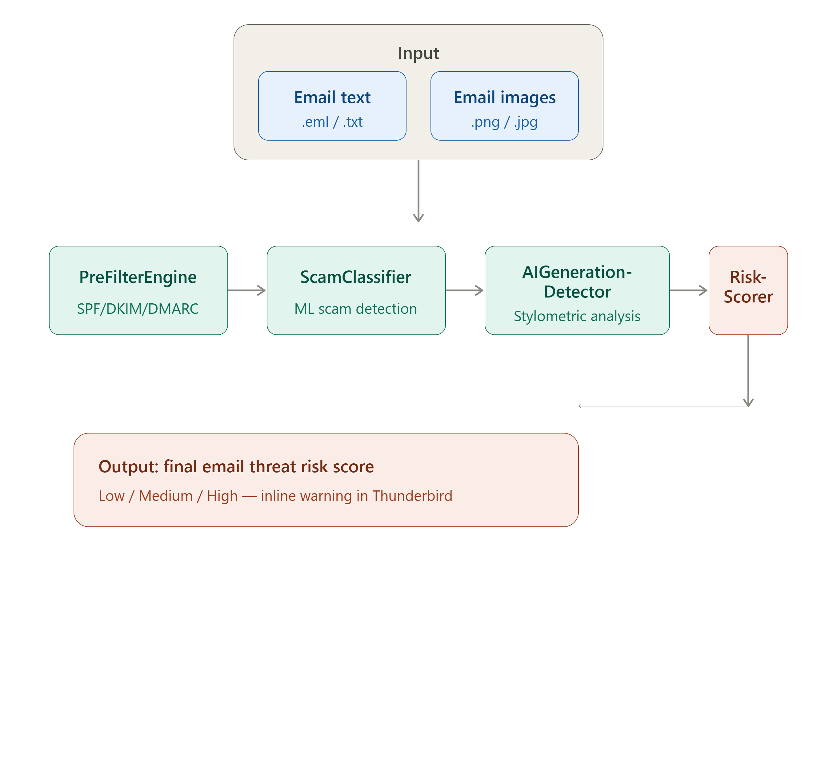
Component 1 Architecture
RP-CS-011 · Progress Presentation 2 · Specializing in Cyber Security
11 / 16

Slide 11
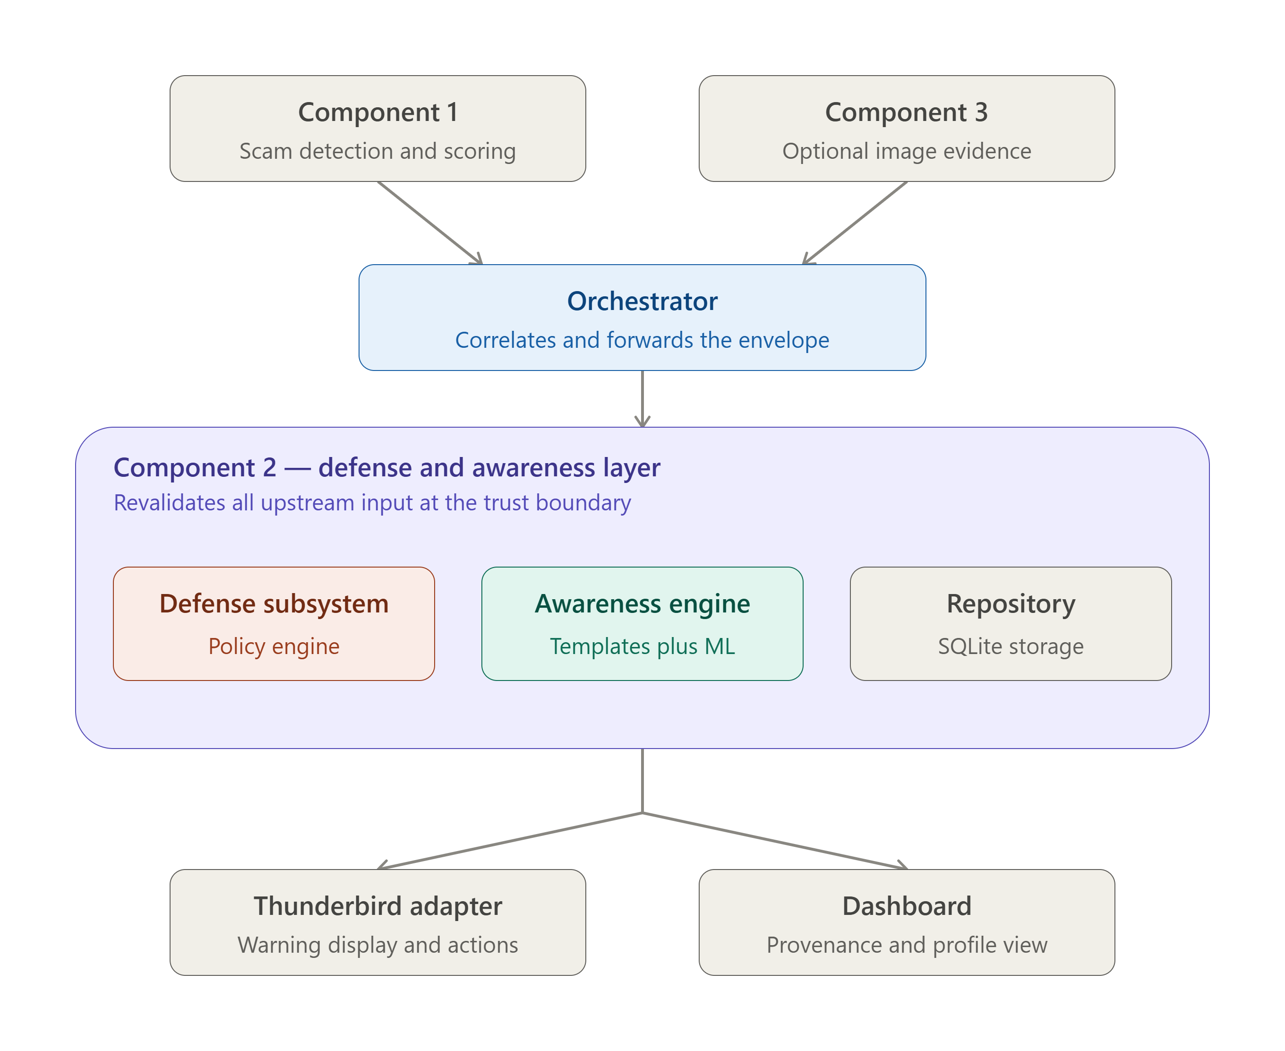
Component 2 Architecture
RP-CS-011 · Progress Presentation 2 · Specializing in Cyber Security
12 / 16

Slide 12
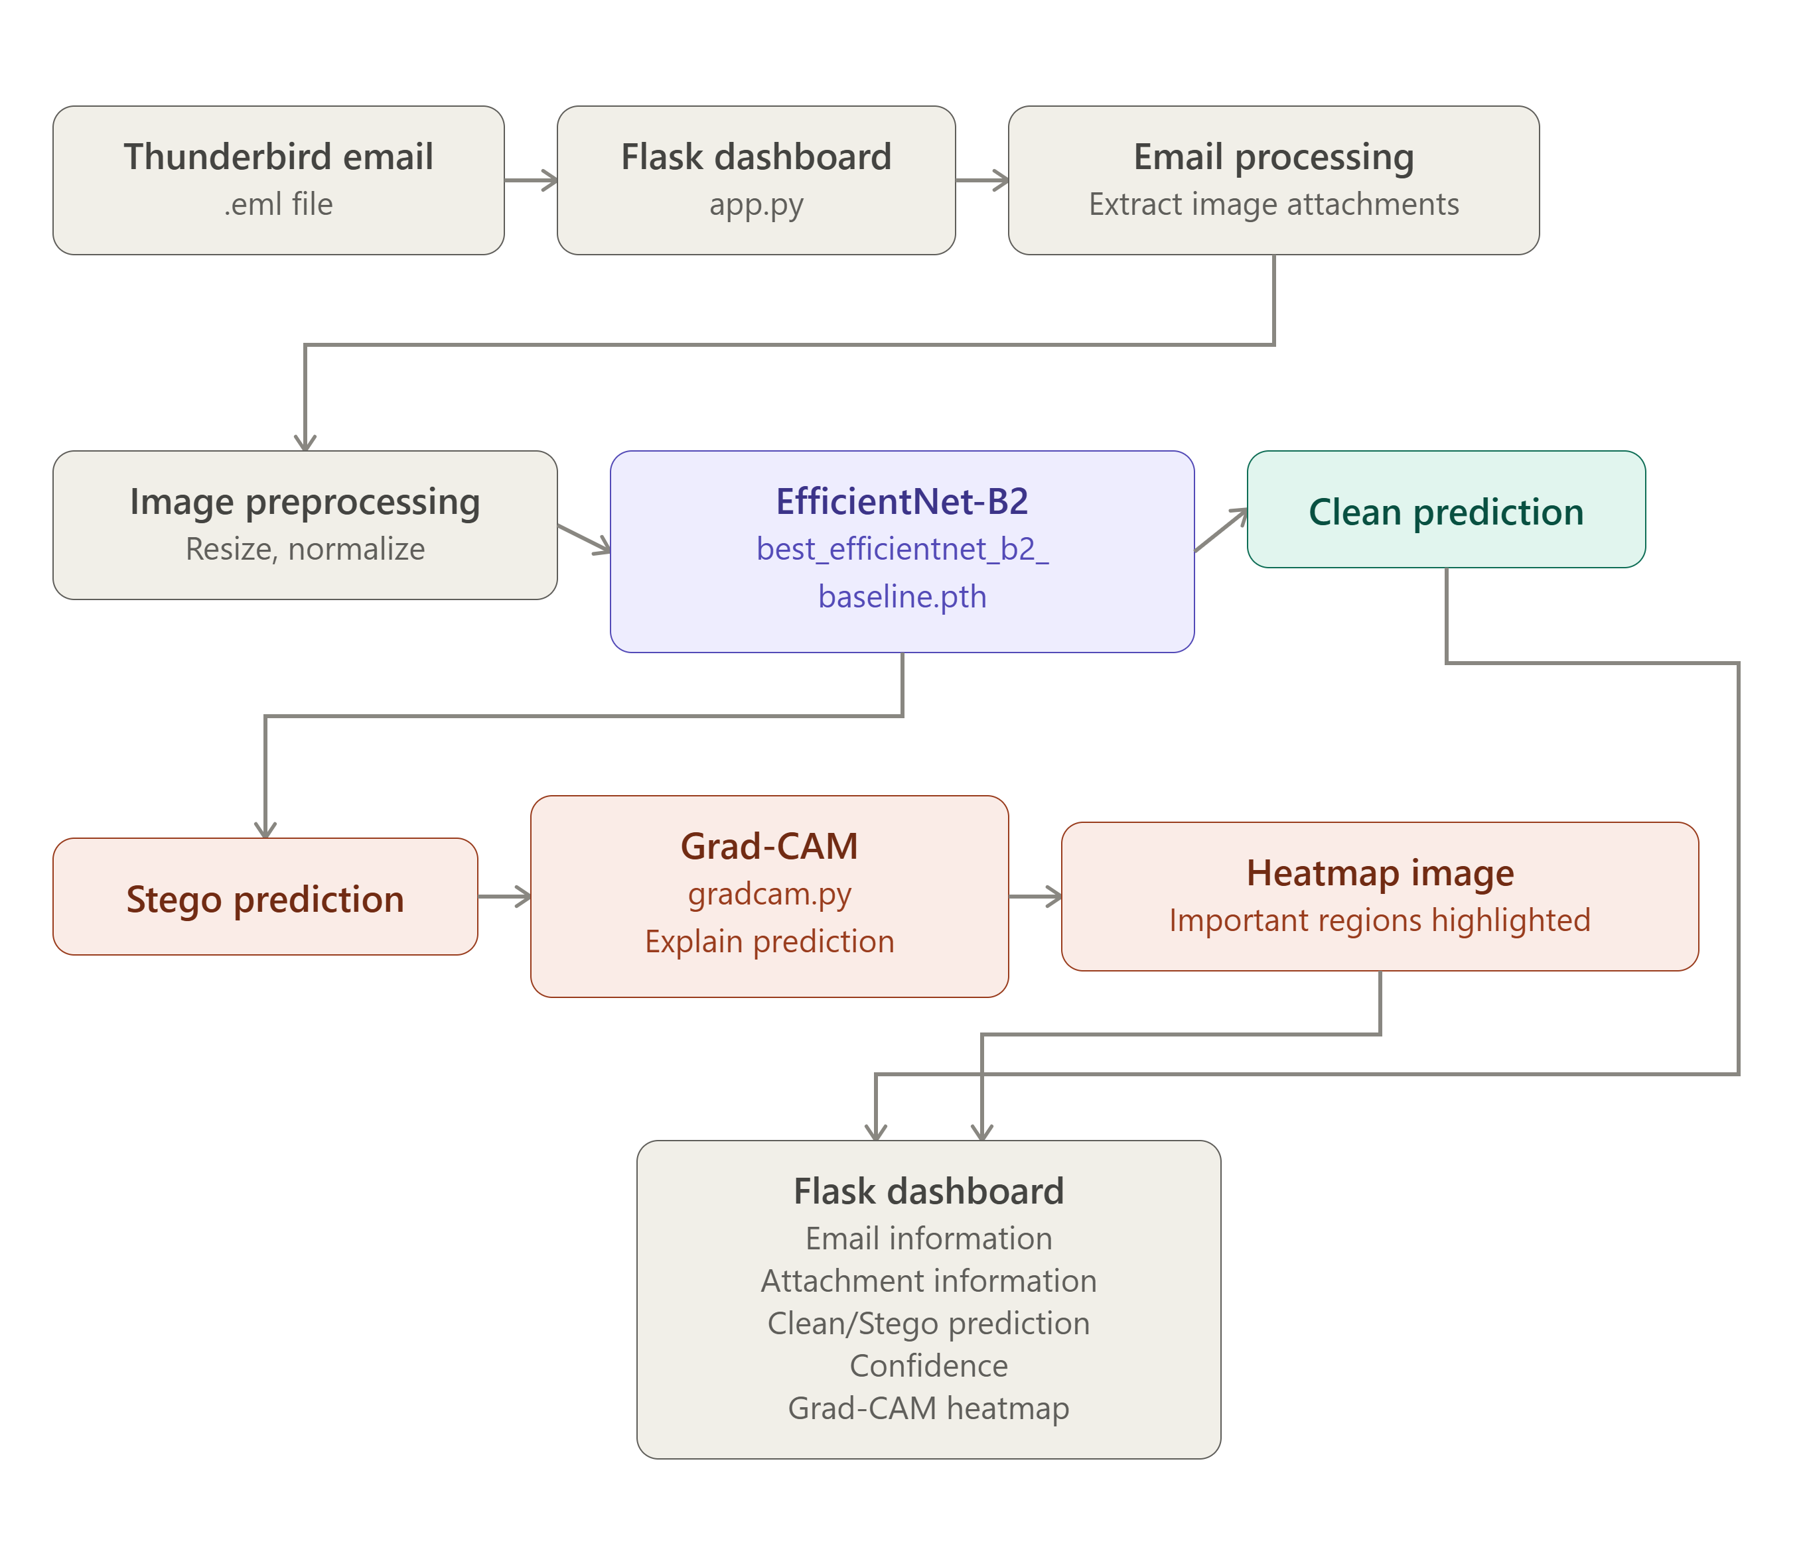
Component 3 Architecture
RP-CS-011 · Progress Presentation 2 · Specializing in Cyber Security
13 / 16

Slide 13
Conclusion
LLM-assisted scams outpace legacy filters and leave users no better equipped for the next attack — this system responds with detection, defensive action, and education combined in one local tool.
Novelty 1: an AI-authorship signal is treated as a first-class detection output, not just scam vs. legitimate.
Novelty 2: an explainable visual-forensics layer brings steganographic image analysis into a consumer email client for the first time.
Novelty 3: defense and education are generated as co-equal, parallel outputs — reducing vulnerability to the next, differently worded attack
Key benefit: every stage runs on one local machine — no email content ever leaves the user's device.
Key benefit: every automated verdict is paired with a plain-language explanation, not delivered as an opaque label.
Industry relevance: a zero-cloud-dependency model fits SMEs and privacy- or compliance-sensitive organizations that cloud-based tools cannot serve.
Business relevance: low infrastructure cost and a staged pilot-to-adoption path make the system realistically deployable, not just a research prototype.
RP-CS-011 · Progress Presentation 2 · Specializing in Cyber Security
14 / 16

Slide 14
Thank you …!!
. .
. .
RP-CS-011 · Progress Presentation 2 · Specializing in Cyber Security
15 / 16

Slide 15
Q / A ?
. .
. .
RP-CS-011 · Progress Presentation 2 · Specializing in Cyber Security
16 / 16

