Slide 1
Efficiently Reconstructing Dynamic Scenes One D4RT at a Time
Chuhan Zhang Guillaume Le Moing Skanda Koppula Ignacio Rocco Liliane Momeni Junyu Xie Shuyang Sun Rahul Sukthankar Joëlle K. Barral Raia Hadsell Zoubin Ghahramani Andrew Zisserman Junlin Zhang Mehdi S. M. Sajjadi
Google DeepMind ⋄University College London ◦University of Oxford
CVPR’26

Slide 2
Motivation
Traditional 3D reconstruction asks: ‘What is the geometry of everything, everywhere, all at once?’ We argue this exhaustive, rigid approach is fundamentally ill-equipped for a dynamic world. Despite the clear need for unified 4D understanding, leading approaches often tackle the problem by dividing it into discrete, task-specific components.

Slide 3
Related work
MegaSaM (CVPR’25): relies on a complex mosaic of off-the-shelf models to separately estimate mono-depth, metric depth, and motion segmentation. Fusing these disparate signals requires computationally expensive test- time optimization to enforce geometric consistency.
VGGT (CVPR’25): employs separate, specialized decoders for distinct modalities.
SpatialTrackerV2 (ICCV’25): incorporates dynamics, it still lacks a unified, single-stage formulation, instead relying on costly iterative refinement.

Slide 4
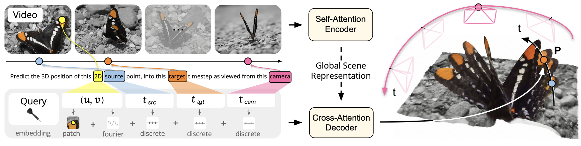
Method
We propose shifting the paradigm from fragmented, frame-level decoding to efficient, on-demand querying.
We introduce D4RT, a feedforward method leveraging a flexible and scalable architecture to achieve full 4D reconstruction.

Slide 5


Method - D4RT Framework
Latent global scene representation:
We define a query q = (u, v, t_{src}, t_{tgt}, t_{cam}), where (u, v, t_{src}) correspond to source parameters and (t_{tgt}, t_{cam}) correspond to target parameters.
Each query q is processed fully independently with the video features F to produce its corresponding 3D point position P:

Slide 6
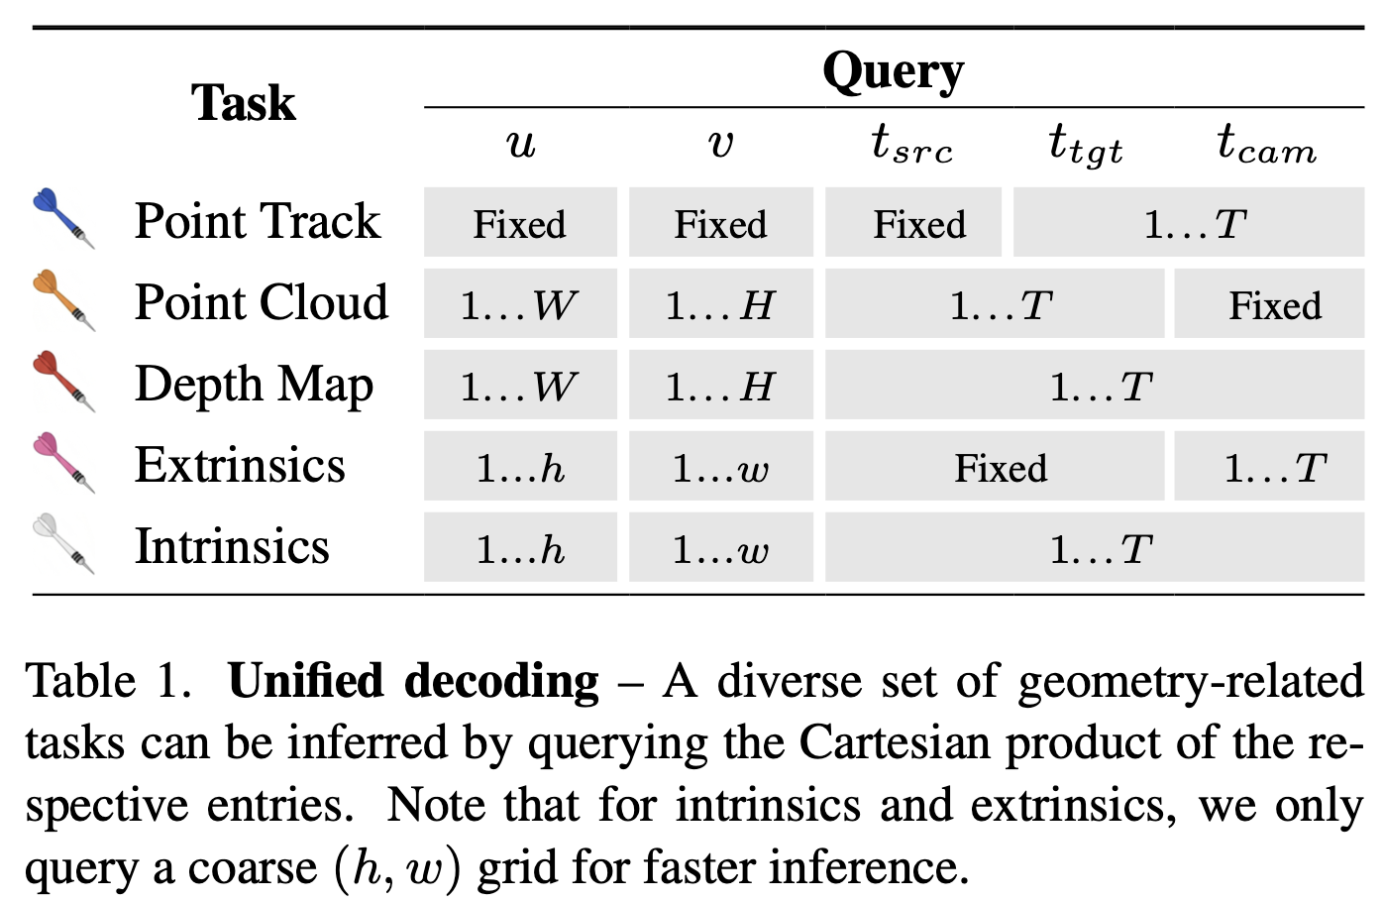


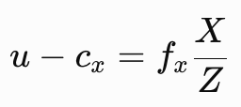
Method - D4RT framework
q = (u, v, t_{src}, t_{tgt}, t_{cam})
From query to 4D reconstruction.
Extrinsics:
Intrinsics:

Slide 7
Method - Model architecture
Our encoder E is based on the ViT with interleaved local frame-wise, and global self-attention layers.
The decoder D is a small cross-attention transformer. A query token is first constructed by adding the Fourier feature embedding of the 2D coordinates (u, v) to the learned discrete timestep embeddings for t_{src}, t_{tgt}, and t_{cam}. Augmenting the query with an embedding of the local 9×9 pixel RGB patch centered at (u, v) dramatically improves performance.

Slide 8
Method - Training and inference
The primary supervision signal is derived from an L1 loss applied to the normalized 3D point position P.
We also supervise a set of auxiliary predictions from additional linear projections on the decoder output: An L1 loss on 2D coordinates of the point positions in image space; cosine similarity for 3D surface normals; binary cross-entropy for target point visibility; and L1 on the vector of point motion.

Slide 9
Experiments
Training setup
  Our training mixture contains public and internal datasets including BlendedMVS, Co3Dv2, Dynamic Replica, Kubric, MVS-Synth, PointOdyssey, ScanNet++, ScanNet, Tartanair, VirtualKitti, and Waymo Open.
  We train on 48-frame clips at 256×256 resolution, decoding 2048 random queries that are oversampled on specific regions for more efficient training. The model is trained for 500 k steps using the AdamW optimizer with a local batch size of 1 across 64 TPU chips, taking a total of just over 2 days to complete.

Slide 10
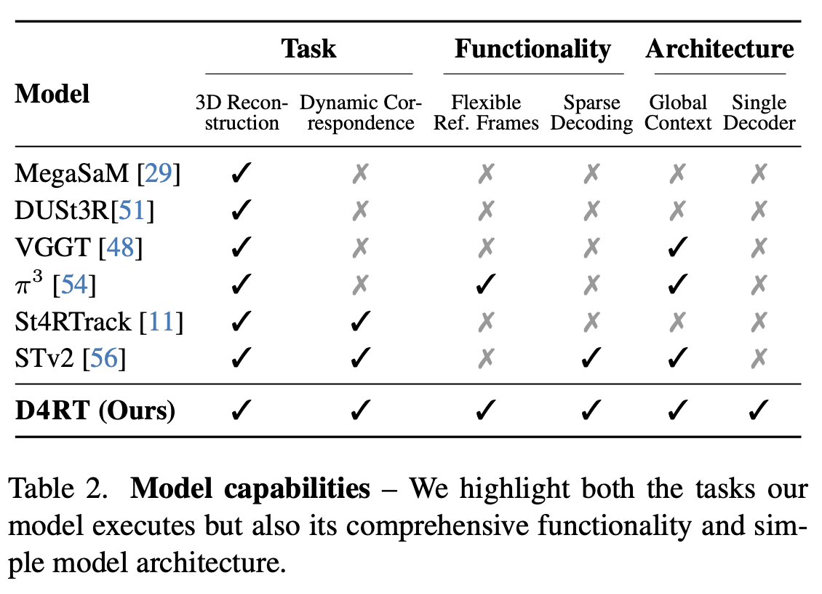
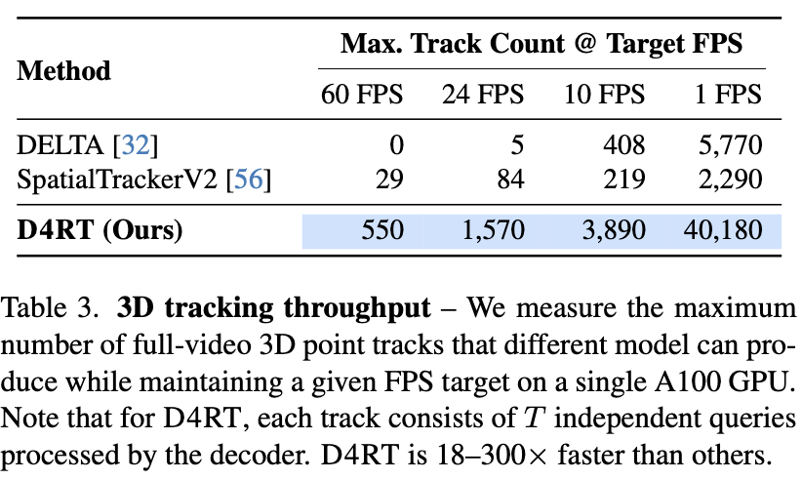
Experiments

Slide 11
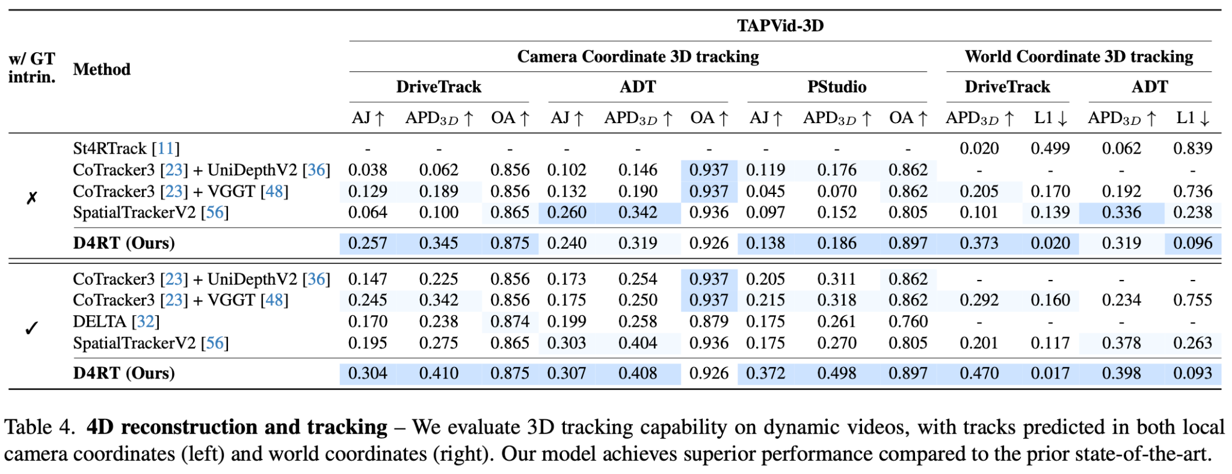
Experiments
Task 1: 4D reconstruction and tracking

Slide 12
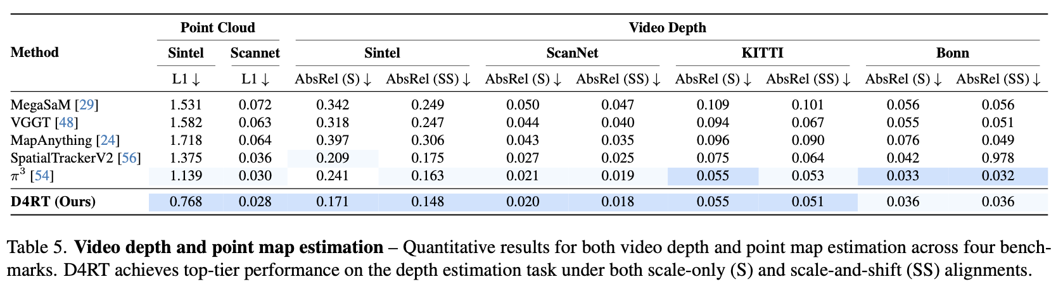
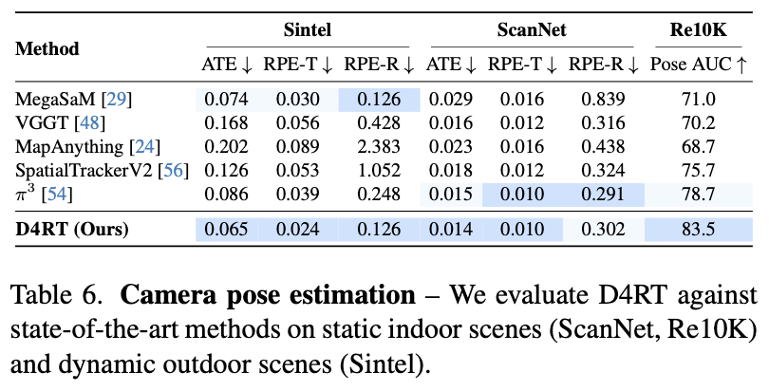
Experiments
Absolute Translation Error (ATE)
Relative Translation Error (RPE trans)
Relative Rotation Error (RPE rot)
Task 2: 3D reconstruction (depth estimation + camera pose estimation)

Slide 13
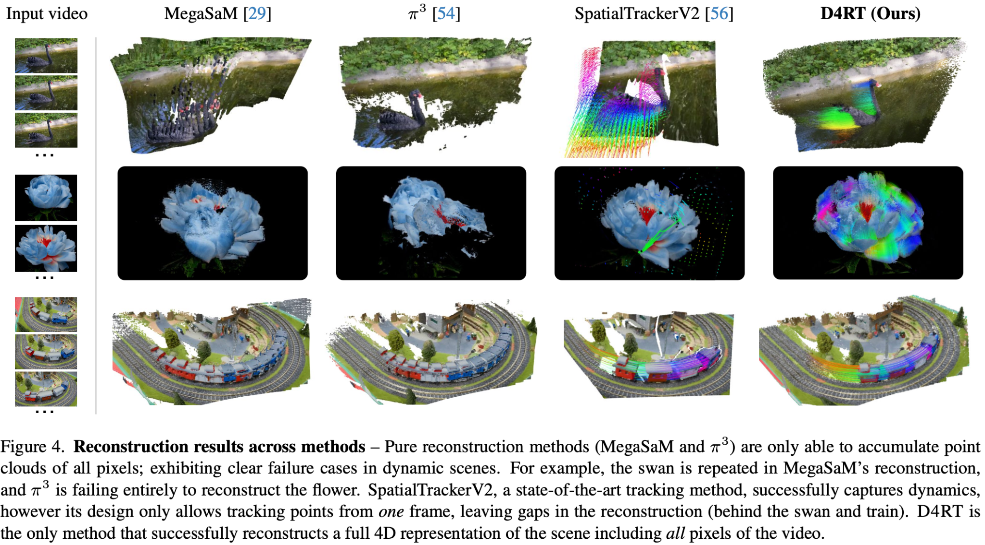
Experiments

Slide 14
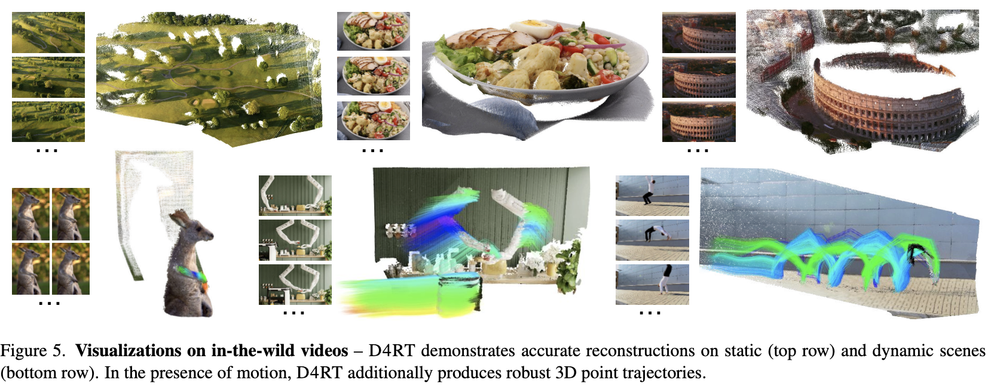
Experiments

Slide 15
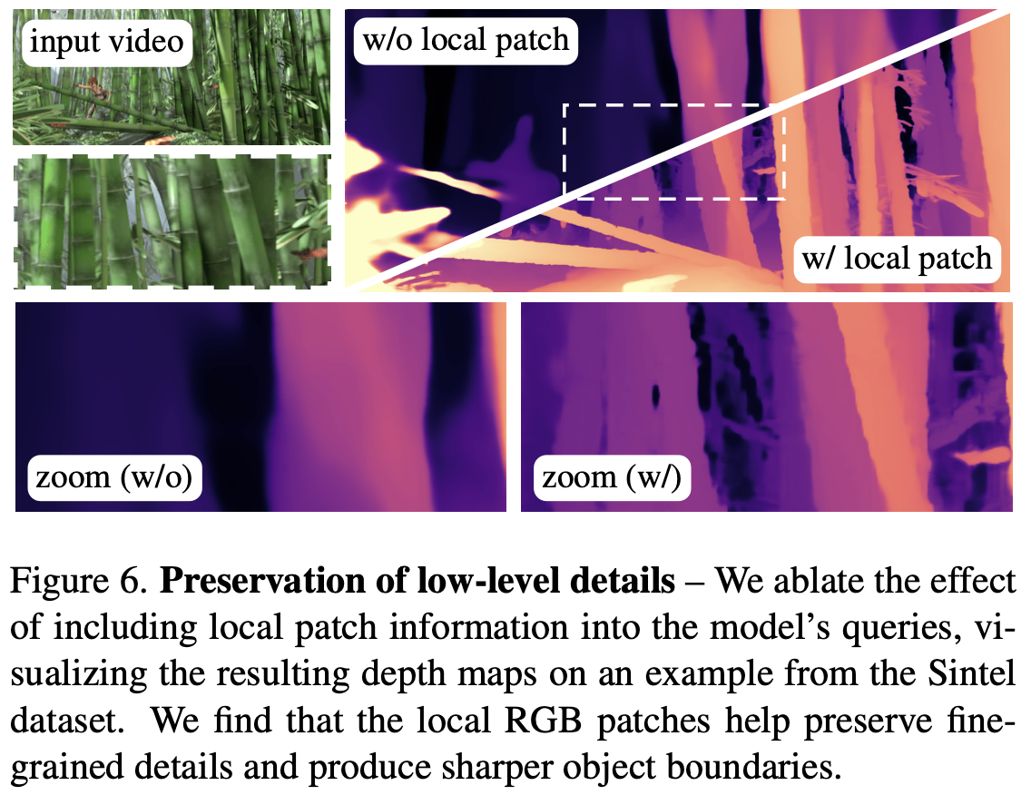
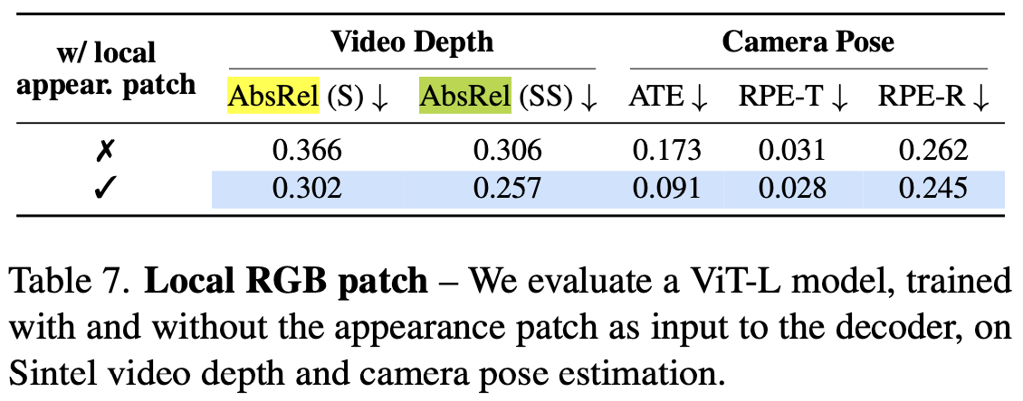
Experiments - ablation study

Slide 16
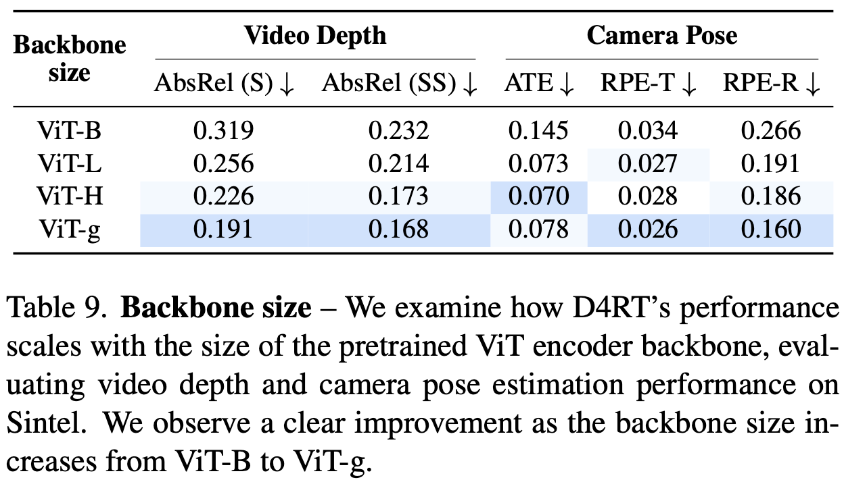
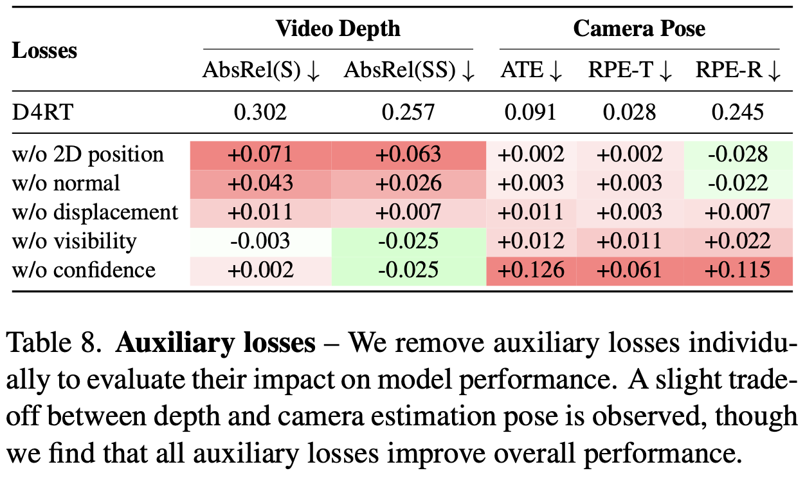
Experiments - ablation study
Encoder size
Auxiliary losses

Slide 17
Takeaway
How to reframe a classic problem with novel techniques
  Query based 4D reconstruction
Network design: end-to-end; simple yet effective; capable of multiple tasks
Network visualization

