Slide 1
Stronger, Fewer, & Superior: Harnessing Vision Foundation Models for Domain Generalized Semantic Segmentation
University of Science and Technology of China
CVPR 2024
Presenter: Jingjing Li
2024.05.27

Slide 2
Domain Generalized Semantic Segmentation, DGSS
> DGSS
DGSS focuses on improving prediction accuracy across multiple unseen domains without accessing their data, thus enabling a high generalization for real applications
> Traditional methods
complex data augmentation approaches
domain invariant feature extraction strategies
classic backbones, e.g., VGGNet, MobileNetV2, and ResNet.
> Vision Foundation Models (VFMs)
CLIP, MAE, SAM, EVA02, and DINOv2
How do VFMs perform in the context of DGSS?
How to harness VFMs for DGSS?

Slide 3
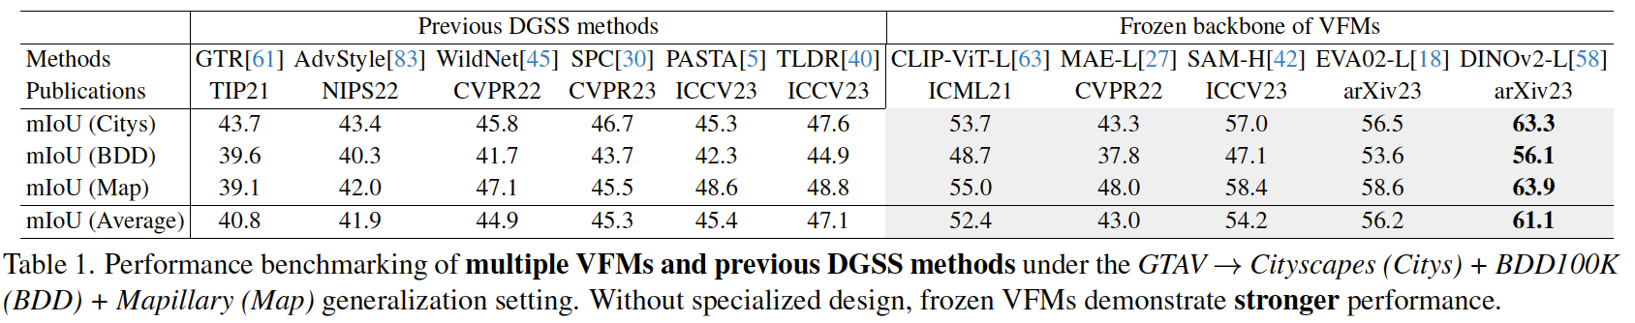
How do VFMs perform in DGSS?
Image encoders from VFMs as backbone for feature extraction
Couple with a decode head, i.e., Mask2Former, to generate semantic predictions
While previous DGSS methods have showcased commendable results, they perform less effectively compared to frozen VFMs.
VFMs serve as Stronger backbones

Slide 4
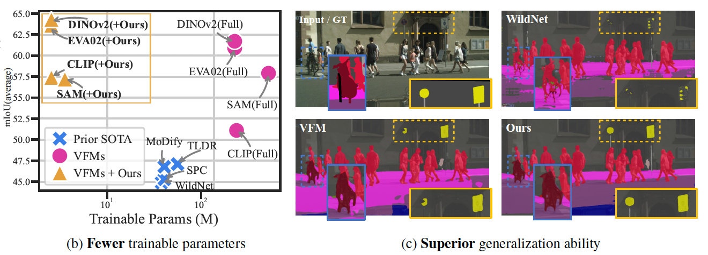
Fine-tune VFMs for DGSS?
Challenges:
Datasets: The datasets commonly used in DGSS tasks are significantly smaller in scale
Parameters: fine-tuning VFMs with their huge number of trainable parameters on these datasets result in limited generalizability.
Solution:
fine-tuning VFMs with fewer trainable parameters.
introduce a robust and efficient fine-tuning approach, namely “Rein”.
achieve superior generalizability with fewer trainable parameters within backbones

Slide 5
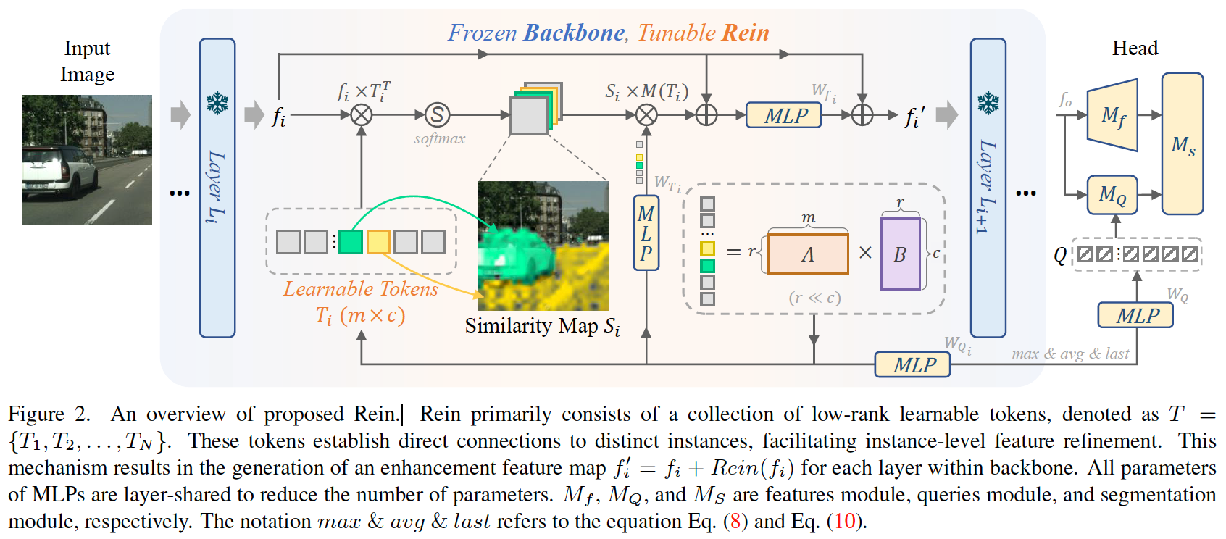
An overview of Rein.
Key designs:
a set of randomly initialized tokens, each directly linked to different instances.
These tokens, through a dot product operation with VFMs features, generate an attention-like similarity map
This map enables Rein to perform precise refinement tailored to each instance within an image, significantly boosting VFMs in the context of DGSS
to reduce the number of trainable parameters, we employ shared weights across MLPs in different layers
design our learnable tokens by multiplying two low-rank matrices.

Slide 6
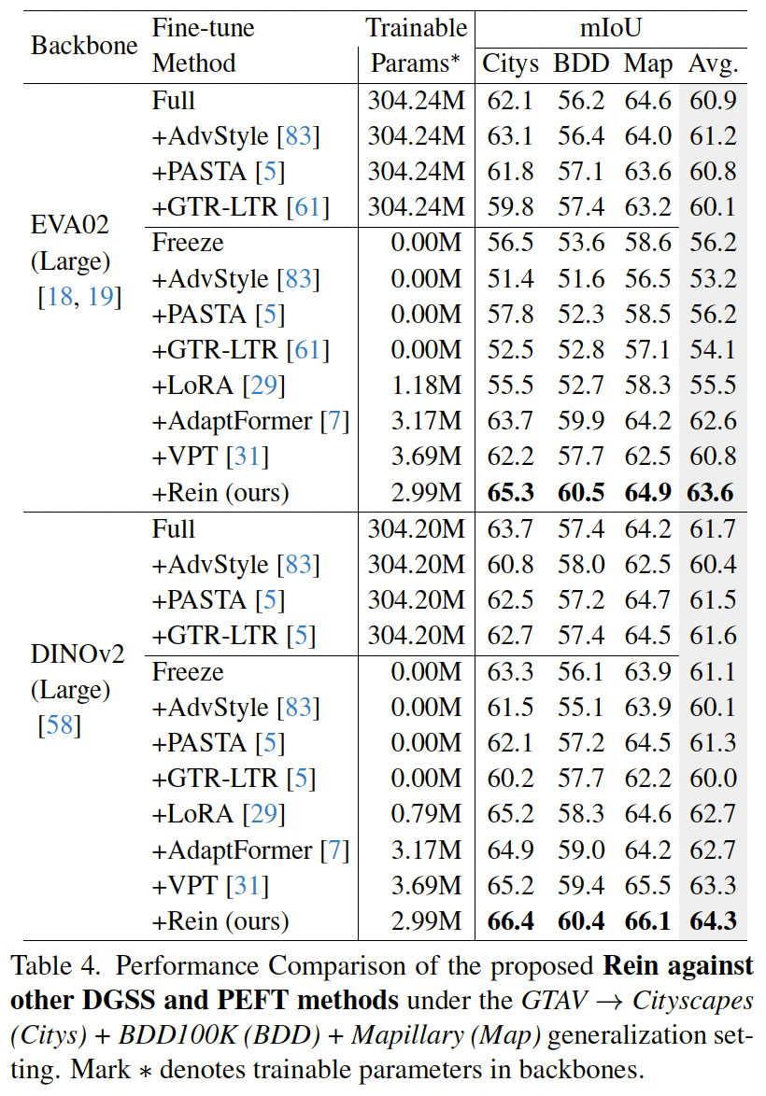
Comparing Rein with SOTA.
Observations:
Rein is benchmarked against state-of-the-art (SOTA) methods, which can be classified into two groups, including domain generalized semantic segmentation (DGSS) methods, and parameter-efficient fine-tuning (PEFT) approaches
Rein achieves superior performance and surpass previous DGSS and PEFT methods.
Owing to the robust feature extraction capabilities inherent in VFMs, DGSS methods, which typically enhance generalizability through strong data augmentation or consistency constraints, (e.g., AdvStyle, PASTA, and GTR), do not exhibit significant performance improvement.

Slide 7
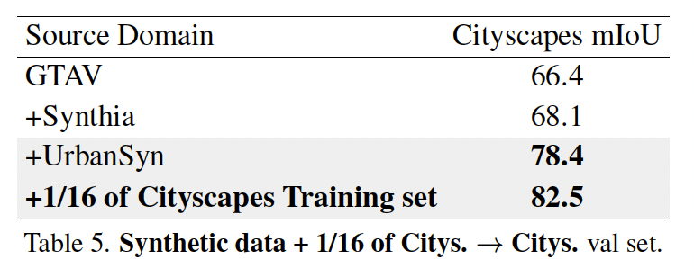
Synthetic-to-real generalization of Rein
Observations:
trained on synthetic UrbanSyn+GTAV+Synthia datasets, Rein achieved a 78.4% mIoU on the Cityscapes validation set.
This result can also be a valuable pre-trained weight for data-efficient training, reaching an 82.5% mIoU with 1/16 of Cityscapes training set.

Slide 8
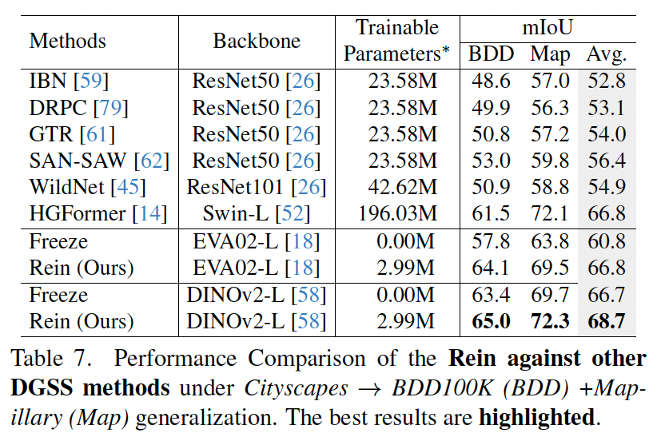
Real-to-Real generalization of Rein.

Slide 9
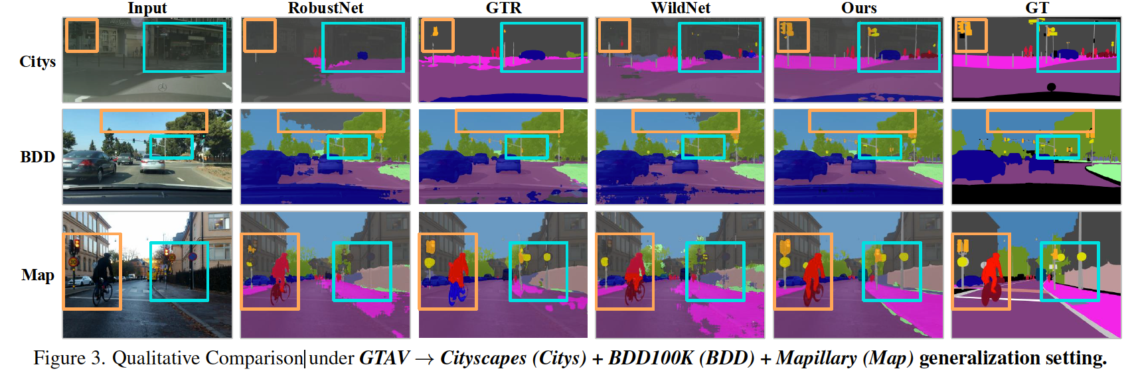
Qualitative Comparison

Slide 10
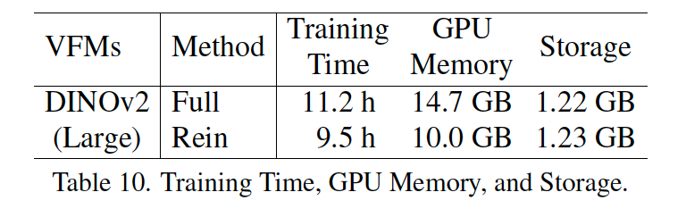
Speed, memory, and storage.
Observations:
compared to “Full” baseline, proposed Rein improves training speed and reduces GPU memory usage.

Slide 11
Summary
investigate the performance of VFMs under diverse DGSS settings.
introduce a robust fine-tuning approach, namely Rein, to parameter-efficiently harness VFMs for DGSS.
With a fewer trainable parameters, Rein significantly enhance generalizability of VFMs, outperforming SOTA methods by a large margin.
Rein can be seamlessly integrated as a plug-and-play adapter for existing VFMs, improving generalization with efficient training.

Slide 12
Thanks!

