Slide 1
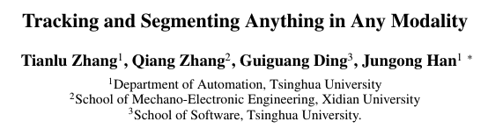
Journal Club
Tracking and Segmenting Anything in Any Modality
AAAI 2026
Reporter: Pengyu Zhang
Date: March 10 2026

Slide 2
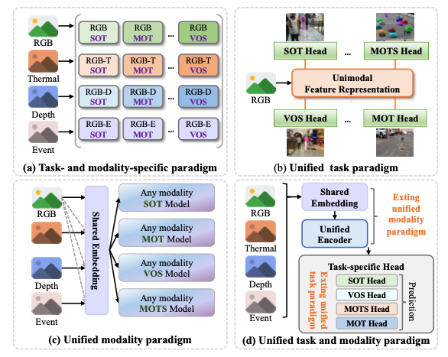
Motivation and Contribution
Existing frameworks handle specific task and modality individually by designing a single model. The feature distribution gap across different modalities and tasks will hinder the learning process of the unified model.
In this paper, a universal tracking and segmentation framework, that unifies a broad spectrum of tracking and segmentation subtasks with any modality input.
Zhang et al.(Tsinghua University) Tracking and Segmenting Anything in Any Modality. In AAAI 26.

Slide 3
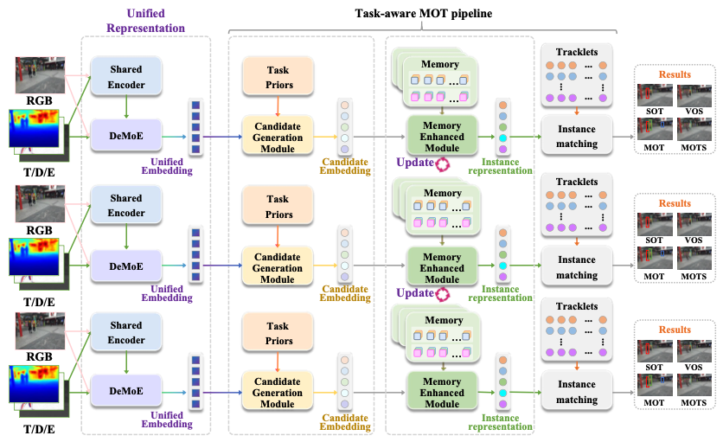
Overall Framework
Unified Representation Learning: Taken RGB and auxiliary modality(thermal, depth or event) as input, the shared and Decoupled Mixture-of-Expert (DeMoE) are introduced to learn both shared and modality-specific representation.
Task-aware MOT pipeline: Based on SAM2, the instance representation are matched and updated to output various formats of results.

Slide 4
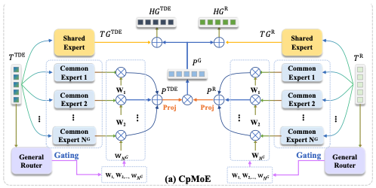


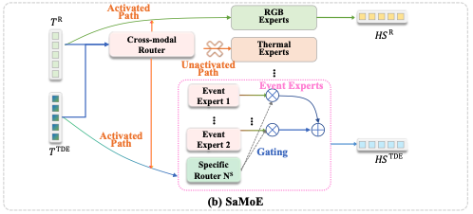


Decoupled Mixture-of-Expert (DeMoE)
Common-prompt Mixture of Expert
The Mixture of Common Experts learns the modality representation and then interact with the representation from other modalities.
Then, the features from shared expert and common experts are fused.
Specific-activated Mixture of Expert
Common-prompt Mixture of Expert
Each inputs are sent to an activated path to generate modality-specific representation.
Specific-activated Mixture of Expert
Multi-modal Fusion
The final features are obtained by fusing features from encoder and both MoEs.

Slide 5
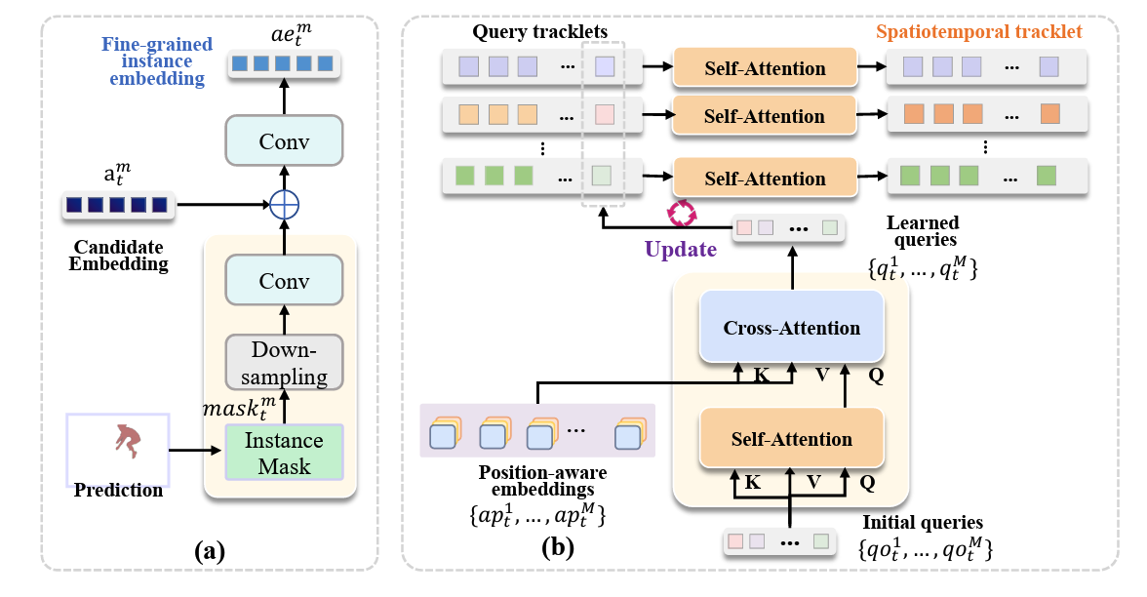
Task-aware MOT Pipeline
Candidate Generation Module
It generates instance embedding using the initial information (bounding box or mask for SOT and VOS) or detection head (candidates for MOT and MOTS)
Memory-enhanced Module
Fine-grained instance embedding: With the guidance of predicted mask, the embedding is further refined to highlight target’s boundary.
Spatiotemporal relationship modeling: The instance embeddings are then updated using objects’ state from previous frames (tracklets).
Instance Matching
The similarity between candidates and tracklets are calculated to generate final results.
Memory-enhanced Module

Slide 6
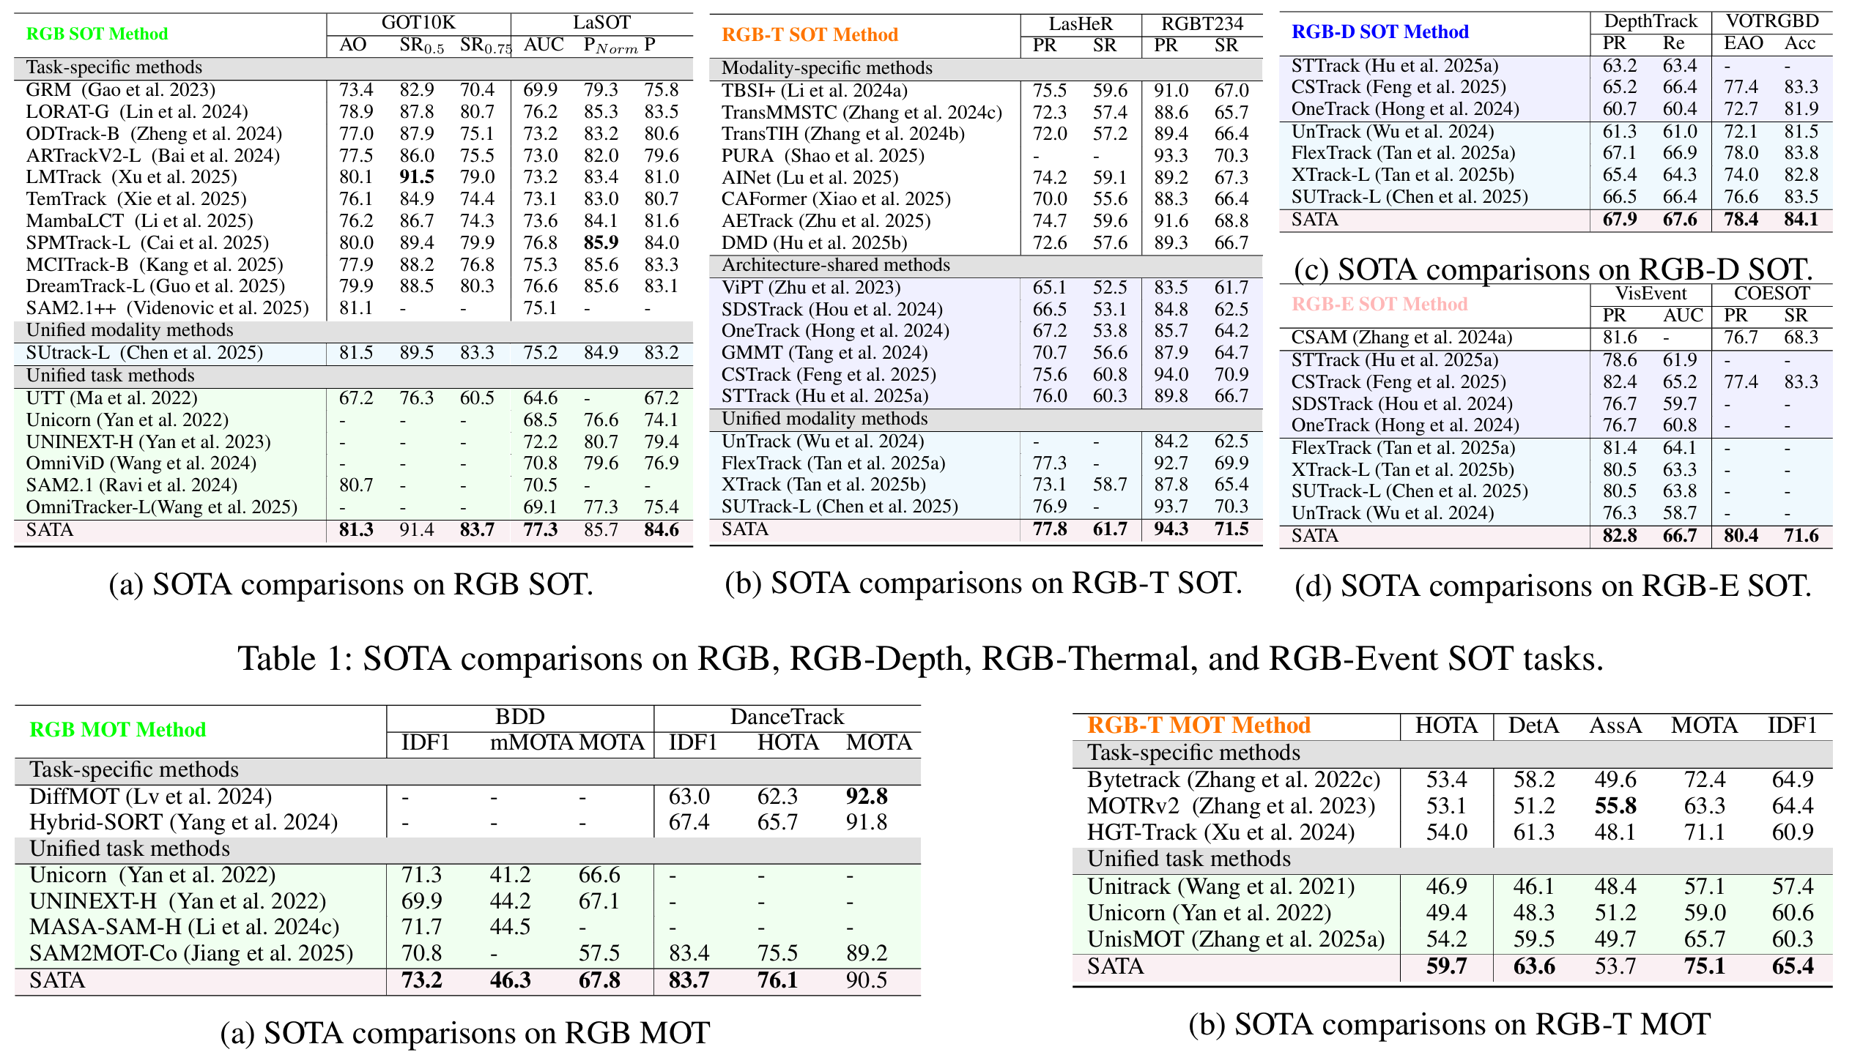
Experiments
Based on the superior performance of SAM2, it achieves SOTA results across various subtasks and benchmarks.
Training cost: 8 x A100

Slide 7
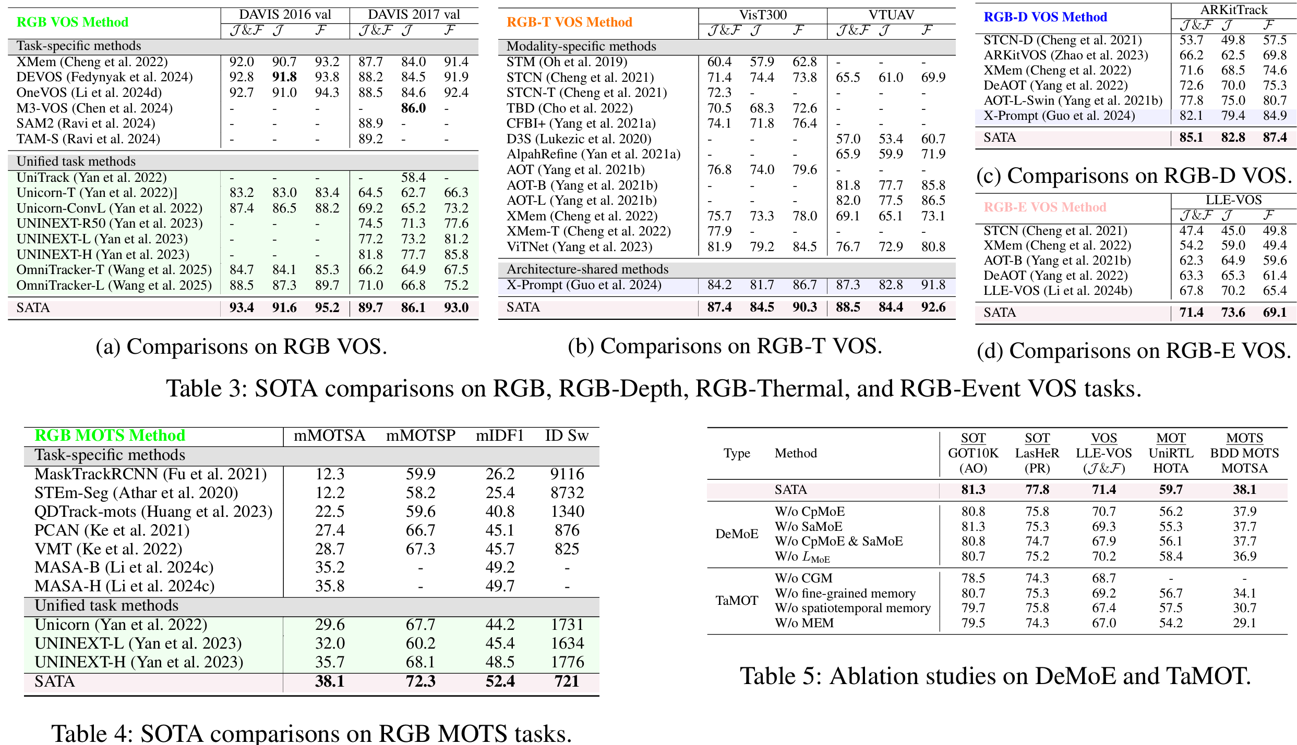
Experiments

Slide 8
Conclusion and Takeaway
SATA build a unified tracking model, obtaining superior performance on 18 tracking benchmarks.
SAM-based model (SAM2 or SAM3) has great potential on build a unified tracking model.
Involving language information towards a more generalized tracking model may the next generation of SATA.

Slide 9
Thanks for Listening
Q & A

