Slide 1
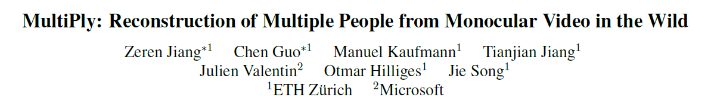
CVPR 2024
Yande Li Sept 20, 2024

Slide 2
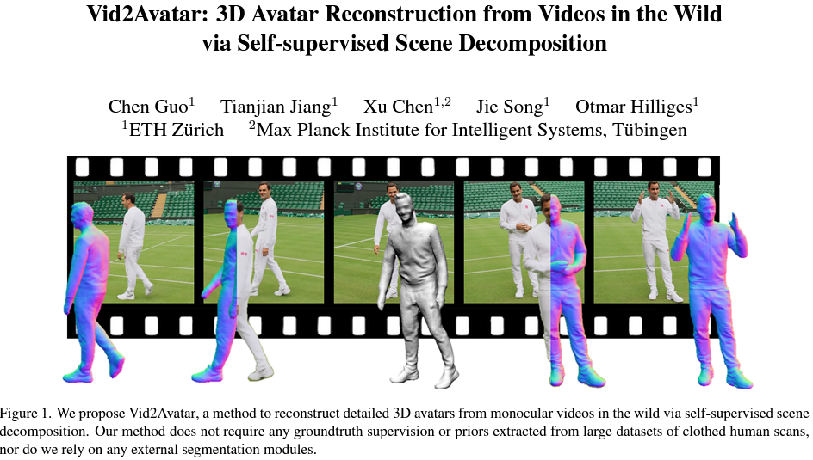
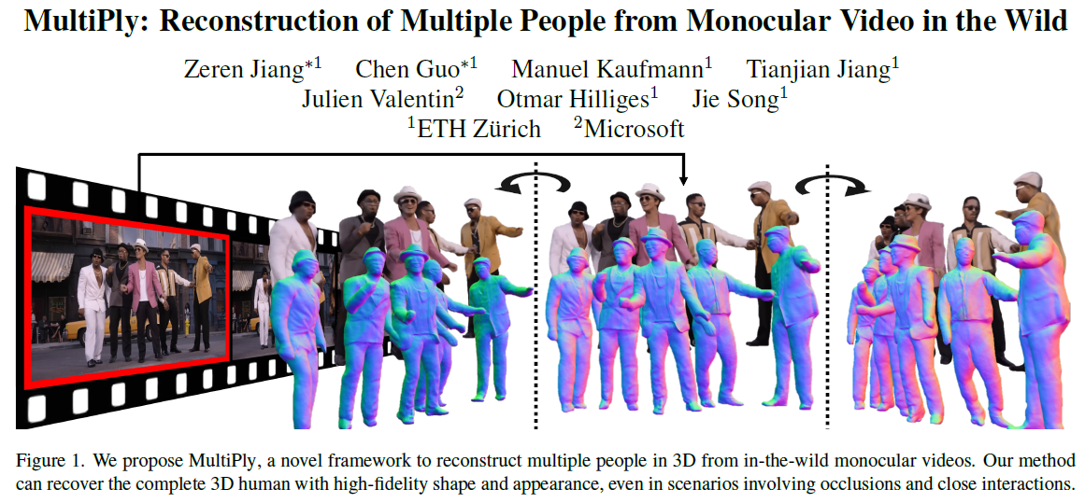
CVPR 2023
CVPR 2024
Notes:
MultiPly, a novel framework to reconstruct multiple people in 3D from monocular in-the-wild videos.
Reconstructing multiple individuals moving and interacting naturally from monocular in-the-wild videos poses a challenging task.
Addressing it needs precise pixel-level disentanglement of individuals without any prior knowledge about the subjects.
Moreover, it requires recovering intricate and complete 3D human shapes from short video sequences.

Slide 3
Main Contribution
A novel framework, MultiPly, to reconstruct multiple detailed 3D human models solely from in-the-wild monocular videos;
A robust instance segmentation approach that achieves a clean separation between people even under close interaction;
A confidence-guided optimization formulation that leads to temporally and spatially coherent 3D reconstructions of people with high fidelity.

Slide 4
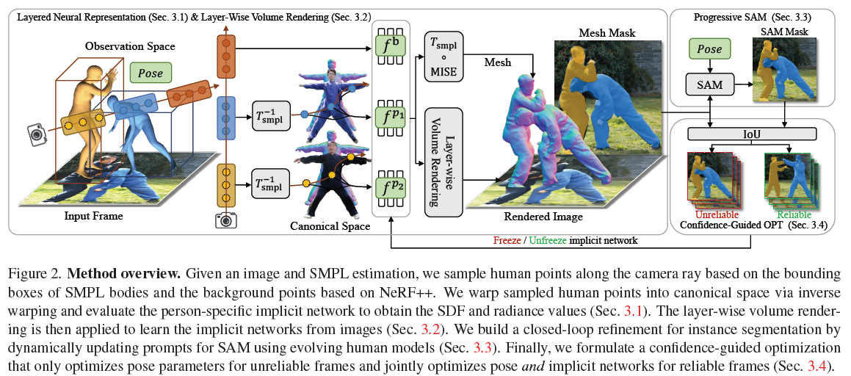
Proposed Method

Slide 5

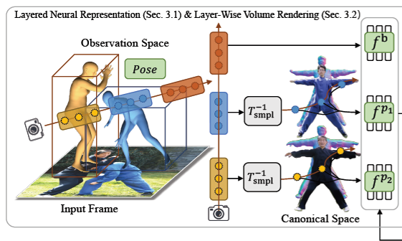



Layered Neural Representation
For each human in the scene, they represent the 3D shape as an implicit signed-distance field (SDF) and the appearance as a texture field in canonical space.
Model the geometry and appearance of each person p in canonical space by a neural network , which predicts the signed distance value and the radiance value at the query point in this space.
Deformation
Linear-blend skinning (LBS) based on SMPL transformation
signed distance value
a neural network
the person’s pose parameters
radiance value
each person
the query point
SMPL-based transformation
Notes:
A canonical point xpc is mapped to the deformed point xpd via linear-blend skinning (LBS) based on SMPL transformation.
Inversely, the point xpd in deformed space canbe mapped to the canonical correspondence xpc.

Slide 6
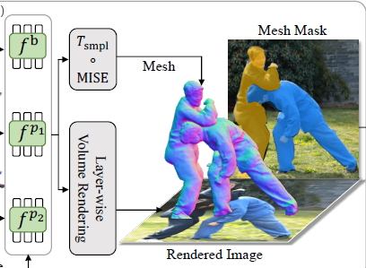





Layer-Wise Volume Rendering
The occupancy for the p-th person and the i-th sampled point is calculated as follows:
where:
represents N points sampled inside the
p-th intersected bounding box.
is the scaled Laplace distribution’s Cumulative Distribution Function (CDF) to convert the signed distance to volume density .
is the distance between two adjacent sample points.
Then they accumulate the radiance by performing numerical quadrature among the layered density field for multiple persons to obtain the color value:
contains all indices of points (belonging to person q) whose depth value is lower than the depth value of the i-th point of person p.
P is the total number of subjects
is the rendered color of humans.
Notes:
We model the background in the same formulation as NeRF++,

Slide 7
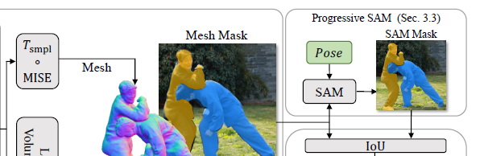




Progressive Prompt for SAM
They apply the Multiresolution IsoSurface Extraction (MISE) to extract the mesh in canonical space:
represents the extracted vertex set in canonical space
denotes the corresponding faces
The deformed vertex set in the observation space is:
The deformed mesh for the p-th person in the observation space is defined as:
To improve efficiency, we opt for a differentiable rasterizer R rather than volume rendering:
instance mask:
serves as one of the prompts for SAM refinement
The point prompts for the p-th subject are then defined by:
3D SMPL keypoints
2D keypoints are obtained by projecting the 3D
keypoint candidates onto the image
Notes:
we propose to leverage the promptable segmentation model SAM [23] and design a progressive prompting strategy based on the evolving human models to provide robust instance segmentation supervision.
the positive point prompts P+ include the 2D keypoints that are inside of the instance mask obtained from the deformed mesh and are outside of the instance masks of all other meshes.
The negative point prompts are the union of all 2D keypoints of all other subjects that are outside of the projected mesh mask Mp-mesh

Slide 8
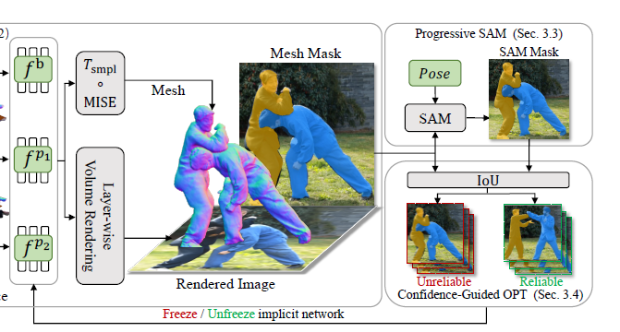


Confidence-Guided Alternating Optimization
To avoid damaging shape updates that are due to wrong poses, they only optimize pose parameters for unreliable frames and jointly optimize pose and shape parameters for reliable frames.
They treat the IoU between the projected mesh mask and the refined SAM mask as their confidence measure for the p-th subject in frame i. We define reliable frames Ir to be those frames with reliable poses based on the average IoU over all subjects:
Notes:
Human-human occlusions often lead to inaccurate pose and wrong depth order estimation. A na¨ıve joint optimization for both the pose and shape parameters may end up with a suboptimal solution. To mitigate this, we introduce a
confidence-guided optimization strategy to alternately optimize the human poses and shapes.

Slide 9


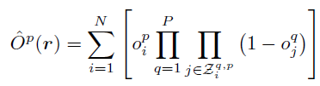



Objectives
Reconstruction Loss
Instance Mask Loss
Eikonal Loss
Depth Order Loss
Interpenetration Loss

Slide 10
Datasets
Hi4D
This dataset contains challenging human interactions between pairs of people with ground truth meshes, human poses, and instance segmentation masks. We use Hi4D to evaluate our approach to all tasks.
Monocular Multi-huMan (MMM).
This dataset is collected by using a hand-held smartphone, which contains six sequences with two to four persons in each sequence. Half of the sequences are captured in the stage with ground truth annotations for quantitative evaluation and the others are captured in the wild for qualitative evaluation.
Notes:
Since the Hi4D dataset only contains two-person interactions with the static camera in the stage. In order to evaluate the generalization of our method, we collect a dataset called Monocular MultihuMan (MMM)

Slide 11
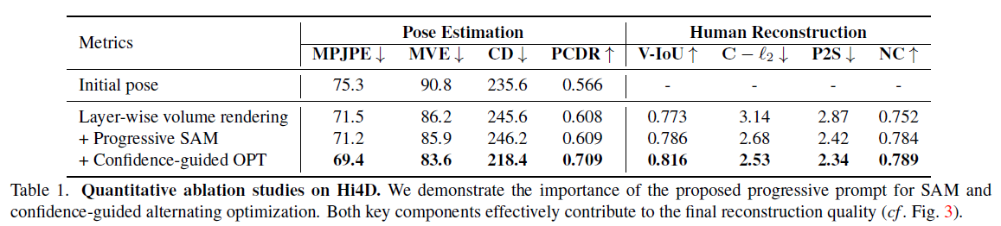
Quantitative Ablation Results
Human Pose Estimation Metrics
Mesh Reconstruction Metrics:
MPJPE [mm],
MVE [mm],
Contact Distance (CD)[mm],
Percentage of Correct Depth Relations (PCDR)
Volumetric IoU (V-IoU)
Chamfer distance (C − ℓ2) [cm]
Point-to-surface distance (P2S) [cm]
Normal consistency (NC).
Note: The initial human poses are obtained from TRACE and ViTPose.
Notes:
Some ablation studies were conducted to demonstrate the effectiveness of the proposed progressive SAM prompt and confidence-guided optimization strategy.
Both pose estimation and human reconstruction tasks are evaluated here.
Applying instance mask supervision based on progressively refined SAM outputs significantly improves the output quality and drastically reduces the reconstruction error

Slide 12
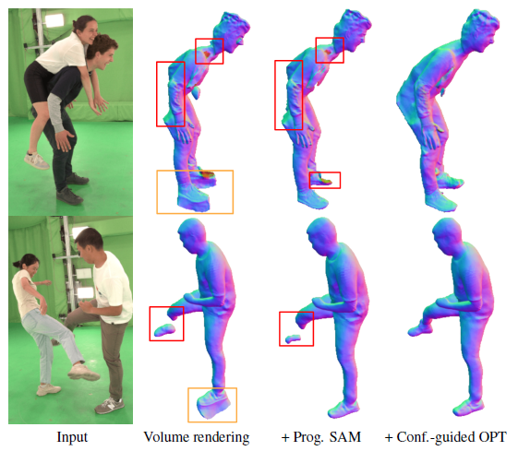
Qualitative Ablation Results
Figure 3. Qualitative ablation studies. Our progressive prompting strategy provides robust instance segmentation supervision and eliminates the noises caused by the environmental dynamic effects. The confidence-guided optimization further improves the reconstruction results and maintains complete human bodies.
Notes:
The qualitative results within the orange bounding boxes highlighted the effectives of refined SAM.
And the red bounding boxes serve as visual evidence for the importance of our confidence-guided optimization. The presence of incomplete human bodies, such as the broken leg, disappeared back, and shrunken neck, is attributed to the incorrect depth order and pose estimation error.
By temporarily freezing the implicit network for frames with unreliable poses, we circumvent such detrimental shape updates, leading to a complete human reconstruction.

Slide 13
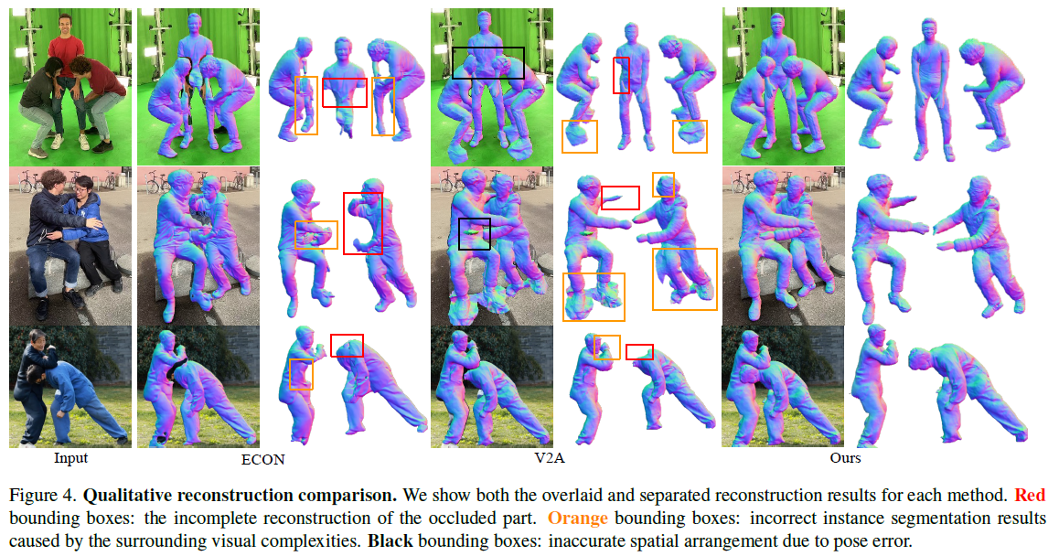
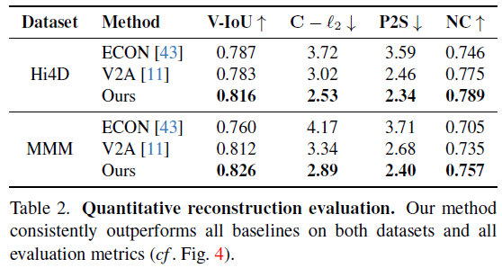
Reconstruction Comparisons
Notes:
there are few video-based reconstruction methods designed for clothed multiple people. Hence, we adapt two state-of-the-art reconstruction approaches to our setting for comparison.
ECON (CVPR 23) is an image-based 3D human reconstruction method capable of handling multi-person scenarios.
Vid2Avatar (CVPR23) is a video-based human reconstruction method designed for a single person. We extend V2A to multi-person scenarios by training a distinct model for each subject individually.
This disparity becomes more visible in qualitative comparisons:
When people closely interact, both ECON and V2A fail to recover complete human bodies but only output corrupted reconstructions (e.g., missing legs/heads).
In contrast, our method generates complete human shapes with sharp boundaries and spatially coherent 3D reconstructions. We attribute this superiority to our proposed representation design and learning schemes.

Slide 14
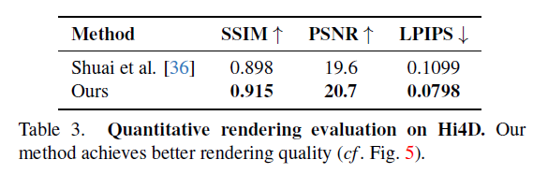
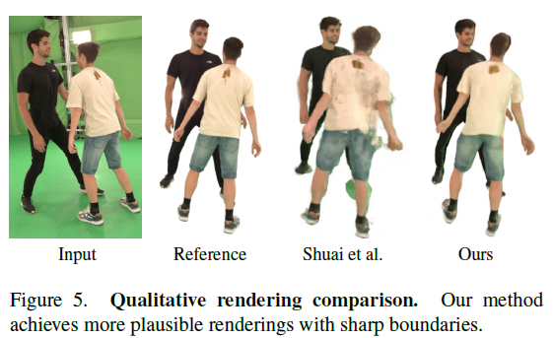
Novel View Synthesis Comparisons
Notes:
There are few novel view synthesis approaches particularly designed for clothed multiple people from monocular video. Hence, we adapt Shuai et al. [SIGGRAPH 22], which is a state-of-the-art multi-person novel view synthesis approach from multi-view videos, to the monocular setting for a fair comparison.
the rendered image from [36] is more blurry and has noisy artifacts compared to ours.
it lacks a reliable pose correction mechanism, leading to large inconsistency between human pose and image information during training;
2) weekly-supervised decomposition cannot ensure robust instance segmentation under close human interaction.
Our framework generates more plausible renderings with clearly sharp boundaries.

Slide 15
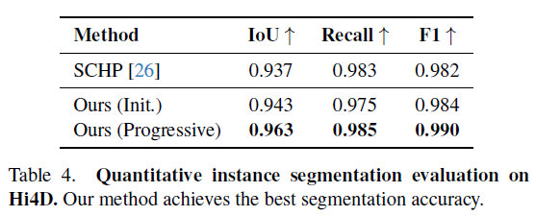
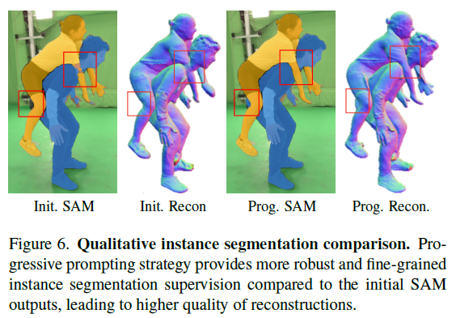
Instance Segmentation Comparisons
Notes:
We compare our instance segmentation result from SAM after convergence with pretrained human instance segmentation network SCHP.
Tab. 4 reveals that our initial SAM outputs achieve comparable results with SCHP,
However, the initial SAM masks are unsatisfactory due to the noisy prompt from the inaccurate SMPL estimation, leading to an incomplete and implausible reconstruction result (e.g., the missing body part and self-interpenetration in the red bounding boxes)
our progressive prompting strategy based on our evolving human models helps to achieve temporally consistent and complete segmentation masks and high-quality reconstructions, surpassing the baseline methods.

Slide 16
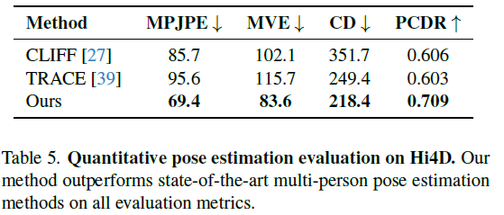
Pose Estimation Comparisons
Notes:
multi-person pose estimation approaches.
bottom-up (TRACE CVPR 23)
top-down (CLIFF [ECCV 22])
our method shows its superiority in pose estimation accuracy of individuals (MPJPE and MVE) and more reasonable spatial arrangement between pairs of people (CD and PCDR).

Slide 17
Limitations
The complexity of our model increases linearly with the number of involved persons, making it inefficient for crowds.
The method does not explicitly model hands and we see the integration of an expressive human model as a future direction.

Slide 18
Thanks for Listening
Notes:
.

