Slide 1
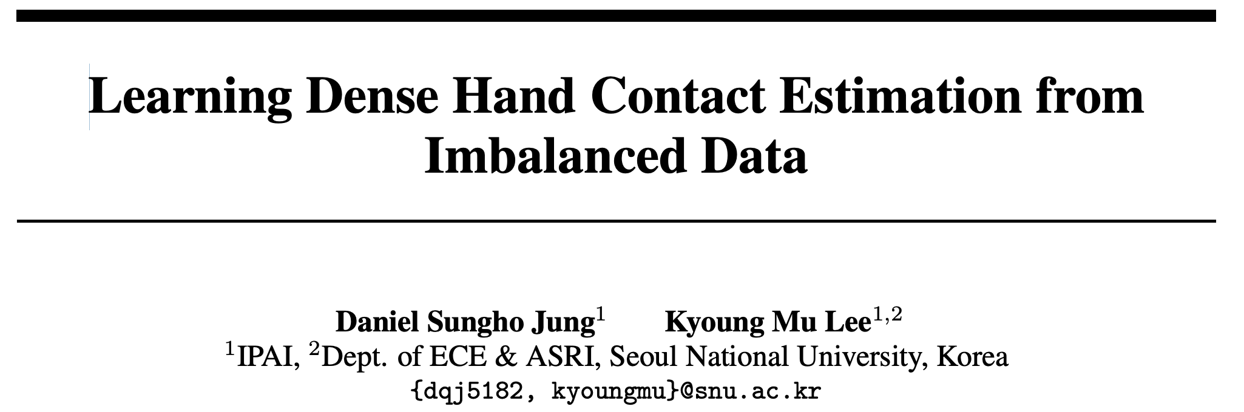
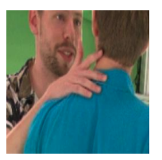
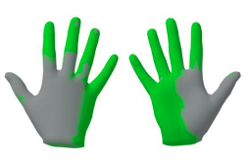
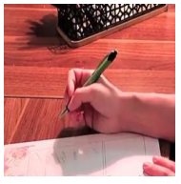
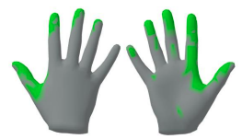

Slide 2
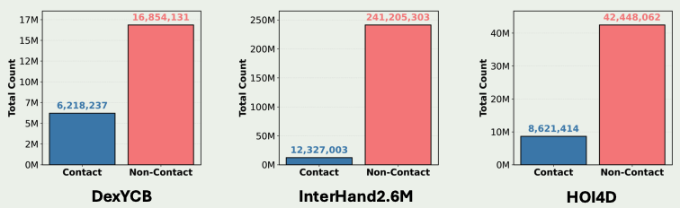
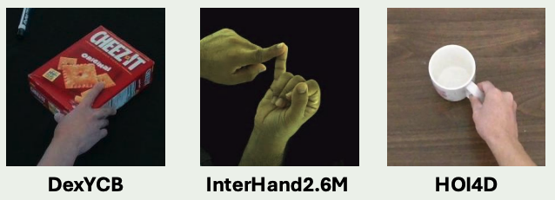
Challenges
Class imbalance: Most hand mesh vertices are labeled as non-contact in existing datasets
Spatial imbalance: Contact is often concentrated at the fingertips, while other areas like the dorsum or palm base are underrepresented

Slide 3
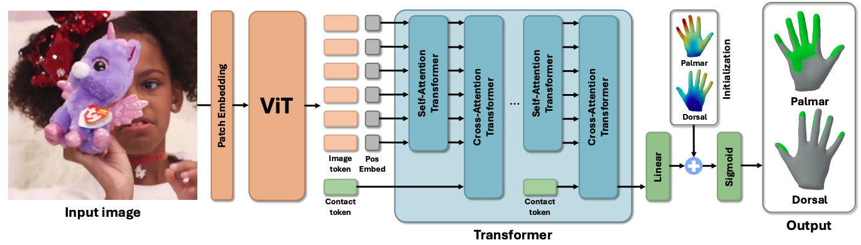
Method
Standard ViT pipeline trained on 840K images from 14 datasets, covering interactions including: hand-object, hand-hand, hand-scene, and hand-body.

Slide 4

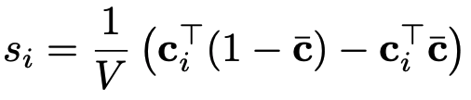
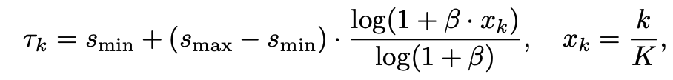





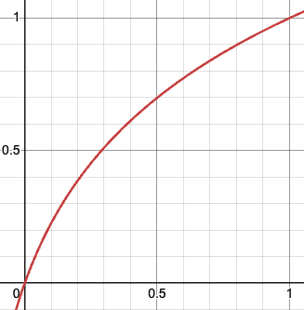
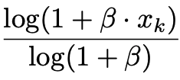

Balanced contact sampling
Compute Contact Balance Score
: contact vertor of sample i
: average contact vector
High indicates more contact and more unique pattern.
Create K sampling bins

Slide 5

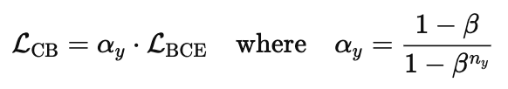


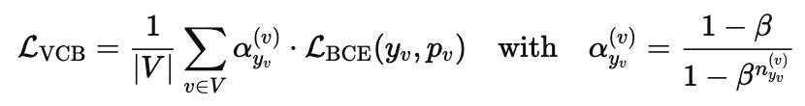

Vertex-level Class-Balanced Loss
Standard BCE Loss:
Class-Balanced Loss (global weighting):
VCB Loss (per-vertex weighting):
: ground-truth contact label at vertex v
: number of times vertex v is labeled as class y across dataset
: hyperparameter controlling weight scaling (typically close to 1)

Slide 6



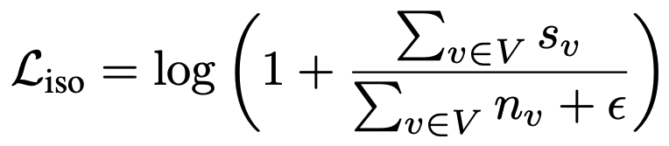

Smooth Loss
Define isolation score:
and : the neighborhood-smoothed estimates for contact and non-contact probabilities.
Smooth loss definition:
: number of neighbors of vertex v

Slide 7
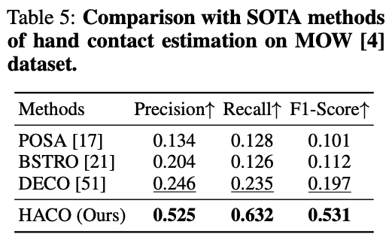
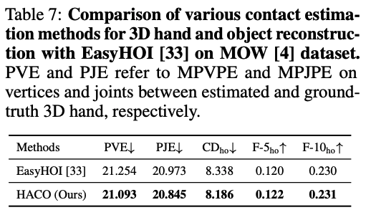
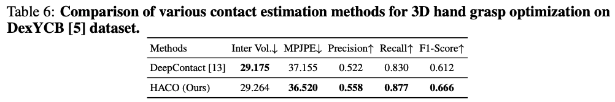
Experiment

Slide 8
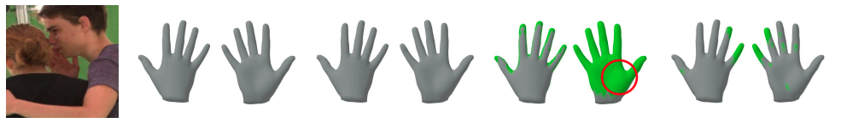
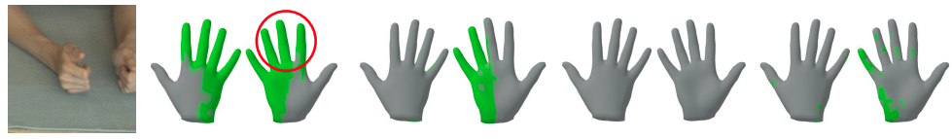
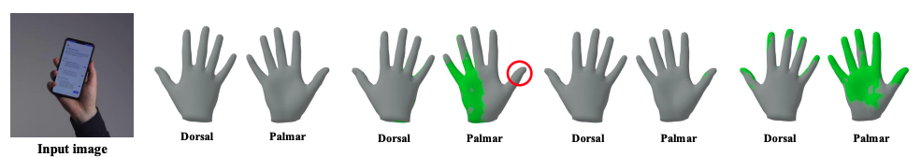
Experiment

Slide 9
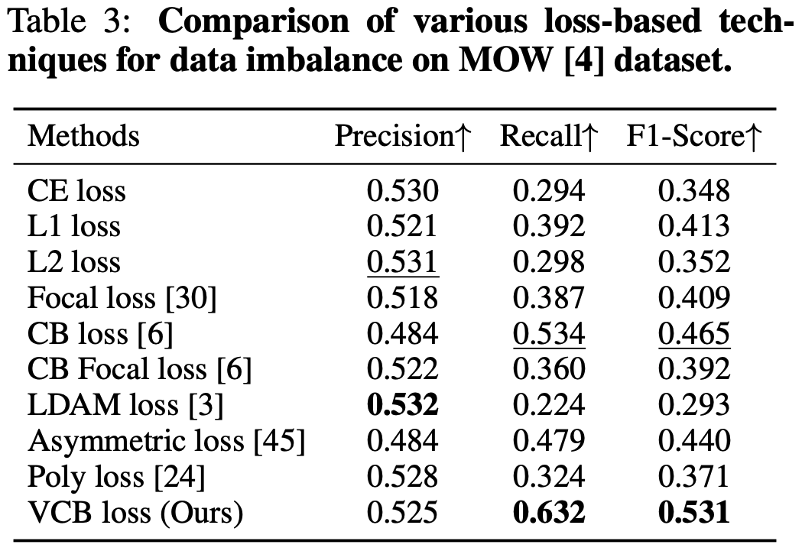
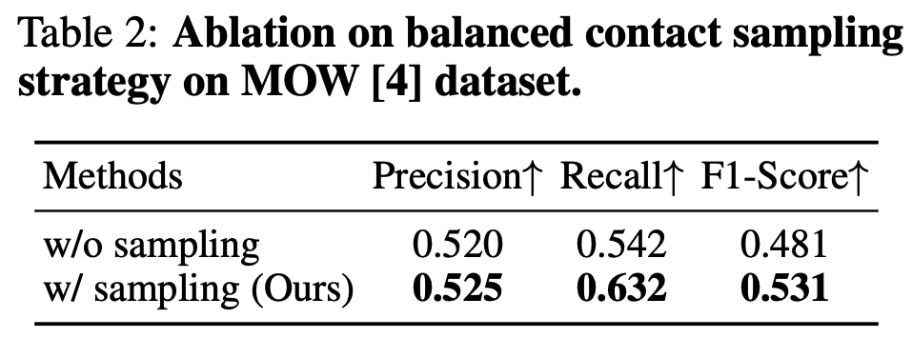
Ablation Study

Slide 10
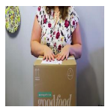
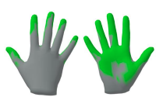
Limitation
The contact prediction is decoupled from hand pose and motion, limiting its ability to inform or improve hand-object or hand-scene interaction reasoning
Contact labels are derived from proximity-based thresholds, which may not accurately reflect real physical contact in the real world
The model explicitly ignores self-contact

Slide 11
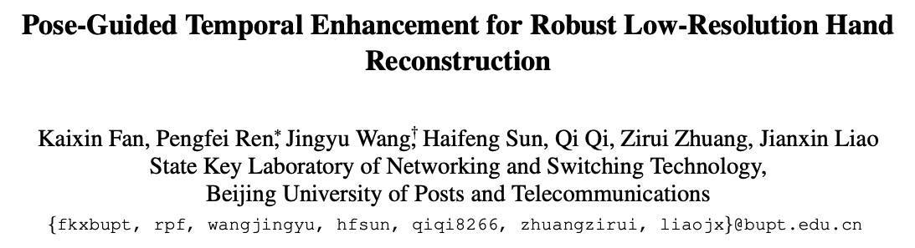
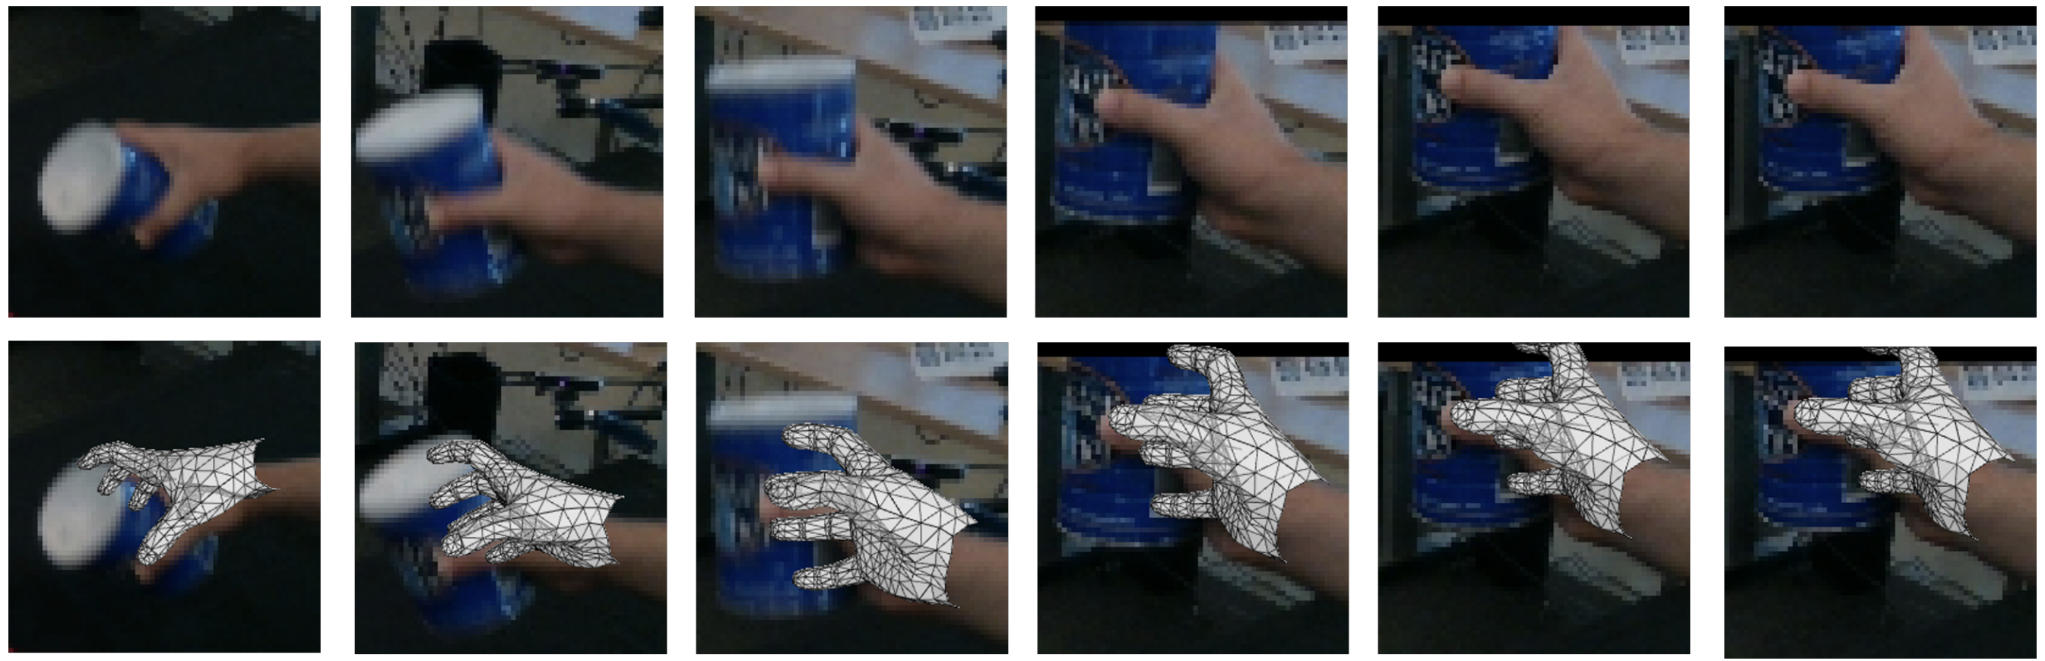

Slide 12
Motivation
A single low-resolution image lacks detailed hand appearance, existing low-resolution method rely on a single image, leading to ambiguous visual representation.
Existing temporal methods typically compress single frame information into joint features, which discard spatial context of visual features.
Integrating spatial with temporal context is challenging:
Sparse joint feature are not aligned with dense visual features
Semanti misalignment:
joint feature contain prior geometric information
Visual feature represent detailed appearance information

Slide 13
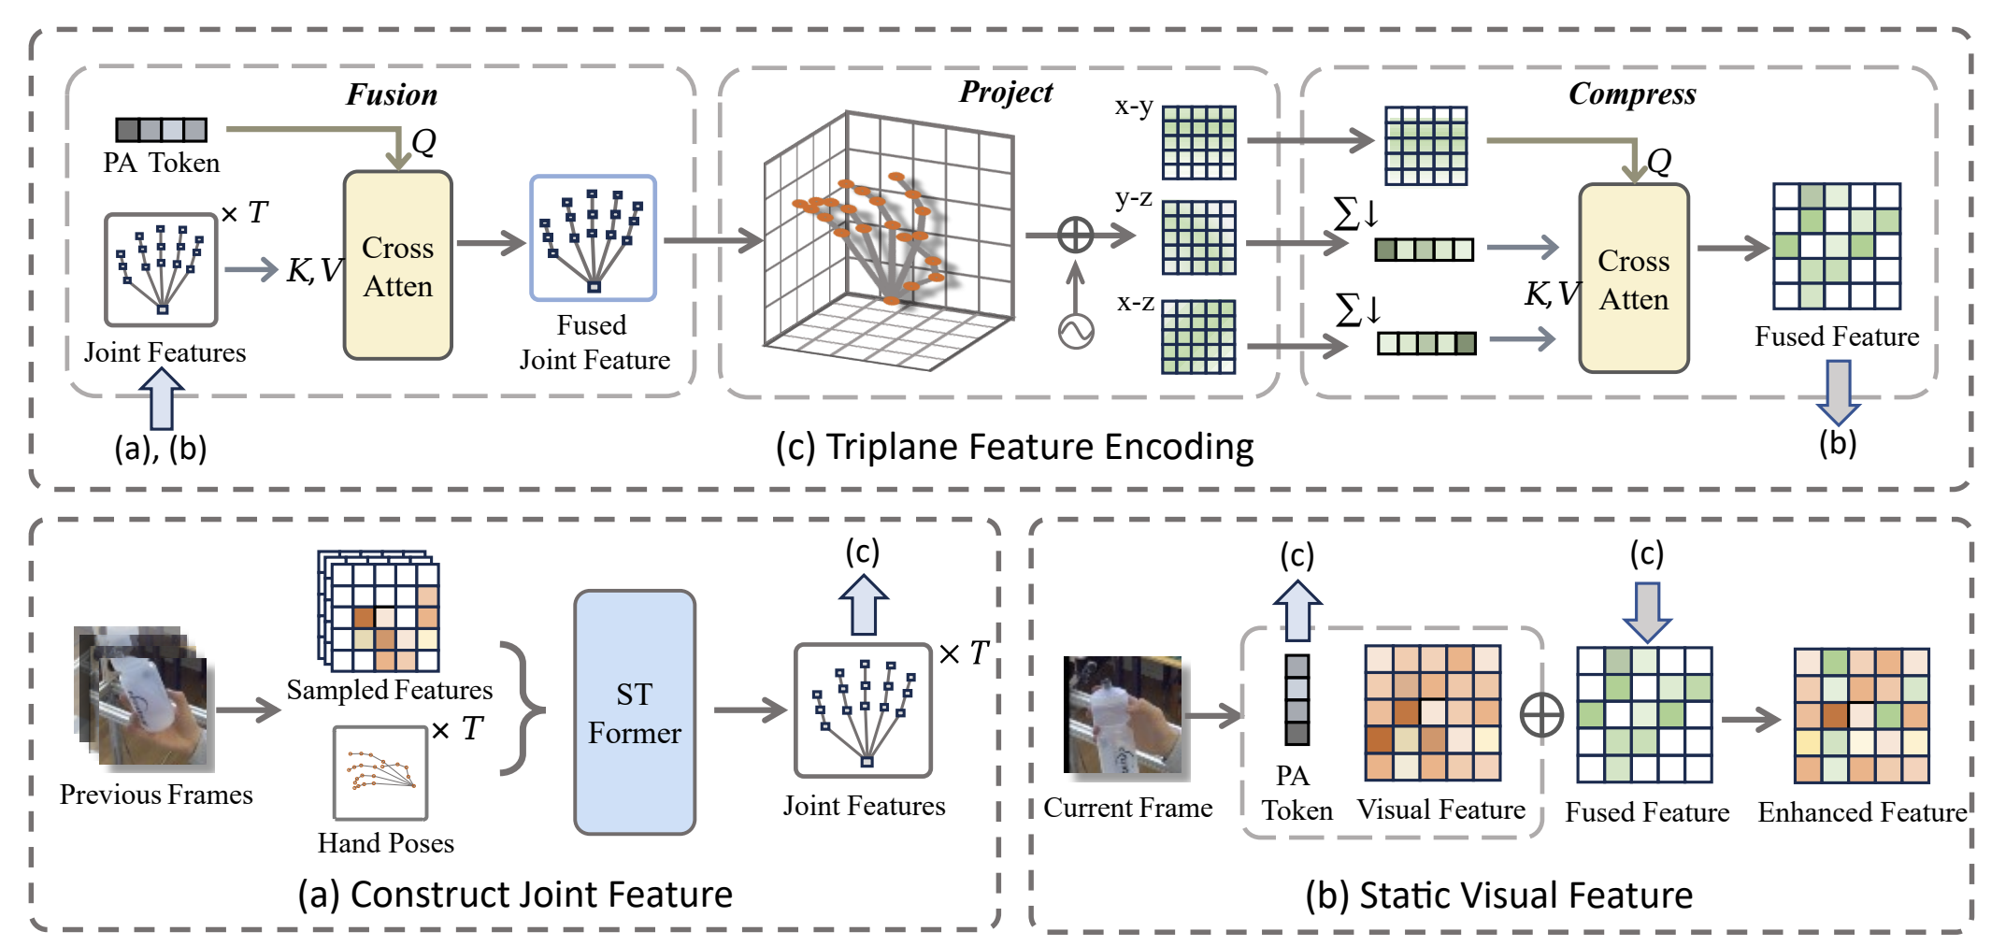
Core Idea
Use a Spatio-Temporal Transformer to extract temporally-enhanced joint features (sparse structure tokens).
Project joint into three orthogonal 2D planes (xy, xz, yz) — the Triplane representation.
Compress and fuse these plane features back into the current frame's visual feature map via cross-attention, yielding a structure-aware dense representation

Slide 14
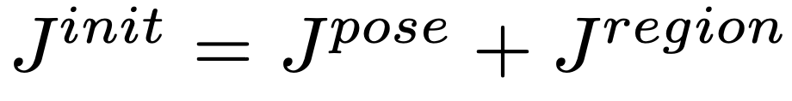
Dynamic Temporal Joint Features
For each frame, pose-aware tokens predict 2D joint locations.
At each joint, sample visual features and add position encoding to form a joint feature：
Concatenate joint features from T previous frames into a temporal sequence:
Apply a Spatio-Temporal Transformer:
Spatial Attention: models intra-frame joint dependencies.
Temporal Attention: models joint trajectories across frames.

Slide 15
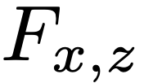
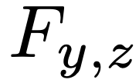
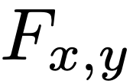
Triplane Feature Encoding
Use the enhanced joint features of the current frame to decode 3D joint coordinates.
Project each joint feature to 3 orthogonal planes via Gaussian heatmap splatting:
Compress ​ and along depth axes into 1D vectors.
Use cross-attention to inject these structural priors into , yielding a structure-enhanced 2D map.
This fused feature is aligned with the visual feature map

Slide 16
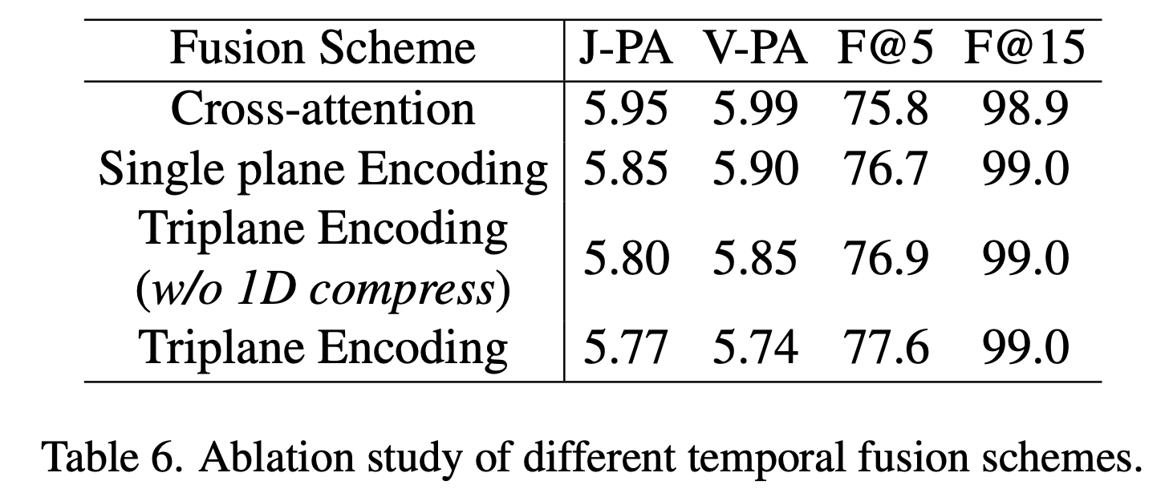
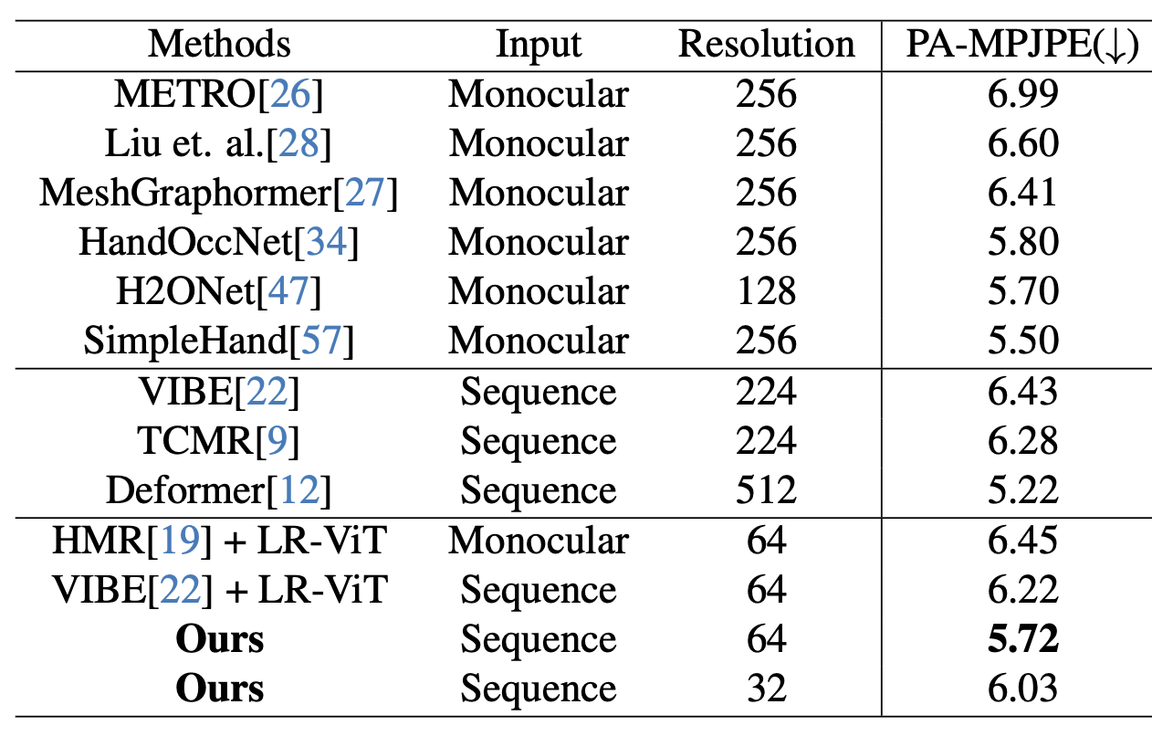
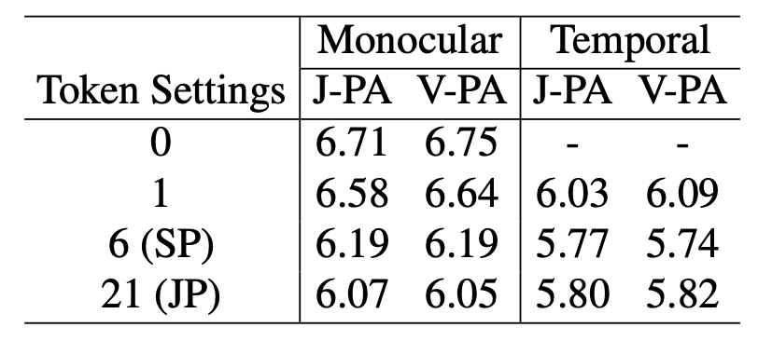
Experiment
Comparison with other methods
Ablation on Point-aware Token

