Slide 1
Quasipseudometric Value Functions
with Dense Rewards
Khadi Valieva · Bikramjit Banerjee
University of Southern Mississippi | TMLR 2025
Notes:
This paper is about goal-conditioned reinforcement learning — training a robot to reach not just one fixed goal, but any goal you give it. The main result is that you can add richer reward signals to this training process without breaking the geometric structure that makes the best architectures work. We published this in Transactions on Machine Learning Research in October 2025.
━━━━━━━━━━━━━━━━━━━━━━━━━━━━━━━━━━━━
TERMINOLOGY REFERENCE
━━━━━━━━━━━━━━━━━━━━━━━━━━━━━━━━━━━━
Reinforcement learning (RL): a framework where an agent learns by trial and error — it takes actions, receives a reward signal, and gradually improves. No labelled dataset; the agent generates its own data by interacting with an environment.
GCRL (Goal-Conditioned RL): a variant where the agent must learn to reach many different goals, not just one. The goal is an extra input to the policy and value function.
TMLR: Transactions on Machine Learning Research — a machine learning journal with open peer review on OpenReview.

Slide 2
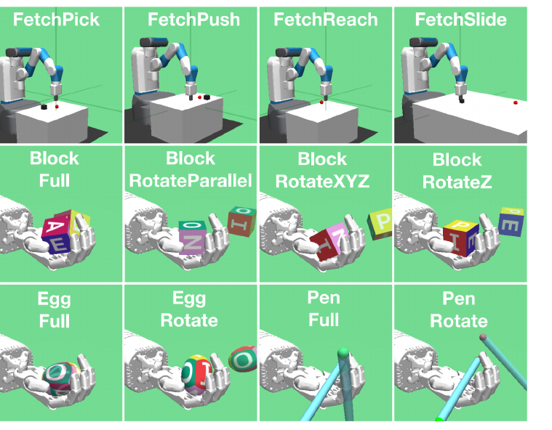
Dense rewards should help — so why did they hurt?
GCRL: teach a robot arm to reach any goal — not just one fixed target
Sparse reward: agent only gets a signal when it succeeds (0) or fails (−1)
Dense reward: feedback at every step — should speed up learning
Yet Plappert et al. (2018) found certain dense rewards made performance significantly worse on these exact tasks
Our answer: it is about the triangle inequality
Notes:
So here's the puzzle that motivated this work. These are the 12 robotics tasks we evaluate on — a robot arm on the top row, a dexterous hand on the bottom. Goal-conditioned RL means we're teaching one agent to reach any target position in these environments, not just a fixed one.
[click] In reinforcement learning you can give the agent feedback in two ways. Sparse: only tell it when it succeeds or fails. Dense: give it feedback at every step, like how close it is to the goal. Dense rewards give much more signal, so intuitively they should always help.
[click — click] But Plappert and colleagues — the people who built these benchmarks — found the opposite. Some dense rewards made training significantly worse.
[click] Our answer: it comes down to a property called the triangle inequality, which I'll explain in a moment.
━━━━━━━━━━━━━━━━━━━━━━━━━━━━━━━━━━━━
TERMINOLOGY REFERENCE
━━━━━━━━━━━━━━━━━━━━━━━━━━━━━━━━━━━━
GCRL: teach one agent to reach any goal — the goal is passed as an extra input alongside the state.
Sparse reward: 0 at success, −1 at every other step. Easy to specify, very little learning signal.
Dense reward: feedback at almost every step, e.g. negative distance to goal. More informative.
Triangle inequality: d(A,B) + d(B,C) ≥ d(A,C). Going via B is never better than going direct.

Slide 3
Background: Goal-Conditioned RL
GOAL-CONDITIONED RL
DDPG + HINDSIGHT EXPERIENCE REPLAY (HER)
– One policy and value function Q(s, a, g) for a whole family of goals — the goal is an extra input
– Sparse reward: 0 if goal reached, −1 otherwise — easy to design but hard to learn from
– Key insight: Q*(s,a,g) behaves like a negative distance to the goal
– DDPG: off-policy actor-critic — a critic estimates Q, an actor selects actions
– HER: relabels failed episodes with the goal the agent actually reached — turns failures into useful data
– Base method for all our experiments
Notes:
Let me quickly set up the two main ingredients we build on.
On the left: goal-conditioned RL. Instead of one fixed goal, the agent learns a single policy and value function that works for any goal. The value function Q(s, a, g) answers: "if I'm in state s, take action a, and act optimally from there, how well do I reach goal g?" Under a sparse reward, this turns out to behave like a negative distance — a point I'll come back to.
On the right: the standard training pipeline. DDPG is an actor-critic algorithm. HER is the key ingredient that makes sparse rewards tractable: when the agent fails, instead of throwing the episode away, it relabels the goal to match where the agent actually ended up. Failure becomes useful data.
━━━━━━━━━━━━━━━━━━━━━━━━━━━━━━━━━━━━
TERMINOLOGY REFERENCE
━━━━━━━━━━━━━━━━━━━━━━━━━━━━━━━━━━━━
Q-function Q(s,a,g): estimates expected total discounted future reward from state s, action a, optimally toward goal g.
Policy π: the agent's decision rule — maps (state, goal) → action. Like a classifier.
DDPG: off-policy actor-critic for continuous actions. Off-policy = learns from stored past experience (replay buffer).
An actor-critic method combines policy optimization (the actor) with value function estimation (the critic) to reduce the high variance typical of pure Monte Carlo policy gradients. \
HER (Hindsight Experience Replay): relabels failed episodes — turns failures into successes. CV analogy: flipping a "failed" sample's label to make it informative.
Actor-critic: critic estimates Q; actor (policy) is updated using the critic's gradient.
TD error: difference between current Q estimate and a one-step bootstrapped target — the critic's loss.

Slide 4
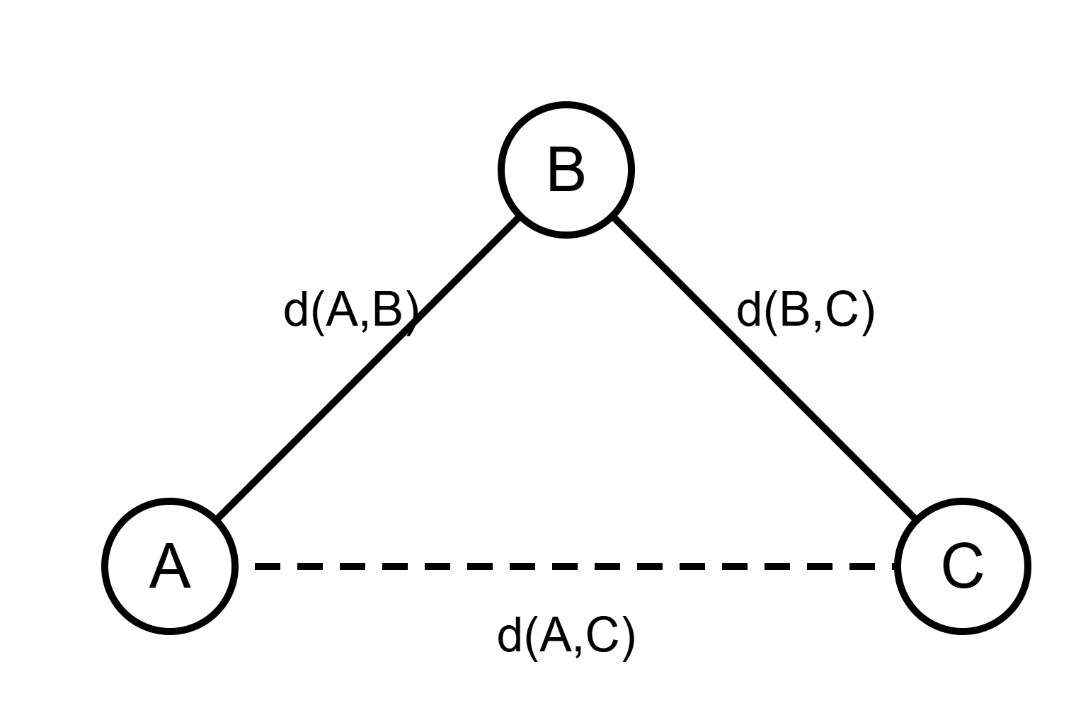
The key insight: value as distance
−Q*(s,a,g) ≈ distance from (s,a) to goal g
"How far away is the goal — in steps?"
Triangle inequality: d(A,B) + d(B,C) ≥ d(A,C)
Going via B is never better than going direct
Quasi: asymmetric — rotating one way may cost more than the other
Pseudo: d = 0 for distinct states — two quaternions can represent the same rotation
Notes:
Here's the core geometric insight. The optimal value function under a sparse reward — Q*(s,a,g) — is essentially a distance. Negating it gives you a measure of how far away the goal is in terms of optimal steps. So −Q* behaves like a distance in step-space.
[click] And once you think of it as a distance, one property becomes very natural: the triangle inequality. Going from A to C via B is never shorter than going direct. =
[click] The technical name for this structure is a quasipseudometric — a distance that doesn't need to be symmetric and allows zero distance between distinct points. Quasi means asymmetric. Pseudo means two distinct states can be distance zero — two different quaternions can represent the same physical rotation.
━━━━━━━━━━━━━━━━━━━━━━━━━━━━━━━━━━━━
TERMINOLOGY REFERENCE
━━━━━━━━━━━━━━━━━━━━━━━━━━━━━━━━━━━━
Quasipseudometric: generalised distance. Quasi = asymmetric (d(A,B) can differ from d(B,A)). Pseudo = allows d(A,B)=0 even when A≠B.
Triangle inequality: d(A,B) + d(B,C) ≥ d(A,C). For value functions: Q*(x1,x2) + Q*(x2,x3) ≤ Q*(x1,x3).
Metric: symmetric quasipseudometric where d(x,y)=0 implies x=y.
Quaternion: 4-number representation of 3D rotation. q and −q describe the same rotation — distance zero between distinct vectors.

Slide 5
Metric Residual Network (MRN) — exploiting structure
– Liu et al. (2023): under sparse rewards, −Q* is a quasipseudometric
– MRN architecture enforces this by construction — decomposes −Q into a symmetric metric part plus an asymmetric residual
– Result: a critic that provably satisfies the triangle inequality and can approximate any quasipseudometric
Symmetric part: Euclidean distance between learned embeddings
Asymmetric part: max-ReLU of coordinate differences
Problem: this justification only holds for sparse rewards. Does the triangle inequality survive with dense rewards?
Notes:
So if the value function is a quasipseudometric, we can build a neural architecture that is designed to always output a valid quasipseudometric, by construction. That's the Metric Residual Network.
[click] MRN decomposes −Q into two parts. A symmetric part — Euclidean distance between learned embeddings. And an asymmetric residual — a max over dimensions of the positive coordinate differences. Sum them and you get a critic that provably satisfies the triangle inequality.
The benefit: you search a smaller space of functions — only those with the right geometric structure — but the true Q* is always in that space. Better sample efficiency without losing correctness.
[click] Here's the problem. This whole justification was only proven for sparse rewards. If we add dense rewards, does the triangle inequality still hold? That's what this paper answers.
━━━━━━━━━━━━━━━━━━━━━━━━━━━━━━━━━━━━
TERMINOLOGY REFERENCE
━━━━━━━━━━━━━━━━━━━━━━━━━━━━━━━━━━━━
MRN (Metric Residual Network): critic architecture that decomposes −Q into d_sym (Euclidean between embeddings, symmetric) + d_asym (max-ReLU of coordinate differences, asymmetric). Always a valid quasipseudometric.
d_sym: Euclidean distance between encoder outputs — symmetric by definition. Like a siamese network distance.
d_asym: max_i(x_i − y_i, 0). Asymmetric because max(x−y) ≠ max(y−x).
Sample efficiency: how few environment interactions needed to reach a given performance. CV analogy: label efficiency.
PQE: a second quasipseudometric critic architecture — used to show generality beyond MRN.

Slide 6
Our three contributions
1
2
3
Optimal Q* still satisfies the triangle inequality with potential-shaped dense rewards
— if the potential acts as an admissible heuristic (ϕ ≥ Q*)
Intermediate Q-functions also satisfy the triangle inequality for "progressive" policies — those making bounded progress toward the goal
12 GCRL benchmarks: dense rewards satisfying the condition improve or match sparse rewards, never significantly hurt
extends Liu et al. (2023)
nuances Wang et al. (2023)
overcomes Plappert et al. (2018)
Notes:
Here are our three contributions — I'll go through each one in detail.
[click] First: the optimal value function still satisfies the triangle inequality even with dense rewards, as long as they're structured correctly as a potential-shaped reward with an admissible potential.
[click] Second: in practice you're never training with the optimal Q* — you use intermediate approximations. We show those also satisfy the triangle inequality for any policy making "bounded progress."
[click] Third: 12 benchmarks confirm the theory. Our dense rewards either improve or match sparse rewards. The wrong dense rewards hurt — exactly as the theory predicts.
━━━━━━━━━━━━━━━━━━━━━━━━━━━━━━━━━━━━
TERMINOLOGY REFERENCE
━━━━━━━━━━━━━━━━━━━━━━━━━━━━━━━━━━━━
Potential-shaped reward: F = γ·ϕ(next) − ϕ(current). Policy-invariant — doesn't change the optimal policy.
Admissible heuristic: ϕ ≥ Q* everywhere. Potential never underestimates how good a state is.
Intermediate value function: Q-function during training, associated with a non-optimal policy.
Progressive policy: policy whose one-step progress stays within a bounded gap of the optimal policy's progress.

Slide 7
Contribution 1: when dense rewards preserve structure
Potential-based shaping (Ng et al., 1999) — does not change the optimal policy
The key condition:
The potential must never underestimate how good a state is — like an admissible heuristic in A* search
Our distance choices (simple, domain-independent):
d_ac: arc-cosine distance (angle ÷ π, bounded in [0,1]) d_E: Euclidean distance (simple, unbounded)
Theorem: if ϕ ≥ Q*, then the shaped optimal value Q*F also satisfies the triangle inequality
Notes:
So what exactly is a potential-shaped reward? You take a potential function ϕ — a scalar that scores how desirable a state is relative to the goal — and the reward you add is the discounted improvement in ϕ from one step to the next. The key property from Ng et al. (1999): this shaping doesn't change the optimal policy.
[click] The condition we need is shown here. The potential must be at least as large as the true value function everywhere — ϕ ≥ Q* for all states, actions, and goals. In plain language: the potential must never underestimate how good a state is. This is exactly like an admissible heuristic in A* search.
[click] For our specific potential, we use two simple, domain-independent distances: arc-cosine (angle between goal vectors, divided by π — bounded) and Euclidean.
[click] And the theorem: if the condition holds, the shaped optimal value function still satisfies the triangle inequality. MRN remains valid with dense rewards.
━━━━━━━━━━━━━━━━━━━━━━━━━━━━━━━━━━━━
TERMINOLOGY REFERENCE
━━━━━━━━━━━━━━━━━━━━━━━━━━━━━━━━━━━━
Potential function ϕ: scores desirability of (state, action, goal). F = γ·ϕ(next) − ϕ(current).
Policy invariance: shaped reward doesn't change which policy is optimal. The agent learns the same final behaviour, potentially faster.
ϕ ≥ Q* (key condition): potential upper-bounds the true value function. Violation at even one state can break the triangle inequality.
Admissible heuristic (A*): cost estimate that never overestimates remaining cost. Here: d/η ≤ L* (d/η never overestimates steps needed).
Q*F: optimal value under sparse + shaped reward. Different from Q* but still a quasipseudometric if the condition holds.
d(s,a,g) - “how far is this situation from the goal?” and d does that. In the paper they try two choices: arc-cosine distance (the angle between the achieved-goal vector and the desired-goal vector, divided by π) and Euclidean distance (straight-line distance between them in state space).
η is the conversion factor: it’s roughly “how much geometric distance does the robot cover in one action?”
L* — the optimal step count

Slide 8
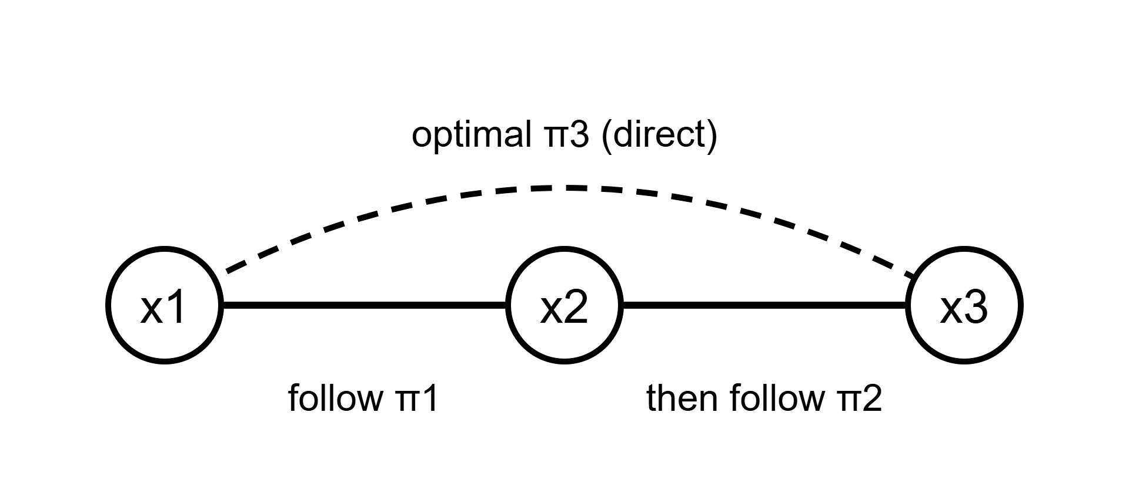
Proof intuition: stitching two paths
Build a "stitched" policy: follow π₁ (optimal x₁→x₂) until x₂ is reached, then switch to π₂ (optimal x₂→x₃)
Each leg of the stitched path is worth at least its own optimal shaped value — the condition ϕ ≥ Q* ensures shaping leftovers are non-positive
Adding the two legs gives Q*F(x₁,x₃) ≥ Q*F(x₁,x₂) + Q*F(x₂,x₃) — the triangle inequality
Note: policy invariance alone is NOT enough — a potential violating ϕ ≥ Q* at even one state can break the inequality while keeping the optimal policy unchanged
Notes:
The proof idea is intuitive once you see it as a path-stitching argument.
[click] Imagine you have an optimal policy π₁ for getting from x₁ to x₂, and an optimal policy π₂ for x₂ to x₃. Stitch them together: follow π₁ until you first reach x₂, then switch to π₂.
[click] The return of this stitched policy can be split into two legs. The condition ϕ ≥ Q* ensures the leftover shaping terms at the intermediate point are non-positive — so each leg is worth at least its own optimal shaped value.
[click] Adding the legs gives a lower bound. Since the optimal direct path can only do better, the triangle inequality follows.
[click] Important: policy invariance alone isn't enough. You can find a potential that keeps the optimal policy unchanged but violates ϕ ≥ Q* at a single state — and that breaks the triangle inequality. We show a concrete 3-state MDP counterexample.
━━━━━━━━━━━━━━━━━━━━━━━━━━━━━━━━━━━━
TERMINOLOGY REFERENCE
━━━━━━━━━━━━━━━━━━━━━━━━━━━━━━━━━━━━
Markov policy: chooses actions based only on current state.
Non-Markov (stitched) policy: uses history — remembers whether x₂ has been visited.
Telescoping: intermediate potential terms γ·ϕ(next) − ϕ(current) cancel along a trajectory, leaving only boundary values.
Policy invariance vs triangle inequality: distinct properties. Shaping can preserve the optimal policy but still break the triangle inequality if ϕ < Q* anywhere.

Slide 9
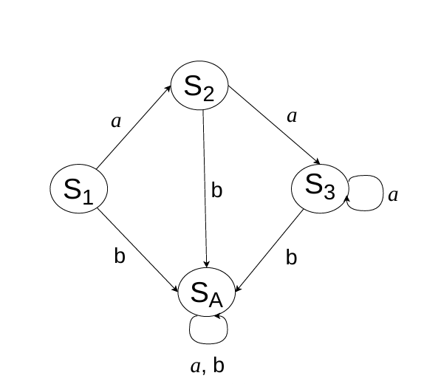
What fails: potential-free dense rewards
Natural choice: use −‖M(s,a) − g‖ as reward — Euclidean distance is a metric, right?
But this is NOT a potential difference — the reward structure is wrong
In this 3-state MDP: S₁→S₂ and S₂→S₃ each reach their goal (distance = 0), but the direct path S₁→S₃ incurs a penalty δ. For large δ: two-step path scores better — triangle inequality fails
This is exactly the default dense reward in Gymnasium-Robotics — explaining why Plappert et al. found negative results
Counterexample (Fig. 1a)
Notes:
Here's why some dense rewards fail. A natural instinct is to use negative Euclidean distance to the goal as the reward. But this is not a potential difference — it's not expressed as γ·ϕ(next) − ϕ(current).
[click — click] The small MDP diagram shows the problem. The two-step path from S₁ to S₂ to S₃ achieves each intermediate goal exactly — zero distance at each step. But the Q-value for going directly from S₁ toward S₃ picks up a distance penalty δ. For large enough δ, the two-step path is "worth more" than the direct path — triangle inequality fails.
[click] And this is exactly the dense reward that Gymnasium-Robotics uses by default. It's why Plappert et al. found negative results. The fix is to structure dense rewards correctly as a potential difference.
━━━━━━━━━━━━━━━━━━━━━━━━━━━━━━━━━━━━
TERMINOLOGY REFERENCE
━━━━━━━━━━━━━━━━━━━━━━━━━━━━━━━━━━━━
Potential-free dense reward: not expressed as γ·ϕ(next) − ϕ(current). Can change the optimal policy and break the triangle inequality.
MDP (Markov Decision Process): states, actions, transition function, reward, discount. The mathematical RL framework.
Absorbing state: a state once entered cannot be left (Sₐ here).
Gymnasium-Robotics: simulation suite (Farama Foundation) with Fetch arm and Shadow-hand tasks. Its built-in dense reward uses −‖achieved_goal − desired_goal‖ — a potential-free form.

Slide 10
Contribution 2: intermediate value functions
Prior result — Wang et al. (2023): an on-policy Q-function can violate the triangle inequality during training, even if Q* satisfies it
– In practice, critics are trained on intermediate policies — not the final optimal one
– We show: a "progressive" policy — one whose progress toward the goal stays within a bounded gap of optimal — still has a Q-function satisfying the triangle inequality
– The gap ε only needs to be finite, not small. Wang et al.'s counterexample uses an extreme policy that is not progressive
Notes:
So far we've talked about the optimal Q*. But during training you never have Q* — you have an approximation learned from an intermediate policy.
[click] Wang and colleagues showed that an on-policy Q-function can violate the triangle inequality even if Q* satisfies it. Their counterexample is an extreme, adversarially constructed policy.
[click — click] We show something more reassuring: if the policy makes "bounded progress" — meaning its one-step gain toward the goal stays within a bounded gap of the optimal policy's gain — its Q-function also satisfies the triangle inequality. We call this a progressive policy. ε just needs to be finite.
[click] Wang et al.'s counterexample policy is not progressive. Normal DDPG training produces progressive policies.
━━━━━━━━━━━━━━━━━━━━━━━━━━━━━━━━━━━━
TERMINOLOGY REFERENCE
━━━━━━━━━━━━━━━━━━━━━━━━━━━━━━━━━━━━
Intermediate value function: Q-function during training — an approximation to Q*, not Q* itself.
On-policy Q-function: the Q-function associated with the current (non-optimal) policy π.
Progress Δ^π(s,a,g): expected one-step gain in Q-value: E[Q^π(s',a',g)] − Q^π(s,a,g). Positive = making headway.
Progressive policy: Δ* − Δ^π stays in [ε, 2ε] for finite ε. Making reasonable forward progress.
Proposition 3: any progressive policy has a Q-function satisfying the triangle inequality — during training, not just at convergence.

Slide 11
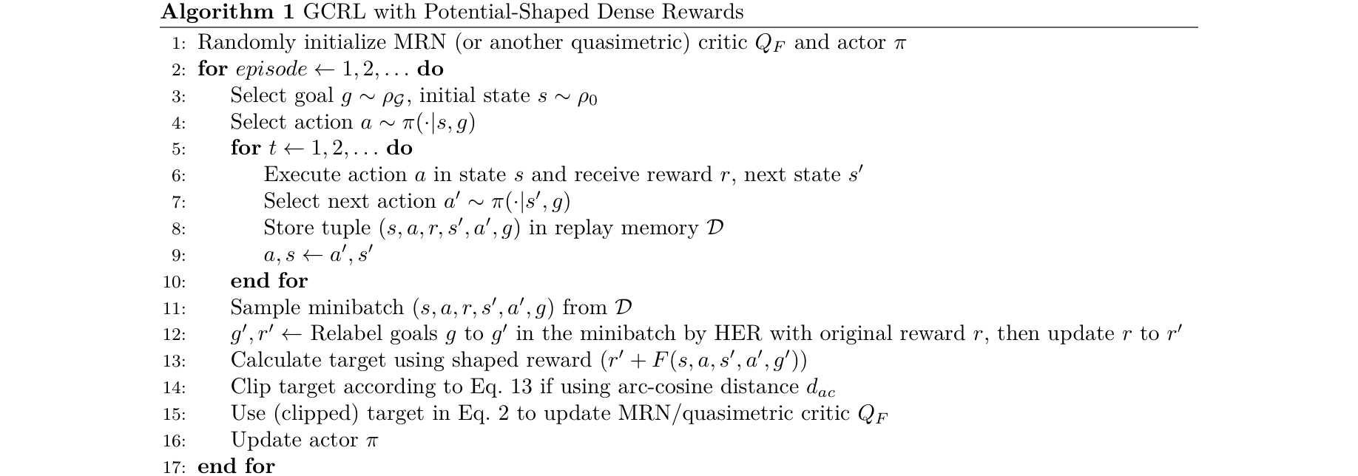
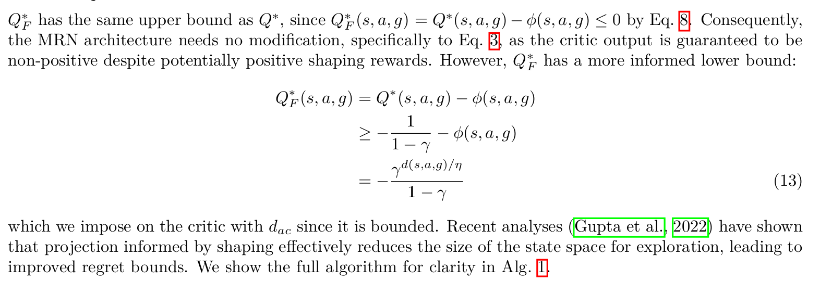
Method: two changes to the standard MRN pipeline
Only 2 changes to the public MRN code:
① Line 13: add shaping term F to the TD target
② Line 14: clip target lower bound (for d_ac only)
No other changes to algorithm or architecture
Clipping (arc-cosine distance only):
Shaped Q* has a tighter lower bound than −1/(1−γ). Clipping reduces effective search space — improves regret bounds.
η: converts geometric distance to step-count estimate. Selected by grid search: {0.01…0.05} for d_ac, {0.02, 0.2, 2.0} for d_E
Notes:
The method is deliberately simple. We take the public MRN code and make exactly two changes.
[click] Line 13: when computing the TD target, add the shaping term F — the discounted potential improvement. Line 14: clip the target to a tighter lower bound. That's it. No new architecture.
[click] The clipping is worth explaining. The shaped Q* has a tighter lower bound than the standard −1/(1−γ). We use that bound to constrain the critic during training — it reduces the effective search space, which improves regret bounds. We only do this for arc-cosine distance because it's bounded — Euclidean distance is not.
[click] The one new hyperparameter is η — a scale that converts geometric distance into an estimate of the number of steps needed. Picked by a small grid search.
━━━━━━━━━━━━━━━━━━━━━━━━━━━━━━━━━━━━
TERMINOLOGY REFERENCE
━━━━━━━━━━━━━━━━━━━━━━━━━━━━━━━━━━━━
TD target: training label for the critic — r + γ·Q(next). We add F to this.
Critic clipping: restricting the target to a known valid range. CV analogy: clamping output activations.
η (action atomicity): converts geometric distance to step-count estimate. d/η ≤ L* = admissibility condition.
Lower bound −γ^(d/η)/(1−γ): tighter than −1/(1−γ). Shaped Q*F is always above this.
Regret bound: theoretical guarantee on cumulative performance loss. Tighter bounds = faster convergence in theory.

Slide 12
Contribution 3: 12 GCRL benchmarks
Fetch arm (top 4)
FetchReach · FetchPush · FetchSlide · FetchPick
Shadow-hand (bottom 8)
Block / Egg / Pen × Full + Rotate variants
Reward conditions
Sparse rewards (baseline)
ϕ with d_ac — arc-cosine ✓ satisfies condition
ϕ with d_E — Euclidean ✓ satisfies condition
Direct ϕ — bypasses scaling ✗ violates condition
Default Gymnasium dense reward ✗ violates condition
5 trials · DDPG+HER · MRN and PQE critics
Notes:
The experiments cover 12 tasks: a Fetch arm in the top row and a dexterous Shadow-hand in the bottom rows, ranging from simple reaching to full manipulation.
[click] We compare five reward conditions. Sparse rewards are the baseline. Orange and green are our two proposed potentials — arc-cosine and Euclidean. Red conditions violate our key condition and serve as negative controls.
[click] We run five independent trials per condition, using two different critic architectures — MRN and PQE — and report success rate over training epochs.
━━━━━━━━━━━━━━━━━━━━━━━━━━━━━━━━━━━━
TERMINOLOGY REFERENCE
━━━━━━━━━━━━━━━━━━━━━━━━━━━━━━━━━━━━
Success rate: fraction of evaluation episodes where goal is reached within tolerance. Y-axis of all plots. CV analogy: top-1 accuracy.
Epoch: fixed number of environment interactions + gradient update. X-axis.
Fetch tasks: FetchReach (reach), FetchPush (push block), FetchSlide (slide puck), FetchPick (pick and place).
Shadow-hand tasks: Block/Egg/Pen × Full (6-DoF pose) or Rotate (rotation only). Full is harder.
PQE: second quasipseudometric critic architecture — different internal structure from MRN, same geometric guarantees.
Negative control: condition included specifically to show failure — here the two reward conditions that violate ϕ ≥ Q*.

Slide 13
The headline result (MRN, 12 tasks)
4 of 12
0 of 12
tasks significantly better with arc-cosine potential
(FetchSlide, BlockFull, EggFull, PenFull)
tasks significantly worse with either potential
— the condition is safe to apply
6 of 12
12 of 12
tasks significantly worse with direct ϕ
(violates condition — confirms the theory)
tasks worse with the default dense reward
— consistent with Plappert et al. (2018)
Notes:
Four numbers tell the whole story.
[click] Four of twelve tasks are significantly better with the arc-cosine potential — the hardest full-manipulation tasks where there's room to improve.
[click] Zero of twelve are significantly worse. Our method is safe — it never hurts.
[click] Six of twelve are significantly worse with the direct potential — the one that bypasses the admissible distance scaling and frequently violates our condition. Exactly what the theory predicts.
[click] And all twelve are worse with the default Gymnasium dense reward. This reproduces and explains Plappert et al.'s negative results from 2018.
━━━━━━━━━━━━━━━━━━━━━━━━━━━━━━━━━━━━
TERMINOLOGY REFERENCE
━━━━━━━━━━━━━━━━━━━━━━━━━━━━━━━━━━━━
Statistically significant: standard deviation bands are non-overlapping between two conditions across five trials.
Direct ϕ: potential function that skips the d/η scaling — no longer admissible, frequently violates ϕ ≥ Q*.
Default Gymnasium dense reward: uses Euclidean distance without potential-difference structure.

Slide 14
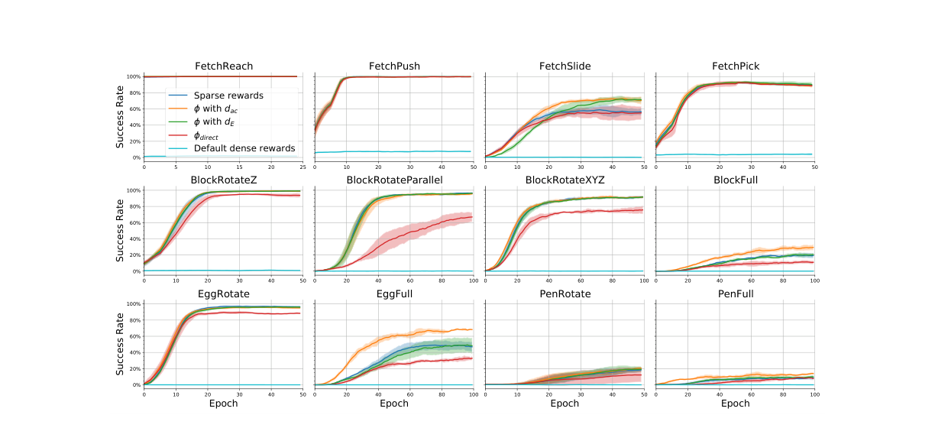
Results: MRN critic — success rate across 12 environments
Notes:
Each panel is one of the 12 environments. X-axis is training epochs, Y-axis is success rate from 0 to 100%.
Row 1: Fetch arm tasks. Row 2: Block manipulation. Row 3: Egg and Pen.
The clearest wins: FetchSlide, BlockFull, EggFull, PenFull — orange (d_ac) is clearly ahead of blue (sparse) with non-overlapping error bands.
For the rotation-only tasks in the middle rows, all conditions converge to near 100% quickly — HER already makes sparse rewards work well there, so there's no headroom to improve.
Red and cyan are consistently below blue in several environments — especially the Shadow-hand tasks — confirming that the wrong dense rewards hurt.
━━━━━━━━━━━━━━━━━━━━━━━━━━━━━━━━━━━━
TERMINOLOGY REFERENCE
━━━━━━━━━━━━━━━━━━━━━━━━━━━━━━━━━━━━
Error bands: ±1 standard deviation across five trials. Non-overlapping = statistically significant difference.
Headroom: gap between current performance and maximum. No headroom = improvement is impossible regardless of reward.
Asymptote: final performance level a learning curve stabilises at.
Full manipulation: agent must achieve correct position AND orientation simultaneously — 6 degrees of freedom. Much harder than rotation-only.

Slide 15
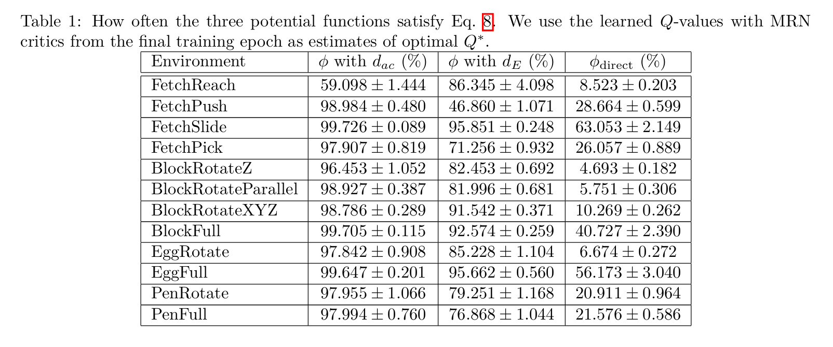
Why the condition matters: how often ϕ ≥ Q* holds
Arc-cosine ϕ satisfies condition ≥ 96% of the time in 11 of 12 environments — high compliance, good performance
Direct ϕ satisfies it only 5–63% — low compliance, bad performance. Same Euclidean distance works fine when wrapped as a proper potential
Notes:
This table is the empirical bridge between theory and results. For each environment and each potential function, we measure what fraction of training states actually satisfy the key condition ϕ ≥ Q* — using the learned Q as a proxy.
[click] Arc-cosine distance satisfies the condition at least 96% of the time in 11 of 12 environments. The exception is FetchReach at 59%, but FetchReach already converges to near-perfect with sparse rewards.
[click] The direct potential satisfies it only 5–63% — systematically violating the condition. Those are exactly the environments with the worst performance degradation. The condition isn't just a proof artifact — it predicts results environment by environment.
━━━━━━━━━━━━━━━━━━━━━━━━━━━━━━━━━━━━
TERMINOLOGY REFERENCE
━━━━━━━━━━━━━━━━━━━━━━━━━━━━━━━━━━━━
Compliance rate: fraction of sampled (s,a,g) triples where ϕ(s,a,g) ≥ Q*(s,a,g). Measured at the final training epoch using learned Q as proxy.
d_ac column: arc-cosine potential — high and stable compliance.
d_E column: Euclidean potential — lower and more variable (FetchPush drops to 47%).
Direct ϕ column: consistently low compliance — explaining its poor performance.

Slide 16
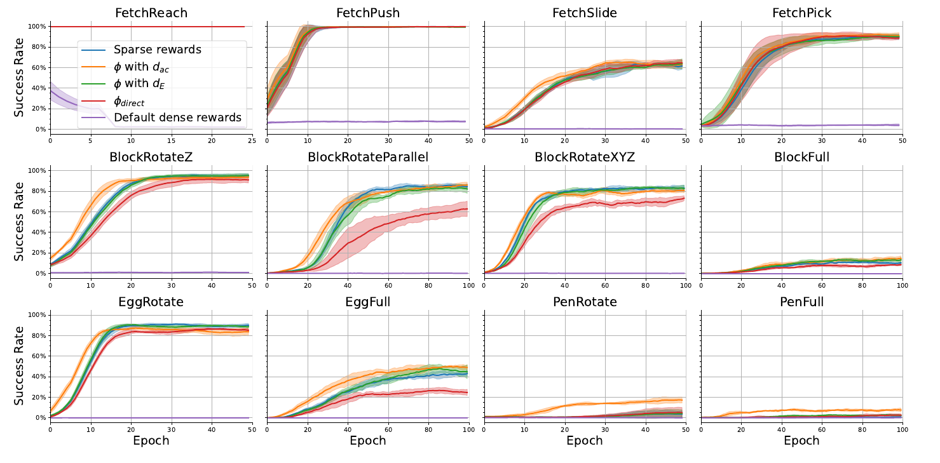
Result generalises to PQE critic
Similar improvements in BlockFull, EggFull, PenRotate, PenFull with d_ac — same η values, no extra tuning
Caveat: EggRotate deteriorates with d_ac — η was not tuned for PQE (future work)
Notes:
To check the result isn't specific to MRN, we repeat the experiments with PQE — a different quasipseudometric architecture. The pattern is similar: BlockFull, EggFull, PenRotate, PenFull show statistically significant improvement with d_ac, using the same η values without re-tuning.
[click] One exception: EggRotate deteriorates slightly. We attribute this to η not being tuned for PQE — the same value that works for MRN isn't optimal for a different architecture. Flagged as a limitation.
The broader point: the theoretical condition determines whether dense rewards help, not the specific architecture.
━━━━━━━━━━━━━━━━━━━━━━━━━━━━━━━━━━━━
TERMINOLOGY REFERENCE
━━━━━━━━━━━━━━━━━━━━━━━━━━━━━━━━━━━━
PQE (Poisson Quasi-metric Embedding, Wang & Isola 2022): encodes states into a space where distances correspond to hitting times of a Poisson process. Triangle inequality by construction.
Generalisability: showing the result holds for two different critic architectures makes it more credible that it's about reward structure, not the model.
η transfer: using the same η across architectures — works mostly but can degrade for one task.

Slide 17
Conclusion
✓
Potential-shaped dense rewards preserve the triangle inequality for Q* — if the potential is an admissible heuristic (ϕ ≥ Q*)
✓
Intermediate Q-functions also satisfy it for progressive policies — nuancing Wang et al. (2023)
✓
12 GCRL benchmarks: our prescriptions improve or match sparse rewards, never significantly hurt
✗
Dense rewards violating the condition hurt — matching and explaining Plappert et al. (2018)
→
Future work: more general reward classes; per-critic η tuning; removing the need for η via learned calibration
Notes:
Let me bring it back to the opening question. Dense rewards hurt in Plappert et al.'s experiments because those rewards violated the triangle inequality — they were structured as direct Euclidean distances, not as potential differences, and corrupted the geometric structure of the value function.
Our paper identifies exactly what you need to do instead: structure the dense reward as a potential-based shaping where the potential is an admissible heuristic — it never underestimates the true value. Do that, and the triangle inequality is preserved, the architecture remains valid, and you get improvement on the harder tasks with no downside on the easier ones.
Practically: two lines of code, one hyperparameter, improvement on the hardest tasks, no degradation anywhere.
━━━━━━━━━━━━━━━━━━━━━━━━━━━━━━━━━━━━
TERMINOLOGY REFERENCE
━━━━━━━━━━━━━━━━━━━━━━━━━━━━━━━━━━━━
Key condition summary: ϕ(s,a,g) ≥ Q*(s,a,g) for all s, a, g. Potential must upper-bound the true value.
Admissible heuristic: d/η ≤ L* (geometric distance divided by η never overestimates steps needed).
Two code changes: (1) add F = γ·ϕ(next) − ϕ(current) to TD target. (2) clip target to [−γ^(d/η)/(1−γ), 0] for d_ac.
What stays the same: network architecture, actor update, HER, everything else.

