Slide 1
DiffMesh: A Motion-aware Diffusion-like Framework for Human Mesh Recovery from Videos
A Pre-Print Paper on Arxiv: December, 2023
Ce Zheng, Xianpeng Liu, Mengyuan Liu, Tianfu Wu, Guo-Jun Qi, Chen Chen
Center for Research in Computer Vision, University of Central Florida
Yande Li 05 Feb, 2024

Slide 2
Publication Records
Zheng, Ce, et al. "POTTER: Pooling Attention Transformer for Efficient Human Mesh Recovery." Proceedings of the IEEE/CVF Conference on Computer Vision and Pattern Recognition. 2023.
Zheng, Ce, et al. "FeatER: An Efficient Network for Human Reconstruction via Feature Map-Based TransformER." Proceedings of the IEEE/CVF Conference on Computer Vision and Pattern Recognition. 2023.
Zheng, Ce, Matias Mendieta, and Chen Chen. "Poster: A pyramid cross-fusion transformer network for facial expression recognition." Proceedings of the IEEE/CVF International Conference on Computer Vision. 2023.
Zheng, Ce, et al. "Deep learning-based human pose estimation: A survey." ACM Computing Surveys 56.1 (2023): 1-37.
Zheng, Ce, et al. "A lightweight graph transformer network for human mesh reconstruction from 2d human pose." Proceedings of the 30th ACM International Conference on Multimedia. 2022.
Zheng, Ce, et al. "3d human pose estimation with spatial and temporal transformers." Proceedings of the IEEE/CVF International Conference on Computer Vision. 2021.
Zheng, Ce, et al. "Lodonet: A deep neural network with 2d keypoint matching for 3d lidar odometry estimation." Proceedings of the 28th ACM International Conference on Multimedia. 2020.

Slide 3
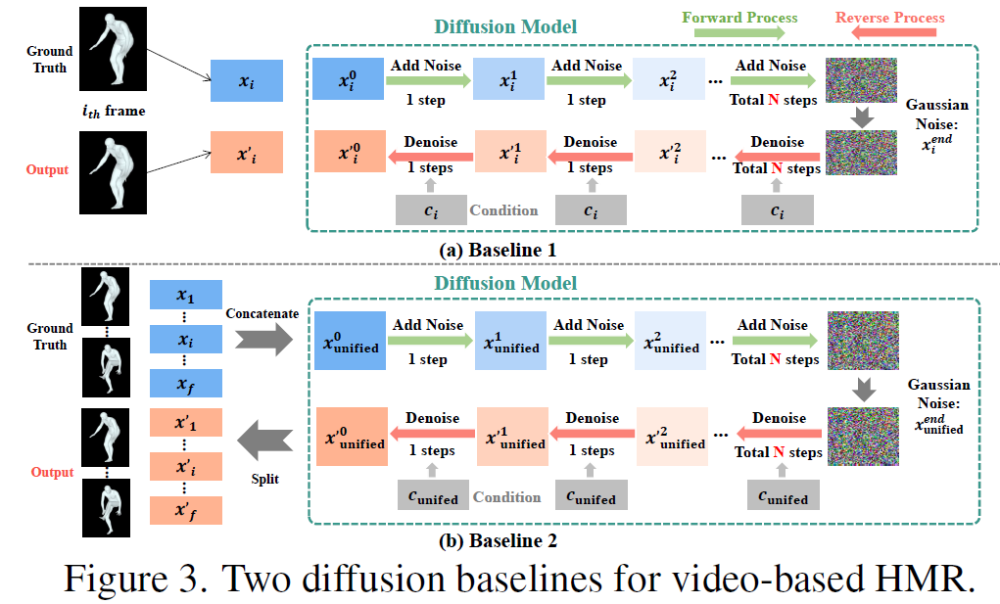
Motivation

Slide 4
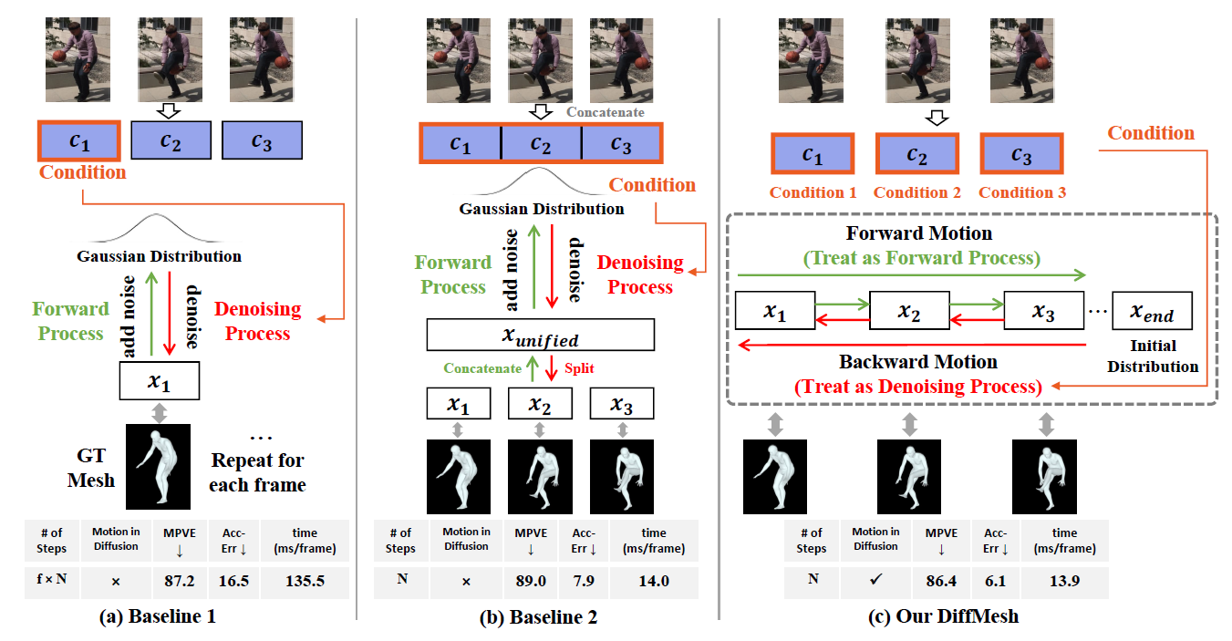
Motivation

Slide 5
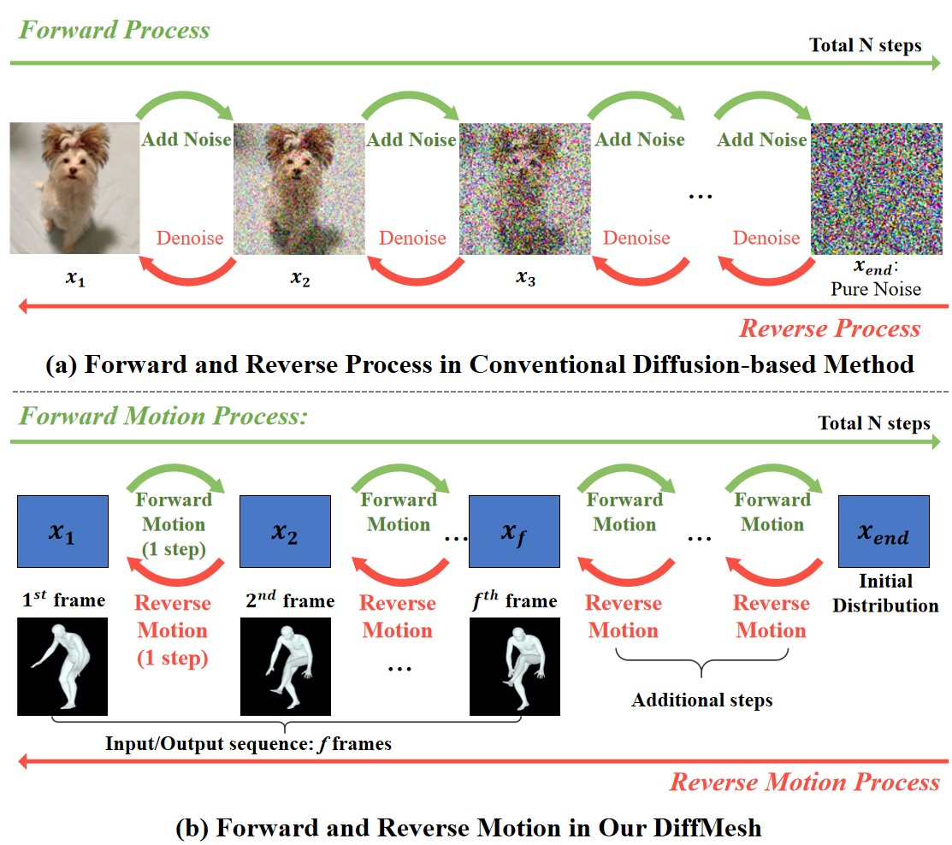
Pipeline
(a) The general pipeline for diffusion model. (b) Human motion is involved over time in the input video sequence. Similar to the forward process in (a), the forward motion between adjacent frames resembles the process of adding noise.

Slide 6
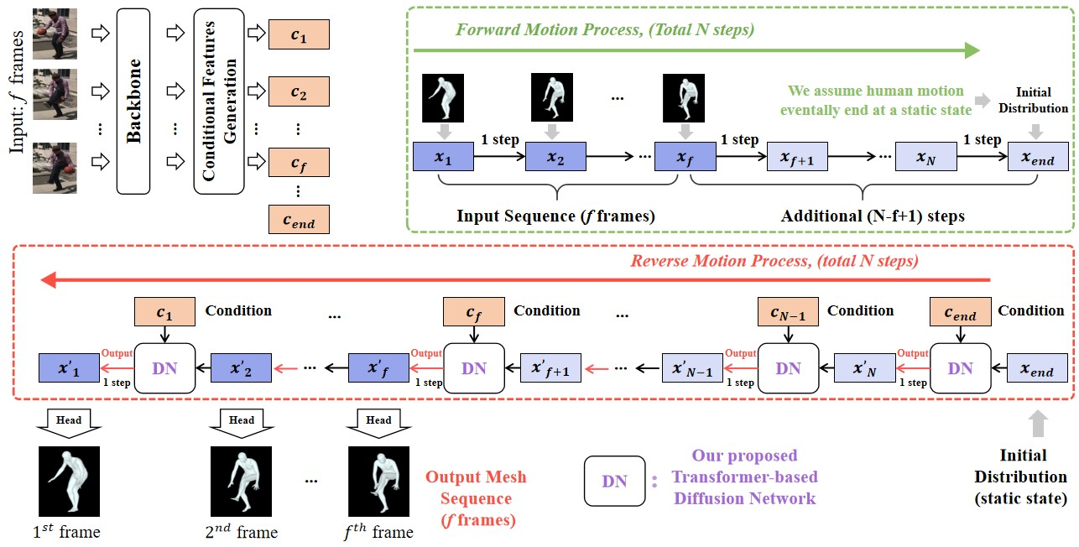
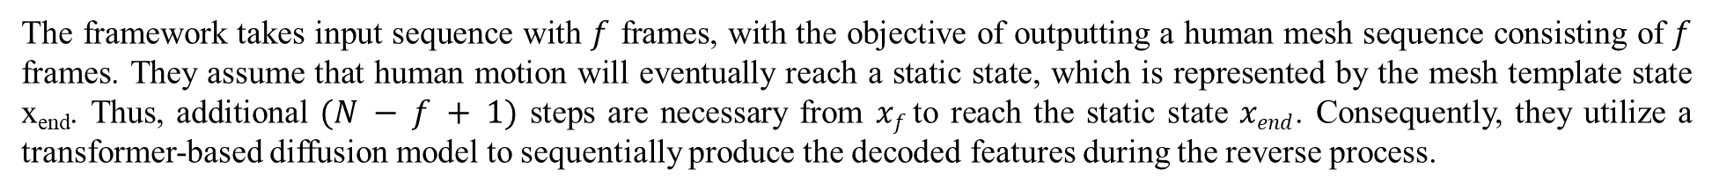
Architecture of DiffMesh
The framework takes input sequence with $f$ frames, with the objective of outputting a human mesh sequence consisting of $f$ frames. They assume that human motion will eventually reach a static state, which is represented by the mesh template state x_{end}. Thus, additional $(N − f + 1)$ steps are necessary from $xf$ to reach the static state $xend$. Consequently, they utilize a transformer-based diffusion model to sequentially produce the decoded features during the reverse process.

Slide 7
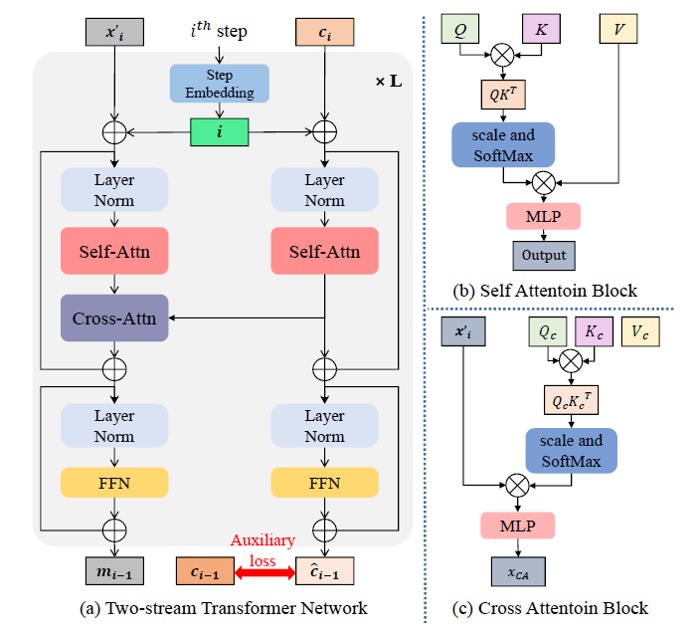
Two-stream transformer network
(a) The architecture of the two-stream transformer network. (b) The self-attention block in the diffusion model. (c) The cross-attention block in the diffusion model. The notation ⊕ represents elementwise addition.

Slide 8

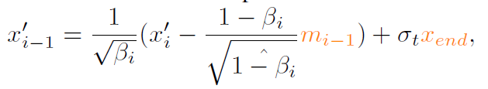
Diffusion-like learning process
Forward Process:
Assumption: human motion consistently influences the human mesh vertices (in the embedded high-dimensional space) across frames
where $mi$ represents the motion pattern from $ith$ frame to $(i + 1)th$frame
Reverse Process:
where $xend$ represents the feature of static state (mesh template),$mi−1$represents the predicted motion

Slide 9
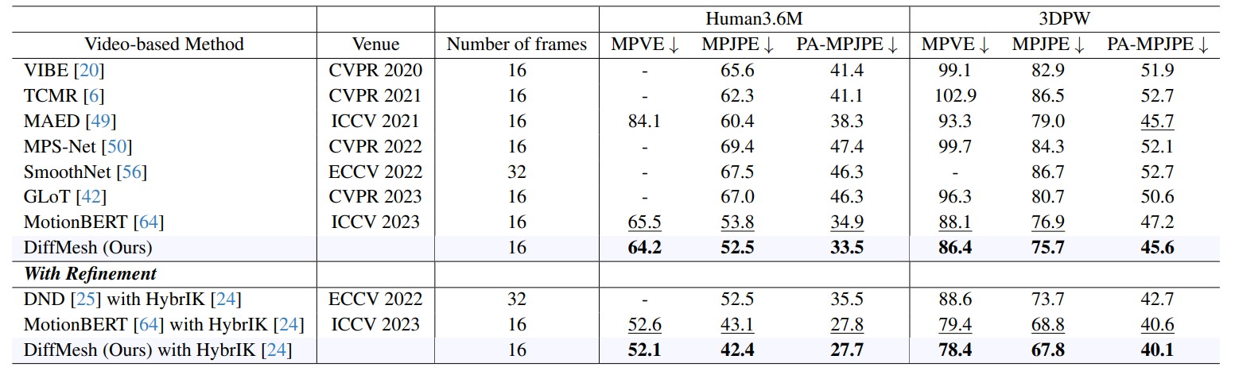
Quantitative results

Slide 10
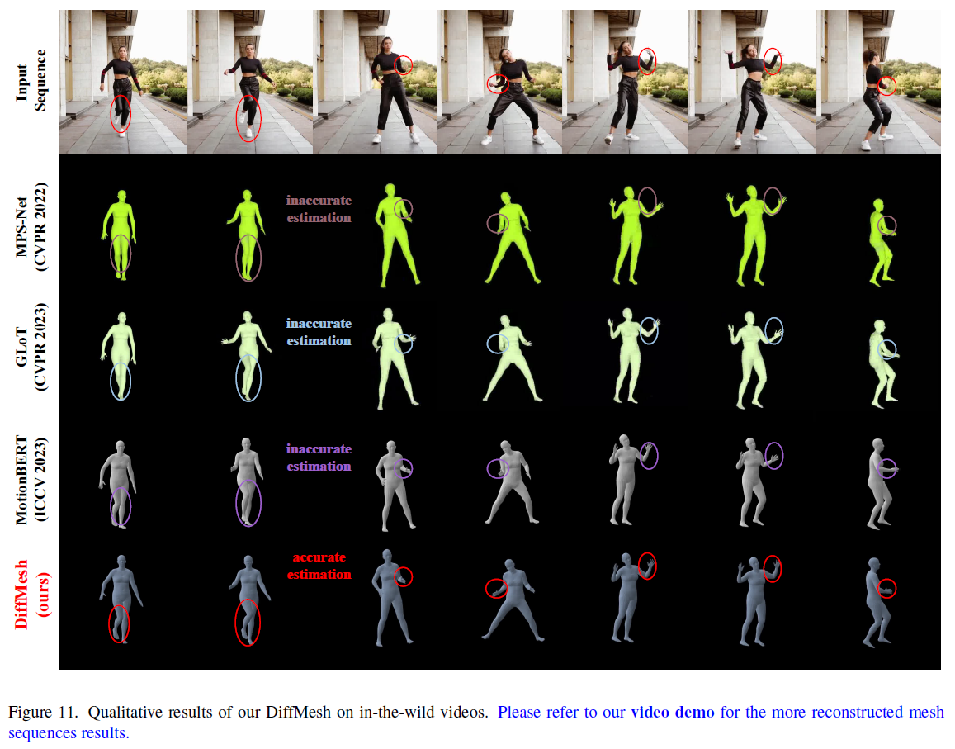
Qualitative results

Slide 11
Thanks for listening
Yande Li 05 Feb, 2024

