Slide 1
TIMECEPTION
FOR COMPLEX ACTION RECOGNITION
Noureldien Hussein, Efstratios Gavves, Arnold W.M. Smeulders
University of Amsterdam
CVPR 2019 (Oral)

Slide 2
Complex Actions
Problem
Preparing Breakfast
Stirring Food
Complex Action
One-action

Slide 3
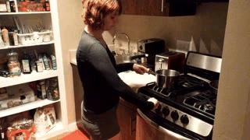
Complex Actions
Problem
Long-range
Temporal Extent
Temporal Dependency
Preparing Breakfast
Complex Action

Slide 4
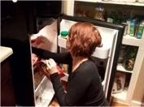
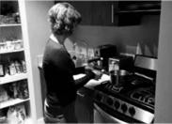

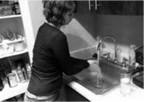
1. Long-range
Problem
• • •
get
cook put
~2 sec.
wash
One-action

Slide 5
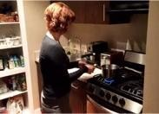
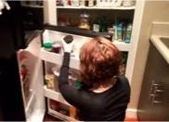

1. Long-range
Problem
• • •
get
cook put
~2 sec.
wash
One-action
~30 sec.
Complex Action

Slide 6
2. Temporal Extent
Problem
• • •
get
cook
put
wash
𝑣₁
get cook put
wash
𝑣₂
get
cook
put
wash
𝑣₃
get
cook
put
wash

Slide 7
2. Temporal Extent
Problem
• • •
get
cook
put
wash
𝑣₁
get cook put
wash
𝑣₂
get
cook
put
wash
𝑣₃
get
cook
put
wash

Slide 8
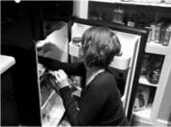
3. Temporal Dependency
Problem
• • •
get
cook
put
wash
get
cook
put
wash

Slide 9


3. Temporal Dependency
Problem
• • •
get
cook
put
wash
get
cook
put
wash

Slide 10




Complex Actions
Problem
1. Dependency
2. Long-range
3. Temporal Extent

Slide 11
Contributions
Introduction of a convolutional temporal layer to learn minute-long action ranges effectively and efficiently
Introduction of multi-scale temporal kernels to account for large variations in duration of action
State-of-the-art results in complex action modeling

Slide 12
Related Works
Temporal Modeling of actions
Max and average pooling – completely neglecting temporal correlation
Using a separate LSTM to model the sequence – multiple frames processing?
Using C3Ds - too computationally expensive to address minute-long videos
Using TRNs to learns relations between several video segments – What about temporal extent tolerance? Only useful for temporal modeling of 4-5 (s)

Slide 13
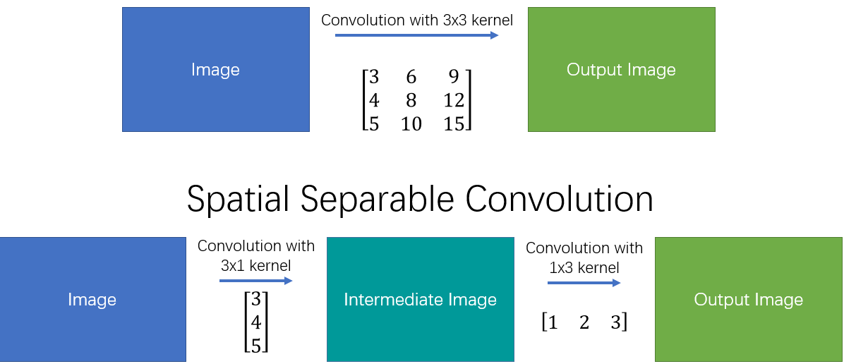
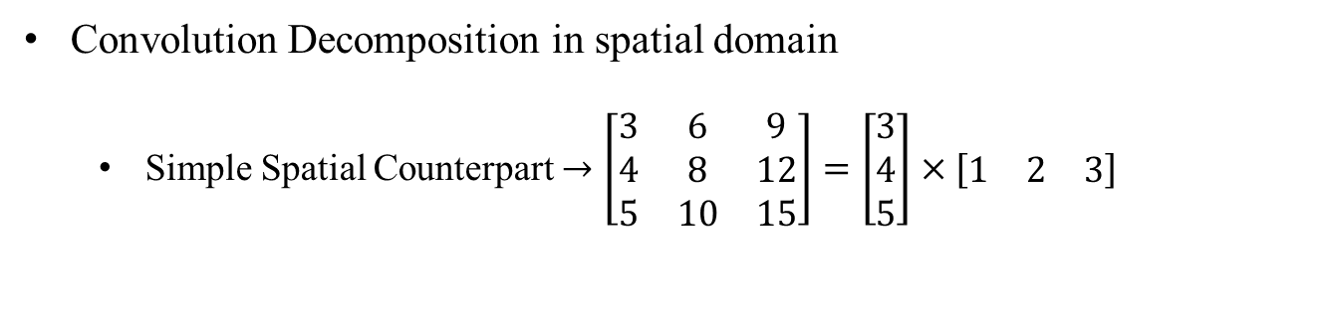
Motivation
How to handle Problem of computational cost in C3Ds
Convolution Decomposition in spatial domain
Simple Spatial Counterpart $→$ $\left[\begin{matrix}3 & 6 & 9 \\ 4 & 8 & 12 \\ 5 & 10 & 15\end{matrix}\right]=\left[\begin{matrix}3 \\ 4 \\ 5\end{matrix}\right]×[\begin{matrix}1 & 2 & 3\end{matrix}]$

Slide 14
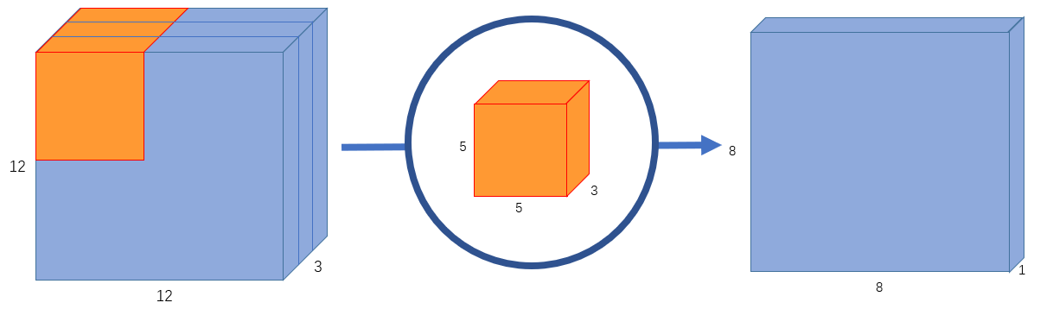
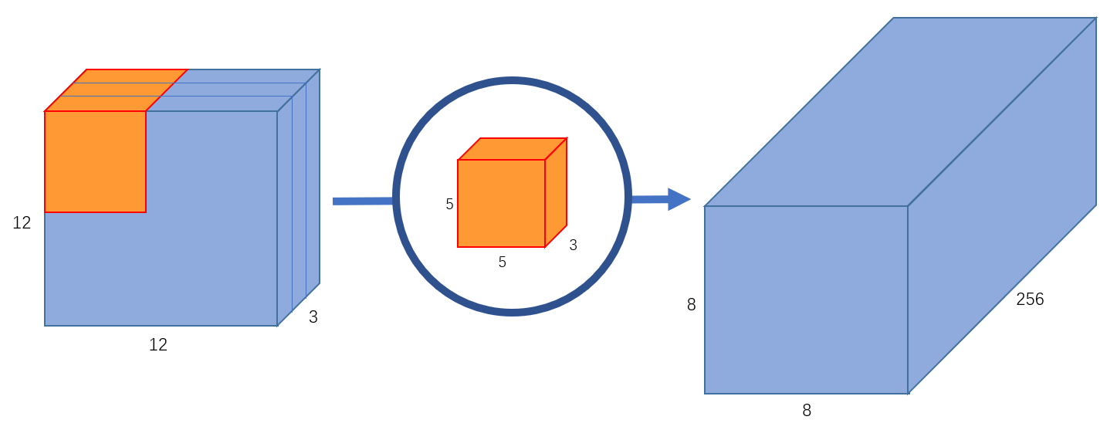
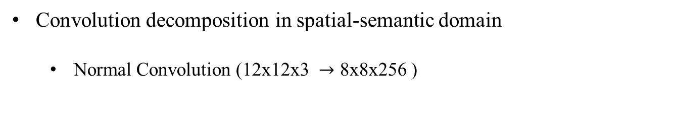
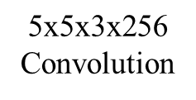
Motivation
How to handle Problem of computational cost in C3Ds
Convolution decomposition in spatial-semantic domain
Normal Convolution ($\text{12}\text{x}\text{12}\text{x}\text{3 }→\text{8}\text{x}\text{8}\text{x}\text{256 }$)
1 kernel
$\text{5}\text{x}\text{5}\text{x}\text{3}\text{x}\text{256}$ Convolution
256 kernels

Slide 15
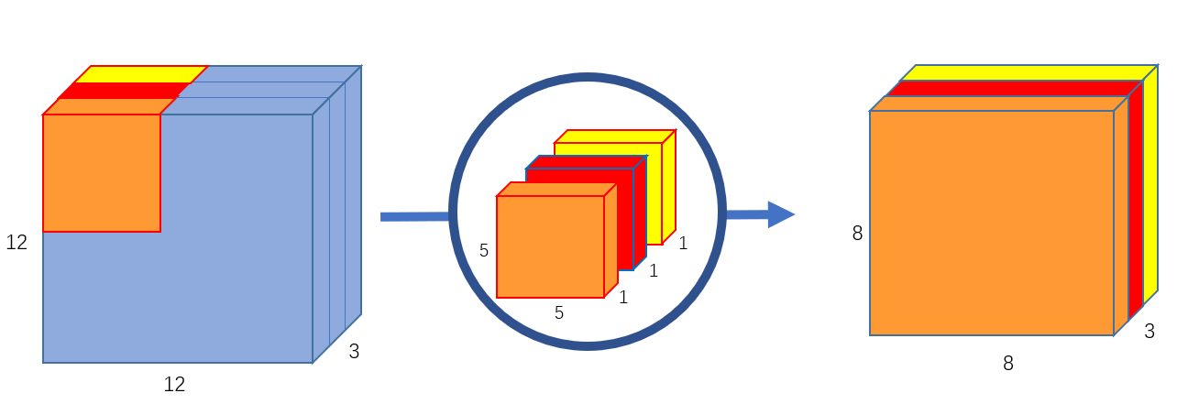
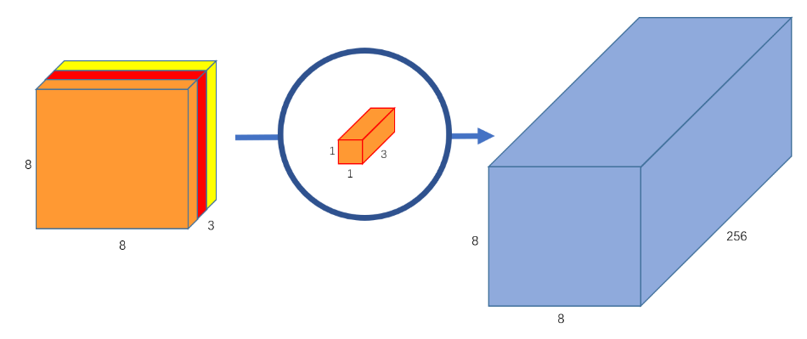
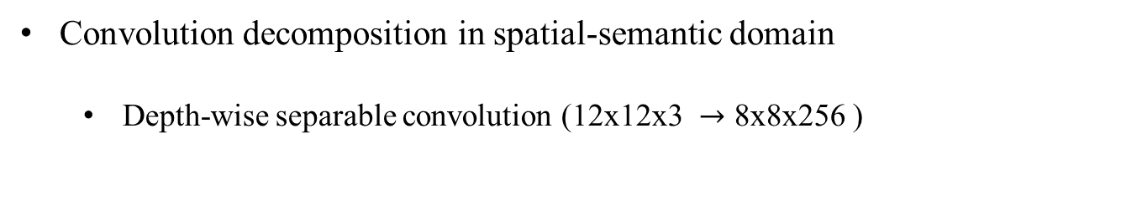
Motivation
How to handle Problem of computational cost in C3Ds
Convolution decomposition in spatial-semantic domain
Depth-wise separable convolution ($\text{12}\text{x}\text{12}\text{x}\text{3 }→\text{8}\text{x}\text{8}\text{x}\text{256 }$)
1
3 5x5x1 kernels
3-5x5x1x1
+
256-1x1x3
2
256 1x1x3 kernels

Slide 16
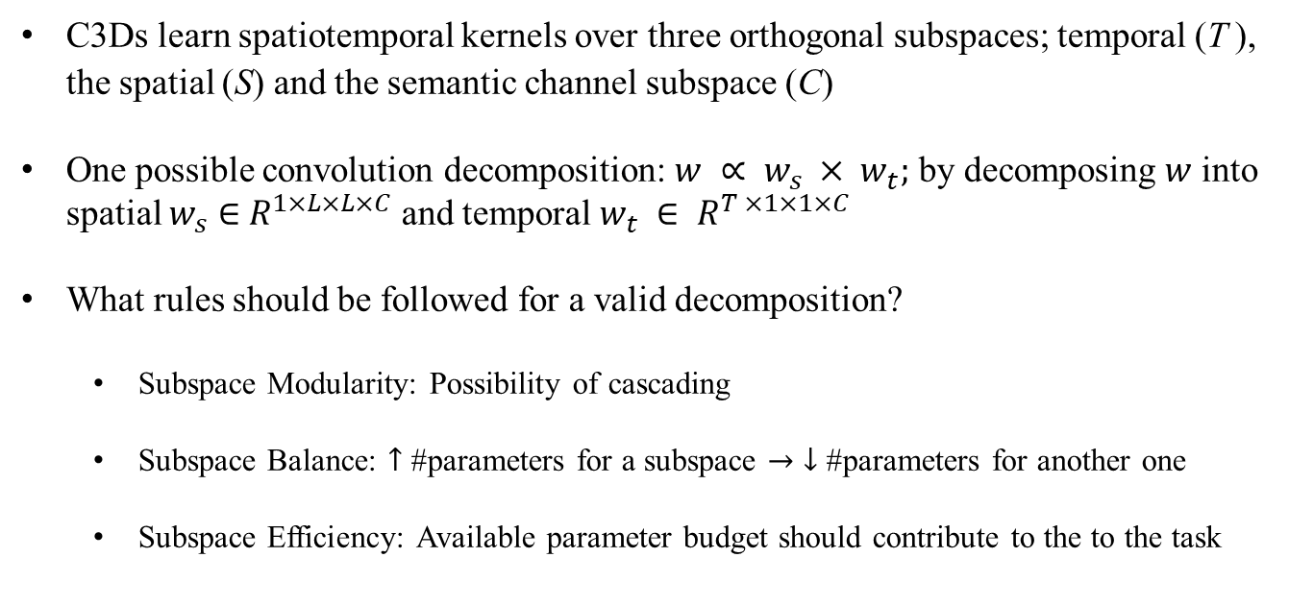
Motivation
Convolution Decomposition in Action Recognition
C3Ds learn spatiotemporal kernels over three orthogonal subspaces; temporal (T ), the spatial (S) and the semantic channel subspace (C)
One possible convolution decomposition: $w ∝ w_{s} × w_{t};$ by decomposing $w$ into spatial $w_{s}$ $∈$ $R^{1×L×L×C}$ and temporal $w_{t} ∈ R^{T ×1×1×C}$
What rules should be followed for a valid decomposition?
Subspace Modularity: Possibility of cascading
Subspace Balance: $↑$ #parameters for a subspace $→$ $↓$ #parameters for another one
Subspace Efficiency: Available parameter budget should contribute to the to the task

Slide 17
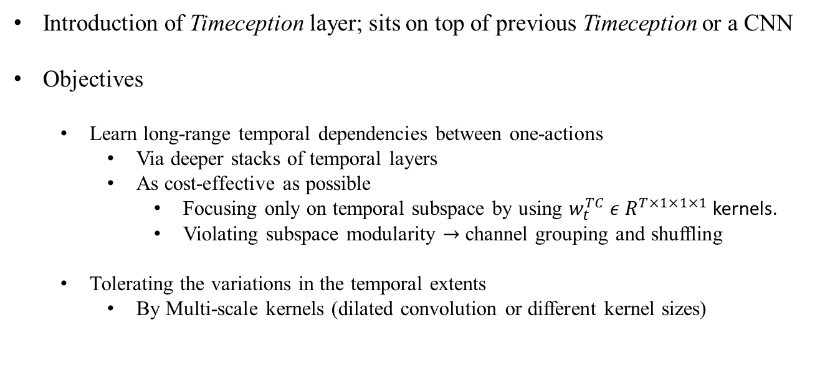
METHOD
Introduction of Timeception layer; sits on top of previous Timeception or a CNN
Objectives
Learn long-range temporal dependencies between one-actions
Via deeper stacks of temporal layers
As cost-effective as possible
Focusing only on temporal subspace by using $w_{t}^{TC} ε R^{T×1×1×1}$kernels.
Violating subspace modularity $→$ channel grouping and shuffling
Tolerating the variations in the temporal extents
By Multi-scale kernels (dilated convolution or different kernel sizes)

Slide 18
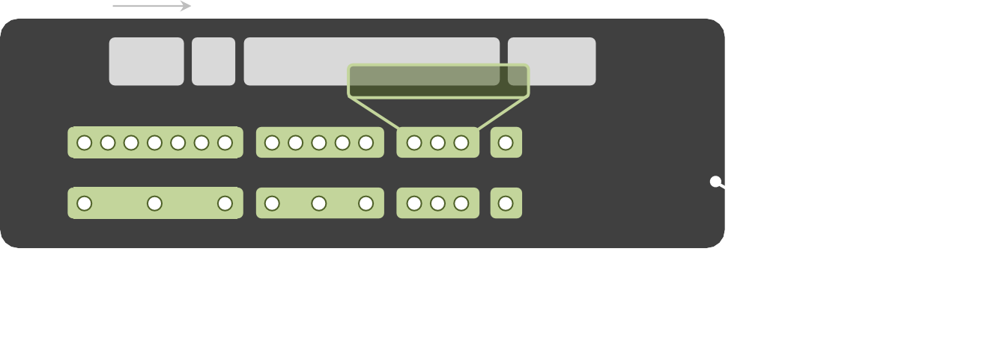
Tolerating Temporal Extents
Method
𝐶
Group
Grouping + Shuffling
Shuffle

Slide 19
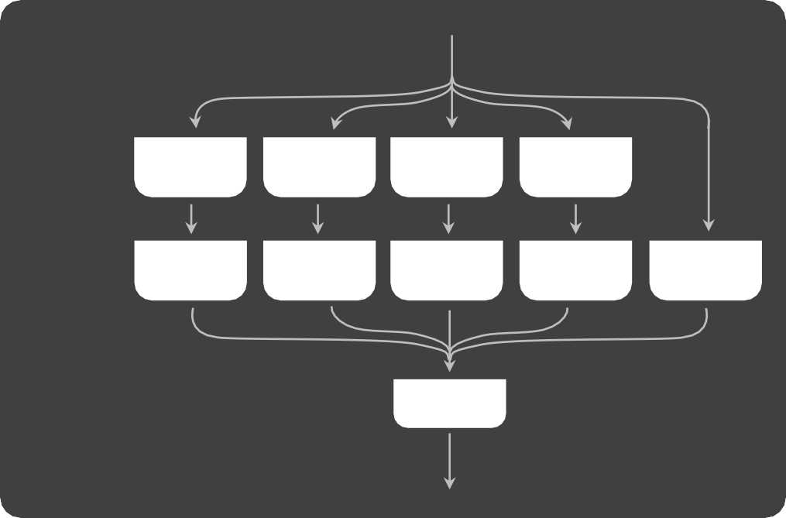
Image
• • •
Method
𝐼₁
𝐼_{𝑇}
2D CNN
Timeception
𝑥₁
𝑥
𝑇
• • •
Timeception
T × L × L × C
𝑥
T × L × L × C/N
T × L × L × C/N
Group
T × L × L × C/N
Conv 1D
k=3 s=1
Conv 1D
k=5 s=1
Conv 1D
k=7 s=1
Max 1D
T × L × L × C/N
Conv 1D
Temp Conv • • • Temp Conv
Conv 2D
K=1*1
Conv 2D
K=1*1
Conv 2D
K=1*1
Conv 2D
K=1*1
Conv 2D
K=1*1
T × T × L × L ×5 C/(M.N)
Concat + Shuffle
T × L × L ×5 C/M
Max 1D
T × L × L × C/(M. N)
Concat
T/2 × L × L ×5 C/M
𝑦
T × L × L × 5C/(M. N)
Model Overview

Slide 20
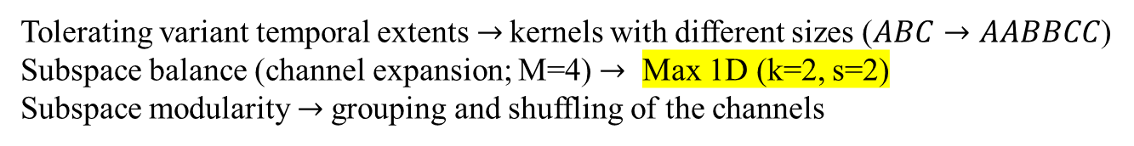
Method
3
6
Tolerating variant temporal extents$→$ kernels with different sizes ($ABC→AABBCC$)
Subspace balance (channel expansion; M=4) $→$ Max 1D (k=2, s=2)
Subspace modularity $→$grouping and shuffling of the channels
T × L × L × C
𝑥
T × L × L × C/N
T × L × L × C/N
Group
T × L × L × C/N
Max 1D
k=2 s=1
Conv 1D
k=3 s=1
Conv 1D
k=5 s=1
Conv 1D
k=7 s=1
T × L × L × C/N
Conv 1D
Temp Conv • • • Temp Conv
Conv 2D
K=1*1
Conv 2D
K=1*1
Conv 2D
K=1*1
Conv 2D
K=1*1
Conv 2D
K=1*1
T × T × L × L ×5 C/(M.N)
Concat + Shuffle
T × L × L ×5 C/M
Max 1D
T × L × L × C/(M. N)
Concat
T/2 × L × L ×5 C/M
𝑦
T × L × L × 5C/(M. N)
Model Overview

Slide 21
Method
Long-term dependency
Conv Layer (1)
Stacking layers of temporal convolution
Local max-pooling operation with size=2
Receptive field of 7 in the first layer
Receptive field of 7*2 in the second
Conv Layer (2)
Conv Layer (3)

Slide 22
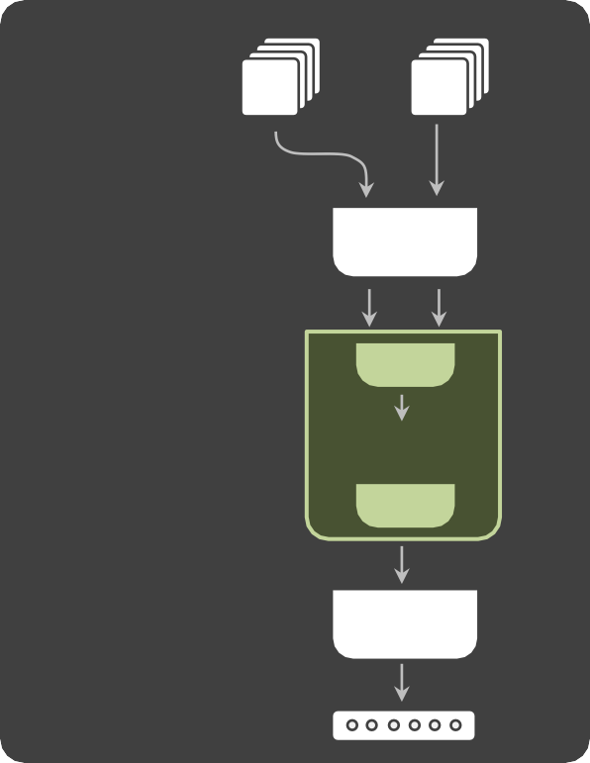
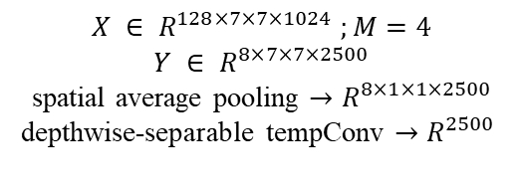
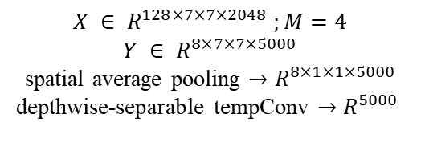
Timeception
Method
Video
Segment
Image
• • •
• • •
𝐼₁
𝐼_{𝑇}
𝑠₁
𝑠_{𝑇}
3D CNN
𝑥_{𝑇}
res5c
2D CNN
Mixed-5c
𝑥₁
𝑥_{𝑇}
𝑥₁
• • •
• • •
×4
×4
• • •
• • •
𝑦
Dense
𝑦
Dense
Predictions
Predictions
$$X ∈ R^{128×7×7×2048} ;M=4$$
$$Y ∈ R^{8×7×7×5000}$$
spatial average pooling $→R^{8×1×1×5000}$
depthwise-separable tempConv $→R^{5000}$
$$X ∈ R^{128×7×7×1024} ;M=4$$
$$Y ∈ R^{8×7×7×2500}$$
spatial average pooling $→R^{8×1×1×2500}$
depthwise-separable tempConv $→R^{2500}$

Slide 23
Datasets
Charades
Multilabel, action classification, video dataset with 157 classes
8k, 1.2k and 2k videos for training, validation and test
Each complex action is about 30 seconds and contains 6 one-actions
Breakfast
1712 videos; 1357 for training and 335 for test
The average length of videos is 2.3 minutes
12 categories of breakfast activities; 48 classes of one-actions in total
MultiTHUMOS
65 action classes and 400 videos
Each complex video comprises 11 one-actions on average

Slide 24
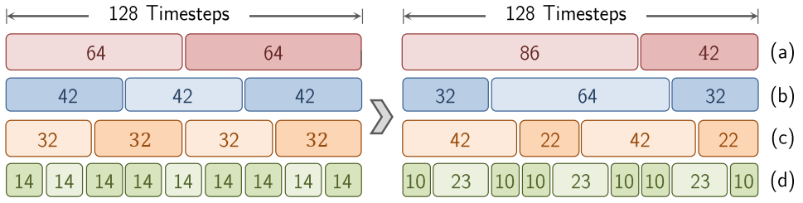
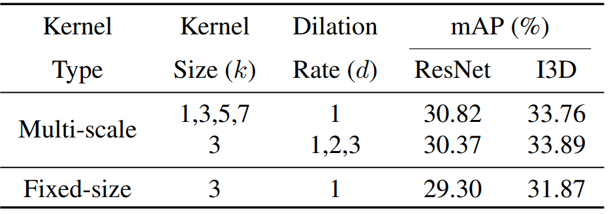
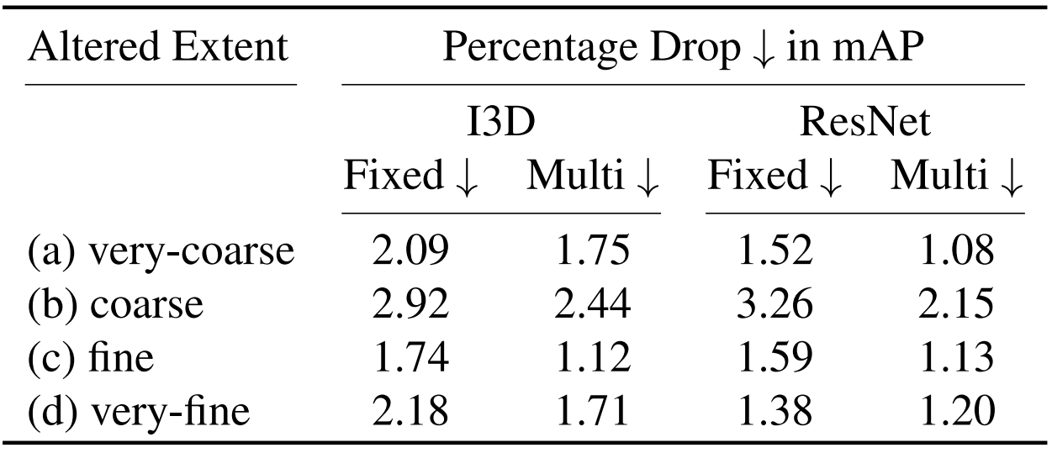
Temporal Extent Tolerance
Results
Contribution of multi-scale kernels on Charades
Training on two baselines (Charades)
Multi-scale temporal kernels and fixed-size kernels
Training on original
Testing on the altered temporal extents
Contribution of multi-scale kernels on Charades
Temporal extent tolerance

Slide 25
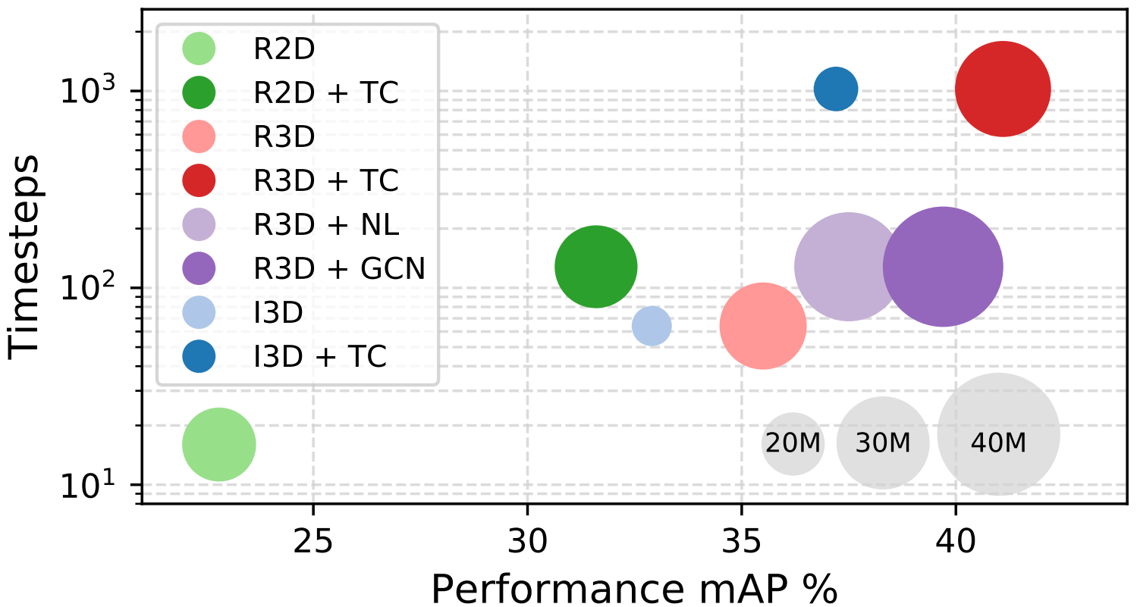
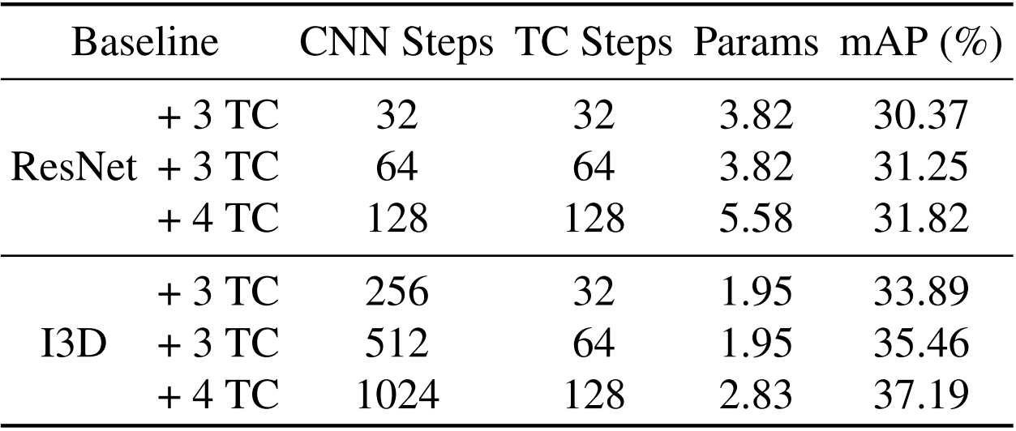
Charades Dataset
Results

Slide 26
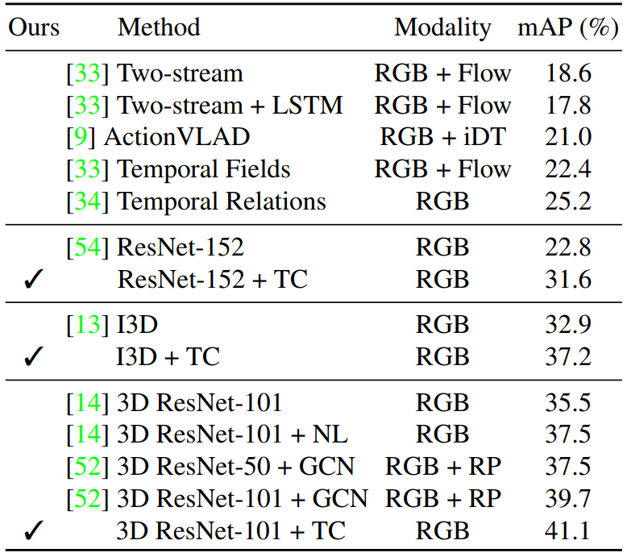
Charades Dataset
Results
Timeception (TC) outperforms related works using the same backbone CNN. It achieves the absolute gain of 8:8% and 4:3% over ResNet and I3D, respectively. More over, using the full capacity of Timeception improves 1:4% over best related work.

Slide 27
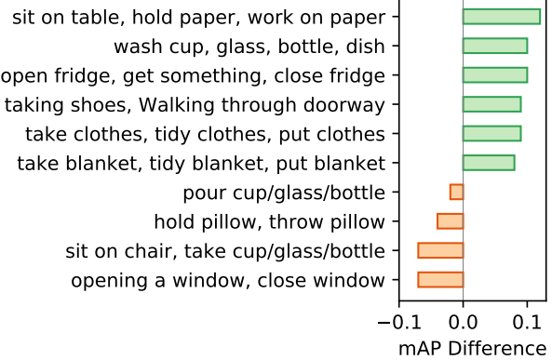
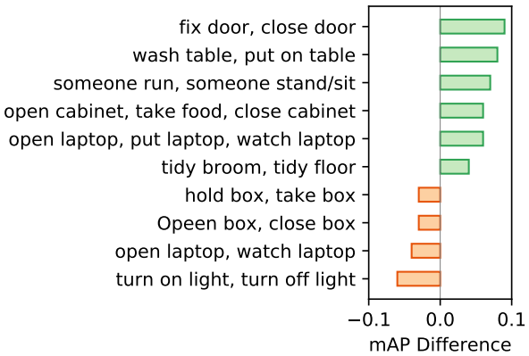
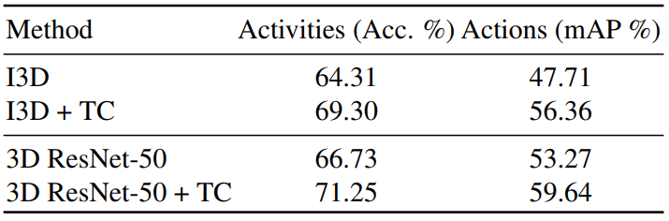
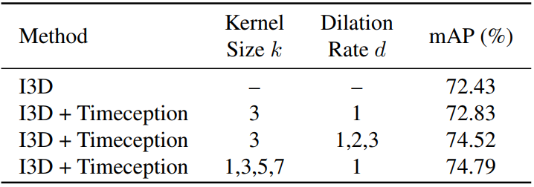
Other Datasets
Results
Charades Dataset
Multi-scale Timeception outperforms the fixedkernel when complex actions are dynamic
Long-range Timeception outperforms the short-range version when complex actions need the entire video to unfold
Breakfast dataset
MultiTHUMOS dataset

Slide 28
Thank you for your attention

