Slide 1
Reasoning with Foundation Models
Zhenglin Pan | MEng 22-Fall

Slide 2
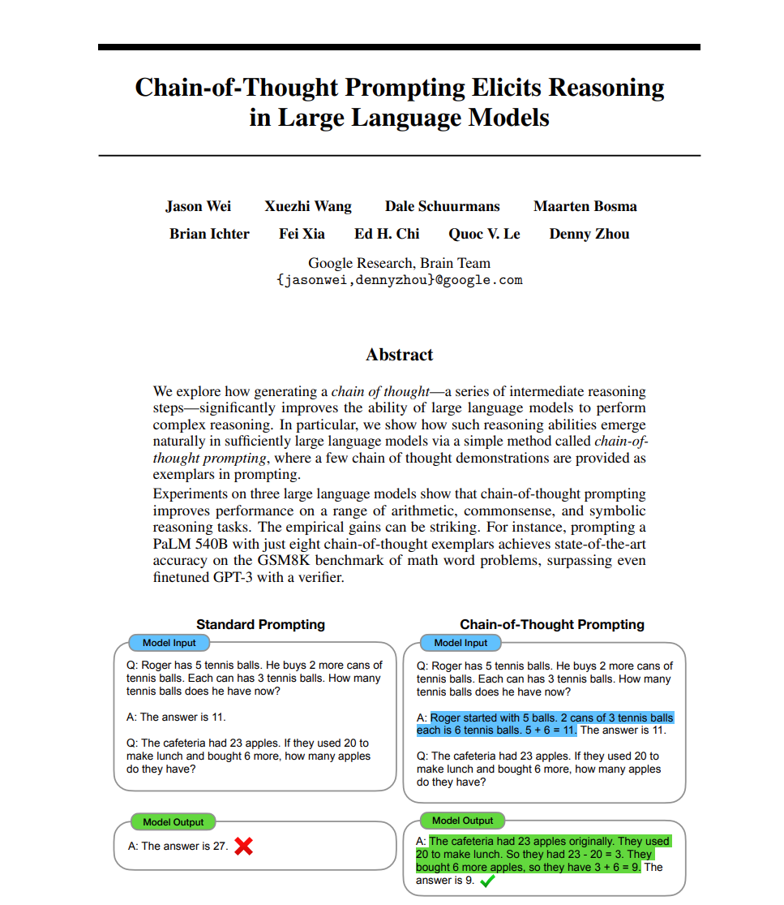
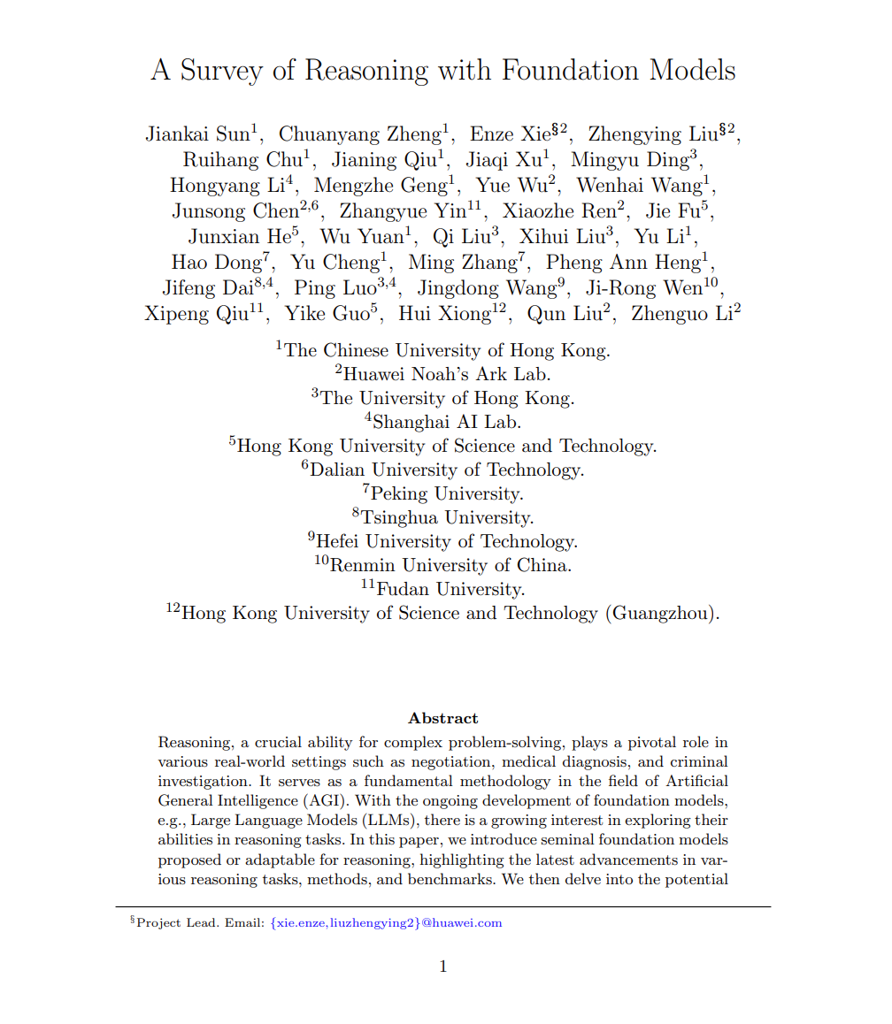
Based on the 2 papers
Chain-of-thought prompting elicits reasoning in large language models[1]
A Survery of Reasoning with Foundation Models [2]

Slide 3
We are going to cover 2 points
- What can we do with Foundation Models (and use them in your research)?
- How could we prompt Foundation Models?

Slide 4

This is NOT a lesson
I am just sharing...

Slide 5
Paper 1
Jan 2024
👈 A Survey of recent Foundation Models
Introduces many FMs in various research area
- Visual
- Multimodal
- Mathematical
- Agent
- Casual
- more...
Miscellaneous! We only cover Visual and Multimodal here!

Slide 6
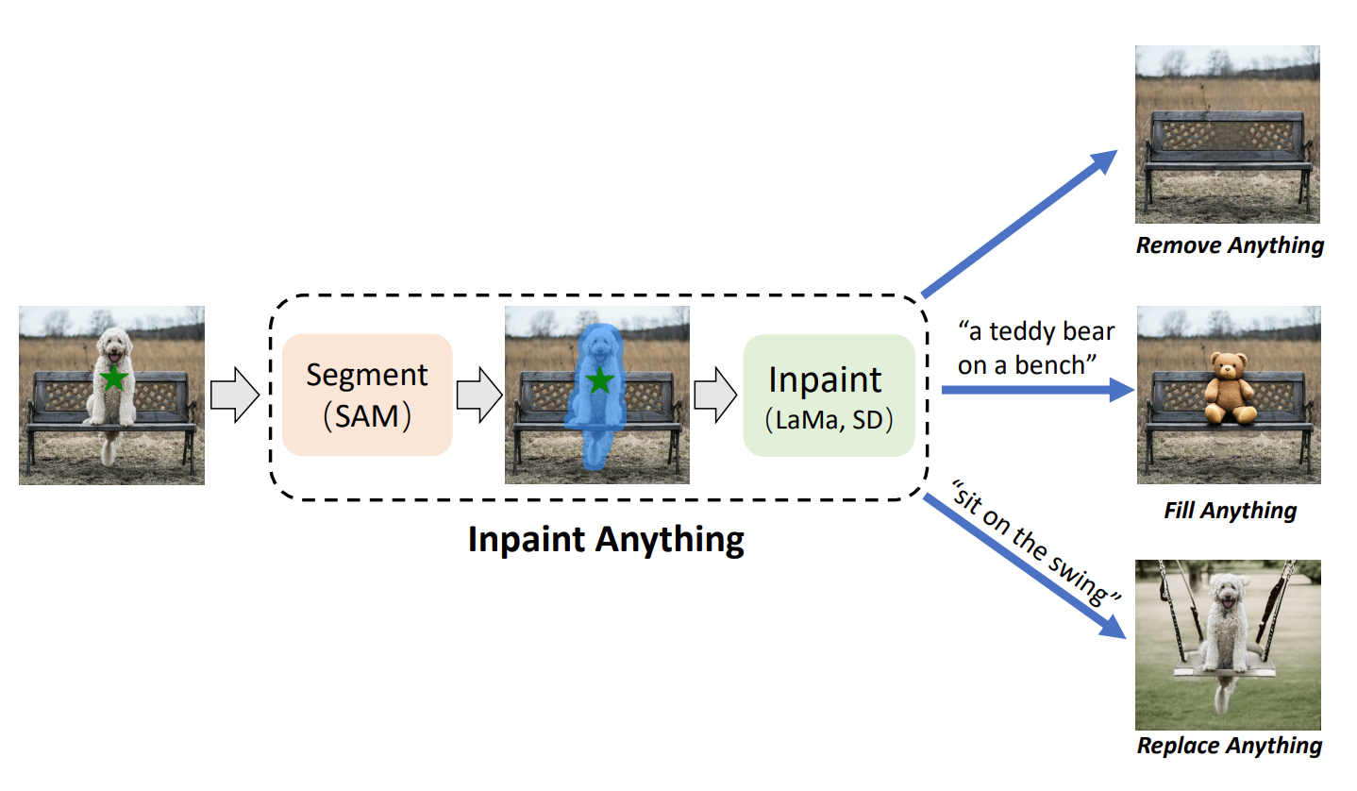
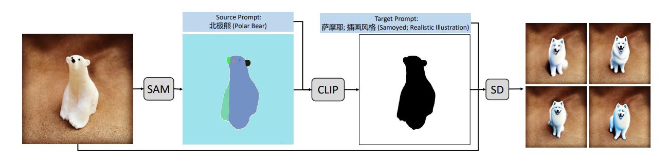
FM Paradigm 1
Paradigm 1
Foundation
Model
Foundation
Model
Foundation
Model
Model Fusion
Inpaint Anything³ = SD⁴ + SAM⁵
Edit Everything⁶ = SAM⁵ + CLIP⁷ + SD⁴

Slide 7
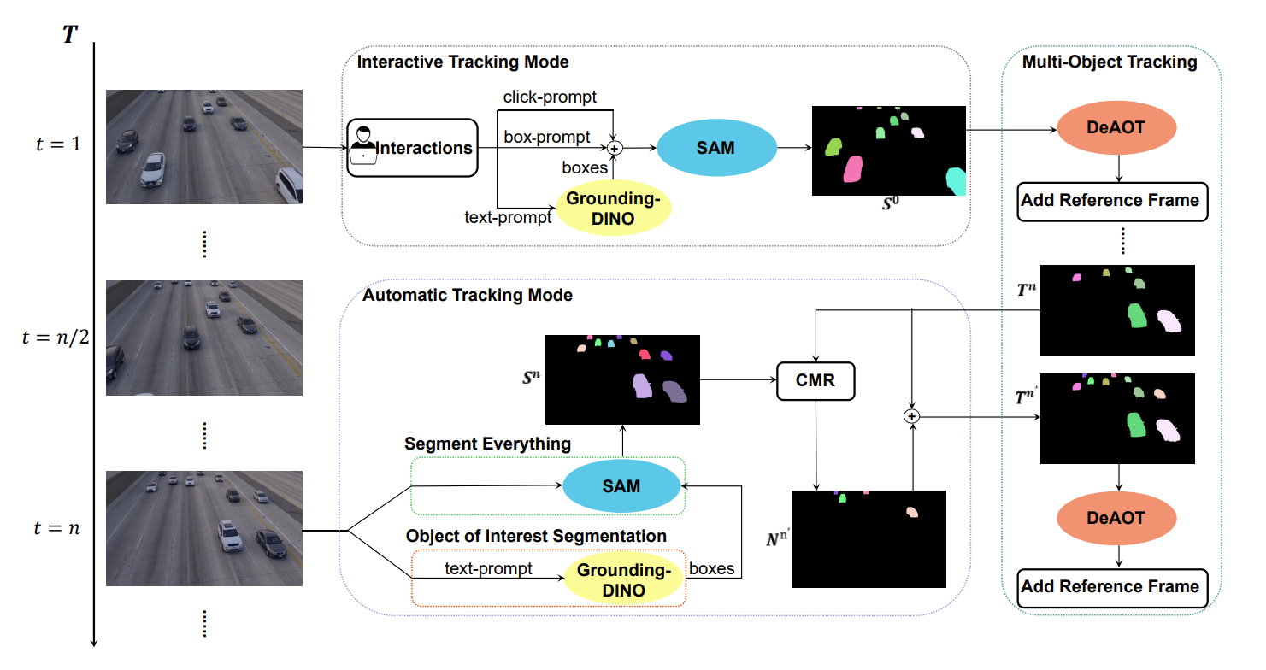
FM Paradigm 2
Paradigm 2
Downstream
Task
Foundation
Model
Downstream
Task
Foundation
Model
Model Concatenation
SAM-Track⁸ = SAM⁵ + DeAOT⁹

Slide 8
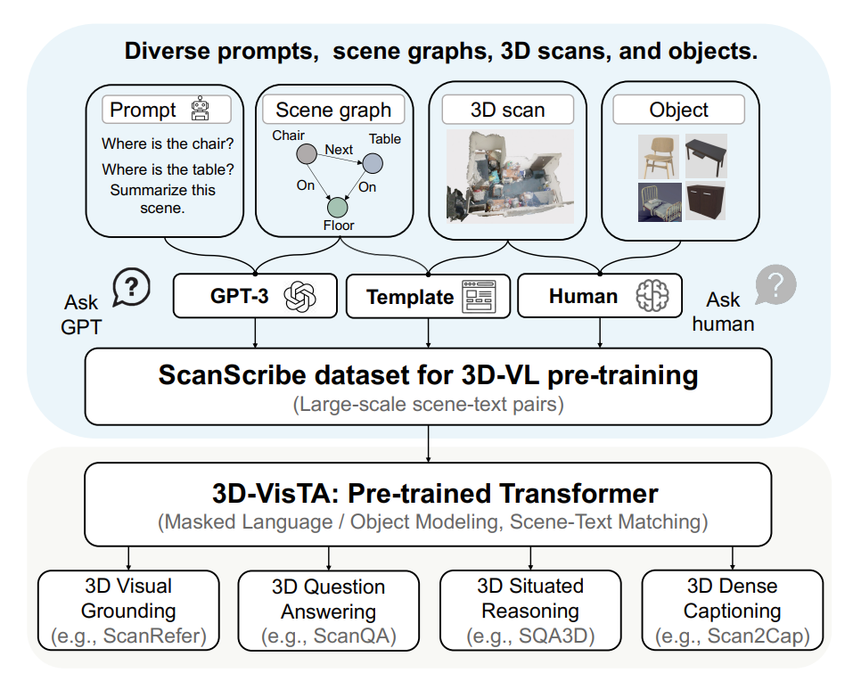
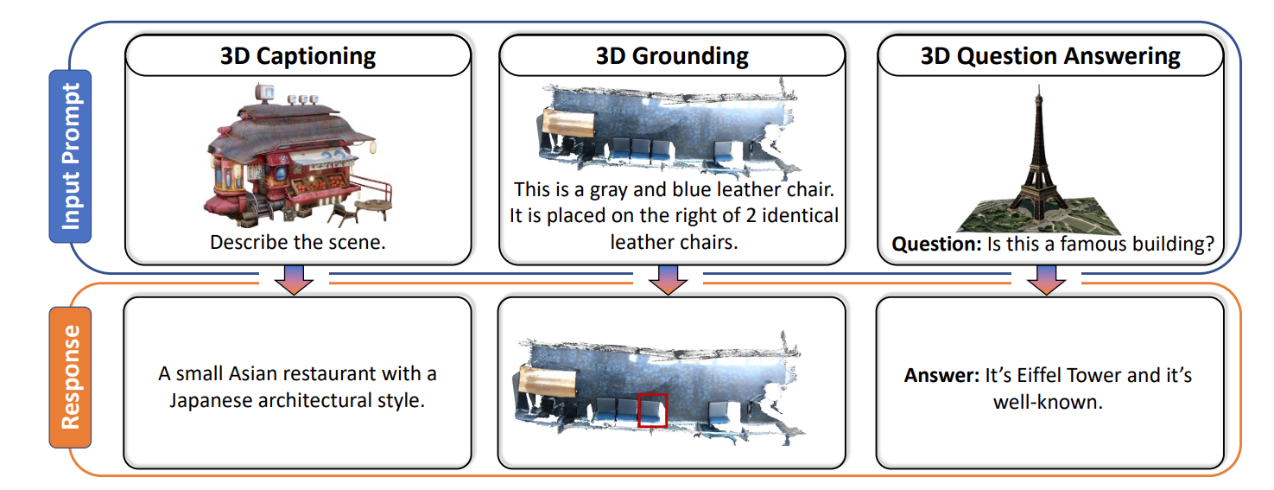
FM Paradigm 3
Paradigm 3
Foundation
Model
Modality
Foundation
Model
Model Transfer
3D-VisTa¹¹ = PointCloud + CLIP⁷
3D-LLM¹⁰ = 3D objects + LLM

Slide 9
Take-aways
What can we do with Foundation Models (and use them in your research)?
Paradigm 1
Foundation
Model
Foundation
Model
Foundation
Model
Model Fusion
Paradigm 2
Downstream
Task
Foundation
Model
Downstream
Task
Foundation
Model
Model Concatenation
Paradigm 3
Foundation
Model
Modality
Foundation
Model
Model Transfer

Slide 10
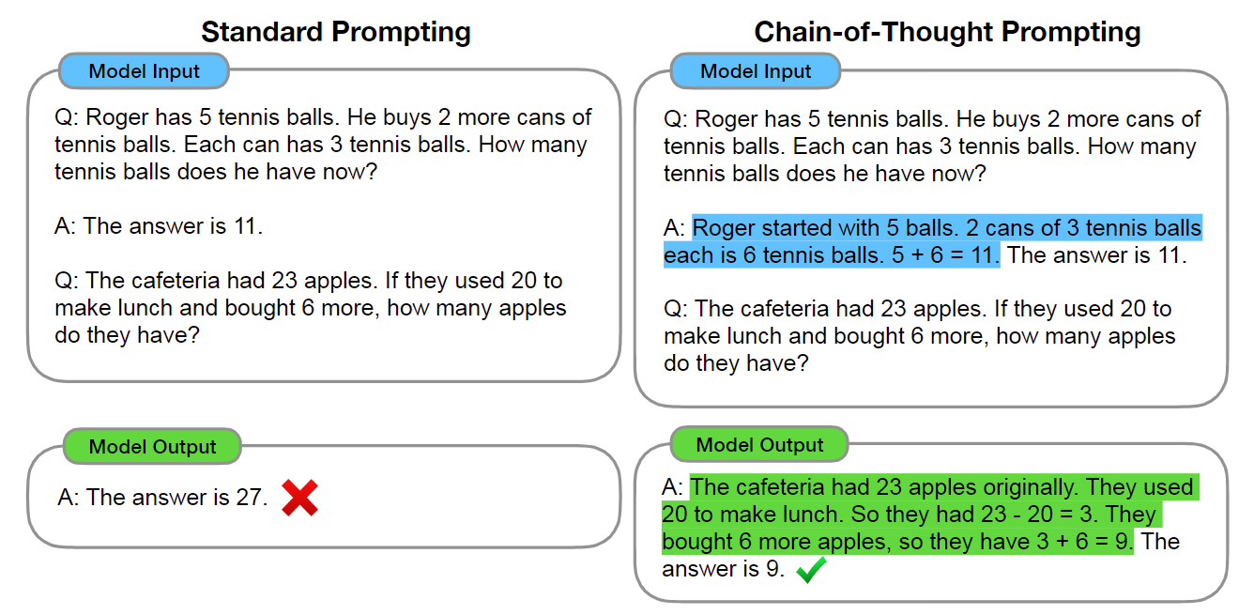
Paper 1
👈 Proposed Train of Thoughts Prompting
Reasoning Step-by-Step

Slide 11
How could we prompt Foundation Models?
1. Role Play
2. Emotion Simulations
3. Train of thoughts
Standard Prompt
Optimized Prompt
“Tell me the result of 1+2+3+4+5.”
“As an math expert, Tell me the result of 1+2+3+4+5. Break it down and solve it step-by-step, you’ll be rewarded with $10 if correct”
“As an math expert, tell me the...”
Role Play
“...you’ll be rewarded with $10 if correct”
Emotion Simulation
“Break it down and solve it step-by-step”
Train of Thoughts

Slide 12
Refernece
[1] Wei, Jason, et al. "Chain-of-thought prompting elicits reasoning in large language models." Advances in neural information processing systems 35 (2022): 24824-24837.
[2] Sun, Jiankai, et al. "A survey of reasoning with foundation models." arXiv preprint arXiv:2312.11562 (2023).
[3] Yu, Tao, et al. "Inpaint anything: Segment anything meets image inpainting." arXiv preprint arXiv:2304.06790 (2023).
[4] Rombach, Robin, et al. "High-resolution image synthesis with latent diffusion models. 2022 IEEE." CVF Conference on Computer Vision and Pattern Recognition (CVPR). 2021.
[5] Kirillov, Alexander, et al. "Segment anything." Proceedings of the IEEE/CVF International Conference on Computer Vision. 2023.
[6] Xie, Defeng, et al. "Edit everything: A text-guided generative system for images editing." arXiv preprint arXiv:2304.14006 (2023).
[7] Radford, Alec, et al. "Learning transferable visual models from natural language supervision." International conference on machine learning. PMLR, 2021.
[8] Cheng, Yangming, et al. "Segment and track anything." arXiv preprint arXiv:2305.06558 (2023).
[9] Yang, Zongxin, and Yi Yang. "Decoupling features in hierarchical propagation for video object segmentation." Advances in Neural Information Processing Systems 35 (2022): 36324-36336.
[10] Hong, Yining, et al. "3d-llm: Injecting the 3d world into large language models." Advances in Neural Information Processing Systems 36 (2023): 20482-20494.
[11] Zhu, Ziyu, et al. "3d-vista: Pre-trained transformer for 3d vision and text alignment." Proceedings of the IEEE/CVF International Conference on Computer Vision. 2023.

