Slide 1
Video Object Segmentation with Episodic Graph Memory Networks (ECCV‘20)
Authors:
Xiankai Lu: Research Associate, Inception Institute of Artificial Intelligence (IIAI), Abu Dhabi, UAE
Wenguan Wang: Postdoc, ETH Zurich
Martin Danelljan: Postdoc, ETH Zurich
Tianfei Zhou: Researcher, Inception Institute of Artificial Intelligence, Abu Dhabi, UAE
Jianbing Shen: Lead Scientist, Inception Institute of Artificial Intelligence (IIAI); Professor, BIT
Luc Van Gool: Professor, Head of Toyota Lab TRACE, ETH Zurich & KU Leuven
Presented by Javad Khaghani
Aug 16, 2020

Slide 2
Outline
Introduction
Proposed Method
Overall Diagram
Controller Signals
Training & Interference Details
Implementation Details
Quantitative Results
Ablation Study
Qualitative Results

Slide 3
Introduction
Previous One-Shot VOS (O-VOS) methods:
Finetuning-based
Propagation-based
Matching-based
Method:
Leaning to update segmentation model using episodic memory reasoning
Contributions:
Episodic Graph Memory Network with Fixed Memory Size to Learning to Update Segmentation Model
Learnable Read and Write Controllers
First Unified Method for O-VOS and Z-VOS

Slide 4
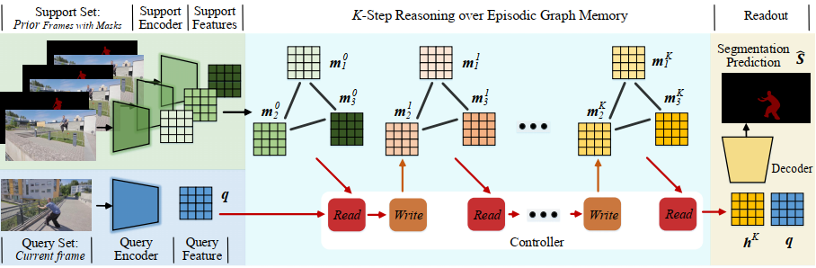



Overall Diagram of proposed graph memory
$$q=f_{enc}(I_{t})$$
For O-VOS: $m_{i}^{0}=f_{enc}(f_{1}(\left({I_{i}, M}_{i},L_{i}\right)))$
$$\hat{S}=f_{R}(h^{K}, q)$$

Slide 5
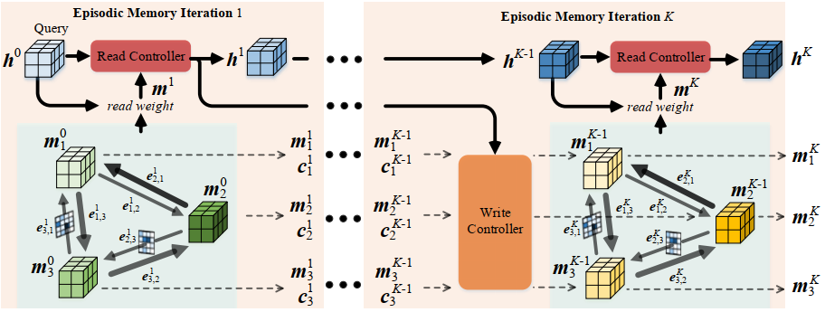

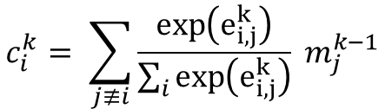
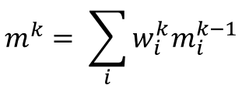

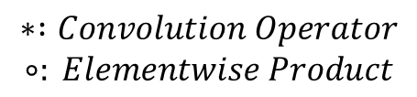
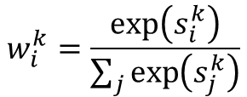

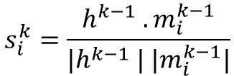



Controller Signals
$$h^{0}=f_{P}\left(q\right)$$
$${\tilde{m_{i}}}^{k}=W_{u}^{m} ∗h^{k}+U_{u}^{m}∗m_{i}^{k−1}+V_{u}^{m} ∗c_{i}^{k}$$
$${\tilde{h}}^{k}=W_{r}^{h} ∗h^{k−1}+U_{r}^{h} ∗m^{k}$$
$$s_{i}^{k}=\frac{h^{k−1} . m_{i}^{k−1}}{{|h}^{k−1} | {|m}_{i}^{k−1}|}$$
$$e_{i,j}^{k}=m_{i}^{k−1} W_{e} ({m_{j}^{k−1})}^{T}$$
$$a_{u}^{k}= σ(W_{u}^{a}∗h^{k}+U_{u}^{a}∗m_{i}^{k−1}+V_{u}^{a} ∗c_{i}^{k})$$
$$a_{r}^{k}= σ (W_{r}^{a} ∗h^{k−1}+U_{r}^{a} ∗m^{k})$$
$$w_{i}^{k}=\frac{\exp\left(s_{i}^{k}\right)}{\sum_{j}{\exp\left(s_{j}^{k}\right)}}$$
$$m_{i}^{k}=a_{u}^{k}∘{\tilde{m_{i}}}^{k}+\left(1−a_{u}^{k}\right)∘m_{i}^{k−1}$$
$$c_{i}^{k}= \sum_{j≢i}{\frac{\exp\left(e_{i,j}^{k}\right)}{\sum_{i}{\exp\left(e_{i,j}^{k}\right)}}} m_{j}^{k−1}$$
$h^{k}=a_{r}^{k}∘{\tilde{h}}^{k}+(1−a_{r}^{k}$) $∘{\tilde{h}}^{k−1}$
$$m^{k}= \sum_{i}{w_{i}^{k}m_{i}^{k−1}}$$
$$∗ :Convolution Operator$$
$$∘: Elementwise Product$$

Slide 6
Training and Interference Details
Training
For each video, sample N+1 frames
N frames for support set
One frame for query set
Use label shuffling strategy for each episode
Prevent from memorizing the relation of instance and label
Use synthetic data for pretraining
For O-VOS, use MSRA10K and COCO
For Z-VOS, use MSRA10K and DUT
Main Training on video-based datasets
For O-VOS, use DAVIS 17 & Youtube-VOS
For Z-VOS, use DAVIS 16
For Z-VOS, we just have RGB input for support set
Interference
Process each video sequentially
Use N frames to form graph memory network
First frame (as we have its ground-truth mask)
Last Segmented Frame
N-2 frames sampled from previous segmented masks
Runs at 5 fps for O-VOS
For Z-VOS, randomly sample N frames from the sequence to form graph memory for each query
Global information is more important for challenging scenarios
For Z-VOS, it runs at 0.3s per frame

Slide 7
Implementation Details
For pretraining, randomly crop 384*384 patches from static images
For main training, randomly crop 384 *640 patches from real video datasets (VOS)
For training, randomly sample N+1=4 samples with maximum skip of 25 frames
Implemented using PyTorch
Trained on four NVIDIA Tesla V100 GPUs with 32 GB memory per card
Batch size of 16
Adam as optimizer with poly learning schedule
For O-VOS, pretraining took 24 hours, and main training 16 hours

Slide 8
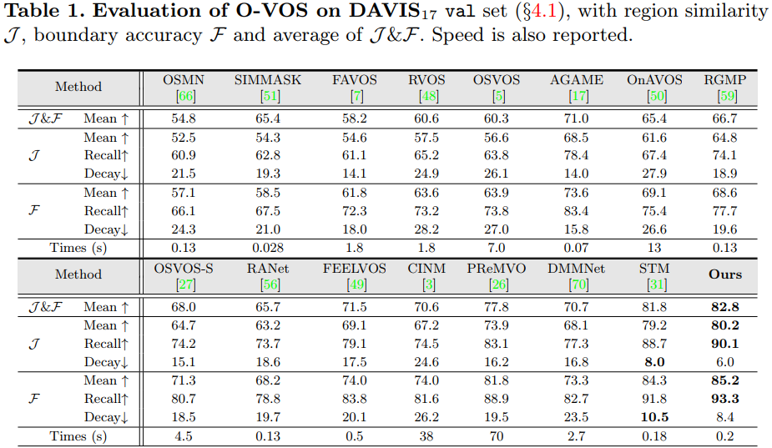
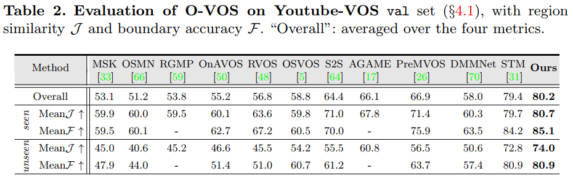
Quantitative Results of O-VOS

Slide 9
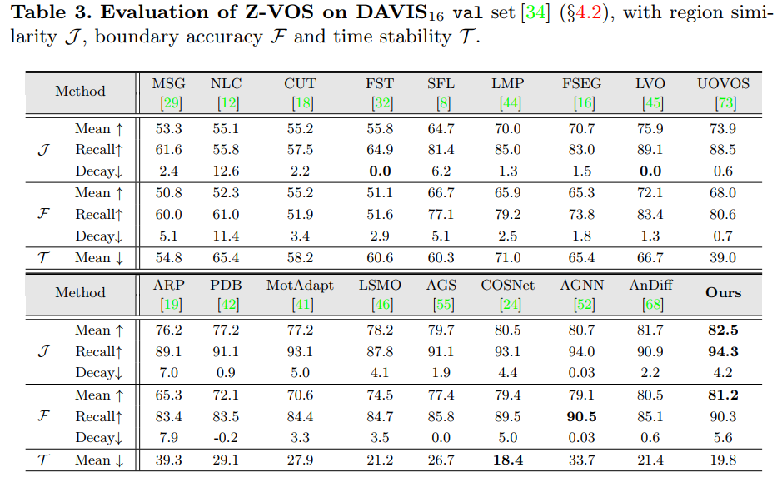
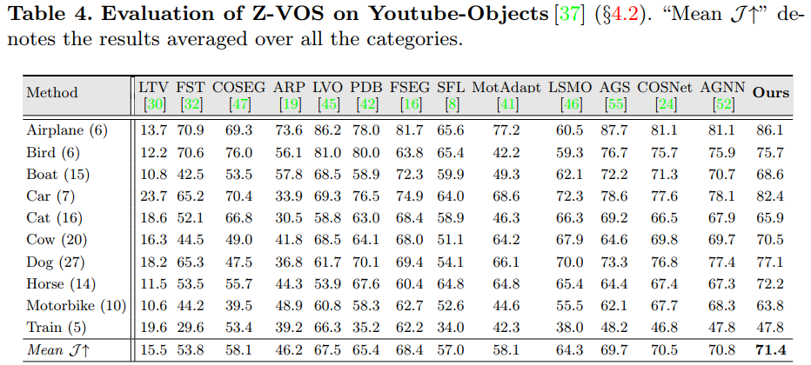
Quantitative Results of Z-VOS

Slide 10
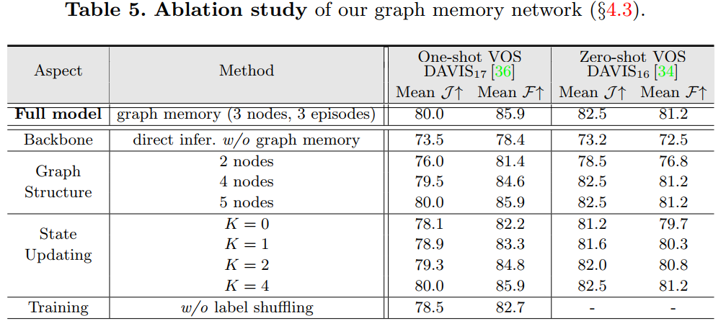
Ablation Study

Slide 11
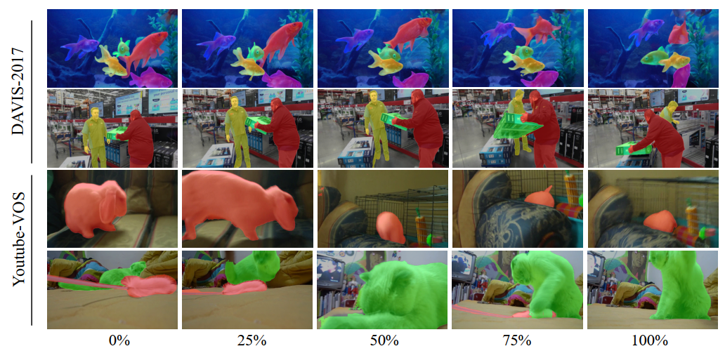
Qualitative Results of O-VOS

Slide 12
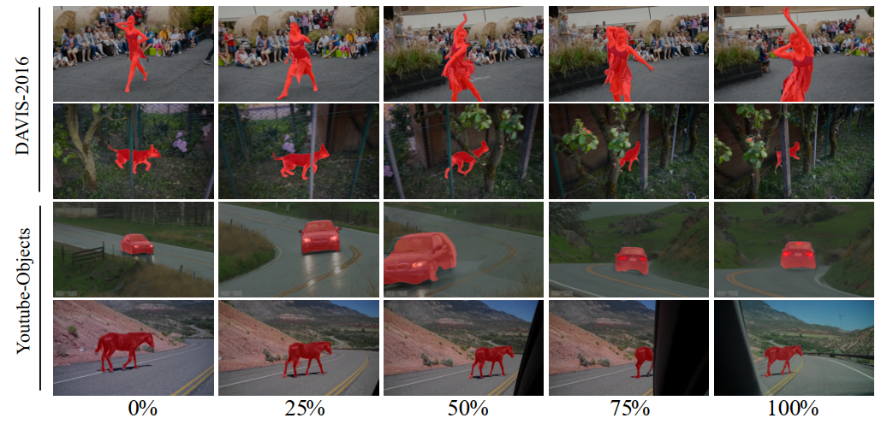
Qualitative Results of Z-VOS

