Slide 1
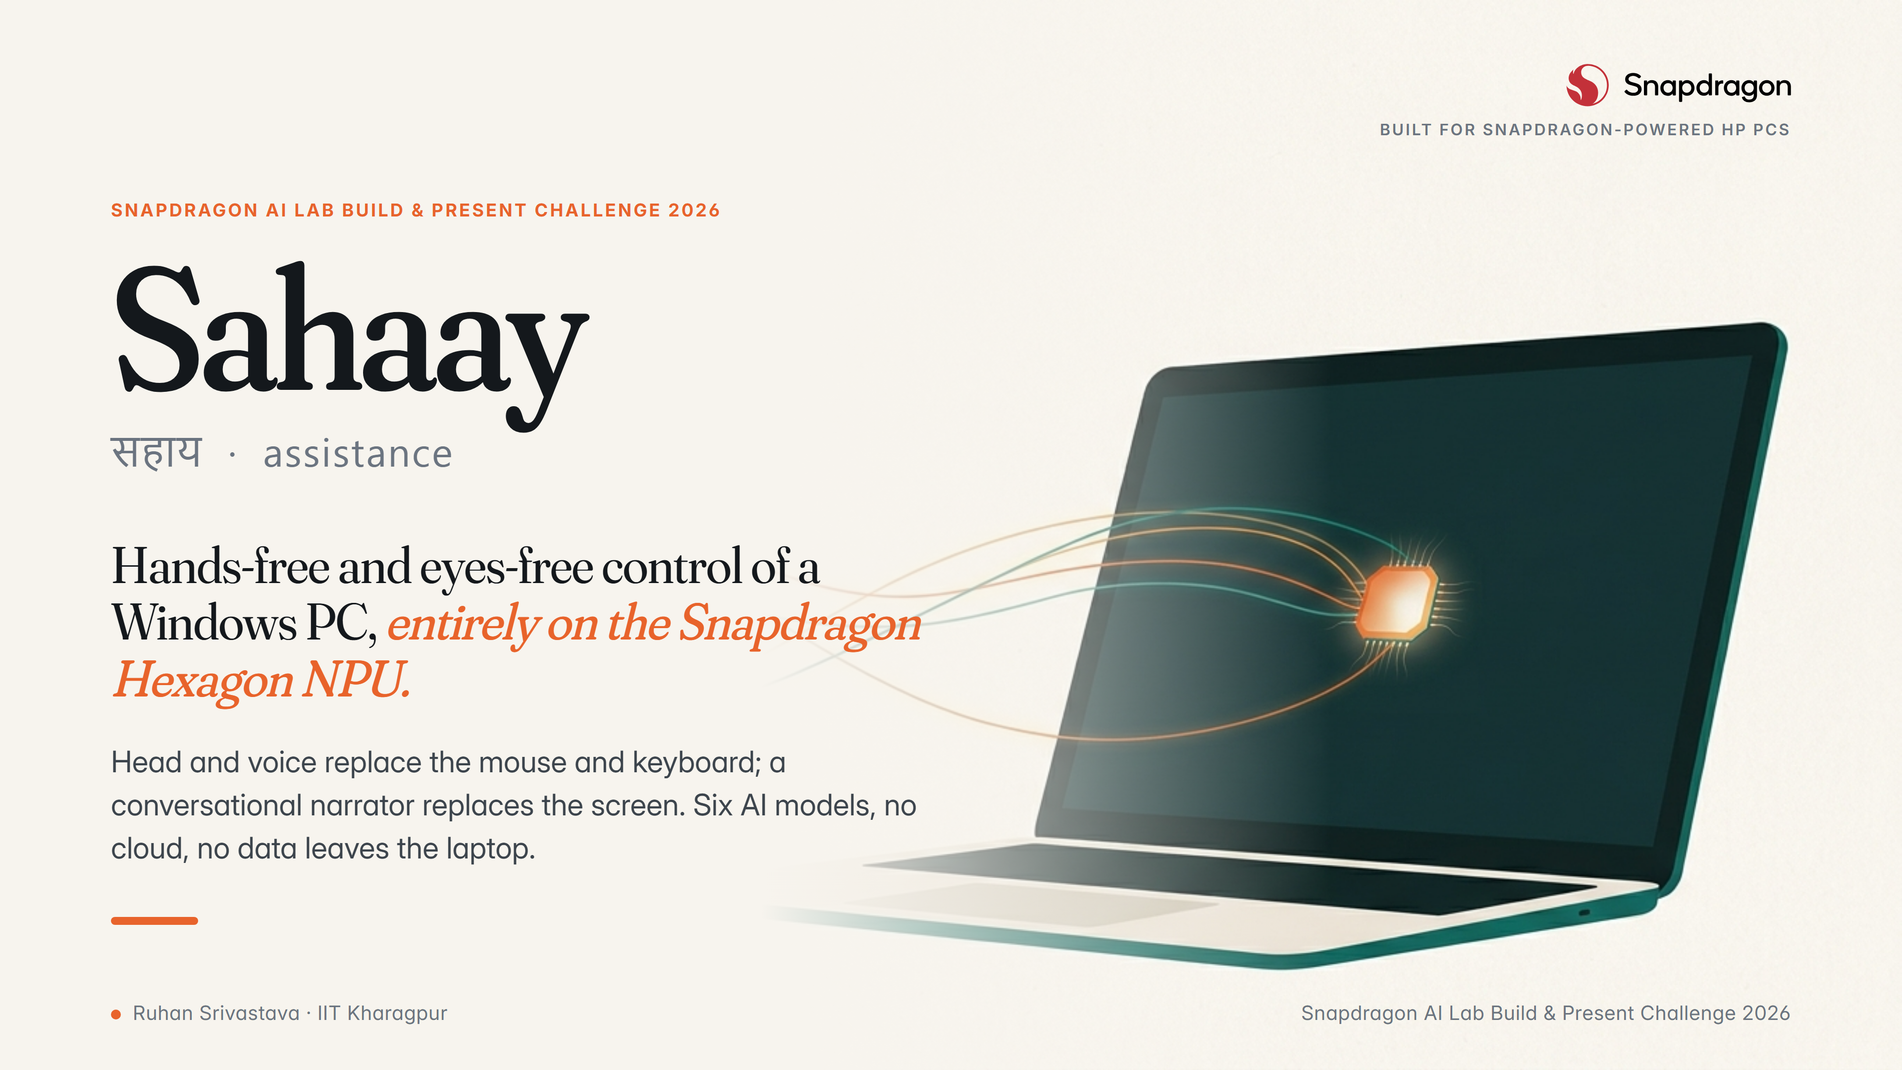
Notes:
Sahaay means assistance in Hindi. It is an accessibility copilot that runs entirely on the Hexagon NPU of a Snapdragon PC: head and voice control for people who cannot use a mouse, and a conversational screen narrator for people who cannot see.

Slide 2
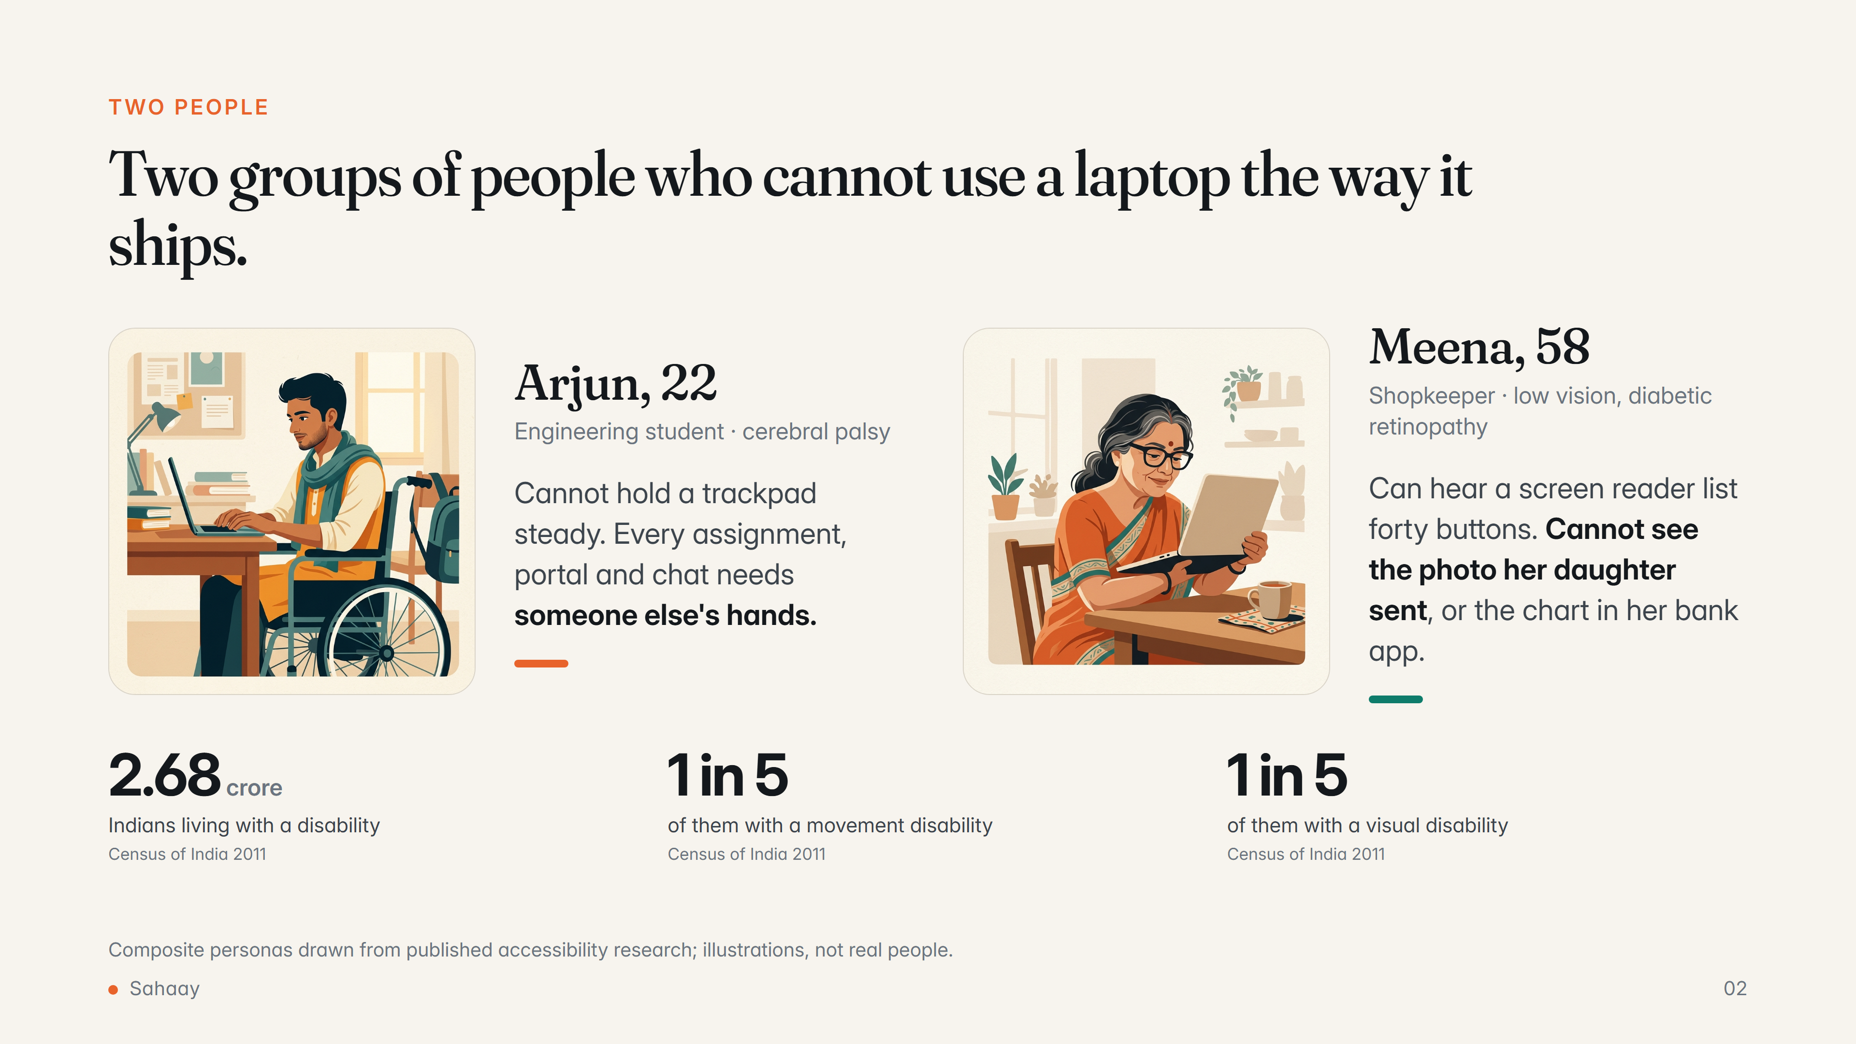
Notes:
Two composite users. Arjun has a movement disability; the mouse and keyboard are the barrier. Meena has low vision; the screen reader reads controls but cannot describe a photo, a chart or the room. Sahaay serves both with one on-device brain.

Slide 3
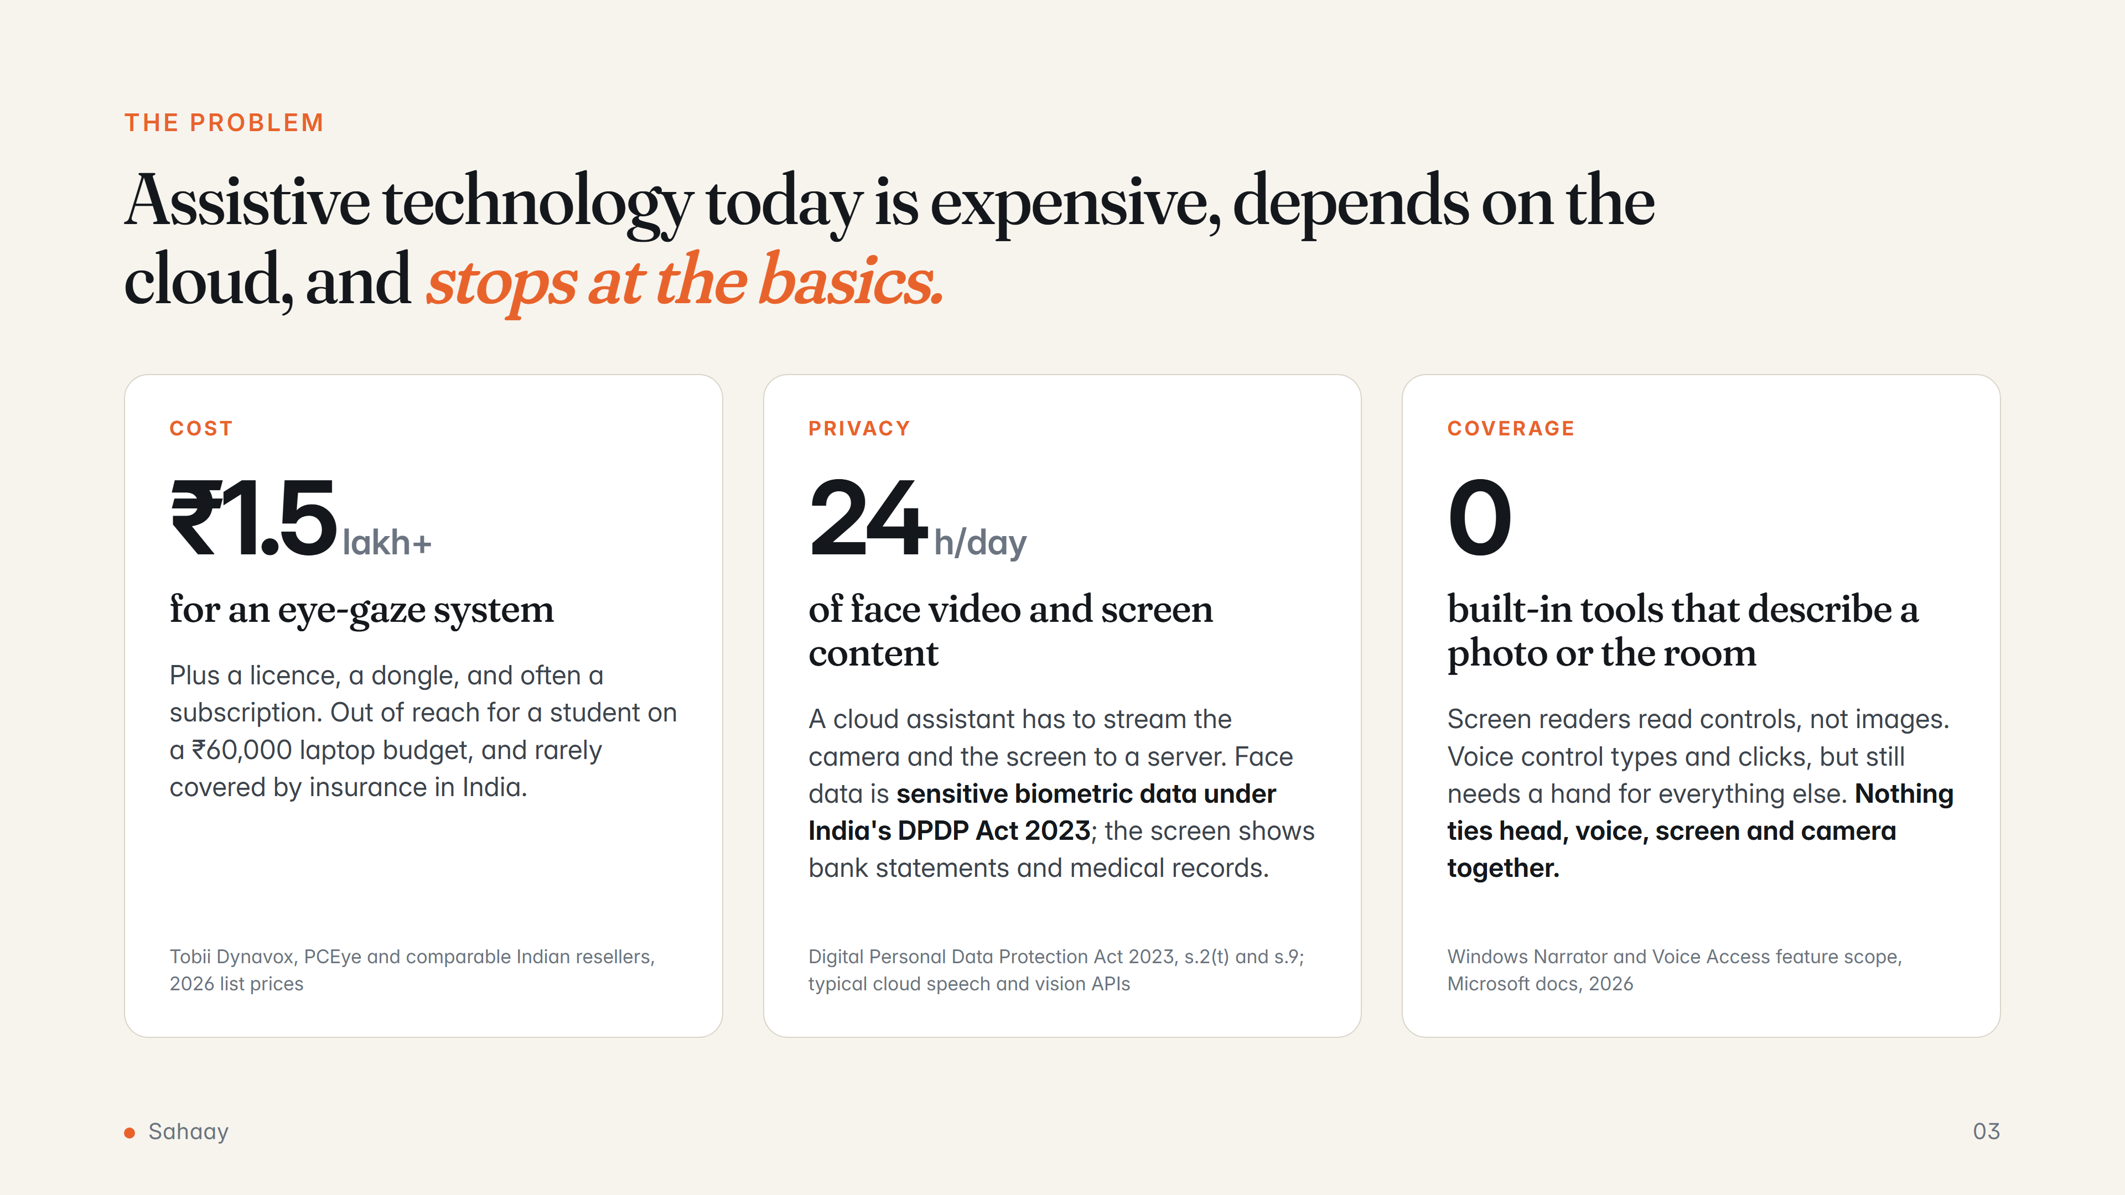
Notes:
Three concrete gaps: price, privacy of a face camera plus screen, and coverage of what built-in tools can do.

Slide 4
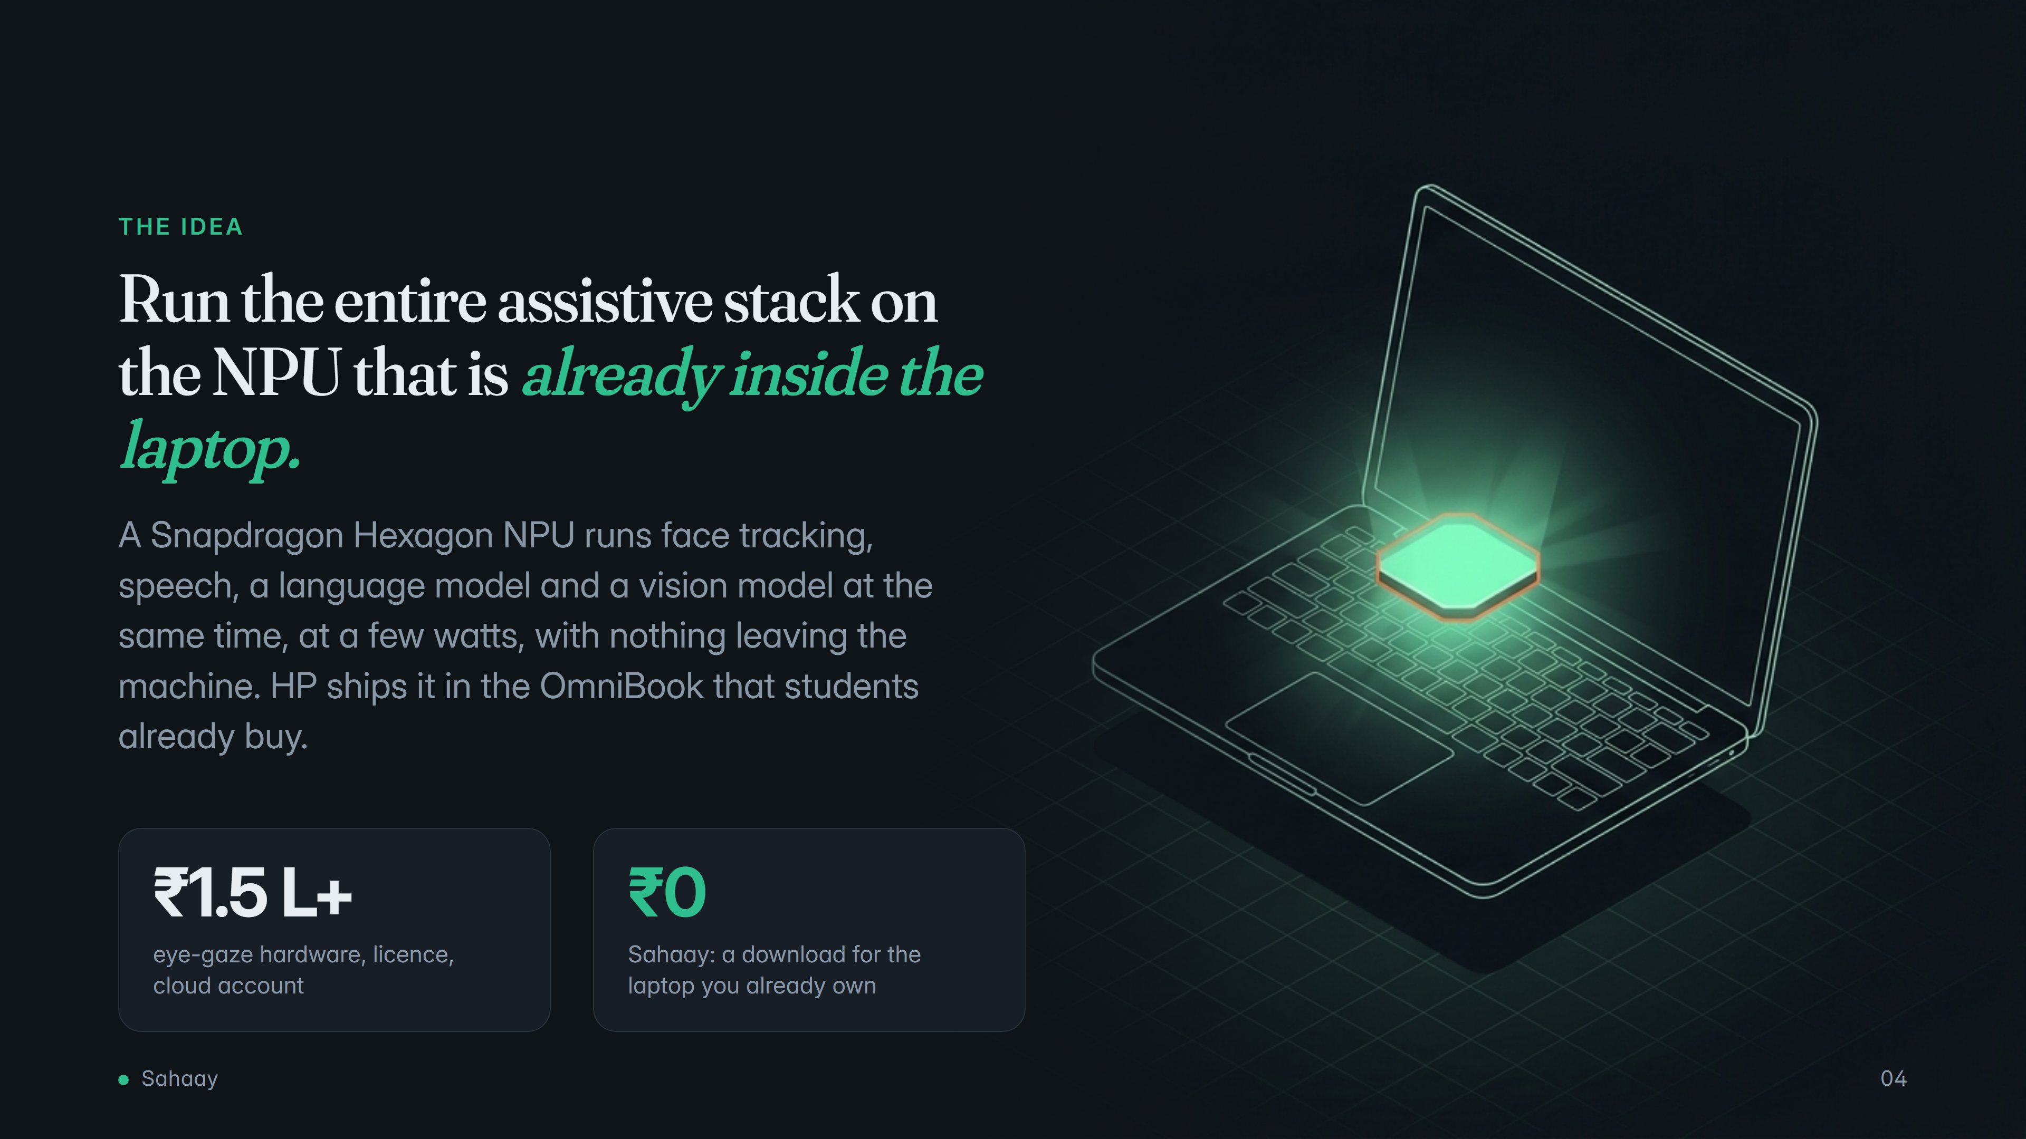
Notes:
The thesis in one line. The NPU is not a feature to show off; it is what makes a mass-market laptop into an assistive device that respects privacy and works offline.

Slide 5
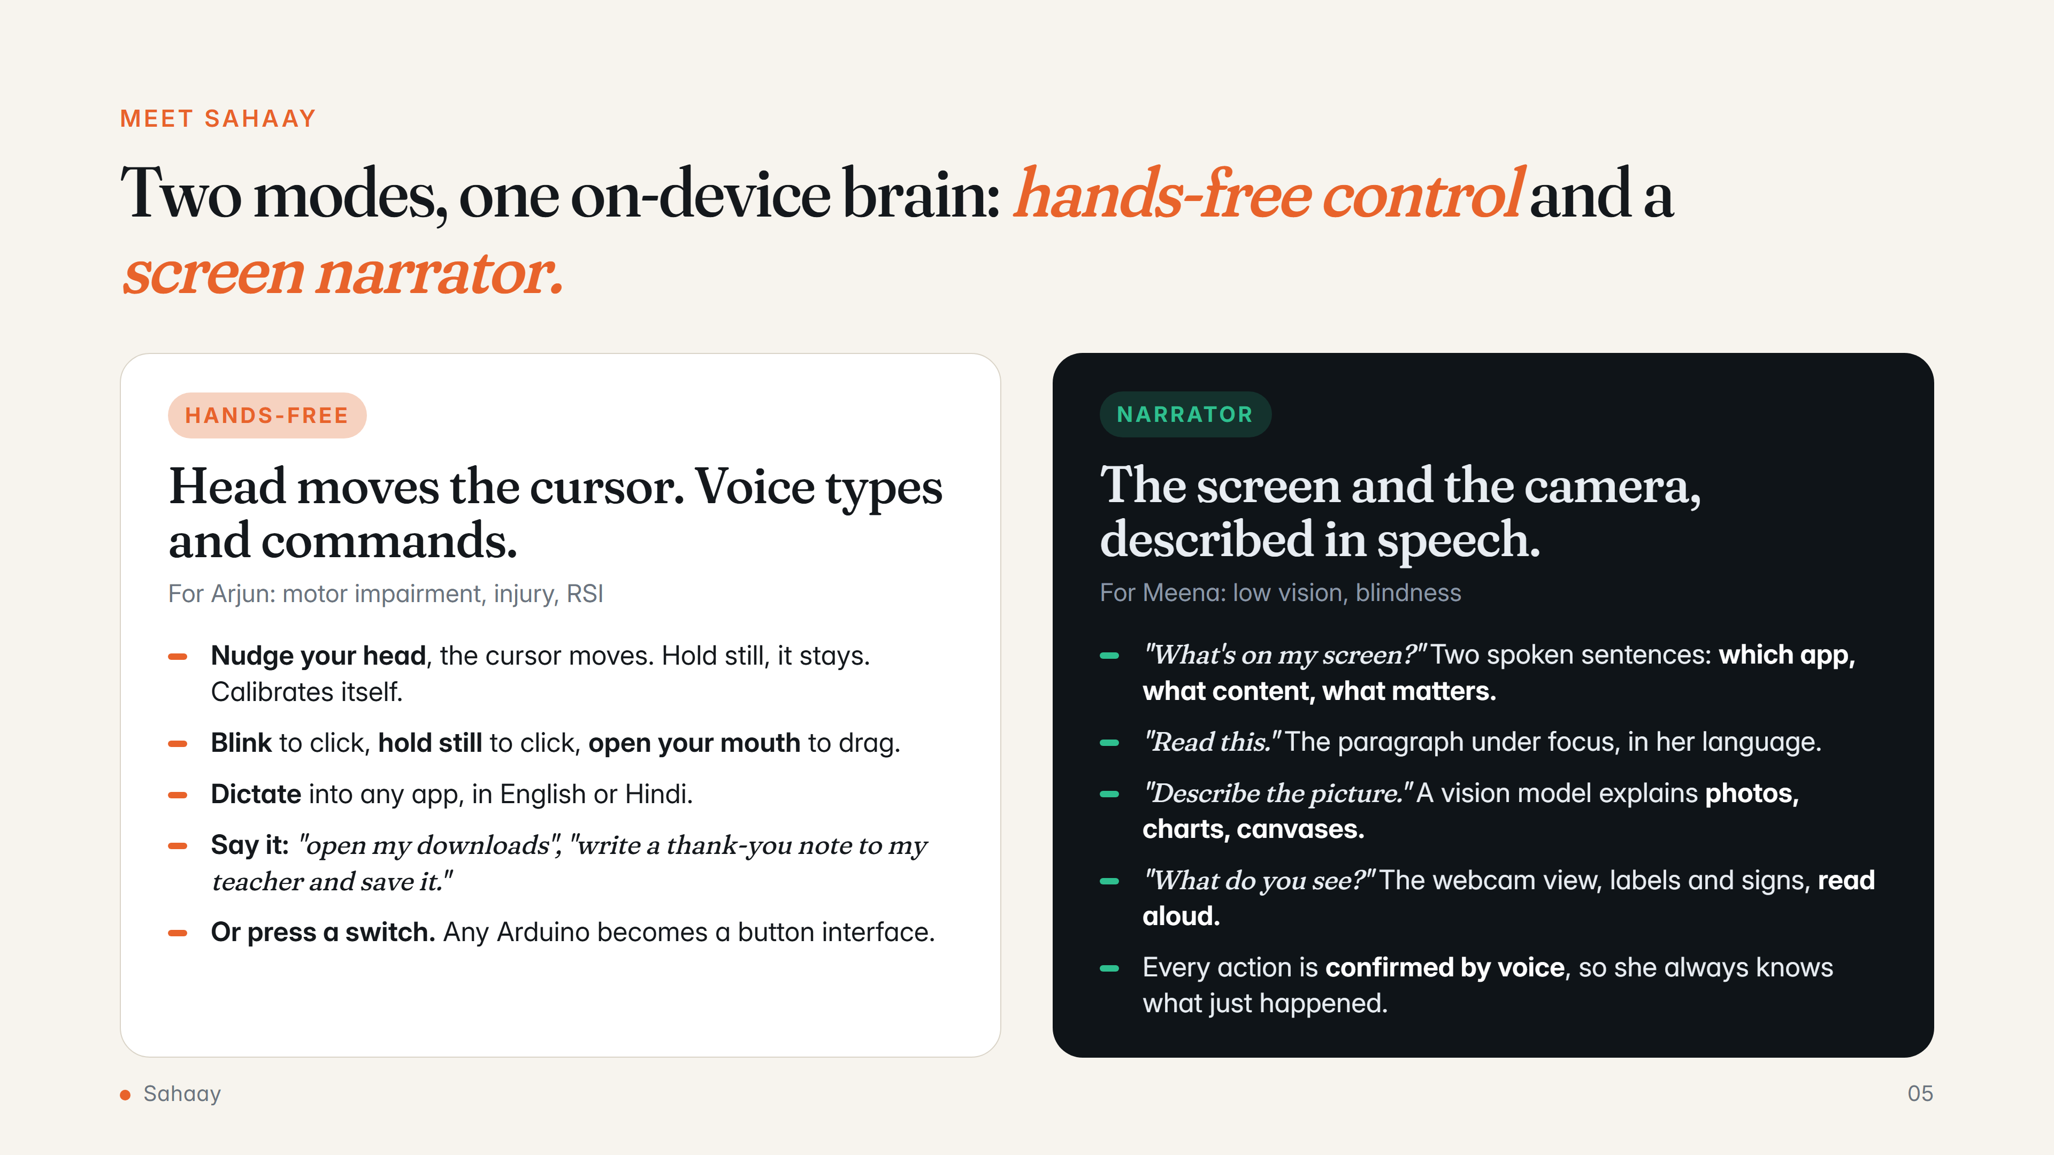
Notes:
Two modes that share one on-device brain. Hands-free mode: head cursor, gestures, dictation, free-form voice commands, switch access. Narrator mode: screen summaries, focused reading, vision-language description of screen and camera, spoken confirmation.

Slide 6
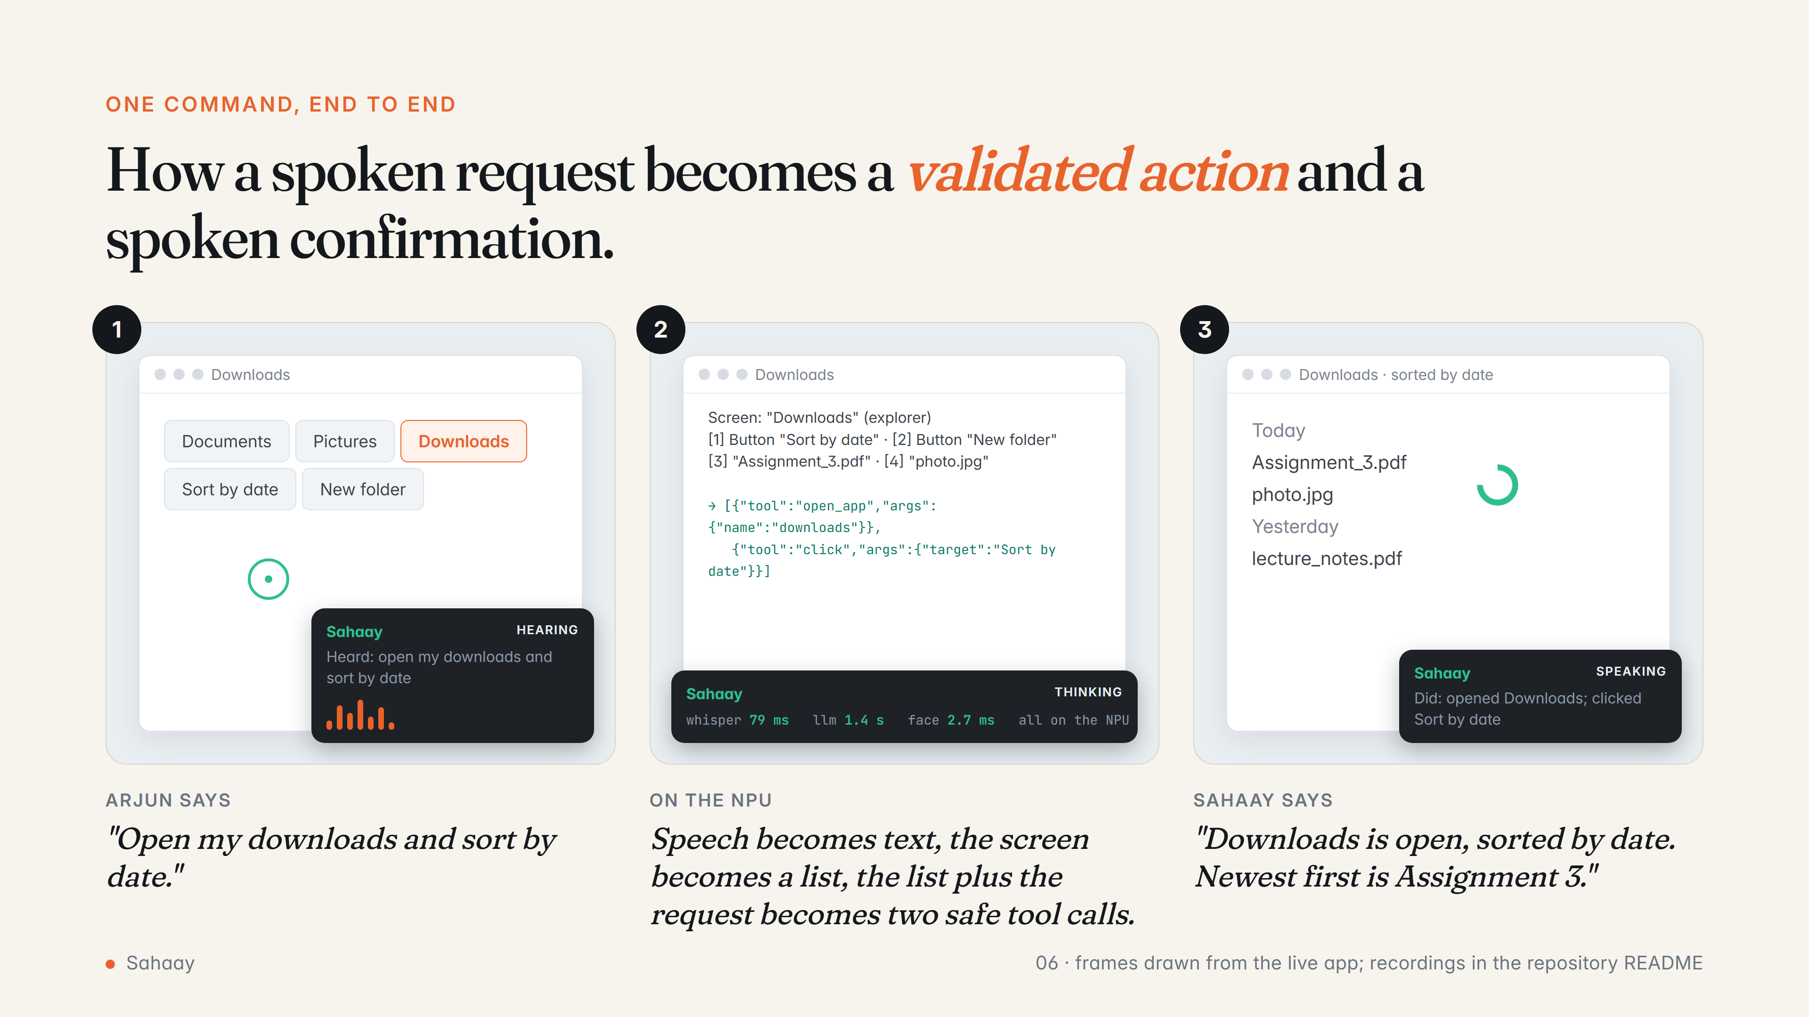
Notes:
A storyboard of one command. Speech is transcribed on the NPU, the screen is turned into a numbered list of controls by UI Automation, the language model returns validated tool calls, the executor runs them, and the result is spoken back. The dwell ring is the head-cursor click indicator.

Slide 7
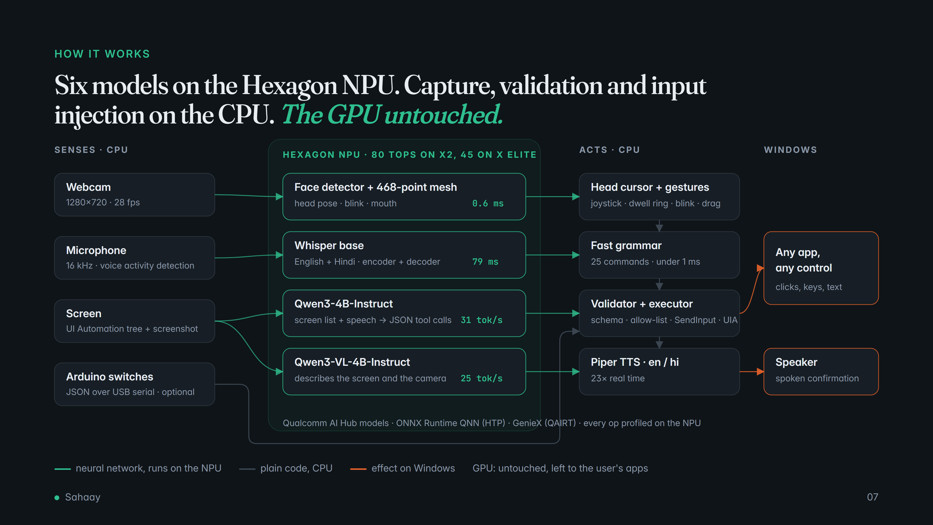
Notes:
Compute cores used. NPU: face detector, face mesh, Whisper encoder and decoder, Qwen3-4B, Qwen3-VL-4B. CPU: capture, VAD, UI Automation, the command grammar, JSON validation, cursor maths and SendInput, TTS. GPU: nothing by design.

Slide 8
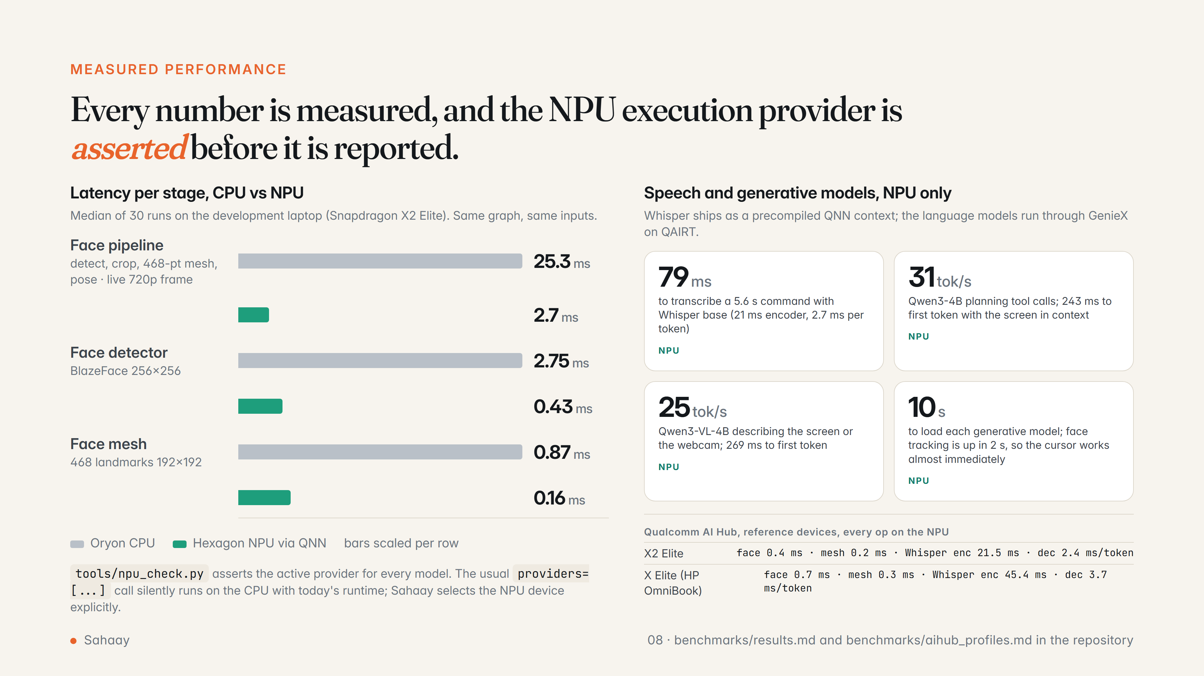
Notes:
All numbers come from tools/bench_all.py and Qualcomm AI Hub profile jobs, both in the repository. The X Elite column is the chip inside the HP OmniBook X and EliteBook Ultra, profiled on Qualcomm's reference device.

Slide 9
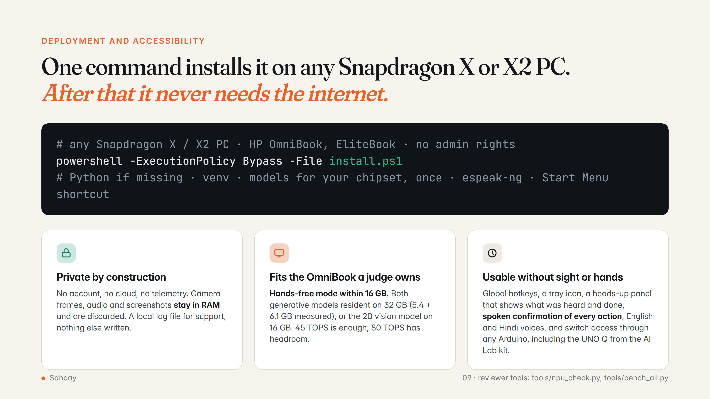
Notes:
Installation is one PowerShell script; runtime is fully offline. The memory figures are measured process growth; the 16 GB OmniBook 3 and 5 run hands-free mode and UI-Automation narration, the 32 GB OmniBook X and Ultra run everything.

Slide 10
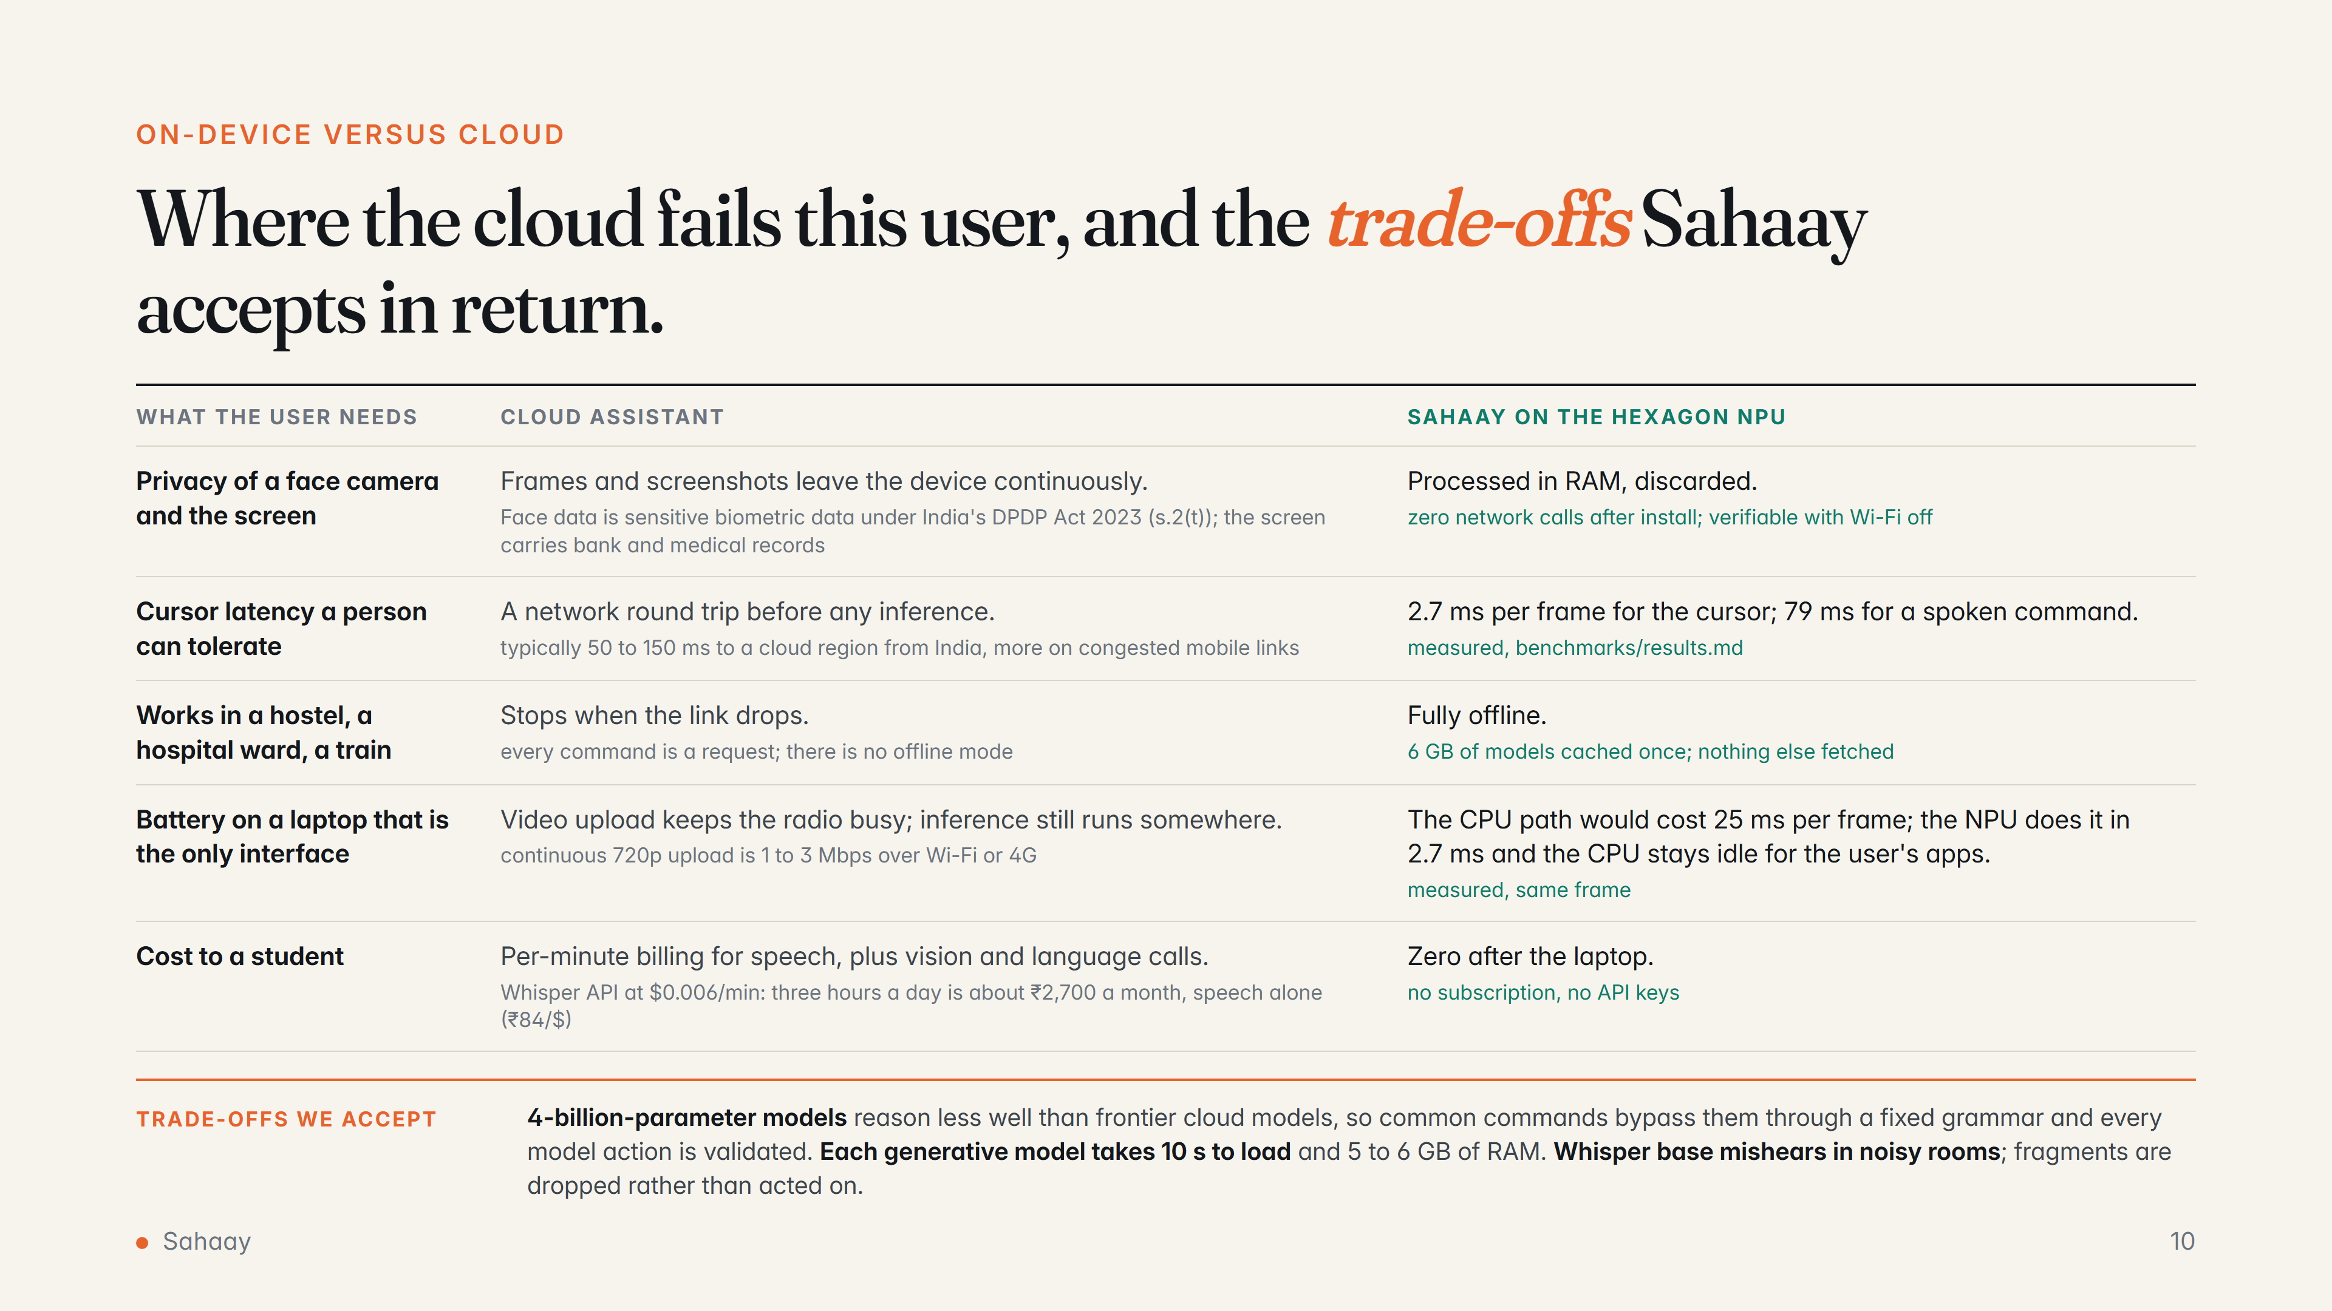
Notes:
Each row is a concrete failure of the cloud approach for this user, with a source or a measurement, and the matching measured behaviour of Sahaay. The trade-offs row is deliberate: smaller models, load time and RAM are the price of privacy and offline operation, and the design mitigates each.

Slide 11
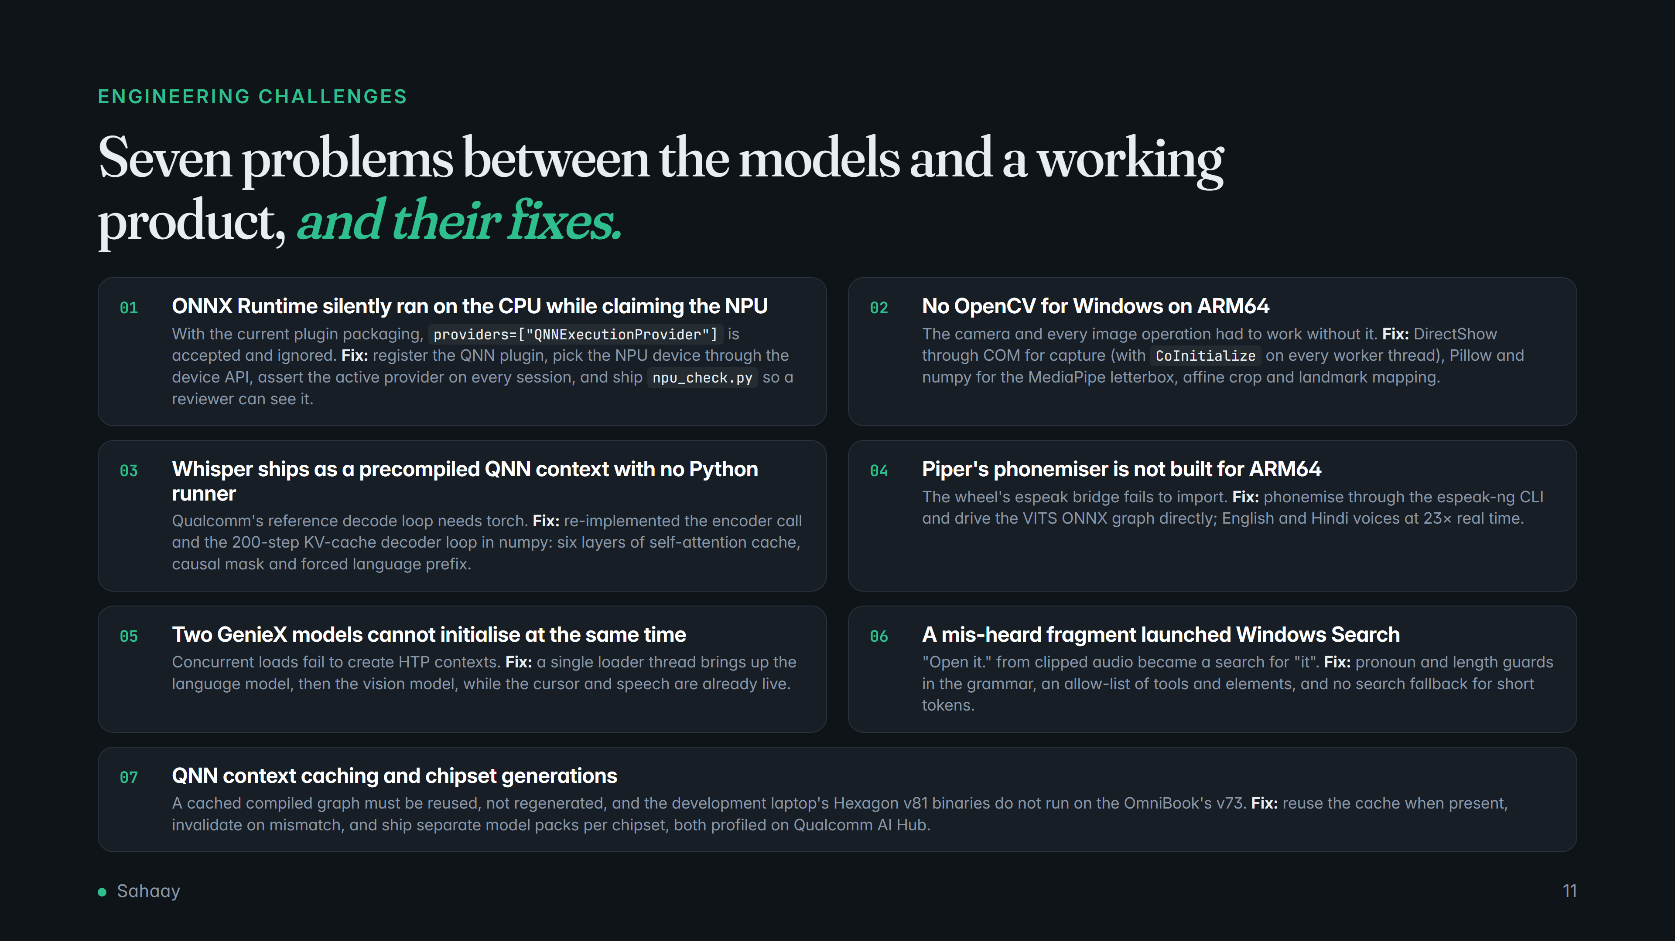
Notes:
The engineering that made the difference, each with its fix. Items 01 and 07 are the ones most likely to trip other teams claiming NPU numbers.

Slide 12
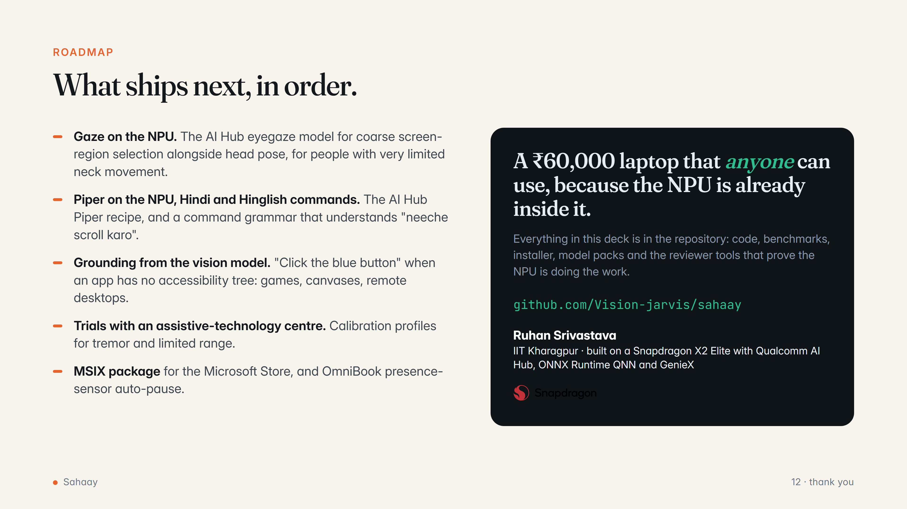
Notes:
Roadmap and close. The repository contains everything needed to reproduce every claim.

