Slide 1
Strategic models for integrated land use and transportation
Regional Visioning
Strategic Models
Plans

Slide 2
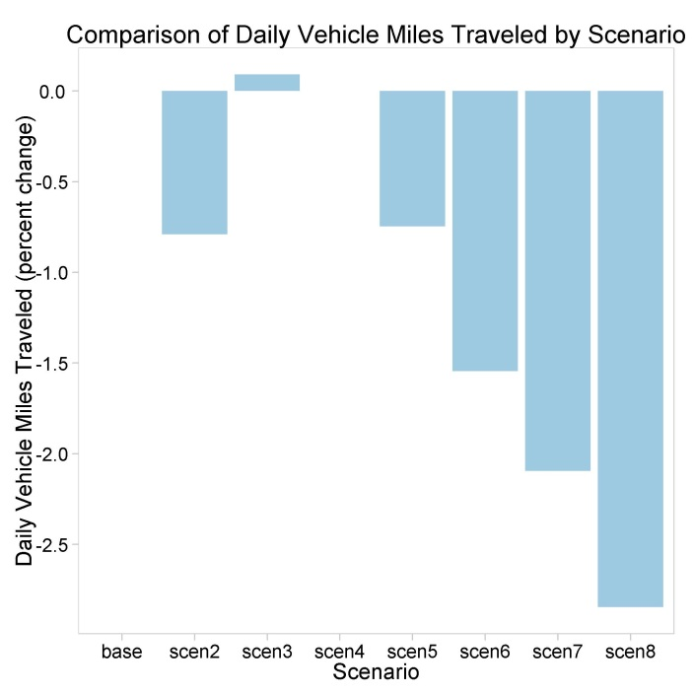
Communicating results
Comparison of Daily Vehicle Mile Traveled by Scenario

Slide 3
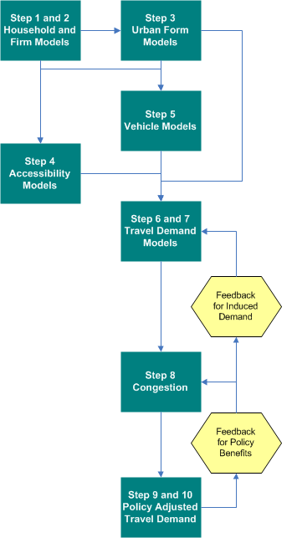
Rapid Policy Assessment Tool Process

Slide 4
VERPAT Process diagram
1. Household and Firm Models
Households Package
Firms Package
2. Urban Form Models
Land Use Package
4. Vehicle Models
Household Vehicles Package
3. Accessibility Models
Transport Supply Package
5. Travel Demand Models
Household Travel Package
7. Induced Demand
Household Travel Package
6. Congestion Models
Transport Supply Use Package
8. Policy Adjusted Demand
Transport Supply Use Household Travel Package

Slide 5
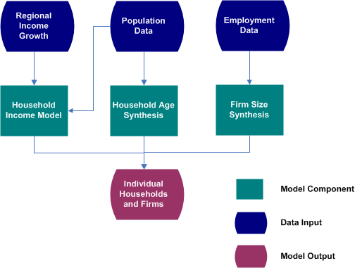
Household and Firm Synthesis

Slide 6
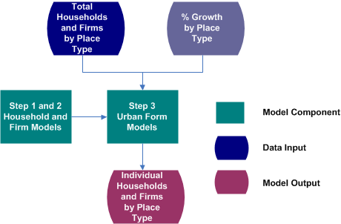
Urban form models

Slide 7
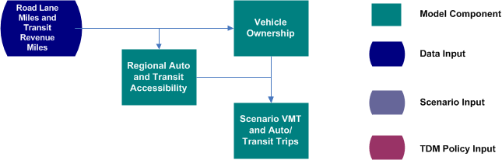
Accessibility

Slide 8
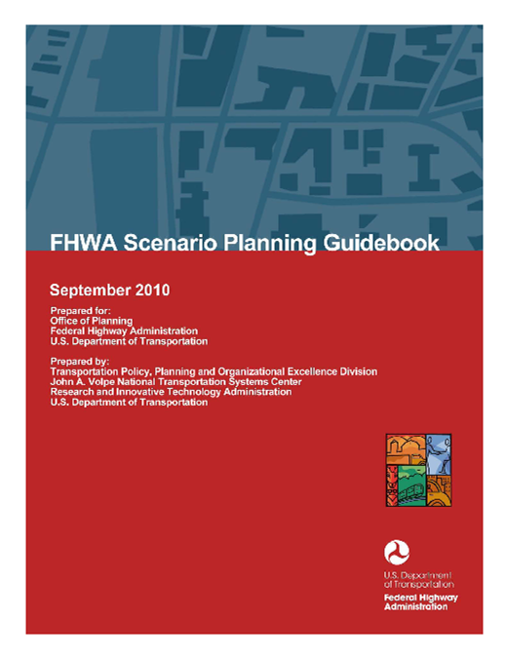
Scenario planning at FHWA / FTA

Slide 9
Needs for a data-driven process
Land Use
Transportation

Slide 10
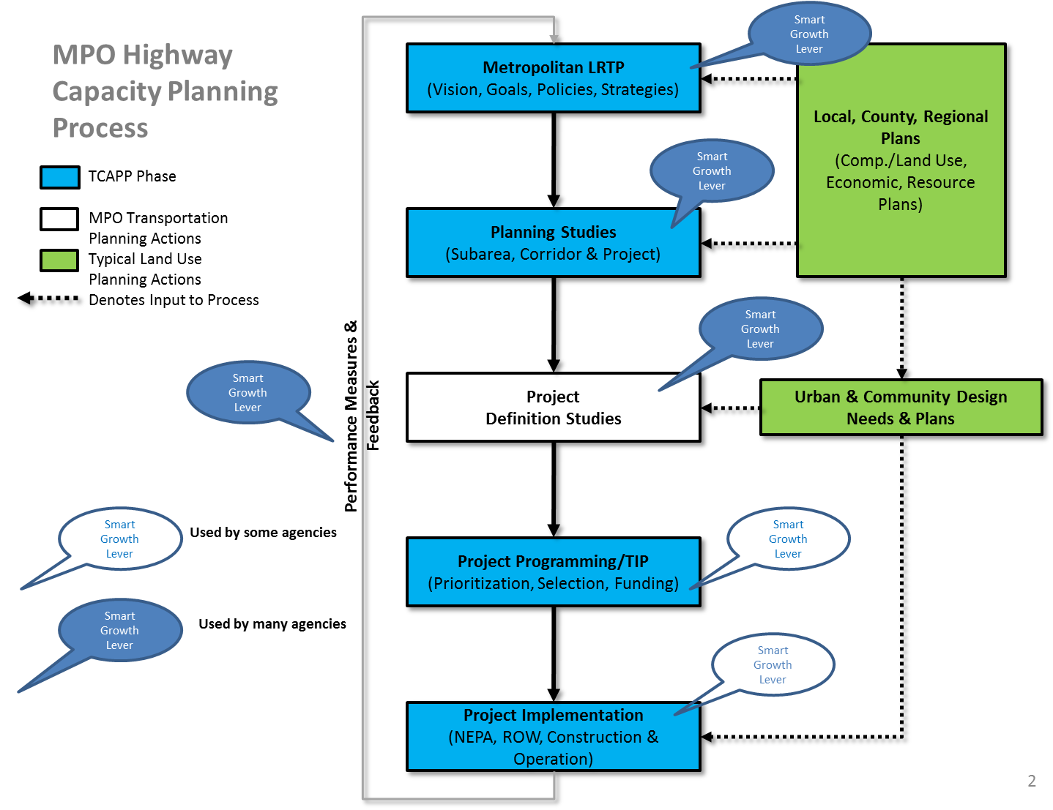
Decision points for smart growth …

Slide 11
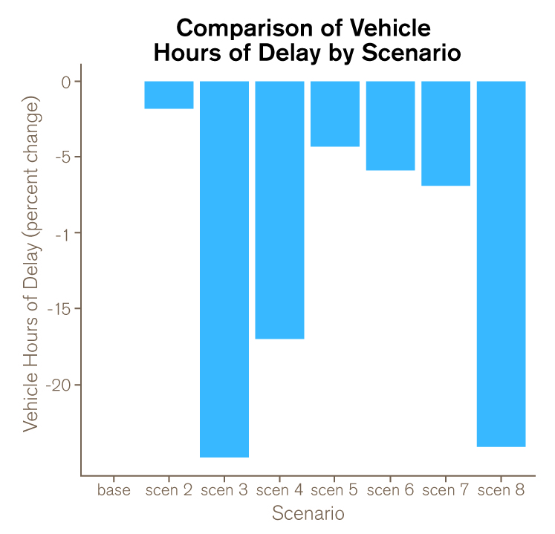
Visualizing performance metrics
Title, including Performance Metric (Vehicle Hours of Delay)
Percent Change in Performance Metric for each Scenario
Axis adjusted for each Performance Metric
Scenarios compared against the Base Scenario

Slide 12
Results screenshots

Slide 13
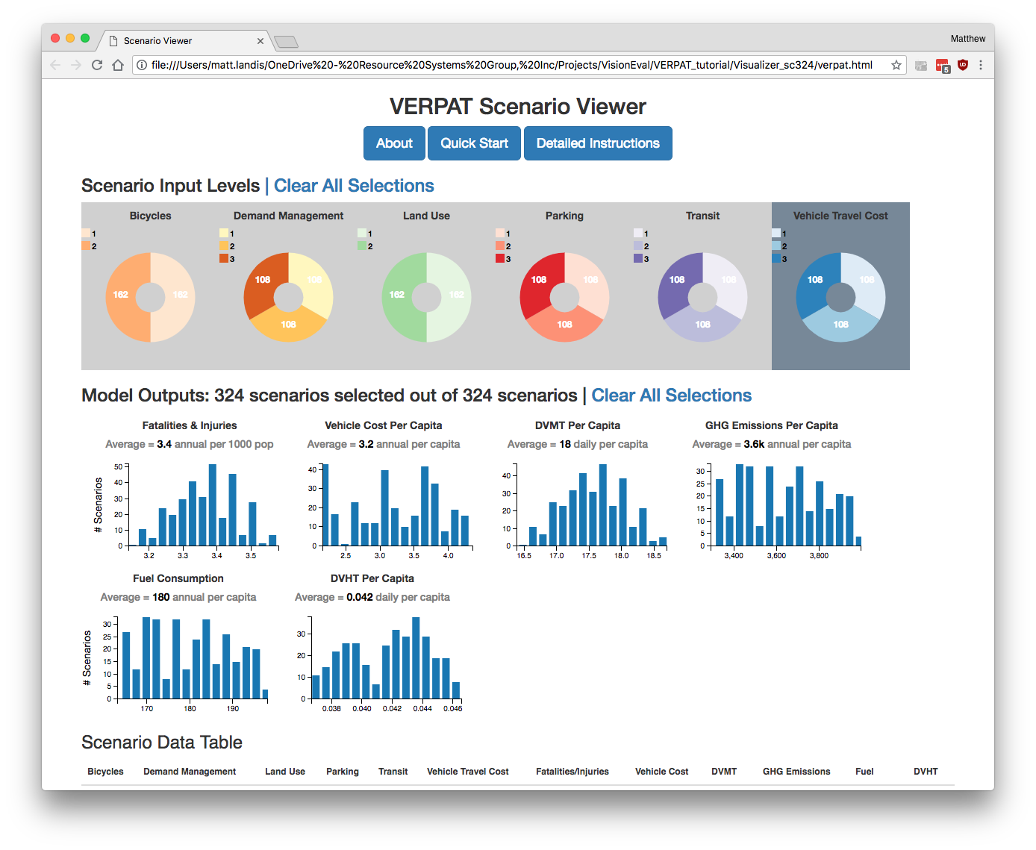

Slide 15
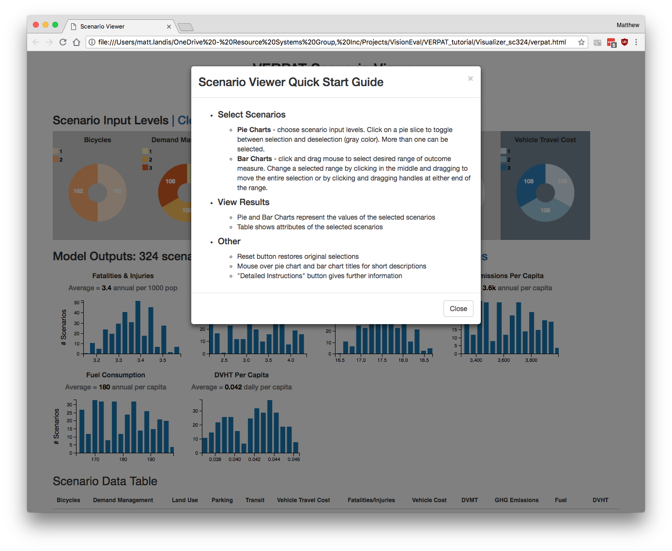

Slide 17
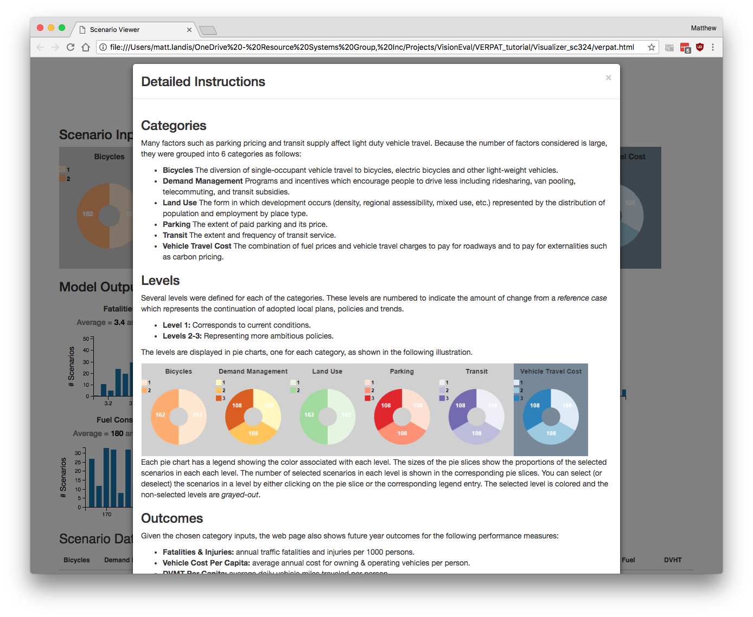

Slide 18
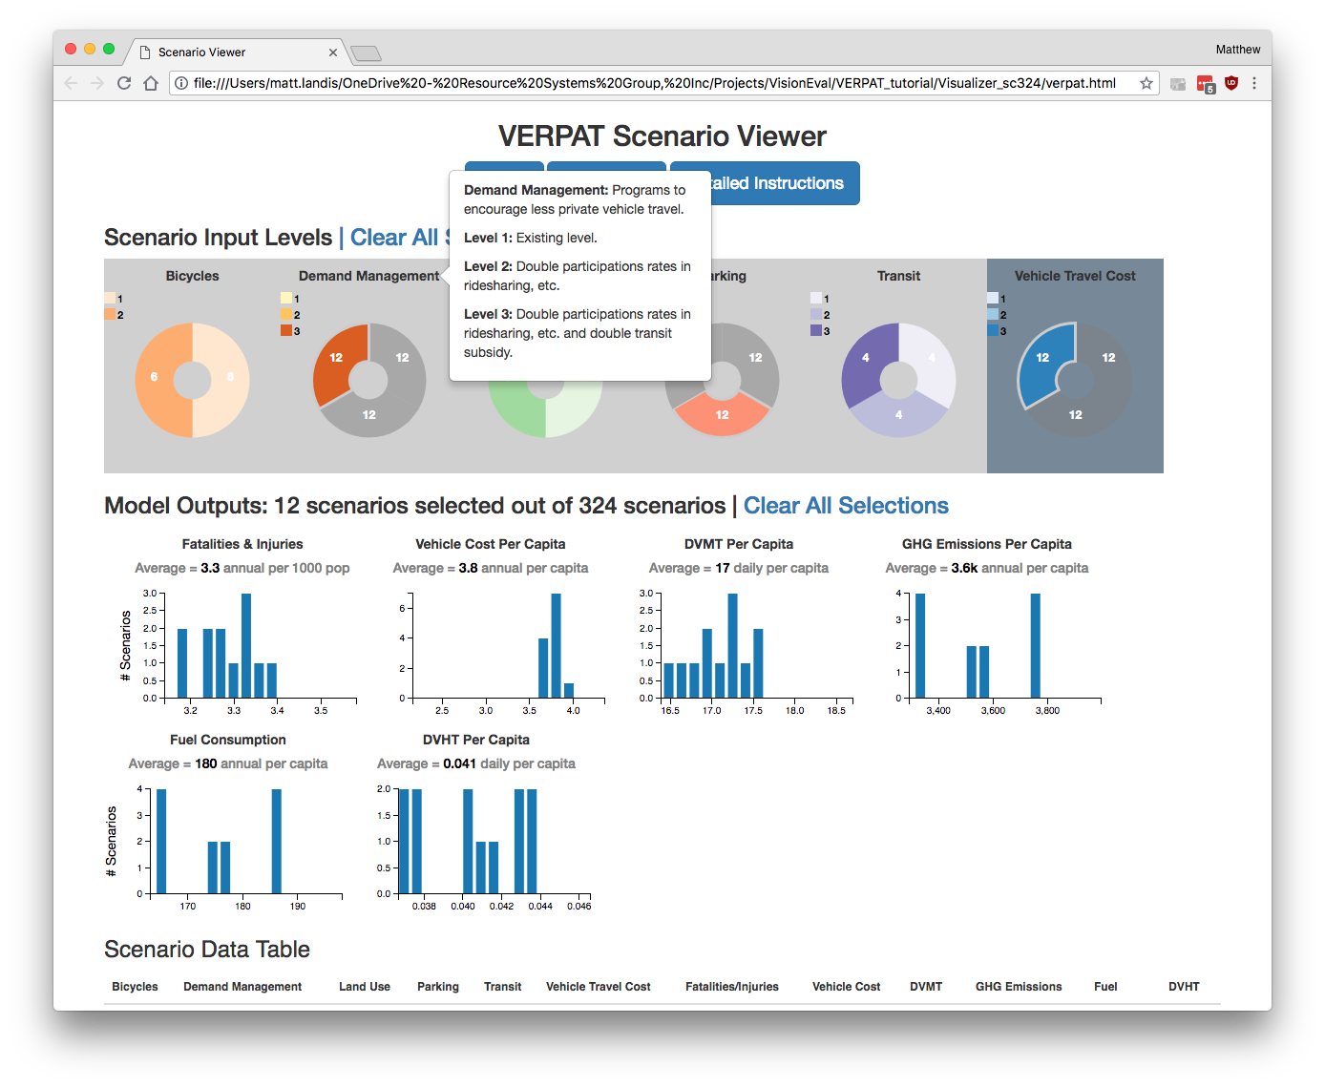

Slide 19
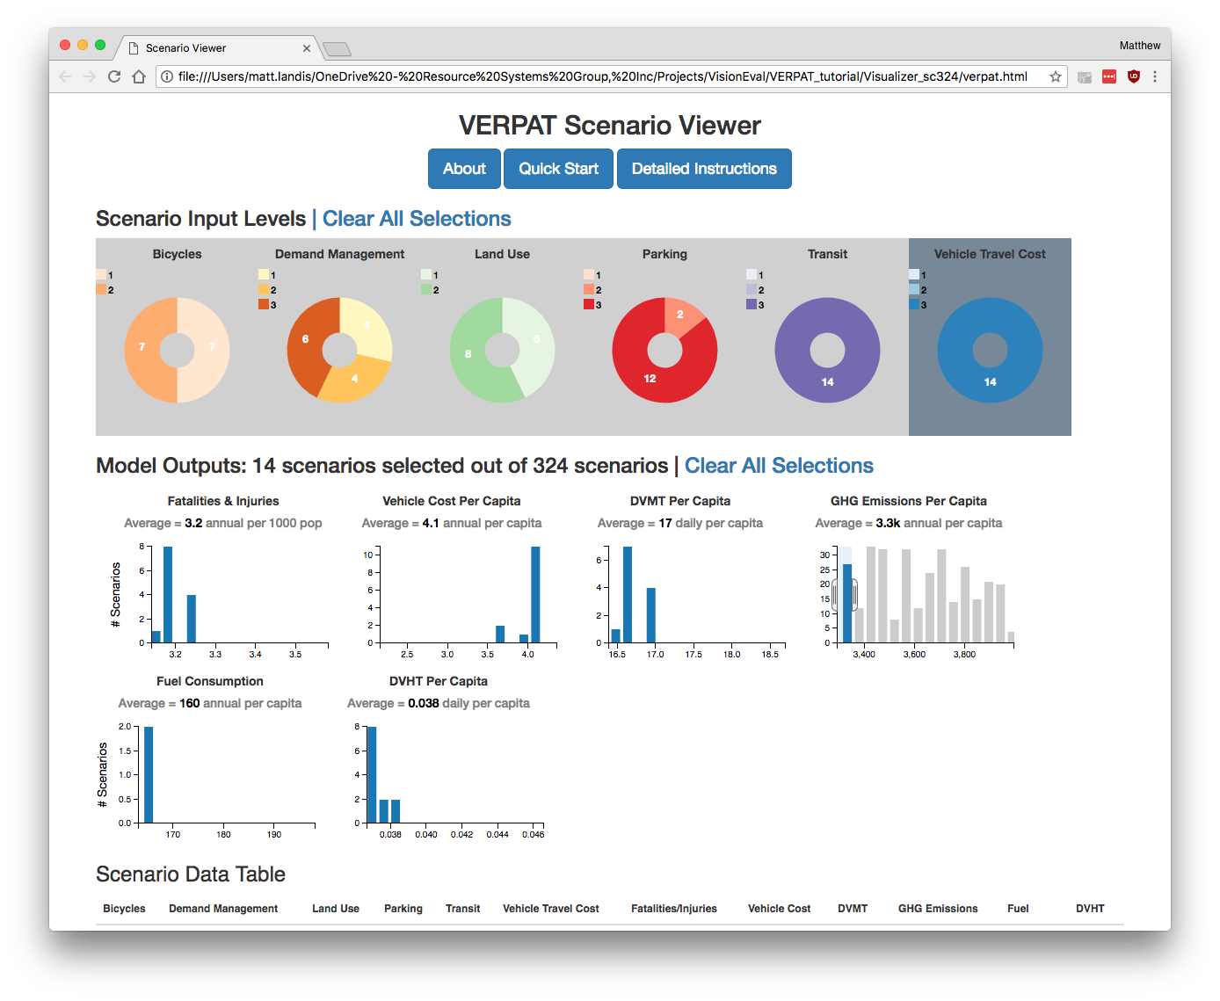

Slide 20
