Slide 1
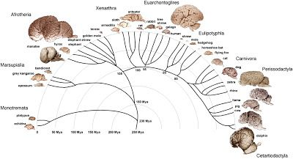
Animal Brain Pipeline Rome, OHBM Hackathon 2019
Austin Benn
Jose Pedro Manzano

Slide 2
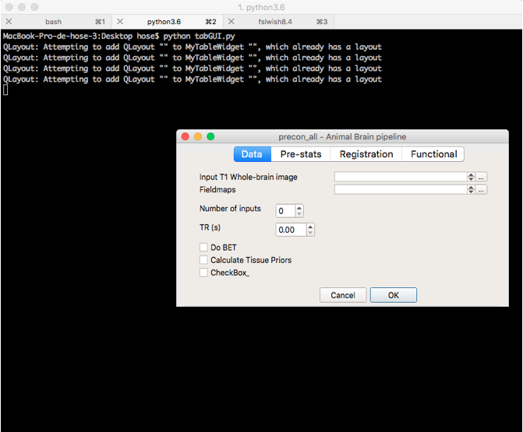
Started the GUI for the pipeline
(with PyQT5…any other suggestions?)

Slide 3
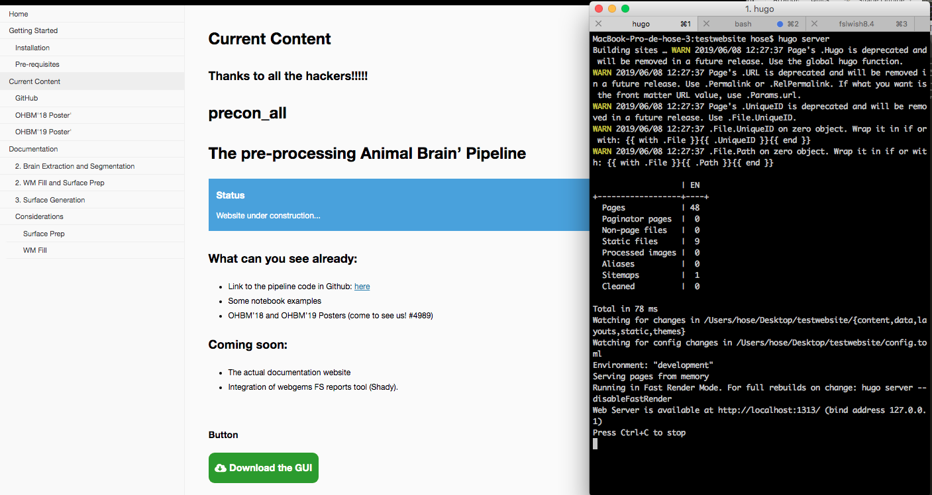
Started the Web Documentation linked to the Gihub (with Hugo)
Thanks to @SamGuay and @lnnrtwttkhn !!!

Slide 4
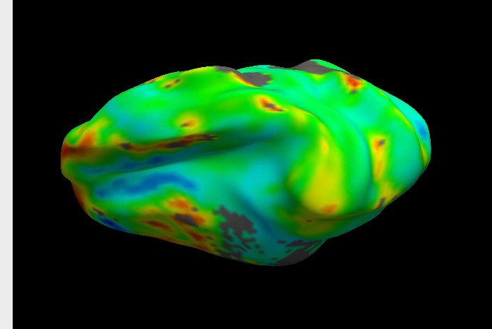
Started to extend the anatomical pipeline to functional data!
Users are responsible for their own use or misuse
Epi to T1 registration using BBR when possible.
Optional manual check
Motion Correction
Optional B0 unwarping
Options for temporal and spatial filtering
Options to train fix
(not yet in the main scripts)
A basic animal connectome pipeline

Slide 5
Other features during the Hackathon:
Already working on (or had a first contact at least):
FS Reports with webgems, thanks @Shady!!
Validation of the pipeline in mice data with @
Migrate the bash pipeline to Nipype and implement it in Giraffe. Thanks @TimVanMourik !!

Slide 6
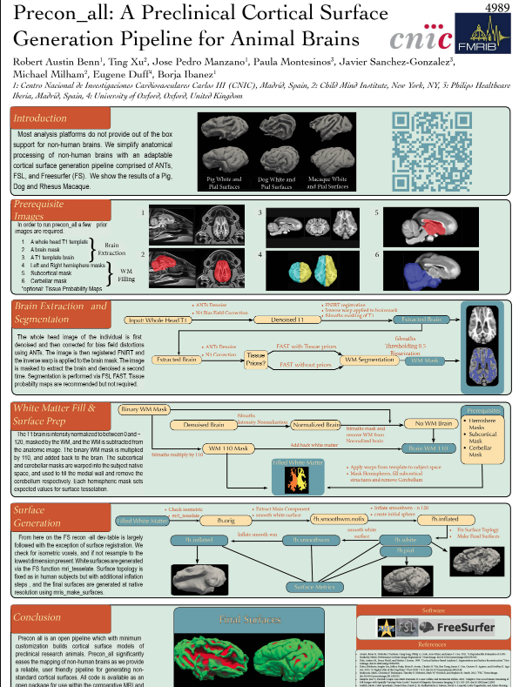
Other features during the Hackathon:
Already working on (or had a first contact at least):
FS Reports with webgems, thanks @Shady!!
Validation of the pipeline in mice data with @
Migrate the bash pipeline to Nipype and implement it in Giraffe. Thanks @TimVanMourik !!
Visit us in the poster #4989
12.45 – 14.15 Tuesday

Slide 7
What we would like to talk about during these days:
Link some Jupyter Notebooks examples from the GitHub to run them online with Binder and maybe upload them to Neurolibre? (sorry @ltetrel, we had no time to talk about it yet!)
Create the Docker container (we have to talk with you @Tom!!)
Do DTI simulations/generative models using Dipy/Dmipy. Thanks Serge @skoudouro !!
Finally talk with @satra about Nobinder and generative models
And, the most important thing……

Slide 8
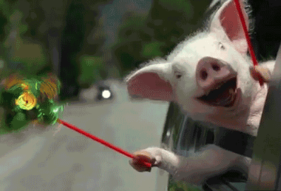

Keep in contact and drink some beers later in the evening!!!!
Contact:
Austin Benn r.austinbenn@gmail.com
Jose Pedro Manzano josepman@ucm.es
@neurabenn
@josepemanzano

