Slide 1
y
y
f(x)
y
yhat
x
x
x
Given (x,y)
Learn the mapping
New x
f(x1,x2)
x2
x2
y=1
y=2
x1
x1
Given (x1,x2,y)
Given (x1,x2,y)

Slide 2
 | Supervised Learning | Unsupervised Learning | Reinforcement Learning
Goal | Learns a model that maps X into Y | Learn the underlying structure of the data | Learn strategy by trial & error
Requirement | Needs the right answer (Y) to start | - | Needs feedback on the agent’s action
 | Inputs are independent and identically distributed | Inputs are independent and identically distributed | Agent’s decision changes the next input

Slide 3
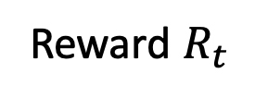


The MDP formalism
Agent
State
Reward $R_{t}$
Action
$$s_{t}∈S$$
$$a_{t}∈A$$
Environment
Markov Decision Process
Markov assumption

Slide 4
Agent
Opponent

Slide 5
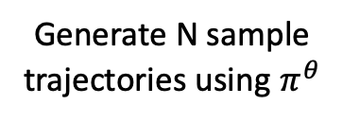
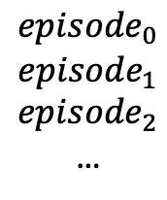
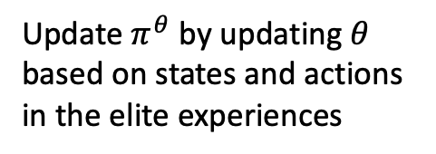
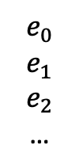
Generate N sample trajectories using $π^{θ}$
Update $π^{θ}$ by updating $θ$ based on states and actions in the elite experiences
if stopping criteria is not met, else, stop
Experiences
$${episode}_{0}$$
$${episode}_{1}$$
$${episode}_{2}$$
…
Extract elite experiences
$$e_{0}$$
$$e_{1}$$
$$e_{2}$$
…

Slide 7







$$θ$$
$$s$$
$$s_{1}$$
NN
$$a$$
$$s_{2}$$
$$s_{3}$$
$$s_{4}$$

