Slide 1

Basic Python Tutorial
Juxihong Julaiti

Slide 2
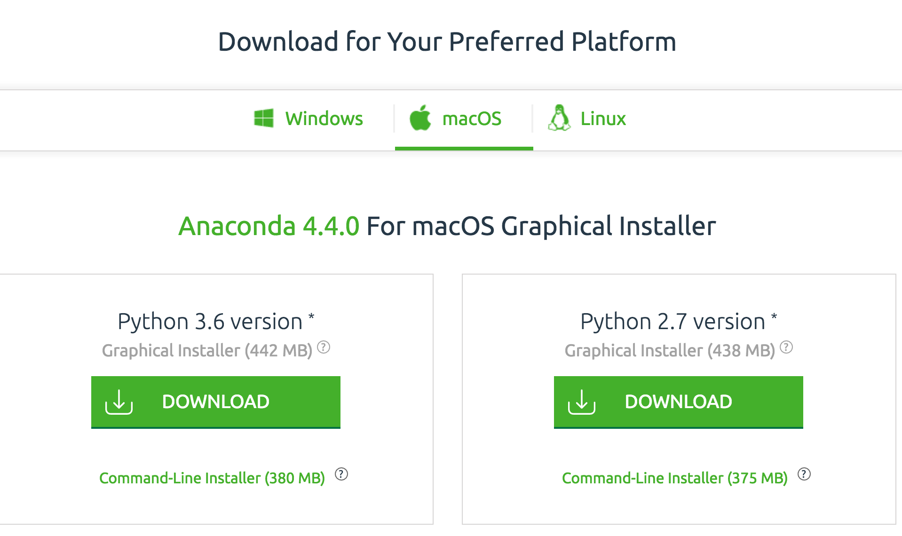
Download & Install Python
Google Anaconda
Download for python 3.6 version
Install & Reboot your system
Open Notebook:
Mac: Open a terminal
Win: Open anaconda prompt
Input: jupyter notebook

Slide 3
Python
Scripting Language, easy to learn and use
Clean, clear syntax and high-level data types
Python makes difficult things easy: so programmers can focus on overriding algorithms and structures rather than nitty-gritty low level details.
Object-Oriented
Everything is an object (functions, classes)
Variables do not need to be defined before using
Data type is a property of the object
You can do things like x=134 and x=‘I’m a string’ without error
Python will detect the type of variable automatically
cost: slower than lower level language
Portable:
high end servers and workstations, down to windows CE

Slide 4
Major Uses of Python
web applications
automation
scientific modelling (Operations Research, cplex, gurobi, etc.)
big data applications
……
It's also often used as "glue" code to get other languages and components to play nice.

Slide 5
Python & Scientific Computing
Large community of users, easy to find help and documentation.
Extensive ecosystem of scientific libraries and environments
– numpy: http://numpy.scipy.org (Numerical Python)
– scipy: http://www.scipy.org (Scientific Python)
– matplotlib: http://www.matplotlib.org (graphics library)
Great performance due to close integration with time
tested and highly optimized codes written in C and Fortran
Good support for
– Parallel processing with processes and threads
– Interprocess communication (MPI)
– GPU computing (OpenCL and CUDA)
Readily available and suitable for use on high-performance computing clusters.
No license costs, no unnecessary use of research budget.

Slide 6
Outline
“Hello World”
Basic Data Types
Operators
Basic Data Flow Mechanisms (control flow)
Compound Data Types
Conditional Expressions

Slide 7

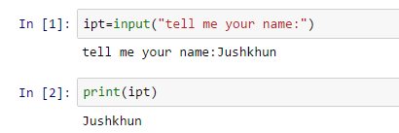
Hello World!
print(‘hello world!’)
# and this is a comment
ipt=input(“tell me your name:”)
print(ipt)

Slide 8
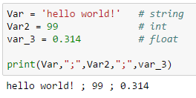

Basic Data Types
Naming rules:
Case sensitive: var1 and Var1 are different
Can’t start with a number
Name can contain letters, numbers, and underscores
Do not use reserved names (int, float, str, bool, list, dict…..... Find more online)
Var = ‘hello world!’ # string
Var2 = 99 # integer
var_3 = 0.314 # float
var4=True # boolean
Assignment: you don’t need to define a variable like JAVA or C
Everything is an object, you can assign the value directly

Slide 9
Basic Data Types
Strings (powerful----web crawler, natural language processing, web app)
c = "I love python"
d = 'I love python‘
c and d are same
e = ''' if you need to use " and ' in your string '''
f = ' or like this \ ' '
List can be indexed
c[0], c[-1], c[:], c[1:], c[:5],c[1:3]
c.lower()
c.upper()
c.count('o')
c.split()
Object-Oriented

Slide 10
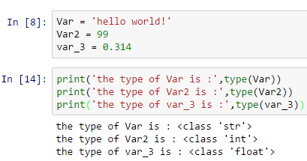
Basic Data Types
Check the type of variables: type(x)

Slide 11
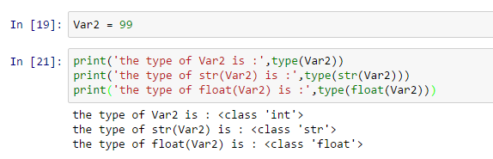
Basic Data Types
Convert the type of variables
int(x) str(x) float(x)
ASCII
int
float
str

Slide 13


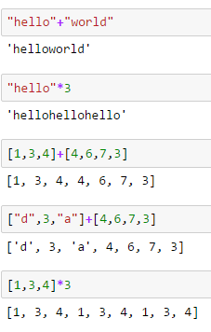
Operators Math Operators
+ - * /
Power: **
Integer division: //
+ and * work on strings as well!!

Slide 14
Exercise
Create a program that asks the user to enter their name and their age.
Print out a message addressed to them that tells them the year that they will turn 60 years old!

Slide 15
Solution
name = input("What is your name: ")
age = int(input("How old are you: "))
year = str((2017 - age)+60)
print(name + " will be 60 years old in the year " + year)
1)Add on to the previous program by asking the user for another number and printing out that many copies of the previous message.
2)Print out that many copies of the previous message on separate lines. (Hint: the string "\n is the same as pressing the ENTER button)
3)Let user confirm(yes/no) the number of copies if it is greater than 10
Do 2) twice, with/without for statement

Slide 16
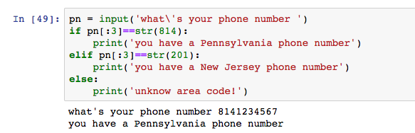
Basic data flow mechanisms (control flow)
IF statement
if statement1:
Action1
elif statement2:
Action2
elif statement 3:
Action3
…....
else:
Action 3
Remember tab after “:”

Slide 17
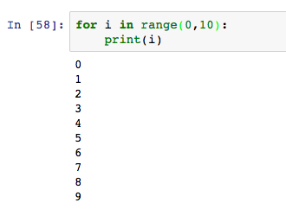
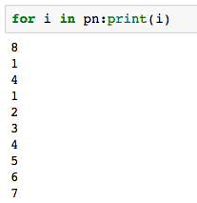
Basic data flow mechanisms (control flow)
FOR Statement
for i in range(0,10):
print(i)
for i in pn:print(i)

Slide 18
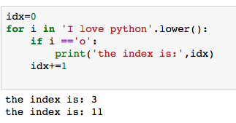
Basic data flow mechanisms (control flow)
FOR Statement
Searching item ‘o’ in ‘I love python’ and return the index
idx=0
for i in 'I love python'.lower():
if i =='o':
print('the index is:',idx)
idx+=1

Slide 19
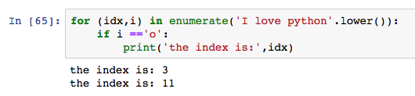
Basic data flow mechanisms (control flow)
FOR Statement
for (idx,i) in enumerate('I love python'.lower()):
if i =='o':
print('the index is:',idx)

Slide 20
Exercise
Create a program that asks the user to enter their name and their age. Print out a message addressed to them that tells them the year that they will turn 100 years old.
Extras:
1)Add on to the previous program by asking the user for another number and printing out that many copies of the previous message.
2)Print out that many copies of the previous message on separate lines. (Hint: the string "\n is the same as pressing the ENTER button)
3)Let user confirm(yes/no) the number of copies if it is greater than 10
Do 2) twice, with/without for statement

Slide 21
Solution
name = input("What is your name: ")
age = int(input("How old are you: "))
num = int(input("How many times should I repeat? "))
if num>10:
cf = input("Are you sure(yes/no)?")
if cf =='no':
num = int(input("How many times should I repeat? "))
year = str((2014 - age)+60)
op=name + " will be 60 years old in the year " +year
print(num*(op))
#print(num*('\n' + op))
for i in range(0,num):print(op)

Slide 23
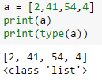

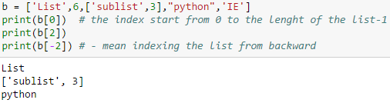
Compound Data Types Lists
Lists can be heterogeneous
List can be indexed

Slide 24
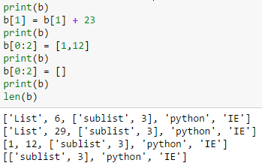
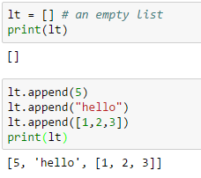
Compound Data Types Lists
Lists can be manipulated
Add new values to a list
Sorting list

Slide 25
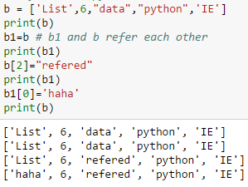
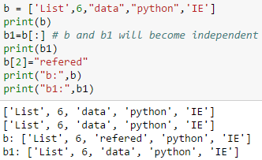
Compound Data Types Lists
a = b # refer
a = b[:] # copy
Refer
Copy

Slide 26

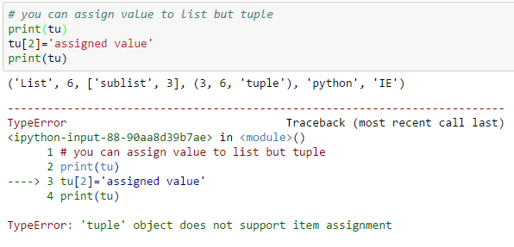
Compound Data Types Tuples
Tuples can be heterogeneous
But you cannot assign value to tuple

Slide 27
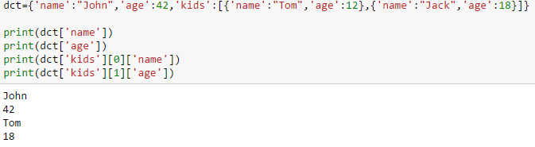
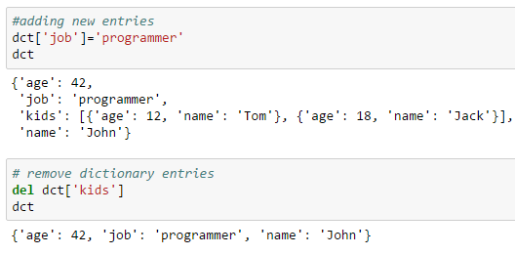
Compound Data Types Dictionary
Adding and removing dictionary entries

Slide 28
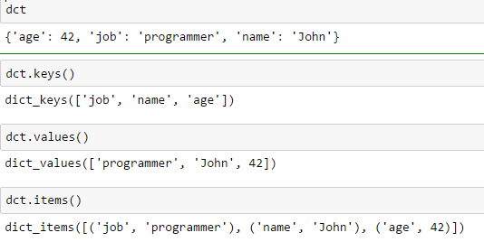
Compound Data Types Dictionary
Useful accessor methods
dict(zip(('a','b','c','d','e'),(1,2,3,4,5)))

Slide 29
Operators Math Operators
+ - * /
Power: **
Integer division: //
It works on strings and lists as well!!

Slide 30

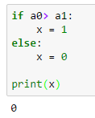
Conditional expressions
One of the most amazing things of Python
It replaced the redundant codes to one simple expression
A0=dict(zip(('a','b','c','d','e'),(1,2,3,4,5)))
A1 = range(10)
A2 = sorted([i for i in A1 if i in A0])

Slide 31
A few key notes
Everything is an object
Input is a string by default
Strings can be indexed
Operator + and * work on strings
Operator + works between the same type of variable
Converting variables is simple:
int(x)/float(x)/str(x), where x is a variable
for (idx,x) in enumerate(x): action
The TAB if change the line

Slide 32
Useful links
Python: https://www.python.org/
Python 3 Tutorial: https://pythonprogramming.net/introduction-to-python-programming/ (include videos and codes)
Programming for Everybody (Getting Started with Python):
https://www.coursera.org/learn/python

