Slide 1
Multiscale Detrended Cross-Correlation Coefficient (MDC₃)

Slide 2
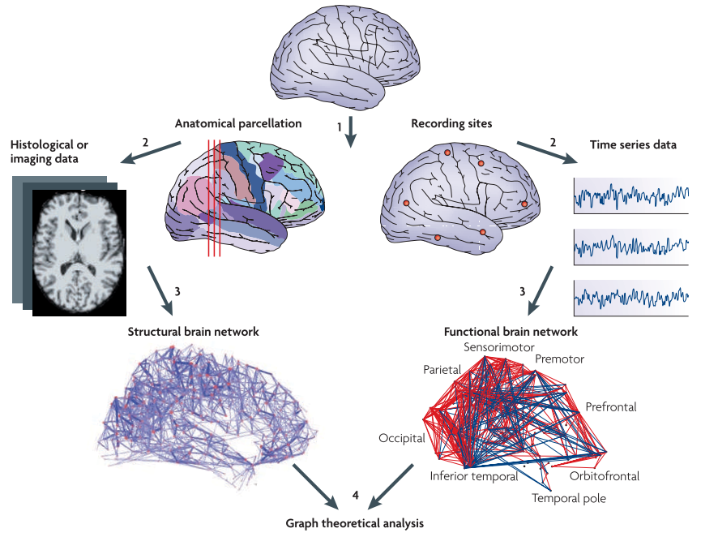
Structural Connectivity vs Functional Connectivity (FC)

Slide 3

Estimating FC
Statistical relationship between time series X and Y
Most well-known: Pearson’s correlation (ρ)
$ρ= \frac{{cov}_{XY}}{\sqrt{{var}_{X}{var}_{Y}}}$

Slide 4
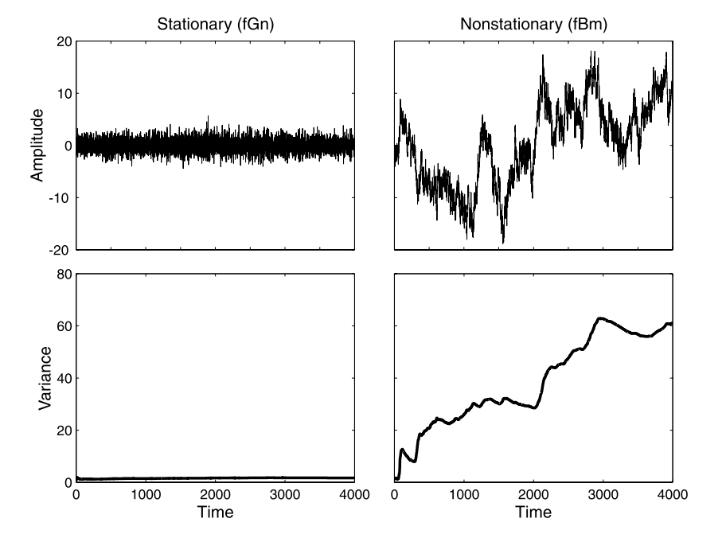
Stationary vs Nonstationary

Slide 5

Detrended Cross-Correlation Coefficient (DCCC)
$r=\frac{F_{XY}}{\sqrt{F_{X}F_{Y}}}$

Slide 6

Detrended Cross-Correlation Coefficient (DCCC)
$r=\frac{F_{XY}}{\sqrt{F_{X}F_{Y}}}$
Detrended Fluctuation Analysis (DFA)

Slide 7

Detrended Cross-Correlation Coefficient (DCCC)
Detrended Cross-Correlation Analysis (DCCA)
$r=\frac{F_{XY}}{\sqrt{F_{X}F_{Y}}}$
Detrended Fluctuation Analysis (DFA)

Slide 8
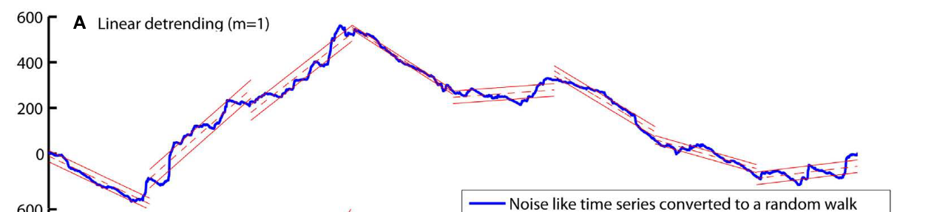

Detrended Cross-Correlation Coefficient (DCCC)
Detrended Cross-Correlation Analysis (DCCA)
$r=\frac{F_{XY}}{\sqrt{F_{X}F_{Y}}}$
Step 1: Divide in N windows and remove trends
Detrended Fluctuation Analysis (DFA)

Slide 9

Detrended Cross-Correlation Coefficient (DCCC)
Detrended Cross-Correlation Analysis (DCCA)
$r=\frac{F_{XY}}{\sqrt{F_{X}F_{Y}}}$
Step 2: Calculate variance/covariance in each window
Detrended Fluctuation Analysis (DFA)

Slide 10

Detrended Cross-Correlation Coefficient (DCCC)
Detrended Cross-Correlation Analysis (DCCA)
$r=\frac{F_{XY}}{\sqrt{F_{X}F_{Y}}}$
Step 3: Calculate average for all windows
Detrended Fluctuation Analysis (DFA)

Slide 11

Detrended Cross-Correlation Coefficient (DCCC)
Detrended Cross-Correlation Analysis (DCCA)
$r=\frac{F_{XY}}{\sqrt{F_{X}F_{Y}}}$
$F_{XY}= \frac{1}{N}\sum_{i=1}^{N}{{cov}_{XY,i}}$
$F_{X}= \frac{1}{N}\sum_{i=1}^{N}{{var}_{X,i}}$
$r= \frac{\frac{1}{N}\sum_{i=1}^{N}{{cov}_{XY,i}}}{\sqrt{\frac{1}{N}\sum_{i=1}^{N}{{var}_{X,i} \frac{1}{N}\sum_{i=1}^{N}{{var}_{Y,i}}}}\frac{1}{N}}$
Detrended Fluctuation Analysis (DFA)

Slide 12

r and ρ Similarities
$r=\frac{\frac{1}{N}\sum_{i=1}^{N}{{cov}_{XY,i}}}{\sqrt{\frac{1}{N}\sum_{i=1}^{N}{{var}_{X,i} \frac{1}{N}\sum_{i=1}^{N}{{var}_{Y,i}}}}}$
$ρ= \frac{{cov}_{XY}}{\sqrt{{var}_{X}{var}_{Y}}}$
r>0 → Positive Correlation [Proof]
r = 0 → No correlation
r<0 → Negative Correlation

Slide 13
r and ρ Differences
r is better estimator for nonstationary series

Slide 14
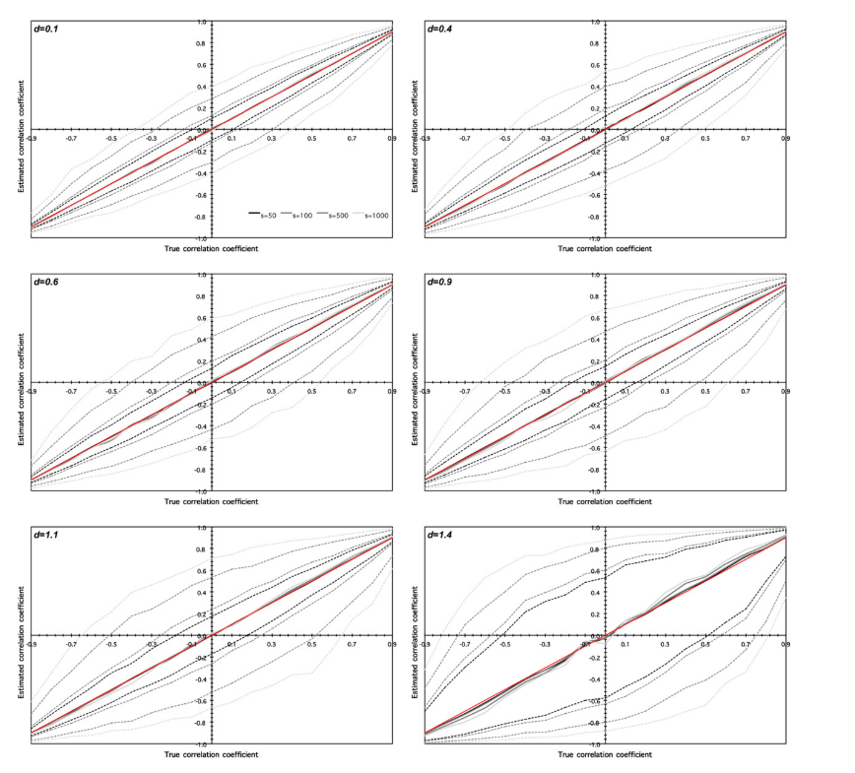
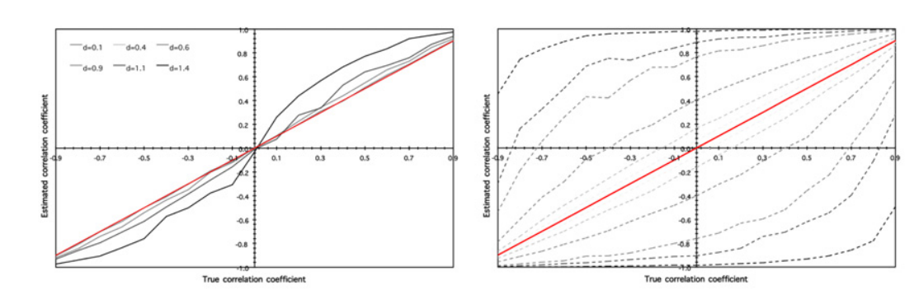

Slide 15
Detrended Cross-Correlation Coefficient (DCCC)
Detrended Cross-Correlation Analysis (DCCA)
$r=\frac{F_{XY}}{\sqrt{F_{X}F_{Y}}}$
Step 1: Divide in N windows and remove trends
Detrended Fluctuation Analysis (DFA)

Slide 16

Detrended Cross-Correlation Coefficient (DCCC)
$r=\frac{F_{XY}}{\sqrt{F_{X}F_{Y}}}$
Step 1: Divide in N
Use different scales

Slide 17
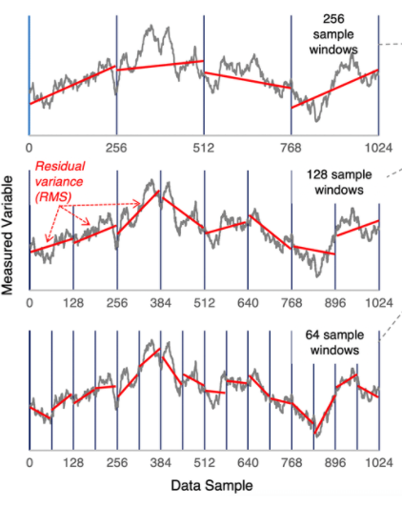

Slide 18
Weighted Average of r
Scale → Frequency
e.g. Sampling rate: 500 Hz and Scale: 100 datapoints → Frequency: 5 Hz
My idea:
Step 1: Calculate r for appropriate frequencies
Step 2: Find relative proportion of frequencies in the signal
Step 3: Calculate weighted average
Result:
One r for the whole signal length – Multiscale Detrended-Cross Correlation Coefficient (MDC₃)

Slide 19
MDC₃ Algorithm
Input: signal, fmin, fmax, fstep, sampling rate and trend degree
signal: array of numbers, # rows = signal datapoints, # columns = channel number
fmin / fmax: define frequency range
fstep: frequency increase step
trend: degree of the polynomial fit for detrending

Slide 20
MDC₃ Algorithm
Input: signal, fmin, fmax, fstep, sampling rate and trend degree
Convert frequency to scales (sampling rate / frequency)
For every scale divide signals into windows
For every window detrend signals and calculate covariance & variance
Find average covariance & variance for every frequency
Find the ratio of each frequency to the cross-spectral density of each connection (before that detrend entire signal)
Calculate weighted average

