Slide 1
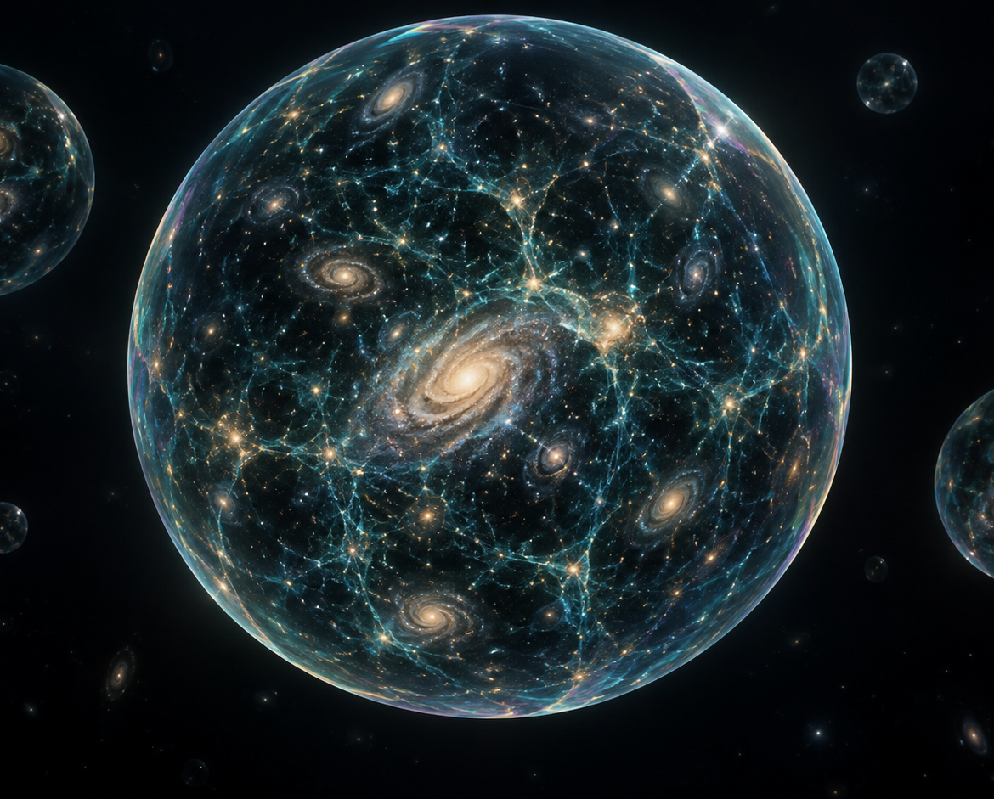
CUTLINE
The audience changes everything.
Audience-directed live cinema
Speculative multiverse artwork
01
Notes:
[00:00–00:12 | 12 seconds]
SPEAKER SCRIPT
CUTLINE turns a theater audience into the director. We begin in imagined deep space, arrive in one shared room, and let that room change the film.
VISUAL / STORYBOARD
Hold the multiverse cover. Begin a slow push toward the central sphere. Keep the title editable and fixed.
DEMO CUE
Presenter begins. No provider request on stage yet.
TIMING
Use the hard time boundary above. Finish narration, then hold until the next cue. All ten slots sum to exactly 180 seconds. Natural speaking rate varies.
SOURCES
Original speculative AI artwork, assets/multiverse.png. Not a factual visualization.

Slide 2
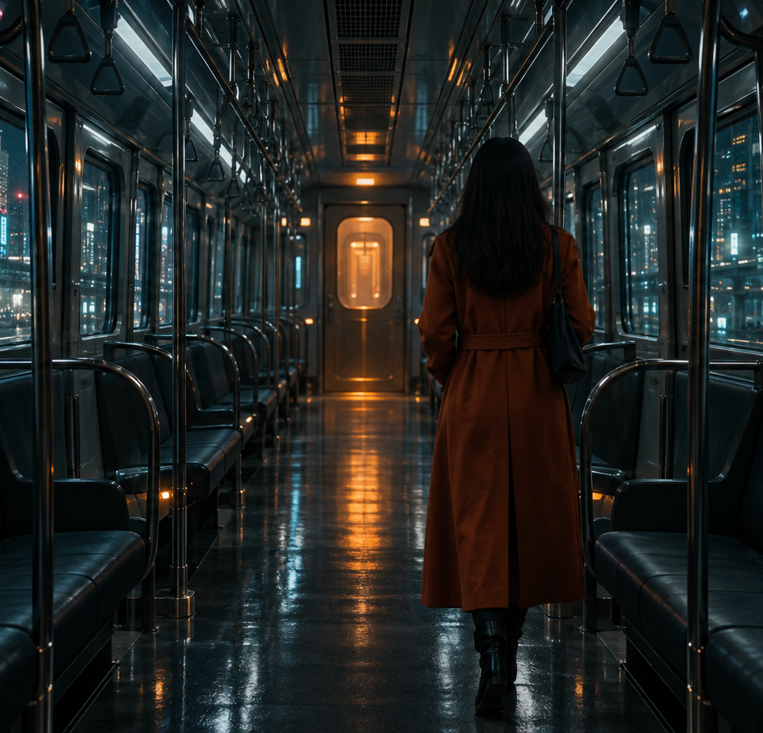
A theater becomes
the director
One shared film.
A choice on every phone.
Open the last door
Follow the flickering light
Pull the emergency brake
“The last train” concept still, AI-generated
02
Notes:
[00:12–00:30 | 18 seconds]
SPEAKER SCRIPT
A woman reaches the last door of a midnight train. Everyone here sees the same uncertainty. On their phones, they choose to open the door, follow a light, or stop the train. The winning choice becomes the next direction.
VISUAL / STORYBOARD
The last train fills the right side. Three exact choices appear as readable text on the left.
DEMO CUE
Show the decision moment. Do not imply a prerecorded branch is live generated.
TIMING
Use the hard time boundary above. Finish narration, then hold until the next cue. All ten slots sum to exactly 180 seconds. Natural speaking rate varies.
SOURCES
repository/lib/cutline/content.ts
repository/components/cutline/audience.tsx
Original AI story still, assets/train.png.

Slide 3
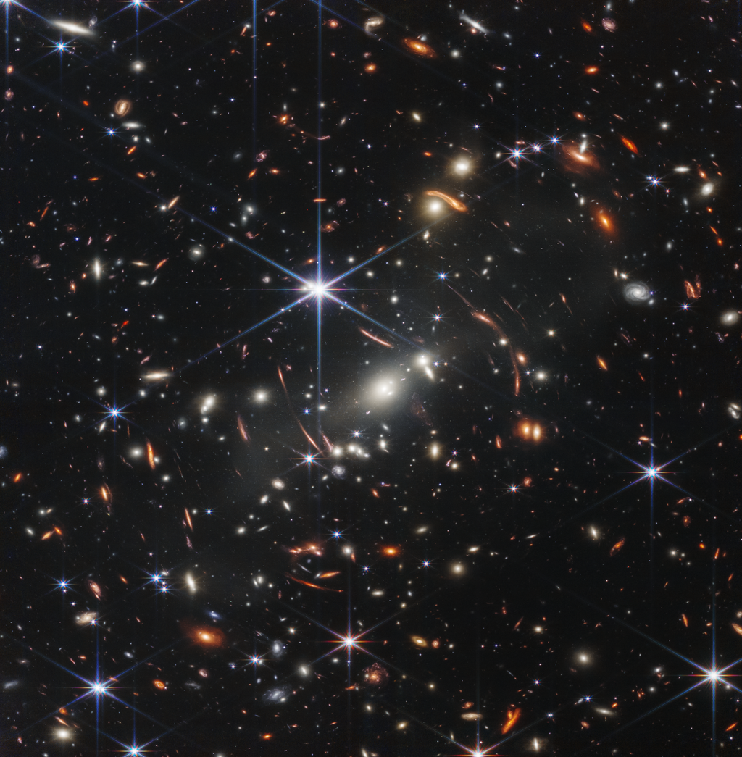
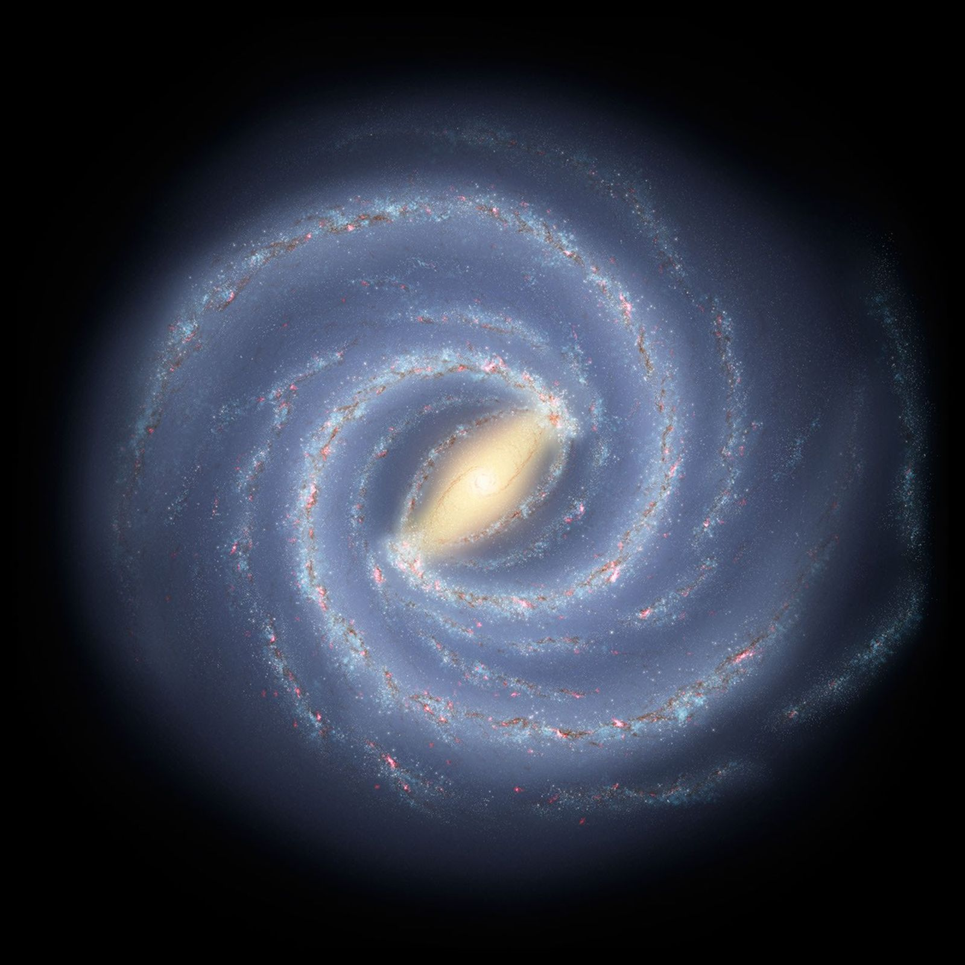
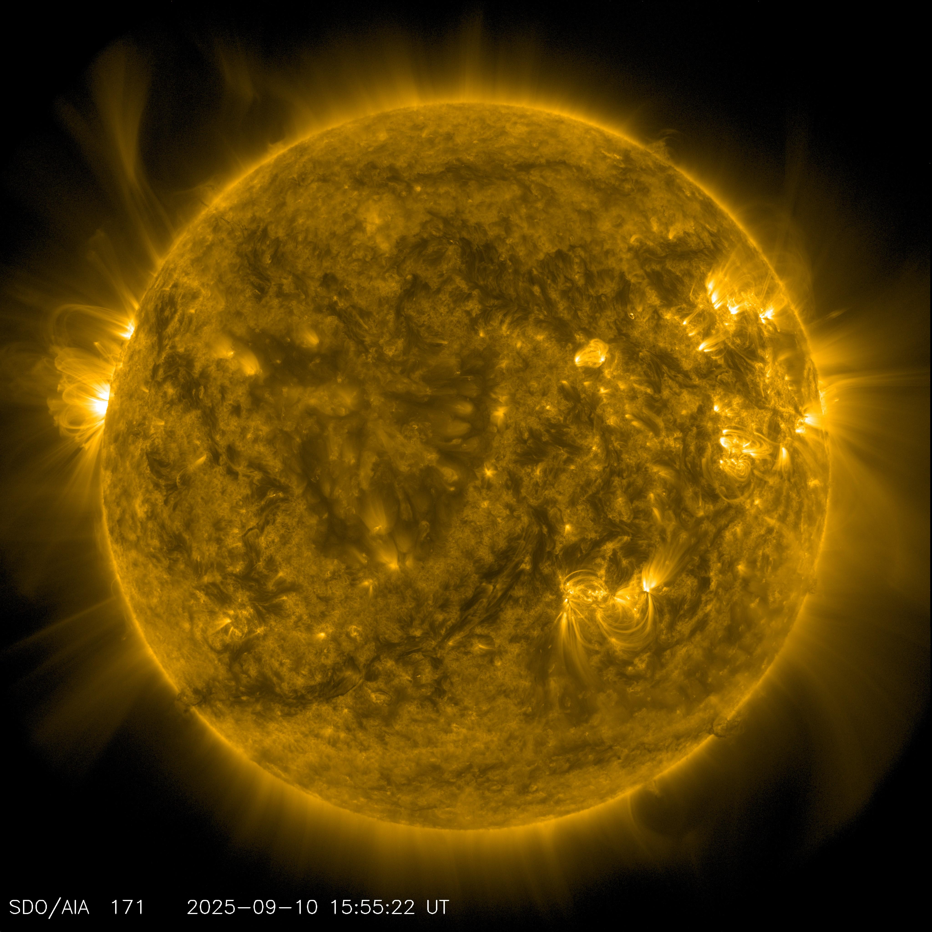
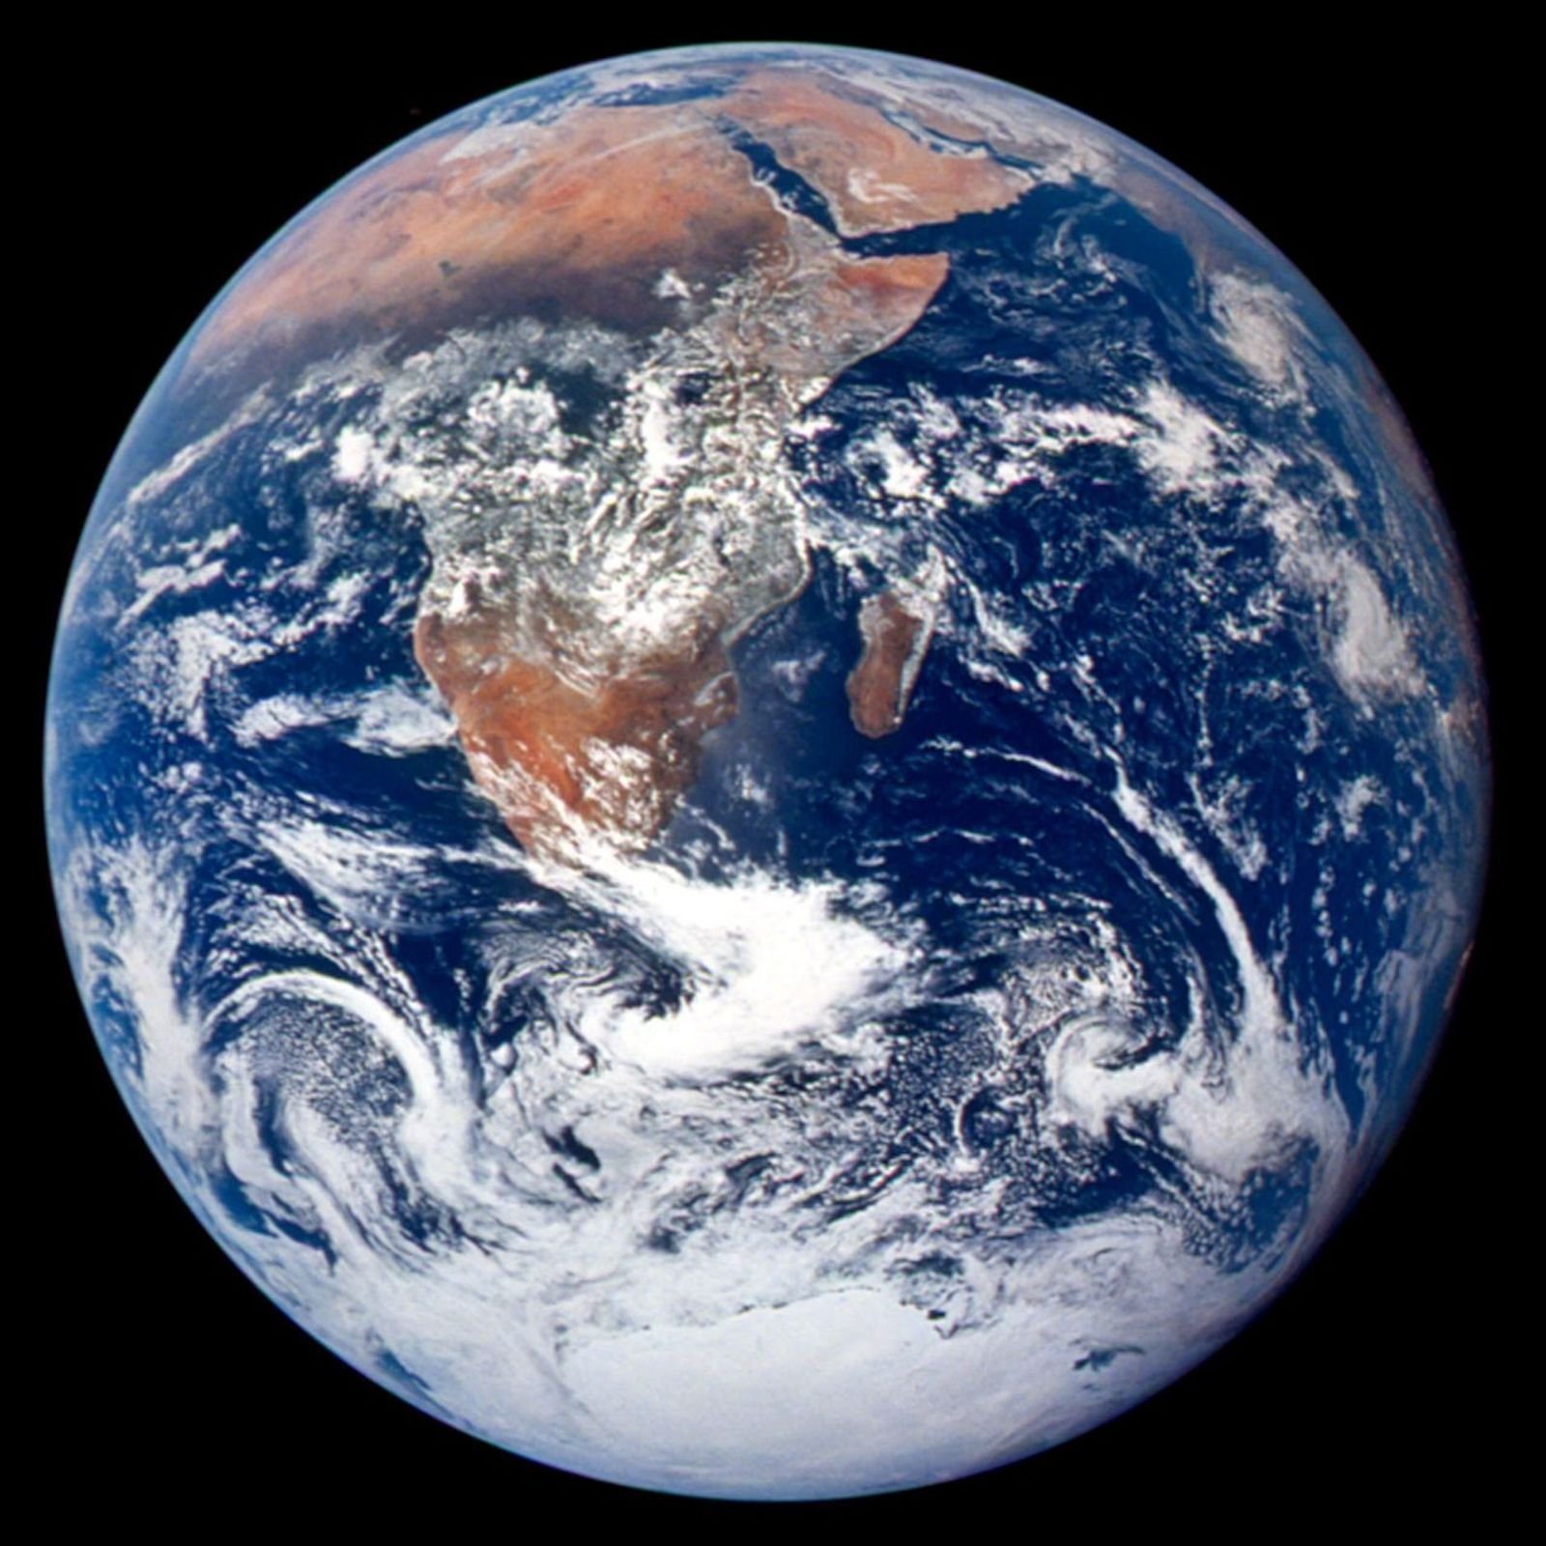
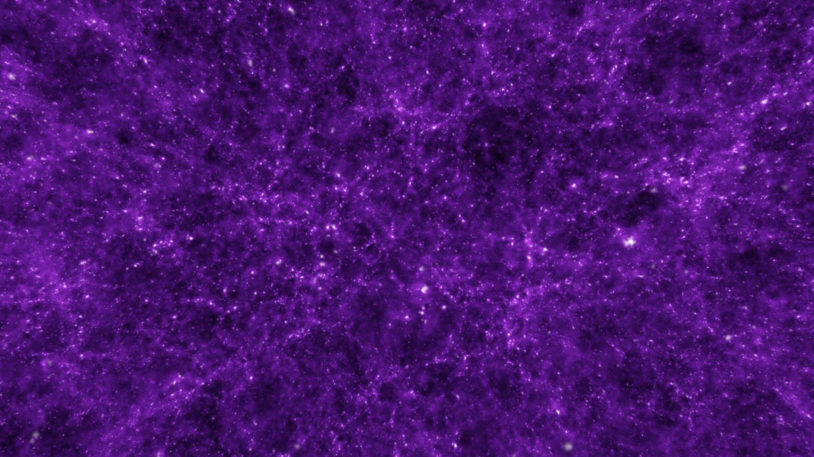
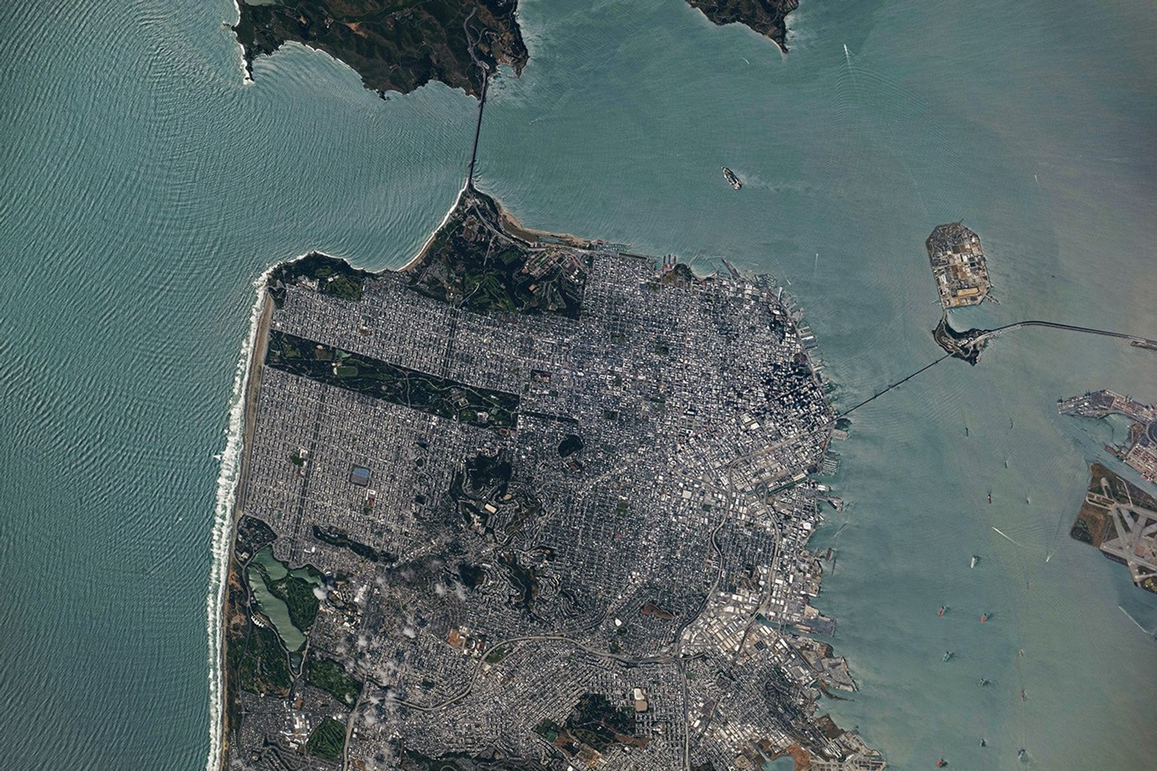
One canvas, from cosmos to cinema
Click a destination. The camera travels.
Universe
Cosmic web
Milky Way
Solar system
Earth
San Francisco
Infrared observation
Scientific simulation
Artist concept
Sun, EUV observation
Apollo 17 photograph
ISS photograph
NASA texture on the Earth sphere
Original San Francisco aerial plane
Source references shown here. The app uses one Three.js canvas with cinematic, compressed scales. Orbis begins in the fictional film.
03
Notes:
[00:30–00:54 | 24 seconds]
SPEAKER SCRIPT
The opening is one continuous three-dimensional canvas. Click a destination and the camera travels toward it. NASA imagery textures the Earth sphere, and an original orbital photograph anchors San Francisco. These are cinematic, compressed scales. The source references shown here are not app screenshots. Orbis takes over inside the fictional film.
VISUAL / STORYBOARD
The gallery shows credited source references, not a screenshot of the application. In the app, one Three.js canvas moves continuously among clickable projected destinations, through a textured Earth sphere and a San Francisco aerial plane, into the theater and fictional film.
DEMO CUE
Rehearse the continuous flight and destination selection before presenting. Keep astronomy labeled as cinematic compressed scales, not physically exact distances. The Earth sphere uses a NASA texture; the San Francisco plane uses an original orbital photograph. The Orbis model handles the fictional film. Do not claim these source thumbnails depict the rendered app.
TIMING
Use the hard time boundary above. Finish narration, then hold until the next cue. All ten slots sum to exactly 180 seconds. Natural speaking rate varies.
SOURCES
repository/components/cutline
repository/lib/cutline/content.ts
Webb's First Deep Field (NIRCam Image) — NASA, ESA, CSA, STScI — https://science.nasa.gov/asset/webb/webbs-first-deep-field-nircam-image/
Journey Through the Cosmic Web: Cosmic Cruising 2 — NASA/NCSA University of Illinois; visualization: Frank Summers (STScI); simulation: Martin White and Lars Hernquist (Harvard University) — https://svs.gsfc.nasa.gov/10118/
Our Milky Way Gets a Makeover (Artist Concept) — NASA/JPL-Caltech — https://science.nasa.gov/photojournal/our-milky-way-gets-a-makeover-artist-concept/
Image of Sun From NASA's Solar Dynamics Observatory — NASA/GSFC/Solar Dynamics Observatory — https://www.jpl.nasa.gov/images/pia26681-image-of-sun-from-nasas-solar-dynamics-observatory/
The Blue Marble — NASA / Apollo 17 crew — https://science.nasa.gov/resource/the-blue-marble/
San Francisco's Metropolitan Mosaic — NASA Earth Observatory / ISS Crew Earth Observations Facility and Earth Science and Remote Sensing Unit, NASA Johnson Space Center — https://science.nasa.gov/missions/station/san-franciscos-metropolitan-mosaic/
Source references shown on this slide are not app screenshots. Multiverse: speculative AI artwork. The Three.js camera journey uses cinematic compressed scales. Six thumbnails retain their exact agency image classifications.

Slide 4
One decision, one shared result
01
02
03
04
Open
Vote
Close
Apply
Host opens the
scene’s poll.
Each viewer can
replace their ballot.
The database freezes
the final tally.
Host applies the
winner once.
Ties follow the visible choice order. A poll with no votes has no winner.
04
Notes:
[00:54–01:14 | 20 seconds]
SPEAKER SCRIPT
The host opens a poll. Audience members can change their vote while it stays open. Closing the poll freezes the tally atomically, resolves a tie using the visible choice order, and allows the winner to apply once. Everyone receives the saved story state.
VISUAL / STORYBOARD
Readable four-step interaction sequence. A live app demonstration can replace the slide while narration continues.
DEMO CUE
If the session is ready, open the phone poll, cast a vote, close it, and apply the winner. If it is not ready, remain on the honest process slide.
TIMING
Use the hard time boundary above. Finish narration, then hold until the next cue. All ten slots sum to exactly 180 seconds. Natural speaking rate varies.
SOURCES
repository/db/schema.ts
repository/app/api/stories/[id]/vote/route.ts
repository/app/api/stories/[id]/action/route.ts
repository/app/api/stories/[id]/events/route.ts

Slide 5
The audience-to-canvas architecture
Audience
Atomic tally
Nebius
Reactor
Canvas
Phone vote
D1 closes poll
Optional director
Visko Orbis
Shared film
Host applies the winner
and sends the prompt
SSE updates
Story storage
Story context
Saved story and tally
D1 state + version
Memory and branch ancestry
Rehearsal can create a beat without Nebius.
Video integration informed by Visko-Platform/orbis-hackathon-starter, commit 6de7ad7. Audience, Nebius and Orbis verified in one combined local run.
05
Notes:
[01:14–01:38 | 24 seconds]
SPEAKER SCRIPT
Phones send votes to the application. D one stores ballots and freezes the result. The optional Nebius director turns that result and story memory into a visual instruction. Reactor carries the host’s prompt to Visko Orbis, which streams the shared canvas. Server sent events synchronize the audience. The official starter informs video integration.
VISUAL / STORYBOARD
Native editable architecture diagram. Trace the main row left to right, then the persistence and state synchronization return path.
DEMO CUE
Explain the actual boundary: a vote alone does not mint a video token or direct the model. Host applies the closed winner.
TIMING
Use the hard time boundary above. Finish narration, then hold until the next cue. All ten slots sum to exactly 180 seconds. Natural speaking rate varies.
SOURCES
repository/db/schema.ts
repository/lib/cutline/director.ts
repository/components/cutline/use-live-video.ts
repository/app/api/stories/[id]/token/route.ts
https://github.com/Visko-Platform/orbis-hackathon-starter/tree/6de7ad733e90967f25979afcfca55b73a71f064a
https://www.reactor.inc/models/visko-orbis-stable/api
Official starter audited at commit 6de7ad733e90967f25979afcfca55b73a71f064a on 2026-09-12. CUTLINE is a separate application, not the unmodified starter.

Slide 6
The live session exposes its progress
2560 × 1440
18 fps
Observed delivery resolution
Stable session observed
Cue sent
Accepted
Next chunk
Picture checked
set_prompt
Command reply
chunk_complete
Human observation
Latency varies. Command acceptance does not establish visual compliance.
Stable session observed with reference image confirmed. Earlier Dynamic session also observed. Delivery is upscaled.
06
Notes:
[01:38–01:58 | 20 seconds]
SPEAKER SCRIPT
One observed Stable session delivered twenty-five-sixty by fourteen-forty video at eighteen frames per second. That describes one observed session. The interface separately tracks a sent cue, command acceptance, and the next chunk. Acceptance alone does not prove the requested change appeared. We inspect the picture live.
VISUAL / STORYBOARD
Large session dimensions and frame-rate typography. Beneath, an editable cue-state chain ending in visual inspection.
DEMO CUE
Point at the live video and trace in the app if available. Do not quote one latency observation as a benchmark.
TIMING
Use the hard time boundary above. Finish narration, then hold until the next cue. All ten slots sum to exactly 180 seconds. Natural speaking rate varies.
SOURCES
Browser observations supplied by project lead. Latest Orbis Stable session showed 2560×1440 delivery, 18 fps, and image_confirmed. Earlier Orbis Dynamic session also delivered live video. No standalone trace log was captured for the earlier timing observation. Earth imagery visibly distorted after 40 seconds in a Stable test, motivating use of original NASA source imagery in the cinematic 3D opening, with generated video reserved for fiction. This is not a measured quality benchmark.
repository/components/cutline/use-live-video.ts
https://www.reactor.inc/models/visko-orbis-stable/api
Reactor documentation describes 832×480 generation at 18 fps with upscaled delivery. 2560×1440 is a delivery resolution, not native model generation resolution.

Slide 7
Creative control preserves the scene
Continuity
Visible change
Story memory anchors the character,
clothing, setting, and active branch.
A direction describes one action
that the picture can show.
Branching
Live cues
Earlier scenes remain available.
Abandoned futures leave the context.
Camera and lighting controls
reshape the ongoing shot.
Continuity is a model instruction, not a guaranteed visual result. Background: NASA/NCSA cosmic-web simulation.
07
Notes:
[01:58–02:16 | 18 seconds]
SPEAKER SCRIPT
Creativity stays visible. Story memory anchors the character and setting. The director requests one visible change. Camera and lighting cues reshape the shot. Branch history preserves decisions, and returning to an earlier scene excludes the abandoned future from director context.
VISUAL / STORYBOARD
Two large text columns, continuity on the left and live direction on the right. Use the cosmic-web simulation as a restrained background texture.
DEMO CUE
Mention that model continuity is a prompt constraint rather than a guarantee. The saved branch context is deterministic application behavior.
TIMING
Use the hard time boundary above. Finish narration, then hold until the next cue. All ten slots sum to exactly 180 seconds. Natural speaking rate varies.
SOURCES
repository/lib/cutline/director.ts
repository/lib/cutline/story.ts
repository/tests/story.test.ts
repository/lib/cutline/content.ts
https://svs.gsfc.nasa.gov/10118/
Cosmic-web background credit: NASA/NCSA University of Illinois; visualization: Frank Summers (STScI); simulation: Martin White and Lars Hernquist (Harvard University); scientific simulation.

Slide 8
The application behavior has test evidence
210
12 / 12
assertions
integration groups passed
Area | Verified behavior
Voting | Replacement, frozen tally, ties, apply once
Consistency | Concurrent mutations and branch ancestry
Access + recovery | Owner isolation, exports, SSE reconnect
Local integration run: 12 September 2026. These checks do not establish provider availability, visual quality, or audience-scale load.
08
Notes:
[02:16–02:34 | 18 seconds]
SPEAKER SCRIPT
Local integration passed twelve groups covering two hundred ten assertions. Tests cover owner isolation, vote replacement, frozen results, races, branching, exports, and event reconnection. Provider availability and picture quality still need observation in each live rehearsal.
VISUAL / STORYBOARD
Native evidence table and two large test totals. Source run date is visible. Avoid checkmark decoration or false provider-test claims.
DEMO CUE
Refer to retained local test report. Do not reframe these application checks as load testing or an end-to-end provider benchmark.
TIMING
Use the hard time boundary above. Finish narration, then hold until the next cue. All ten slots sum to exactly 180 seconds. Natural speaking rate varies.
SOURCES
repository/docs/testing/api-results.json
repository/docs/testing/sse-evidence.json
repository/tests/integration.mjs
repository/tests/story.test.ts
Recorded integration run completed 2026-09-12T22:23:48.873Z. 12 passed groups, 0 failed, 210 assertions.

Slide 9
The complete live loop was verified
Stage | Combined local run | Evidence
Audience | Open the last door won | Winner saved and applied
Nebius | Scene + three new choices | Memory and source retained
Orbis Stable | Prompt accepted at 93 ms | Next chunk at 1,927 ms
Movie | 18 fps; image confirmed | Doorway visually inspected
One observed run. Timings vary with each session.
Local production build, 12 September 2026. Cue acceptance does not prove every pictured detail.
09
Notes:
[02:34–02:48 | 14 seconds]
SPEAKER SCRIPT
One combined local run carried a real vote through Nebius into Orbis. The movie continued at eighteen frames per second. We inspected the doorway scene. These timings describe one sample.
VISUAL / STORYBOARD
An editable evidence table traces the combined local run: saved audience winner, Nebius scene and three choices, Orbis acceptance, subsequent chunk, and picture inspection. The 93 ms acknowledgment and 1,927 ms next chunk are separate observed timings.
DEMO CUE
Explain the single combined observation, not a performance benchmark. The audience page used a separate tab; independent identities were verified by the API suite. Check provider readiness for the current demonstration. Deployment and GitHub publication are separate release tasks.
TIMING
Use the hard time boundary above. Finish narration, then hold until the next cue. All ten slots sum to exactly 180 seconds. Natural speaking rate varies.
SOURCES
repository/docs/testing/combined-live.json
repository/docs/testing/api-results.json
repository/lib/cutline/director.ts
2026-09-12T23:30:48.972571+00:00: local production build, reactor/visko-orbis-stable, Nebius openai/gpt-oss-120b. Open the last door won; Nebius produced Mara Opens the Amber Door with three choices; source nebius; image conditioning confirmed; 18 fps; prompt acknowledgment 93 ms; next chunk after cue 1927 ms. Visual inspection showed Mara near an amber train doorway. These are one-run observations, not a benchmark or proof of every requested semantic detail.

Slide 10
CUTLINE
The audience changes everything.
One room chooses the next scene.
Live demonstration
Speculative multiverse artwork
10
Notes:
[02:48–03:00 | 12 seconds]
SPEAKER SCRIPT
The demonstration ends with a real choice in this room. Join the audience, choose the next direction, and watch the shared film respond. This is CUTLINE.
VISUAL / STORYBOARD
Return to a clean cinematic closing frame. Presenter ends exactly at 03:00. A separate live demonstration may continue after the timed pitch.
DEMO CUE
At 03:00 stop narration. Leave the room ready for a vote. Do not invent a working public URL or a QR code in the deck.
TIMING
Use the hard time boundary above. Finish narration, then hold until the next cue. All ten slots sum to exactly 180 seconds. Natural speaking rate varies.
SOURCES
repository/components/cutline/studio.tsx
repository/components/cutline/audience.tsx
Original speculative AI background, assets/multiverse.png.

