Slide 1

DATA SCIENCE • MACHINE LEARNING • BEGINNER FRIENDLY
AI/ML Job Salary Prediction
How 500 AI & machine-learning job records are used to teach a computer to estimate salaries, explained step by step.
Start the tour →
Jump to quiz
Based on the GitHub project by Vismay Vinod • MIT License

Slide 2
Agenda
Big Picture
Data
Explore
Models
Results
Quiz
Today's journey
Click any card to jump straight to that part of the deck
01
The Big Picture
What the project does, in plain words
02
The Data
The 500 job records and how clean they are
03
Exploring Patterns
What affects salary? Charts & numbers
04
Building Models
The four 'learning' models and how we prepared data
05
Results & Takeaways
Which model won, how accurate it is, and why
✓
Test yourself
Three quick questions with click-to-reveal answers
AI/ML Job Salary Prediction • interactive deck
2

Slide 3
Agenda
Big Picture
Data
Explore
Models
Results
Quiz
01
The Big Picture
What this project is about, and how a computer learns from examples.
← Back to agenda

Slide 4
Agenda
Big Picture
Data
Explore
Models
Results
Quiz
What is this project?
A simple way to say: 'here is what a similar AI/ML job usually pays'
The problem
Job-seekers and companies want a fair idea of what an AI/ML role should pay.
Salary depends on many things at once.
The data
500 job records.
Each record has 11 facts: experience, education, skills, city, company and more.
The method
Train computer models on past jobs.
Then ask them to predict salaries for jobs they have never seen.
Everyday analogy
A student studies 400 solved salary problems, then is tested on 100 new ones they have never seen. If they score well, we trust them to answer the next question. That is exactly what this project does.
AI/ML Job Salary Prediction • interactive deck
4

Slide 5
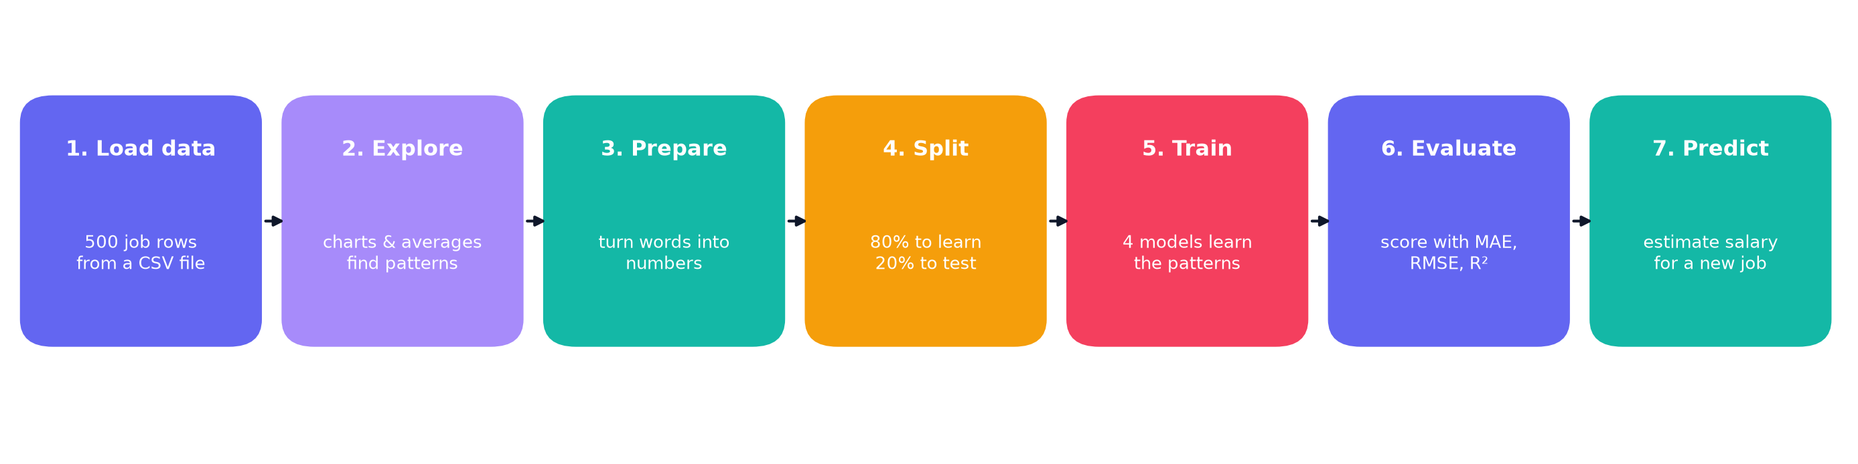
Agenda
Big Picture
Data
Explore
Models
Results
Quiz
The seven steps, top to bottom
Every part of the notebook follows this same path
Think of it like cooking: gather ingredients (data), taste them (explore), wash and chop (prepare), keep some for a test dish (split), cook several recipes (train), taste-test (evaluate), then serve (predict).
AI/ML Job Salary Prediction • interactive deck
5

Slide 6
Agenda
Big Picture
Data
Explore
Models
Results
Quiz
02
The Data
Where the numbers come from, what each column means, and whether we can trust them.
← Back to agenda

Slide 7
Agenda
Big Picture
Data
Explore
Models
Results
Quiz
The dataset at a glance
ai_ml_job_analysis.csv: one row per job, one column per fact
500
job records
11
columns (11 facts each)
15
different job titles
20
employers
$89,119
average salary (USD)
$8k–$216k
salary range
AI/ML Job Salary Prediction • interactive deck
7

Slide 8
Agenda
Big Picture
Data
Explore
Models
Results
Quiz
Meet the 11 columns
What each column means, with a real example from row 3 of the file
Column | What it means | Example (row 3)
ID | Row number (ignored by the model) | 3
Job Title | Role name | AI Consultant
Experience (Years) | Years of work experience | 13.0
Education | Highest degree: Bachelors / Masters / PhD | Masters
Skill Count | How many technical skills are listed | 16
Industry | Sector the job belongs to | Technology
Company | Employer name | Cognizant
Location | City or country (15 values) | London, UK
Remote Work | Yes / No / Hybrid | No
Certification | Professional certificate held, or 'None' | IBM Data Science Cert
Salary (USD) | THE TARGET: the number we want to predict | 143,200
AI/ML Job Salary Prediction • interactive deck
8

Slide 9
Agenda
Big Picture
Data
Explore
Models
Results
Quiz
Where does the salary sit?
Most jobs pay between $41k and $134k. Few jobs pay very high salaries.
Average vs typical
Average $89,119
Median $85,700
Why they differ
A few very high salaries pull the average upward. This is called a 'right skew'.
Hover me!
Click the chart to see the exact count for each bin.
AI/ML Job Salary Prediction • interactive deck
9

Slide 10
Agenda
Big Picture
Data
Explore
Models
Results
Quiz
03
Exploring Patterns
Before modelling, look at the data: what raises or lowers salary?
← Back to agenda

Slide 11
Agenda
Big Picture
Data
Explore
Models
Results
Quiz
Location is the biggest driver
Average salary by city/country (hover a bar for the exact value)
USA: $137k average
137 jobs in this group
Europe / Canada / Singapore: $115k average
137 jobs in this group
Remote: $88k average
32 jobs in this group
India: $38k average
194 jobs in this group
AI/ML Job Salary Prediction • interactive deck
11

Slide 12
Agenda
Big Picture
Data
Explore
Models
Results
Quiz
More experience, higher salary
Each dot is one job. The pink line shows the overall direction.
Average salary by experience
0-3 yrs: $65k
68 jobs
3-6 yrs: $73k
81 jobs
6-10 yrs: $80k
113 jobs
10-15 yrs: $92k
122 jobs
15-20 yrs: $120k
116 jobs
Correlation r = 0.36 (a moderate positive link)
AI/ML Job Salary Prediction • interactive deck
12

Slide 13
Agenda
Big Picture
Data
Explore
Models
Results
Quiz
Education, remote work and certificates
Two quick charts, then a short note on certificates
Average salary by education
Average salary by remote work
Takeaway: a PhD earns about $100k on average vs $81k for a Bachelors. Remote work barely changes pay. Certificates vary from $77k (TensorFlow Developer) to $99k (IBM Data Science Cert).
AI/ML Job Salary Prediction • interactive deck
13

Slide 14
Agenda
Big Picture
Data
Explore
Models
Results
Quiz
Job titles: role matters
Average salary per job title, sorted from highest to lowest
Top: AI Solutions Architect
Average $111,306. Often senior, strategy-focused roles.
Lowest: Research Intern
Average $31,439. Typically early-career roles in this data.
AI/ML Job Salary Prediction • interactive deck
14

Slide 15
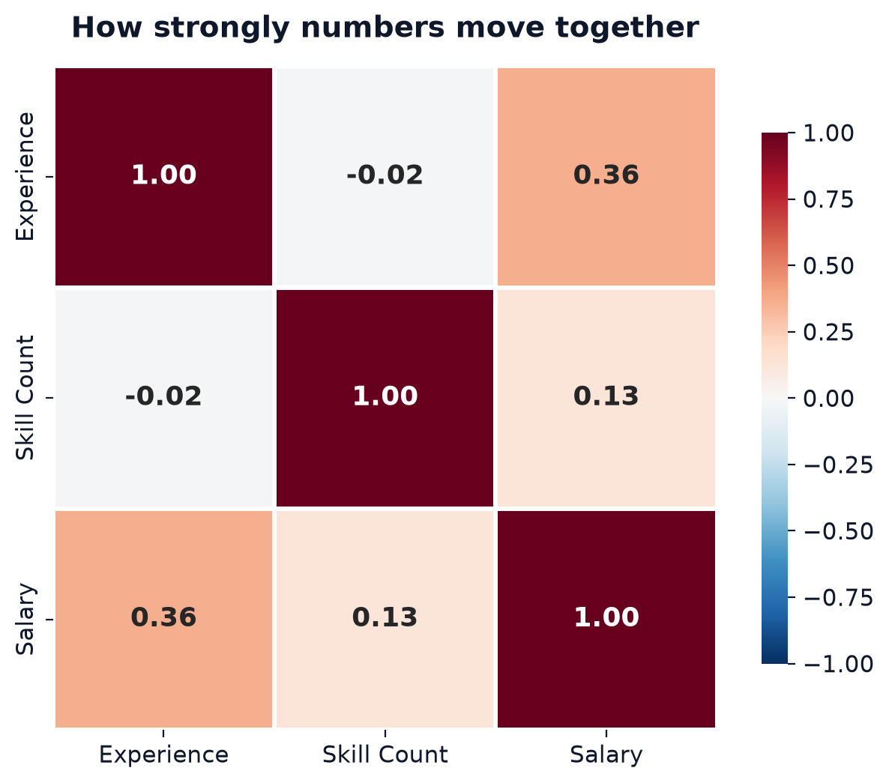
Agenda
Big Picture
Data
Explore
Models
Results
Quiz
How numbers move together
A correlation score runs from -1 to +1. Closer to 0 means little link.
Experience vs salary: +0.36
A moderate positive link. More experience usually means higher pay.
Skill count vs salary: +0.13
A weak link. Listing more skills does not guarantee a big salary.
Experience vs skill count: -0.02
Basically unrelated: the two carry different information for the model.
Quick question: what does -0.02 mean? (click the box below)
Answer: almost no straight-line relationship. The two numbers do not move together.
AI/ML Job Salary Prediction • interactive deck
15

Slide 16
Agenda
Big Picture
Data
Explore
Models
Results
Quiz
04
Building the Models
Preparing the data, splitting it, and teaching four different models.
← Back to agenda

Slide 17
Agenda
Big Picture
Data
Explore
Models
Results
Quiz
Preparing the data
Computers only understand numbers, so words must be converted first
Step | What we do | Why
1. Drop ID | Remove the row number | It has no link to salary
2. Education | Bachelors = 0, Masters = 1, PhD = 2 | Keeps the natural order of degrees
3. Remote Work | Turn Yes / No / Hybrid into three 0-or-1 columns | These options have no natural order
4. Text columns | Job Title, Industry, Company, Location, Certification get a number each (LabelEncoder) | Models need numbers. Note: this order is arbitrary (see limitations)
5. Scale numbers | Put numbers on a similar range (linear model only) | Helps the straight-line model work well
AI/ML Job Salary Prediction • interactive deck
17

Slide 18
Agenda
Big Picture
Data
Explore
Models
Results
Quiz
Four models, four ways to learn
Same data, same split. Each model learns the pattern differently.
Linear Regression
Draws one straight line through the data. Fast and simple. The baseline everyone compares against.
Analogy: a ruler
Decision Tree
Asks a chain of yes/no questions such as 'Is experience above 10 years?'
Analogy: a flowchart
Random Forest
300 trees are each trained on a random part of the data, then their answers are averaged.
Analogy: asking 300 experts and averaging
Gradient Boosting
Trees are built one after another; each new tree fixes the mistakes of the previous ones.
Analogy: correcting your own homework again and again
Train/test split: 400 jobs to learn from • 100 jobs hidden for testing (80/20, random_state = 42)
AI/ML Job Salary Prediction • interactive deck
18

Slide 19
Agenda
Big Picture
Data
Explore
Models
Results
Quiz
05
Results & Takeaways
Which model predicts best, how big the errors are, and what we learned.
← Back to agenda

Slide 20
Agenda
Big Picture
Data
Explore
Models
Results
Quiz
Which model predicts best?
Higher R² and lower errors are better. Gradient Boosting wins on every measure.
Model | R² | MAE | RMSE
Linear Regression | 0.277 | $36,749 | $42,274
Decision Tree | 0.828 | $14,212 | $20,621
Random Forest | 0.853 | $13,886 | $19,066
Gradient Boosting | 0.935 | $9,090 | $12,646
What do these mean?
R² = how much of the salary variation the model explains (1.0 = perfect).
MAE = on average, the guess is off by about $9,090.
AI/ML Job Salary Prediction • interactive deck
20

Slide 21
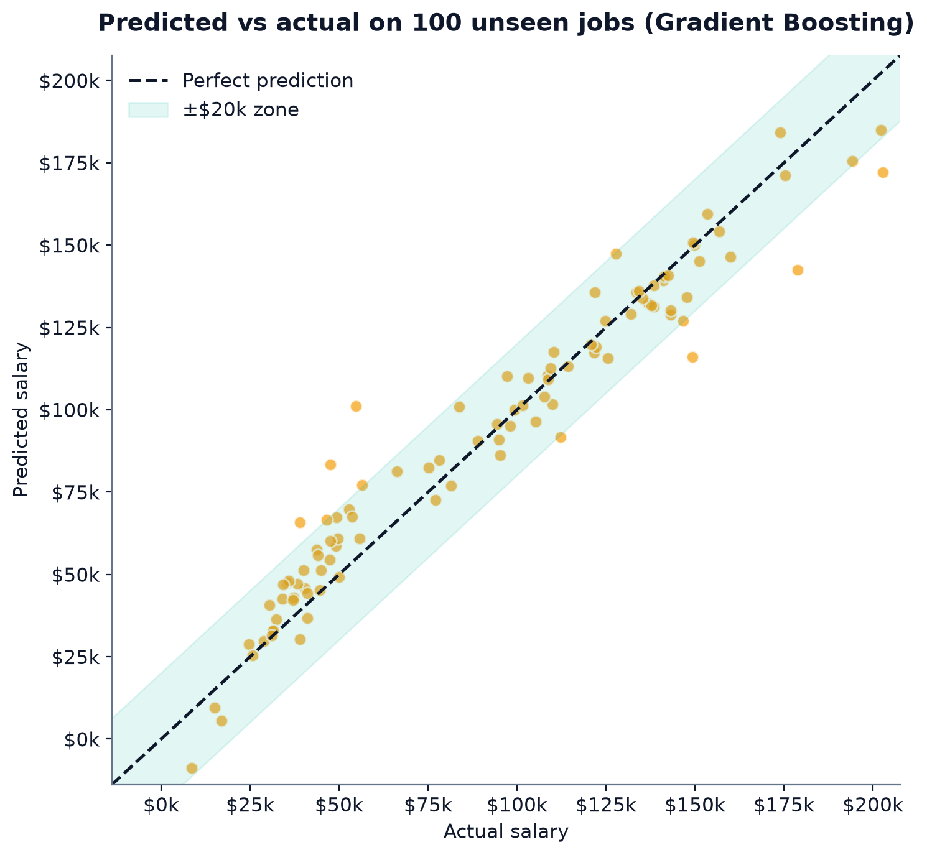
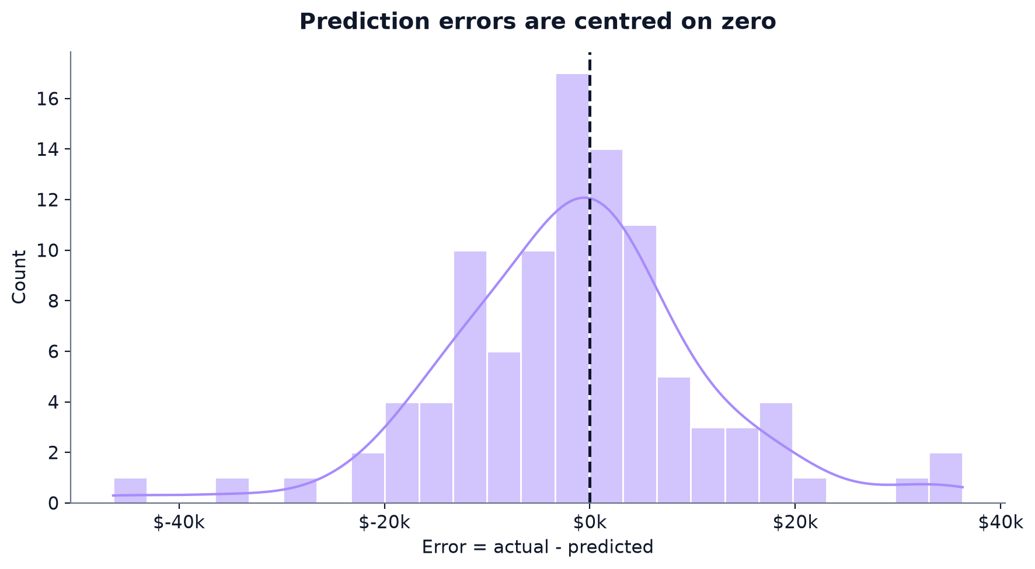
Agenda
Big Picture
Data
Explore
Models
Results
Quiz
How close are the predictions?
Left: each dot is a test job. Dots near the dashed line were predicted correctly.
91% of the test predictions were within $20,000 of the real salary.
Errors (right) are centred near zero, so the model is not systematically too high or too low.
AI/ML Job Salary Prediction • interactive deck
21

Slide 22
Agenda
Big Picture
Data
Explore
Models
Results
Quiz
Is the result lucky? Cross-validation says no
We repeated the test 5 times on 5 different splits of the data
How to read it
Cross-validation shares the data into 5 parts and rotates which part is the test set.
What we found
Gradient Boosting averages R² 0.93 (± 0.009), the highest and steadiest.
Simple summary
The winner is not a fluke of one lucky split.
AI/ML Job Salary Prediction • interactive deck
22

Slide 23
Agenda
Big Picture
Data
Explore
Models
Results
Quiz
What does the model rely on?
Feature importance from the Random Forest (share of its decisions)
Location: 51%
The single most important input. Where the job is matters most.
Experience: 23%
The strongest number-based factor, ahead of skill count.
Remote work: under 1% each
Surprisingly little influence on salary in this data.
AI/ML Job Salary Prediction • interactive deck
23

Slide 24
Agenda
Big Picture
Data
Explore
Models
Results
Quiz
Try a prediction
A new candidate profile, predicted by two models
Example candidate
Job Title: Machine Learning Engineer
Experience (Years): 5.0
Education: Masters
Skill Count: 12
Industry: Technology
Company: Google
Location: Bengaluru, India
Remote Work: Yes
Certification: AWS ML Specialty
Random Forest
$114,232
with 'Bengaluru' (see note)
Gradient Boosting
$105,315
with 'Bengaluru' (see note)
Important catch
'Bengaluru, India' is not in the dataset (it is spelled 'Bangalore, India'). The notebook silently treats it as 'Austin, USA'.
With the correct spelling: Random Forest $41,522, Gradient Boosting $33,857.
AI/ML Job Salary Prediction • interactive deck
24

Slide 25
Agenda
Big Picture
Data
Explore
Models
Results
Quiz
Limits: what to keep in mind
A good score is not the same as a perfect tool
Small dataset
500 rows. Results could change with more data.
Data source unclear
Some labels look odd (e.g. many 'Research Interns' with 5+ years). It may be synthetic.
Arbitrary codes
LabelEncoder gives text values numbers in alphabetical order, which the model may misread.
Unseen names
A city missing from the data silently falls back to the first known one (see the Bengaluru example).
Correlation ≠ cause
Patterns show association. They do not prove that a skill or city causes a higher salary.
Single split
The notebook evaluates one 80/20 split. Cross-validation (slide 22) adds more confidence.
AI/ML Job Salary Prediction • interactive deck
25

Slide 26
Agenda
Big Picture
Data
Explore
Models
Results
Quiz
Key takeaways
1
Location matters most
US & Europe-based roles average far above India-based roles in this data.
2
Experience pays
Average salary climbs from about $65k (0-3 yrs) to $120k (15-20 yrs).
3
Boosting wins
Gradient Boosting: R² 0.935, average error about $9,090.
4
Check the data
Clean labels and clear city names matter more than fancy models.
5
Start simple
Begin with a baseline, then move to better models. Compare them honestly.
AI/ML Job Salary Prediction • interactive deck
26

Slide 27
Agenda
Big Picture
Data
Explore
Models
Results
Quiz
Test yourself
Think of the answer first, then click to reveal it
Q1. If a model's R² is 0.93 on unseen jobs, is that good?
Answer: Yes. R² is close to 1, so the model explains about 93% of the salary variation on jobs it never saw.
Q2. Which input mattered most to the Random Forest?
Answer: Location, with about 51% of its decisions. Experience came second.
Q3. Why do we keep 100 jobs hidden during training?
Answer: To check the model on jobs it has never seen, so we do not fool ourselves with memorised answers.
AI/ML Job Salary Prediction • interactive deck
27

Slide 28
Agenda
Big Picture
Data
Explore
Models
Results
Quiz
Thank you!
Next steps to explore: GridSearchCV tuning, XGBoost/LightGBM, and a Streamlit app for live predictions.
Source: github.com/Vismay-dev1/AI-ML-Salary-Prediction
Back to agenda
Retake quiz

