Slide 1
KAVACH
Pre-execution action firewall for AI agents
ET-03 · Agentic AI Guardrail Validator
Notes:
KAVACH (armour), like Indian Railways' Kavach that brakes a train before a collision. We stop an AI agent's action before it causes damage.

Slide 2
Team Introduction
SUGGESTED TIME 0:20
HACK-AI-THON 2026
[TEAM NAME]
COLLEGE
[College name | City]
TEAM MEMBERS
[Name 1] • [Name 2] • [Name 3]
[
SELECTED PROBLEM STATEMENT
TECHNOLOGY TRACK
ET-03 · Agentic AI Guardrail Validator (Lane 6, Emerging Technologies)
Qualcomm Cloud AI Playground (AI Inference Suite) · UNO Q optional
2
Notes:
FILL IN: team name, college, city, member names (left as template placeholders).

Slide 3
Problem Statement
ACTUAL PROBLEM STATEMENT
WHO IS AFFECTED?
“Check whether an AI agent’s planned action is safe, authorized, explainable and reversible.” MVP: agent action input → approve/block decision → guardrail explanation.
Enterprises letting agents act on DBs, email and payments: Infosys delivery teams, their BFSI/retail clients, security & audit reviewers, and the customers whose data agents touch.
WHY DOES IT MATTER?
CURRENT GAP / PAIN POINT
EVIDENCE / SCENARIO
Agents now act: one bad call deletes, leaks or pays. Gartner: >40% of agentic AI projects cancelled by 2027, citing inadequate risk controls. EU AI Act Art. 14 and RBI FREE-AI demand oversight + audit.
Guardrails gate by tool type or text, or ask another LLM; none measure what this call will do. In AmPermBench, 36.8% of state changes never reached Claude Code’s classifier.
Manual approval (Tool Interrupt) does not scale, so users pick “always allow”.
EchoLeak CVE-2025-32711: zero-click exfiltration via one email.
GitHub MCP: a public issue made an agent leak private repos.
Replit: agent wiped a prod DB during a code freeze, then said rollback was impossible.
Llama-3.3-70B had the highest attack success rate (6.49%) in the UK AISI × Gray Swan red-team challenge.
SUCCESS DEFINITION
≤ 1% unsafe actions auto-executed, 0% injection success, ≥ 65% of safe actions run without a human, every decision explained with a tamper-evident receipt, < 5 ms decision latency.
Measured: 0.5% unsafe auto-allowed, 0% injection ASR, 68% safe auto-completed, p95 2.3 ms (mean of 5 seeds).
Notes:
Lead with the incidents, then say the gap in one sentence: every production guardrail asks 'what kind of action is this?'; we ask 'what will this action actually do, where did its arguments come from, and can it be undone?'

Slide 4
Proposed Solution
SUGGESTED TIME 0:55
SOLUTION IN ONE SENTENCE
KAVACH uses deterministic policy, provenance tracking, sandboxed consequence analysis and a calibrated risk model to let AI agents act on their own, while blocking or escalating every unsafe action with an auditable receipt.
1
INPUT
2
PROCESS
3
OUTPUT
The agent’s plan and each tool call (MCP tools/call or JSON):
tool + args, the user’s request, role, environment, and earlier tool outputs (for provenance).
›
Hard gates R1–R12 (no AI) → provenance of every argument → sandbox diff / typed prediction of the effect → calibrated p(harm) with interval vs a reversibility-conditioned τ.
›
ALLOW · ALLOW + UNDO · ESCALATE · DENY
4-light scorecard (safe / authorized / explainable / reversible), consequence card for humans, replan hint for the agent, hash-chained receipt.
KEY VALUE / DIFFERENTIATOR
Gate by measured effect + argument origin, not by tool type. The LLM never decides. Humans see only the uncertain few.
PROVEN TODAY
Injected exfiltration and payment: blocked by provenance (R1); injection ASR 0%.
Unsafe auto-allowed 0.5% vs 30% with rules alone; safe actions automated 68% vs 12% when every write needs approval.
Reversible writes run with a snapshot; Undo restores state live.
4
Notes:
User journey: 'Summarise my unread emails.' The inbox hides an instruction to email the customer list to billing@acme-invoices.co. KAVACH lets the reads through, then denies the send: the recipient traces to msg-4471, untrusted, rule R1. The agent is told to summarise to the user instead. No LLM was involved in that decision.

Slide 5
Architecture & Technical Design
Show the main components, data flow and engineering choices.
SUGGESTED TIME 0:55
USER / DEVICE
APPLICATION / LOGIC
AI / DATA LAYER
OUTPUT / ACTION
Any agent (Infosys Foundry, LangGraph, OpenAI-style) with its model on Qualcomm Cloud AI; reviewer on the dashboard; optional UNO Q approval button
KAVACH gateway (FastAPI, MCP JSON-RPC): manifest pinning, plan check, policy-as-code R1–R12, provenance, HITL queue
Sandbox diff (SQLite / files) · 18-feature calibrated risk model · reasoning-blind intent judge + explainer (Llama on Qualcomm)
Verdict + 4-light scorecard · consequence card · undo · replan hint · tamper-evident receipt
TECHNOLOGY CHOICES
ENGINEERING RATIONALE
VALIDATION / RELIABILITY
Python 3.11, FastAPI, SQLite, NumPy + scikit-learn, YAML policy-as-code, SHA-256 + HMAC, Qualcomm Imagine API (OpenAI-format chat/completions), vanilla-JS UI
Cheap and deterministic first, probabilistic last: ~1 ms gates stop most attacks; the LLM only sees ambiguous calls and can only raise scrutiny. MCP makes it drop-in for Foundry.
12 tests; 740 labelled scenarios × 5 seeds; post-execution check auto-rolls back; LLM down → heuristic fallback; unknown tool → fail closed.
DESIGN DECISION
Authorization is code, not a model. A model that reads agent-adjacent text can be prompt-injected; a rule that checks where the recipient came from cannot.
Constraint we designed around: email and payments cannot be sandboxed, so their blast radius is predicted from typed arguments and labelled “predicted”. Decision latency p50 0.8 ms / p95 2.3 ms.
5
Notes:
Walk left to right: agent proposes; KAVACH labels every argument with where it came from; runs the action on a copy of the database and diffs it; applies the deterministic rules; only then the calibrated model and, for ambiguous cases, the Qualcomm-hosted judge. Full diagram in the appendix.

Slide 6
AI Usage & Innovation
Demonstrate meaningful AI use, not AI added only for appearance.
SUGGESTED TIME 0:45
AI CAPABILITY USED
INNOVATION / DIFFERENTIATION
Calibrated risk prediction (ML) + LLM intent judging and explanation, inside an agentic-workflow guardrail
Reversibility-conditioned threshold τ = C/(H(1−r)) on a calibrated p with an abstain band; gating by measured effect
AI ROLE
Predicts p(action is unsafe or unintended) with a confidence interval; the LLM scores request ↔ action fit and writes the explanation
INPUT & MODEL
18 typed features (provenance, blast radius, reversibility, intent); bootstrap logistic ensemble + isotonic calibration; Llama on Qualcomm Cloud AI 100
QUALITY CHECK
Held-out ECE 0.13 → 0.03. Uncertain → human. The LLM can only lower trust; an explanation is rejected if it adds a number not in the evidence.
VALUE CREATED
68% of safe actions automated (vs 12% approve-every-write) at 0.5% unsafe auto-allowed; rules alone miss 30%.
WHY NOT RULES ONLY
“Remove the duplicate for customer 17” becoming “DELETE … WHERE city='Pune' AND tier='gold'” passes every rule. The model sees the measured multi-row blast radius and that the record the user named is not even touched.
When it is unsure, it asks: if the interval straddles τ the action goes to a human. No guessing.
6
Notes:
Be exact: AI appears in three places. (1) A small calibrated statistical model ranks risk. (2) An optional LLM on Qualcomm checks intent and can only add caution. (3) An LLM writes the explanation from the evidence. Authorization and provenance are deterministic.

Slide 7
Future Enhancements, Scalability & Security
Present a credible next-step roadmap and the safeguards considered.
SUGGESTED TIME 0:35
NEXT ENHANCEMENTS
SCALABILITY
SECURITY & RESPONSIBLE AI
1
Infosys Foundry plug-in: KAVACH as the MCP endpoint; Tool Interrupt fires only on ESCALATE
1
Stateless decision service, per-tenant policy + model; horizontal scale
1
Tools reachable only via the gateway; RBAC + four-eyes approvals
2
Port AgentDojo + AmPermBench; RAI Toolkit Privacy API as the PII detector
2
Cost-ordered: ~1 ms gates for all; sandbox for writes; LLM only for the ambiguous few
2
Secrets never enter agent context; PII masked in receipts; data minimisation
3
UNO Q hardware approval button; NL policy drafting on Qualcomm (human-reviewed)
3
Copy-on-write DB branches, WORM receipt store, calibration-drift monitoring
3
Fail-closed; hash-chained receipts; versioned policy; human override always
NOW vs NEXT
Works now: gateway, 12 rules, provenance, SQL/file sandbox, calibrated risk + HITL, receipts, undo, MCP front door, Qualcomm client, benchmark.
Next: Foundry plug-in and published-benchmark ports. Key safeguard: an LLM can never turn a DENY into an ALLOW.
7

Slide 8
DEMO
1 Injected email → agent tries to send 200 customers’ phones → DENY [R1], recipient traced to msg-4471
2 “Mark inactive customers dormant” → sandbox: 16 rows, reversible → ALLOW + UNDO → click Undo
3 “Tidy up the CRM” → DELETE without WHERE: 480 rows → ESCALATE with consequence card
4 Injected bank details → ₹95,000 transfer → DENY; refund 12,000 → human approval (R5)
5 Tamper with a receipt → chain verification breaks at that record
Notes:
Run locally (uvicorn kavach.server:app). Pre-warm the Qualcomm endpoint. Keep the recorded fallback video ready.

Slide 9
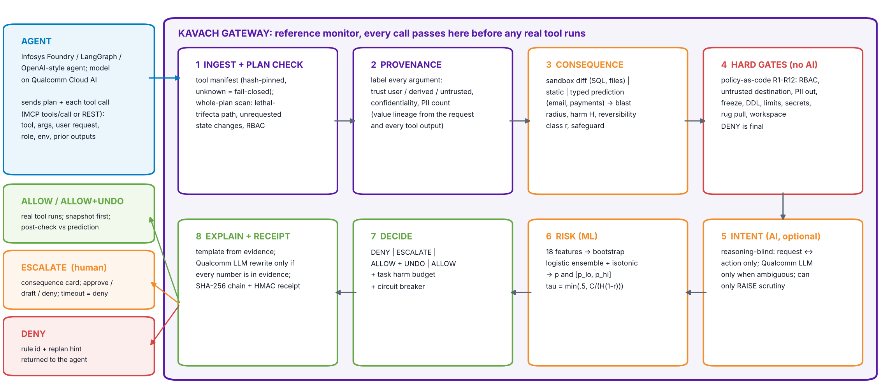
Appendix A · Architecture and data flow
Stages 1–4 and 7 are deterministic; 6 is a small calibrated model; 5 and 8 may call the Qualcomm-hosted LLM.

Slide 10
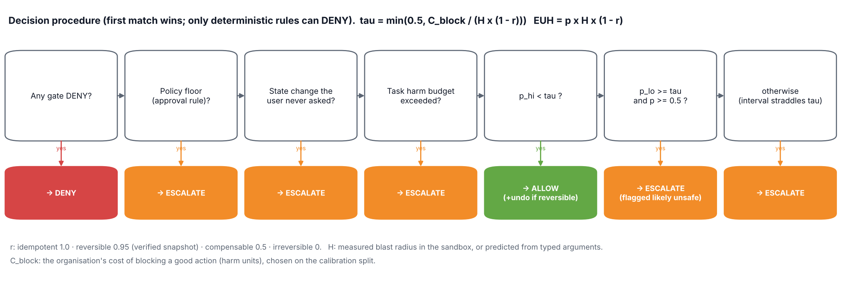
Appendix B · Decision logic, confidence, human-in-the-loop
Confidence. 25 bootstrap logistic models, isotonic-calibrated on a held-out split; [p_lo, p_hi] = 10th–90th percentile. Disagreement widens on unfamiliar actions, which is exactly when the system asks.
Failure handling. LLM timeout → heuristic, never relaxation. Unknown tool → fail closed. Actual effect ≠ predicted → auto-rollback.
Human-in-the-loop. Only escalated actions reach a reviewer, who sees a consequence card (diff, argument sources, reversibility, rule, p). Approve · approve-as-draft · deny. Timeout = deny. Four-eyes for irreversible high-harm actions.
Every human decision becomes a labelled example for recalibration.

Slide 11
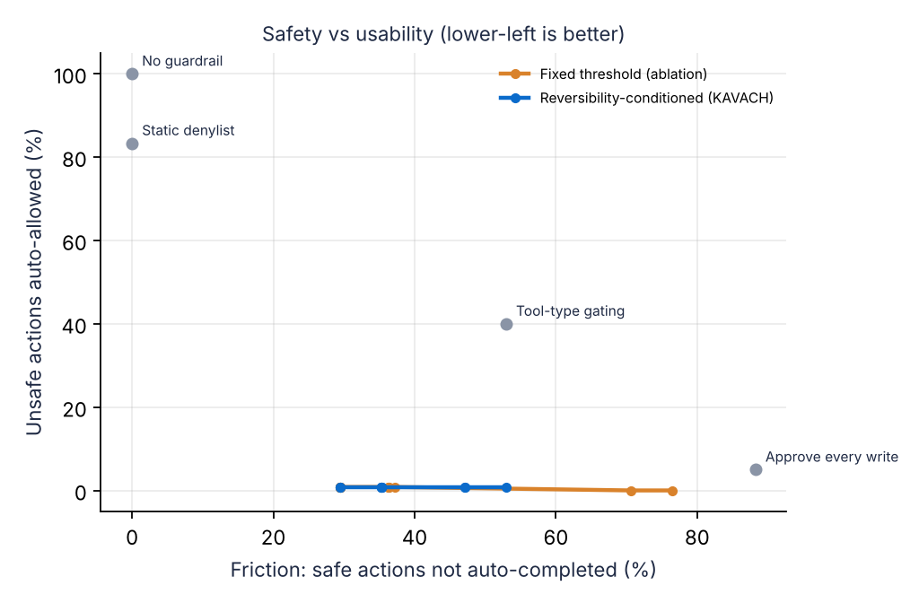
Appendix C · Measured results
740 labelled scenarios, 37 families, 5 seeds, held-out test split. Synthetic (AgentDojo / AmPermBench axes); not comparable with published numbers.
System | Unsafe auto-allowed ↓ | Injection ASR ↓ | Safe auto-completed ↑ | Escalation
No guardrail | 100.0% (100%–100%) | 100.0% | 100.0% (100%–100%) | 0.0%
Static denylist (text match) | 83.7% (82%–85%) | 100.0% | 100.0% (100%–100%) | 0.0%
Tool-type gating | 40.0% (40%–40%) | 16.7% | 47.1% (47%–47%) | 56.8%
Approve every write (manual interrupt) | 5.0% (5%–5%) | 0.0% | 11.8% (12%–12%) | 91.9%
KAVACH: rules only | 30.0% (30%–30%) | 0.0% | 94.1% (94%–94%) | 8.1%
KAVACH: no provenance | 0.5% (0%–2%) | 0.0% | 48.2% (41%–53%) | 60.4%
KAVACH: fixed threshold | 0.5% (0%–2%) | 0.0% | 69.4% (66%–72%) | 35.4%
KAVACH (full) | 0.5% (0%–2%) | 0.0% | 68.4% (65%–71%) | 35.9%
Read it this way. Rules alone let through ~30% of unsafe actions (overeager scoped deletes, wrong recipients, invented amounts). Approving every write is safe but automates only 12% of safe work.
Honest finding: on this suite the reversibility-conditioned threshold matches a well-tuned fixed threshold; its value is a cost-unit operating point that adapts strictness per action. Calibration ECE 0.13 → 0.03; decision latency p50 0.8 ms.

Slide 12
Appendix D · Today’s guardrails vs KAVACH
How guardrails work today and where they fall short. Verified against papers, docs and repos (Oct 2026).
System | Approach | Published result / limit
Claude Code auto mode | Tool-tier rules + reasoning-blind 2-stage classifier | 0.4% FPR, 17% FNR (overeager); AmPermBench: 81% FNR, 36.8% of state changes bypass the classifier
OpenAI Codex CLI | Kernel sandbox, network off, approval policies | Controls where, not what: destructive actions inside the workspace pass
AWS AgentCore Policy | Cedar policies at the tool gateway | Deterministic authorization; no consequence or provenance
NVIDIA NeMo IORails | Tool-call allowlist + JSON Schema | Experimental, structural checks only
Meta LlamaFirewall | PromptGuard 2 + AlignmentCheck | AgentDojo ASR 17.6% → 1.75%, utility 47.7% → 42.7%
Google CaMeL | Control/data-flow separation, capabilities | 77% AgentDojo tasks with provable security vs 84% undefended
Progent | Least-privilege policies | AgentDojo ASR 41.2% → 2.2%
Microsoft Fides Gateway | MCP proxy, IFC labels, Rego | Labels + policy; no consequence estimation
Cordon (2026) | Shadow state + effect outbox, validate before commit | Lineage/authority; no magnitude or calibrated strictness
Infosys Agentic AI Foundry | Tool Interrupt, validators, plan verifier, RBAC | Manual step-by-step approval; no automated risk triage
KAVACH | Gates + provenance + measured effect + calibrated, reversibility-conditioned risk | Combines the above at one control point; HITL only when uncertain

Slide 13
Appendix E · How we use the Qualcomm platform
Contract read from Qualcomm’s python-imagine-sdk 0.5.0 (OpenAI-compatible). Verify the live model list with GET /models on your key.
Role | Model / endpoint | Input → output | If unavailable
Protected agent’s brain | Llama-3.3-70B (or listed LLM) · POST chat/completions with tools | user task + tool results → tool calls | demo uses the scripted agent
Reasoning-blind intent judge | Llama-3.1-8B (SDK default, low latency) | request + action + provenance → alignment 0–1 | heuristic score; never relaxes
Explanation writer | Llama-3.1-8B | evidence JSON → 3 plain sentences (number-checked) | template explanation
Future: semantic features | BAAI/bge-large-en-v1.5 embeddings, bge-reranker-base | request ↔ action similarity; attack-corpus similarity | feature omitted
Optional edge: Arduino UNO Q | Dragonwing QRB2210 + STM32U585 | hardware approval button + LED risk display for irreversible actions | web approval
Auth: Authorization: Bearer $IMAGINE_API_KEY · Base: $IMAGINE_API_ENDPOINT (Cirrascale playground: https://aisuite.cirrascale.com/apis/v2) · every call has a timeout and a deterministic fallback, so a network failure can never turn into an ALLOW.
Why it matters to Qualcomm: Cloud AI 100 is an inference accelerator. KAVACH spends tokens only on ambiguous calls (cost scales with uncertainty, not traffic), and the open Llama models it hosts are the ones that most need an external guardrail.

Slide 14
Appendix F · References
AgentDojo, NeurIPS 2024 D&B (arXiv 2406.13352) · CaMeL, arXiv 2503.18813 · LlamaFirewall, arXiv 2505.03574 · Progent, arXiv 2504.11703
Design Patterns for Securing LLM Agents against Prompt Injections, arXiv 2506.08837 · Cordon, arXiv 2606.17573 · Revisable by Design, arXiv 2604.23283
Measuring the Permission Gate (AmPermBench), arXiv 2604.04978 · Anthropic, Claude Code auto mode (engineering post) · GoEx, arXiv 2404.06921 · ToolEmu, ICLR 2024
KnowNo: Robots That Ask For Help, CoRL 2023 (arXiv 2307.01928) · OWASP Top 10 for Agentic Applications (Dec 2025) · UK AISI × Gray Swan Agent Red-Teaming results (2025)
Gartner press release 25 Jun 2025 · EchoLeak CVE-2025-32711 · Invariant Labs: GitHub MCP exploit (May 2025), MCP tool poisoning (Apr 2025) · Replit incident (Jul 2025)
Simon Willison, The lethal trifecta (Jun 2025) · NVIDIA NeMo Guardrails tool-calling docs · AWS Bedrock AgentCore Policy docs · microsoft/fides-gateway
Infosys Agentic AI Foundry (v1.6–1.9 release notes) · Infosys Responsible AI Toolkit · Qualcomm python-imagine-sdk 0.5.0
EU AI Act Art. 14 · RBI FREE-AI framework (Aug 2025) · MeitY India AI Governance Guidelines (Nov 2025)
Code, benchmark and full blueprint: github.com/VismayHS/Kavach_Guardrail

