Slide 1
Azure Case Study - Swiggy
Comprehensive Data Pipeline with Azure Data Factory, Databricks and Dashboard on Swiggy Restaurants Dataset
January 8 2025
Vismaya B
Developer 1 – Software Engineering

Slide 2
Objective / Goal
Objective:
Build a comprehensive, scalable data pipeline using Azure services to process and analyze the Swiggy restaurants dataset.
Goal:
Transform raw data into actionable insights through structured data processing (Bronze ⇒ Silver ⇒ Gold), with business-ready visualizations.

Slide 3
Approach
1.Data Ingestion
Source: Raw JSON data from HTTP source.
Tool Used: Azure Data Factory (ADF)
Copy Data Activity: This activity is used to copy raw data from the HTTP source (JSON format) to Azure Data Lake Storage Gen2 (ADLS2).
2. Data Transformation
Tool Used: Databricks
Transforms raw Bronze Layer data into structured Delta Tables (Silver Layer).
Cleans data by addressing inconsistencies and missing values.
Filters the latest records from the Silver Layer and saves them into the Gold Layer for analysis and visualization.

Slide 4
Approach
3. Analysis & Visualization
Tools Used: Databricks
Queries the Gold Layer Delta Table for analysis using Spark SQL.
Performs SQL-based analytics to derive meaningful insights.
Generates visualizations in Databricks to represent the analyzed data effectively.
4. Security and Logging
Used Azure Key Vault with Databricks Secret Scope for secure credential management.
Pipeline details (e.g., name, status, timestamps) logged into SQL audit tables via ADF Copy Activity.

Slide 5
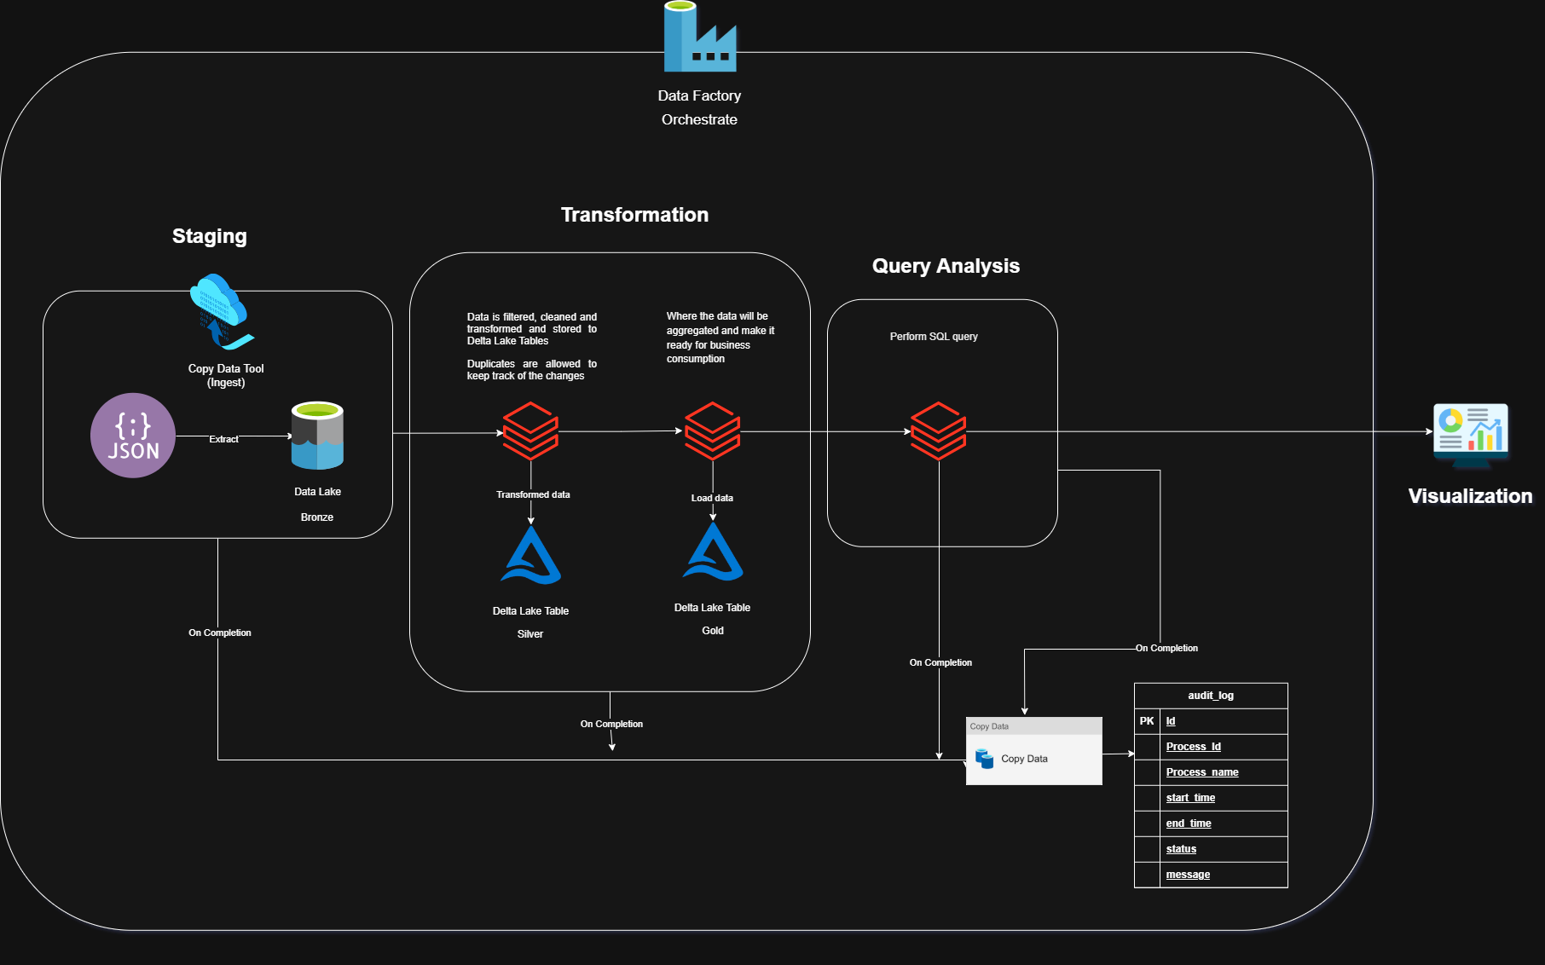
Approach
Architecture:
Medallion Architecture: Incrementally improve data quality and structure across Bronze, Silver, and Gold layers.

Slide 6
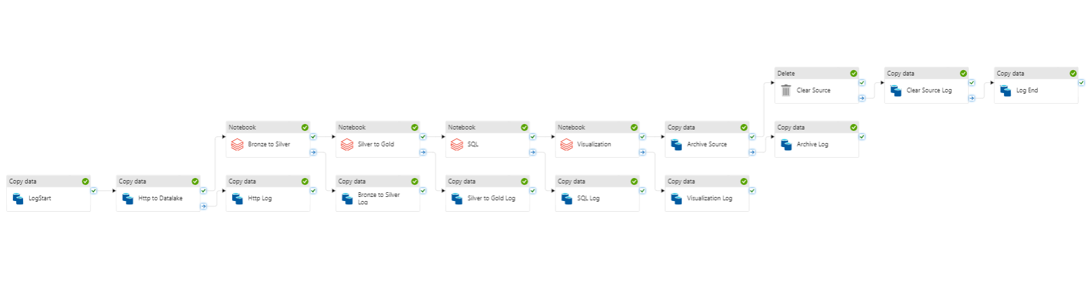
ADF pipeline

Slide 7
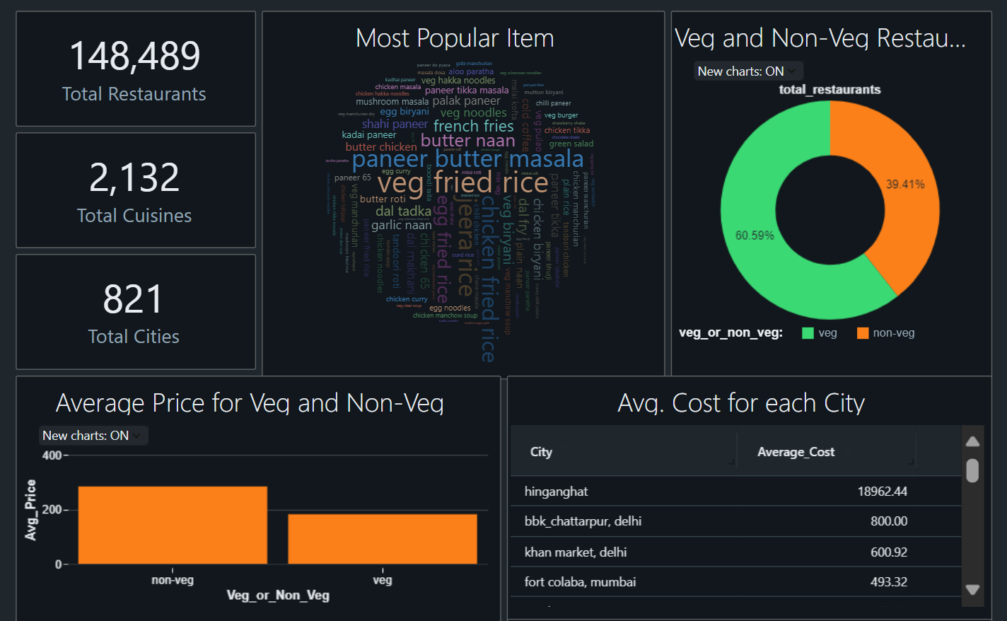
Output / Visualization

Slide 8
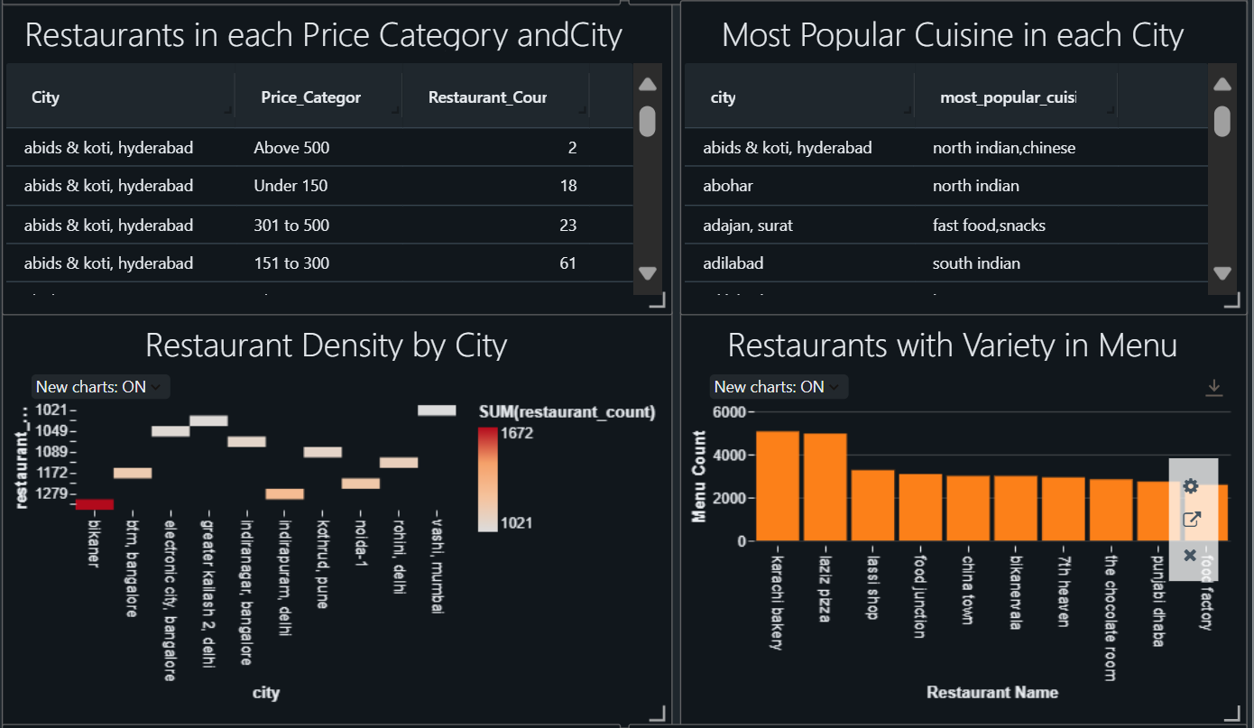
Output / Visualization

Slide 9
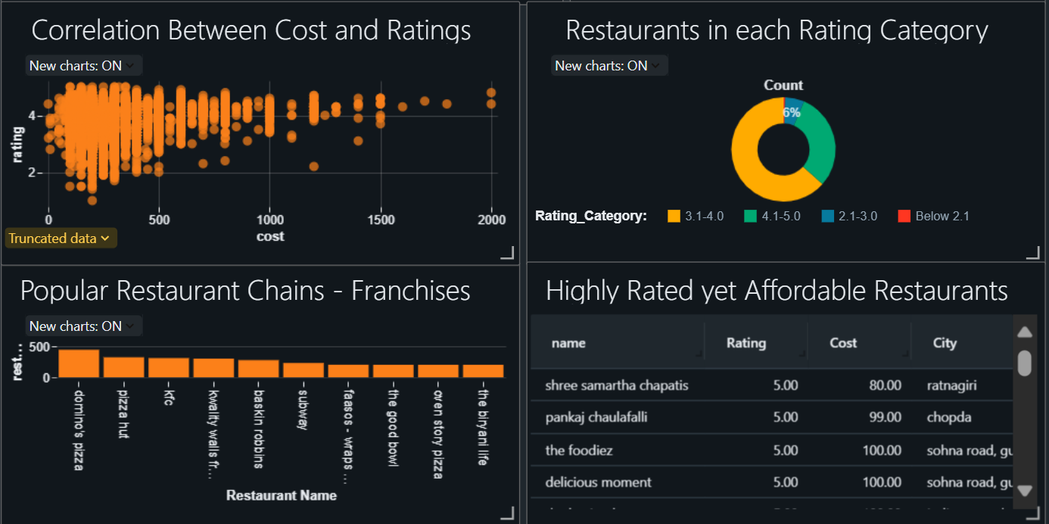
Output / Visualization

Slide 10
Insights
Popular Food Preferences
Insight: Indian comfort food is highly favored. Promotions featuring these items can attract more customers. Partnering with restaurants to create combo offers for these dishes would likely increase order volumes.
2. Vegetarian vs Non-Vegetarian Restaurants
Insight: Non-vegetarian items have a higher average cost compared to vegetarian items. This indicates that non-vegetarian restaurants can potentially generate higher revenue per dish.
3. Restaurant Density by City
Insight: In high-density cities,
competition is intense.
Swiggy can focus on optimizing
delivery times and introducing
exclusive offers for popular
restaurants to differentiate itself.

Slide 11
Insights
4. Most Popular Cuisines by City
Insight: Cuisine preferences vary significantly by city. This insight can guide city-specific promotions or recommendations.
5. Restaurants with Extensive Menus
Insight: Promote restaurants with larger menus in the app as they appeal to customers seeking diverse options.
6. Cost and Rating Correlation
Insight: Affordable restaurants
with high ratings are valuable for
attracting budget-conscious
customers. Highlight these as
"Top Budget Picks" in the app.

Slide 12
Insights
7. Rating Distribution
Majority of Restaurants: Fall into the 3.1- 4.0 rating.
Highly Rated Restaurants: Less common but can be promoted as “Premium Picks.”
Insight: Encourage restaurants with lower ratings to improve through loyalty programs and customer feedback.
8. Popular Restaurant Chains
Top Chains: Domino’s, KFC, Pizza Hut.
Insight: Well-established franchises dominate the market. Strengthen partnerships with these brands to secure exclusive discounts or priority listings in the app.
9. Highly Rated Yet Affordable Restaurants
Examples: Shree Samartha Chapatis (5.0 rating, ₹80).
Pankaj Chaufalalli (5.0 rating, ₹99).
Insight: Feature these hidden gems in-app campaigns to attract quality-conscious but budget-sensitive customers.

Slide 13
Challenges Faced
1. Fetching Data from Nested JSON
Faced challenges due to inconsistencies in the nested JSON structure.
Resolved by analyzing the schema and using Python to break down and process the JSON data effectively.
2. Managing Credentials Securely
Ensured secure storage of credentials without exposing them in pipelines or notebooks.
Utilized Azure Key Vault for secure credential management.
Integrated with Databricks Secret Scope for seamless and protected access.
3. Data Logging
Implemented an effective method for monitoring pipeline activity.
Evaluated two approaches:
Using Copy Activity to log details into a SQL audit table.
Integrating Azure Data Factory with Log Analytics Workspace for centralized monitoring and logging.
4. Data Quality
Ensured consistent and accurate results by handling:
Duplicates
Missing values

Slide 14
Learnings
Robust Logging: Learned the importance of detailed logging for traceability and quick debugging of pipeline issues.
Medallion Architecture Benefits: Realized the advantages of modular pipelines (Bronze, Silver, Gold layers) for progressive data enrichment.
Azure Log Analytics: Learned how to use Azure Log Analytics to capture logs and errors during data ingestion and transformation, aiding in debugging and improving pipeline performance.
Schema Understanding and Transformation: Gained valuable experience in handling complex nested JSON schemas and converting them into usable formats.

