Slide 1
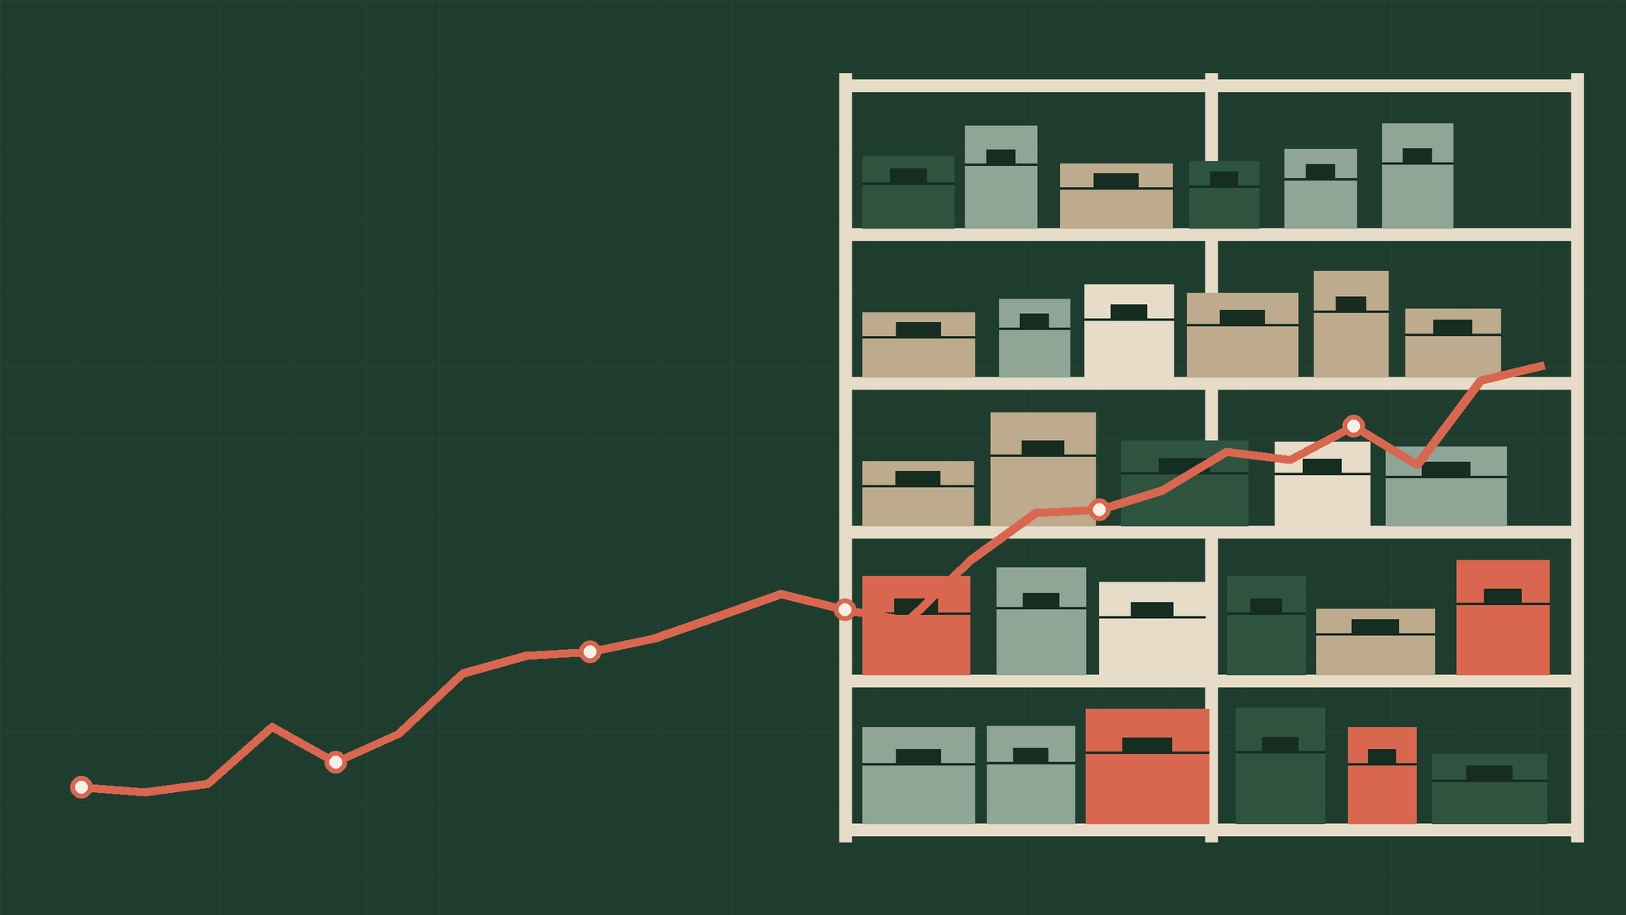
PREDICTIVE ANALYTICS | KDD METHODOLOGY
Demand Forecasting for Supply Chain Optimization
Using Historical Sales Data
Datasets: Store Item Demand Forecasting and Rossmann Store Sales
Vismayaa Rajan
PRN: 23070521169
Notes:
Introduce the project: forecasting daily retail demand with five regression models across two datasets, structured by the six KDD steps. Replace the PRN placeholder before presenting.

Slide 2
01 THE PROBLEM
Forecast errors surface as empty shelves or idle stock
2
retail datasets, 913,000 and 1,017,209 records
Retail supply chains depend on knowing how much will sell, and when. This project analyses historical retail sales, identifies demand patterns, builds and compares machine learning regression models, and evaluates them to support inventory management and supply chain planning.
5
regression algorithms compared
1
Which demand patterns repeat in historical sales?
6
KDD steps, from selection to presentation
2
Which regression model forecasts them most accurately?
3
How does that accuracy support inventory planning?
Notes:
Frame the business problem and the three questions the project answers.

Slide 3
02 THE DATA
Two retail datasets at very different scales
Attribute | Store Item Demand | Rossmann Store Sales
Raw records | 913,000 | 1,017,209
Columns | 4: date, store, item, sales | 9: Store, DayOfWeek, Date, Sales, Customers, Open, Promo, StateHoliday, SchoolHoliday
Mean sales per record | 52.25 | 5,773.82
Maximum sales | 231 | 41,551
Daily series used | 1,812 days | 928 days
110x
Rossmann sales per record are about 110 times larger than Store Item Demand (5,773.82 against 52.25).
Notes:
Store Item Demand has item-level daily sales per store; Rossmann has store-level daily sales with promotion and holiday flags. Mean values come from the describe() output in the notebook.

Slide 4
03 METHOD: KDD
Six KDD steps, each one feeding the next
6
5
4
Presentation
3
Evaluation
2
Data Mining
Tables, graphs and conclusions for planning.
1
Transformation
MAE, RMSE, WAPE, R² and actual vs predicted.
Cleaning
Train five regressors on each dataset.
Selection
Daily totals, calendar and lag features, 80/20 split.
Check missing values, duplicates, types; convert dates.
Choose Store Item Demand and Rossmann; load each train file.
Notes:
Fayyad et al. KDD process applied to both datasets. Steps 1 and 2 are covered together on the next slide.

Slide 5
04 KDD STEPS 1 AND 2
Clean data in, nothing discarded
0
missing values in either dataset
Check | Store Item Demand | Rossmann
Missing values | 0 in all 4 columns | 0 in all 9 columns
Duplicate rows | 0 | 0
Date column | object to datetime | object to datetime
Sales column | int64, numeric | int64, numeric
Rows after cleaning | 913,000 | 1,017,209
0
duplicate rows in either dataset
0
rows dropped during cleaning
Selection: the train.csv of each dataset is loaded as a separate problem. Only issues found in inspection are handled, so the sole change was converting date strings to datetime. Valid historical sales, including zero-sales days, are preserved.
Notes:
Step 1 selects the two datasets; step 2 finds no missing values or duplicates, so only dates are converted.

Slide 6
05 KDD STEP 3
Transformation: daily totals, memory features, a chronological split
A
Aggregate to daily totals
FEATURES (8)
Every record is summed by date, giving one total-sales value per day for each dataset.
year
month
day
day_of_week
day_of_year
lag_1
lag_7
lag_14
B
Add calendar and lag features
Calendar features (sand) capture seasonality. Lag features (coral) carry recent demand forward.
Year, month, day, day of week and day of year, plus sales 1, 7 and 14 days earlier. Rows without a full lag history are dropped.
CHRONOLOGICAL SPLIT, DAYS
Store Item Demand
C
Split by time, not at random
Train 1,449
363
The earliest 80% of days train the models; the latest 20% validate them, so no future information leaks into training.
Rossmann
Train 742
186
Notes:
Both daily series start on 2013-01-15 after the 14-day lag is applied. Training and validation counts follow int(0.8 x n): 1,449 + 363 and 742 + 186. Coral segment = validation window.

Slide 7
06 KDD STEP 4
Data mining: five regressors, five ways of learning
APPROACH
1
Linear Regression
Fits one straight-line equation across all eight features. Fast and transparent, but cannot bend to non-linear patterns.
2
Decision Tree
Splits the data into branches on feature thresholds and predicts each leaf's average. Depth is capped to limit overfitting.
3
Random Forest
Grows 100 trees on bootstrap samples and averages them, which reduces the variance of any single tree.
4
Extra Trees
Also averages 100 trees, but picks split thresholds at random instead of searching for the best one, which smooths the prediction.
5
Gradient Boosting
Builds trees one after another, each fitted to the errors left by the trees before it.
Notes:
Each model is trained independently on each dataset's training window with the same eight features.

Slide 8
07 KDD STEP 5
Evaluation: four metrics, one validation window
MAE
RMSE
HOW MODELS ARE JUDGED
Mean absolute error
Root mean squared error
Latest 20% of days held out, never shuffled.
The average size of a miss, in sales units. Easy to read and robust to a few large misses.
Squares each miss before averaging, so large errors weigh more. A gap between RMSE and MAE signals occasional big misses.
Same eight features and split for all five models.
WAPE
R²
Best model per dataset = lowest MAE.
Weighted absolute percentage error
Coefficient of determination
Total absolute error divided by total actual sales, in percent. Scale free, so it compares the two datasets fairly.
The share of variation in daily sales that the model explains. 1.0 is a perfect fit.
Notes:
The notebook selects the best model by sorting on MAE; the other three metrics confirm the ranking.

Slide 9
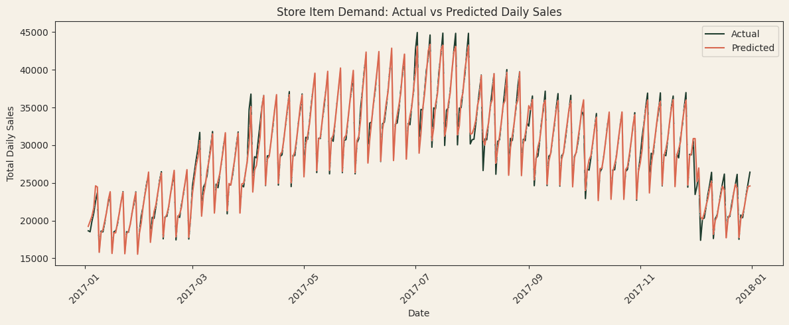
08 RESULT: STORE ITEM DEMAND
Extra Trees follows the weekly rhythm and the July peak
R²
0.9808
MAE
540.58
RMSE
898.45
The forecast tracks the weekly saw-tooth and the summer peak near 45,000 units almost line for line, and only undershoots a few sharp peaks. At WAPE 1.83%, daily totals are off by under 2% on average, which is tight enough to plan replenishment from.
WAPE
1.83%
Notes:
Best model for Store Item Demand is Extra Trees. Validation window is calendar year 2017 (chart from the original notebook, restyled to the deck palette).

Slide 10
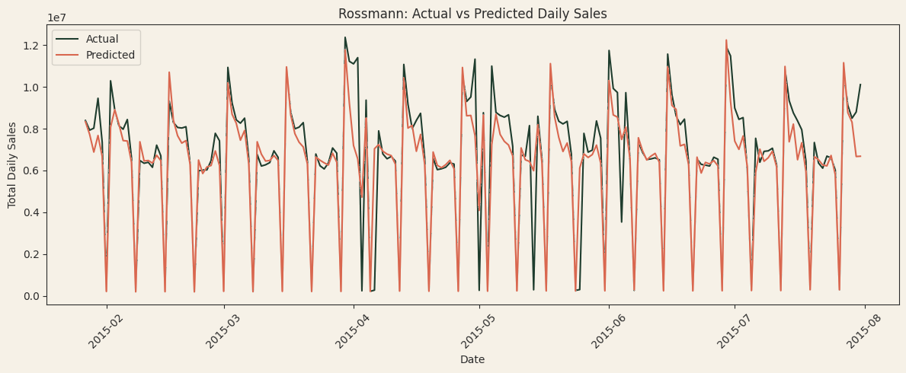
09 RESULT: ROSSMANN
Rossmann is harder: weekly cycle caught, spikes missed
R²
0.8281
MAE
724,881
RMSE
1,332,483
WAPE
Predictions follow the weekly cycle and the near-zero closure days, but miss the height of some peaks and a few isolated zero-sales days. The models see no Open or Promo input, which likely explains the 10.95% WAPE against 1.83% on Store Item Demand.
10.95%
Notes:
Best model for Rossmann is Extra Trees. Validation window runs to 2015-07-31 (chart from the original notebook, restyled). The Open/Promo explanation is an interpretation: those columns were not in the feature set.

Slide 11
10 MODEL COMPARISON
Extra Trees ranks first on both datasets
Store Item Demand
Rossmann
WAPE (%), lower is better
WAPE (%), lower is better
R² runs from 0.9808 (Extra Trees) down to 0.9330 (Linear Regression, last).
R² runs from 0.8281 (Extra Trees) down to 0.5962 (Linear Regression, last).
Notes:
Only the middle places differ: Gradient Boosting is second on Store Item Demand, Random Forest second on Rossmann. Coral bar = best model.

Slide 12
11 WHY EXTRA TREES
Extra Trees wins on all four metrics, on both datasets
Store Item Demand
Rossmann
Model | MAE | RMSE | WAPE % | R²
Extra Trees | 540.58 | 898.45 | 1.83 | 0.9808
Gradient Boosting | 599.70 | 929.09 | 2.04 | 0.9794
Random Forest | 606.68 | 1,033.40 | 2.06 | 0.9745
Decision Tree | 833.34 | 1,416.52 | 2.83 | 0.9522
Linear Regression | 1,075.59 | 1,675.99 | 3.65 | 0.9330
Model | MAE | RMSE | WAPE % | R²
Extra Trees | 724,881 | 1,332,483 | 10.95 | 0.8281
Random Forest | 751,936 | 1,434,824 | 11.35 | 0.8006
Gradient Boosting | 816,629 | 1,463,634 | 12.33 | 0.7925
Decision Tree | 911,149 | 1,779,977 | 13.76 | 0.6932
Linear Regression | 1,402,377 | 2,041,933 | 21.18 | 0.5962
MAE BELOW THE RUNNER-UP
RMSE BELOW THE RUNNER-UP
MAE BELOW LINEAR REGRESSION
9.9%
3.6%
3.3%
7.1%
49.7%
48.3%
Store Item
Rossmann
Store Item
Rossmann
Store Item
Rossmann
Notes:
Improvements computed from the notebook metrics: MAE 540.58 vs 599.70 (9.9%) and 724,881 vs 751,936 (3.6%); RMSE 898.45 vs 929.09 (3.3%) and 1,332,483 vs 1,434,824 (7.1%); MAE vs Linear Regression 1,075.59 (49.7%) and 1,402,377 (48.3%).

Slide 13
12 KDD STEP 6 | RESEARCH SUMMARY
Extra Trees gives the most reliable demand forecast on both datasets
FINDING
Extra Trees achieved the best MAE, RMSE, WAPE and R² on both datasets: R² 0.9808 on Store Item Demand and 0.8281 on Rossmann.
IMPLICATION
Under 2% WAPE on Store Item Demand supports replenishment and safety-stock planning; about 11% on Rossmann is useful but needs more demand drivers.
LIMITS AND NEXT STEPS
Models forecast total daily sales from eight features with one chronological split and fixed settings. Next: add Open, Promo and holiday inputs, tune hyperparameters, validate on rolling windows and forecast per store.
Notes:
Close on the research summary. References are standard sources for the KDD process, the algorithms, the library and the two Kaggle datasets.

