Slide 1
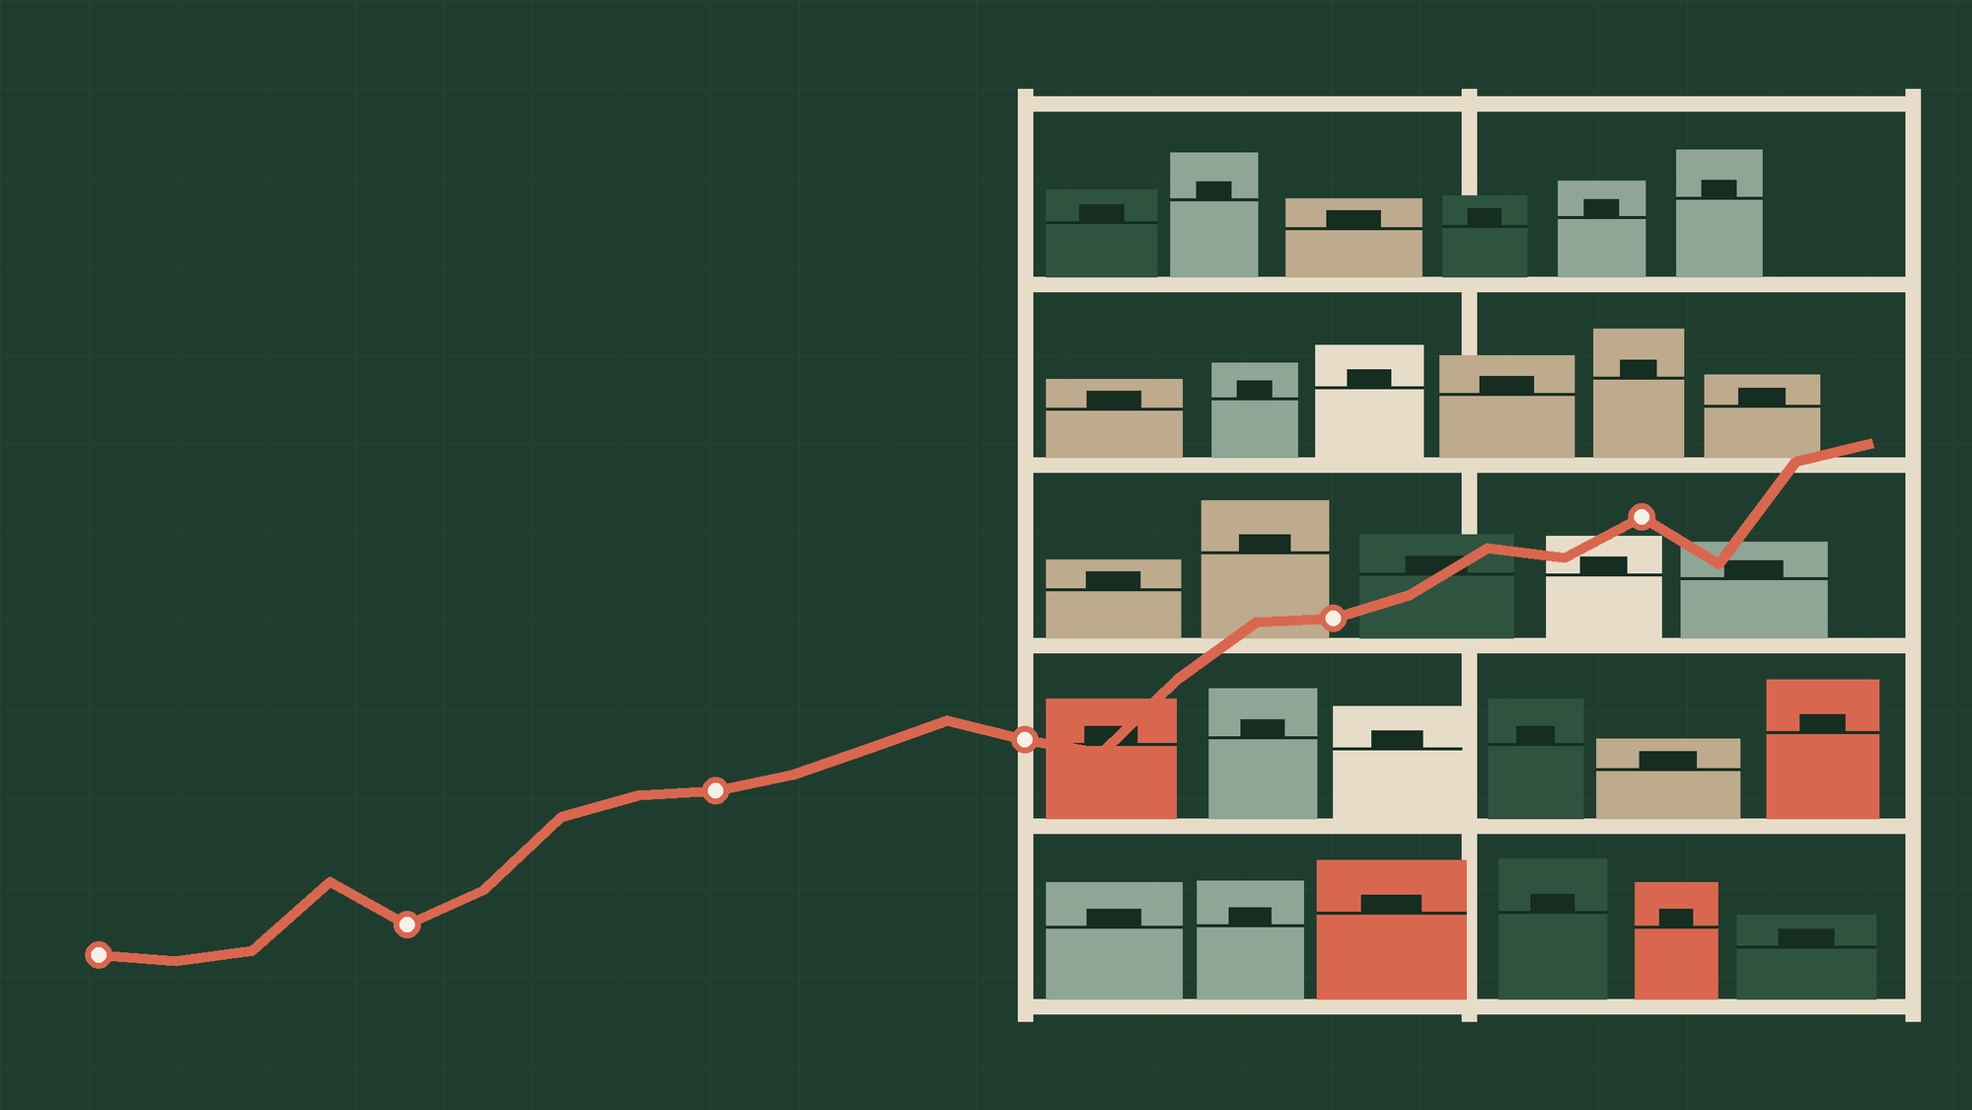
PREDICTIVE ANALYTICS | KDD METHODOLOGY
Demand Forecasting for Supply Chain Optimization
Using Historical Sales Data
Symbiosis Institute of Technology, Nagpur
Course: Predictive Analytics
Vismayaa Rajan
PRN: 23070521169
Notes:
Title slide. Predictive Analytics project using the KDD methodology on two Kaggle sales datasets.

Slide 2
01 PROBLEM AND MOTIVATION
Why demand forecasting matters for supply chains
2
retail datasets, 913,000 and 1,017,209 records
Retailers must decide how much stock each store should hold before the sales happen. Forecasting too low causes empty shelves and lost sales; forecasting too high ties up money in unsold stock. This project forecasts daily demand for each store item (Dataset 1) and each store (Dataset 2) from historical sales.
5
regression models compared
1
Too little stock: empty shelves and lost sales
6
KDD steps, from selection to presentation
2
Too much stock: storage cost and unsold goods
3
Better forecasts support better stocking decisions.
Notes:
Why forecasting matters: too little stock means lost sales, too much stock means unsold goods. The project forecasts daily demand per store item and per store.

Slide 3
02 OBJECTIVES
Objectives and research questions
OBJECTIVE 1
RESEARCH QUESTIONS
Analyse historical retail sales to find demand patterns such as weekly cycles, promotions and seasonality.
1. Which demand patterns repeat in historical sales?
2. Which regression model forecasts them most accurately?
3. How can that accuracy support inventory and supply chain planning?
OBJECTIVE 2
Build and compare five regression models that forecast daily demand for each store item (Dataset 1) and each store (Dataset 2).
OBJECTIVE 3
Evaluate the models with MAE, MSE, RMSE, WAPE and R² on unseen recent days, and identify the best model for inventory planning.
Notes:
Three objectives and three research questions. Everything later in the deck answers these.

Slide 4
03 THE DATASETS
The two datasets
Attribute | Store Item Demand | Rossmann Store Sales
Source | Kaggle: Store Item Demand Forecasting Challenge | Kaggle: Rossmann Store Sales
Records (train.csv) | 9,13,000 | 10,17,209
Period | 2013-01-01 to 2017-12-31 | 2013-01-01 to 2015-07-31
Series forecast | 500 store-item series (10 stores x 50 items) | 1,115 store series
Columns | 4: date, store, item, sales | 9, plus store details from store.csv
Mean sales per record | 52.25 | 5,773.82
Maximum sales | 231 | 41,551
Notes:
Dataset 1 has 913,000 rows: 10 stores x 50 items = 500 series, 2013 to 2017. Dataset 2 has 1,017,209 rows for 1,115 stores, Jan 2013 to Jul 2015. Raw sales scales differ by about 110 times. Rossmann columns: Store, DayOfWeek, Date, Sales, Customers, Open, Promo, StateHoliday, SchoolHoliday.

Slide 5
04 METHODOLOGY: KDD
The project follows the six stages of KDD
6
5
4
Knowledge Presentation
3
Evaluation
2
Data Mining
Present results, interpretation and conclusions.
1
Transformation
Score with MAE, MSE, RMSE, WAPE and R² on unseen days.
Data Cleaning
Train five regression models on each dataset.
Data Selection
One row per series; calendar, lag and promo features; date split.
Check missing values, duplicates and types; fix dates.
Choose the two datasets and load each train file.
Notes:
The six KDD stages applied to both datasets. Stages 1 and 2 are on the next slide.

Slide 6
05 KDD STAGES 1 AND 2
Stages 1 and 2: selection and cleaning
0
missing values in either dataset
Check | Store Item Demand | Rossmann
Missing values | 0 in all 4 columns | 0 in all 9 columns
Duplicate rows | 0 | 0
Date column | object to datetime | object to datetime
Other steps | None needed | StateHoliday coded; store.csv joined
Rows after cleaning | 9,13,000 | 10,17,209
0
duplicate rows in either dataset
0
rows dropped during cleaning
Each train file is loaded as its own problem, and Rossmann store.csv (store type, assortment, competition, Promo2) is joined by store. No valid sales were removed. Closed-store days (172,817 rows, sales always 0) keep their history for lag features but are not used for training or scoring.
Notes:
No missing values or duplicates. Only dates and the StateHoliday codes needed handling. Closed-store days (172,817 rows) keep lag history but are not used for training or scoring.

Slide 7
06 KDD STAGE 3
Stage 3: data transformation
A
Keep each series separate
FEATURE GROUPS (7)
Each row is one item in one store on one day (Dataset 1), or one store on one day (Dataset 2). No sales are added up across stores.
calendar
store / item
promo
holiday
past sales
recent avg
typical level
B
Create features for each series
Sand chips give calendar and context; coral chips are sales history. Promo and holiday apply to Dataset 2 only.
Calendar details, promo and holiday flags (Dataset 2), and sales 1, 7, 14 and 28 days ago (plus 364 for Dataset 1). Lags are created separately for each series.
SPLIT, ROWS (NOT TO SCALE)
Store Item Demand
C
Split by time, not at random
Train 686,000
45,000
The latest days are held out for testing: the last 90 days for Dataset 1 and the last 42 days for Dataset 2. Earlier days train the models.
Rossmann
Train 778,563
40,282
Notes:
Each series is kept separate; lag and rolling features are computed inside each series. Test window: last 90 days (45,000 rows) for Dataset 1, last 42 days (40,282 rows) for Dataset 2. Bars are not to scale.

Slide 8
07 KDD STAGE 3 | FEATURES
How the features help predict demand
Feature group | Examples | Why it helps
Store / item identifier | store, item (Dataset 1); Store, StoreType, Assortment, CompetitionDistance (Dataset 2) | Tells the model which series it predicts, since each sells at its own level
Calendar | day of week, month, day, year, week and day of year | Captures weekly cycles and seasonality
Promotions and holidays | Promo, Promo2, SchoolHoliday, StateHoliday (Dataset 2 only) | Explains jumps and dips around offers and holidays
Lag sales | Sales 1, 7, 14 and 28 days ago (plus 364 for Dataset 1, 21 for Dataset 2) | Recent sales are the best clue to tomorrow's sales
Rolling averages | 7 and 28 day mean (plus 7 day spread for Dataset 2) | Smooths daily noise and shows the recent level
Series average | Average sales of the series in the training data | Gives each series its own baseline level
16 and 22
features for Store Item Demand and Rossmann. All lags and rolling averages are calculated inside each series, so one store never leaks into another.
Notes:
Dataset 1 uses 16 features; Dataset 2 uses 22. Series average is computed from training data only, so nothing from the test period leaks in.

Slide 9
08 KDD STAGE 4
Stage 4: data mining with five regression models
HOW IT WORKS
1
Linear Regression
Fits one straight-line equation to all features. Simple and fast, but cannot capture curves or sudden changes.
2
Decision Tree
Asks a chain of yes/no questions (is it a weekend? is there a promo?) and predicts the average of each group. Depth is limited to 12.
3
Random Forest
Builds 60 trees on random samples of the data and averages their answers, so one weak tree matters less.
4
Gradient Boosting
Builds trees one after another, each fixing the mistakes of the trees before it (histogram based, 400 rounds).
5
LightGBM
A fast boosting method. It adds 800 small trees, each correcting the remaining errors, and splits the most useful leaf first.
Notes:
Settings: Decision Tree depth 12; Random Forest 60 trees, depth 14; Gradient Boosting (histogram based) 400 rounds, learning rate 0.08; LightGBM 800 trees, learning rate 0.05, 63 leaves. Linear Regression uses default settings.

Slide 10
09 KDD STAGE 5 | EVALUATION SETUP
Stage 5: evaluation metrics and validation setup
WHAT IT MEASURES
1
MAE
Mean absolute error: the average size of the miss. An MAE of 6 means the forecast is off by about 6 units on average.
VALIDATION SETUP
Chronological split: train on earlier days, test on the latest days. No shuffling.
Dataset 1: last 90 days, 45,000 rows.
Dataset 2: last 42 days, 40,282 open-store rows.
Same features and split for all five models. Best model = lowest MAE.
2
MSE
Mean squared error: the average of the squared misses, so large misses count much more.
3
RMSE
Square root of MSE, back in sales units. A gap between RMSE and MAE means a few large misses.
4
WAPE
Total absolute error as a percent of total actual sales. It has no units, so it suits comparing datasets.
5
R²
The share of the variation in actual sales that the model explains. 1 is perfect; 0 is no better than the average.
Notes:
MSE is the squared version of RMSE. WAPE and R2 have no units, which is why they are used to compare the two datasets. The best model is chosen by lowest validation MAE.

Slide 11
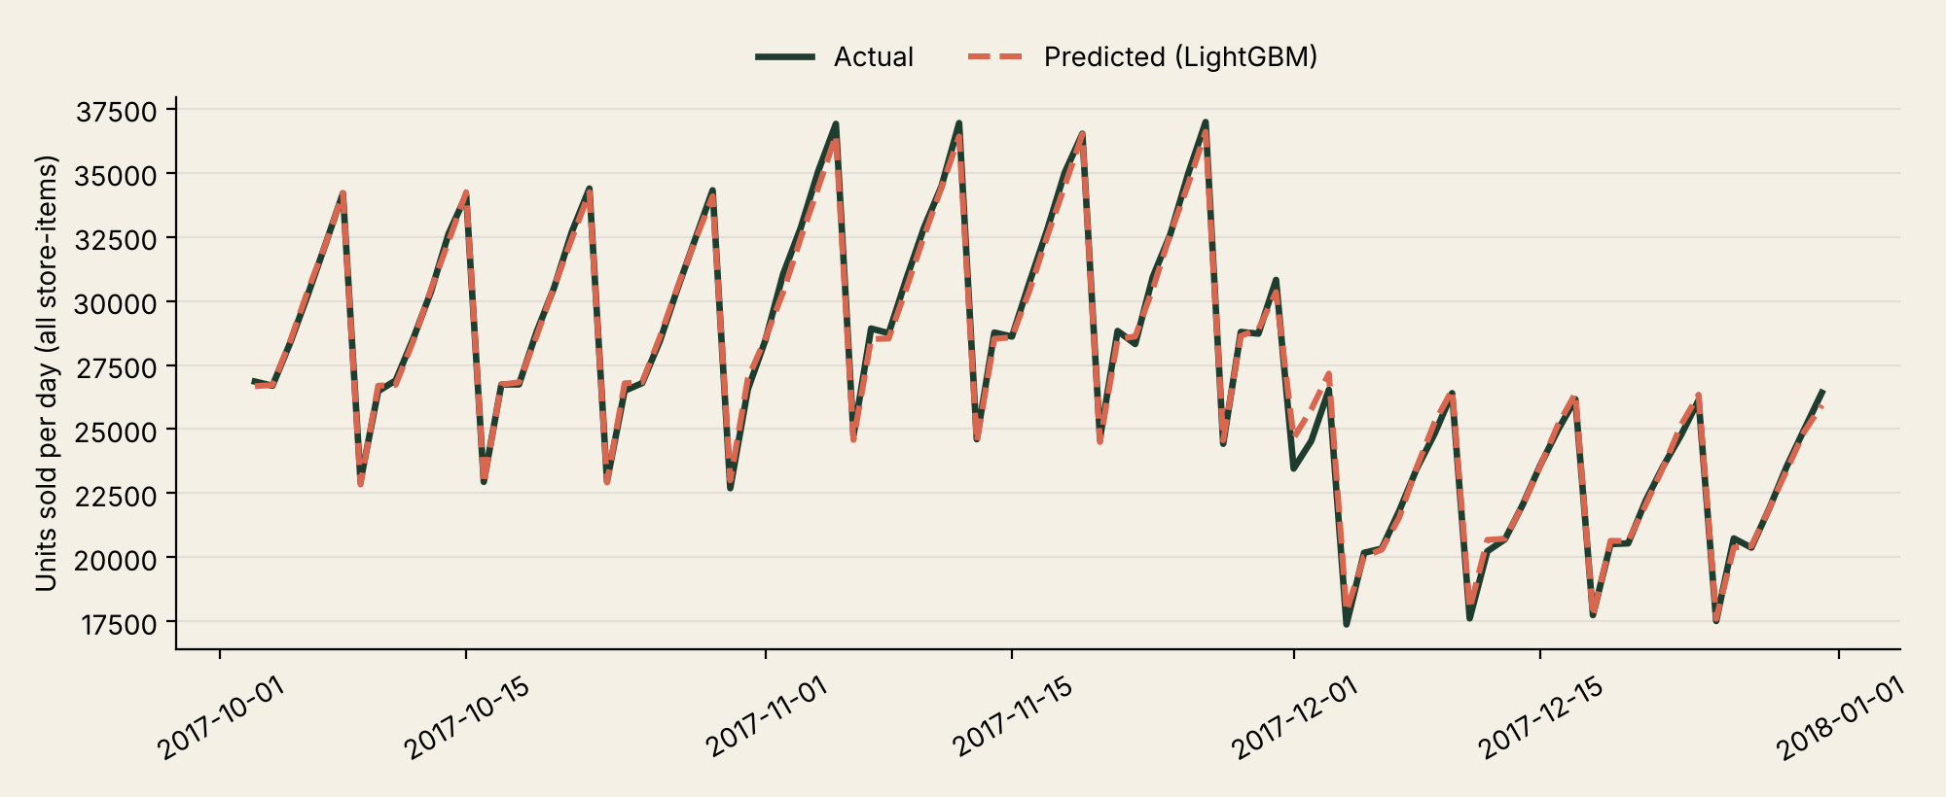
10 KDD STAGE 5 | STORE ITEM DEMAND
Results: Store Item Demand
Model | MAE | MSE | RMSE | WAPE % | R²
LightGBM | 5.87 | 57.91 | 7.61 | 10.75 | 0.9284
Gradient Boosting | 5.91 | 58.66 | 7.66 | 10.82 | 0.9275
Random Forest | 6.12 | 63.54 | 7.97 | 11.20 | 0.9215
Decision Tree | 6.53 | 73.06 | 8.55 | 11.96 | 0.9097
Linear Regression | 6.77 | 77.77 | 8.82 | 12.38 | 0.9039
Total units per day over the 90-day test period, summed across all 500 store-items for display. Metrics are scored per store-item-day.
READING THE RESULT
LightGBM is best on every metric. On average its forecast is off by 5.87 units for a typical value of about 55 units a day (10.75% WAPE). It explains 92.8% of the variation in sales.
0.9284
5.87
10.75%
R²
MAE
WAPE
Notes:
Validation window 2017-10-03 to 2017-12-31. The chart sums all 500 store-items by day only for readability; the metrics are scored on each store-item-day.

Slide 12
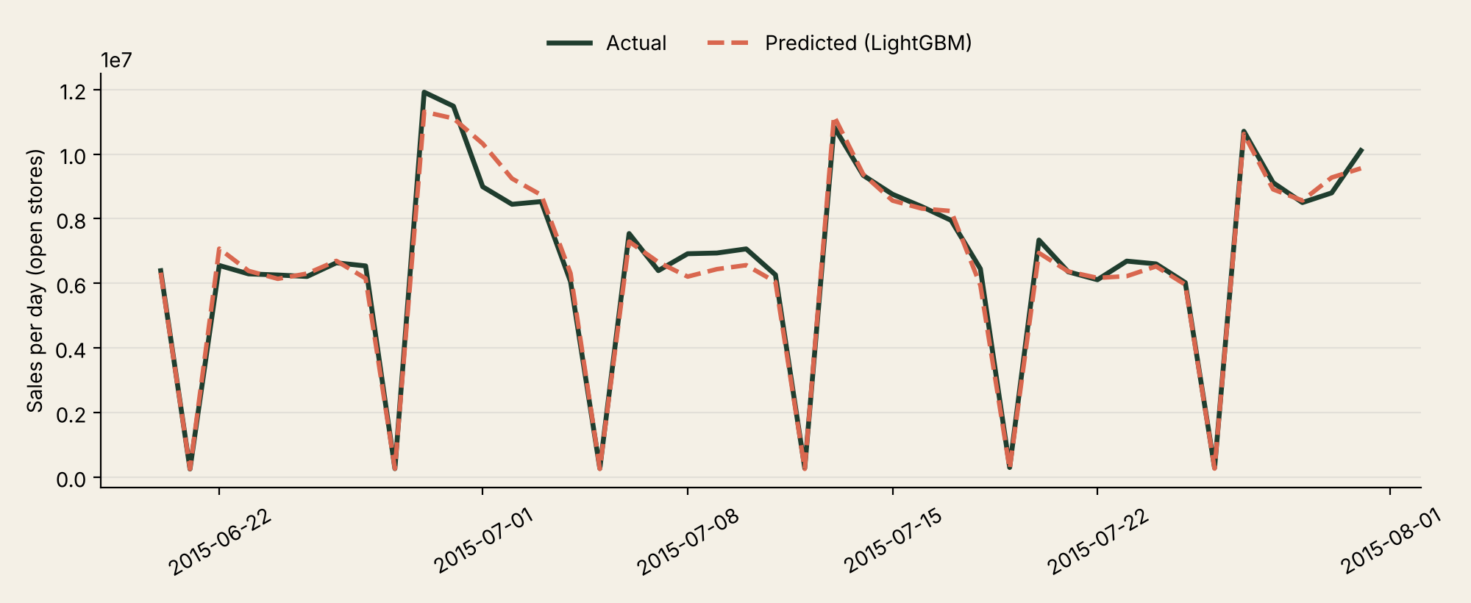
11 KDD STAGE 5 | ROSSMANN
Results: Rossmann Store Sales
Model | MAE | MSE | RMSE | WAPE % | R²
LightGBM | 551.7 | 645,598 | 803.4 | 7.97 | 0.9300
Random Forest | 569.2 | 694,168 | 833.2 | 8.16 | 0.9256
Gradient Boosting | 570.8 | 685,687 | 828.1 | 8.18 | 0.9265
Decision Tree | 657.9 | 912,439 | 955.2 | 9.43 | 0.9022
Linear Regression | 790.4 | 1,231,990 | 1,110.0 | 11.33 | 0.8680
Total sales per day over the 42-day test period, summed across open stores for display. Metrics are scored per store-day.
READING THE RESULT
LightGBM is best on every metric. On average its forecast is off by 552 for a typical value of about 6,979 a day (7.97% WAPE). It explains 93.0% of the variation in sales.
0.9300
552
7.97%
R²
MAE
WAPE
Notes:
Validation window 2015-06-20 to 2015-07-31, open stores only. The chart sums stores by day for readability; the metrics are scored on each store-day.

Slide 13
12 KDD STAGE 5 | MODEL COMPARISON
Model comparison: LightGBM is lowest on both datasets
Store Item Demand
Rossmann
WAPE (%), lower is better
WAPE (%), lower is better
Mean sales per store-item-day: 54.6. Bars start at 9.5% (not 0), so small gaps show.
Mean sales per store-day: 6,979. Bars start at 7% (not 0), so small gaps show.
MAE, MSE and RMSE are in each dataset's own sales units, so compare the two datasets by WAPE and R², not by raw errors.
Notes:
Lower is better. Bar scales start above zero so small gaps are visible. The two datasets have different sales scales, so compare them by WAPE and R2.

Slide 14
13 KDD STAGE 5 | INTERPRETATION
Interpretation: what drives the forecast
Store Item Demand
Rossmann
Share of LightGBM's importance (%)
Share of LightGBM's importance (%)
Past sales (dark bars) carry 98% of the importance. Sales from the same day last year matter most.
Past sales carry 86%. Promo (coral) is the main non-sales driver at about 7%.
Notes:
Feature importance from the LightGBM model in the notebook (share of total gain). Past-sales features carry 97.5% for Dataset 1 and 85.9% for Dataset 2.

Slide 15
14 KDD STAGE 6 | CONCLUSION
Conclusion: LightGBM is best on both datasets
FINDING
FUTURE SCOPE
LightGBM gave the lowest MAE, MSE, RMSE and WAPE and the highest R² on both datasets: MAE 5.87 and R² 0.928 for Store Item Demand, MAE 552 and R² 0.930 for Rossmann.
Forecast several weeks ahead
Validate on rolling time windows
Tune model settings
Add more demand drivers, such as price or local events
IMPLICATION
Average errors of about 11% (store-item level) and 8% (store level) make the forecast a useful guide for replenishment and safety-stock planning.
LIMITATIONS
One-day-ahead forecasts that use actual recent sales, one chronological split and fixed model settings. Error values of the two datasets are on different scales.
Notes:
References: Fayyad, Piatetsky-Shapiro and Smyth (1996), From Data Mining to Knowledge Discovery in Databases; Ke et al. (2017), LightGBM: A Highly Efficient Gradient Boosting Decision Tree; Pedregosa et al. (2011), Scikit-learn: Machine Learning in Python; Kaggle: Store Item Demand Forecasting Challenge and Rossmann Store Sales.

