Slide 1
Urban Company Care plus Services
IS 685 – System Analysis and Design
Bryan Horkan

Slide 2
TABLE OF CONTENTS
1
INTRODUCTION
SKETCHING AND STORYBOARD
5
2
PURPOSE
6
PROTOTYPE
3
PROJECT PLANNING
4
SPRINT DESIGN
CONCLUSION
7

Slide 3

INTRODUCTION
Urban Company is a technology platform offering a variety of services at home.
Customers use this platform to book services such as beauty treatments, haircuts, massage therapy, cleaning, plumbing, carpentry, appliance repair, painting etc.
These services are delivered in the comfort of their home and at a time of their choosing.

Slide 4
OUR OBJECTIVE
Introducing ‘ Care Plus ‘ – our heartfelt commitment to enhancing the comfort and well-being of our cherished older clients.
With personalized attention, specialized professional care, and streamlined communication.
We will ensure every service experience is safe, seamless, and delightful. Join us in celebrating the wisdom and grace of our seniors with Urban Company’s ‘ Care Plus ’ – because their happiness is our priority.

Slide 5
PROJECT PLANNING
Primary Goals
Our goal is to redefine senior care in US with personalized services that prioritize well -being.
Target Audience
Our primary target audience is the already existing Customer. Urban Company's personalized support features helps us tap into this growing market, offering both societal impact and financial opportunity.
Can be achieved through Stakeholder Consultations, Feedback Collection Mechanisms, Metrics and Key Performance Indicators (KPIs), and Adaptive Communication Strategies.
Iterative Feedback

Slide 6
PROJECT PLANNING
Customer Base Expansion
Our customer-based expansions are strategically aligned with the growing senior population in America.
User Engagement and Loyalty
To track metrics such as weekly time spent per session, and user interactions with various features to assess the platform's appeal and stickiness and offer personalized
Long Term Goals
Our market expansion initiatives are strategically centered on catering to the evolving needs of seniors and also aligns well with the customer base expansion strategy.

Slide 7
SPRINT DESIGN
Venus
MAPPING IDEAS
DECISION MAKING
TESTING
Monday
Wednesday
Friday
SKETCHING
PROTOTYPE
Tuesday
Choosing the best Idea
Storyboard the idea
Thursday
Testing with the target Customer
Interviews and Assessments
What the plan ?
why are we doing it ?
How are we doing it ?
Brainstorming for the multiple ideas
User need focus
Building a realistic prototype
Organize and build

Slide 8
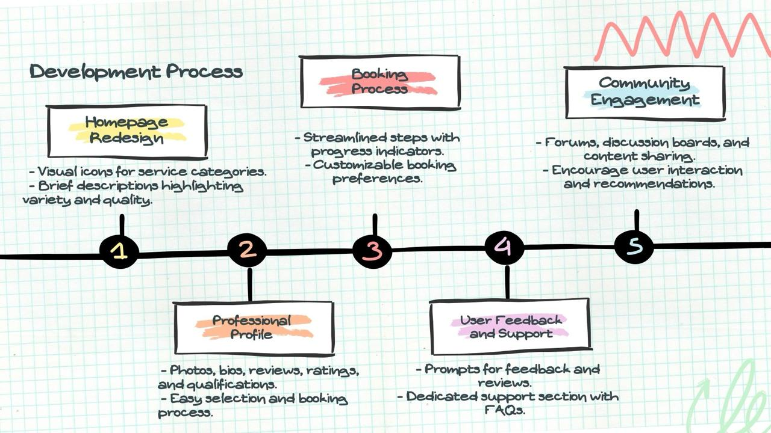
SKETCH

Slide 9
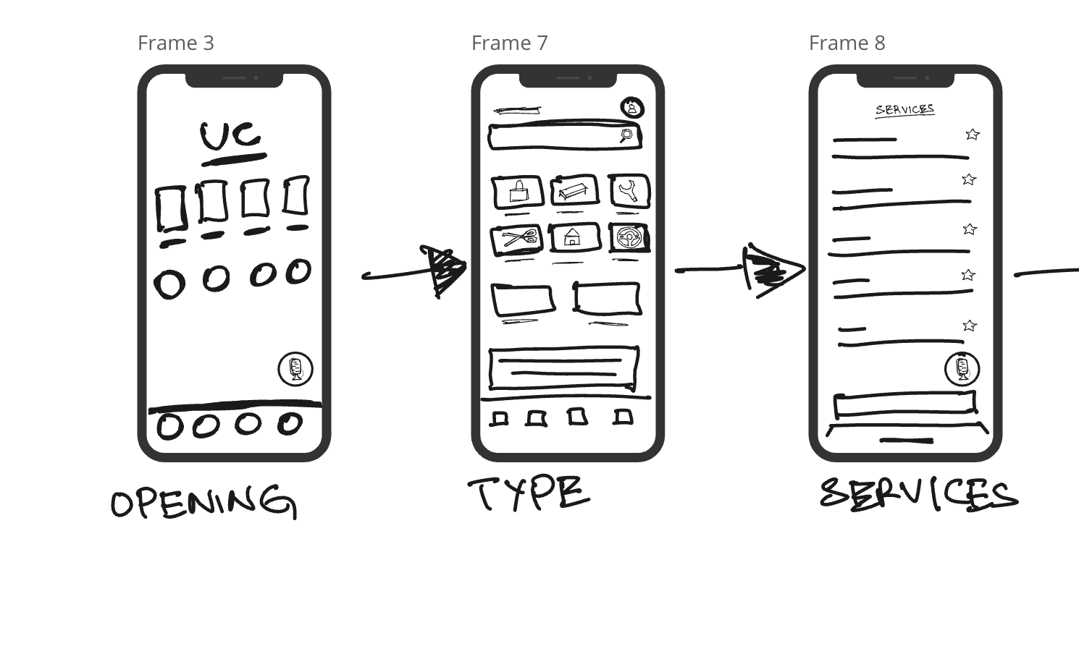
STORYBOARD

Slide 10
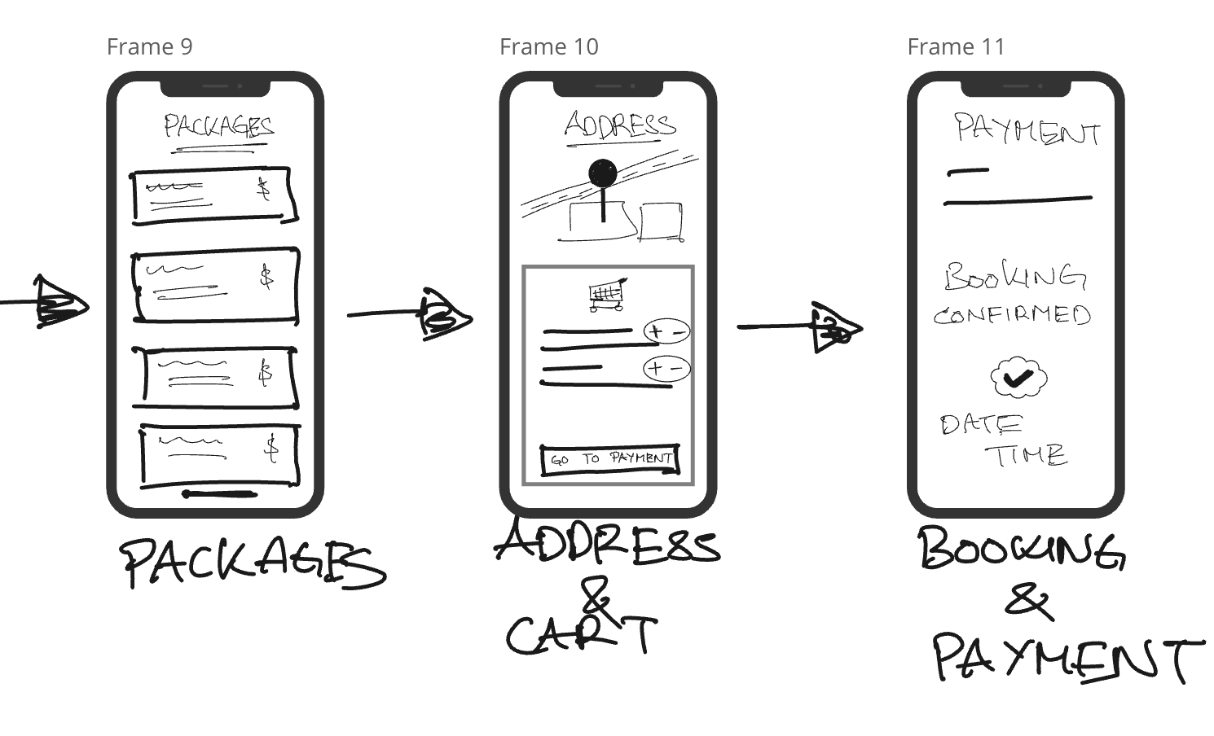
STORYBOARD

Slide 11
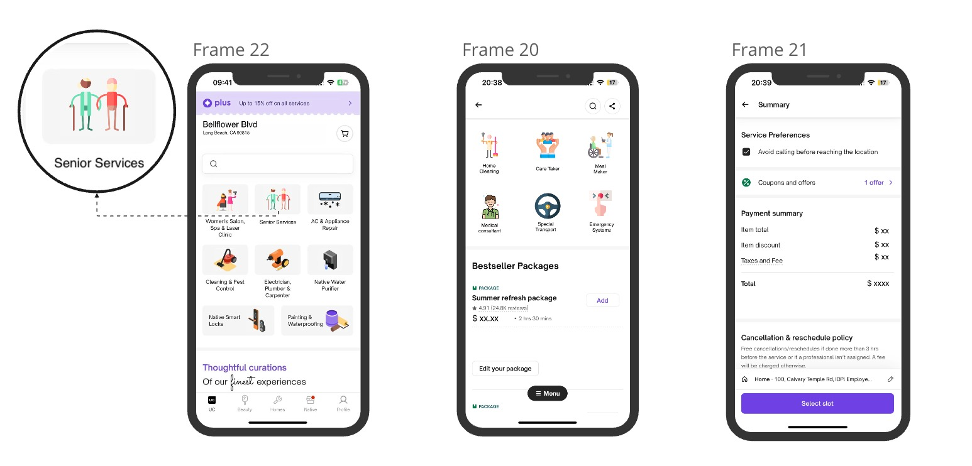
PROTOTYPE

Slide 12
CONCLUSION
“Urban Company's new folder care feature isn't just about serving seniors - it's about empowering them to thrive and fostering a more compassionate society. By prioritizing personalized care, we're not only enhancing individual lives but also igniting a ripple effect of kindness and support within our communities.
Together, we're not just redefining senior care; we're shaping a brighter, more inclusive future for all..”

