Slide 1




SQL
NoSQL
Real Time
Processing
Batch
Processing
Gathering
Filtering,
Cleaning
Processing,
Transforming
Analysing,
Visualizing
Storing

Slide 2
Client Application
MapReduce
Bigtable
Google File System
Linux kernel

Slide 3
Shadow Master
System control messages
Master
Client
Instructions to chunkserver
Chunkserver-1
...
Chunkserver-n
Data messages

Slide 4
Master
6
6
1
2
5
5
Client
3
Replica2
(secondary)
Replica1
(primary)
Replica3
(secondary)
data
4
7

Slide 5
1 def map(key, value):
2 list = []
3 for x in value:
4 if some_condition_holds:
5 list.append((key, x))
6 return list
1 def reduce(key, list_of_values):
2 result = 0
3 for x in list_of_values:
4 result += x
5 return (key, result)

Slide 6
User code
1
7
1
Master
1
2
2
split 0
worker
intermediate
file 1
worker
output
file 1
split 1
3
4
5
6
...
...
...
...
split 2
...
worker
intermediate
file n1
worker
output
file n2
split n
Input files
Map phase
Intermediate
files
Reduce phase
Output files

Slide 7
REST
API
Client
gathered data
Server
feedback
UI
SQLCipher
database
PostgreSQL
database

Slide 8


Slide 9
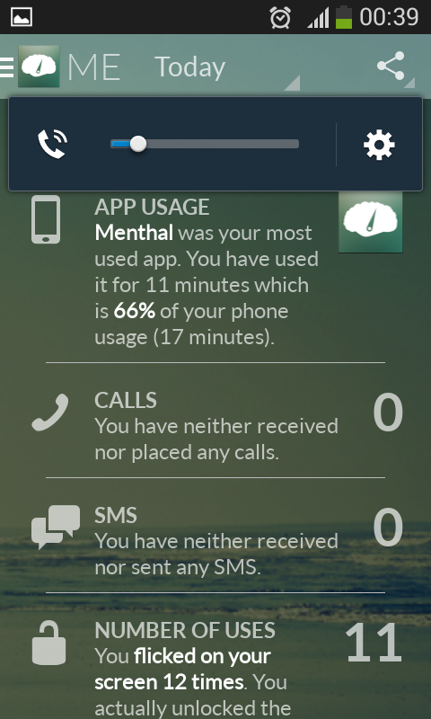

Slide 10


Slide 11
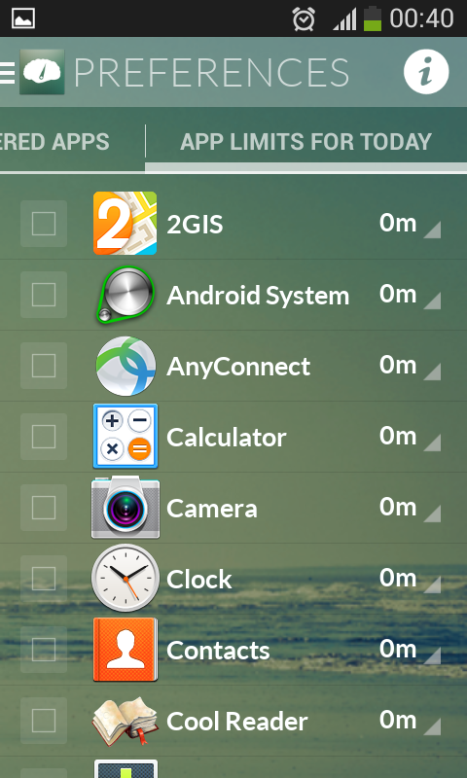

Slide 12
metadata tablet 2
user table 1
metadata tablet 3
root tablet
...
user table m
metadata tablet n

Slide 13
/
/app1
/app2
/app1/p1
/app1/p2
session p1
session p2
client 1
client 2

Slide 14
spout
tuple stream
bolt
bolt
spout
bolt
tuple stream

Slide 15
Partition 0
0
1
2
3
4
5
...
Partition 1
0
1
2
3
...
writes
Partition 2
0
1
2
3
4
...
old
new

Slide 16
Producer 1
Consumer 1
Kafka
cluster
Producer 2
Consumer 2
...
...
Producer n
Consumer m

Slide 17
delete
retention
point
cleaner
point
0
4
6
10
11
13
17
22
25
28
31
32
33
34
35
log tail
log head

Slide 18
offset
0
1
2
3
4
5
6
7
8
9
key
k1
k2
k3
k4
k5
k6
k7
k8
k9
k10
log before
compaction
value
v1
v2
v3
v4
v5
v6
v7
v8
v9
v10
compaction
offset
2
3
5
7
8
9
key
k3
k4
k6
k8
k9
k10
log after
compaction
value
v3
v4
v6
v8
v9
v10

Slide 19
client
server
stateful
state
client
request-specific state
server
stateless
state
state changes

Slide 20
Scribe-
Hadoop
clusters
Production
Hive-Hadoop
cluster
Adhoc
Hive-Hadoop
cluster
Web Servers
Federated
MySQL

Slide 21
Hadoop
Map-reduce and HDFS
Hive
Command line
interface
Job Tracker
Name Node
Driver
Web
interface
JDBC
Data Node
and
Task Tracker
Thrift server
Metastore
ODBC

Slide 22
Hadoop
Map-reduce and HDFS
Hive
Command line
interface
Job Tracker
Name Node
Driver
Web
interface
JDBC
Data Node
and
Task Tracker
Thrift server
Metastore
ODBC

Slide 23
Active
AvatarNode
writes
transactions
NFS
reads
transactions
Standby
AvatarNode
location
messages
location
messages
DataNode

Slide 24
Browser
Web Server
Content
delivery
network
Haystack
Cache
Haystack
Directory
Haystack
Store

