Slide 1
BOSTON Housing Data Set
By: Vishnu Panicker Assignment: IBM supervised Machine learning regression

Slide 2
About the Data
The Boston Housing Dataset
The Boston Housing Dataset is a derived from information collected by the U.S. Census Service concerning housing in the area of Boston MA.

Slide 3
Feature Description: -
CRIM - per capita crime rate by town
ZN - proportion of residential land zoned for lots over 25,000 sq.ft.
INDUS - proportion of non-retail business acres per town.
CHAS - Charles River dummy variable (1 if tract bounds river; 0 otherwise)
NOX - nitric oxides concentration (parts per 10 million)
RM - average number of rooms per dwelling
AGE - proportion of owner-occupied units built prior to 1940
DIS - weighted distances to five Boston employment centres
RAD - index of accessibility to radial highways
TAX - full-value property-tax rate per $10,000
PTRATIO - pupil-teacher ratio by town
B - 1000(Bk - 0.63)^2 where Bk is the proportion of blacks by town
LSTAT - % lower status of the population
MEDV - Median value of owner-occupied homes in $1000'

Slide 4
OBJECTIVE: -
To analyze the given data and clean it for better model building.
Remove the outliers or perform transformations to remove the skewness of the data.
Gain useful insights from the data.
Perform Linear, Ridge and Lasso Regresion on the Train-test split dataset and find the best model and calculate the r2 score.
Find the features which have the highest valued coefficients / weights in the model.
Find what possible steps could be taken next to improve the model.

Slide 5
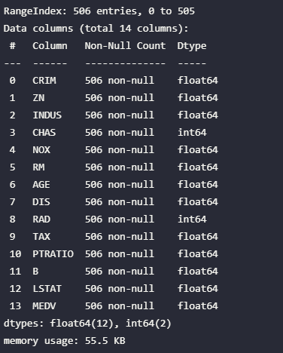
Feature Summary: -
ALL are numerical type data columns. There are no object type features so one hot encoding isn't needed.
There are no NULL values since there are 506 non-null values for all the features out of 506 rows of data.
No object type Feature are present in this dataset.

Slide 6
UNIVARIATE ANALYSIS: -

Slide 7
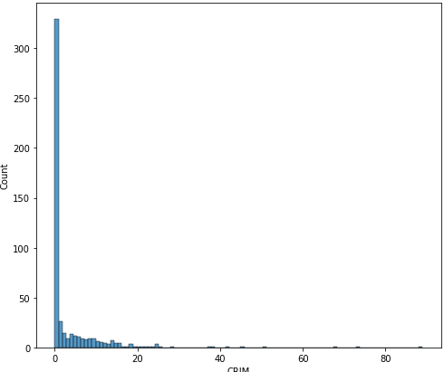
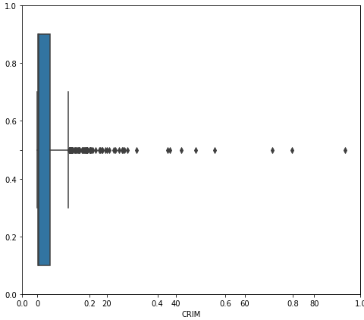
Feature `CRIM`: - per capita crime rate by town
The histogram shows that the data is very skewed and appropriate actions need to be taken.
There are a lot of outliers but since this feature represent crime rate of a town. It could be a really important feature and its data cannot be removed to improve skewness.
Transformation is a possible way to reduce skewness.

Slide 8
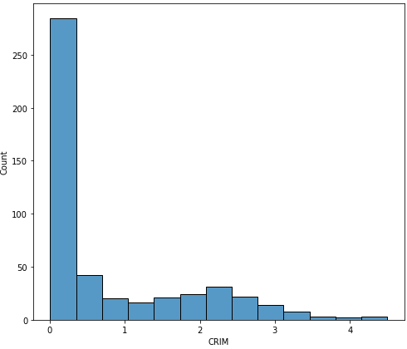
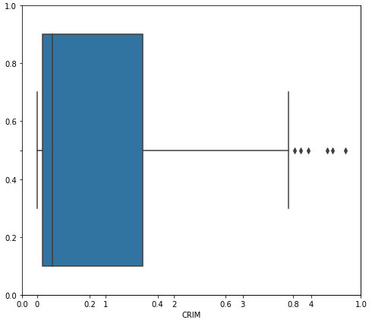
`CRIM` Continued: -
Log transformation is applied to the feature and the skewness has decreased by 75%
Distribution has improved significantly.
Number of outliers have been reduced to the interquartile range due to transformation.

Slide 9
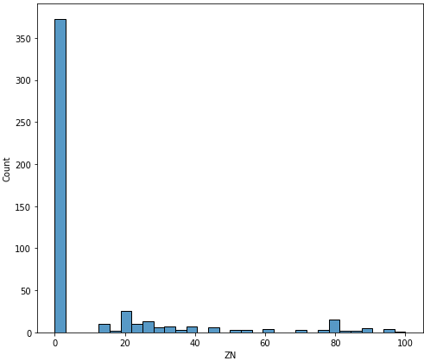
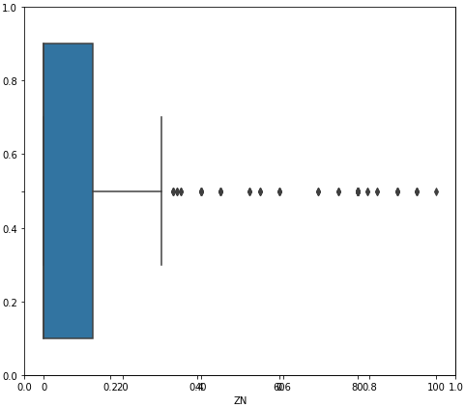
Feature `ZN`: - proportion of residential land zoned for lots over 25,000 sq.ft.
The histogram shows that the data is very skewed and appropriate actions need to be taken.
There are a lot of outlier and skewness needs to be reduced to build a good model..
Transformation is a possible way to reduce skewness.

Slide 10
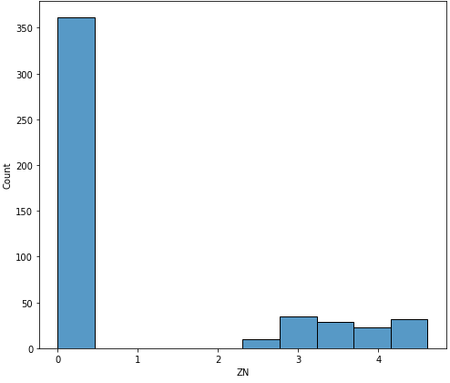
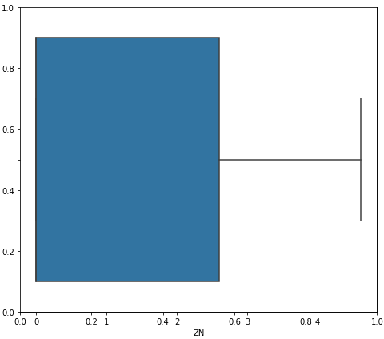
`ZN` Continued: -
Log transformation is applied to the feature and the skewness has decreased by 45.9%
Distribution has improved significantly.
All of the outliers have been reduced to the interquartile range due to transformation.

Slide 11
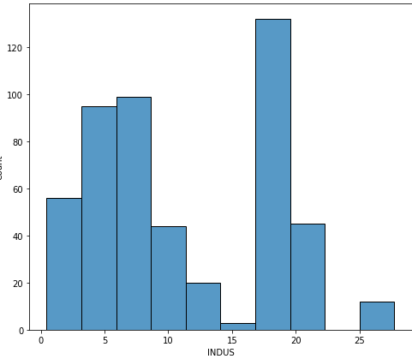
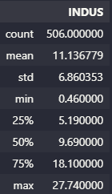
Feature `INDUS`: - Proportion of non-retail business acres per town.
The histogram shows that the data is not skewed and is appropriate for model building.
Skew value is under 0.5
Mean value lying at 11 with min at 0.4 and max being 27.

Slide 12
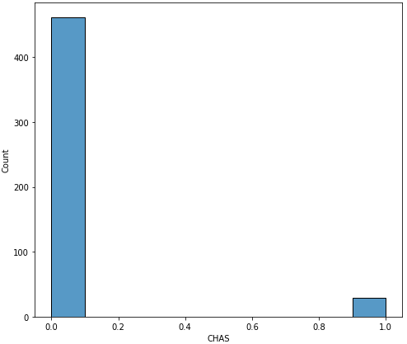
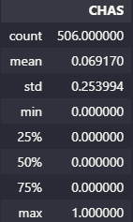
Feature `CHAS`: - Charles River dummy variable (1 if tract bounds river; 0 otherwise)
This was an object type value which has already been one hot encoded to a binary value.
Skew value is high (3.4).
Transformation cannot help with its skewness since it has only two values.

Slide 13
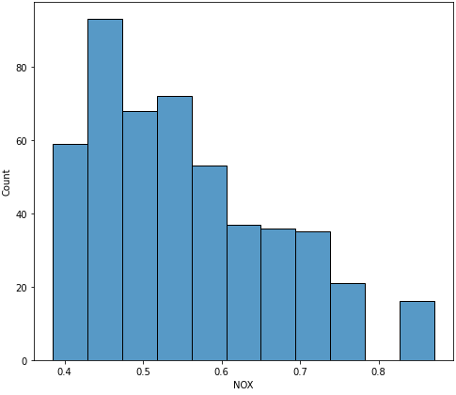
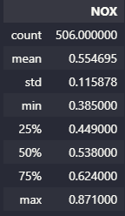
Feature `NOX`: - Nitric oxides concentration (parts per 10 million)
This was an integer type value which
Skew value is moderate (0.72).
It follows a normal distribution as well.

Slide 14
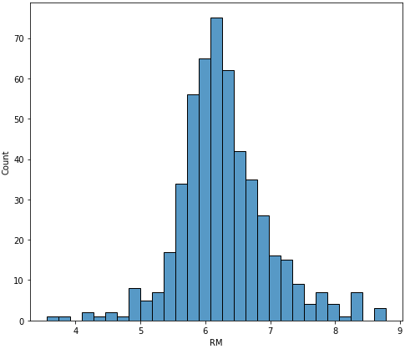

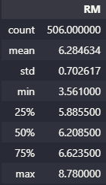
Feature `RM`: - Average number of rooms per dwelling.
This feature follows a normal distribution with very low skewness.
It doesn’t need any transformations.

Slide 15
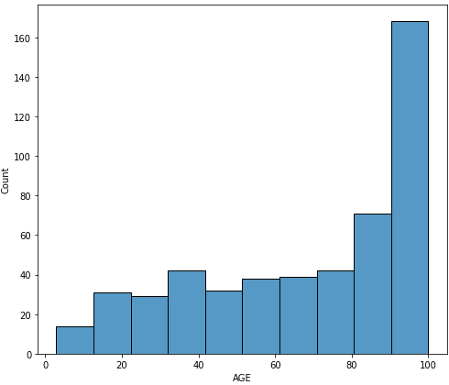
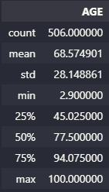
Feature `AGE`: - Proportion of owner-occupied units built prior to 1940.
This feature follows an exponential distribution with low skewness.
It doesn’t need any transformations.

Slide 16
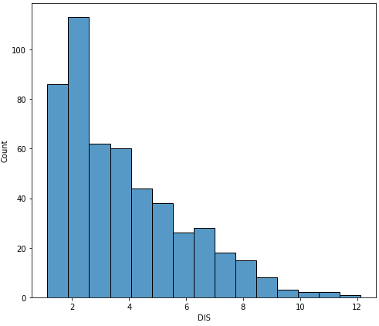
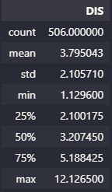
Feature `DIS`: - Weighted distances to five BOSTON employment centres.
This feature follows a linear distribution with moderate skewness.
It doesn’t need any transformations.

Slide 17
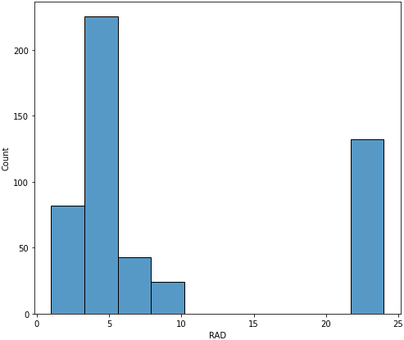
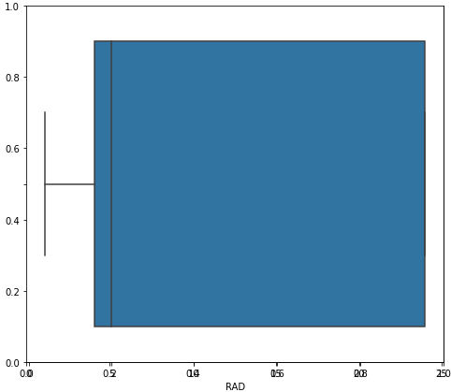
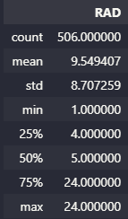
Feature `RAD`: - Index of accessibility to radial higways.
This feature doesn’t have any outlier.
Its skew value is moderate compared to others.
It doesn’t need any transformations.

Slide 18
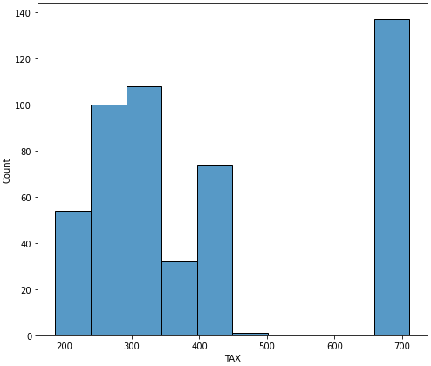
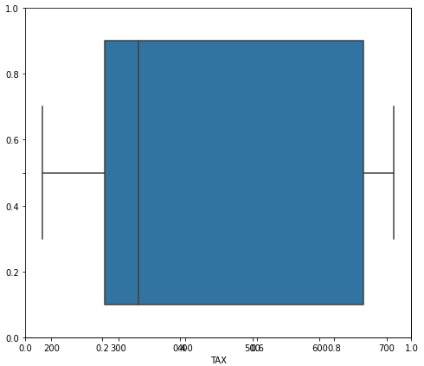
Feature `TAX`: - Full-value property-tax rate per dollars 10,000
This feature doesn’t have any outliers and its skew value is low as well
It doesn’t need any transformations.

Slide 19
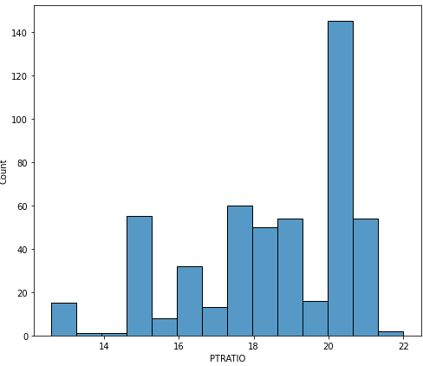
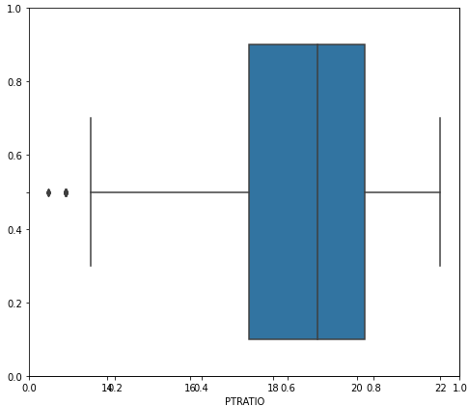
Feature `PTRATIO`: - pupil-teacher ratio by town.
This feature doesn’t have any outliers and its skew value is low as well.
It doesn’t need any transformations.

Slide 20
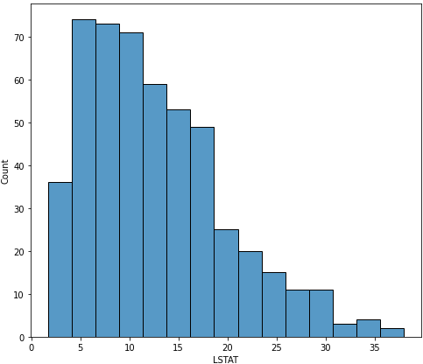
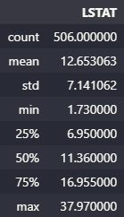
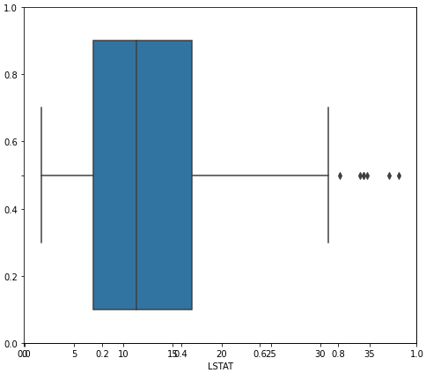
Feature `LSTAT`: - % lower status of the population
This feature follows the normal distribution and has a moderate skew value of 0.906.
It doesn’t need any transformations.

Slide 21
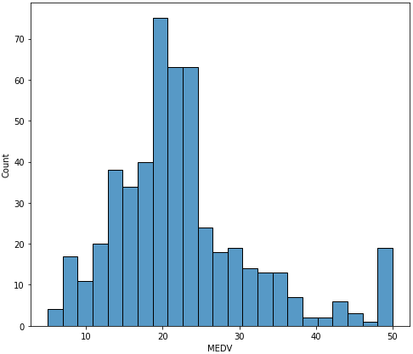
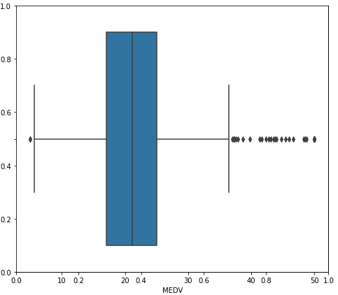
Feature `MEDV`: - Median value of owner-occupied homes in dollars 1000's
This feature follows the normal distribution and has a high skew value of 1.10.
It has an outlier at 50.
This could make the model biased and may increase the variance.

Slide 22
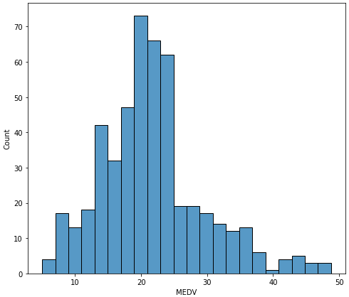
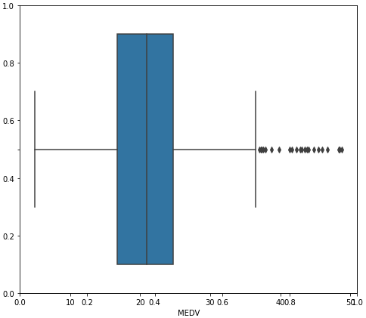
`MEDV` Continued: -
Values greater than or equal to 50 were removed to improve variance.
The skewness has been reduced by 0.2.

Slide 23
LINEAR REGRESSION MODELS: -

Slide 24
Model 1: LINEAR REGRESSION
Used GridSearchCV to find the best polynomial degree for linear regression with 4 cross validation splits.
Used standard Scaler to scale all the features within a same scale.
Found an average score of 0.74 within the 4 hold out sets for Linear regression with polynomial degree of 1.
Got an r2 score of 0.70.
This shows slight overfitting since r2 score is calculated on the training set.

Slide 25
Model 2: RIDGE REGRESSION
Used GridSearchCV to find the best polynomial degree for linear regression with 4 cross validation splits.
Used standard Scaler to scale all the features within a same scale.
Found an average score of 0.8808 within the 4 hold out sets for Ridge regression with polynomial degree of 2 and lambda value (hyper parameter) as 0.528 over the range of [0.005, 2].
Got an r2 score of 0.9132 over the training set.
This model performed better when compared to model 1 (linear regression).

Slide 26
Model 3: LASSO REGRESSION
Used GridSearchCV to find the best polynomial degree for linear regression with 4 cross validation splits.
Used standard Scaler to scale all the features within a same scale.
Found an average score of 0.8836 within the 4 hold out sets for Lasso regression with polynomial degree of 2 and lambda value (hyper parameter) as 0.005 over the range of [0.005, 1] with maximum iterations of 50000 (learning rate for gradient descent).
Got an r2 score of 0.9077 over the training set.
This model performed better when compared to model 1 (linear regression).

Slide 27
BEST MODEL: -
Best model would be the model 3 (Lasso Regression model).
Lasso and Ridge model had better scores when compared to linear regressin model.
When comparing Ridge and Lasso, Ridge had higher r2_score (0.9132) than Lasso(0.9077) but this is over the training set.
What we need to analyse is the test set result, where Lasso had a score of 0.8836 while Ridge had 0.8808.
This makes Lasso model more generalized to all the data sets out there.
Thus, Lasso Model is better than Linear and Ridge Regression Model.

Slide 28
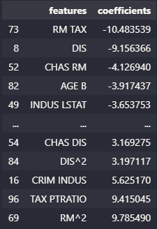
Insights: -
Lasso model was found to be the best among the three models built.
Coefficients were also found for this model and were ordered according to their magnitudes.
‘Room’, ‘Tax ’ and the ‘DIS ’have a very negative affect to the price of a house in Boston.
‘Room ^2’ and ‘Tax’, ‘parent-pupil ratio’ have a very positive affect to the price of a house in Boston.

Slide 29
Summary: -
The Data set was already very clean and didn’t require much of data cleaning.
The outliers were transformed to get better results in model building since skewness may affect prediction values.
The features were scaled for all models. Linear regression doesn’t need scaling but for interpretation puropose scaling is required.
Next step for this project would be to have go deeper on how Tax and parent-pupil ratio have a positive affect on the price of a house.
Removing some more outliers to reduce the skewness of the data and building another Ridge and Lasso model would be a good analysis.

Slide 30
Github Link: Click Here

