Slide 1
Titanic Data Set
By: Vishnu Panicker
Assignment: IBM Exploratory Data Analysis week – 2 (peer review)

Slide 2
Titanic Data Set: -
The sinking of the Titanic is one of the most infamous shipwrecks in history.
On April 15, 1912, during her maiden voyage, the widely considered “unsinkable” RMS Titanic sank after colliding with an iceberg. Unfortunately, there weren’t enough lifeboats for everyone onboard, resulting in the death of 1502 out of 2224 passengers and crew.
While there was some element of luck involved in surviving, it seems some groups of people were more likely to survive than others.
Kaggle link: https://www.kaggle.com/c/titanic/overview

Slide 3
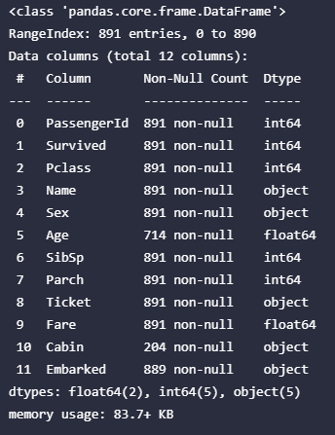
Data Description: -
Feature description: -
1 PassengerId: Unique ID of each passenger
2 Survived: 1 for survived 0 for dead (target variable).
3 Pclass: A proxy for socio-economic status (SES)
1 = Upper class
2 = Middle class
3 = Lower class
4 Name: Name of the Passenger
5 Sex: Gender of Passenger
6 Age: Age is fractional if less than 1. If the age is estimated, then t is in the form of xx.5.
7 SibSp: Family Relation: sibling or spouse. Basically, it’s the number of siblings or spouse each passenger has.
8 Parch: Number of children + parents (0 for those who are alone).
9 Ticket: Ticket Number
10 Fare: Fares Price
11 Cabin: Cabin class
12 Embarked: Destination of a passenger
(C = Cherbourg, Q = Queenstown, S = Southampton)

Slide 4
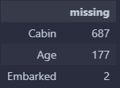


Overview: -
The data set initially has 891 rows and 12 columns.
Only 3 of the features have missing data in them and those are: ‘Cabin’, ‘Age’ and ‘Embarked’.
Categorical Features are :
Numerical Features are :

Slide 5
EDA FOR CATEGORICAL FEATURES: -
'Survived', 'Pclass', 'Sex', 'SibSp', 'Parch', 'Embarked'

Slide 6
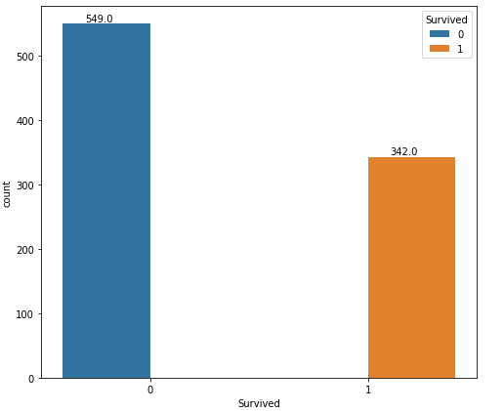

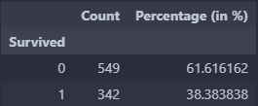
Feature: Survived
There were more casualties than those who survived.
Percentage of passengers who died: 61.61 %.
Percentage of passengers who survived: 38.38 %.

Slide 7
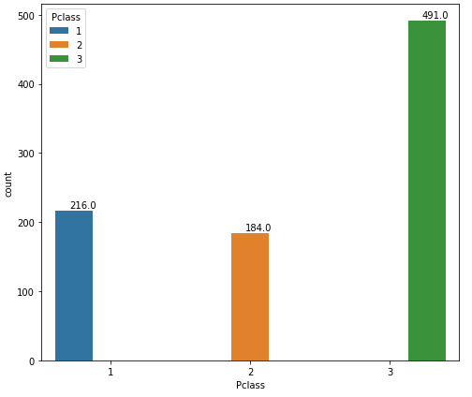
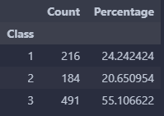
Feature: Pclass
Class: -
  1: Upper Class
  2: Middle Class
  3: Lower Class
Majority of the passengers are in class 3.
Percentage of class 3 passengers: 55.10%.
Percentage of class 2 passengers: 20.65%.
Percentage of class 1 passengers: 24.24%.
Conclusion: Majority of passengers preferred class 3 (cheapest) and class 1 (most expensive).

Slide 8
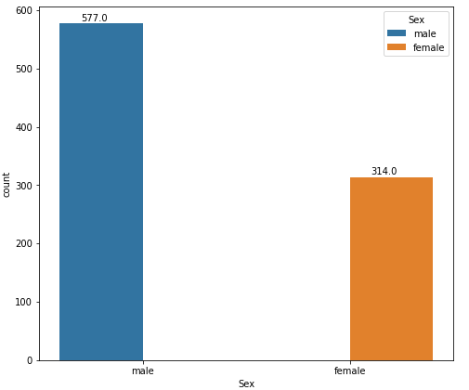
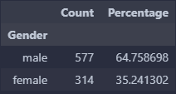
Feature: Sex
Majority of passengers are male.
Percentage of Male being: 64.75 %.
Percentage of Females being: 35.25 %.

Slide 9
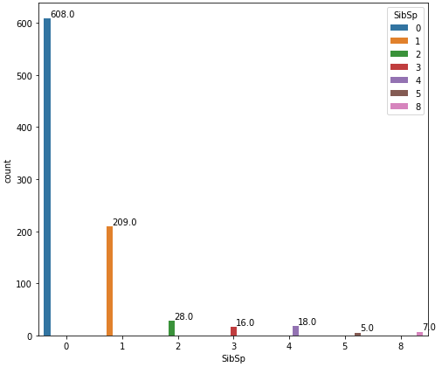
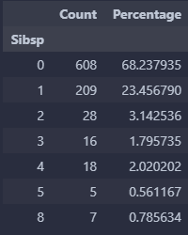
Feature: SibSp
Majority of passengers don’t have siblings or spouse with a count of 608 (68.23 %).
The second highest majority have only one sibling or spouse having a count of 209 (23.45 %).
A total of 7 passengers have 8 SibSp (siblings + Spouse) which is the maximum value.

Slide 10
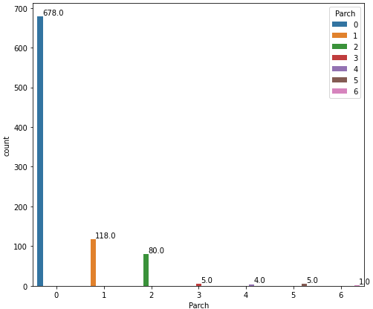
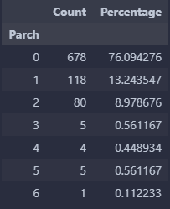
Feature: Parch
Majority of passengers don’t have any children or Parents with them on the ship and they all have a total count of 678 (76.09 %).
The second highest majority have only one child or parent and are having a total count of 118 (13.24 %).
Only 1 passenger has 6 Parch (children + Parents) which is the Maximum Value.

Slide 11
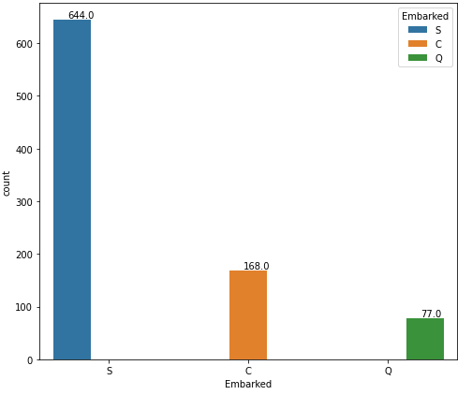
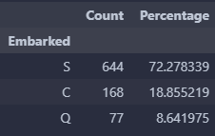
Feature: Embarked
C = Cherbourg, Q = Queenstown, S = Southampton
A total of 644 (72.27 %) passengers embarked at Southampton.
168 (18.85 %) passengers embarked at Cherbourg.
77 (8.64 %) passengers embarked at Queenstown.

Slide 12
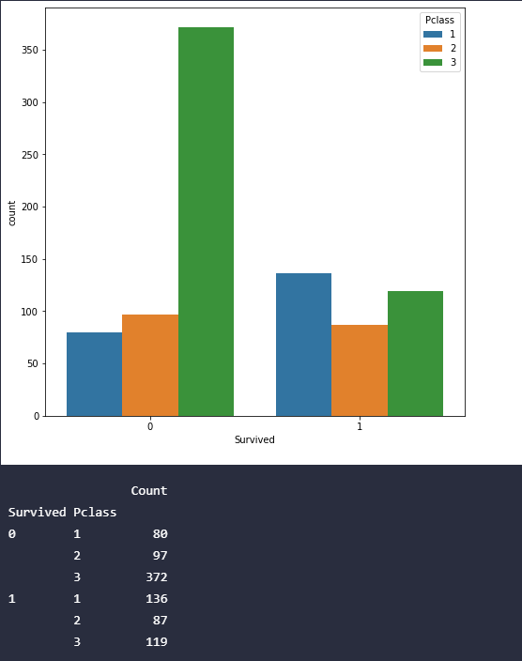
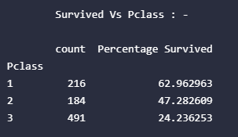
Pclass – Survived Analysis
In Table-1, we can see that number of casualty is higher for class 3 but in this histogram, we haven’t considered the total number of passengers in a particular class which is shown in Table 2.
In Table-3, we have accounted the total number of passengers in each class(given by count column) and calculated the percentage survived from a given class.
We can Conclude that the survival rate is decreasing gradually form class 1(Upper class) to class 3(lower Class).
Table-3
Table-1
Table-2

Slide 13
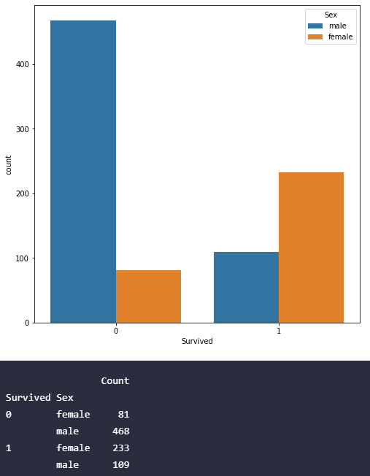
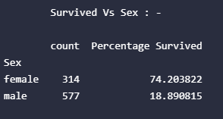
Sex – Survived Analysis
In Table-1, We can see that the casualty rate for female is higher, but we haven’t considered the total number of females, yet which is given in Table-2.
In Table-3, I have accounted for the total number of passengers of each Sex (count in Table-3) and calculated the percentage survived from it.
From Table-3, Conclusion is that the number of female survived more than the number of males.
A possible conclusion would be that females were given rescued before males.
Table-3
Table-1
Table-2

Slide 14
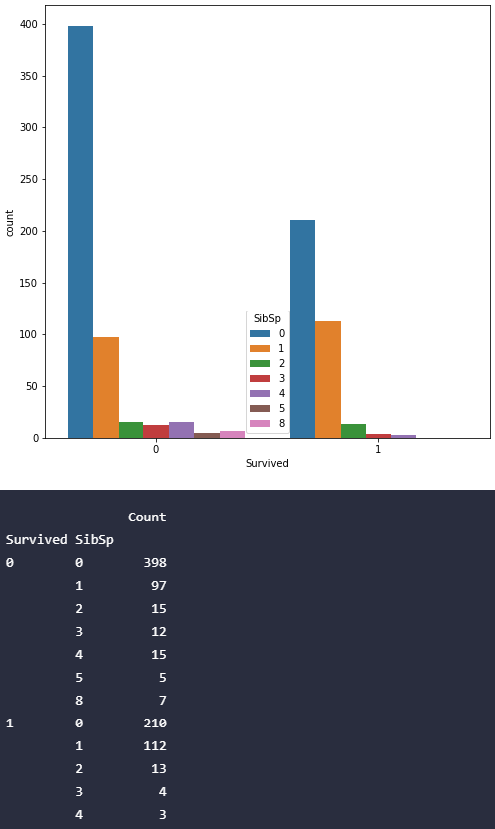
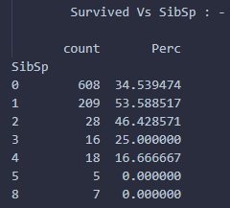
SibSp – Survived Analysis
In Table-1, Passenger who don’t have any siblings/Spouse have much higher survival rate than those who have siblings/Spouse and again we haven’t taken the total set into this histogram in Table-1.
Table-2 gives the total number of siblings/Spouses a passenger is traveling with.
Table-3 gives us the percentage of passengers who survived the Titanic.
Table-3 shows that highest survival chances are for those passengers who have 1 sibling or spouse (more likely to be couples).
A possible conclusion is that couples were given more priority in rescue. Having a lot of SipSp have less chances to survive.
Table-3
Table-1
Table-2

Slide 15
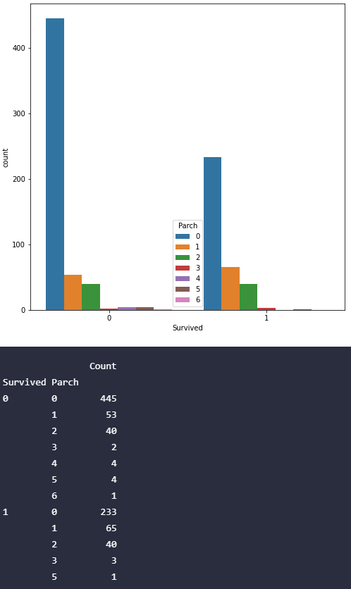
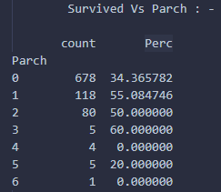
Parch – Survived Analysis
In Table-1, Passenger who don’t have any Parents/Children have much higher survival rate than those who have Parents/Children and again we haven’t taken the total set in this histogram in Table-1.
Table-2 gives the total number of Parents/children a passenger is traveling with.
Table-3 gives us the percentage of passengers who survived the Titanic.
Table-3 shows that highest survival chances are for those passengers who have 1 to 3 Children + Parents.
A possible conclusion is that families were given more priority and were together during the rescue. Small families are more likely to survive. (Refer table-3)
table-3
table-1
table-2

Slide 16
EDA FOR NUMERICAL FEATURES: -
'Age', ’Fare'

Slide 17
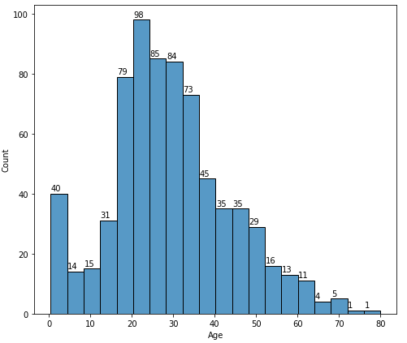
Age Analysis
The highest frequency is for the passengers between the Age of 20-25.
A very few passengers are between age range of 70-80.
Hist-1

Slide 18
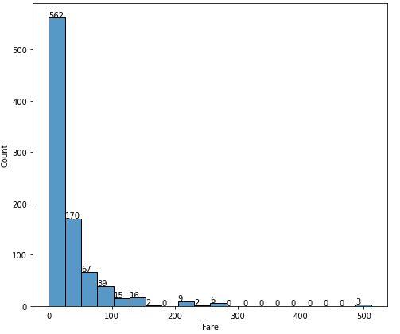
Fare Analysis
562 passengers (majority) traveled with a fare of less than 50$.
Only 3 passengers paid around 500$.
Hist-1

Slide 19
OUTLIER DETECTION

Slide 20
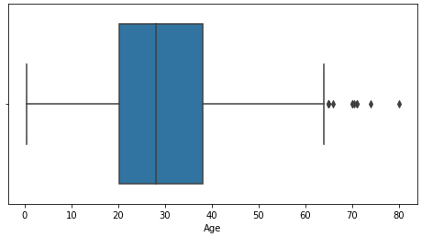
Age Boxplot: -

Slide 21
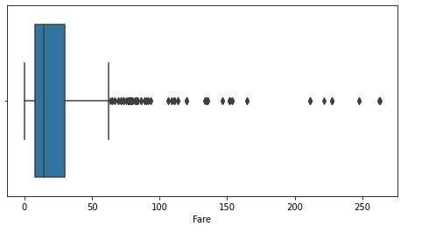
Fare BoxPlot: -

Slide 22
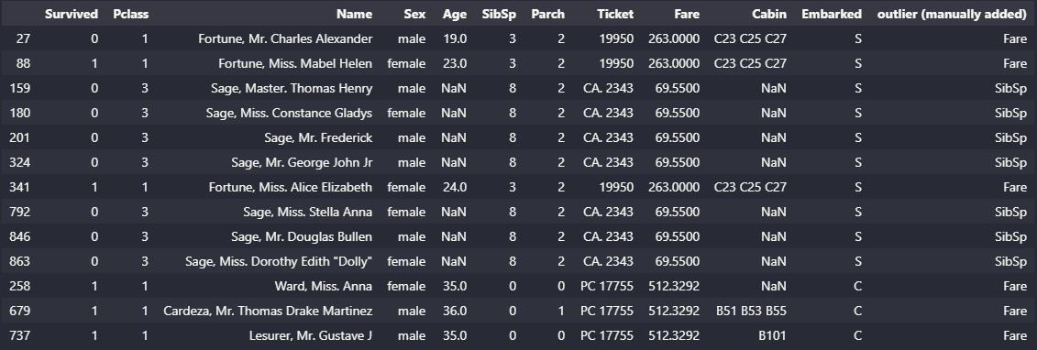
Outlier Detection Condition: -
Outliers Detected for the features: 'Age', 'SibSp', 'Parch', 'Fare'
First, I stored the indices of all the records in a list who were in the outlier range i.e, above (75 percentile + 1.5 * IQR) or below (25 percentile - 1.5 * IQR).
Then made a dictionary to count the number of times a particular record was marked as an outlier and then displayed it.
Dropped the outliers which had more than 2 count since single count outliers may be having a reason for being an outlier which counts as a useful data.

Slide 23
Filling Missing Values
Embarked has only two missing values.
Cabin and Age have a lot of NULL values so filling it with dummy values may lead to wrong model building.

Slide 24
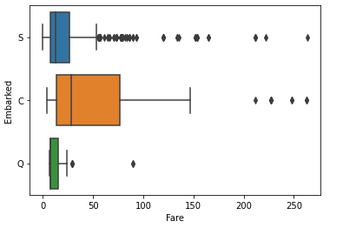
Filling Embarked: -
Embarked is the destination of a passenger.
Fare must be having a high correlation with Embarked since Fare would vary with passengers' destination.
I box plotted Fare for all Destinations.
The missing records have same Fare and according to the boxplot only ‘Cherbourg’ has a Fare of 80 within its IQR(Inter-Quartile range).
So, I filled both their records with ‘Cherbourg’ as their Destination according to their Fare Price.

Slide 25
HYPOTHESIS TESTING

Slide 26
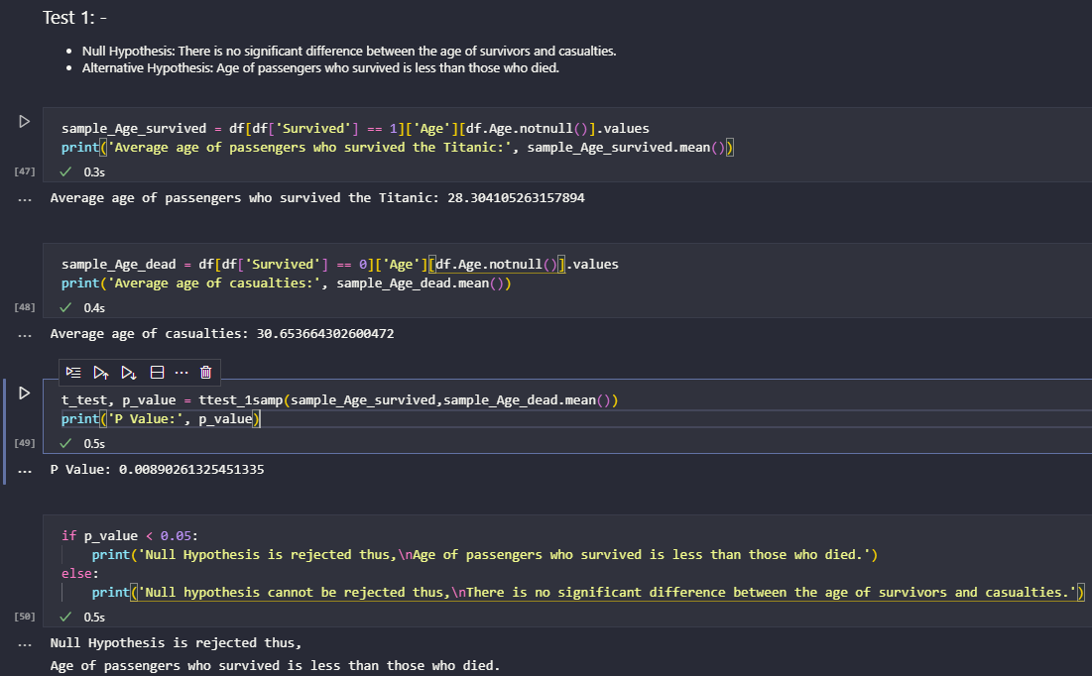
TEST 1
Null Hypothesis: There is no significant difference between the age of survivors and casualties.
Alternative Hypothesis: Age of passengers who survived is less than those who died.
Average age of passengers who survived the Titanic: 28.30
Average age of casualties: 30.65
I used t test to find the p value with 5% confidence interval.
P value: 0.0089, which is less than 0.05.
So, We reject the null hypothesis and Age of passengers who survived is less than those who died.

Slide 27
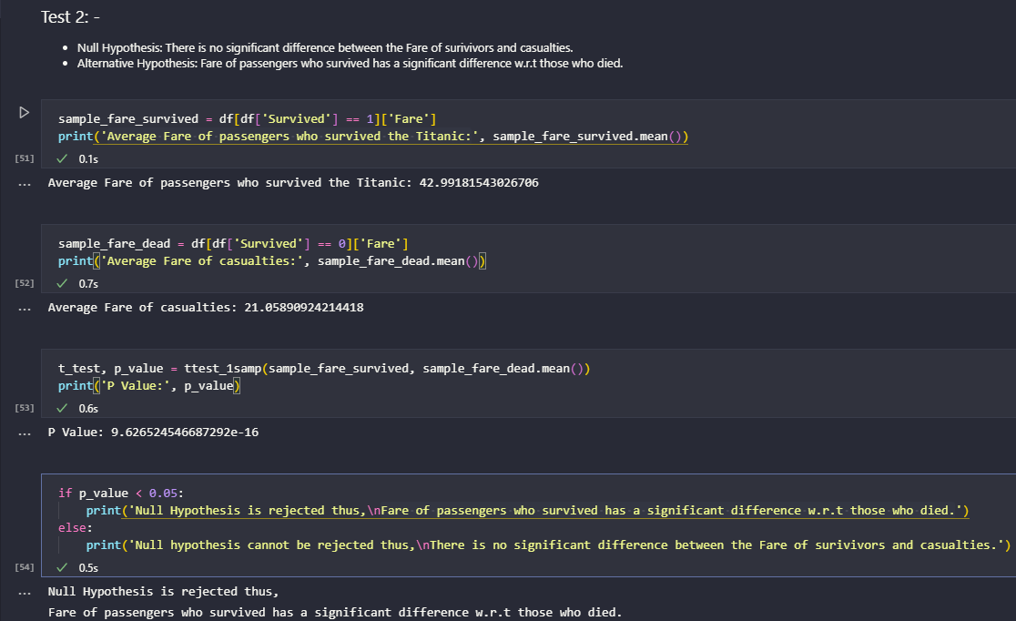
TEST 2
Null Hypothesis: There is no significant difference between the Fare of survivors and casualties.
Alternative Hypothesis: Fare of passengers who survived has a significant difference w.r.t those who died.
Average Fare of passengers who survived the Titanic: 42.99 $
Average Fare of casualties: 21.05 $
I used t test to find the p value with 5% confidence interval.
P value: 9.626 * 10⁻¹⁶, which is less than 0.05.
So, We reject the null hypothesis thus, fare of passengers who survived has a significant difference w.r.t those who died.

Slide 28
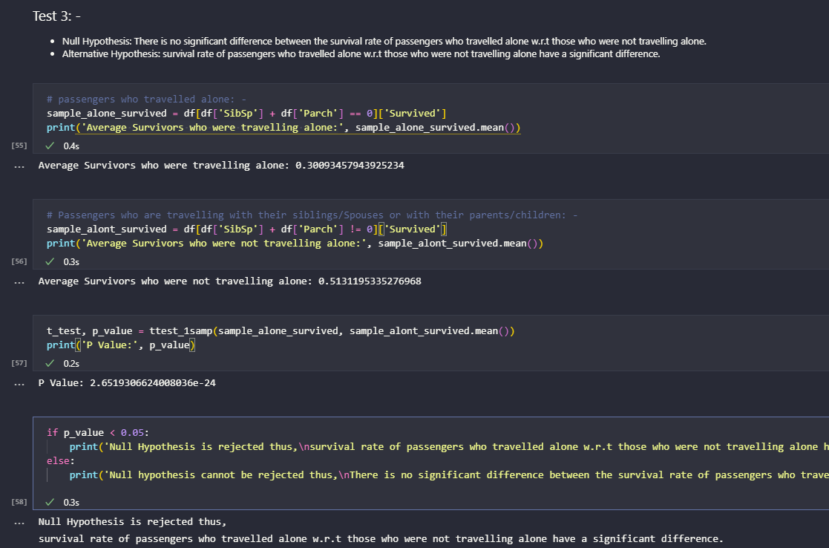
TEST 3
Null Hypothesis: There is no significant difference between the survival rate of passengers who travelled alone w.r.t those who were not travelling alone.
Alternative Hypothesis: survival rate of passengers who travelled alone w.r.t those who were not travelling alone have a significant difference.
Average Survivors who were travelling alone: 0.300.
Average Survivors who were not travelling alone:0.513.
I used t test to find the p value with 5% confidence interval.
P value: 2.651 * 10⁻²⁴, which is less than 0.05.
So, We reject the null hypothesis thus, survival rate of passengers who travelled alone w.r.t those who were not travelling alone have a significant difference.

