Slide 1
Titanic Data Set
By: Vishnu Panicker
Assignment: IBM Exploratory Data Analysis week – 2 (peer review)

Slide 2
Titanic Data Set: -
The sinking of the Titanic is one of the most infamous shipwrecks in history.
On April 15, 1912, during her maiden voyage, the widely considered “unsinkable” RMS Titanic sank after colliding with an iceberg. Unfortunately, there weren’t enough lifeboats for everyone onboard, resulting in the death of 1502 out of 2224 passengers and crew.
While there was some element of luck involved in surviving, it seems some groups of people were more likely to survive than others.
Kaggle link: https://www.kaggle.com/c/titanic/overview

Slide 3
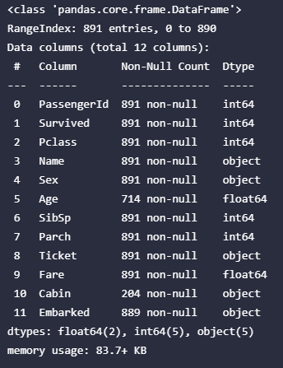
Data Description: -
Feature description: -
1 PassengerId: Unique ID of each passenger
2 Survived: 1 for survived 0 for dead (target variable).
3 Pclass: A proxy for socio-economic status (SES)
1 = Upper class
2 = Middle class
3 = Lower class
4 Name: Name of the Passenger
5 Sex: Gender of Passenger
6 Age: Age is fractional if less than 1. If the age is estimated, then t is in the form of xx.5.
7 SibSp: Family Relation: sibling or spouse. Basically, it’s the number of siblings or spouse each passenger has.
8 Parch: Number of children + parents (0 for those who are alone).
9 Ticket: Ticket Number
10 Fare: Fares Price
11 Cabin: Cabin class
12 Embarked: Destination of a passenger
(C = Cherbourg, Q = Queenstown, S = Southampton)

Slide 4
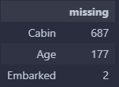


Overview: -
The data set initially has 891 rows and 12 columns.
Only 3 of the features have missing data in them and those are: ‘Cabin’, ‘Age’ and ‘Embarked’.
Categorical Features are :
Numerical Features are :

Slide 5
EDA FOR CATEGORICAL FEATURES: -
'Survived', 'Pclass', 'Sex', 'SibSp', 'Parch', 'Embarked'

Slide 6
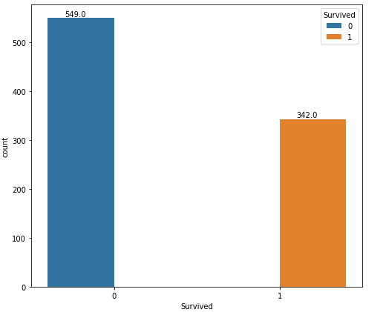

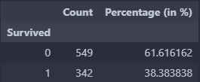
Feature: Survived
There were more casualties than those who survived.
Percentage of passengers who died: 61.61 %.
Percentage of passengers who survived: 38.38 %.

Slide 7
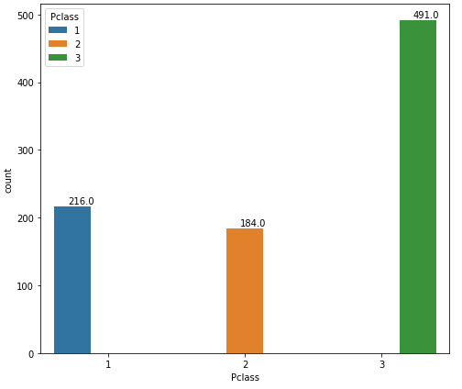
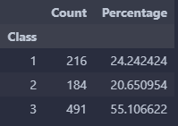
Feature: Pclass
Class: -
  1: Upper Class
  2: Middle Class
  3: Lower Class
Majority of the passengers are in class 3.
Percentage of class 3 passengers: 55.10%.
Percentage of class 2 passengers: 20.65%.
Percentage of class 1 passengers: 24.24%.
Conclusion: Majority of passengers preferred class 3 (cheapest) and class 1 (most expensive).

Slide 8
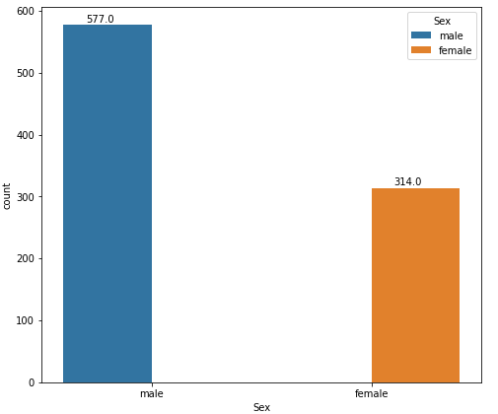
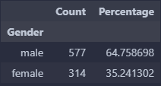
Feature: Sex
Majority of passengers are male.
Percentage of Male beingL: 64.75 %.
Percentage of Females being: 35.25 %.

Slide 9
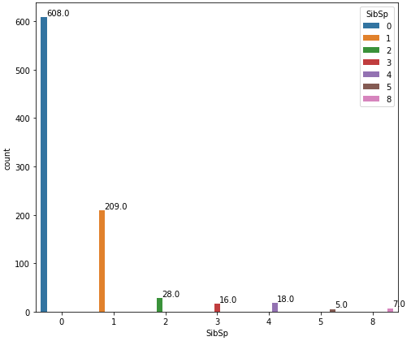
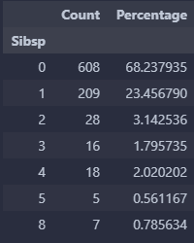
Feature: SibSp
Majority of passengers don’t have siblings or spouse with a count of 608 (68.23 %).
The second highest majority have only one sibling or spouse having a count of 209 (23.45 %).
A total of 7 passengers have 8 SibSp (siblings + Spouse) which is the maximum value.

Slide 10
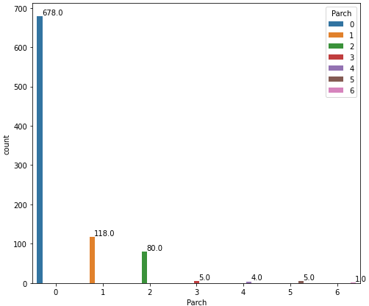
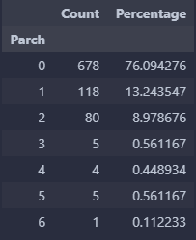
Feature: Parch
Majority of passengers don’t have any children or Parents with them on the ship and they all have a total count of 678 (76.09 %).
The second highest majority have only one child or parent and are having a total count of 118 (13.24 %).
Only 1 passenger has 6 Parch (children + Parents) which is the Maximum Value.

Slide 11
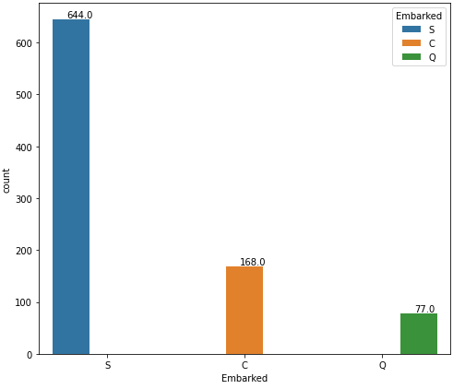
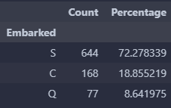
Feature: Embarked
C = Cherbourg, Q = Queenstown, S = Southampton
A total of 644 (72.27 %) passengers embarked at Southampton.
168 (18.85 %) passengers embarked at Cherbourg.
77 (8.64 %) passengers embarked at Queenstown.

Slide 12
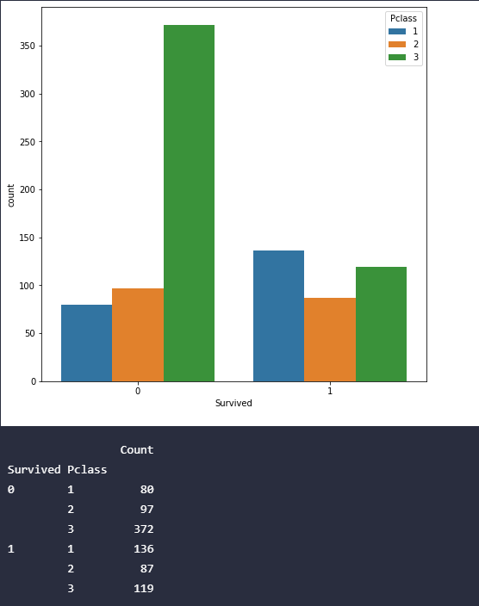
Pclass – Survived Analysis

Slide 13
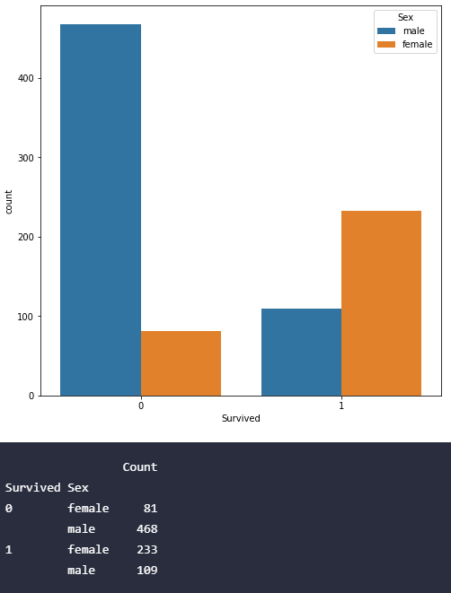
Sex – Survived Analysis
According to the histogram, male Causality is very high when copmpared to Female Casualties.

Slide 14
EDA FOR NUMERICAL FEATURES: -
'Survived', 'Pclass', 'Sex', 'SibSp', 'Parch', 'Embarked'

