Slide 1

SALARY PREDICTION
Project Supervisor : DR.N.S. Usha, M.E., Ph.D
Assistant Professor,CSE
Name of the Student : G.VISHWANTH
Register Number : 41111386
Guide Name : Dr.J.ALBERT MAYAN

Slide 2
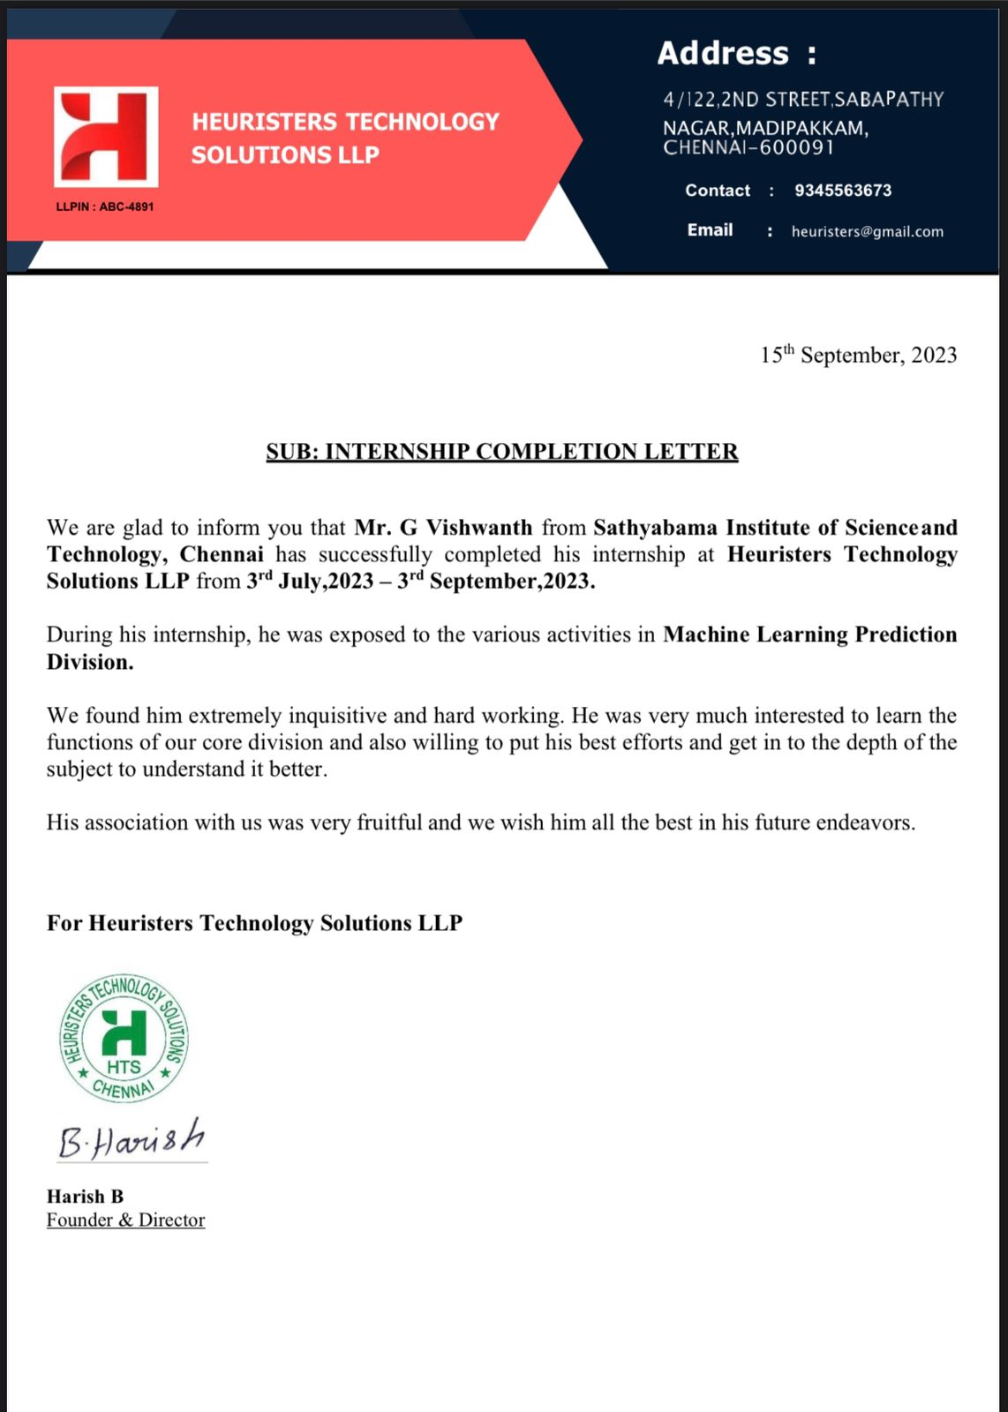
Course Certificate

Slide 3
Presentation Outline
Course Certificate
Abstract
Introduction
Objectives
Project implementation
Methodology
Results and discussion
Snapshots
Conclusion
References

Slide 4
Abstract
Machine learning is a technology which allows a software program to became more accurate at pretending more accurate results without being explicitly programmed and also ML algorithms uses historic data to predicts the new outputs. Because of this ML gets a distinguish attention. Now a day’s prediction engine has become so popular that they are generating accurate and affordable predictions just like a human, and being using industry to solve many of the problems. Predicting justified salary for employee is always being a challenging job for an employer. In this paper and proposing a salary prediction model with suitable algorithm using key features required to predict the salary of employee.
KEYWORDS:
Salary Prediction: This refers to the process of using data and mathematical models, particularly machine learning algorithms, to estimate or predict an individual's expected salary based on various factors or features.
Machine Learning:. In the context of salary prediction, machine learning algorithms are used to learn the relationship between various features (such as education, experience, location, etc.) and salary.

Slide 5
Abstract
Gradient Boosting: Gradient boosting is a machine learning technique that belongs to the ensemble learning family. Each new model corrects the errors of the previous ones Gradient boosting is known for its high predictive power and is frequently used in regression tasks like salary prediction.
Feature Importance: In machine learning, feature importance refers to the assessment of the significance of each input variable (feature) in predicting the target variable (in this case, salary).. It's crucial for model interpretation and can guide decisions, such as salary negotiation strategies.

Slide 6
Introduction
In today's rapidly evolving job market, both job seekers and employers are keenly interested in understanding and predicting salaries. Salary prediction using machine learning has emerged as a valuable tool in this endeavor. This approach leverages the power of data science and artificial intelligence to estimate future earnings based on various factors and historical data, providing valuable insights for both job candidates and organizations.
The process of salary prediction involves collecting and analyzing a wide range of features or variables that can influence an individual's income. These variables may include educational qualifications, years of experience, location, industry, job title, skills, and more. By building predictive models using historical salary data, machine learning algorithms can identify patterns and relationships between these variables, enabling us to make accurate salary predictions for new job openings or candidates.
There are several key benefits to using machine learning for salary prediction:

Slide 7
Introduction
Data-Driven Insights: Machine learning algorithms can uncover hidden patterns and relationships in large datasets, allowing for a more data-driven and objective approach to salary estimation.
Customization: Models can be customized to specific industries, regions, or job roles, ensuring that predictions are tailored to the unique characteristics of a given job market.
Fairness: By considering various factors, including demographic information, machine learning models can help identify and mitigate salary disparities and promote fairness in compensation.
Efficiency: Automated salary prediction models save time for both job seekers and recruiters, streamlining the hiring process and reducing negotiation time.
Informed Decision-Making: For job seekers, accurate salary predictions can help in making informed career decisions, while organizations can use these predictions to optimize their compensation strategies and budget allocation.
To build a salary prediction model, one typically collects and preprocesses relevant data, selects an appropriate machine learning algorithm, and trains the model using historical salary data.
In this era of data-driven decision-making, salary prediction using machine learning is a powerful tool that empowers job seekers and organizations to make more informed choices and ensure equitable compensation practices. This introduction sets the stage for exploring the various steps and techniques involved in building and deploying salary prediction models in the world of machine learning.

Slide 8
Objectives
Transparency and Fairness:
Ensure fairness in compensation by identifying and addressing salary disparities based on factors such as gender, race, and age.
Promote transparency in salary negotiations and compensation practices, making it easier for candidates and employees to understand how salaries are determined.
Data-Driven Decision-Making:
Enable job seekers to make informed career decisions by providing salary expectations based on their qualifications, skills, and industry standards.
Empower employers to make data-driven decisions when setting salary ranges for job openings, considering factors such as location, job role, and candidate qualifications.
Efficiency in Hiring:
Streamline the hiring process by reducing the time spent on salary negotiations. Predictive models can help align candidate expectations with the employer's budget.
Improve the efficiency of job matching by ensuring that candidates are presented with roles that align with their salary expectations.

Slide 9
Objectives
Optimized Compensation Strategies:
Assist organizations in optimizing their compensation strategies by analyzing historical data to identify trends and patterns in salary distributions.
Enable organizations to allocate their compensation budgets more effectively by understanding how various factors impact salary levels.
Improved Employee Retention:
Help organizations retain talent by ensuring that employees are compensated fairly and competitively within their industry and region.
Identify and address situations where existing employees may be underpaid relative to their qualifications and contributions.
Compliance and Accountability:
Ensure compliance with labor laws and regulations by identifying and addressing potential pay disparities that may result in legal challenges.
Establish accountability in compensation practices, making it easier to track and justify salary decisions.
Continuous Improvement:
Enable organizations to continuously refine their salary prediction models and compensation strategies based on evolving market conditions and workforce trends.
Encourage the development of more accurate and sophisticated machine learning models for salary prediction.

Slide 10
Project Implementation
Software Requirements
Operating System : Windows 8 and above (64-bit)
Software : ANACONDA NAVIGATOR
Hardware Requirements
Processor : i3 and above
RAM : 4GB and above

Slide 11
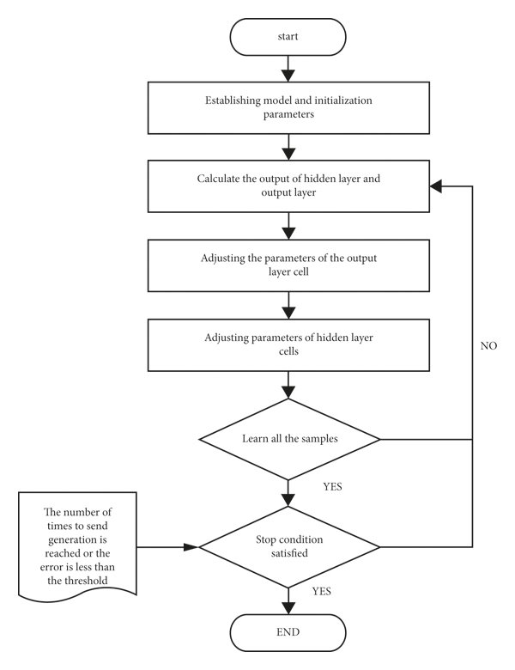
Methodology

Slide 12
Results & Disscusion
Model Performance Metrics:
Mean Absolute Error (MAE): A common metric that measures the average absolute difference between predicted and actual salaries.
Root Mean Square Error (RMSE): Measures the square root of the average squared differences between predicted and actual salaries. It penalizes larger errors more heavily than MAE.
R-squared (R2): Indicates the proportion of variance in the salary that is explained by the model. A higher R2 suggests a better fit.
Feature Importance:
Identify which features have the most significant impact on salary predictions. This helps job seekers and employers understand what factors influence compensation the most.
Visualization:
Visual representations of model predictions compared to actual salaries can provide insights into the model's performance and potential areas of improvement.
Fairness Analysis:
Evaluate the fairness of the model's predictions by assessing any demographic or other biases. Results may show whether certain groups are disproportionately affected by the model's predictions.

Slide 13
Results & Disscusion
Error Analysis:
Examine specific instances where the model's predictions deviate significantly from actual salaries. This can help identify potential issues or outliers in the data.
Model Interpretability:
Use techniques like SHAP values, partial dependence plots, or feature importance plots to explain how individual features impact salary predictions.
Deployment Metrics:
If the model is deployed, monitor its real-world performance by tracking prediction accuracy, fairness, and user feedback over time.
Practical Implications:
Discuss the practical implications of the model's predictions for job seekers and employers. Are the predictions useful for salary negotiations, career planning, or compensation strategy?
Future Recommendations:
Based on the results, provide recommendations for further model improvements or enhancements, such as refining fairness measures, including additional features, or scaling up the model.
Visualization of Model Deployment:
If applicable, visualize how the model is integrated into a web application, API, or other deployment methods. Highlight user interfaces and interaction flows.

Slide 14
Results & Disscusion
Stakeholder Feedback:
Gather feedback from job seekers and employers who have used the salary prediction tool, and include any testimonials or insights they provide.
Comparison with Baseline:
Compare the performance of your salary prediction model with a baseline model (e.g., a simple linear regression or a mean salary predictor) to demonstrate the improvement achieved.
Ultimately, the results should demonstrate the accuracy and usefulness of the salary prediction model, along with any measures taken to ensure fairness and mitigate bias. These insights can inform job seekers' career decisions and help organizations make more informed compensation decisions in a fair and transparent manner.
Let us see some snapshots of how the model works:

Slide 15
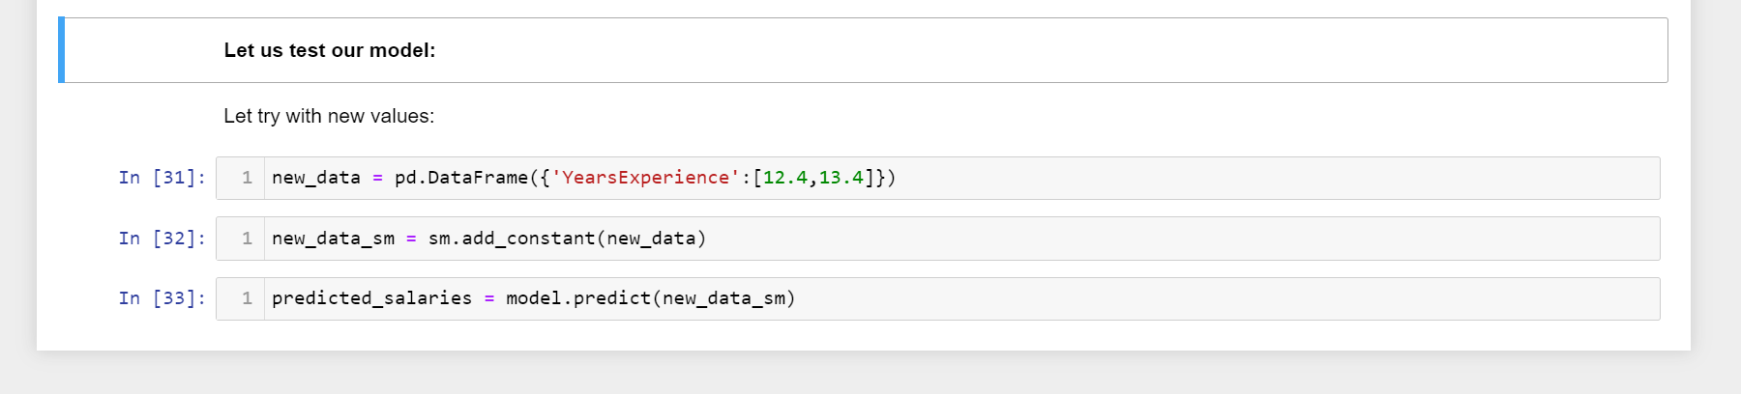
Snapshots:
Before prediction(Uploading values to the model

Slide 16
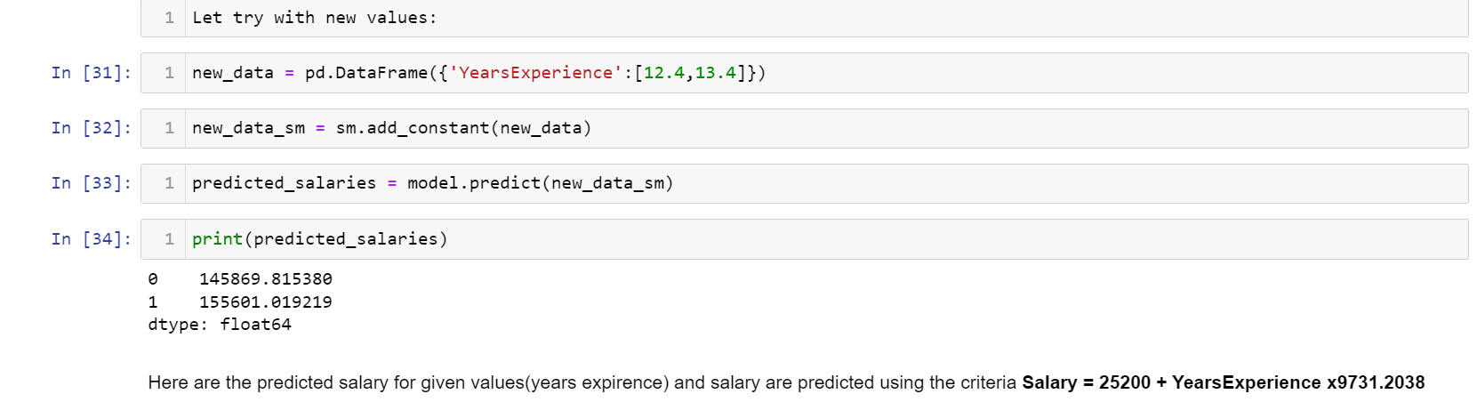
After prediction:

Slide 17
References
DATASET:- https://www.kaggle.com
https://towardsdatascience.com
https://www.datasciencecentral.com

Slide 18
Conclusion
The "Salary Prediction Using Linear Regression" project addresses a critical need in the job market by harnessing the capabilities of machine learning to provide accurate salary estimates. Linear regression offers transparency and interpretability, making it an ideal choice for this task. By helping individuals and organizations make data-driven decisions about salaries, this project contributes to improved career planning, negotiation, and workforce management. It underscores the potential of machine learning to empower individuals and organizations in the realm of compensation and career development.
In summary, salary prediction using machine learning serves as a powerful tool for enhancing transparency, fairness, and efficiency in the job market. It empowers individuals to make informed career decisions and assists organizations in making equitable compensation decisions. This project not only achieves its immediate goals but also sets the stage for ongoing advancements in the field of salary prediction and data-driven compensation practices. As the job market evolves, these models will play a vital role in ensuring that compensation remains competitive, unbiased, and reflective of the diverse talent pool.

