Slide 1

Real-Time Commodity Percentage Change Prediction using Web Scraping & Machine Learning
Web Scraping Final Project
By
Visshnu Prethi Manjere Kumar
Master’s in Computer Science & Data Science

Slide 2
PROJECT OVERVIEW
Scraped data from the page: https://tradingeconomics.com/commodities
Focused on multiple dates
Cleaned and preprocessed the dataset to remove inconsistencies, missing values, and formatting issues
Calculated 10+ Key Performance Indicators (KPIs), such as:
Revenue growth
Profit margins
Revenue per employee
Market share by country
Employee distribution by company size
Created visualizations (scatter plots, bar charts, bubble charts) for better understanding
Designed the project for academic insight into global technology industry trends

Slide 3
PROBLEM STATEMENT
Commodity prices are highly volatile and influenced by global economic factors.
Reliable and real-time commodity data is often scattered or paid.
Predicting raw prices is misleading
PROJECT IDEA
The goal of this project is to analyze and predict percentage price changes (% change) in commodities.
Instead of predicting absolute prices, % change captures market volatility and trend direction.
This is more realistic for:
Trading analysis
Risk management
Market trend detection
Why % Change?
Normalizes prices across different commodities
Reduces scale bias (gold vs wheat vs oil)
Better reflects real-world financial movement

Slide 4



TOOLS & TECHNOLOGIES
Python Libraries:
BeautifulSoup
Requests
Pandas
Database: PostgresSQL
PowerBI

Slide 5
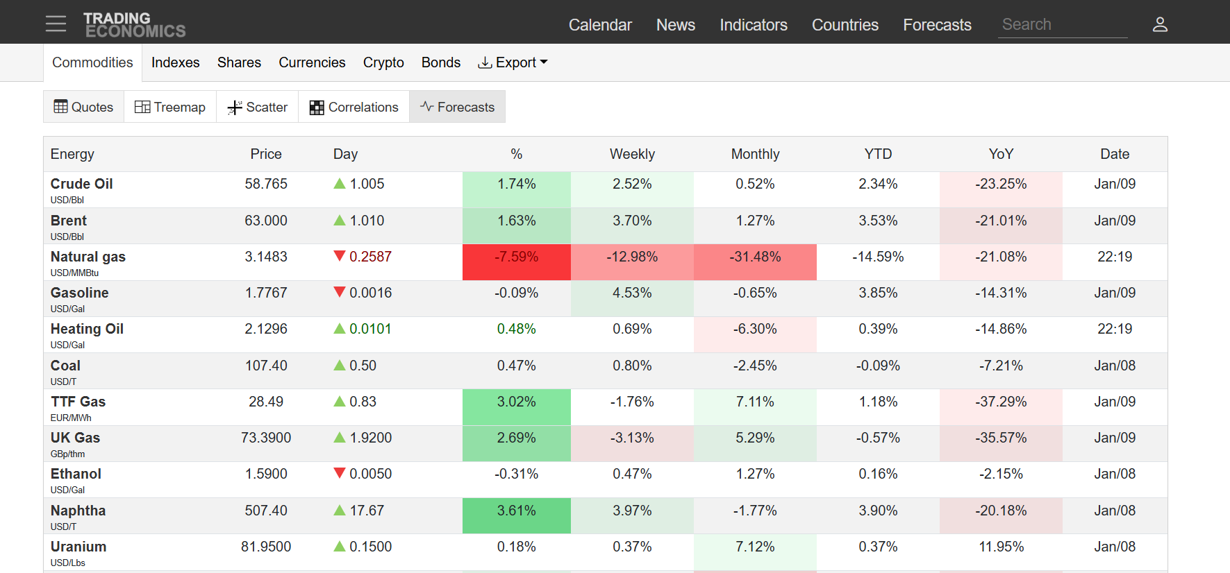
DATA SOURCE
Website Page: TradingEconomics – Commodities section https://tradingeconomics.com/commodities
Why TradingEconomics?
Reliable economic & financial data
Frequently updated (near real-time)
Covers multiple commodities (Gold, Oil, Copper, etc.)
Data Collected
Commodity name
Date
Price
Unit
Currency
Percentage change
Day Change
YTD/YOY metrics

Slide 6
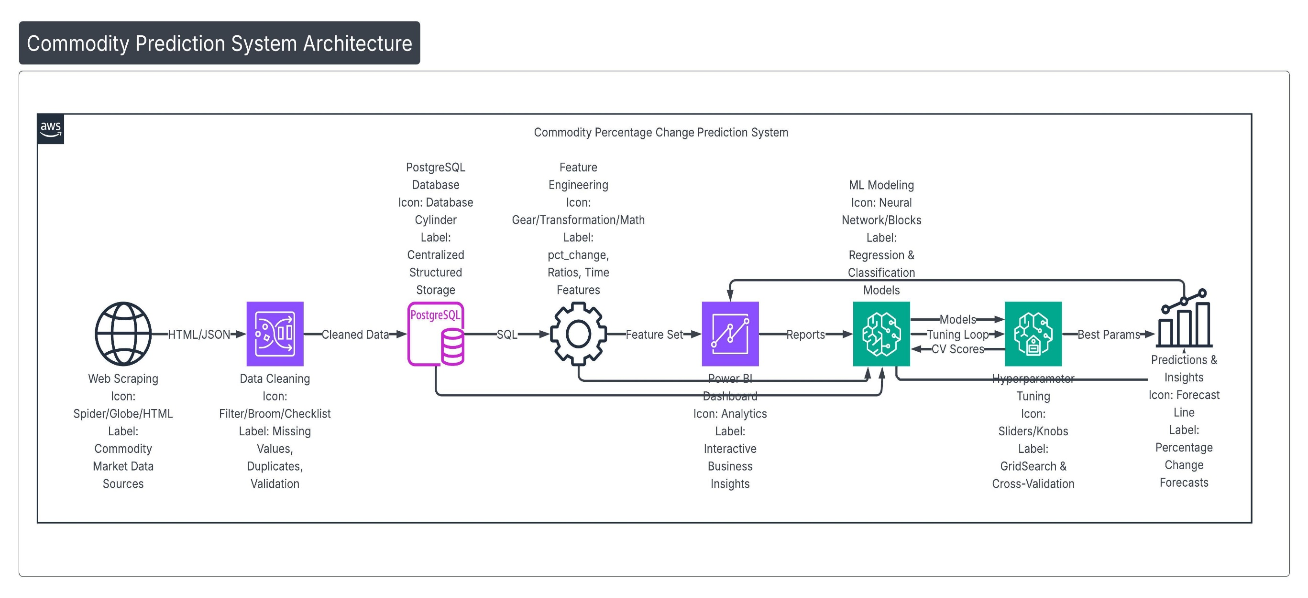
ARCHITECTURE DIAGRAM

Slide 7
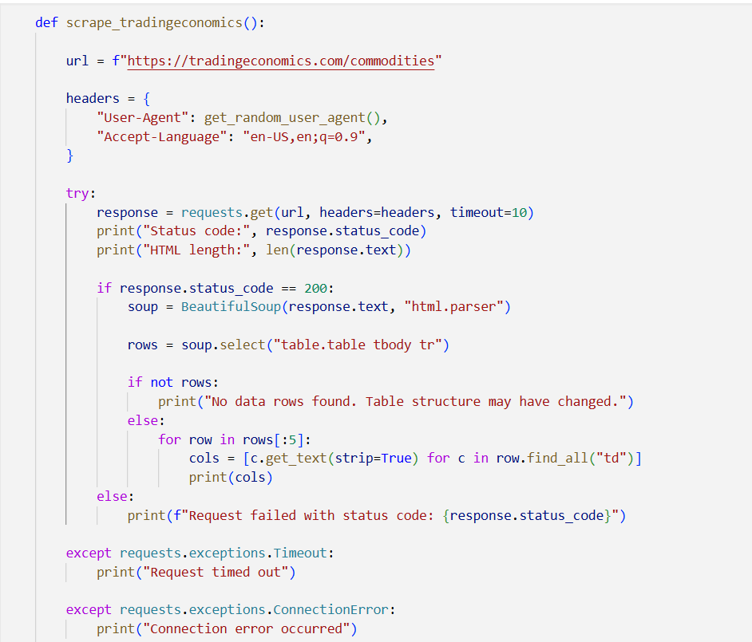
WEB SCRAPING APPROACH
Send a GET request to the Website page.
Parse the HTML content using BeautifulSoup.
Send HTTP request to TradingEconomics commodity pages
Parse HTML content using BeautifulSoup.
Extract relevant fields (price, date, commodity)
Store raw data as CSV / DataFrame

Slide 8
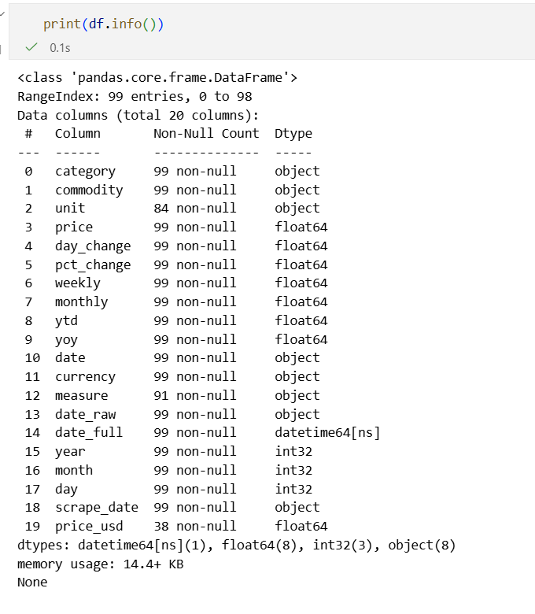
DATA CLEANING
Removed duplicates
Handled missing values
Fixed inconsistent units (USD, index points, etc.)
Validated numeric columns
Removed invalid rows where % change was not meaningful
Why important?
Ensures reliable ML predictions
Prevents data leakage and bias

Slide 9
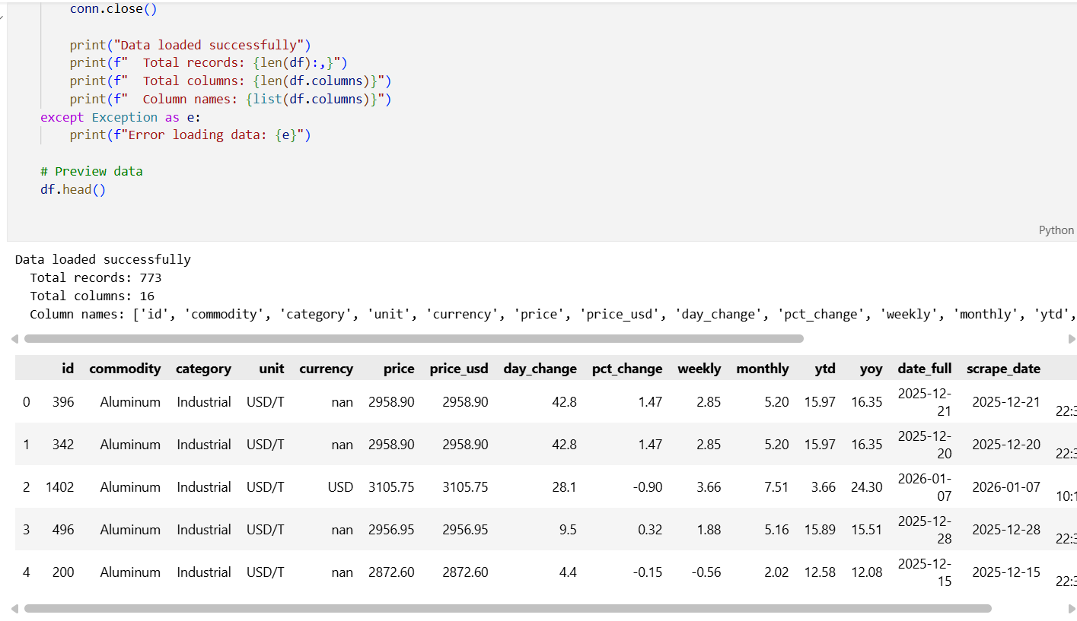
DATA PREPROCESSING & TRANSFORMATION
Challenges
Different currencies (USD, CNY, MYR, etc.)
Units like USD/T, cents
Missing or inconsistent dates
Transformations Applied
Currency normalization (converted to USD)
Unit standardization
Date formatting
Handling missing values
Feature engineering (lag values, rolling averages)
Final Dataset
Clean, structured, ML-ready dataset

Slide 10
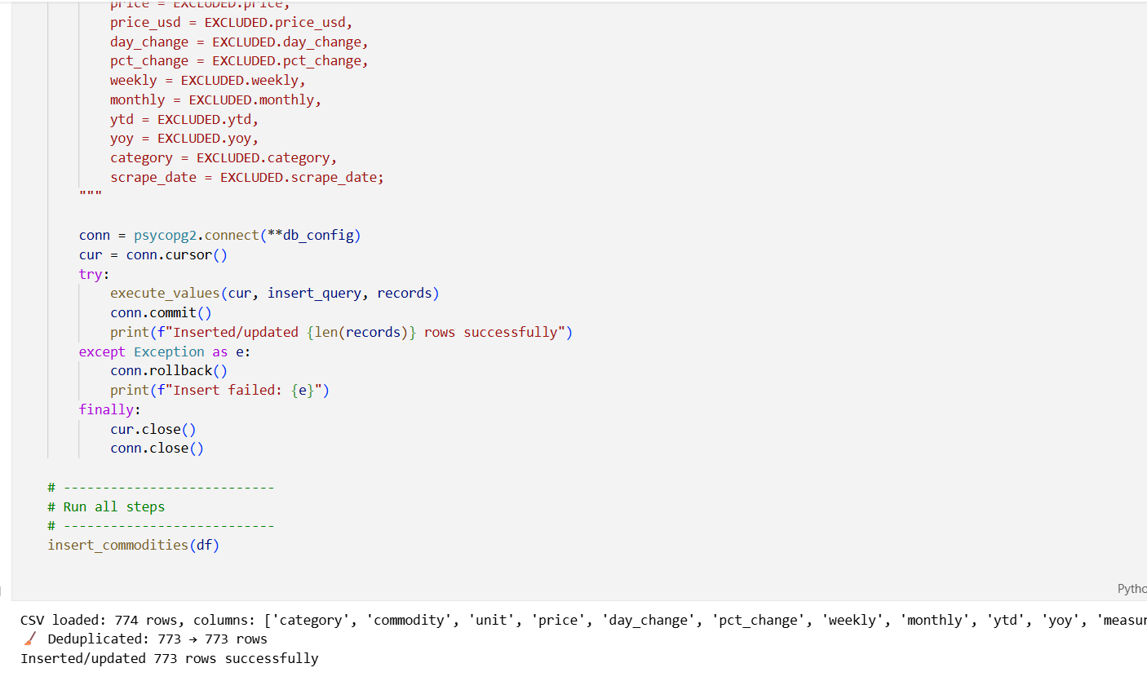
DATA STORAGE (POSTGRESQL)
Why PostgreSQL?
Structured storage
Data integrity
Easy integration with Python & BI tools
Pipeline
Scraped data → PostgreSQL → Analytics & ML

Slide 11
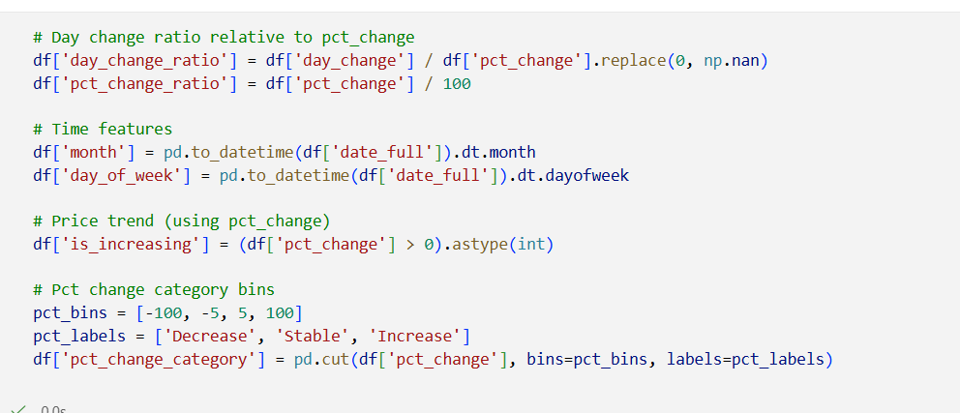
FEATURE ENGINEERING
Engineered Features
New features are engineered to capture relative movements and relationships, for example:
`day_change_ratio` = `day_change` divided by price-related measure
`pct_change_ratio` = function of `pct_change` relative to another baseline
A correlation matrix is computed for:
`pct_change`, `day_change`, `day_change_ratio`, `pct_change_ratio`, `ytd`, `yoy`
This reveals relationships such as:
- Strong positive correlation between `ytd` and `yoy`
- Moderate relationships between change metrics and ratios
Time features:
Month
Day of week
Trend indicator:
is_increasing
Target Variable
pct_change

Slide 12
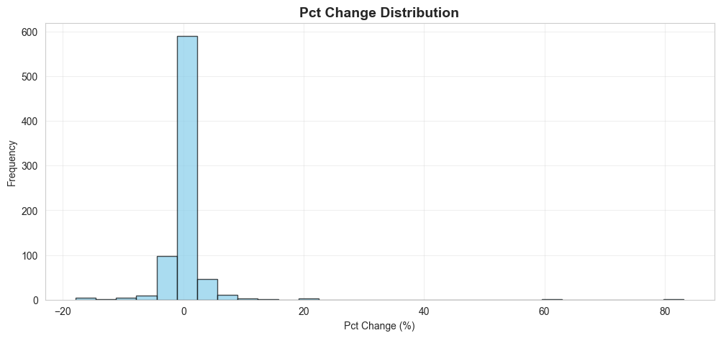
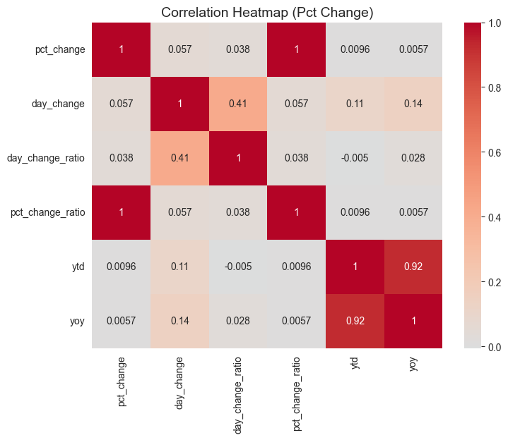
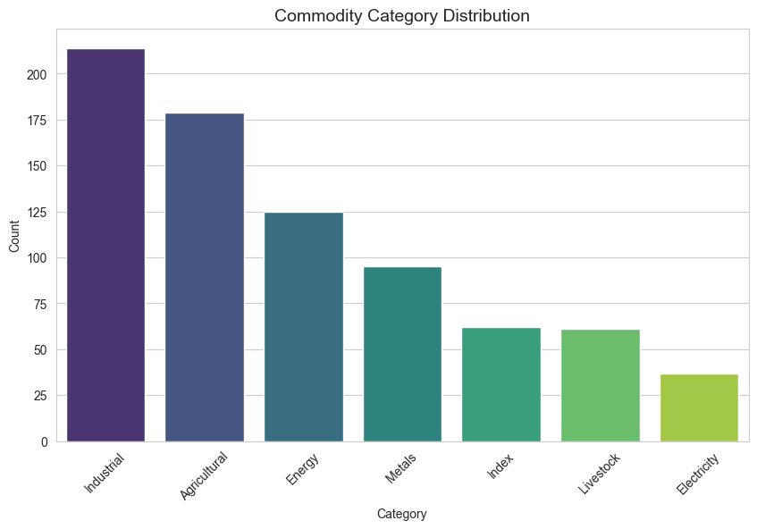
EXPLORATORY DATA ANALYSIS (EDA)
Key Insights
High volatility across commodities
Presence of extreme outliers
Skewed distributions

Slide 13
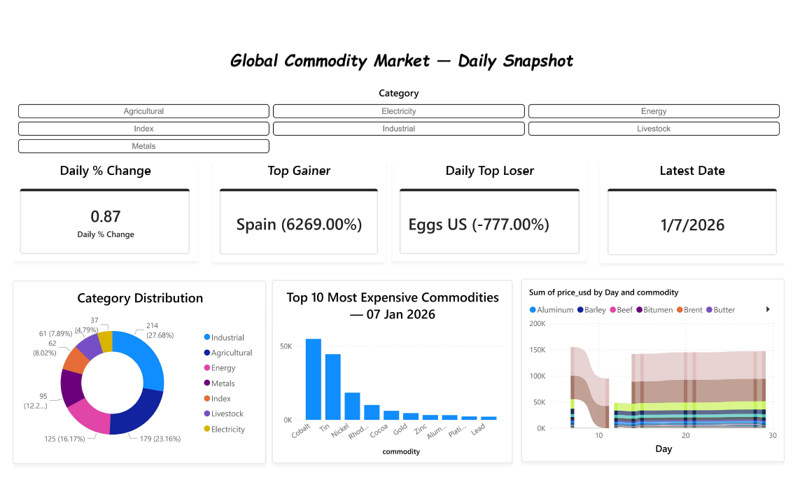
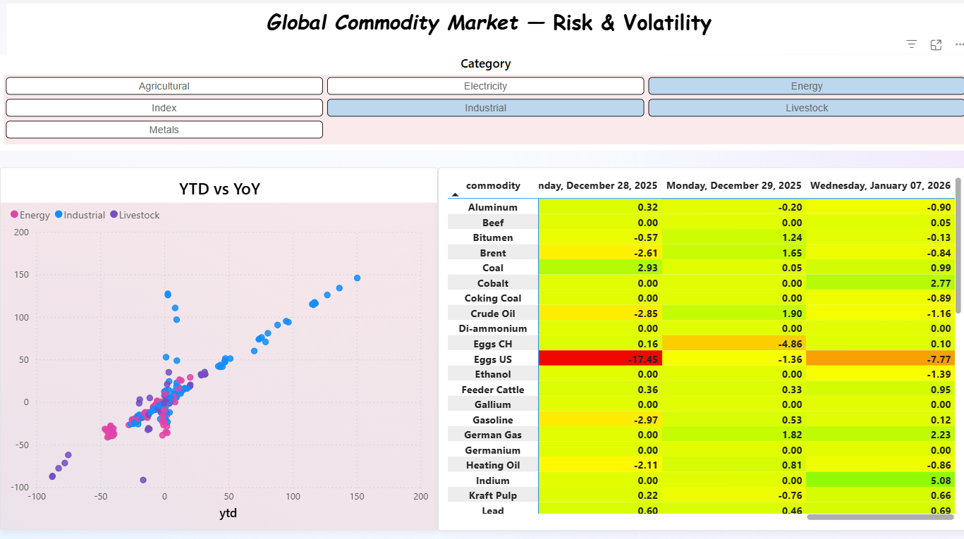
BUSINESS INTELLIGENCE

Slide 14
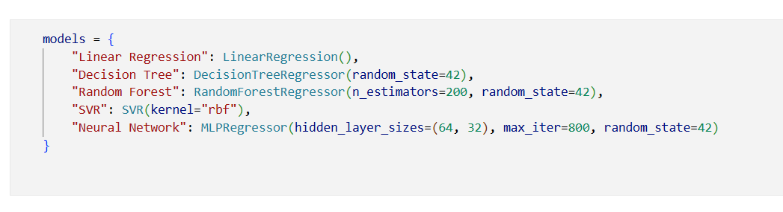
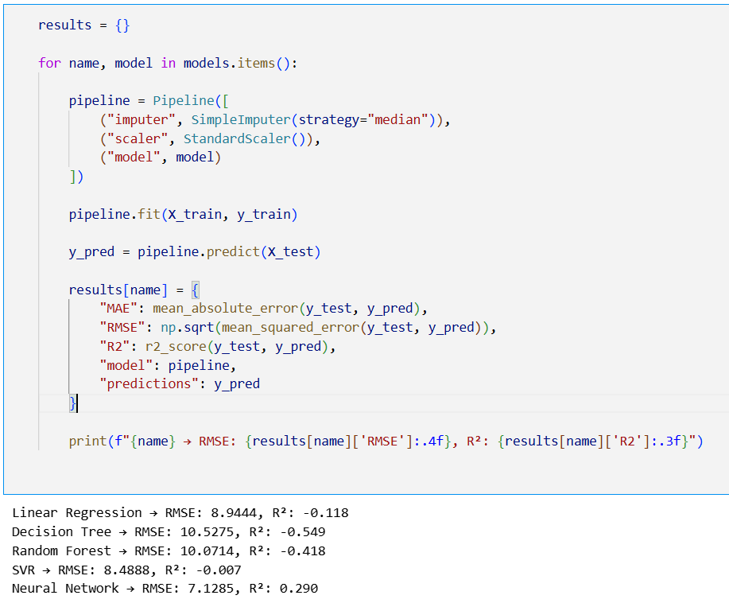
MACHINE LEARNING MODELS USED
Objective
Predict Percentage Change based on historical data
Models Implemented
Random forest
Decision Tree
Linear Regression
Neural Network
Support Vector Regressor
Train-Test Split
80% Training
20% Testing

Slide 15
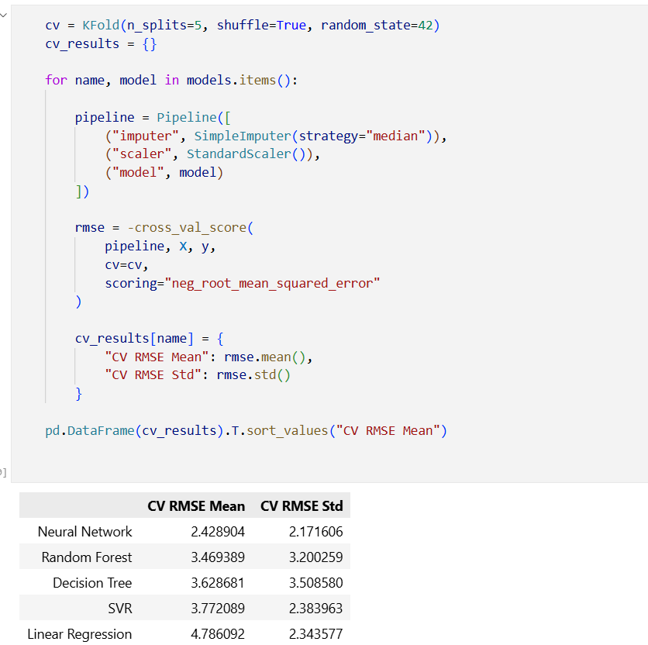
MODEL EVALUATION METRICS
Regression Metrics
MAE – Average absolute prediction error
RMSE – Penalizes large errors
R² – Variance explained by the model
Why these metrics?
Financial data requires error-sensitive evaluation

Slide 16
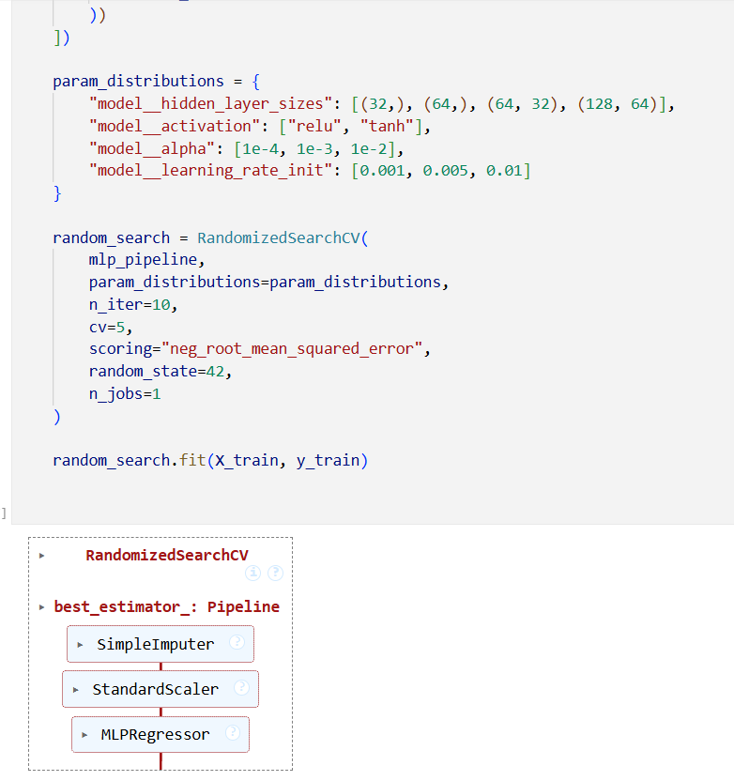
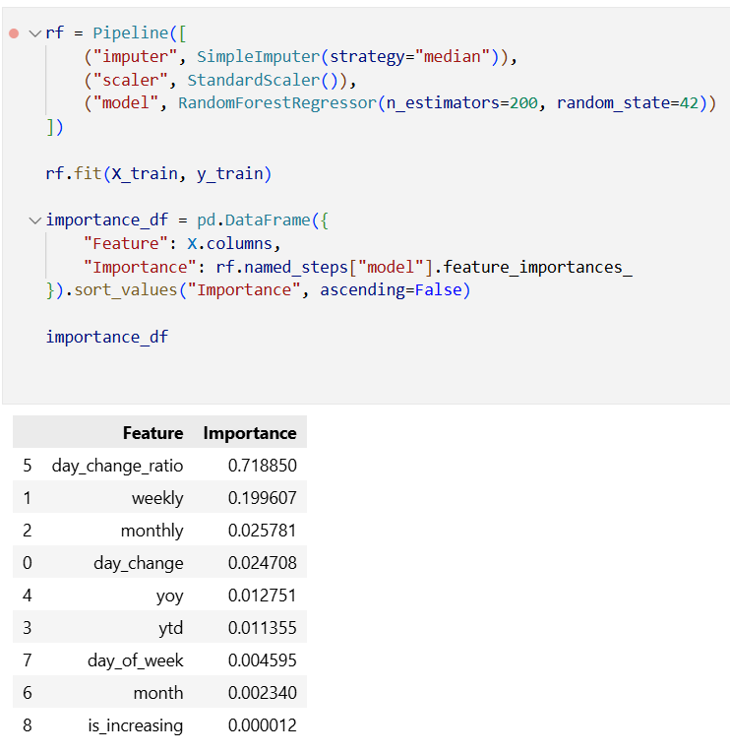
CLASSIFICATION EXTENSION
Objective
Predict direction of movement:
Increase (1)
Decrease (0)
Models Used
Decision Tree
Random Forest

Slide 17
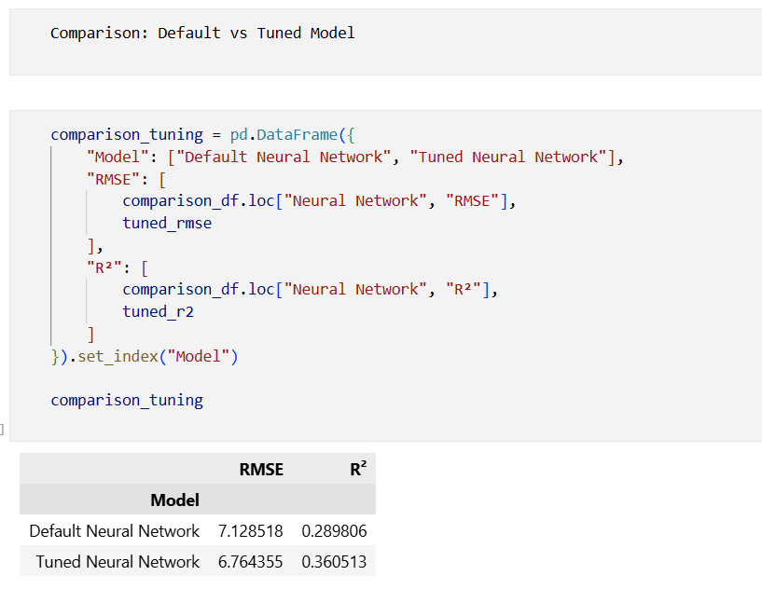
HYPERPARAMETER TUNING
Techniques Used
GridSearchCV
Cross-validation
Parameters Tuned
Tree depth
Number of estimators
Learning rates
Regularization

Slide 18
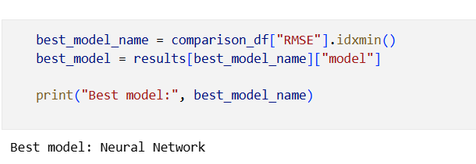
FINAL RESULTS
Best Model
Selected based on lowest RMSE & stable R²
Performance
Improved generalization
Reduced overfitting
Modeling percentage price change ensures consistency across currencies, units, and commodities while preserving economic meaning.
Among all tested models, the neural network achieved the best predictive performance, both on test data and under cross-validation.
Hyperparameter tuning further reduced errors and improved explained variance, highlighting the importance of model capacity and regularization.
Feature importance analysis shows short-term relative change features are the primary drivers, with long-term trends and calendar effects playing a secondary role.
The final tuned neural network pipeline is saved and reusable, providing a reproducible and deployment-ready forecasting solution.

Slide 19
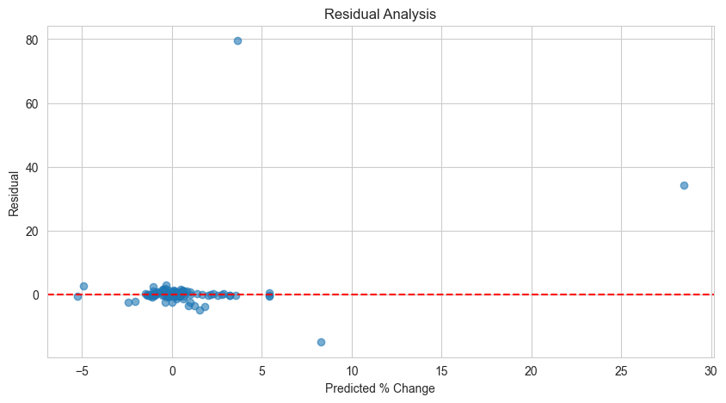
CONCLUSION & FUTURE WORK
Conclusion
PCT_CHANGE is more reliable than raw price
End-to-end scalable pipeline built
Strong analytical & predictive insights
Modeled percentage commodity price changes to ensure cross-currency and cross-unit consistency.
Built an end-to-end automated pipeline from web scraping to PostgreSQL, Power BI, and ML modeling.
Engineered short-term and temporal features capturing real market dynamics.
Selected a tuned neural network through cross-validation and robust evaluation.
Delivered a reproducible, deployment-ready forecasting system.
Future Work
Time-series models (ARIMA, LSTM)
Automated retraining

Slide 20
THANK YOU

