Slide 1
Bank Customer Insight
DS Sprint Skill-Based Assessment 2 | Use Case 08
TrustWave Bank | Synthetic-data study

Slide 2
Business problem and objectives
Business question: How do customers use banking services, and which segments show changing engagement?
Understand channel preferences, account activity, balance differences, complaints, and repeat service needs.
Build an interpretable customer-level engagement prototype to inform targeted service decisions.
Synthetic-data findings | TrustWave Bank

Slide 3
Synthetic dataset overview
1,200 customers across five regions and four age bands.
1,907 accounts; 48,169 raw transaction rows including injected duplicates.
1,200 channel profiles and 1,971 service records.
Fixed seed 20261013. All records and results are synthetic; they do not describe real bank customers.
Synthetic-data findings | TrustWave Bank

Slide 4
Data preparation
Removed 476 repeated transaction IDs; unique transaction IDs preserve similar legitimate payments.
Standardized inconsistent account labels and filled 277 missing channel cells using age-band medians.
IQR bounds: 0.00 to 279.81; flagged 3,655 and capped extreme amounts.
Filled incomplete service categories/statuses with explicit labels and imputed missing resolution time; saved before/after quality counts.
Synthetic-data findings | TrustWave Bank

Slide 5
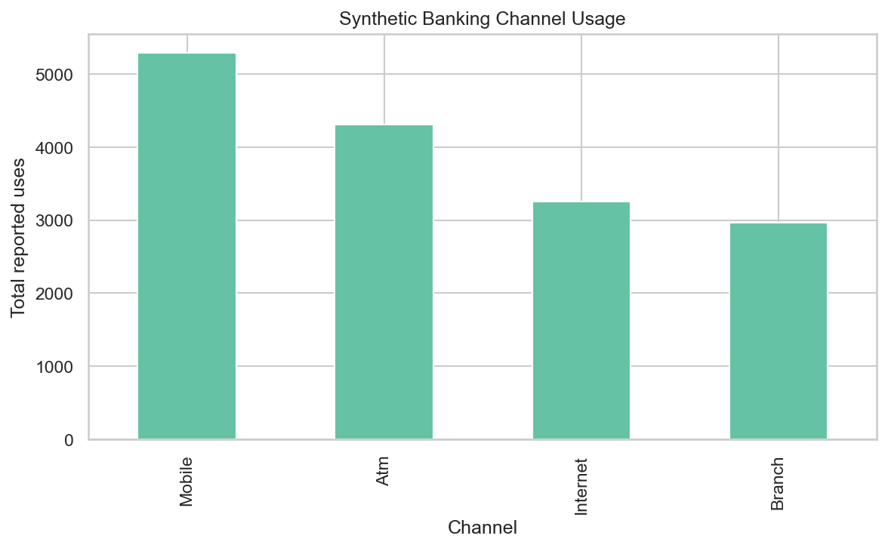
EDA: channels and customer balances
Mobile is the most-used channel (5,286 reported uses).
Highest complaint count: North region.
Mean total balance by segment: Low $14,921; Medium $16,443; High $18,416.
Synthetic-data findings | TrustWave Bank

Slide 6
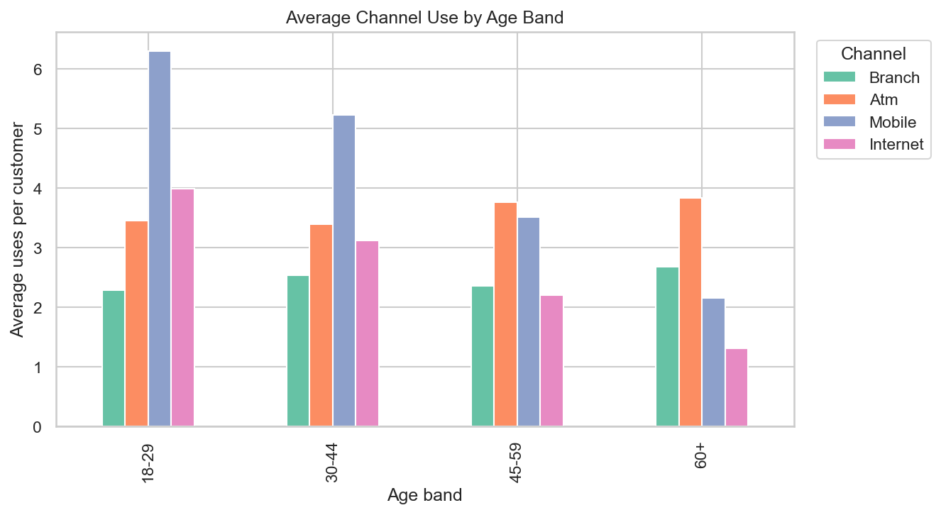
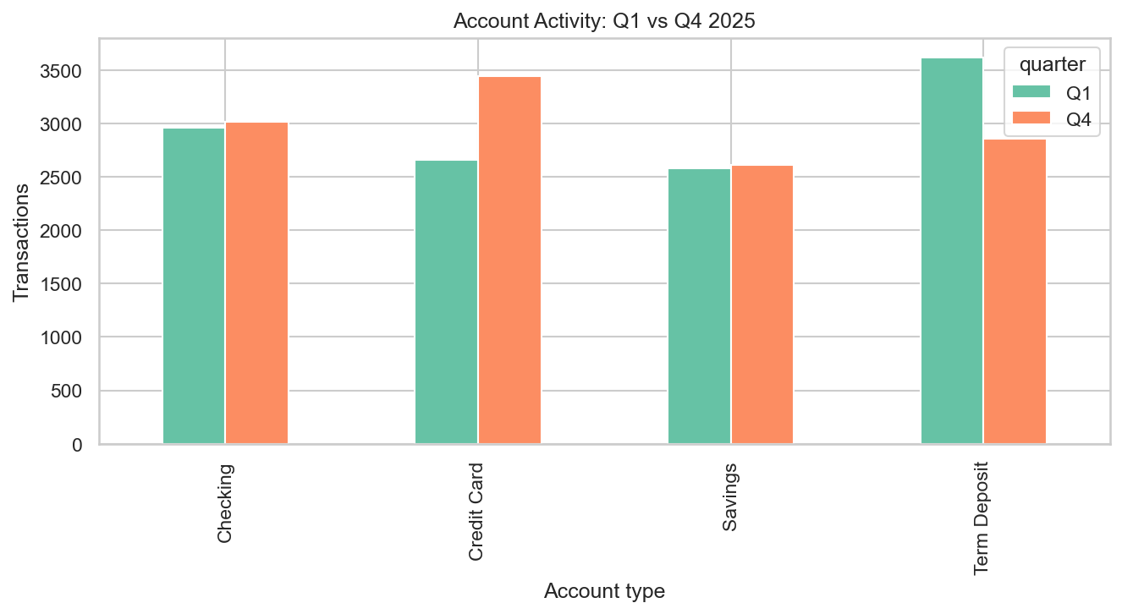
Age, account activity, and service
Account types with lower Q4 than Q1 transaction activity: Term Deposit.
Most repeated service type: Card support.
Synthetic-data findings | TrustWave Bank

Slide 7
Machine-learning results
Compared majority-class DummyClassifier, Logistic Regression, and Random Forest on a stratified 75/25 split.
Selected Logistic Regression by test macro F1 (accuracy breaks ties): accuracy 0.703, macro F1 0.699.
Test set: 300 customers. Full class report and confusion matrix are saved under outputs/metrics/.
Target is simulated from a latent engagement propensity; the latent value is not a predictor feature.
Synthetic-data findings | TrustWave Bank

Slide 8
Evidence-based recommendations and conclusion
Pilot assisted digital onboarding for customers aged 60+, the age band with the lowest combined average mobile and internet use; measure adoption and repeat use before scaling.
Investigate complaint drivers in North and redesign follow-up for Card support, the service type with the most customers making repeat requests. Review retention journeys for Term Deposit accounts, which recorded lower Q4 than Q1 activity.
Treat results as a synthetic prototype; validate any intervention using real, governed bank data.
Synthetic-data findings | TrustWave Bank

