Slide 1


Accelerated Gradient-free Neural Network Training by Multi-convex Alternating Optimization
Junxiang Wang *, Hongyi Li, Yongchao Wang, Liang Zhao
ICML 2021 Workshop “Beyond first-order methods in ML systems”
Presented by Hongyi Li

Slide 2
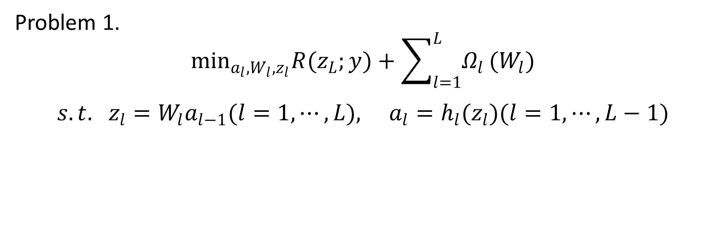
Problem Formulation
Our goal is to train a deep neural network, which is equivalent to solving the following problem:
loss function
regularization term
Problem 1.
$$\begin{aligned}\min_{a_{l},W_{l},z_{l}}R(z_{L};y)+\sum_{l=1}^{L}{Ω_{l}}(W_{l}) \\ s.t. z_{l}=W_{l}a_{l−1}(l=1,⋯,L), a_{l}=h_{l}(z_{l})(l=1,⋯,L−1)\end{aligned}$$
convex constraint
nonconvex constraint

Slide 3
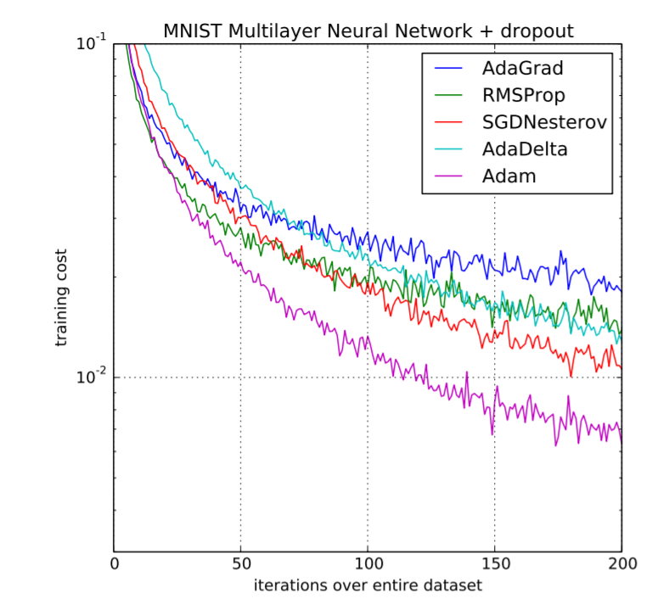
SGD and its Variants as DNN Optimizers
SGD and its variants are state-of-the-art optimizers for training deep neural networks.

Slide 4
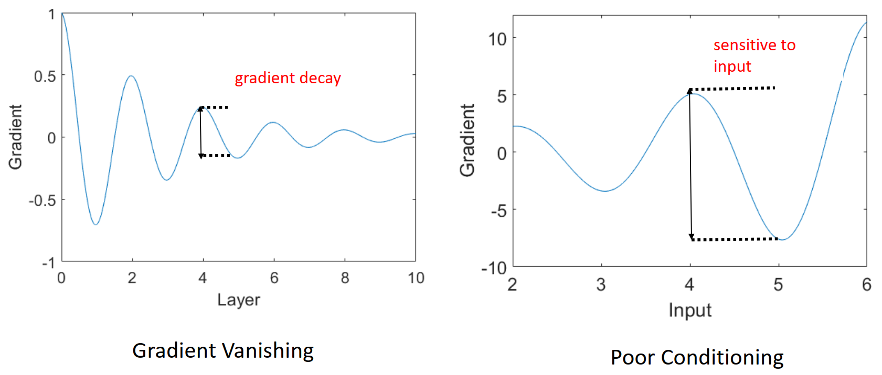
Limitations of SGD-based DNN Optimizers
However, they suffer from the following limitations:
Gradient Vanishing

Slide 5
Limitations of SGD-based DNN Optimizers
However, they suffer from the following limitations:
Poor conditioning
Lack of theoretical convergence guarantee

Slide 6
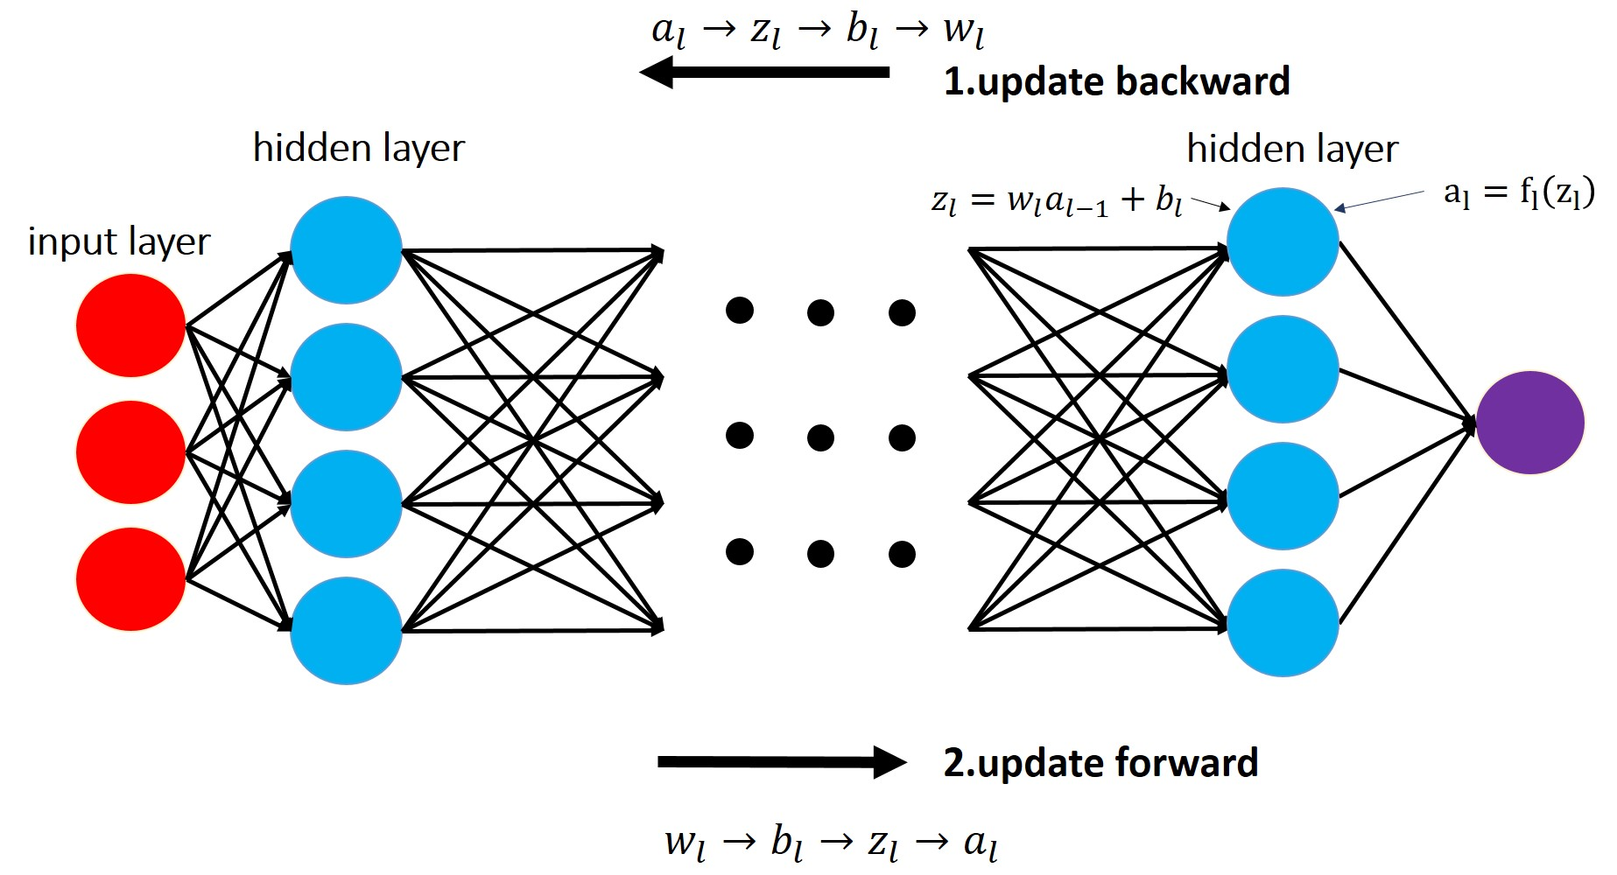
Alternating Minimization as an Alternative

Slide 7
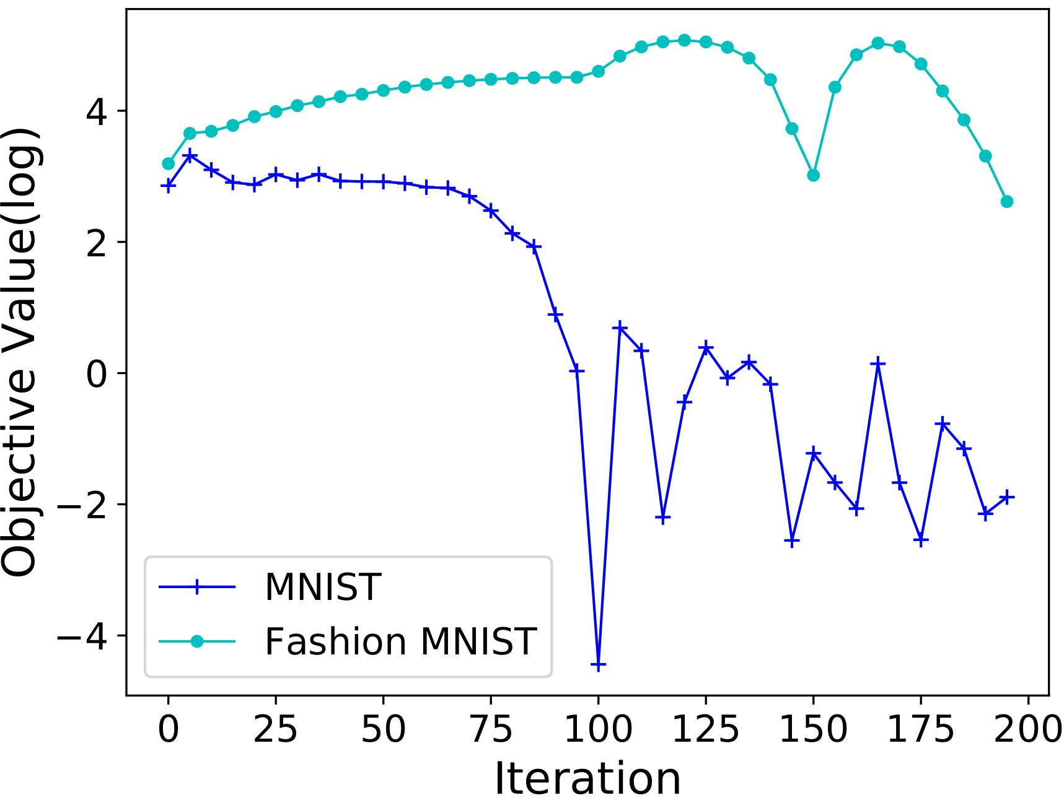

The Challenges of Alternating Minimization
Sensitive to the choice of penalty hyperparameters
$ρ={10}^{−6}$: fail to converge when $ρ$ is small

Slide 8
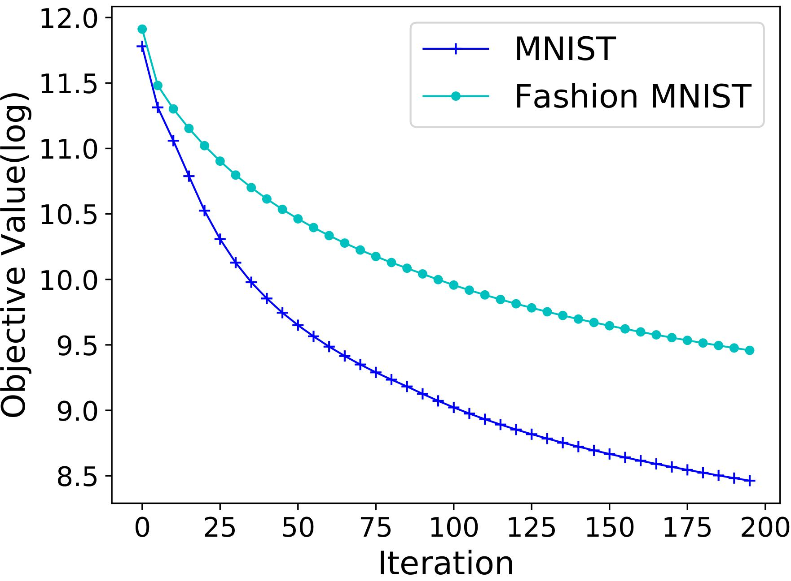

The Challenges of Alternating Minimization
Converges slowly
$ρ=1$: slow convergence rate of $o(\frac{1}{n})$
Only allows ReLU and leaky ReLU activations

Slide 9
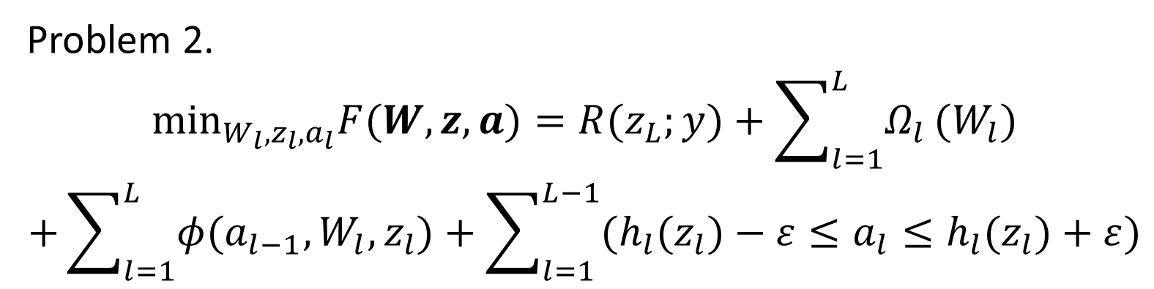
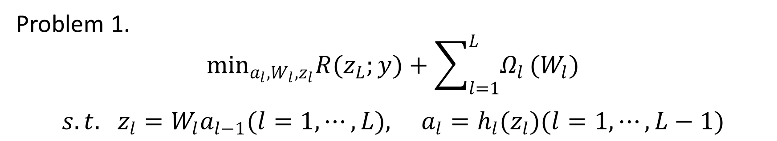
Deep Learning Alternating Minimization (DLAM) Algorithm
loss function
regularization term
Problem 1.
$$\begin{aligned}\min_{a_{l},W_{l},z_{l}}R(z_{L};y)+\sum_{l=1}^{L}{Ω_{l}}(W_{l}) \\ s.t. z_{l}=W_{l}a_{l−1}(l=1,⋯,L), a_{l}=h_{l}(z_{l})(l=1,⋯,L−1)\end{aligned}$$
convex constraint
nonconvex constraint
Problem 2.
$$\begin{aligned}\min_{W_{l},z_{l},a_{l}}F(W,z,a)=R(z_{L};y)+\sum_{l=1}^{L}{Ω_{l}}(W_{l}) \\ +\sum_{l=1}^{L}{φ(a_{l−1},W_{l},z_{l})}+\sum_{l=1}^{L−1}{(h_{l}(z_{l})−ε≤a_{l}≤h_{l}(z_{l})+ε)}\end{aligned}$$
loss function
regularization term
penalty term
convex inequality constraint

Slide 10
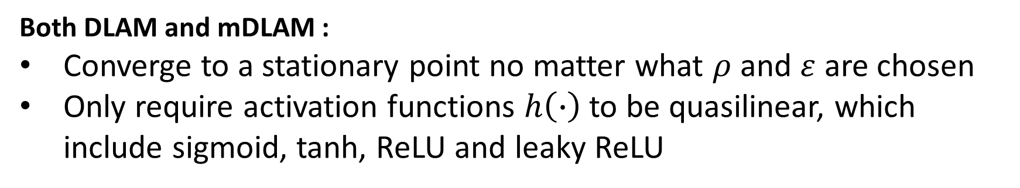

Convergence Analysis
Both DLAM and mDLAM :
Converge to a stationary point no matter what $ρ$ and $ε$ are chosen
Only require activation functions $h\left(∙\right)$ to be quasilinear, which include sigmoid, tanh, ReLU and leaky ReLU
DLAM
Monotonous DLAM (mDLAM)
Sublinear convergence rate of $o(\frac{1}{n})$
Linear convergence rate
Objective decrease

Slide 11
Thank you! Feel free to contact: jwan936@emory.edu

