Slide 1

Managing Modern IT
Accelerating Service Delivery with Proven Infrastructure
June 2013

Slide 2


















Vistara Corporate Overview
Who We Are
Our Customers
Incorporated July 2012
Headquarters in San Jose, CA
Development center in Hyderabad with 50 R&D engineers
Representative office in Japan
Used by managed service providers for seven years
Over 1100 customers using Vistara
Available for enterprise since January 2013
SaaS platform
Strong channel distribution – over 140 VARs through parent company alone
Available in North America and Japan
Patent pending technology
Our Distributors and VARs
Our Partners

Slide 3








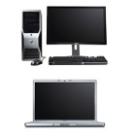
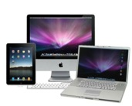


The Legacy
The reality is that most IT professionals have many kinds of infrastructure they must manage.
Physical Devices
Virtualized Servers
Private Cloud
Public Cloud
App
App
App
APP
VM
VM
App
App
App
App
App
App
Virtualization
VM
VM
VM
Virtualization
Switch
Router
Bring Your Own Device
Physical, virtual and cloud continue environments continue to expand
Notes:
You have all styles if IT infrastructure and applications to manage.

Slide 4
One Source of Control, One Source of Truth
At the end of the month, IT professionals have to govern data and services across all delivery methods.
Physical Devices
Virtualized Servers
Private Cloud
Public Cloud
Monitor and Manage
App
App
App
APP
VM
VM
App
App
App
App
App
App
Virtualization
VM
VM
VM
Virtualization
Service Delivery
Switch
Router
Inventory and Governance
Bring Your Own Device
Requirement: visibility across the entire enterprise
Notes:
You have to execute management of the infrastructure, service delivery, and governance of partners and data use across all of these infrastructures.

Slide 5
Modern IT Requirements
Types of IT Infrastructure
Mobile
Silos of infrastructure
Internal Private Cloud
External Private Cloud
Business Outsource Services
IT Responsibilities
Availability
Maintenance
Service Management
Audit
Change Management
Inventory
Access Management
Incident Response
Cost Control

Slide 6

What If You Could…
Integrate management of internal and external private cloud?
Accelerate private cloud?
Offer the business an IT dashboard?
Focus on service delivery instead of integration?
Offer improved self service over time without disruptive upgrades?

Slide 7
Why Proven Infrastructure, Why VSPEX?
VSPEX Simplifies Your Environment
Simple Consolidation
Flexible Reference Architecture
Optimized for Virtualization
Sells Easily
Simplifies Security
VSPEX Reduces Your Costs
6. Built-in Efficiencies
7. Reduced Backup Storage and Bandwidth
8. Centrally Managed and Protected
VSPEX Accelerates Your Environment
9. EMC Flash 1st
10. Speed Up Backup and Recovery

Slide 8



What It Takes To Complete The Private Cloud
Self-Service Catalog
User Dashboard Reporting
Audit and Correct Configurations-as-a-Service
Multi-Tenant Ticket System
Application-Infrastructure Correlation
Audit and Governance
Internal and External Private Cloud, One Pane of Glass
Patch Management
Multi-Tenancy/Multi- Workload Support
Automated Reporting
Vistara Enables Private Cloud Service Delivery

Slide 9

Unify Element Management
One pane of glass unifies all the elements of a private cloud.
API integration with EMC VNX, VNXe
API Integration with Brocade VDX
API Integration with Cisco Nexus and UCS
Ready integration with Microsoft SCOM
Ready integration with VMware Virtual Center

Slide 10
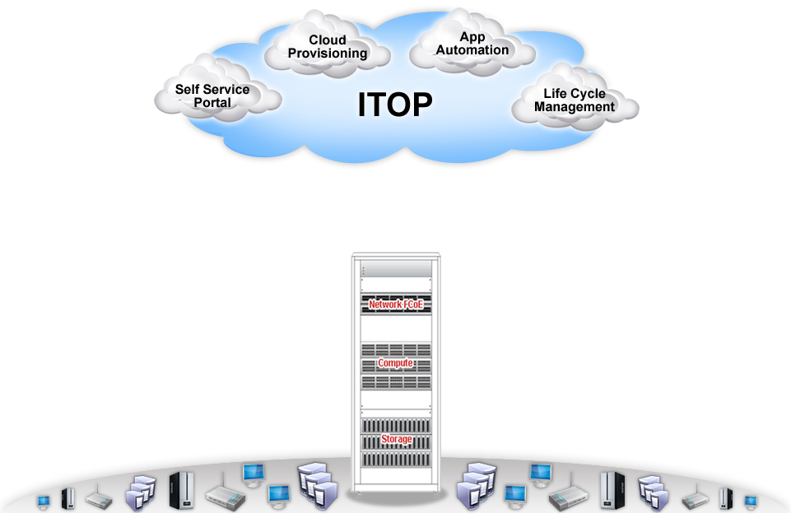




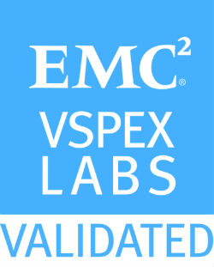
VSPEX Enabled
Bare
Metal
Bare Metal provision
Configure Compute Blades
IaaS
Network and Storage Configuration
Validate with OEM Components
Certify
Certify Environment Readiness
Change Control and Patch Approvals
Service Catalog
Define Service Catalog
Simple Approval Flow
Provision
Automated Instance Provisioning
Post Provision Automation
Life cycle
Application Deployment
Enforce and Audit Best Practices

Slide 11













Only Cloud Delivery is Cloudlike
Vistara
Alert Processing
VCare Servers
Vistara Servers
File Server
Database Server
DB
DB
Web Server
Router
Application
Server
Switch
Internet
FTP Server
VCare
Firewall
Active Directory
Public Cloud
VG
MS Exchange
Backup Server
App
App
App
App
App
App
VM
VM
VM
Enterprise IT
Virtualization
Private Cloud
Notes:
Make the point the Vistara is a SaaS Platform. It’s the logic is shared in the cloud- multi-multi tenant. That means

Slide 12
Integrated Private Cloud Is Real
We’ll show you!

Slide 13
Things to Remember
Modern IT
Highlights Service Delivery
Requires Transparency
Is Trending Toward Self Service
Demands Reliability, Scalability and Security
Increasingly Demands Integration of Internal Infrastructure and External Infrastructure
Risk reduction and efficiency are easier with proven Infrastructure
Flexibility can be preserved with VSPEX

Slide 14

Let’s Get Started Today
Schedule a Demo!
Email
sales@vistarait.com
Website
www.vistarait.com
EMC Solution Gallery
www.vistarait.com/emcgallery/

