Slide 1
Managing Modern IT
Measuring the Success of Cloud-Based Services
Mahesh Ramachandran
Senior Director, Product
Management, Vistara
Eric Krock
Director of Product Marketing, Vistara
The IT Operations Cloud
2013-06-28

Slide 2
Agenda
Cloud and metric driven management
Relevant IT metrics and considerations
Process and best practices
How Vistara can help

Slide 3

Cloud and the imperative for IT metrics
Cloud…
Represents a new model for IT service delivery
Resources consumed on demand, sourced from a mix of private and public clouds
Brings transparency to service levels and costs of IT resources
Requires IT to manage operations to meet specific service level and cost goals
Lines of Business
Enterprise IT
Resource | Service Level | Cost
Small Instance | 1CPU/2GB | $0.05/hour
… | … | …
Public Cloud
Resource | Service Level | Cost
… | … | …
… | … | …
Private Cloud
What metrics should Enterprise IT measure and track?

Slide 4
Cloud and the imperative for IT metrics
IT metrics should measure
Service levels delivered to lines of business – Service Level Metrics
Effectiveness and efficiency with which services are delivered – Service Delivery Metrics
Service Level Metrics
Availability
Performance
Service Fulfillment
Service Delivery Metrics
Problem
Response
Capacity & Cost
Lines of Business
Enterprise IT
Resource | Service Level | Cost
Small Instance | 1CPU/2GB | $0.05/hour
… | … | …
Public Cloud
Resource | Service Level | Cost
… | … | …
… | … | …
Private Cloud

Slide 5
Agenda
Cloud and metric driven management
Relevant IT metrics and considerations
Process and best practices
How Vistara can help

Slide 6
Availability
What Availability metrics measure
Quantifies up or down status of services, as experienced by the end user
% of time service is available for use, over a time interval – e.g. last month
What to measure
 | Typical Measures
Servers | Ping Response, OS service or agent status
Network Devices | Ping Response, Interface/Port Status
Applications, URLs, Web Services | Ping, HTTP GET

Slide 7


Availability
Considerations
Element level availability vs. availability of an entire service
Do you track availability of individual elements or an entire service compose of multiple elements?
Is Availability a binary quantity (Up / Down) or more fine grained?
How do you account services that are available, but running with degraded redundancy/performance?
Planned Downtime vs. Unplanned Downtime
Do you count downtime due to planned activities (e.g. patching)?
Web App
App Server 1
App Server 2
Database

Slide 8
Performance
What Performance metrics measure
Quantifies responsiveness to user or application requests
Throughput and latency delivered by the service – OS, application …
What to measure
 | Typical Measures
Servers, Cloud Instances | CPU queue length, memory swap rate, I/O latency
Applications, URLs, Web Services | Response time to requests – transactions, http requests/response, API calls

Slide 9
Performance
Considerations
Focusing on the right metrics
Apps, hypervisors expose tons of metrics – which ones are the best measures of performance?
Using the right statistical measures
How do you define “bad” user response time – average, max, percentile?
Performance of cloud instances
How can you tell if your cloud instances are getting promised resources?
CPU
I/O Latency
Promised
Inconsistent I/O performance
Received
time
time
Cloud Instance Performance

Slide 10
Service Fulfillment
What service fulfillment measures
Quantifies timely fulfillment of lifecycle management tasks – e.g.
Service Requests, Patching, Anti-Virus, Network Configuration Backups …
What to measure…
 | Typical Measures
Service Requests | Time to resolve service requests
Server Patching | Patching frequency, time lag between patch release and patch roll out
Anti-Virus | Servers up-to-date on anti-virus signature
Considerations
Focusing on the right service attributes to measure
E.g. Patches – all types of patches vs. only critical security patches

Slide 11
Problem
What Problem metrics measure
Provide actionable insight into causes of problems
What to measure…
Type | Practical Measures
Common problem types | Problem and incident tickets by problem type
Failure modes of devices & applications | OS / application error codes
Considerations
Identifying the right data sources to mine
Do your tickets contain enough information to classify problems accurately?
Interpreting collected data
How do you make sense of OS / application error codes?

Slide 12
Response
What Response metrics measure
Quantifies how fast you are resolving incidents and problems
What to measure…
Type | Practical Measures
Incident and problem resolution times | Ticket resolution times
Incident and problem resolution rate | Ticket resolution rate
Correctness and completeness of resolution | Ticket re-opens, Ticket volume by problem type
Considerations
Identifying the right data sources to mine
Do your tickets contain enough information to classify problems accurately?

Slide 13
Capacity and Cost
What Capacity and Cost metrics measure
How efficiently you are using capacity
How much capacity you will likely need in the future
How much your services are costing you to deliver
What to measure…
Type | Practical Measures
Resource utilization | Utilization of server, storage, switch/router interfaces, unused virtual machines
Demand forecasts | Number of VMs over time, average VM sizes over time
Hardware costs | Server and software license costs
Resource usage accounting | Compute, storage, network used by different types of virtual machines
Considerations
Resource usage accounting is challenging in a shared infrastructure
Identifying the right data sources

Slide 14
Agenda
Cloud and metric driven management
Relevant IT metrics and considerations
Process and best practices
How Vistara can help

Slide 15
High Performing Organizations are Metrics-Driven
Below-average performers show lower use of IT metrics across the board.
Particularly true for external benchmarking.
 | Type of IT organization (performance level self-identified by respondents) and rate at which metric is used
Metric used | Top | Average | Below-average
“contribution to business value or business outcome” | 56% | 21% | 9%
“comparison of benchmarking against others” | 39% | 15% | 8%
Source: Kurt Potter, Gartner Inc., “Top Performers Use More Metrics,” 10 September 2012

Slide 16
IT Must Proactively Define & Drive Measurement
Gathering data for benchmarking takes time.
If IT must gather data reactively in response to management demands, delay harms credibility.
Metrics without a historical baseline will be questioned.
Agreeing on right metrics and achieving apples-to-apples comparisons takes time.
Source: Kurt Potter, Gartner Inc., “IT Metrics: Intervention to Avoid Strategic Missteps with IT Benchmarking and IT Cost Transparency,” 24 August 2012

Slide 17
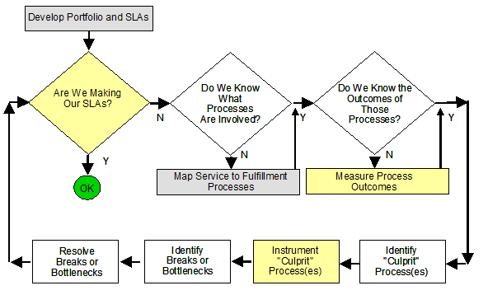
IT Metrics Definition and Measurement Process
Source: Colleen Young, Gartner Inc., “A Framework for Designing IT Service and Process Metrics,” 18 September 2006

Slide 18
Cloud & IT Self-Service Drive Cost Transparency
Cloud gives organizations a choice between internal and cloud-based services
IT self-service empowers line of business to make the choice
Therefore embedding clear, understandable cost information in IT service catalog is critical to enable rational, optimal choices

Slide 19
Getting ready for service pricing
IT understands benefits of service pricing and why transition is happening
List of IT services validated with LOB
Prices can be compared with market prices
Business case approved for transition
IT has chart of accounts to enable pricing
Organization understands resources needed for initiative to succeed
Source: Jim McGittigan, Barbara Gomolski , Gartner Inc., “Making a Smooth Transition to Service Pricing,” 15 June 2012

Slide 20
Additional metrics to consider for cloud services
Agility: Can IT service respond in real-time to changes in demand & business needs?
Elasticity: How much can service’s capacity scale upward and downward to match demand?
Continuity: Maximum time between interruptions
Consistency: Can variations in service levels be reduced?
Source: Tapati Bandopadhyay, Gartner Inc., “Business-Aligned Metrics for IT Services in Cloud: Returns on Agility, Elasticity, Continuity and Consistency,” 10 January 2012

Slide 21
Agenda
Cloud and metric driven management
Relevant IT metrics and considerations
Process and best practices
How Vistara can help

Slide 22
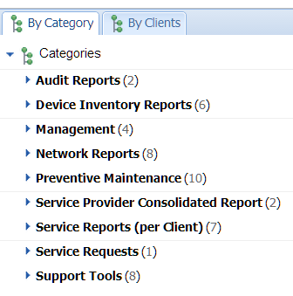
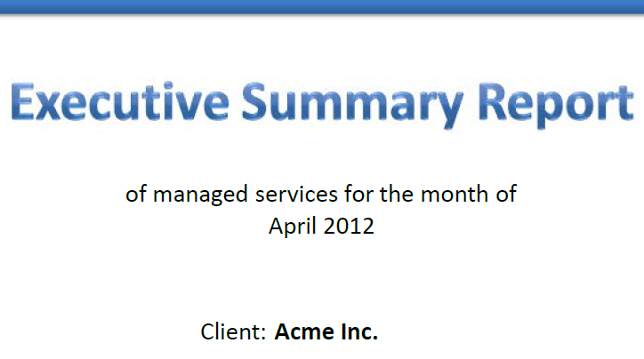
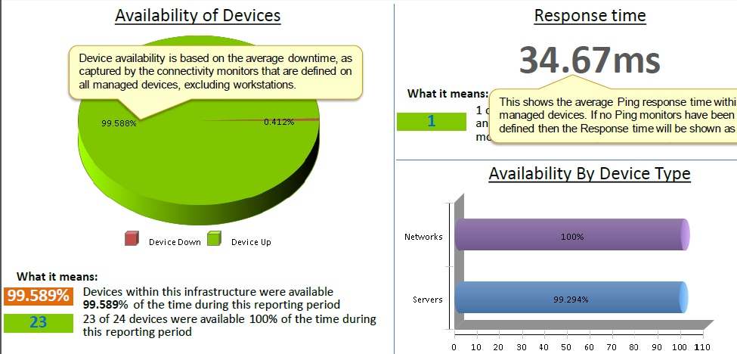
How Vistara can help
Data: collects relevant data
100s of built-in monitoring templates to collect relevant metrics across
Servers, applications, storage, and network
Analytics: analyzes data to extract relevant metrics
Availability, performance, problem, response, …
Reports: presents metrics to help you gain insight
Reports to spot key trends and patterns in key metrics
Action: single tool for managing entire system in response to metrics

Slide 23
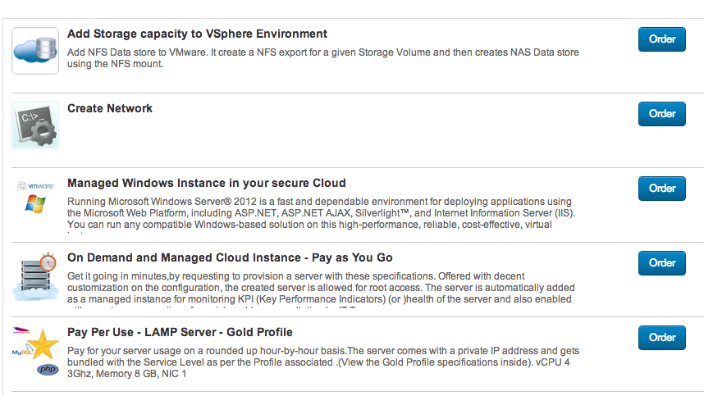
How Vistara can help: service catalog
Service catalog
Internal and external services
Embedded cost model to drive rational choices by IT and LOB

Slide 24
Agenda
Cloud and metric driven management
Relevant IT metrics and considerations
Process and best practices
How Vistara can help

Slide 25

Let’s Get Started Today
Schedule a Demo!
Attend Our Next Webinars!
Email
sales@vistarait.com
Website
www.vistarait.com

