Slide 1

Company and Product Overview
The IT Operations Cloud
June 2013

Slide 2


















Vistara Overview: The Company
Who We Are
Our Customers
Incorporated July 2012
Headquarters in San Jose, CA
Development center in Hyderabad with 50 R&D engineers
Representative office in Japan
Used by managed service providers for seven years
Over 1100 customers using Vistara
Available for enterprise since January 2013
SaaS platform
Strong channel distribution – over 140 VARs through parent company alone
Available in North America and Japan
Patent pending technology
Our Distributors and VARs
Our Partners

Slide 3

Problems
“Enterprise” tools too costly, complex
“Cloud” tools don’t easily integrate cloud + premise
No way to prioritize issues across environments and tools
No solution for both enterprises and their service providers
No solution for large midmarket companies
Proactive management difficult

Slide 4

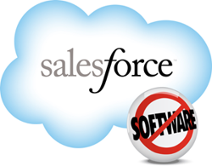






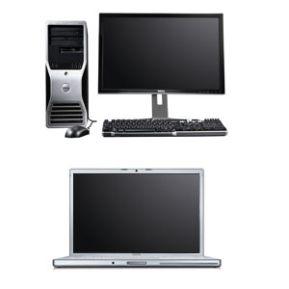

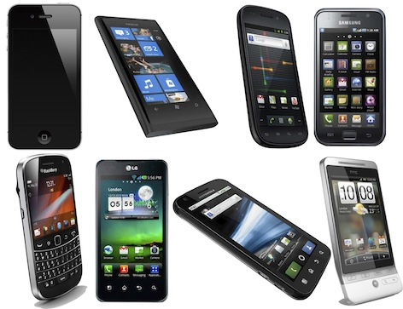

The Need for Unified IT Operations Management
How can IT unify the entire enterprise: physical, virtual and cloud?
Physical Devices
Virtualized Servers
Private Cloud
Public Cloud
App
App
App
APP
VM
VM
App
App
App
App
App
App
Virtualization
VM
VM
VM
Virtualization
Switch
Router
Bring Your Own Device
              Monitor and manage
              Bottom to top of the stack
              On-premise and cloud
              Physical and virtual
              Many platforms, vendors, clouds
              Service delivery
Unify IT Operations Management
Notes:
Allows interoperability and information sharing between semi-autonomous de-centrally organized lines of business, IT systems and applications
Development, maintenance and use
Monitor and Manage
Service Delivery
Inventory and Governance

Slide 5





Solution: Modern IT Operations Platform
Customer Infrastructure
H/M
Vistara
Needs
Customer
portal
On-Premise
Unified Management
SaaS
Secure
Intuitive
Limitless scale
Self-Service
Analytics/Services Reporting
Service Delivery
Customer/end user communication
In Data Center
SLAs/Metrics/Compliance;
Inventory and Governance
RBA; SOP; Self Healing; Ticketing
On Private Clouds
Alert processing across
Customers/locations
Patch/Configuration Management
On Public Clouds
Secure Role Base & Auditable Remote Access
Monitor, Manage, Operate
Monitoring – Closet, Premise, Mobile

Slide 6

Solution: Deployed in the Real World—CMaaS
“What we have is a way for customers to operationalize cloud. The market is dying for this.
You cannot have an enterprise hybrid cloud environment without these tools. Otherwise, it’s just too painful and unmanageable.”
Ron Dupler, CEO Green Pages, top 10 solution provider
CRN 8/10/2012

Slide 7
























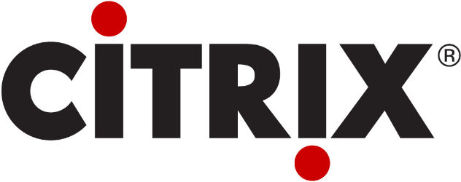
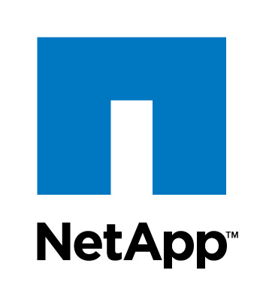

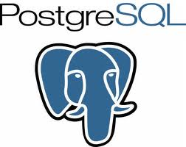










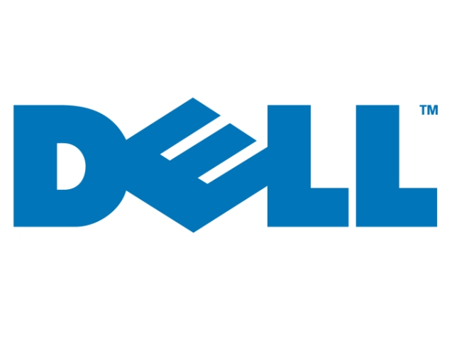


Broad Coverage of Platforms, Vendors, Clouds
Application | Backup | Unified Communication | Database | Servers | Cloud | Virtualization | Storage | Networks
Application | Backup | Unified Communication | Database | Servers | Cloud | Virtualization | Storage | Networks

Slide 8
Demo

Slide 9
Things to Remember
Modern IT
Highlights Service Delivery
Requires Transparency
Is Trending Toward Self Service
Demands Reliability, Scalability and Security
Increasingly Demands Integration of Internal Infrastructure and External Infrastructure

Slide 10
Questions?

Slide 11


















Vistara SaaS Architecture
Vistara ITOP
Alert Processing
VCare Servers
ITOP Servers
Desktops
File Server
Database Server
DB
DB
Converged
Infrastructure
Web Server
Router
Switch
FTP Server
Internet
VCare
Agent
Firewall
Active Directory
Vistara
Gateway
Public Cloud
MS Exchange
Backup Server
Private Cloud
App
App
App
App
App
App
VM
VM
VM
Virtualization
Application Server
VAR Staff
Customer IT
End Customer Network

Slide 12
Why Converged Infrastructure, Why VSPEX?
VSPEX Simplifies Your Environment
Simple Consolidation
Flexible Reference Architecture
Optimized for Virtualization
Sells Easily
Simplifies Security
VSPEX Reduces Your Costs
6. Built-in Efficiencies
7. Reduced Backup Storage and Bandwidth
8. Centrally Managed and Protected
VSPEX Accelerates Your Environment
9. EMC Flash 1st
10. Speed Up Backup and Recovery

Slide 13



What It Takes To Complete The Private Cloud
Self-Service Catalog
User Dashboard Reporting
Audit and Correct Configurations-as-a-Service
Multi-Tenant Ticket System
Application-Infrastructure Correlation
Audit and Governance
Internal and External Private Cloud, One Pane of Glass
Patch Management
Multi-Tenancy/Multi- Workload Support
Automated Reporting
Vistara Enables Private Cloud Service Delivery

Slide 14

Unify Element Management
One pane of glass unifies all the elements of a private cloud.
API integration with EMC VNX, VNXe
API Integration with Brocade VDX
API Integration with Cisco Nexus and UCS
Ready integration with Microsoft SCOM
Ready integration with VMware Virtual Center

Slide 15
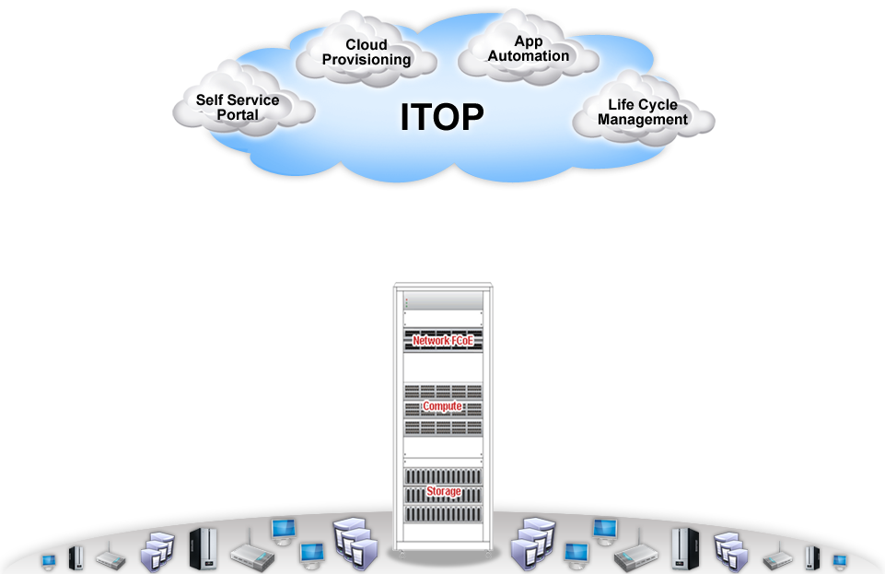




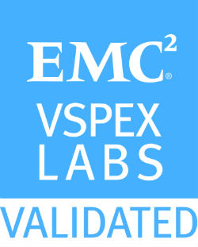
VSPEX Enabled
Bare
Metal
Bare Metal provision
Configure Compute Blades
IaaS
Network and Storage Configuration
Validate with OEM Components
Certify
Certify Environment Readiness
Change Control and Patch Approvals
Service Catalog
Define Service Catalog
Simple Approval Flow
Provision
Automated Instance Provisioning
Post Provision Automation
Life cycle
Application Deployment
Enforce and Audit Best Practices

