Slide 1

Modern IT Operations Management in the Cloud
September 24th, 2013

Slide 2




























Vistara Overview
Who We Are
Our Customers
HQ in San Jose, CA
Comprehensive SaaS solution for modern IT operations management
Unify IT operations
Manage public & private clouds
Deliver self-service IT
Over 1000 customers and over 100 service providers use Vistara today
Strong channel distribution – distributors, VARs, SIs, MSPs
Multi-tenant, multi-tier SaaS solution to support tiers of partners
Extensive integration to industry-leading point tools and technologies
Platform/Cloud Integrations
Distributors, VARs, & MSPs
Notes:
Key Points:
Vistara is a well-established, mature, proven solution with broad distribution through our network of distributors, VARs, and MSPs including Ingram Micro, Arrow, Green Pages, Fujitsu, Sigma Solutions, Denali Advanced Integration, and more.
Vistara has a strong customer list including some of the world’s leading brands and enterprises and model IT enterprises like NetFlix and Tesla.
Vistara is the only SaaS solution for unified IT operations management that can manage both on-premise and cloud infrastructure. Vistara has native integrations with the Amazon EC2 APIs and supports other public cloud solutions including Rackspace OpenCloud, IBM SmartCloud, and Verizon Terremark through its support for OpenStack.
Vistara has built-in support for managing converged infrastructure solutions. Vistara is the first SaaS solution validated by EMC Labs for managing VSPEX proven infrastructure solutions and VNX and VNXe unified storage solutions. Vistara can also manage NetApp FlexPod.

Slide 3

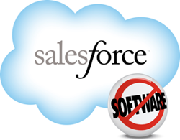






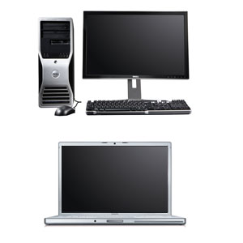
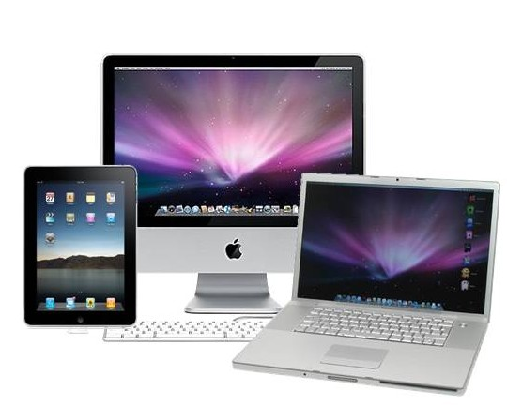
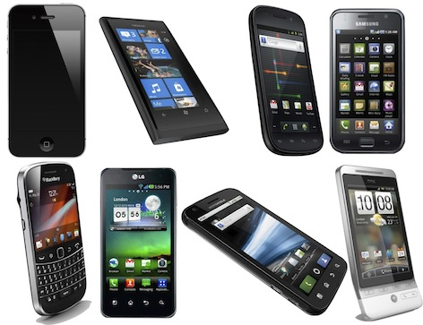

The Need for Unified IT Operations Management
How can IT unify the entire enterprise: physical, virtual and cloud?
Physical Devices
Virtualized Servers
Private Cloud
Public Cloud
App
App
App
App
VM
VM
App
App
App
App
App
App
Virtualization
VM
VM
VM
Virtualization
Switch
Router
Bring Your Own Device
Monitor and manage
Bottom to top of the stack
On-premise and cloud
Physical and virtual
Many platforms, vendors, clouds
Secure remote service delivery
Unify IT Operations Management
Notes:
Key Points:
Vistara is a solution for monitoring and management, not just monitoring.
Vistara supports both on-premise and cloud infrastructure.
Vistara supports both the private cloud and the public cloud.
Vistara can monitor and manage all of your physical and virtual infrastructure from the bottom to the top of the stack, including storage, network devices, servers and blades, virtual machines, OSes, applications, and client devices including desktops, laptops, and mobile devices.
It has broad support for platforms (including server and configuration and patch management for both Linux and Windows), vendors (EMC, NetApp, Cisco, Brocade, Juniper, HP, Dell, and many more), and clouds (Amazon, Rackspace, IBM, Verizon, and any OpenStack-compliant public cloud).
It enables secure remote service delivery, which is why leading MSPs use Vistara to power their service delivery.

Slide 4



Solution: Modern IT Operations Platform
Modern IT
Infrastructure
Enterprise
Service Provider
SLA/Analytics
Customer Portal
On-Premise
IT Tone
Service Delivery
Multi-tenant & SSD
In Data Center
Service Platform
Service Catalog
Orchestration
ITIL
Inventory and Governance
On Private Clouds
IT Operations
Automation
Escalation/Pager Duty
Alert Mgmt.
Patch/Config Mgmt.
On Public Clouds
Monitor, Manage, Operate
Monitoring
Auditable Remote Access
Notes:
Vistara enables modern IT operations management in which IT becomes a service provider for internal and external clients and services can be sourced from any combination of internal and external resources. Vistara is ready for Hybrid IT today.
It supports everything needed for modern, unified IT operations.
Automatic discovery & asset management over lifecycle.
100s of built-in templates for device and server monitoring.
All administrator sessions are automatically recorded to enable later playback by auditors.
Unified management of alerts from all sources.
Ticket management and including an escalation matrix.
Standard operating procedures and runbook automation.
Configuration management (including backup and restore) for network devices, patch & configuration management for Linux and Windows servers.
Built in antivirus solution & ability to manage 10 others.
Vistara is a platform for secure remote service delivery with support for a service catalog with role-based access controls, orchestration, and achieving ITIL compliance.
It supports the needs of service providers with its multi-tenant architecture & support for secure remote service delivery and a portal that provides appropriate views for the MSP or client.
It supports the needs of enterprises with IT analytics, monitoring of internal service level agreements, and “IT Tone” service on demand.

Slide 5
Customer Case Studies
Unified IT operations platform for managing 2000+ elements in production facility, data center, distributed offices NOC operations, monitoring & alert correlation
NOC tool for unified IT operations management Asset management over lifecycle with data source integrations Monitor and manage VMs provisioned on-demand by LOB Configuration & patch for Linux across private & public cloud
Complete and current asset inventory KPI reporting by business unit IT now discovers problems before business users 95% of time > 70% incidents resolved within Vistara 85% of repeat incidents have SOP > 30% of incidents to be automated
416 devices → 14283 alerts → 680 tickets → 85% resolved by MSP 14 min. Average Response Time for High Criticality incidents HAL saves > 400 hrs. of staff time and $21k/mo.
Notes:
Tesla
IT automation, runbook automations, application management (MySQL, MongoDB), server management, patch management (Windows & Linux)
NetFlix
NetFlix needed a unified NOC command center, unified IT operations management spanning the private and public cloud, asset management with bar code scanning and vendor DB integration, and configuration and patch management.
KAR Auction Services
300 car auction sites managed by many business units. Needed ITOM solution providing views and M&M at the global, business unit, site, and device type levels.
Vistara used to manage infrastructure and other management tools including XYMON, SCOM, ServiceNow.
Holland America
One-month trial monitoring 416 devices demonstrated savings through SOP, RBA, unified alert and ticket management, and leveraging a service provider.
Unified management of offices, data centers, and fleet.
Integrate with SCOM, Splunk, ExtraHop, VMware, ServiceNow.
Monitoring, alert correlation, remote administration & services.

Slide 6
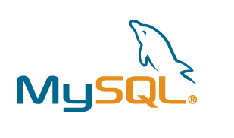









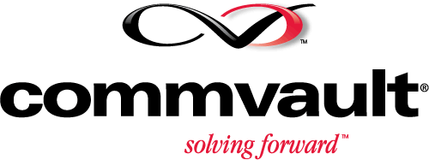























Breadth of Technology: Premise, Private, Public
Application | Backup | Unified Communication | Database | Servers | Cloud | Virtualization | Storage | Networks
Vistara Delivered as SaaS: Built-In Best Practices & Maintenance-Free
Notes:
Vistara has broad and deep support for third-party hardware, software, and solutions from the bottom to the top of the stack.

Slide 7













Vistara SaaS Architecture
Office #1
Laptops /
Desktops
File Server
Database Server
File Server
Office #2
…
Router
Router
Web Server
Switch
Converged
Infrastructure
Firewall
Office #N
Switch
Office #1
Data Center #1
FTP Server
Vistara
Gateway
Backup Server
Data Center #2
…
Active
Directory
Firewall
Data Center #N
Public Cloud
MS Exchange
App
App
App
App
App
App
VM
VM
VM
Virtualization
Application
Server
Enterprise IT Staff
Private Cloud
Data Center #1
Notes:
It’s easy to get started with Vistara. You deploy a Vistara Gateway (a hardened VM) into each data center, public cloud instance, and office. The Gateway discovers all of the IT elements and provides a secure channel for monitoring and management. (Optionally, smaller offices can be managed with a Vistara Agent only.)
If customers wants to perform patch & configuration and/or antivirus management on a server, desktop, or laptop, they deploy the lightweight Vistara Agent on to that machine.
Vistara is SaaS so all solution elements update themselves.
Vistara scales without limit. A single Vistara Gateway can manage 500 devices. Multiple VGs can be deployed into larger data centers or office networks.
IT staff can manage all of their distributed physical and virtual infrastructure in all data centers, offices, and clouds by logging into Vistara through their browser.

Slide 8
Demo

Slide 9
Questions?

