Slide 1
Budget Buddy
Bottom text

Slide 2
Team Members
Harrison Black -Project manager
Jacob Caulk -
Jesus Duran -
Tuan Pham -Web app’s front-end, back-end, RESTful API
Terrell Richardson -
Tom Serrano -React Native iOS development
Xixian Yang -

Slide 3
Gantt Chart

Slide 4
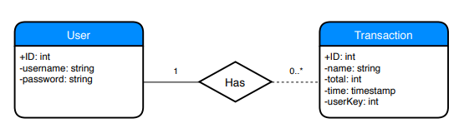
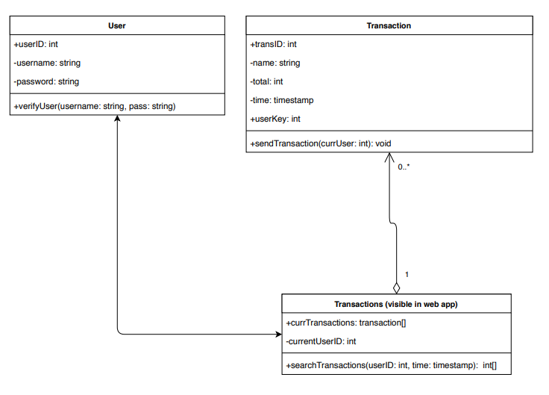
ERD, Class, Use-Case

Slide 5
Harrison’s Slide

Slide 6
Jacob’s Slide

Slide 7
Jesus’ Slide

Slide 8
Tuan – Front/Back ends, API
Front-end
Bootstrap
Chart JS for data’s graphical presentation
Back-end
Django: provide scaffold, easy to build more complex features
RESTful API
Model Serializers: convert data to JSON for HTTP requests from mobile app
JSON Web Token Authentication: authenticate users and requests

Slide 9
Terrell – Mobile App UI
Android App
Creates transactions to be stored in database
Android Studio
Java
Version control
User Interface
Layouts
Transitions
Design

Slide 10
Tom – React Native
iOS App
Would supplement Android app
React Native
High demand
Platform independent
Incomplete
High learning curve
Little experience on team
Stretch Goal (Only one dedicated developer)

Slide 11
David’s Slide

Slide 12
Stacks

Slide 13
Successes

Slide 14
Failures

Slide 15
What We Would Do Differently

Slide 16
Live Demo
Web Page
Github

